Slide 1
Threat/Risk Submission Pictures

Slide 2
Conceptual Model Layering
Operational threat situational awareness and response
Operational risk evaluation and treatment
Cross-risk/threat – Fundamental “wide and shallow” risk and threat concepts/ E.G. Risk, threat, danger, consequence
Concept Library – Provides concepts and links across multiple viewpoints, not just threat/risk. E.G. Person, Objective
Core Concept Library – Fundamental concepts for modeling anything: Entities, Roles, Relations, Types, Information, Rules, Identity, Etc…
Subset of the model from SIMF

Slide 3
Cyber
Crime
Terrorism
Critical Infrastructure
Natural
Disasters
Integrating Framework for Threats and Risks
Sharing & Analytics
Sharing & Analytics
Sharing & Analytics
Sharing & Analytics
Sharing & Analytics

Slide 4
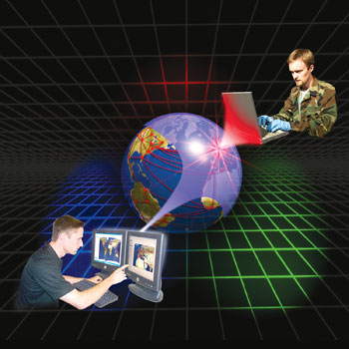





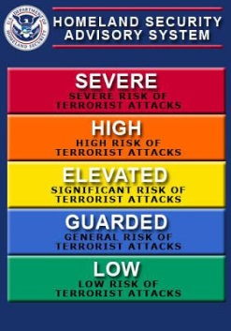
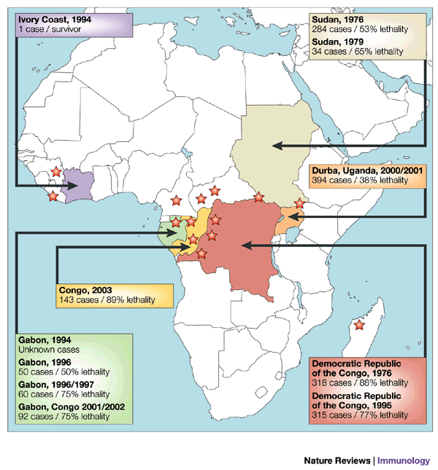
Stakeholder Knowledge
Capabilities
Federation
Analytics
Simulation
Data

Slide 5
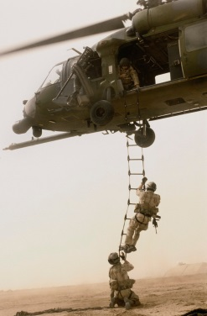

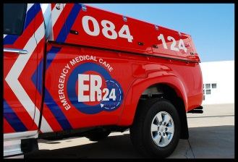
Stakeholder roles in our community
Risk/Threat
Information Sources
Data Fusion
& Brokering
Analysts
Responders
Vendors & Service Providers
One organization may play multiple roles

