Slide 1


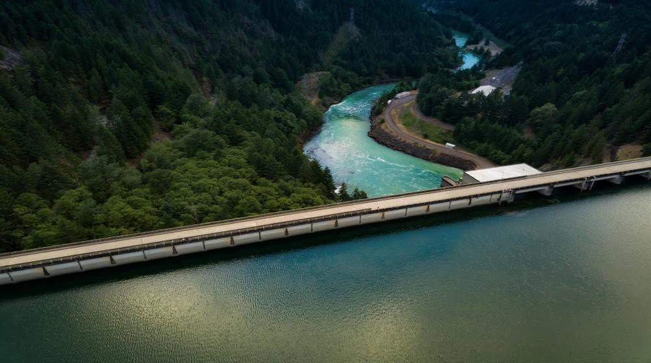
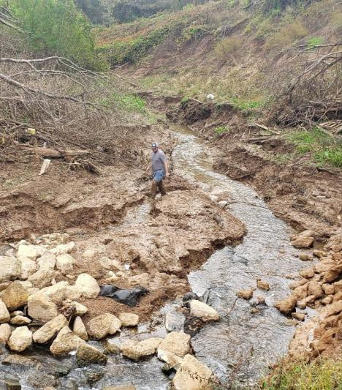
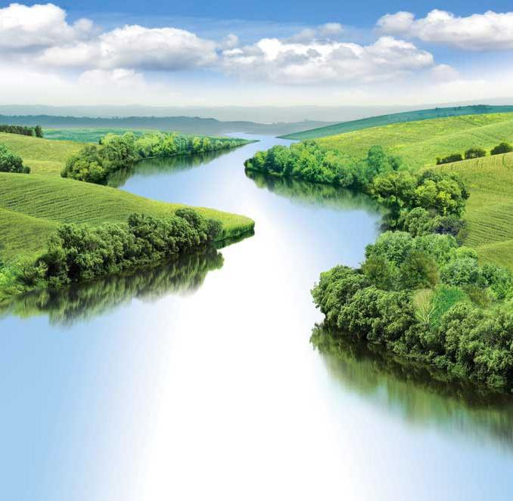




WATER QUALITY MODELING
UNCLASSIFIED
Todd Steissberg
U.S. Army Engineer Research and Development Center, Environmental Laboratory
CE-QUAL-W2 Workshop
July 08-09, 2024
UNCLASSIFIED
DISCOVER | DEVELOP | DELIVER
1

Slide 2

Outline
Concept/Background
Schematic
Assumptions
Mass Balance
Conservative
Complete Process Representation
Water quality capabilities
State variables
Derived variables
WQ processes

Slide 3
Water Quality
Water quality is agglomeration of physical, chemical, and biological components of water column that determine its overall “condition.”
Physical components include temperature and suspended solids and conservative dissolved
substances.
Chemical components include dissolved substances whose levels are impacted by physical,
chemical , and biological processes.
Biological components are living organisms whose normal biological processes are impacted by and have impacts on the conditions present in the water column.

Slide 4
Conceptual Water Quality Model
^{Q}in
^{Q}out
C
C
^{C}in
V
𝑑𝑉
= σ 𝑄𝑖𝑛 - σ 𝑄𝑜𝑢𝑡
𝑑𝐶𝑉
𝑑𝑡
= σ 𝑄𝑖𝑛 𝐶𝑖𝑛 - σ 𝑄𝑜𝑢𝑡 𝐶
+ 𝑟 𝑉
kinetic transformations
𝑑𝑡
change in mass over time
total inflow of mass
total outflow of mass

Slide 5
CE-QUAL-W2 Water Quality
∂⎛⎜ BD ^{∂Φ⎞}⎟
∂⎛⎜ BD ^{∂Φ⎞}⎟
∂ BΦ ∂ UBΦ ∂ WBΦ
⎝
^{x} ∂ x ⎠
⎝
^{z} ∂ z ⎠
+ +
-
-
= q_{Φ} B +
SΦ B
∂ t ∂ x ∂ z
∂ x
∂ z
y=y₂
Kinetics
c
Laterally averaging
c
y=y₁

Slide 6
Mass Balance
Mass of all substances in model is conserved, not created nor destroyed.
Mass can be transformed from one form to another (i.e., Nitrogen from NH4 to NO2/NO3 to N2)
Mass can enter and leave model by specified processes and means.
Important that our representation of process is thorough and complete as possible

Slide 7
Conservation
The mass of all substances in model is conserved, not created nor destroyed.
Assumption is crucial to our use of model and interpretation of its results.
Important that our representation of process is thorough and complete as possible.
Specified process rates should be supported by data or from technical literature.

Slide 8
CE-QUAL-W2 Water Quality
Arbitrary Constituents
Inorganic suspended solids groups
CH₄, H₂S
N₂, DGP, TDG
Labile and refractory dissolved organic matter groups (DOM, DOC, DON, DOP)
Labile and refractory particulate organic matter fractions (POM, POC, PON, POP)
Dissolved and particulate silica
Alkalinity, Total inorganic carbon (TIC), PH
Different algal groups
NH₄-N, NO₃-N+NO₂-N
PO₄-P
Fe, Mn
CBOD groups
Sediment diagenesis model
SYSTDG

Slide 9
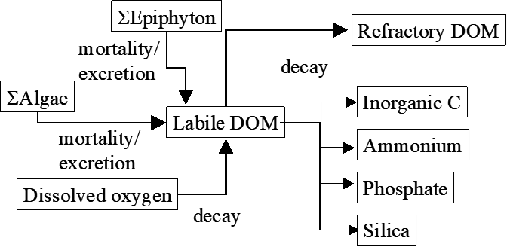
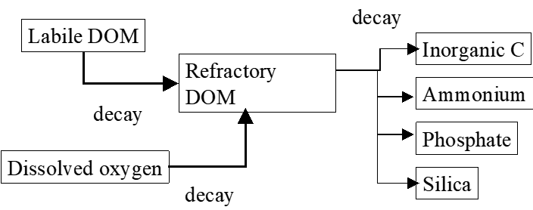
CE-QUAL-W2 DOM

Slide 10
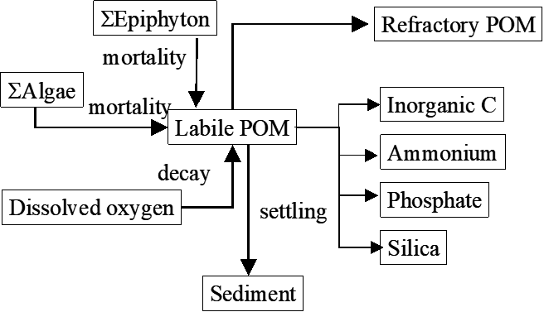
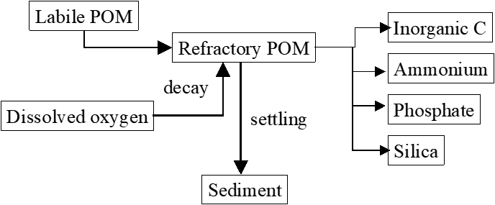
CE-QUAL-W2 POM

Slide 11
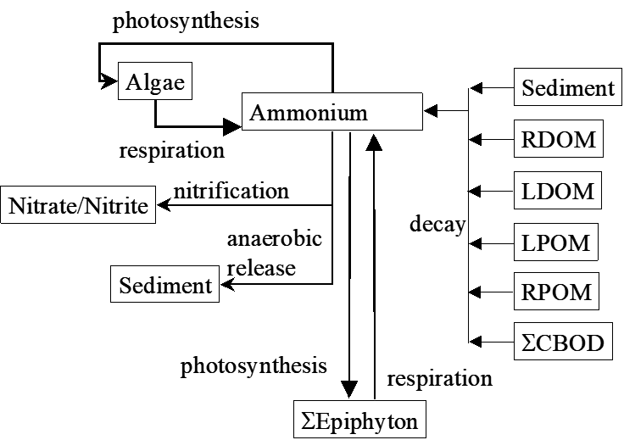
CE-QUAL-W2 Ammonium

Slide 12
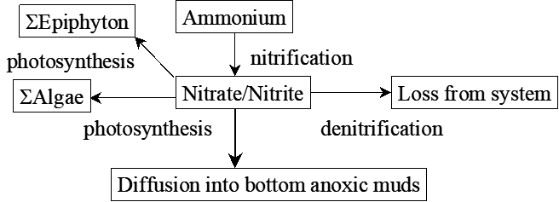
CE-QUAL-W2 Nitrate/Nitrite

Slide 13
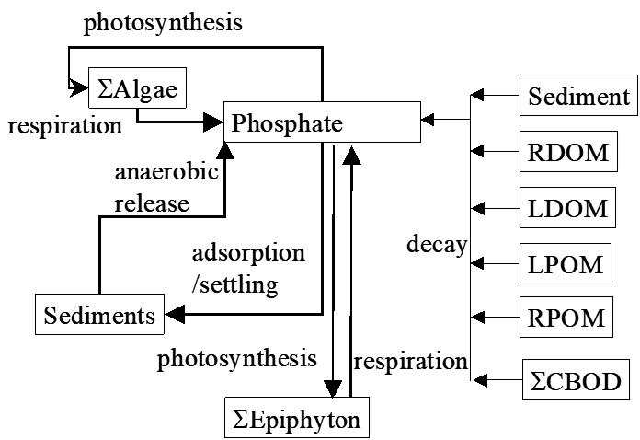
CE-QUAL-W2 Phosphate

Slide 14
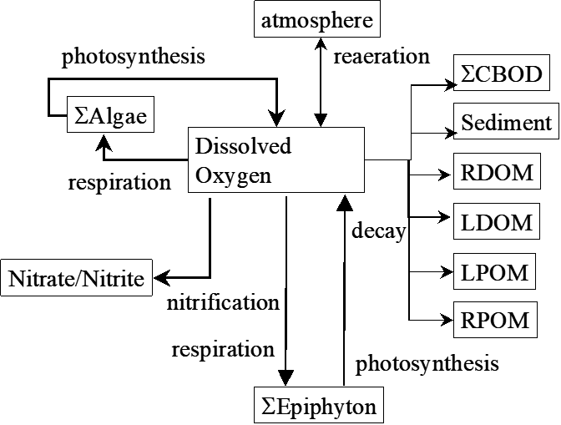
CE-QUAL-W2 DO

Slide 15
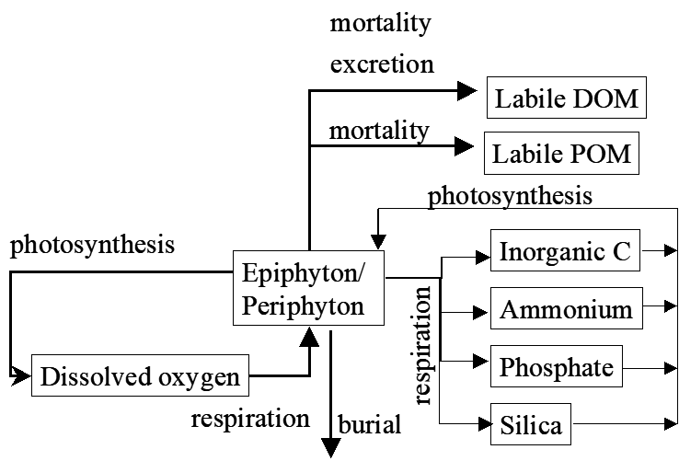
CE-QUAL-W2 Algae

Slide 16
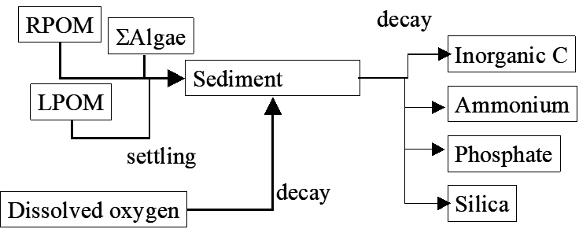
CE-QUAL-W2 Bed Sediment – First Order Approach

Slide 17
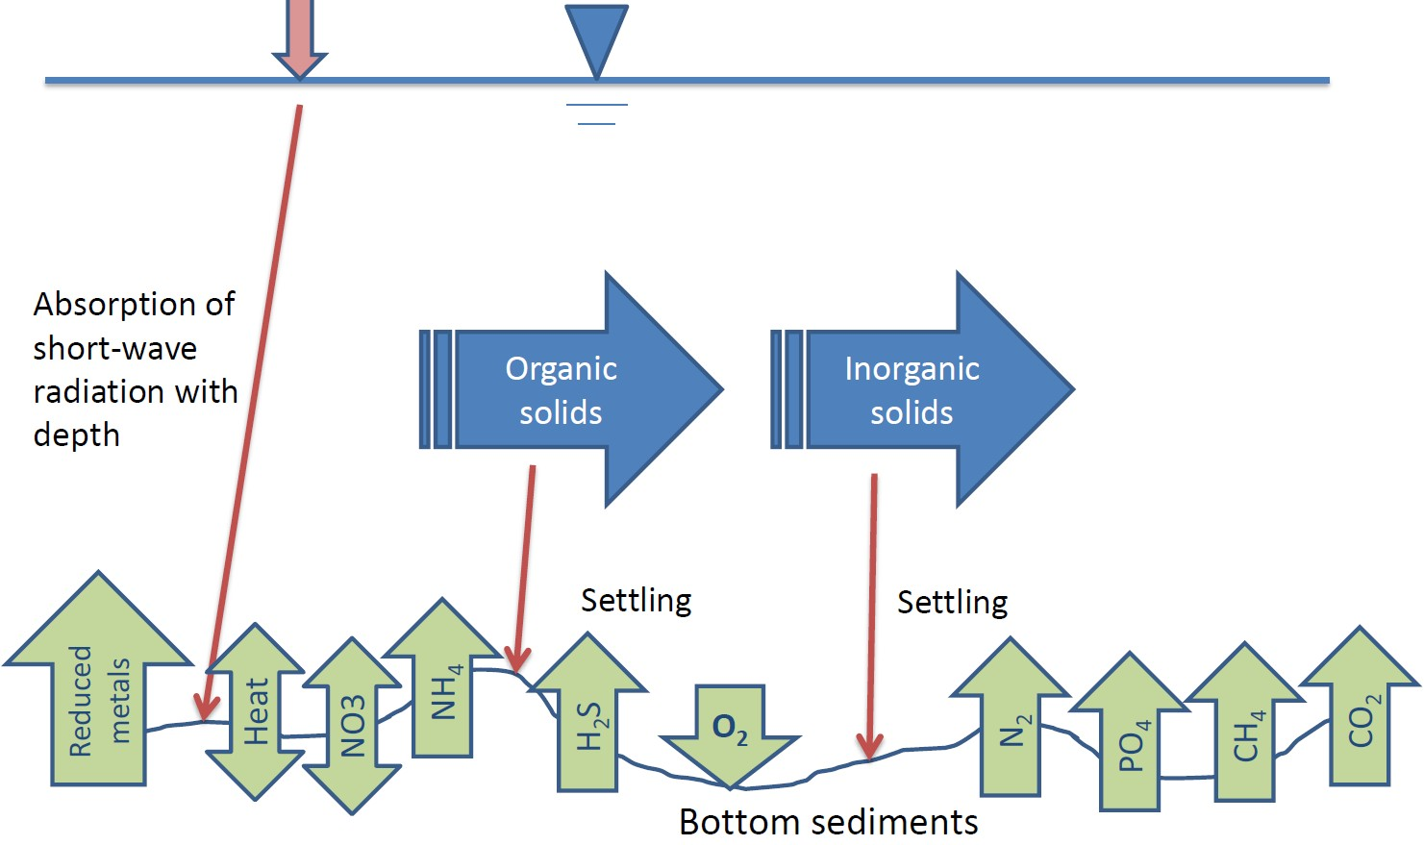
CE-QUAL-W2 Bed Sediment – Sediment Diagenesis Model

Slide 18
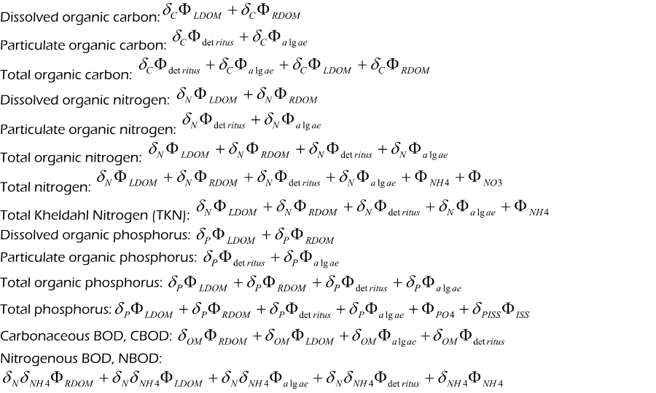
Conversions between CE-QUAL-W2 State Variables and Commonly Used
Field Data

Slide 19



Questions?
UNCLASSIFIED
US Army Corps of Engineers •
Engineer Research and Development Center
UNCLASSIFIED
19

