Slide 1


CE-QUAl-W2 Model Calibration/Validation
UNCLASSIFIED
Todd Steissberg
U.S. Army Engineer Research and Development Center, Environmental Laboratory
CE-QUAL-W2 Workshop
July 08 - 09, 2024
Environmental Systems
Modeling Team
UNCLASSIFIED

Slide 2
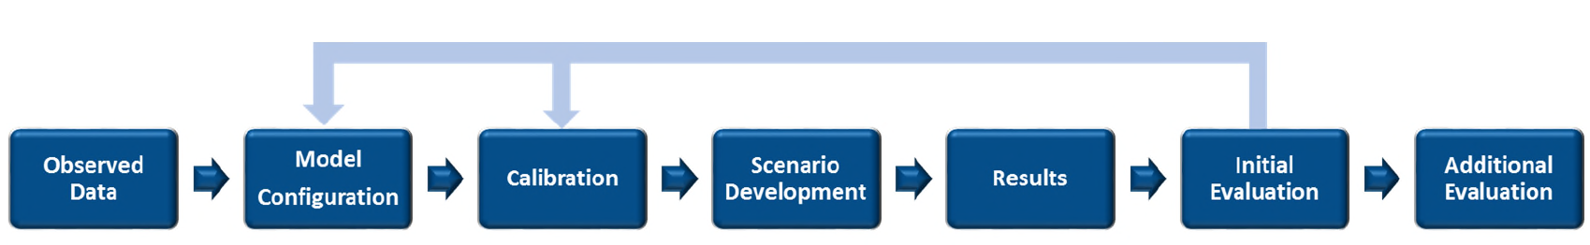
Water Quality Model Application Processes
Integrated Modeling in the Delta: Status, Challenges and a View to the Future (2019)
Use observed data from the field to configure and calibrate the model
Apply to various scenarios
Report results
Model results are compared against field data and can be subjected to a variety of tests to evaluate performance
Additional evaluation such as sensitivity and uncertainty analysis maybe required.

Slide 3
Model Calibration/Validation
In EPA guidance, calibration is defined as the process of adjusting model parameters within physically defensible ranges until the resulting predictions give the best possible fit to the observed data (EPA 1994).
In some disciplines, calibration is also referred to as parameter estimation (Beck et al. 1994).
A portion of the simulation period will be reserved for model validation. Data availability may impact calibration and validation periods.
Calibration parameters are parameters whose values are uncertain.
Adjustments for calibration parameters should be constrained by physically sensible limits.
Calibration is an iterative process whereby model coefficients are adjusted until an adequate fit of observed versus predicted data is obtained.

Slide 4
Model Calibration/Validation
Model parameter/coefficient values are adjusted manually by trial and error. This requires the user to do multiple runs of the model.
Sufficient observed data must be collected to allow for an accurate calibration as well as analysis of different alternatives in the system.
The model cannot be expected to be more accurate than the errors (confidence intervals) in the input and observed data. You cannot calibrate the model to any greater accuracy than the inherent uncertainty associated with the data used to develop the model.

Slide 5
Model Calibration Process
Begin with literature values for model parameters
Adjust within acceptable ranges, until…
Model results “match” observed data
Start with hydrodynamics
Fluid and energy balance checks
Ensuring the model reproduces flow and water level at various control points in the model domain
Get temperature right
Assessed with water temperature profiles
Ensuring accurate meteorological data
Proceed to water quality
Inorganic suspended solids
Phytoplankton
Dissolved oxygen
N and P

Slide 6
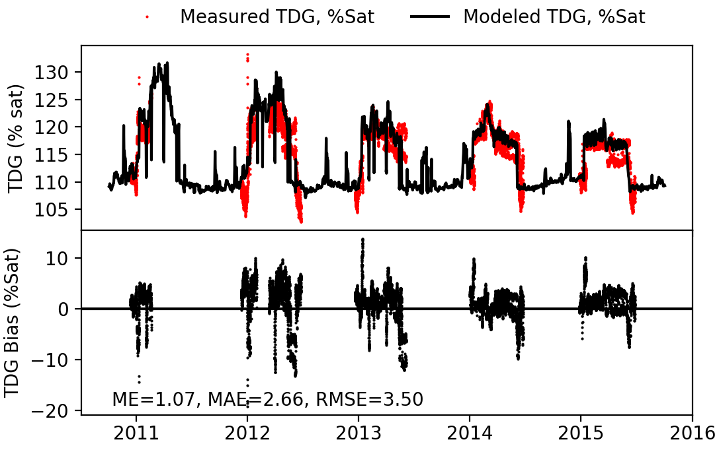
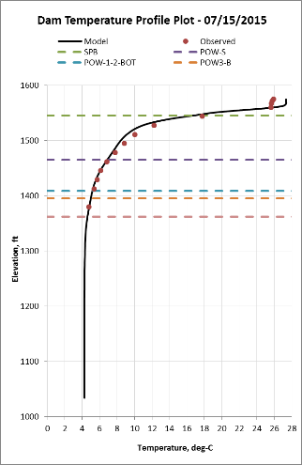
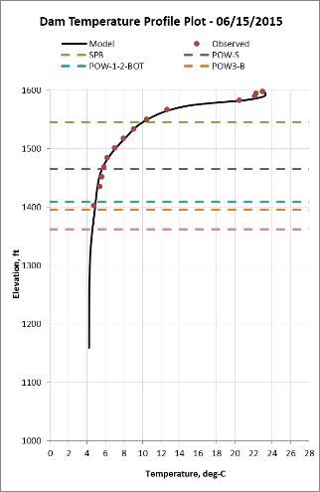
Model Performance Evaluation
Model results will be presented graphically and statistically for assessment
Graphical plots of model vs. data
Calculate model performance statistics
Graphical comparisons
Time series plots of modeled results and observed data for state variables (e.g., nutrient concentrations) or fluxes (e.g., flow x concentration)
Modeled and observed scatter plots, with 45º linear regression line displayed, for state variables or fluxes
Profile plots

Slide 7
Model Performance Error Statistics
Mean Absolute Error (MAE)
Mean Error (ME)
Root Mean Square Error (RMSE)
Nash-Sutcliffe efficiency (NSE)
Percent bias (PBIAS)
Coefficient of determination R²

Slide 8
Model Performance Error Statistics
Performance statistics:
Mean absolute error (MAE) determines the average magnitude of the difference between simulated and observed values
Relative error (RE) averages the differences between each simulated value and the observed value
Root mean square error (RMSE) is the measure of the differences between values predicted by a model and the observed or measured values.
R² describes the degree of collinearity between simulated and measured data
Nash-Sutcliffe efficiency (NSE) determines the relative magnitude of the residual variance compared to the measured data variance
There is no single accepted performance statistic or standard that determines whether a model is valid.
Temperature: MAE < 1ºC, ME close to 0ºC

Slide 9
Model Sensitivity Analysis
Quantify the effect of error on state (model) variables
Identify sensitive parameters or variables that have on predicting water quality
Indicate the relationship between control variables and decision (or state) variables to help ensure that a change in control variable can have a desirable effect on the decision variables

Slide 10
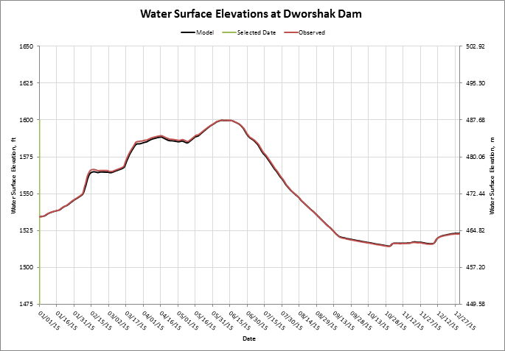
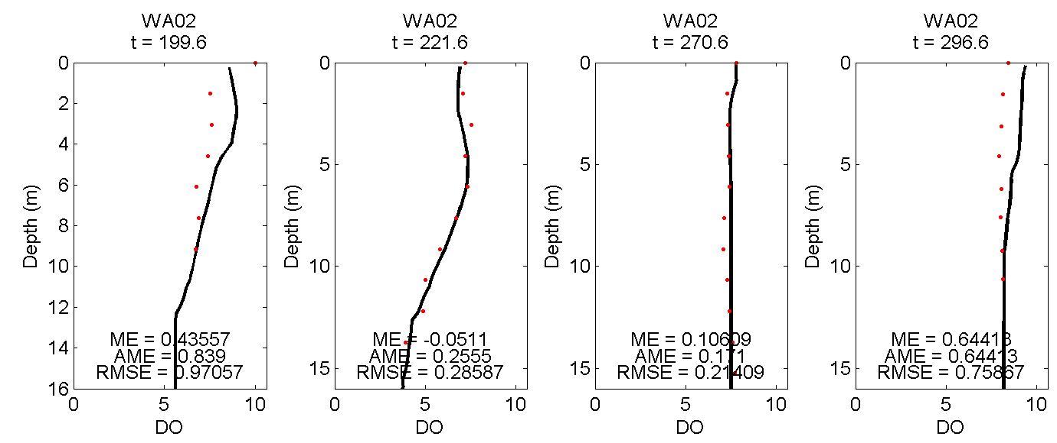
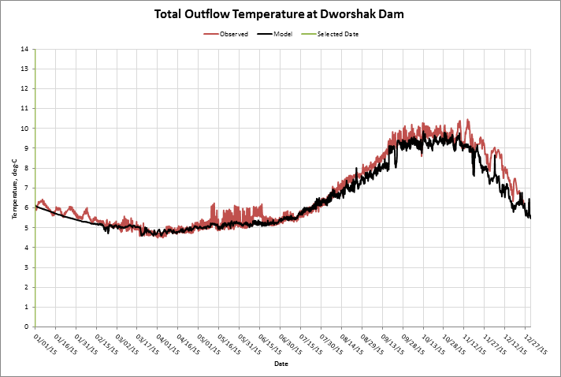
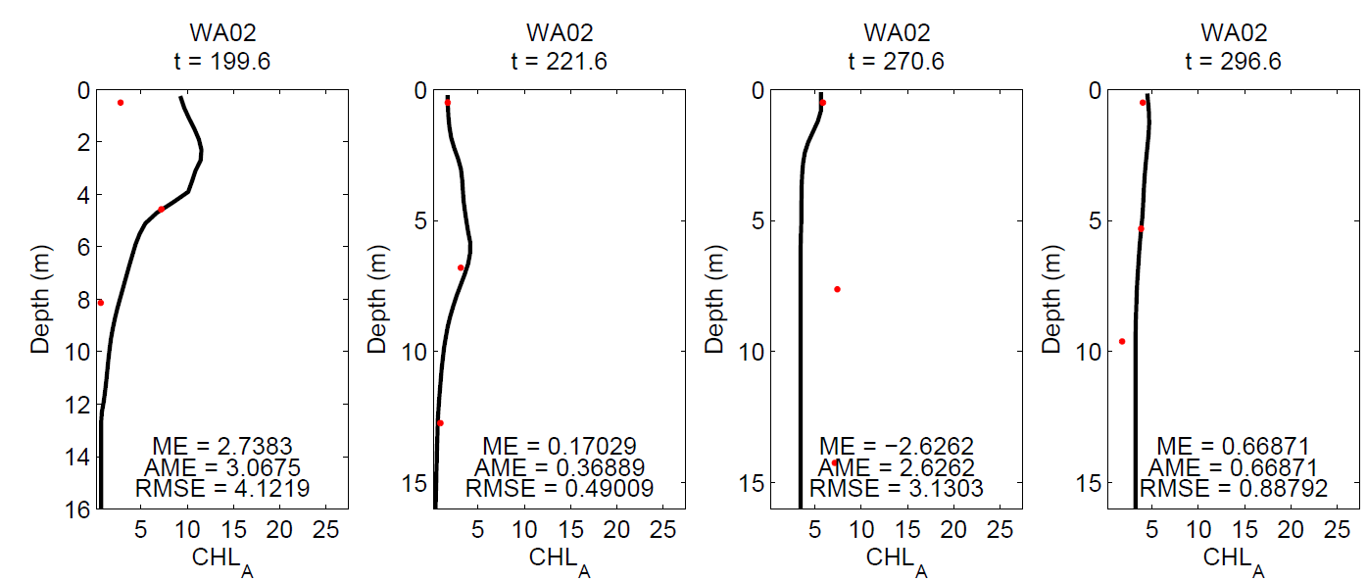
Model Calibration Data
Observed data records are fundamental during the calibration and validation phases of W2 model.
Time Series
Flow and water level data
Water temperature and water quality data
In-reservoir or in-river temperature and water quality profile data
Temperature profiles
Secchi disk depth
Dissolved Oxygen
Nutrient profiles
Algae data
Biomass for algal species
Chlorophyll a concentration

Slide 11
Calibration Data

Slide 12
Calibration Data

Slide 13
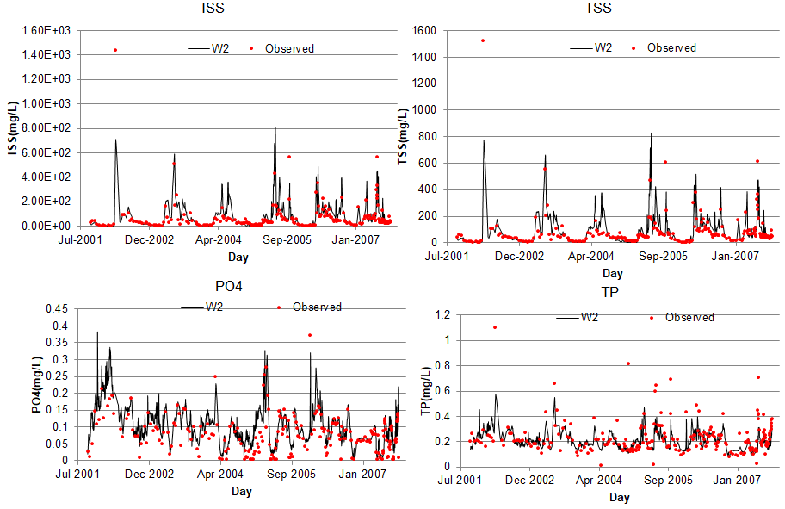
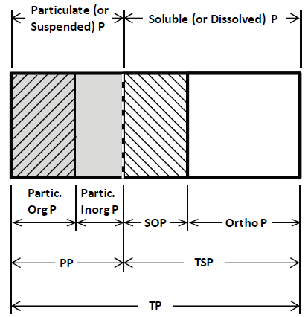
Calibration Data
Suspended Sediment is a mixture of
clay particles
silt particles
sand particles
organic material
Chemical forms of phosphorous (P):
TP = total P
PP = particulate P
Partic. OrgP = organic P associated with particulates
Partic. InorgP = inorganic P associated with particulates
TDP = total dissolved P
Ortho P = inorganic P
SOP = soluble organic P
TISS = TSS – VSS
POM = VSS – r_{da}Chla

Slide 14
Hydrodynamics/Water Temperature Calibration Parameters
longitudinal eddy viscosity (Ax)
vertical eddy viscosity (Az)
bottom friction
sediment heat exchange
wind-sheltering coefficient that varies by segment and time
interaction with density field - SS, TDS, etc.
bathymetry of the model
The W2 model is relatively insensitive to hydraulic parameters, dispersion coefficients, and bottom friction parameters for the Chezy friction model and default values are often used.

Slide 15
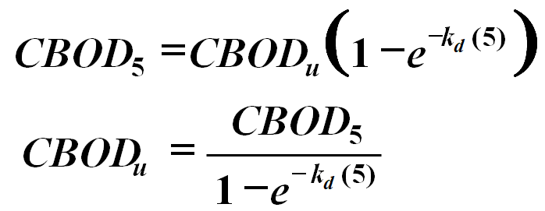
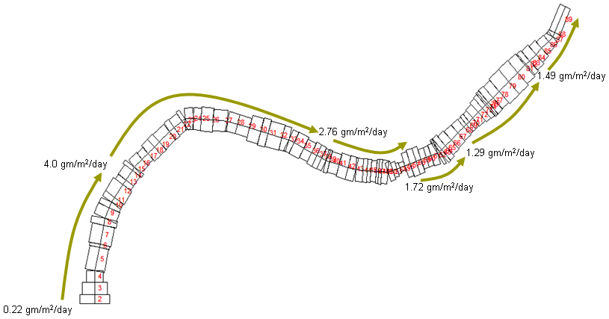
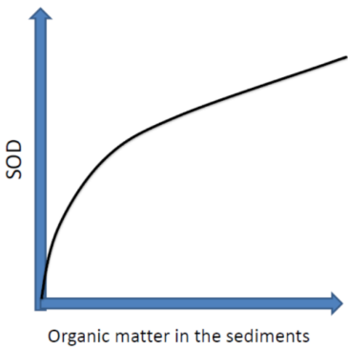
Water Quality Calibration Parameters
For water quality simulations, calibration parameters are varied widely, , it is preferable to obtain actual measurements of water quality coefficients …
CBOD decay rates
Decay rates of organic matter (carbon)
SOD is known to vary spatially in reservoirs, SOD typically ranges from 0.1 to 1.0 gO₂ m⁻² day⁻¹, but can be high­er.
Zero-order
First-order
Sediment diagenesis
Courtesy of Dr. Chapra

Slide 16
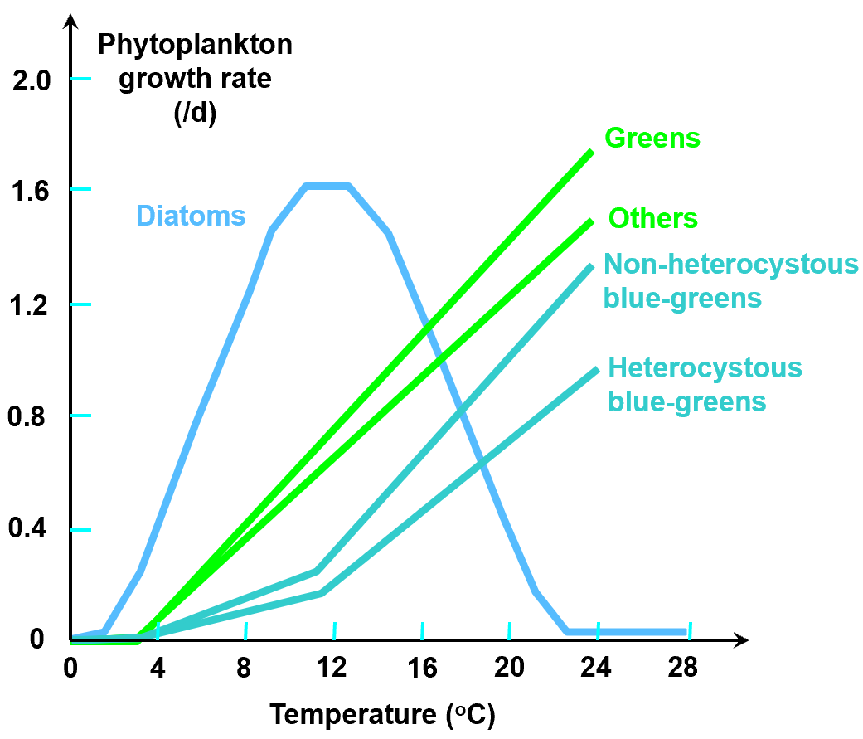
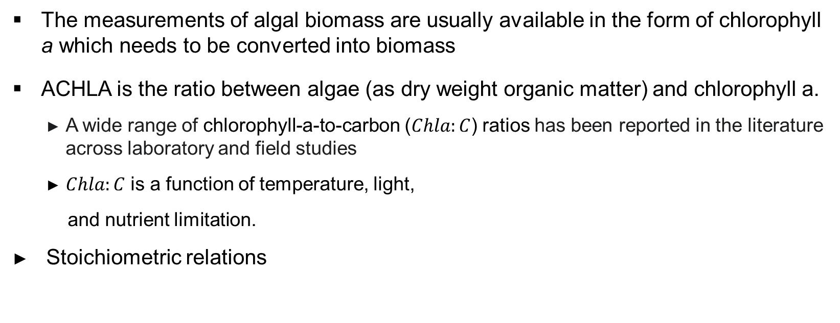
Water Quality Calibration Parameters
The measurements of algal biomass are usually available in the form of chlorophyll a which needs to be converted into biomass
ACHLA is the ratio between algae (as dry weight organic matter) and chlorophyll a.
A wide range of chlorophyll-a-to-carbon ($Chla:C$) ratios has been reported in the literature across laboratory and field studies
$Chla:C$ is a function of temperature, light,
and nutrient limitation.
Stoichiometric relations
100 g-D : 40 g-C : 7.2 g-N : 1.0 g-P : (0.4 ~ 1.0) g-Chla
Courtesy of Dr. Chapra

Slide 17
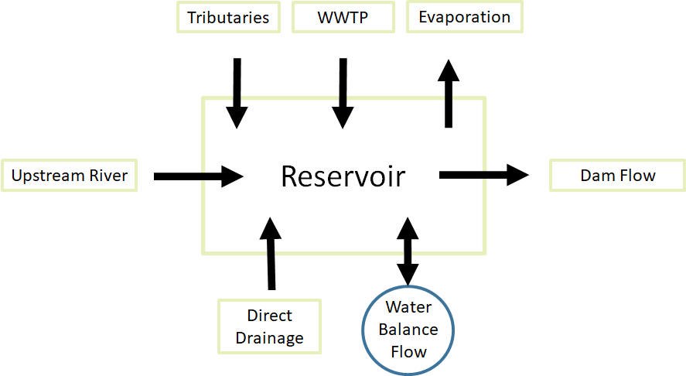
Fluid, Mass and Energy Balance
Involve detailed evaluation of inflows and outflows, boundary conditions
Have you accounted for all water?

Slide 18
Water Quality Model Calibration Suggestions
Make sure model output is appropriate.
Averaged vs instantaneous
Only tweak appropriate model input parameters/coefficients.
Physically relevant
Begin with literature values for model parameters.
Start with water temperature and proceed to other water quality constituents.
All reactions are temperature dependent
Do not force a calibration to fit with unrealistic water quality parameter’s values

Slide 19
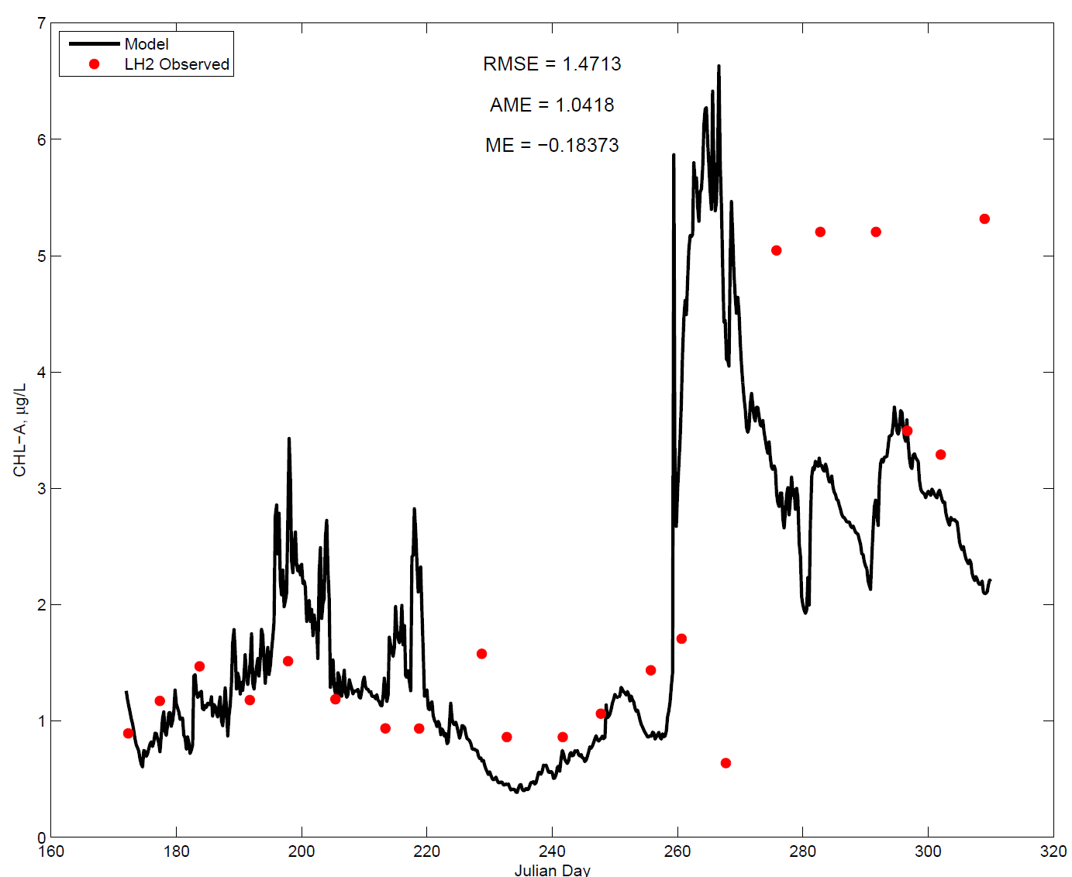
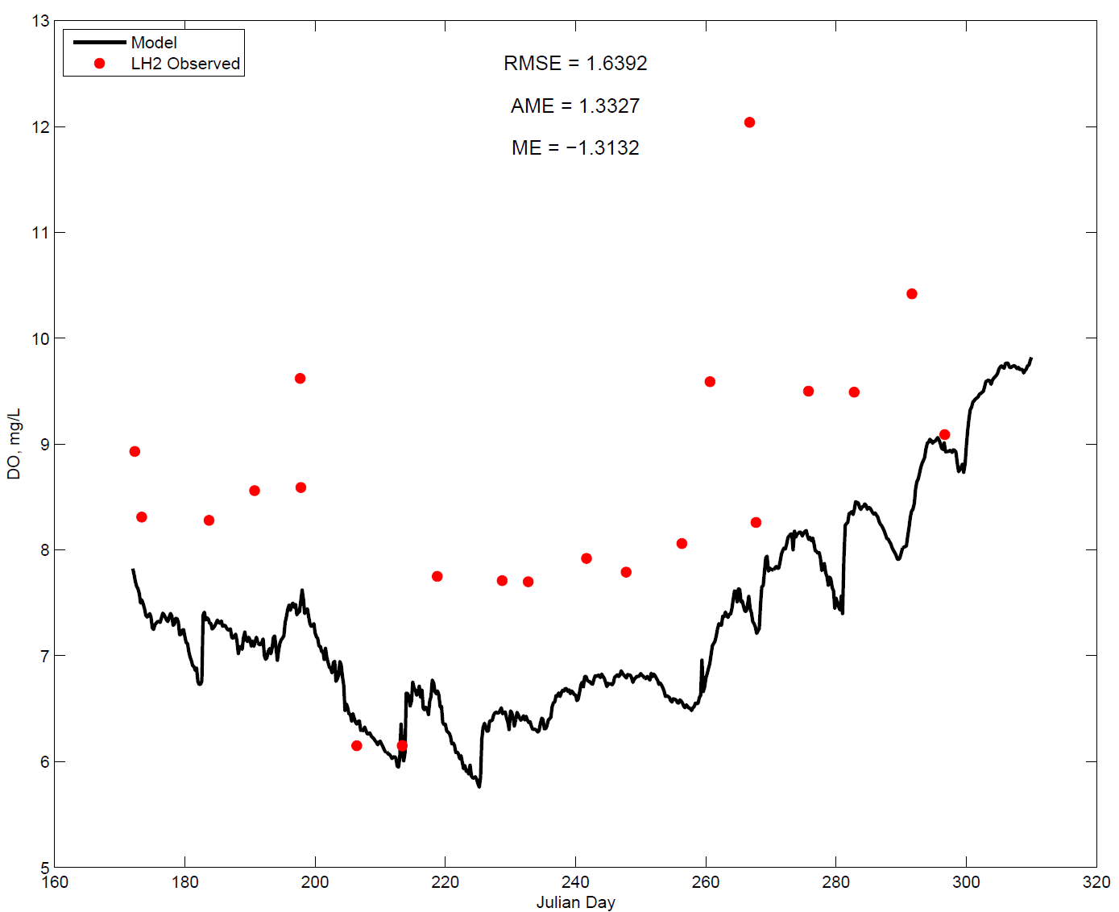
Water Quality Model Calibration Suggestions (cont.)
Use sensitivity analysis to investigate relations between observations, parameters, and model predictions
For water quality simulations, it is important the user provide accurate initial and time-varying boundary conditions.
If nutrient loadings are not adequately characterized, then it will be impossible for the model to accurately reproduce phytoplankton/nutrient/DO dynamics.

Slide 20
W2 Model Stability
The W2 model works with dynamic time steps. Auto-time-stepping does not guarantee numerical stability.
The W2 model uses the minimum timestep necessary to maintain numerical stability throughout the entire system.
Time step selection will be based on the size of the grid cells and velocity of water in the cells.
Large time steps lead to stability violation and very small time-steps increase the computation time.
To have the stability, the spatial and temporal steps (Δx and Δt) should be fine enough.
The timestep adjustment is based on the characteristics of the waterbody and boundary conditions.
For the times or regions with too many fluctuations in flow, the model uses a smaller time step and increases that when a small time step is not necessary.

Slide 21

W2 Model Stability
If the current timestep is less than or equal to the minimum timestep, then the model run is stopped
Unstable water surface elevation - negative surface layer thickness
the user can reduce the maximum timestep [DLTMAX] and/or the fraction of the timestep [DLTF]

Slide 22
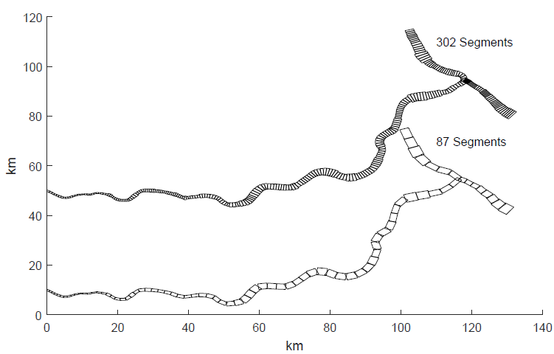
W2 Model Stability
Numerical solution scheme: UPWIND, QUICKEST, or ULTIMATE with the latter being the recommended option.
W2 model grids: the conceptual model and
grid resolution affect the model’s stability.
Riverine section may need to be a separate
branch with a branch slope to keep it hydrated rather than having it wet and dry.

Slide 23
Hands-on Exercises
Review the model inputs from “Minnesota River W2 Project”
Review the model outputs of DO, CHLA, NH4, NO3, PO4 from Segment 83 and corresponding observed data
Change the water quality parameters in the control file and rerun the model and see the difference of DO, NH4, PO4 from Segment 83

Slide 24

Questions?

