Slide 1


CE-QUAL-W2 Model Outputs: Overview
UNCLASSIFIED
Todd E. Steissberg, PhD, PE
Environmental Laboratory
Engineer Research and Development Center (ERDC)
U.S. Army Corps of Engineers
CE-QUAL-W2 Water Quality Modeling Workshop
September 17-18, 2025
Environmental Systems
Modeling Team
UNCLASSIFIED

Slide 2
W2 Model Outputs
Model preprocessor outputs
pre.opt
pre.wrn
pre.err
Model outputs
w2.wrn
w2.err
W2ErrorDump.csv

Slide 3
W2 Model Output Files
1 SNP – Snapshot
2 PRF – Profile
3 SPR – Spreadsheet profile
4 W2L – W2Post
5 CPL – Contour
6 TECPLOT – Contour
7 FLUX – Kinetic fluxes
8 TSR – Time series
9 WLEVEL – Water level
10 FLOWBAL – Flow balance
11 NPBAL – N and P mass balance
WDO – Withdrawal outflow
RESTART

Slide 4
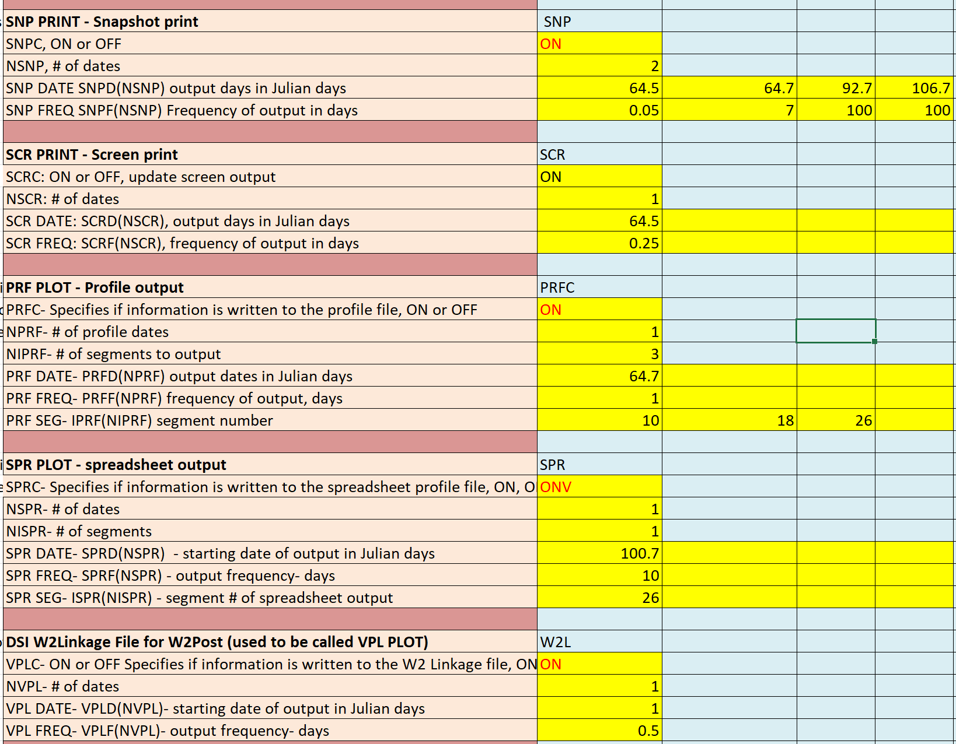
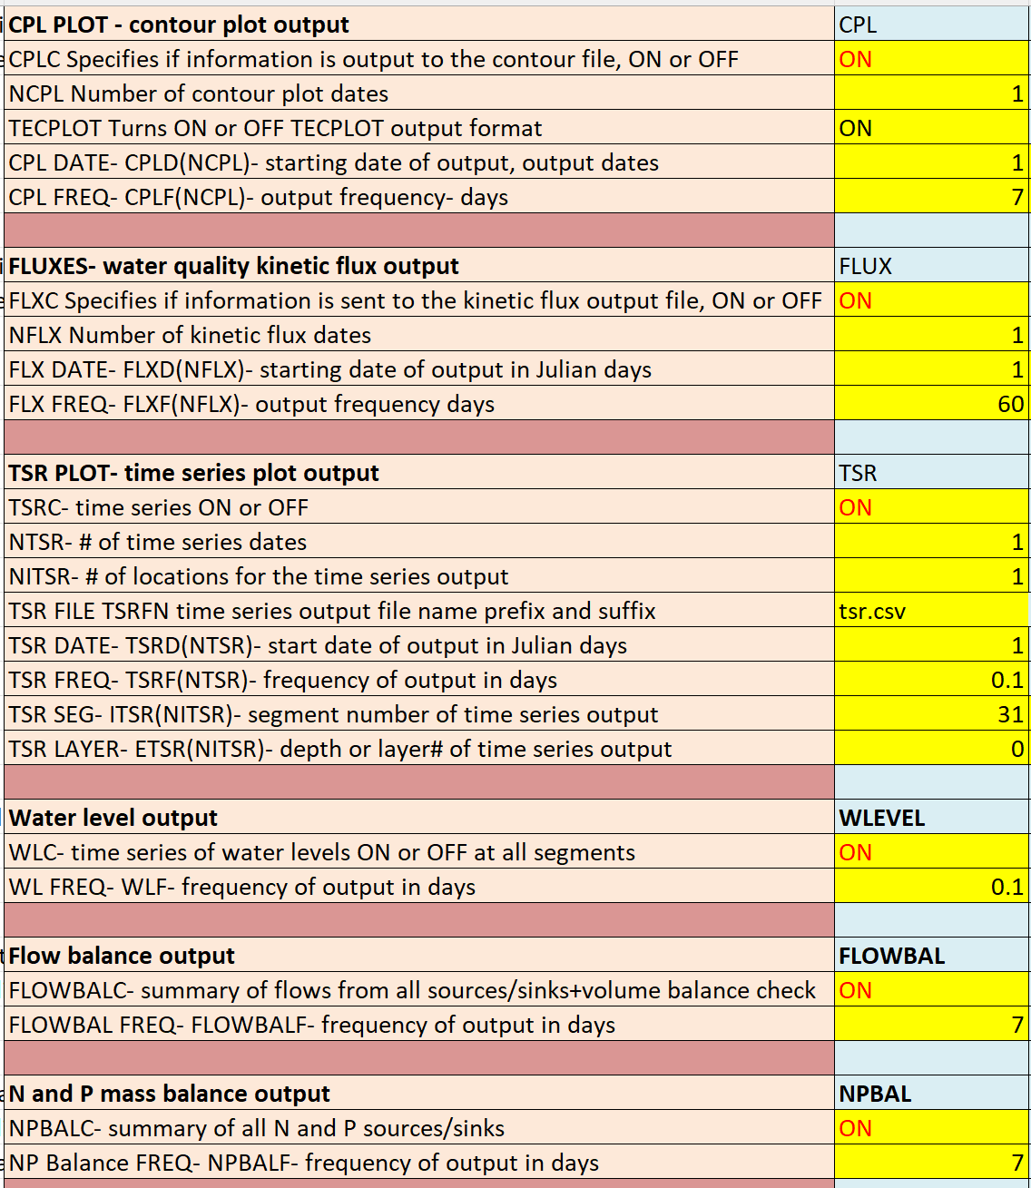
W2 Model Output Control

Slide 5
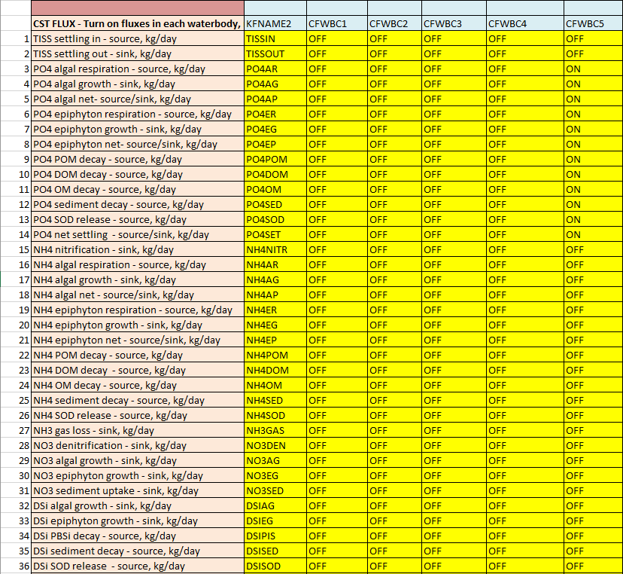
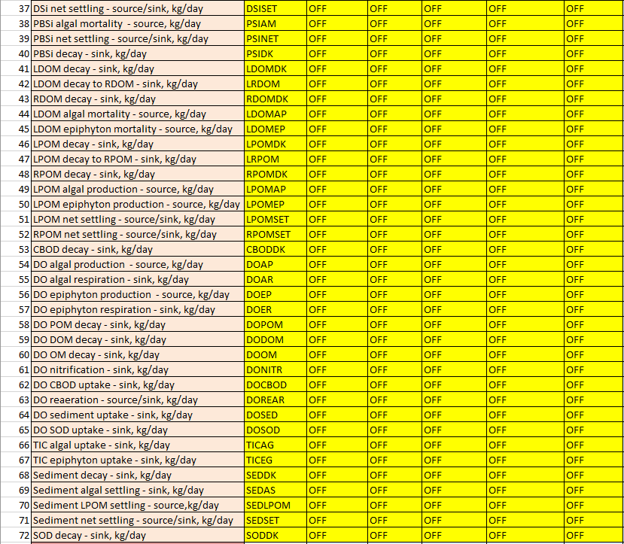
W2 Model Output Control

Slide 6
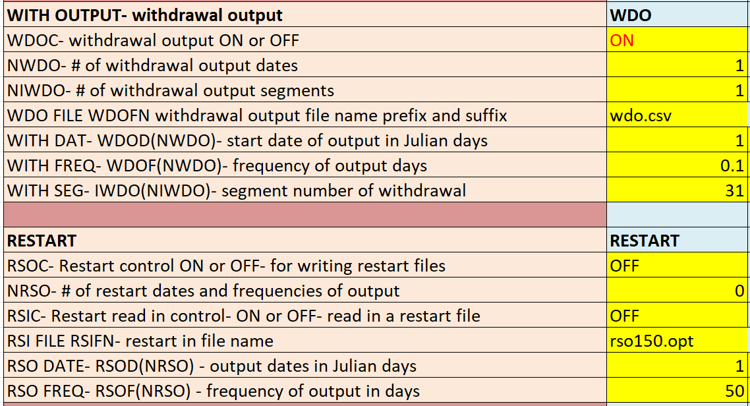
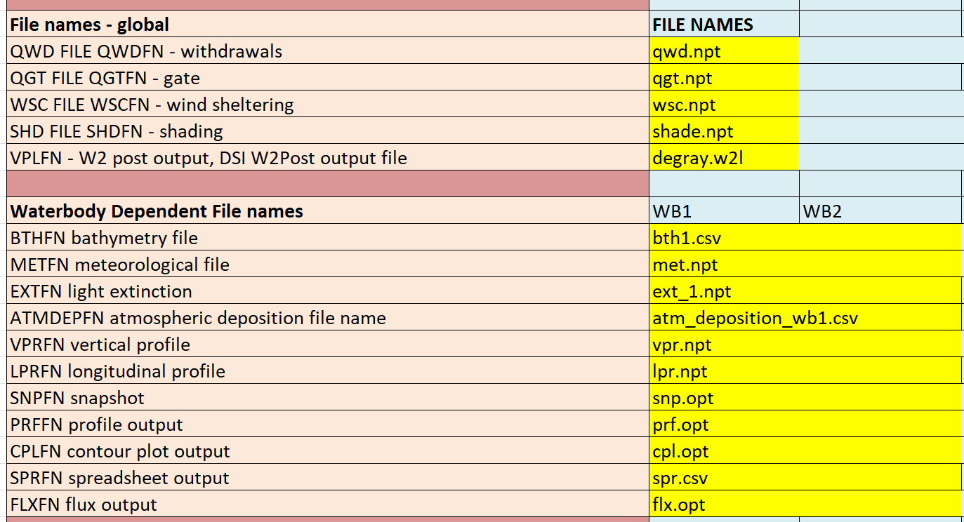
W2 Model Output Control

Slide 7
Review DeGray Reservoir Output Files
Run the DeGray W2 model
Review the following W2 model output files
pre.opt – Preprocessor
tsr_1_seg31.csv – Segment time series plot
spr.csv – Segment spreadsheet profile
flx.opt – Segment flux
kflux_wb1.csv – Waterbody flux
qwo_31.csv – Withdrawal outflow file for flow
two_31.csv – Withdrawal outflow file for temperature
cwo_31.csv – Withdrawal outflow file for constituent concentrations
dwo_31.csv – Withdrawal outflow file for derived constituent concentrations
wl.csv – Surface water level
flowbal.csv – Waterbody flow balance
massbal.csv – Waterbody N and P mass balance
degray.w2l – W2Post Postprocessor
snp.opt – Snapshot

Slide 8
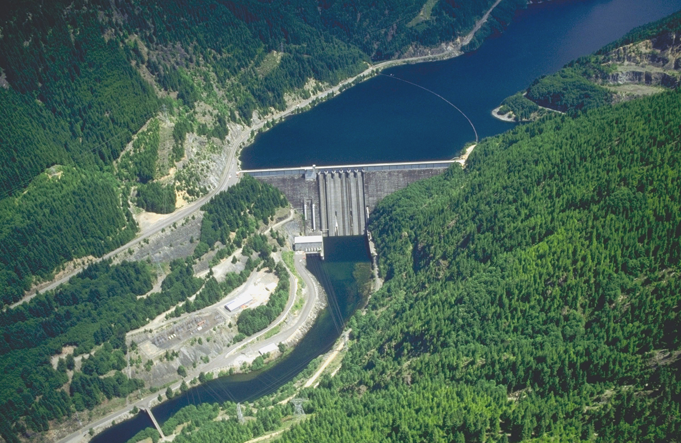
Questions?

