Slide 1


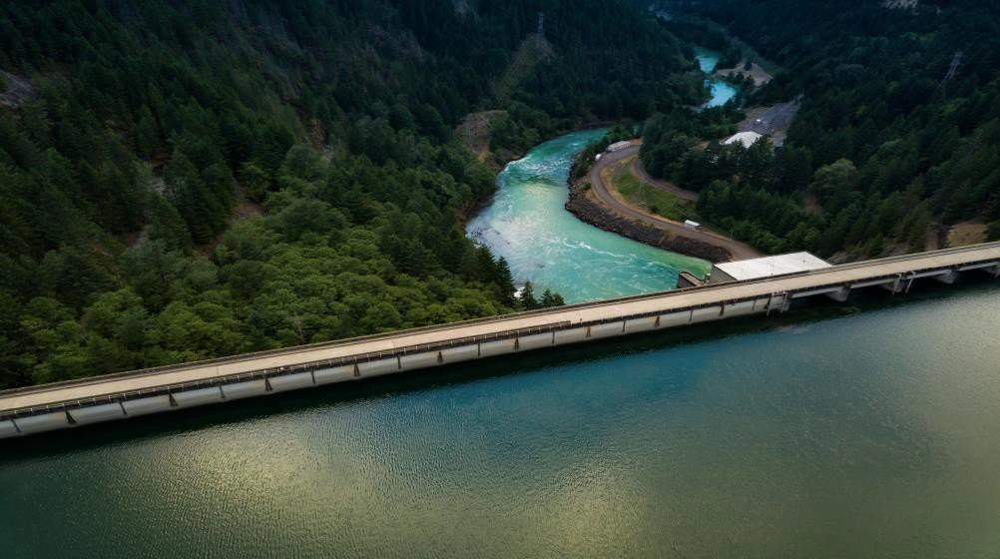
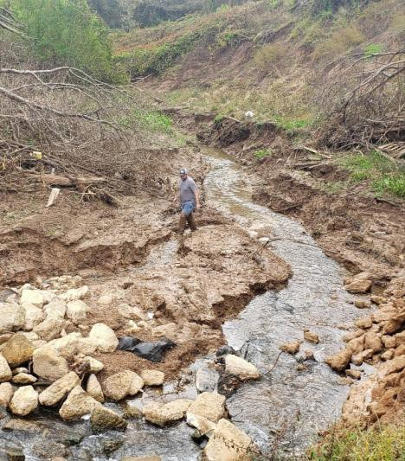
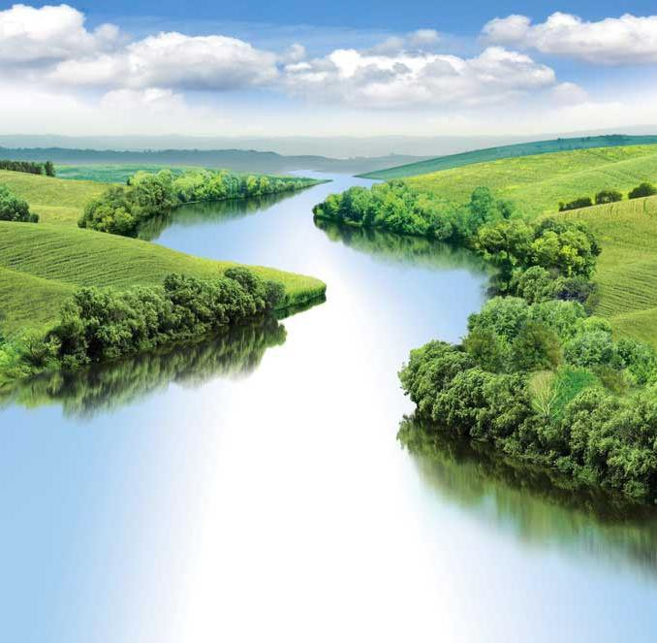




DISSOLVED OXYGEN CASE STUDY
UNCLASSIFIED
Lauren Melendez
U.S. Army Engineer Research and Development Center, Environmental Laboratory
CE-QUAL-W2 Workshop
July 08 - 09, 2024
UNCLASSIFIED
DISCOVER | DEVELOP | DELIVER
1

Slide 2
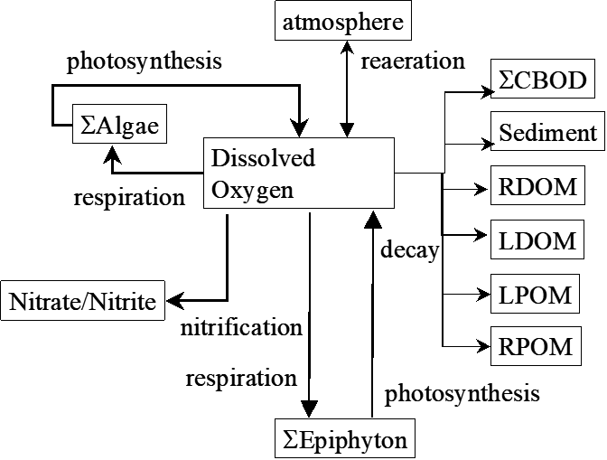
CE-QUAL-W2 DO
UNCLASSIFIED
Complete model DO process
Typically reduced suite of
variables and processes
Minimum required:
Dissolved Oxygen
Reaeration
Oxygen demand
UNCLASSIFIED

Slide 3
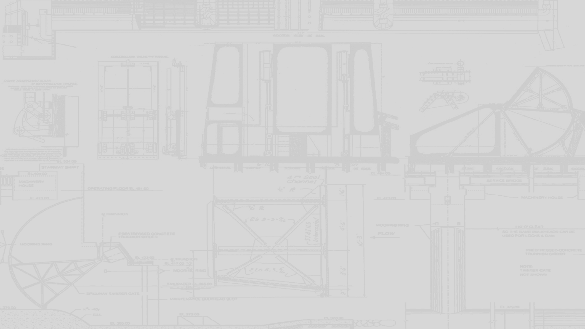

CE-QUAL-W2 DO
UNCLASSIFIED
UNCLASSIFIED

Slide 4
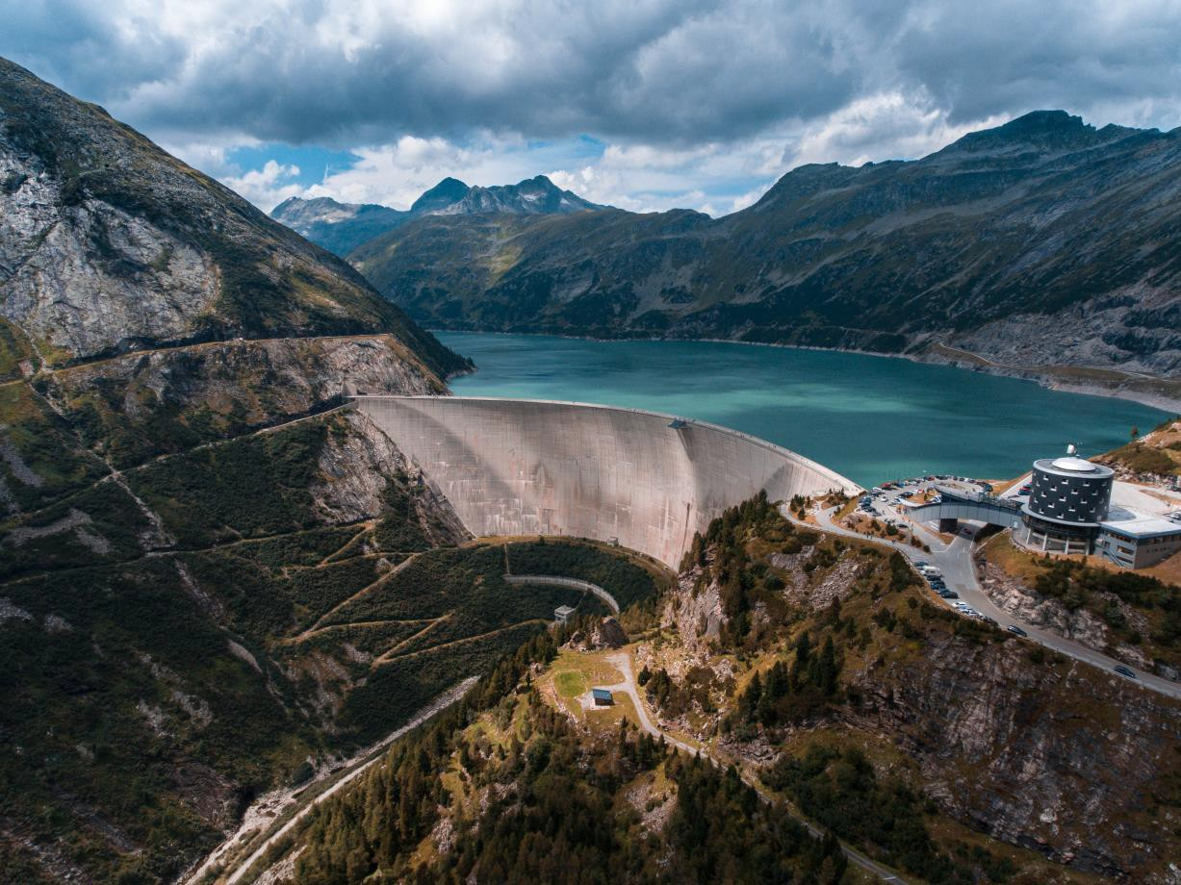
DO Modeling Requirements
UNCLASSIFIED
Typical Sources:
Boundary Conditions for all inflows
Initial Conditions for water body
Reaeration
Typical Sinks
Water quality variables that utilize DO in
their kinetic processes
CBOD, DOM, POM, SOD, etc…
Interactions in the DO cycle are temperature dependent.
Efforts to model DO without reasonable
temperature model are futile.
UNCLASSIFIED

Slide 5
DO Modeling Requirements (cont.)
UNCLASSIFIED
Dissolved Oxygen Observed Data
Boundary conditions
Estimates of initial conditions
In-situ comparisons with model predictions for Calibration/Validation
Understanding of system behavior and
model performance
Oxygen Sinks
Boundary conditions and in-situ values
External loadings (Point and Non-point source)
Sediments
Meteorological Data
UNCLASSIFIED

Slide 6
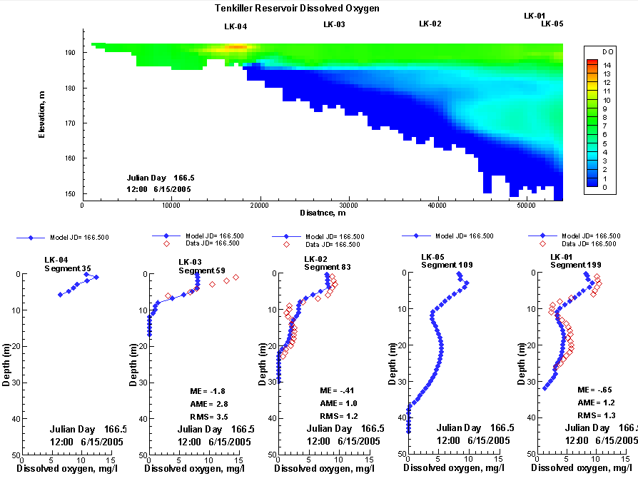
Model DO Performance
UNCLASSIFIED
Compare Model output with observations
Evaluate Model DO performance using:
Time Series
Water Column Profiles
Statistics
Incorporate model Temperature performance in assessment, aka does it look right?
UNCLASSIFIED

Slide 7
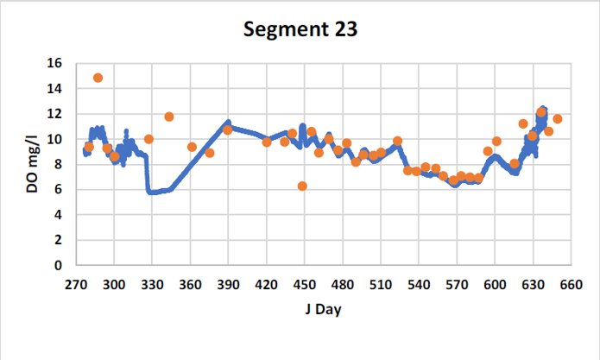
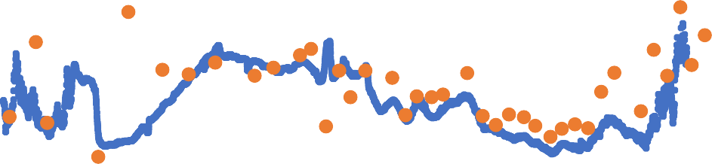
Minnesota River DO
UNCLASSIFIED
Segment 46
16
14
12
10
8
6
4
2
0
270 300 330 360 390 420 450 480 510 540 570 600 630 660
J Day
DO mg/l
UNCLASSIFIED

Slide 8
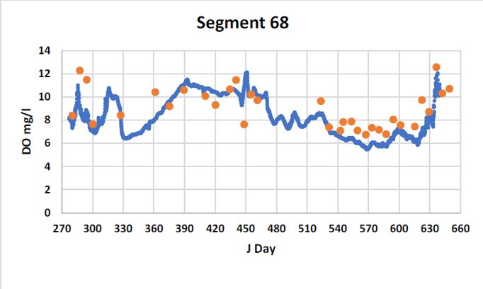
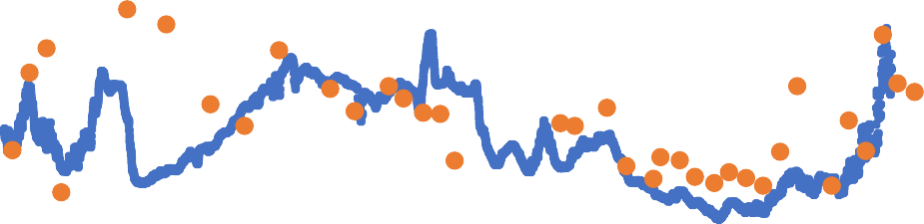
Minnesota River DO (cont.)
UNCLASSIFIED
Segment 83
14
12
10
8
6
4
2
0
270 300 330 360 390 420 450 480 510 540 570 600 630 660
J Day
UNCLASSIFIED

Slide 9
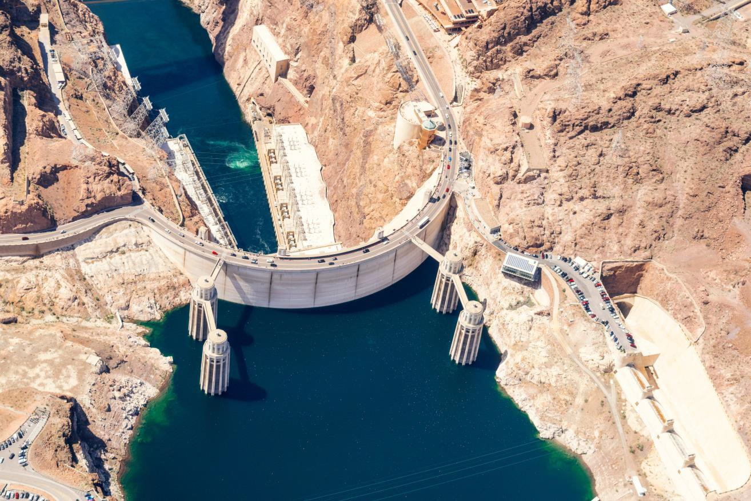
Evaluating Model DO Performance
UNCLASSIFIED
DO is culmination of all other processes occurring in model.
DO Predictions sensitive or insensitive depending upon location and conditions in model.
Proceed slowly
UNCLASSIFIED

Slide 10
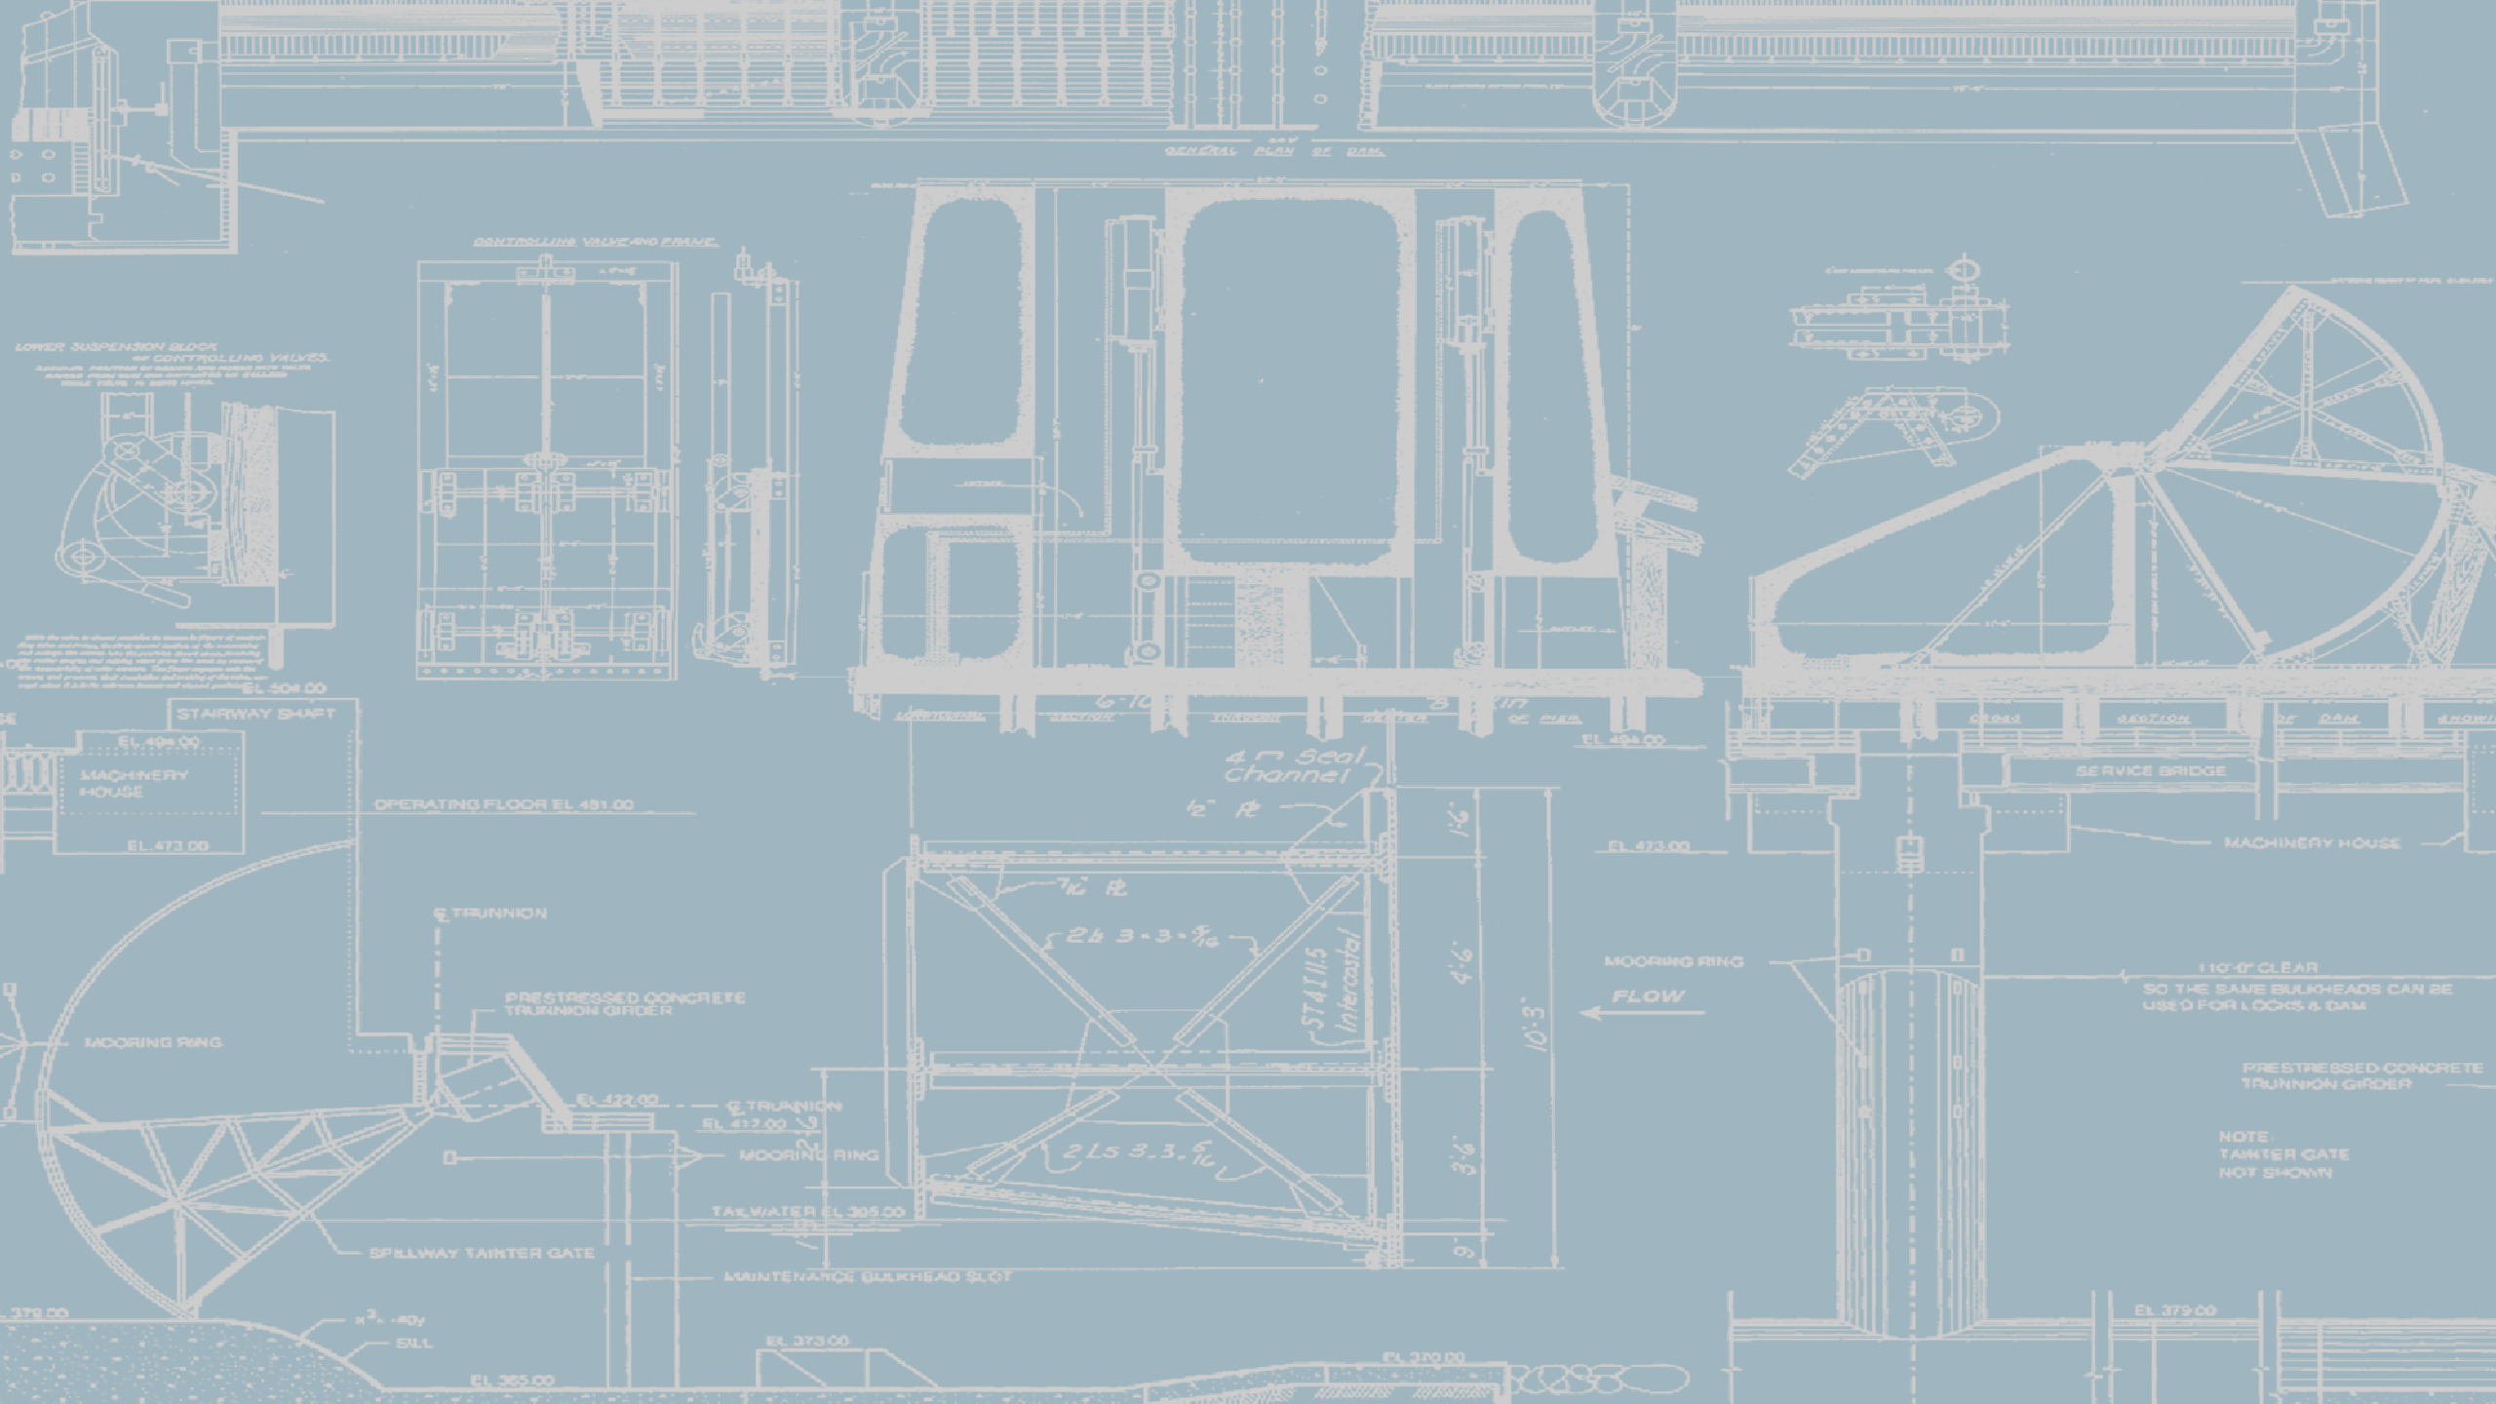
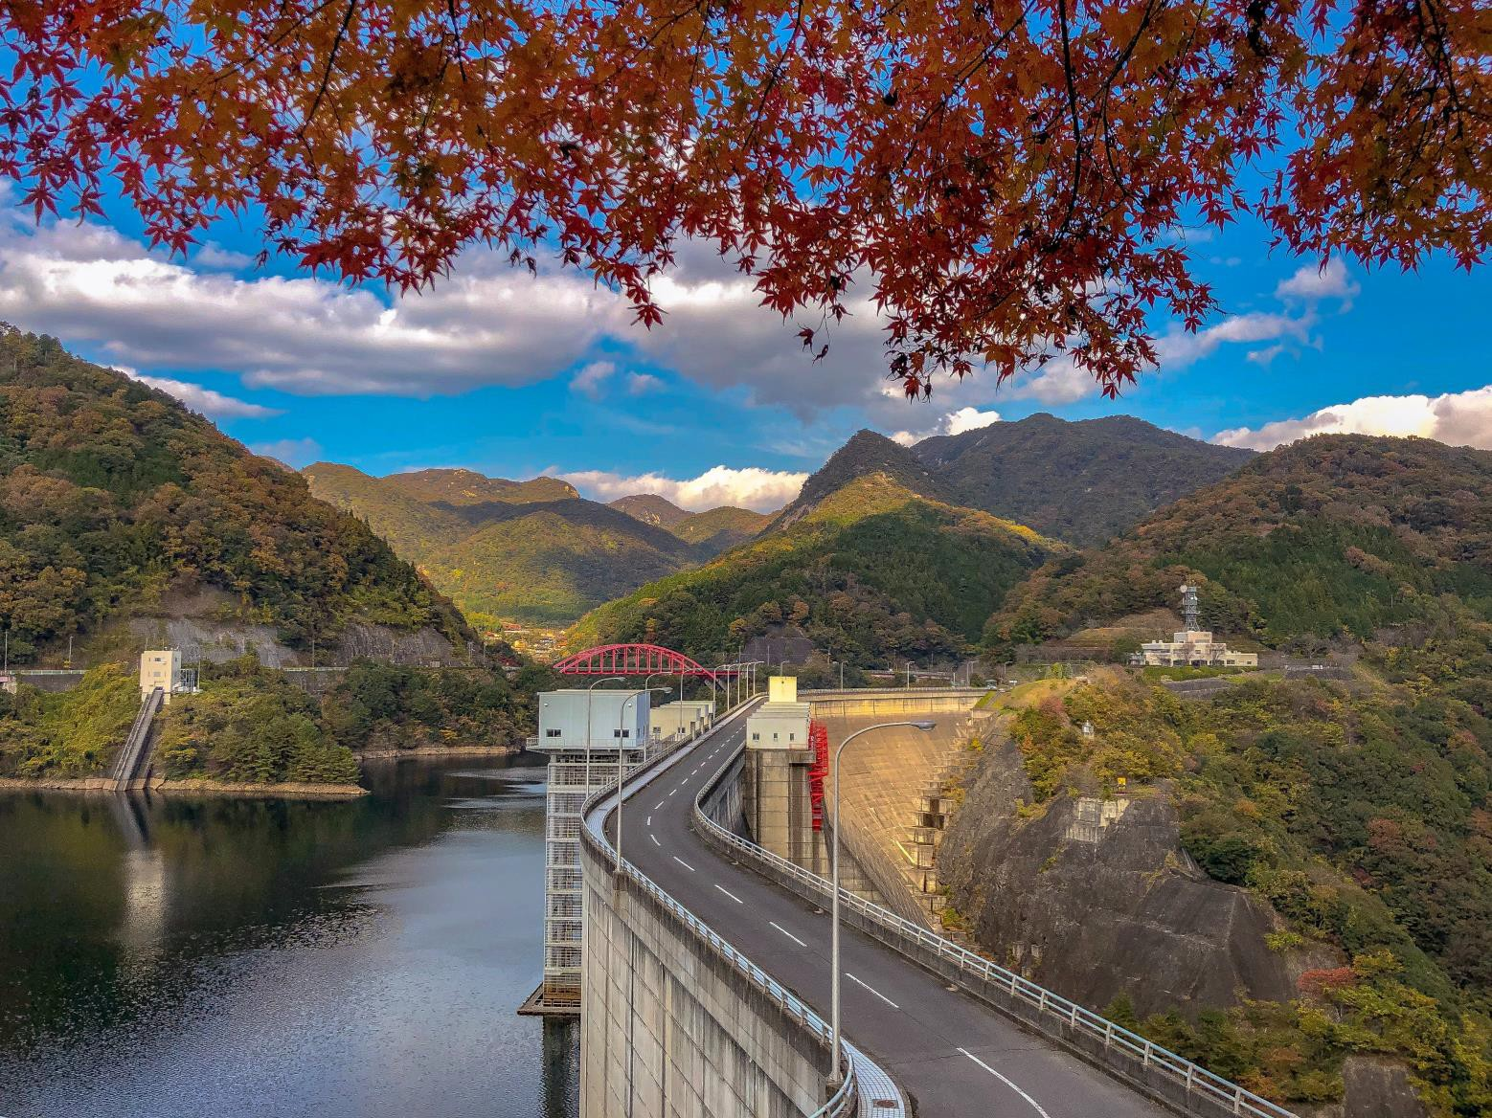
Questions?
UNCLASSIFIED
Engineer Research and Development Center
UNCLASSIFIED
10

