Slide 1


Water Temperature Modeling
UNCLASSIFIED
Todd E. Steissberg, PhD, PE
Environmental Laboratory
Engineer Research and Development Center (ERDC)
U.S. Army Corps of Engineers
CE-QUAL-W2 Water Quality Modeling Workshop
September 17-18, 2025
Environmental Systems
Modeling Team
UNCLASSIFIED

Slide 2
Heat and Temperature
 | Coffee | Constituent (e.g., salinity) | Heat Balance
Extensive | sugar | mass | heat
Intensive | sweetness | concentration | temperature
Relationship | lumps/cup | mass/volume | Heat/(density x specific heat capacity x volume)

Slide 3
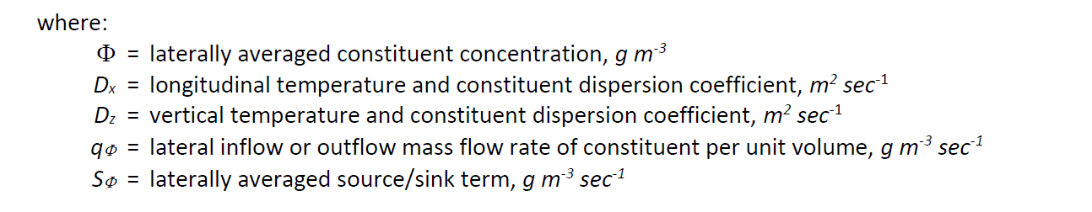
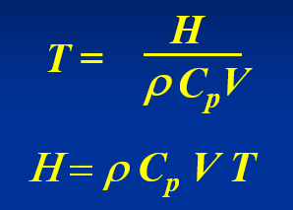
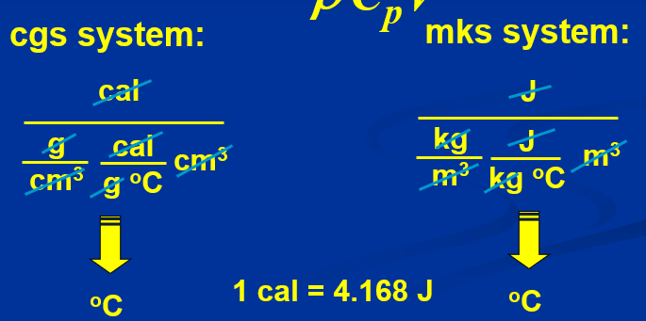
Advection-Dispersion Equation Balance
Substitute H into the equation for Ф, which relates to temperature as:
Units:

Slide 4
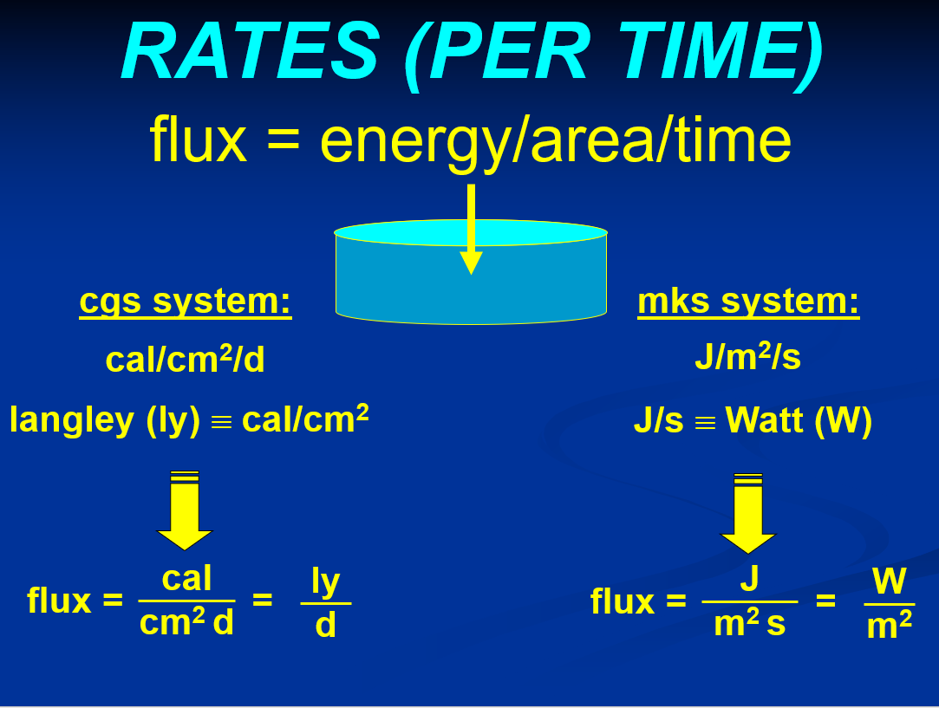
Rates
Blue slide images from Heat, Temperature, and Stratification lecture, Steve Chapra (2019)

Slide 5
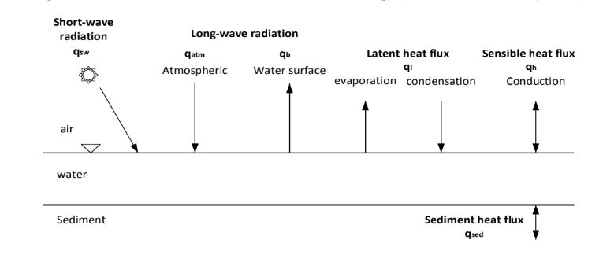
Energy Balance
From ERDC-EL TR-16-1
See also:
Tennessee Valley Authority. (1972). Heat and Mass Transfer between a Water Surface and the Atmosphere. Water Resources Research Laboratory Report 14, Report No. 0-6803.

Slide 6
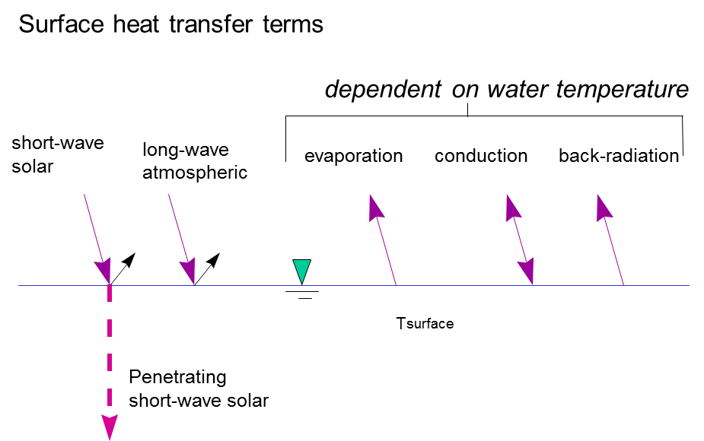
Sources and Sinks
Sources:
Short-wave solar radiation
Long-wave atmospheric radiation
Conduction of heat from the atmosphere to the water
Direct heat inputs
Sinks:
Long-wave radiation emitted by the water
Evaporation
Conduction of heat from the water to the atmosphere
Source: CE-QUAL-W2 User’s Manual

Slide 7
Radiation
Everything that has a temperature gives off electromagnetic radiation (light). Shortwave radiation contains higher amounts of energy, and longwave radiation contains a smaller amount of energy. Therefore, the sun gives off shortwave radiation, as it is extremely hot and has a lot of energy to give. On the other hand, Earth’s energy is emitted as longwave radiation, as it is much cooler but still emits radiation.
Source: North Carolina Climate Office

Slide 8
Latent vs. Sensible Heat
Sensible Heat:
Sensible heat is when energy is transferred as heat to an object, changing the temperature but not its state. If you can measure the temperature of the heat, it is sensible. A body (solid, liquid, or gas) of mass, m, and specific heat, c, is heated to change its temperature from T1 to T2 without changing its state. Indeed, the volume or the pressure of the body is unchanged. The energy received by the body responsible for its risen temperature is given by the relation:
Q = m*c*(T2 – T1), in joules
Q = m*c*(T2 – T1)*1055.06, in BTU
Latent Heat:
In contrast to sensible heat, latent heat is the energy released or absorbed that changes the state of a body during a constant temperature process. This process leaves temperature unaffected – it won’t get higher or lower. The most common forms of latent heat are fusion at vaporization.
Source: hvacbrain.com

Slide 9
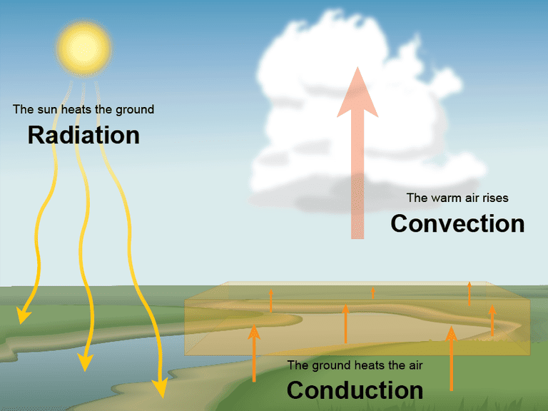
Convection vs. Conduction
Convection and conduction are both mechanisms of heat transfer. The main difference between them is:
Convection: Heat is transferred through the flow of material.
Conduction: Heat is transferred through collisions of particles that make up the material.
Source: University Corporation for Atmospheric Research (UCAR)

Slide 10
Surface Heat Exchange
The surface heat exchange is computed as:
φ_{n} = net surface heat flux, W m^{‑2}
φ_{s} = incoming short-wave solar radiation, W m^{‑2}
φ_{sr} = reflected short-wave solar radiation, W m^{‑2}
φ_{sn} = net short-wave solar radiation, φ_{s}-φ_{sr}, W m^{‑2}
φ_{a} = incoming long-wave atmospheric radiation, W m^{‑2}
φ_{ar} = reflected atmospheric long-wave radiation, W m^{‑2}
φ_{br} = back long-wave radiation, W m^{‑2}
φ_{e} = evaporative heat loss, W m^{‑2}
φ_{c} = conductive heat loss, W m^{‑2}
Source: CE-QUAL-W2 User’s Manual

Slide 11
Short-Wave Solar Radiation
Short-wave solar radiation is:
Measured directly by a pyranograph or another instrument and contained in a data file with units W/m²
Flawed because it is hard to know all the details of how the data was collected… Does it account for reflection? Is it really measuring all radiation including long-wave?
Computed based on sun angle, according to the following equation:
This is the EPA formulation based on empirical methods, which is similar to the Bird Clear Sky Model (https://www.nrel.gov/grid/solar-resource/clear-sky.html)
Calculates for radiation at sea-level. Elevation adjustments are made according to Annear and Wells 2007.
This equation is for clear day radiation, so we need to correct for cloud cover and shading from mountains or trees later.
Reflected short-wave atmospheric radiation is defined by the model user as a percentage.
Terms:
Solar Altitude (A_{o})
Local Hour Angle (H)
Equation of time – difference between true solar time and mean solar time (EQT)
Local hour and latitude/longitude terms
Solar Declination Angle (δ)
Angular Fraction of the Year (τ_{d})
$$φ_{s}=24\left(2.044A_{o}+0.1296A_{o}^{2}−1.941E−3A_{o}^{3}+7.591E−6A_{o}^{4}\right)\text{∗} \text{0.1314}$$
Source: CE-QUAL-W2 User’s Manual, Chapter 4

Slide 12

Shading
Shading of the waterbody can occur from cloud cover or nearby physical features, such as trees, mountains, or buildings.
The CE-QUAL-W2 model uses the following equation:
Where C is defined in the met.npt file as ‘cloud’.
Shading from physical features on the ground is defined in the shade.npt file as ‘dynshade’.
$$φ_{s_net}=φ_{s_clearsky}(1−0.65C^{2})$$

Slide 13
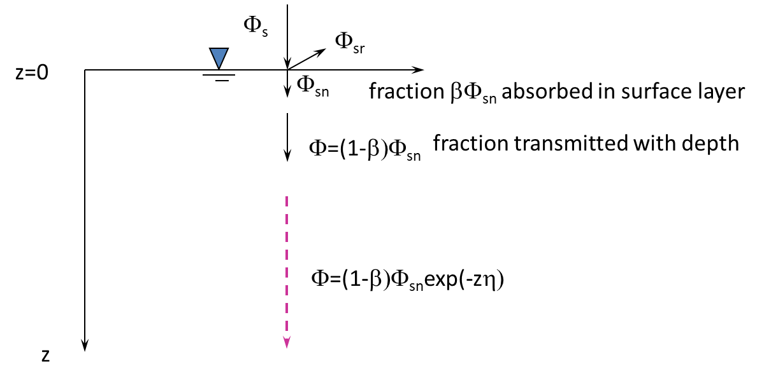
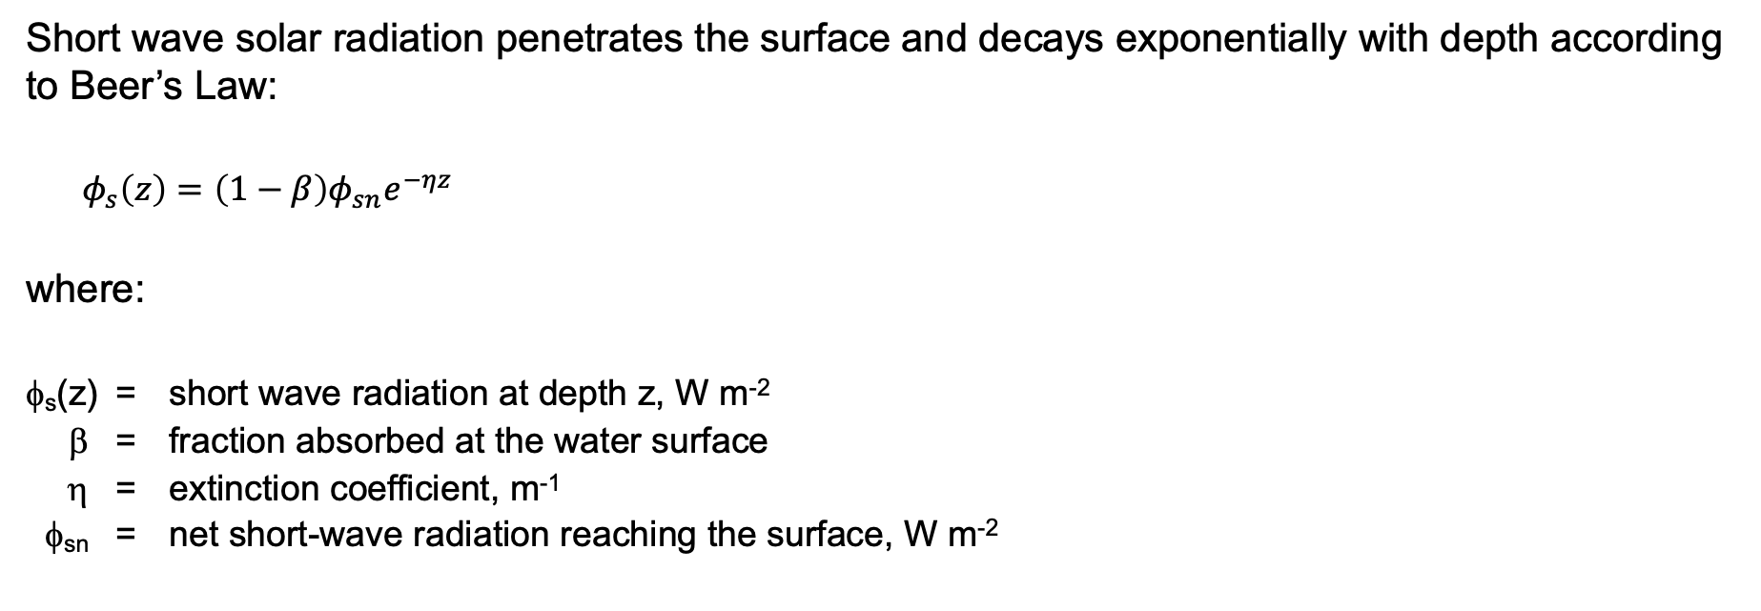
Short-Wave Solar Radiation Penetration Depth
Short wave solar radiation penetrates the surface and decays exponentially with depth according to Beer’s Law:
$φ_{s}\left(z\right)=\left(1−β\right)φ_{sn}e^{−ηz}$
where:
φ_{s}(z) = short wave radiation at depth z, W m^{‑2}
β = fraction absorbed at the water surface
η = extinction coefficient, m^{‑1}
φ_{sn} = net short-wave radiation reaching the surface, W m^{‑2}

Slide 14
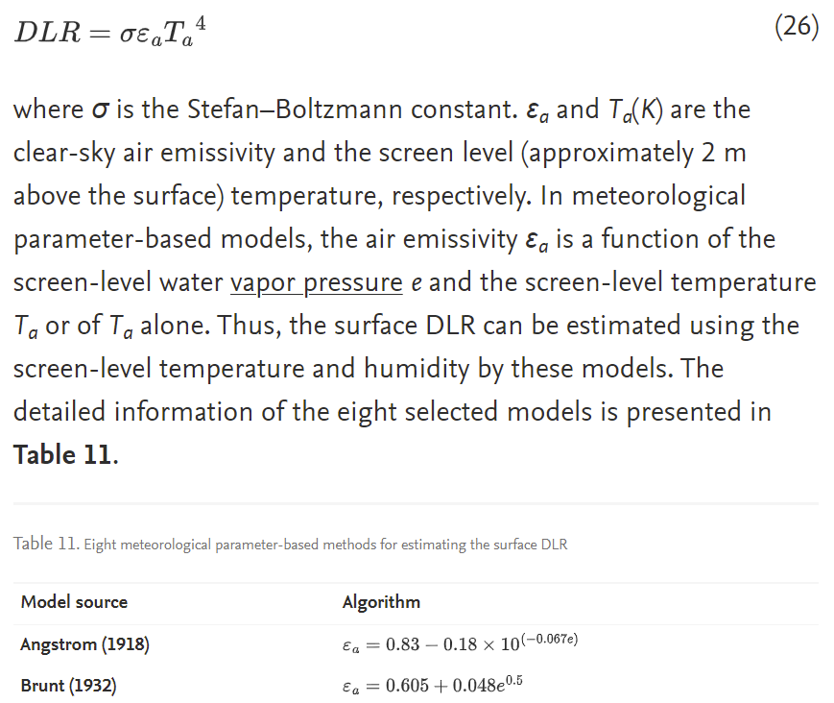
Long-Wave Atmospheric Radiation
The long wave atmo­spheric radiation is comput­ed from air temperature and cloud cover or air vapor pressure using Brunt’s formula. The right‑hand terms are all water surface temperature depen­dent.
Source:
S. Liang, D. Wang, X. Tao, J. Cheng, Y. Yao, X. Zhang, T. He,
2.12 - Methodologies for Integrating Multiple High-Level Remotely Sensed Land Products, Editor(s): Shunlin Liang, Comprehensive Remote Sensing, Elsevier, 2018

Slide 15
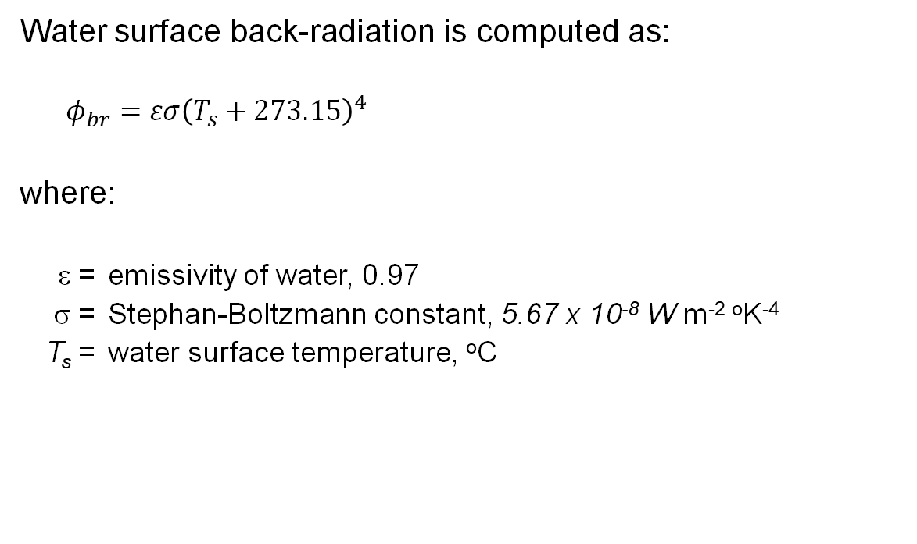
Water-Emitted Long-Wave Radiation
Water surface back-radiation is computed as:
$$φ_{br}=εσ{\left(T_{s}+273.15\right)}^{4}$$
where:
ε = emissivity of water, 0.97
σ = Stephan-Boltzmann constant, 5.67 x 10⁻⁸ W m^{‑2} ºK⁻⁴
T_{s} = water surface temperature, ºC

Slide 16
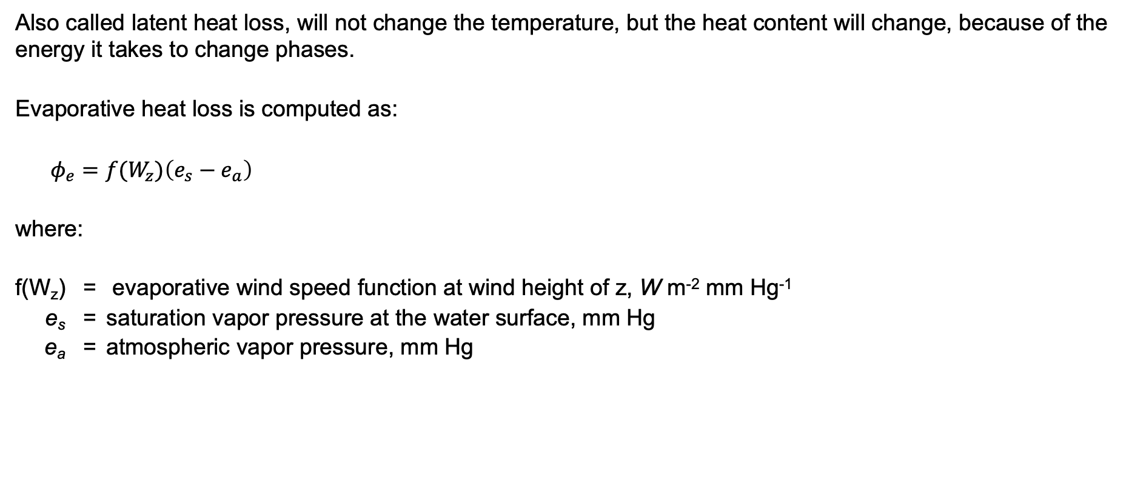
Evaporative Heat Loss
Also called latent heat loss, will not change the temperature, but the heat content will change, because of the energy it takes to change phases.
Evaporative heat loss is computed as:
$φ_{e}=f(W_{z})\left(e_{s}−e_{a}\right)$
where:
f(W_{z}) = evaporative wind speed function at wind height of z, W m^{‑2} mm Hg⁻¹
e_{s} = saturation vapor pressure at the water surface, mm Hg
e_{a} = atmo­spheric vapor pres­sure, mm Hg

Slide 17

Conductive/Convective Heat Loss
Surface heat conduction is computed as:
$φ_{c}=C_{c}f(W_{z})\left(T_{s}−T_{a}\right)$
where:
C_{c} = Bowen's coefficient, 0.47 mm Hg ºC⁻¹
T_{a} = air temperature, ºC

Slide 18
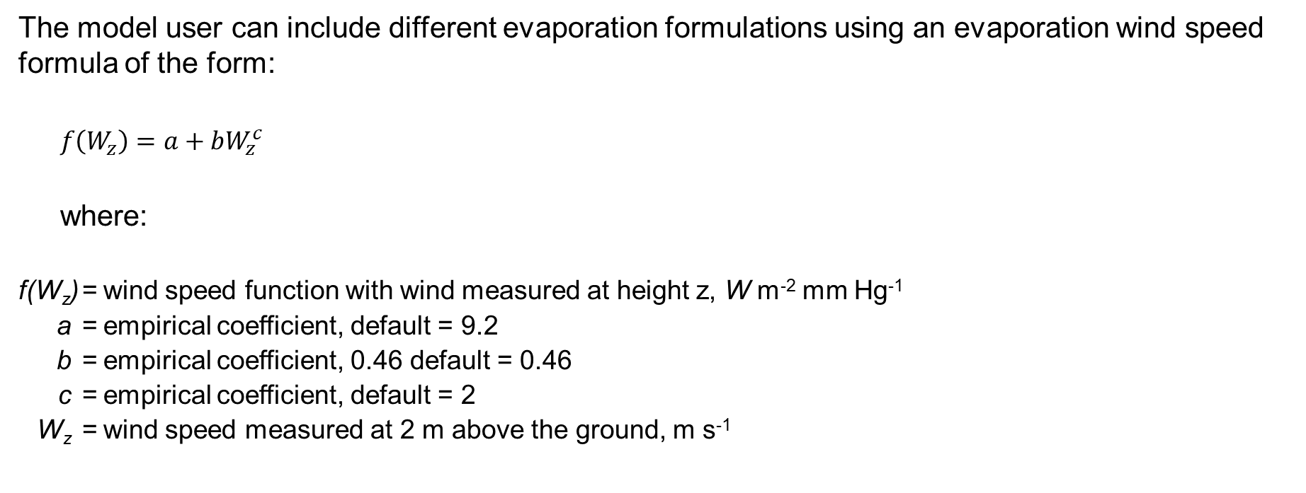
Wind Function
The model user can include different evaporation formulations using an evaporation wind speed formula of the form:
$f\left(W_{z}\right)=a+bW_{z}^{c}$
where:
f(W_{z}) = wind speed function with wind measured at height z, W m⁻² mm Hg⁻¹
a = empirical coefficient, default = 9.2
b = empirical coefficient, 0.46 default = 0.46
c = empirical coefficient, default = 2
W_{z} = wind speed measured at 2 m above the ground, m s⁻¹

Slide 19

Questions?

