Slide 1


Water Temperature Case Study
UNCLASSIFIED
Todd E. Steissberg, PhD, PE
Environmental Laboratory
Engineer Research and Development Center (ERDC)
U.S. Army Corps of Engineers
CE-QUAL-W2 Water Quality Modeling Workshop
September 17-18, 2025
Environmental Systems
Modeling Team
UNCLASSIFIED

Slide 2
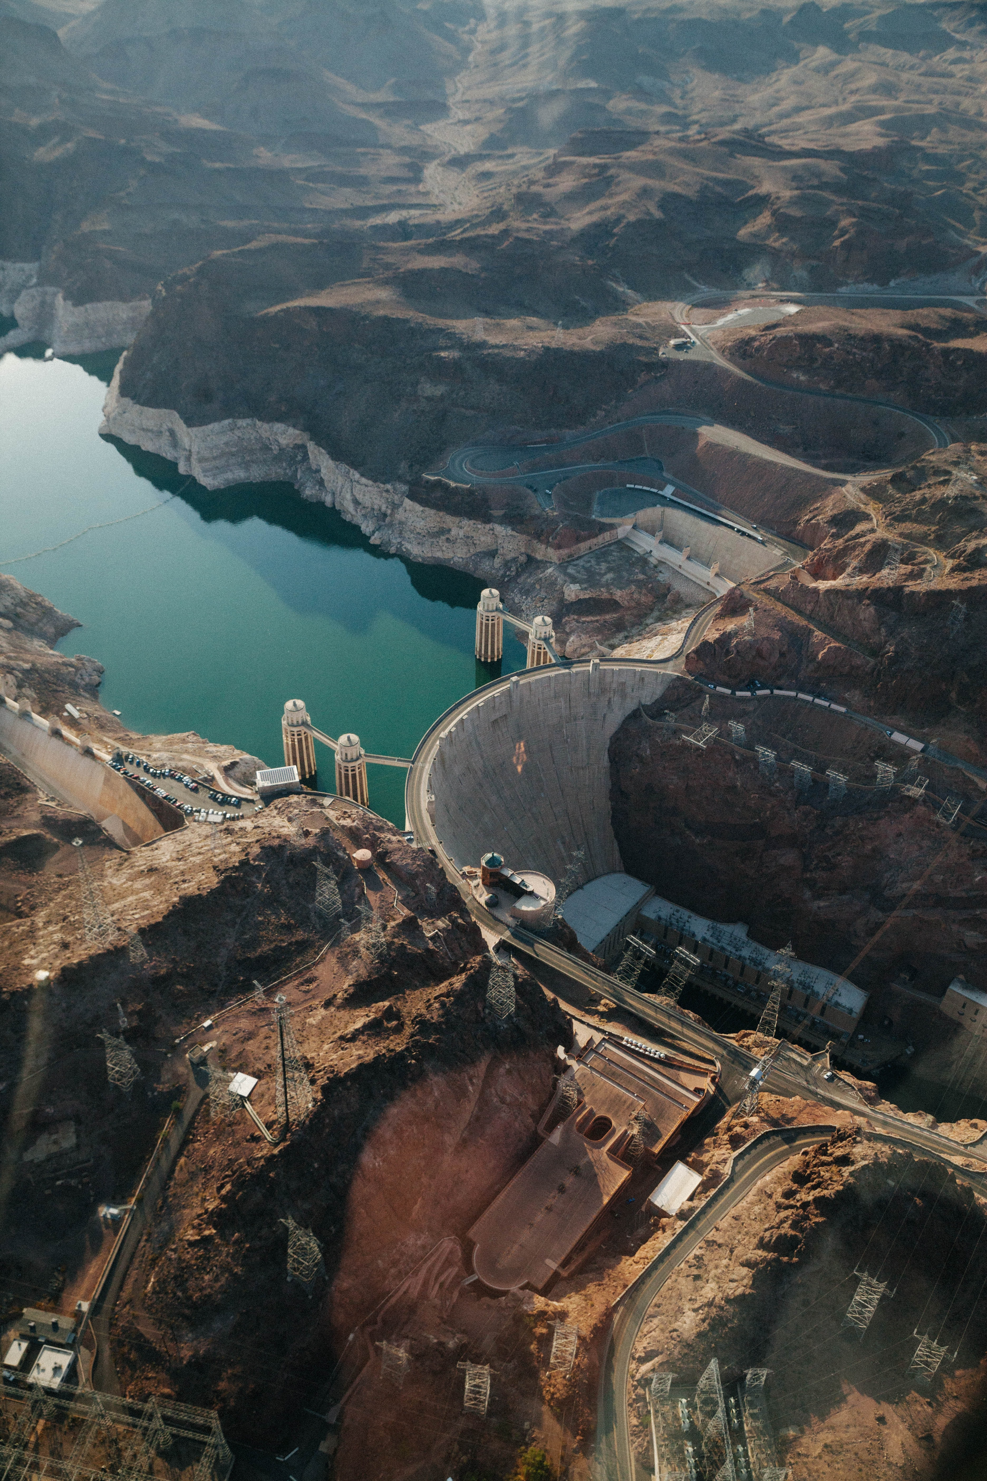
Case Study Overview
Purpose: become familiar with where temperature inputs and outputs exist in CE-QUAL-W2
We will focus on where the temperature-related parameters show up in the control file, and the input and output files associated with running a successful temperature model
Tying the theory section of the user-manual to the input/output section of the user-manual
Will be followed by a case-study where water quality parameters are changed and output analyzed

Slide 3

Start with an existing model
We will use the DeGray Reservoir model, which is available automatically in the CE-QUAL-W2 download – it is currently set up to model sediment-diagenesis and vertical algae migration
We will edit it down until it features only the essentials for modeling temperature
We are happy with the bathymetry and will not change it for this case study. It is simple, with one main waterbody and branch.

Slide 4
W2 Model Input Files
Organized by File Directory
File type | Label in Control File | File name
Control File | - | w2_con.csv
Wind sheltering | WSC FILE WSCFN | wsc.npt
Shading | SHDFN | shade.npt
Bathymetry | BTHFN | bth1.csv
Meteorological | METFN | met.npt
Branch inflow | QINFN branch inflow | qin_br1_equal.npt
 | TINFN branch temp | tin_br1.npt
 | CINFN branch conc | cin_br1.csv
 | QDTFN Distributed flow | qin_br1.npt
Spillway/Gate | QGTFN | qgt.npt
Sets many heat-flux control parameters
Wind func impacts both sensible and latent flux
Local shading – not cloud cover
Sets many heat-flux control parameters
Temperature inflow – boundary conditions

Slide 5
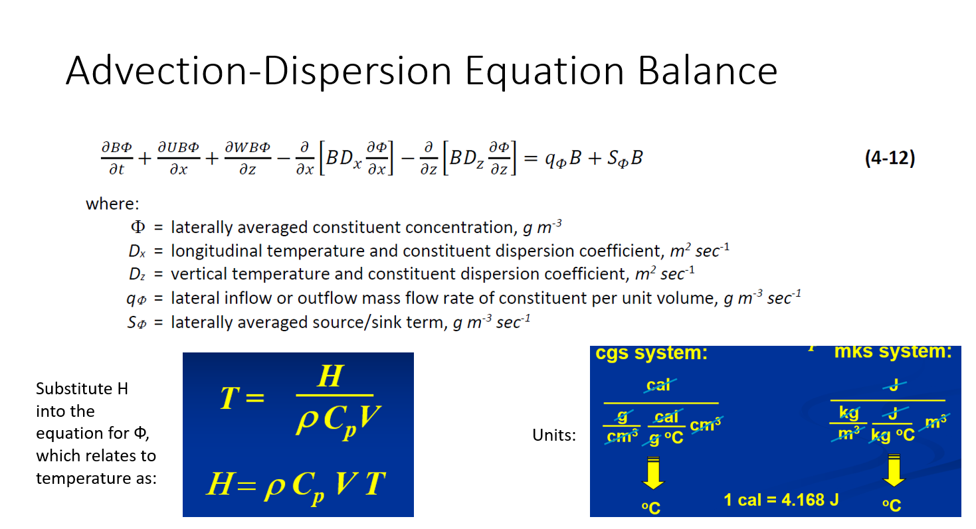
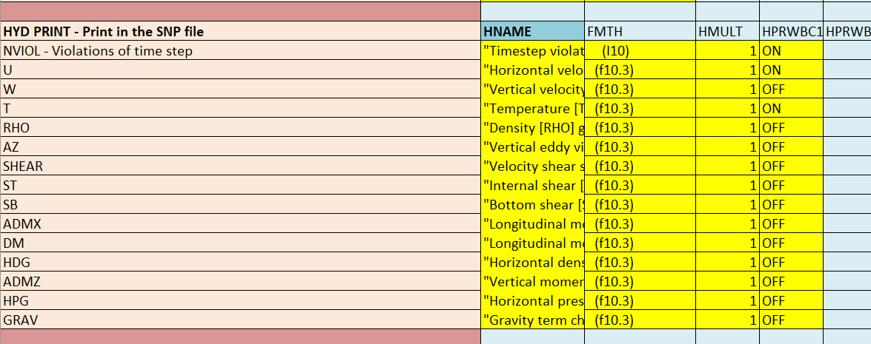
Advection Dispersion of Temp
Temperature is included in the hydraulic calculations because it affects density and viscosity. We don’t need to turn this on and off.
Will need initial and boundary conditions for this. BCs for temperature are in the tin_br1.npt file.

Slide 6
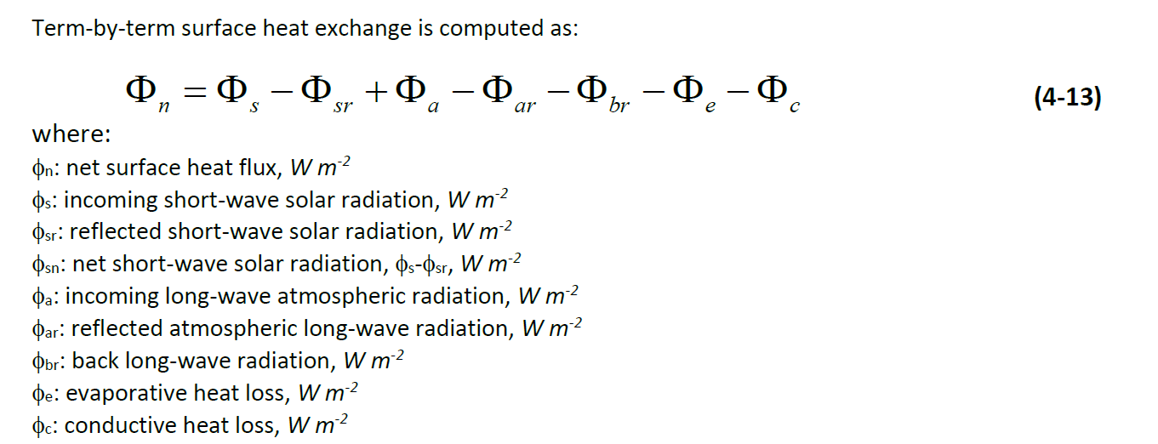
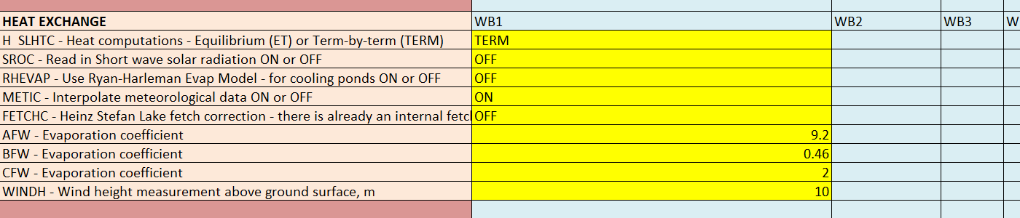
Kinetics – Equilibrium Model or Term by Term?
Sources/Sinks from manual:
Heat Exchange Parameters in the w2_con.xslm control file:
EQ process described on pages 101-102 of Part 2 of the User’s Manual.

Slide 7
Shortwave Solar Radiation
File input or computed?
It is rare to have a good short-wave solar radiation data source. Therefore, CE-QUAL-W2 uses an empirical calculation of short-wave solar radiation based on solar altitude and other parameters, as described in the user-manual, page 95-96. Many of these parameters are based on latitude/longitude and time of day.

Slide 8
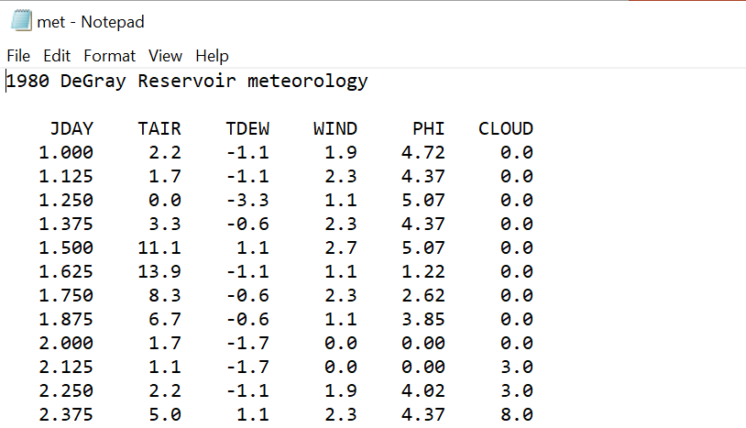
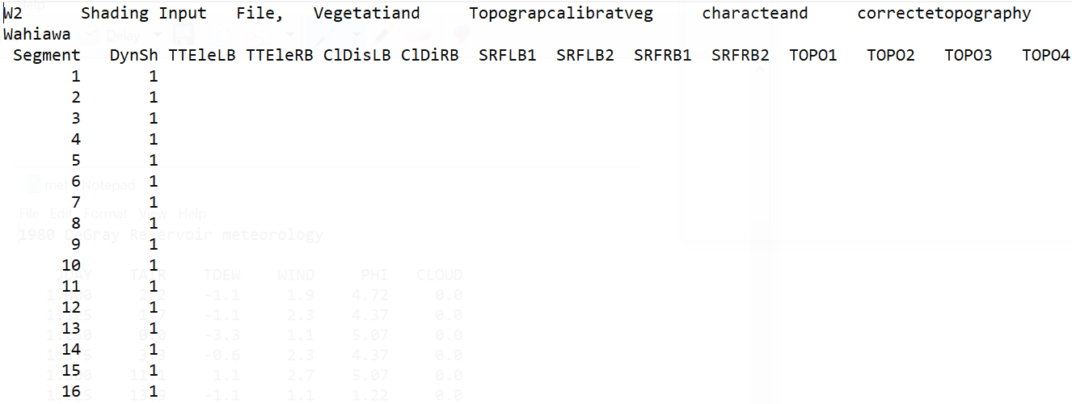
Shortwave Solar Radiation – Cloud Cover and Shade
The shortwave solar radiation is dampened by a cloud cover factor that is defined in the meteorological file.
The shortwave solar radiation is also dampened by a local shading factor defined in the shade file.

Slide 9
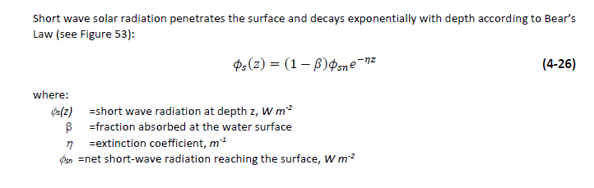
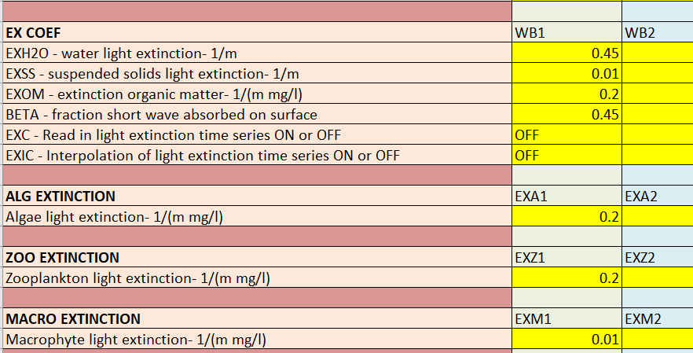
Shortwave Solar Radiation – Penetration
Theory: Every cell in the model performs this computation.
Model Input:
Extinction coefficient will be a combination of light extinction due to various constituents, such as suspended solids, algae, zooplankton, etc. Extinction will be a function of their concentrations.

Slide 10
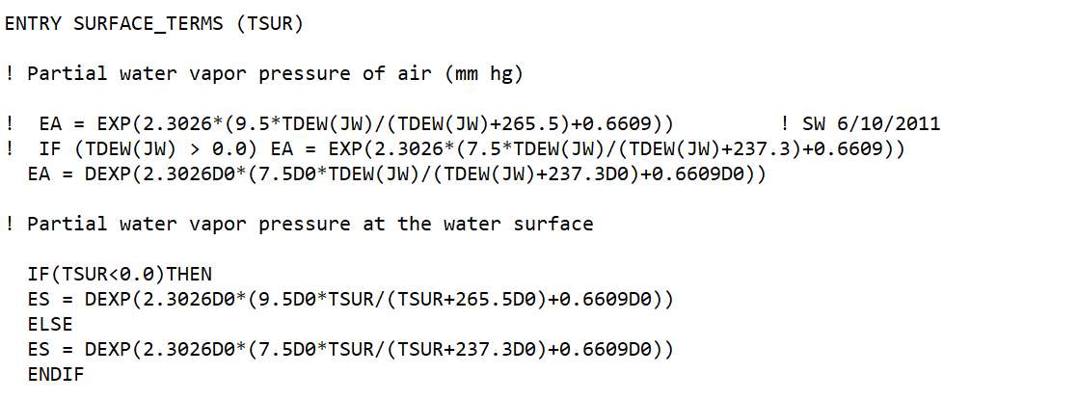
Longwave Radiation
Longwave radiation from air to water and water back to air use the same formula, based on the temperature of the emitting body, the Stephan-Boltzmann coefficient, and the emissivity of the body.
Emissivity is a function of vapor pressure, which can be calculated from the measured dew point.
Fortran source code showing how vapor pressure is calculated

Slide 11
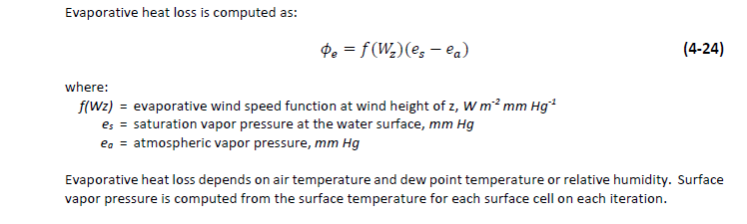
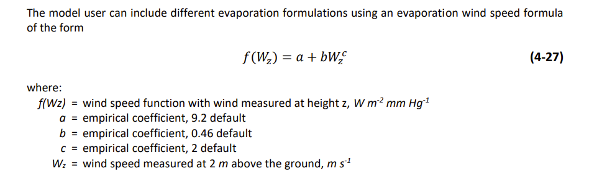
Latent Heat – Evaporation
Parameters that control evaporation are specified in the met data file and the control file.

Slide 12
Latent Heat – Evaporation
Parameters that control evaporation are specified in the met data file and the control file.

Slide 13
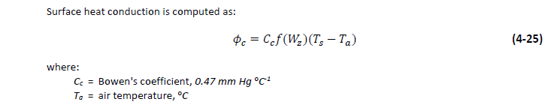
Sensible Heat – Conduction and Convection
Constant
Met file

Slide 14
Temperature Output Comparison
Model run with (1) default DeGray settings and with (2) all accessory modules and water quality calculations turned off.

Slide 15
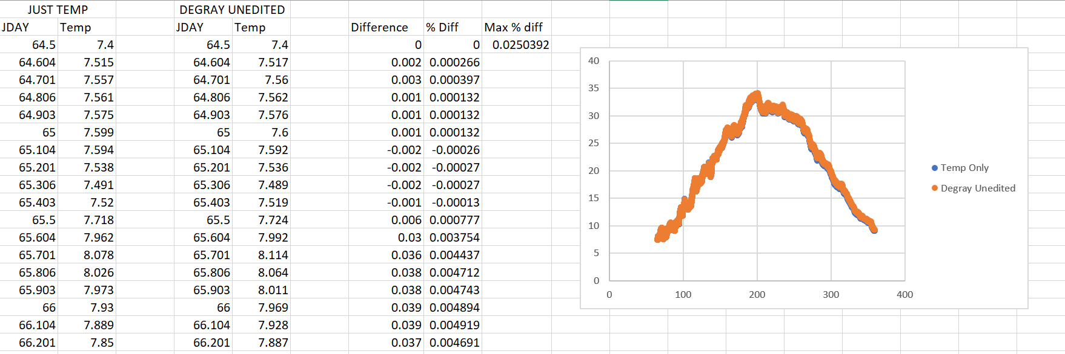
Comparison at Layer 2

Slide 16
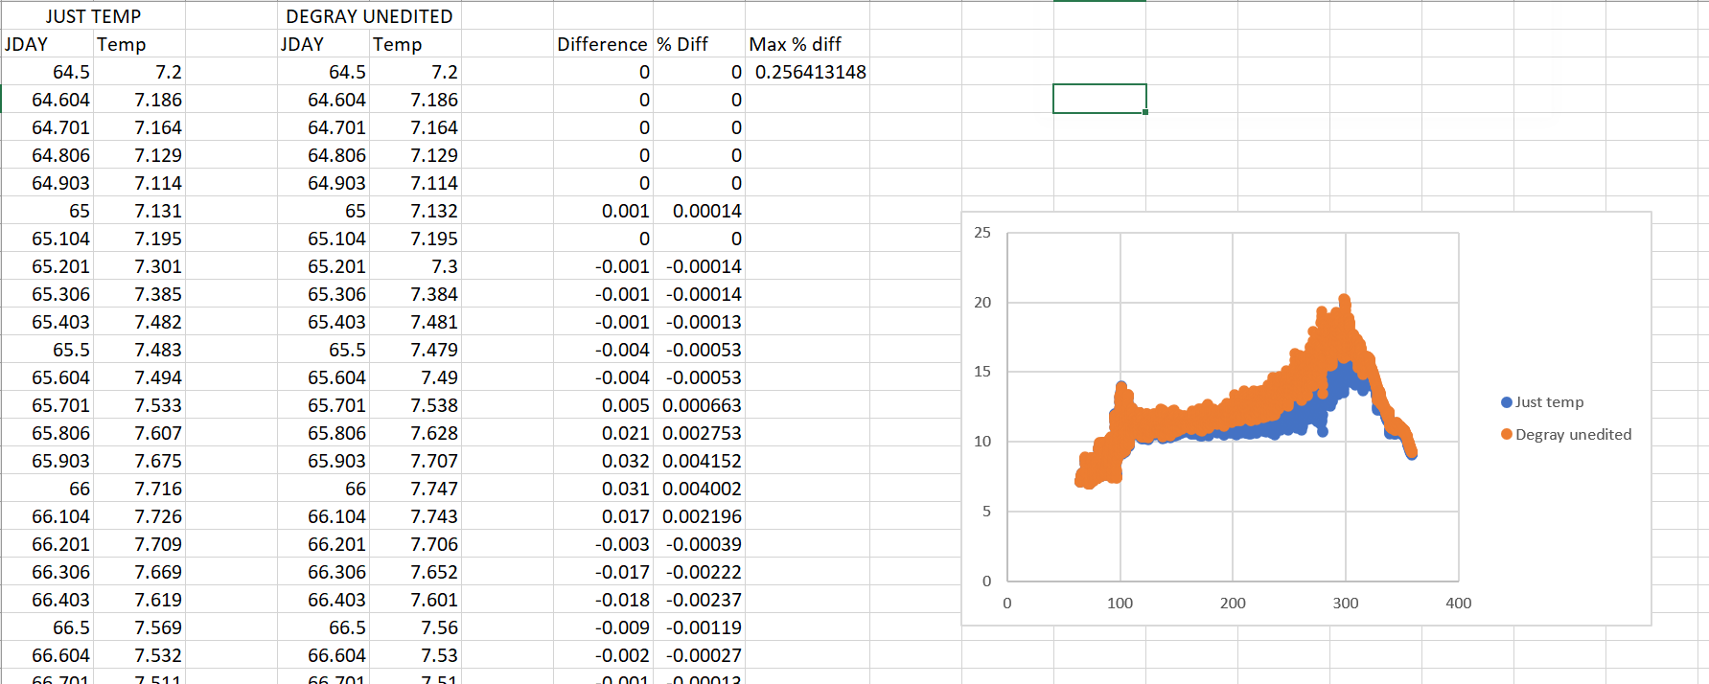
Comparison at Layer 16

Slide 17
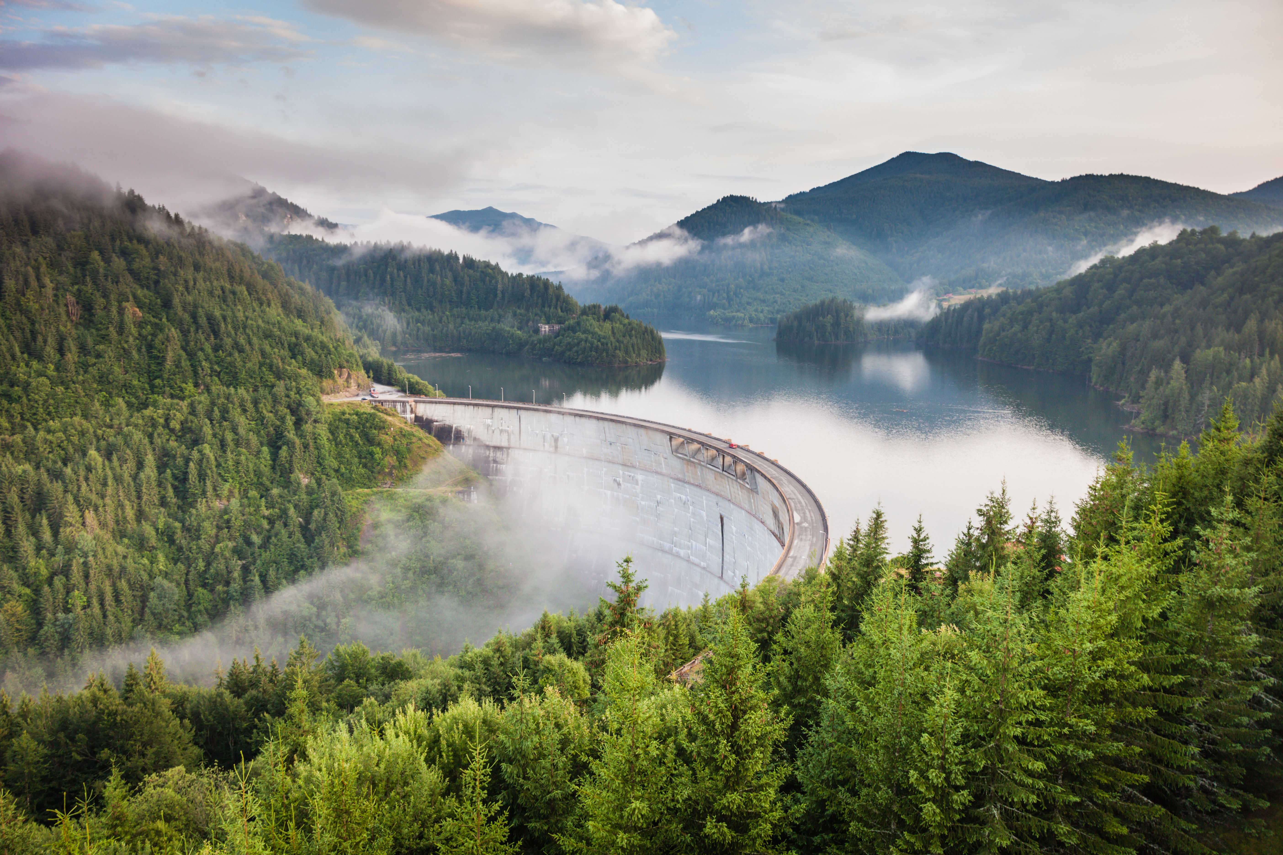
Questions?

