Slide 1


MODEL SETUP I: LECTURE
UNCLASSIFIED
Hailie Suk, PhD
Cold Regions Research and Engineering Laboratory (CRREL)
Engineer Research and Development Center (ERDC)
U.S. Army Corps of Engineers
CE-QUAL-W2 Water Quality Modeling Workshop
September 17-18, 2025
Environmental Systems Modeling Team
UNCLASSIFIED

Slide 2
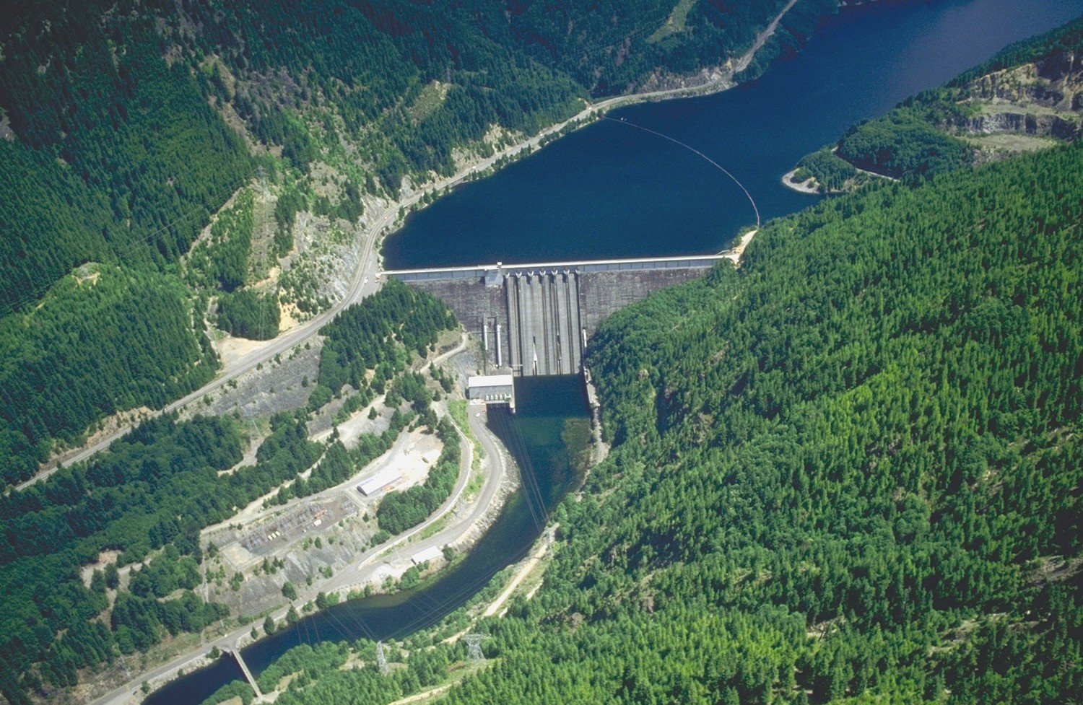
Outline
Background
Definition of problem
Required Information
Bathymetry
Flow
Meteorology
Observations
Other
Output
Detroit Dam, Oregon

Slide 3
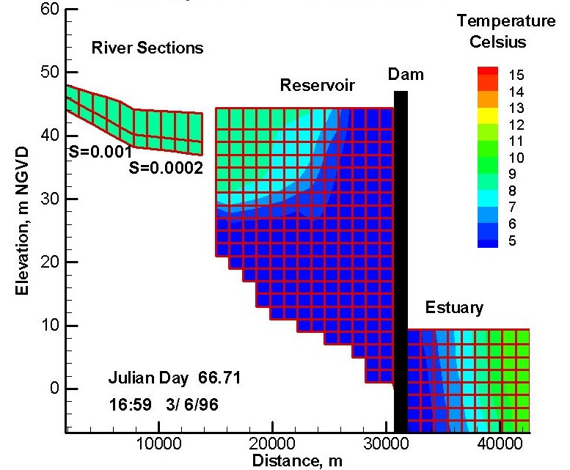
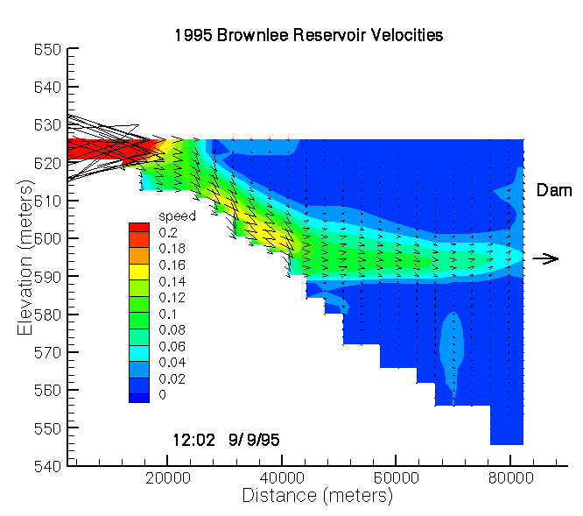
Background
Setting up a computational model is an effort to create a computational approximation of a real system.
A model enables one to investigate past behavior or future conditions with regard to changes in conditions.
Approximations, simplifications, and omissions are necessary but must be balanced with regards to the model’s ability to accurately capture the behavior of the real system.

Slide 4
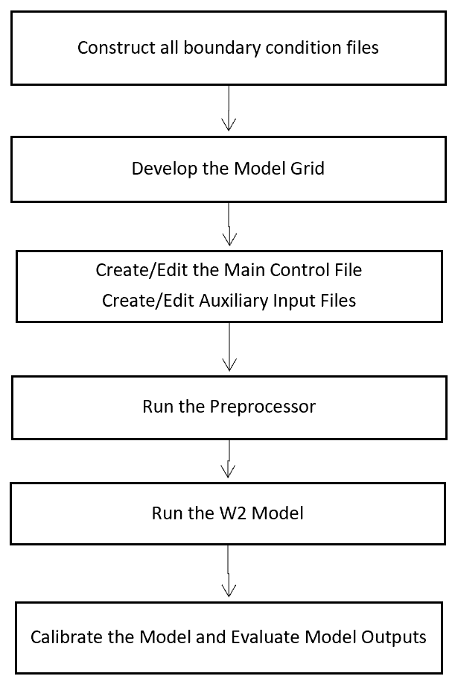
How to Set Up and Run a Model Application

Slide 5

Definition of Problem
What are water quality issues occurring in system that warrant a model?
Are they the result of:
Flow alterations?
Operations?
Boundary Loadings?
Intermediate loadings?
Meteorology?
Altered system conditions?
Anticipated future changes in any of above?
Other?
What information is required to set up a model to capture the behavior in question?
Source: https://www.erdc.usace.army.mil/Media/Images/igphoto/2002471 393/

Slide 6
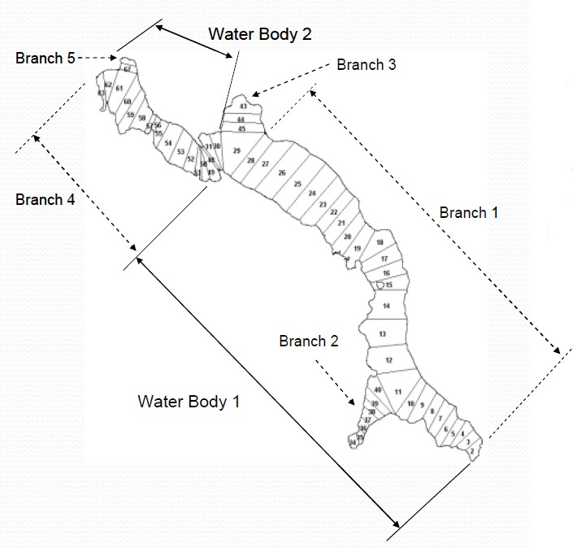
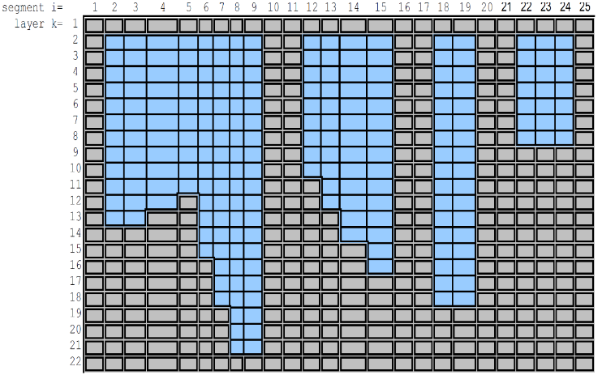
Bathymetry
Defines the physical structure of the natural system for the model
Sources
Sediment range surveys
Cross Sections
Pre-impoundment surveys for reservoirs
Extent
All of area of concern and beyond
Reaching upstream to control point
Resolution
Horizontal (across system) – meters
Longitudinal (along system) – 10s or meters or more
Vertical (through water column) – meter or less

Slide 7
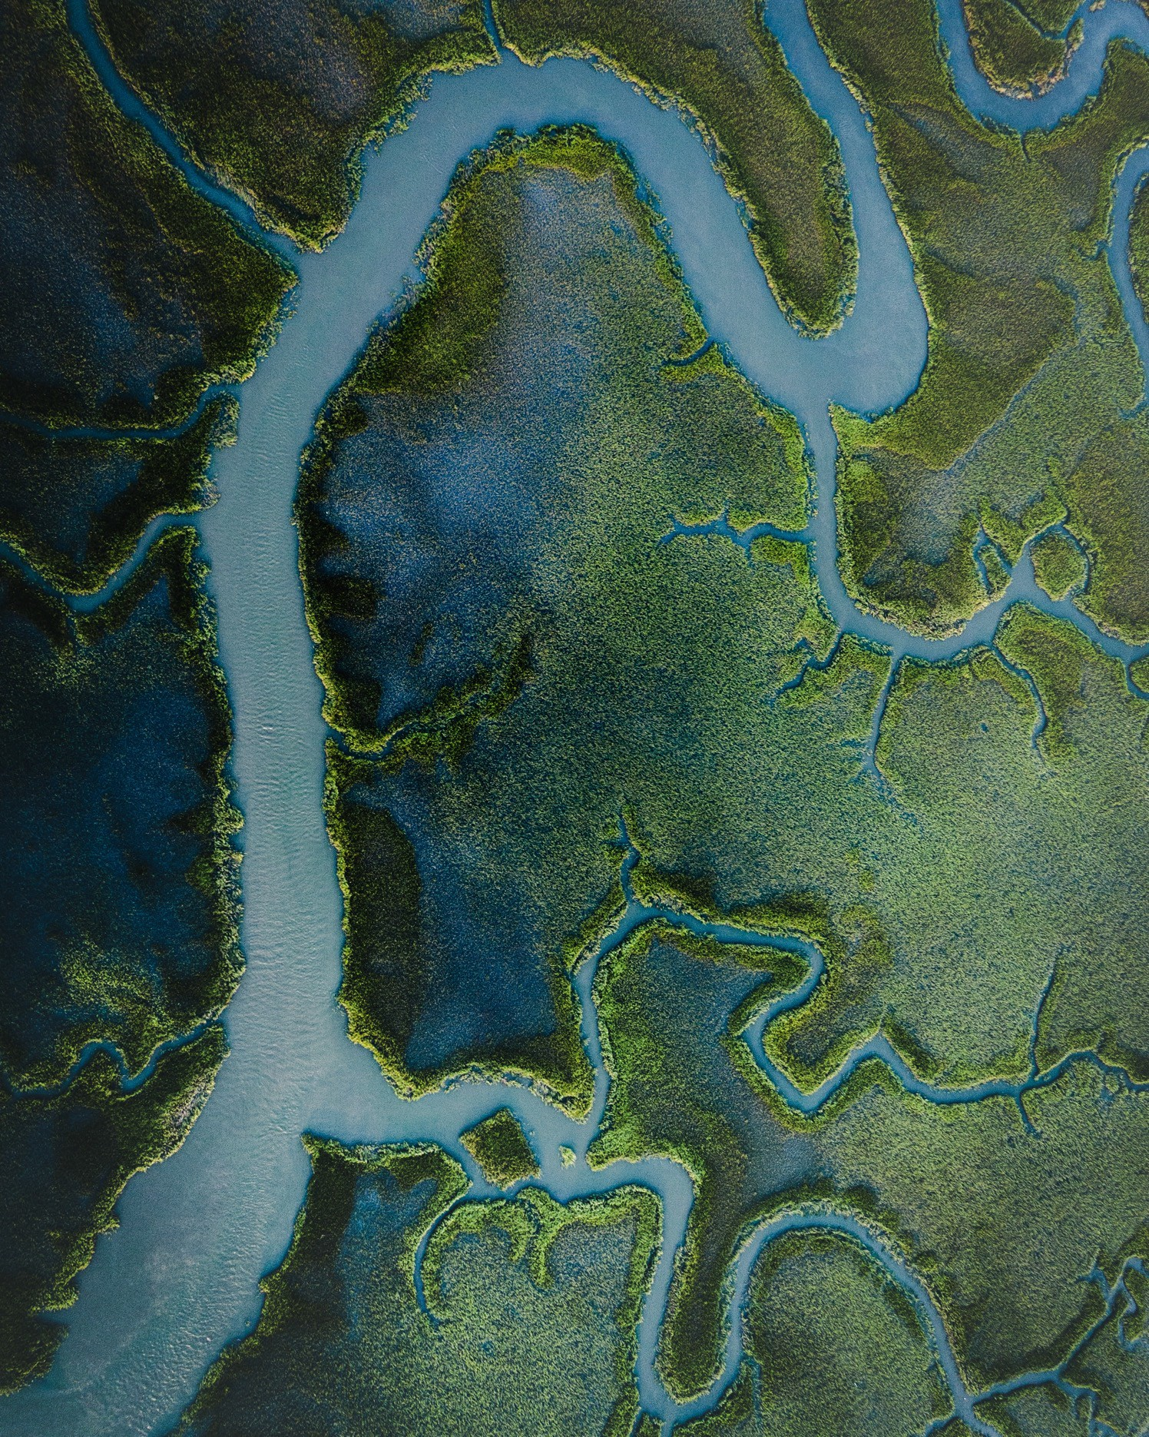
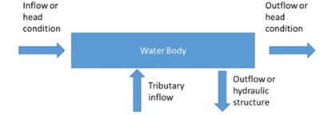
Flow
Required
Headwater
Downstream
Tributary
Withdrawals
Water surface elevations

Slide 8
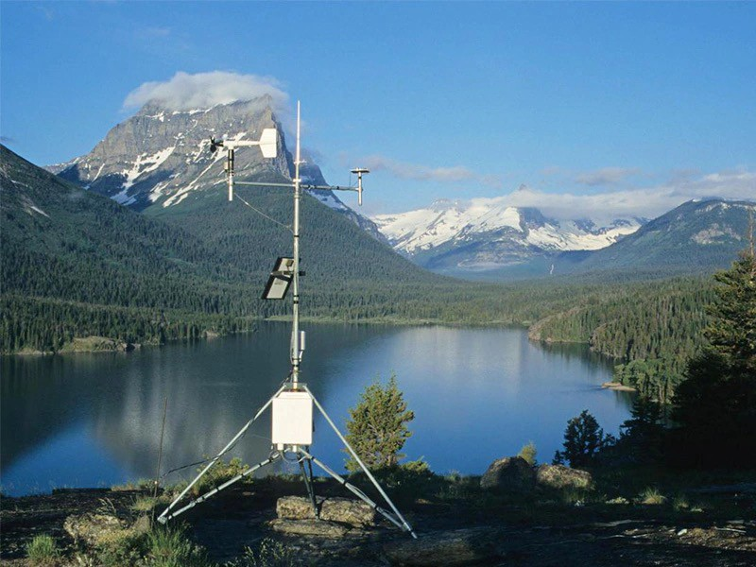
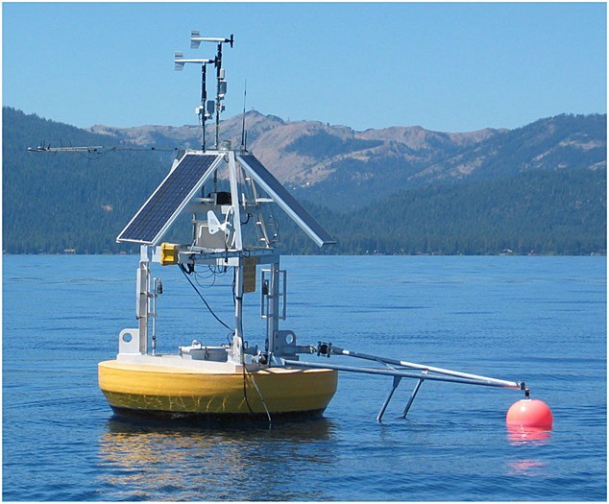
Meteorology
Reliable data is essential to model performance, accuracy of model results, and validity of any concepts developed from model.
There is no substitute for good met data.
Typical sources are airports in vicinity of project.
If available multiple airports may be used to evaluate model sensitivity.
Class A
Required information:
Air Temperature
Dew Point Temperature
Wind Speed
Wind Direction
Cloud Cover
Solar Radiation

Slide 9
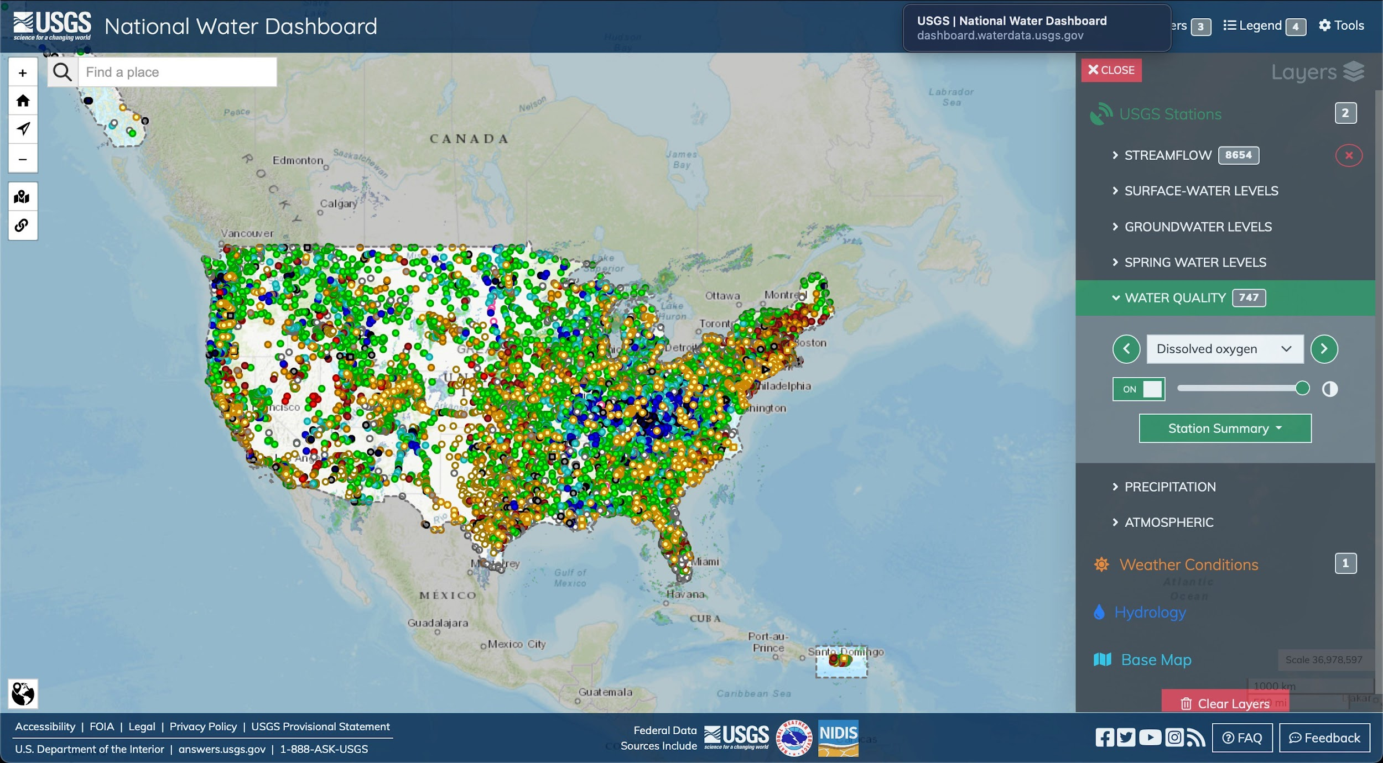
Observations
Observed data
For all water quality constituents
Provides Boundary conditions
Calibration
Analysis provides insight as to what is occurring in system PRIOR to modeling.
Aids in refinement of modeling approach.

Slide 10
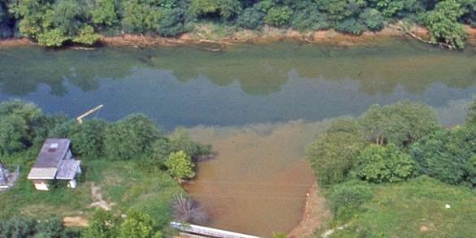

Other
Loadings
Point source
Non-point source/runoff
Other forms of water quality constituent loads
Sediment
Operations records
Which gates used for how long
Power generation
Spills
Anything else that impacts water movement

Slide 11
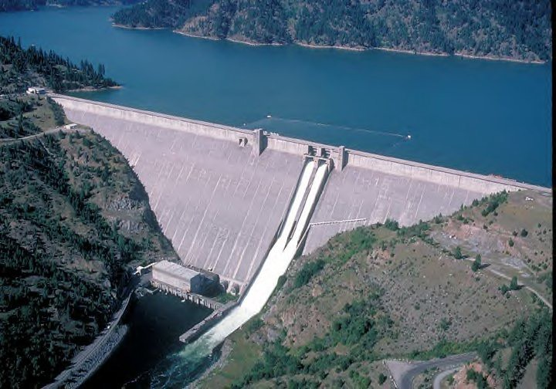

Output
Identify what information is desired from model output.
Ensure that it is being output at times and locations desired.
Process and evaluate model output and compare to applicable observations.

Slide 12
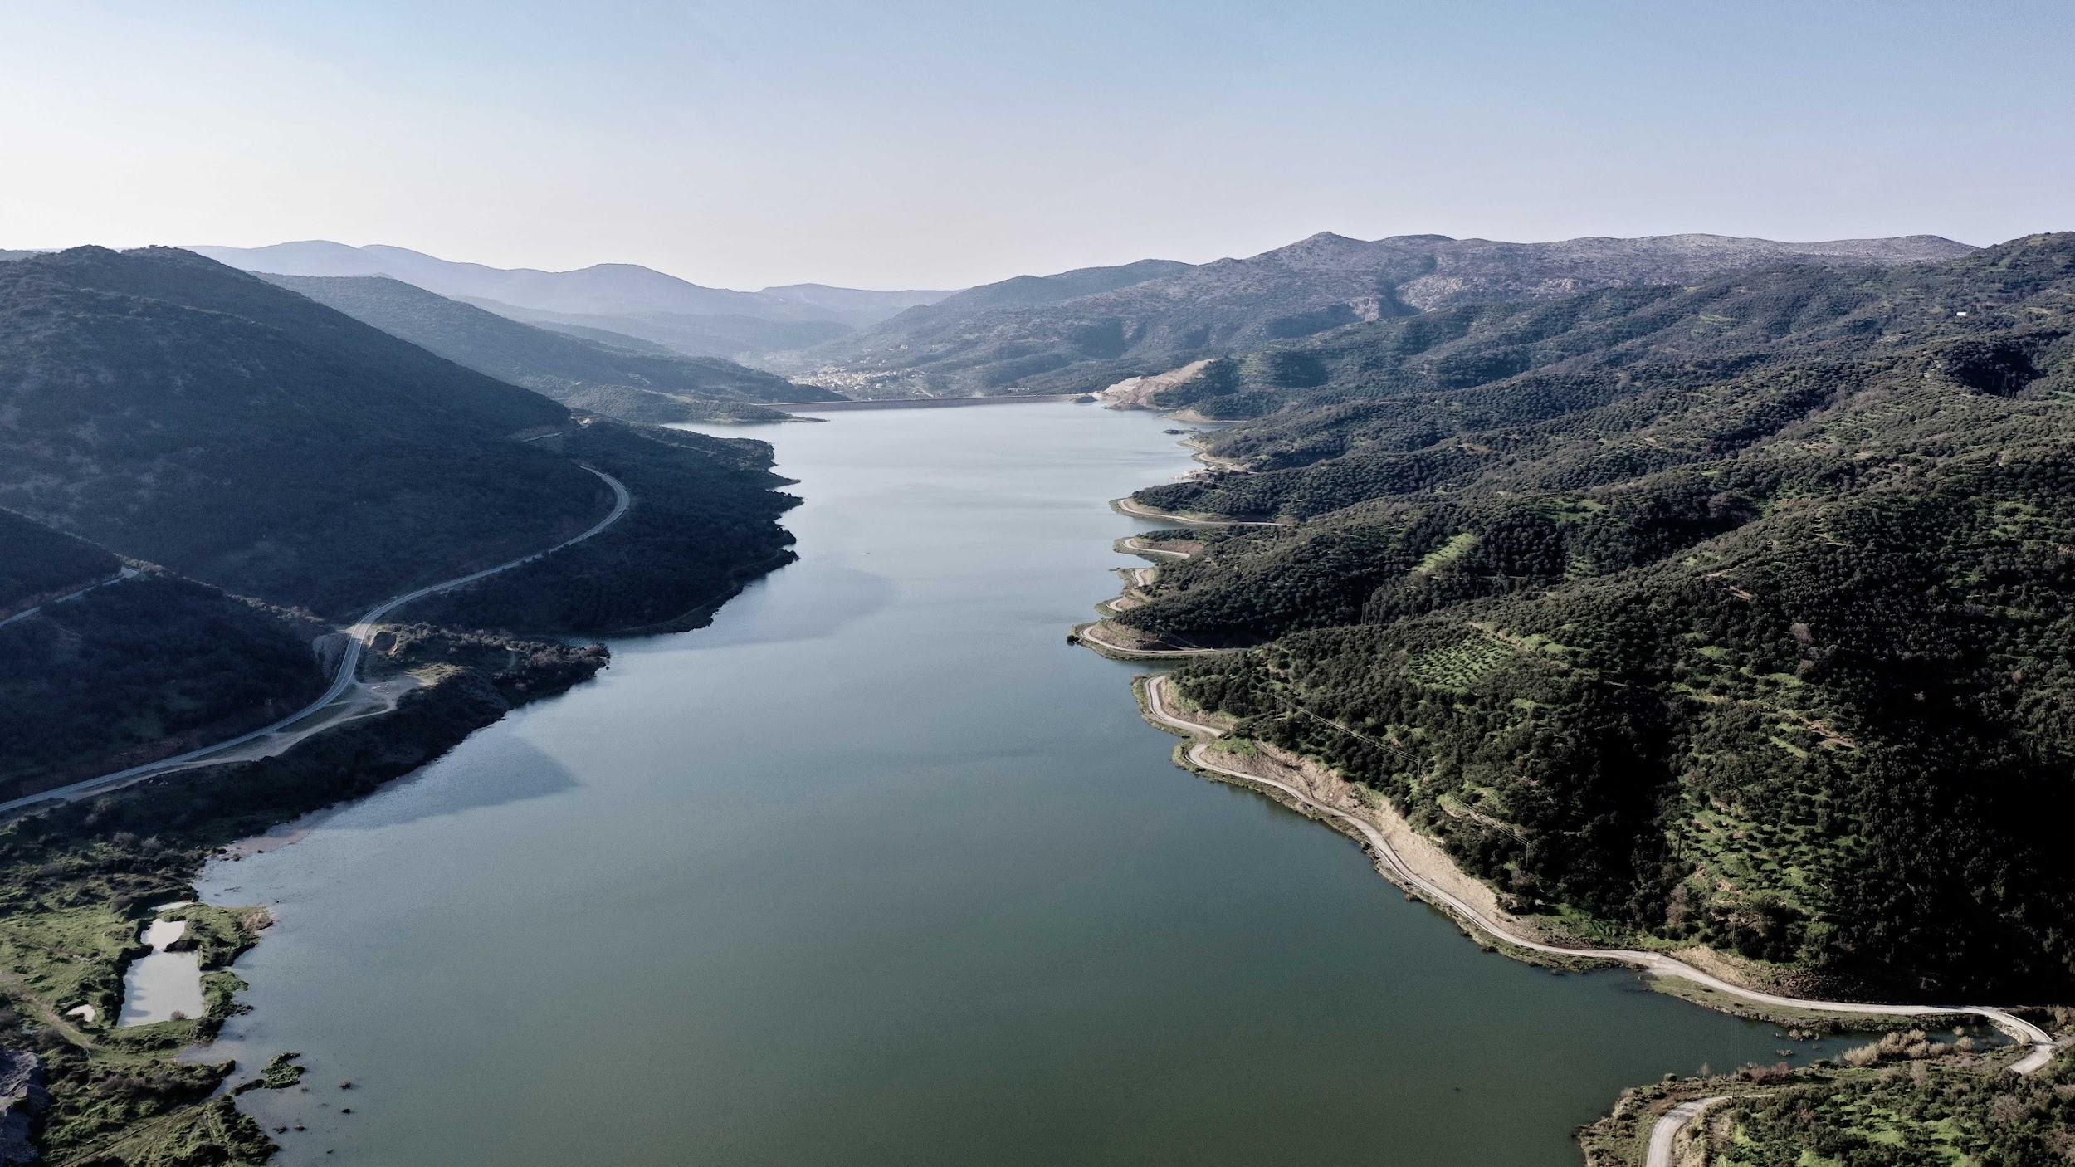
Questions?

