Slide 1


New and Future Capabilities
UNCLASSIFIED
Todd E. Steissberg, PhD, PE
Environmental Laboratory
Engineer Research and Development Center (ERDC)
U.S. Army Corps of Engineers
CE-QUAL-W2 Water Quality Modeling Workshop
September 17-18, 2025
Environmental Systems
Modeling Team
UNCLASSIFIED

Slide 2
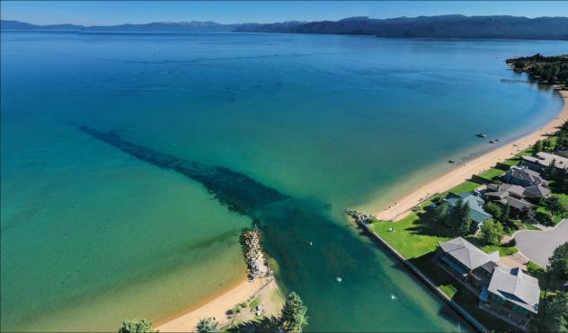
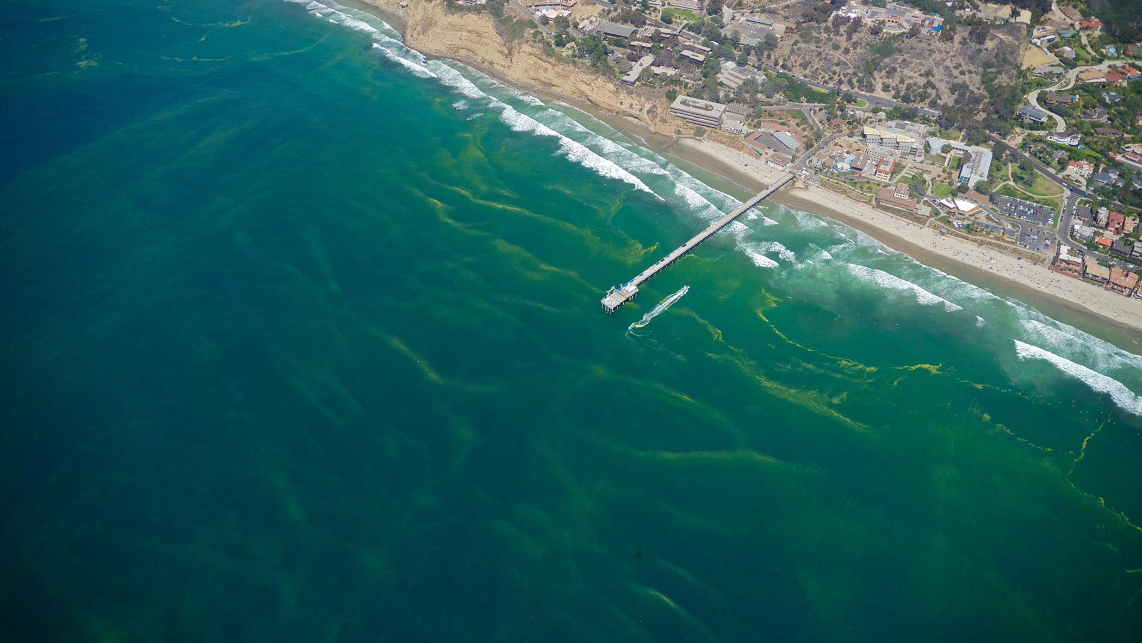
Enhancements to Improve Harmful Algal Bloom Modeling
Harmful Algal Blooms (HABs) occur when colonies of algae grow out of control and produce toxic or harmful effects on people, fish, shellfish, mammals, and birds.
Algae blooms can deplete dissolved oxygen in the water and/or release toxins that are harmful to human and ecosystem health through exposure to contaminated water or affected seafood.
The algae in toxic blooms can produce neurotoxins which directly affect fish and other marine life leading to massive fish kills and the accumulation of toxins in the food chain.

Slide 3
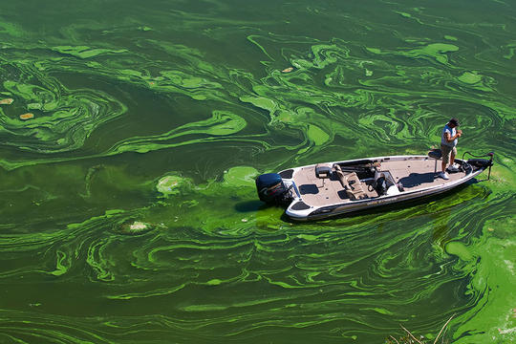
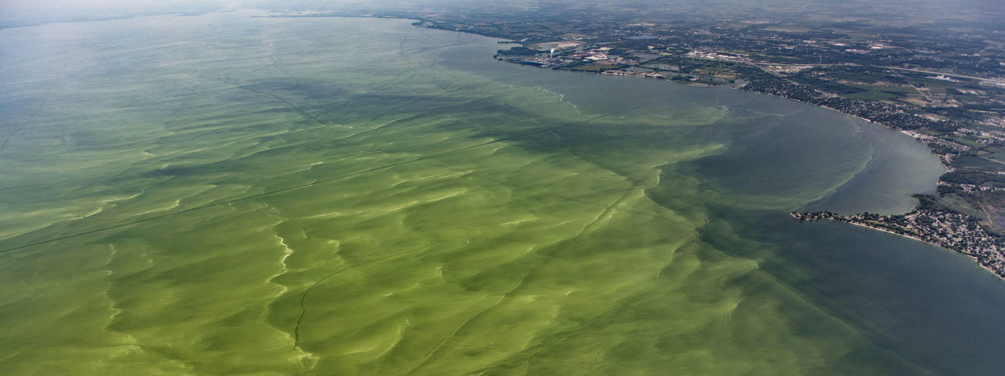
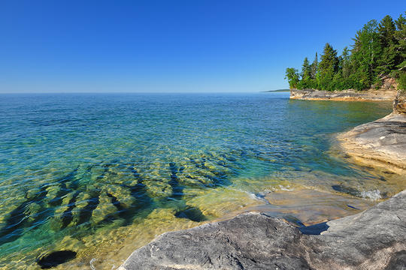
Introduction
Problem: Existing models inadequately predict the timing, frequency, intensity, spatial variability, and impacts of Harmful Algal Blooms (HABs).
Solution: New capabilities have been added to CE-QUAL-W2 to improve its ability to simulate and manage HABs.

Slide 4
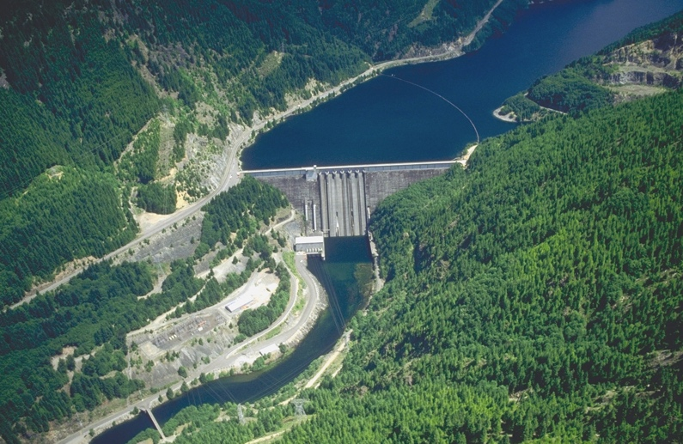
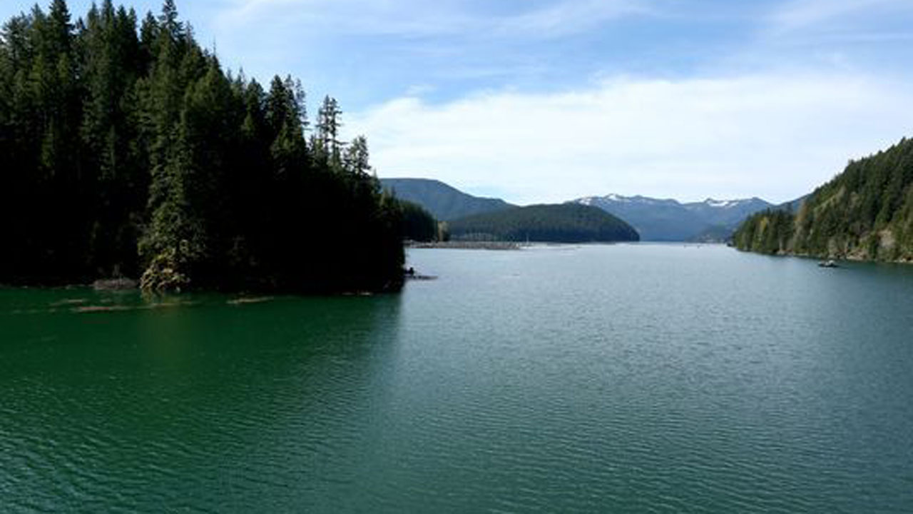
Challenges and Solutions
Developing HAB simulation capabilities applicable to any reservoir is challenging. Reservoirs have characteristics that can vary significantly:
Algal species
Water body morphometry (length, width, etc.)
Volume
Depth
Mixing dynamics (wind forcing, fetch orientation)
Harmful algal blooms can exhibit rapid changes and non-linear dynamics that are difficult to capture in model simulations.
To address these issues:
Extensive literature review. Feedback gathered from HAB experts.
Case study site (Detroit Lake, Oregon) was selected to provide adequate data and a range of conditions that enables development of scaling methods.
Single species selected for algorithm development.
Detroit Lake, Oregon
Detroit Lake HAB

Slide 5
Survey Results: CE-QUAL-W2 Development Opportunities

Slide 6
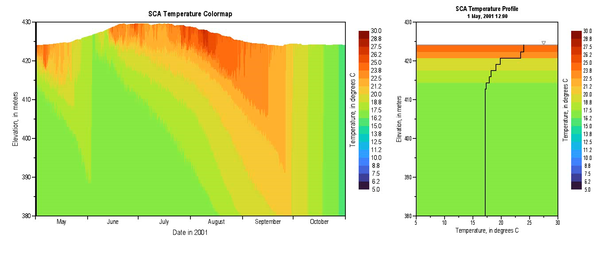
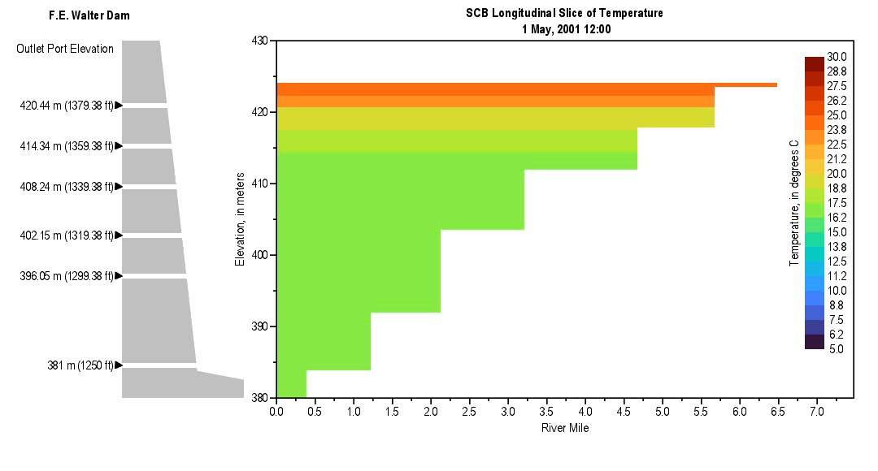
CE-QUAL-W2 Enhancements
Minimum algae concentration enforcement to support post-crash recovery.
Mechanical removal (treatments, harvesting) to simulate interventions such as skimming or pumping.
Hypoxia-induced mortality to reflect algal population dynamics under low oxygen stress.
Nitrogen fixation to support simulation of cyanobacteria dominance in low-nitrogen conditions. Cyanobacteria may outcompete native algae since they can fix nitrogen.
Improved buoyancy dynamics. Developing guidance for use.

Slide 7
Minimum Algae Concentration
Purpose: To prevent complete depletion of algae due to high mortality events, enabling post-bloom recovery in the absence of boundary-driven reintroduction.
Implementation:
A user-defined floor value for algal biomass is enforced after each time step.
The logic is embedded within the wqconstituents.f90 file and applied across all layers and segments where algal concentrations fall below the minimum.
An optional input parameter allows global or group-specific specification of the threshold.
The minimum value acts as a lower bound; once concentrations fall below it due to mortality or other sinks, they are reset to the threshold for subsequent time steps.

Slide 8
Mechanical Removal (Algal Harvesting and Other Treatments)
Purpose: To simulate segment-specific algal biomass removal, reflecting surface skimming, pumping, or other mechanical control actions.
Implementation:
New input file harvest_option_input.csv defines the active segments, interpolation method, and time-series file path.
A time-varying file (e.g., algal_harvesting_time-series.csv) provides fractional reductions by segment and simulation day.
Variables are declared in w2modules.f90, and logic is added to input.f90, time-varying-data.f90, and wqconstituents.f90.
Removal is implemented as an instantaneous fractional reduction in the algal state variables during the time step corresponding to the input.

Slide 9
Hypoxia-Induced Mortality
Purpose: To increase algal mortality in response to low dissolved oxygen (DO), reflecting physiological stress and bloom collapse under hypoxic conditions.
Implementation:
Logic added to algal growth and mortality routines to apply increased death rate when DO falls below a user-defined threshold.
Supports multiple response forms: step function, linear scaling, or Monod-style inhibition.
Applies uniformly to all algae in affected segments unless otherwise configured.

Slide 10
Nitrogen Fixation
Purpose: To simulate atmospheric nitrogen uptake by diazotrophic algae under nitrogen-limited conditions.
Implementation:
Optional activation per algal group, enabled through user input.
Adds a supplementary nitrogen source term when DIN concentrations fall below a user-defined threshold.
Internal logic uses a Monod-like function to modulate fixation rate based on DIN availability.
Ensures conservation of mass and allows continuous algal growth in nitrogen-limited but phosphorus-replete environments.

Slide 11
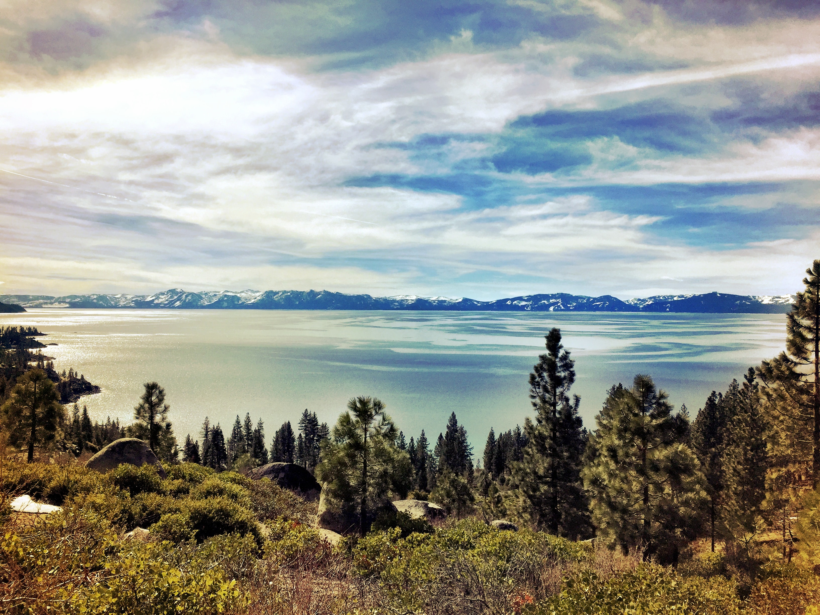
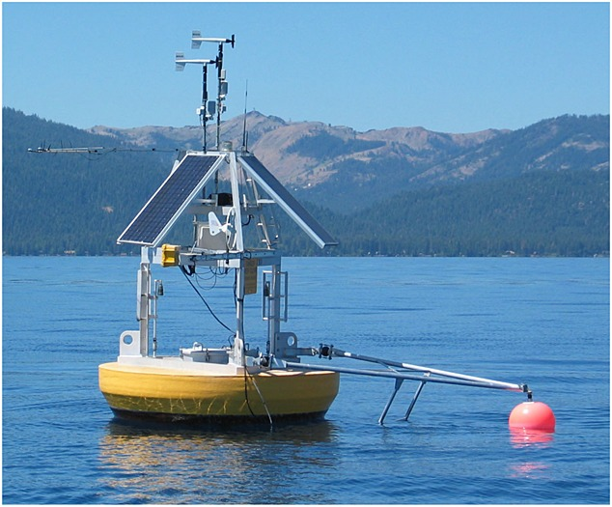
Benefits
CE-QUAL-W2 (W2) will simulate HAB occurrences with greater precision.
W2 will improve understanding of how various environmental factors contribute to HAB dynamics, enabling more proactive management.
W2 outputs will help formulate effective mitigation strategies to reduce the frequency and severity of HAB events by targeting identified key contributing factors.
W2 outputs will facilitate adaptive management practices.
Improve HAB simulation of multiple future scenarios will improve emergency response and sampling.
Early detection and management of HABs will help protect ecosystem health and public safety, minimizing the adverse effects on wildlife and human populations.

Slide 12
New and Future Capabilities

Slide 13
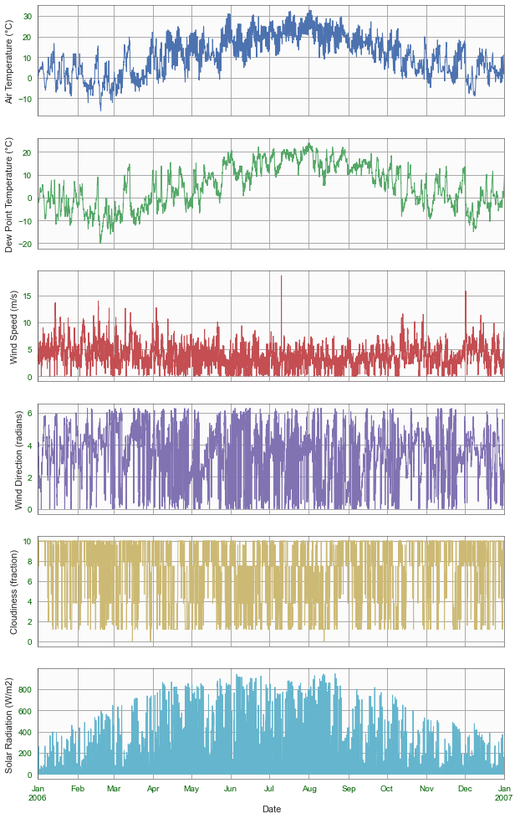
Python CE-QUAL-W2 Library
Supports reading and writing CE-QUAL-W2 model files (legacy fixed-width format and CSV format).
Julian Days are converted to date-time format allowing the date axis to scale from minutes to decades with readable tick intervals and labels.
Plotting functions were developed for the meteorology and water quality input and output data.
Default plot options were set to make clear and readable plots.
Reporting capabilities are in development.

Slide 14
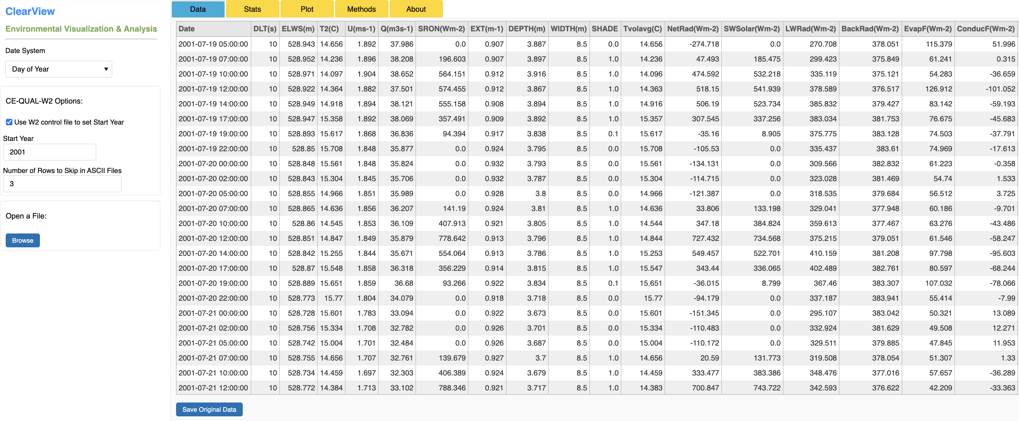
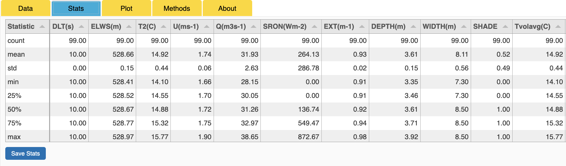
ClearView
A new graphical tool to view and analyze water quality time series data.
Designed to work with CE-QUAL-W2 model input and output data
Reads legacy ASCII formats, CSV, Excel, and SQLite (Data tab)
Converts data to calendar date format
Supports time series operations
Writes Excel and SQLite
Automatically computes summary statistics of all variables (Stats tab)
Leverages the new “cequalw2”Python library

Slide 15
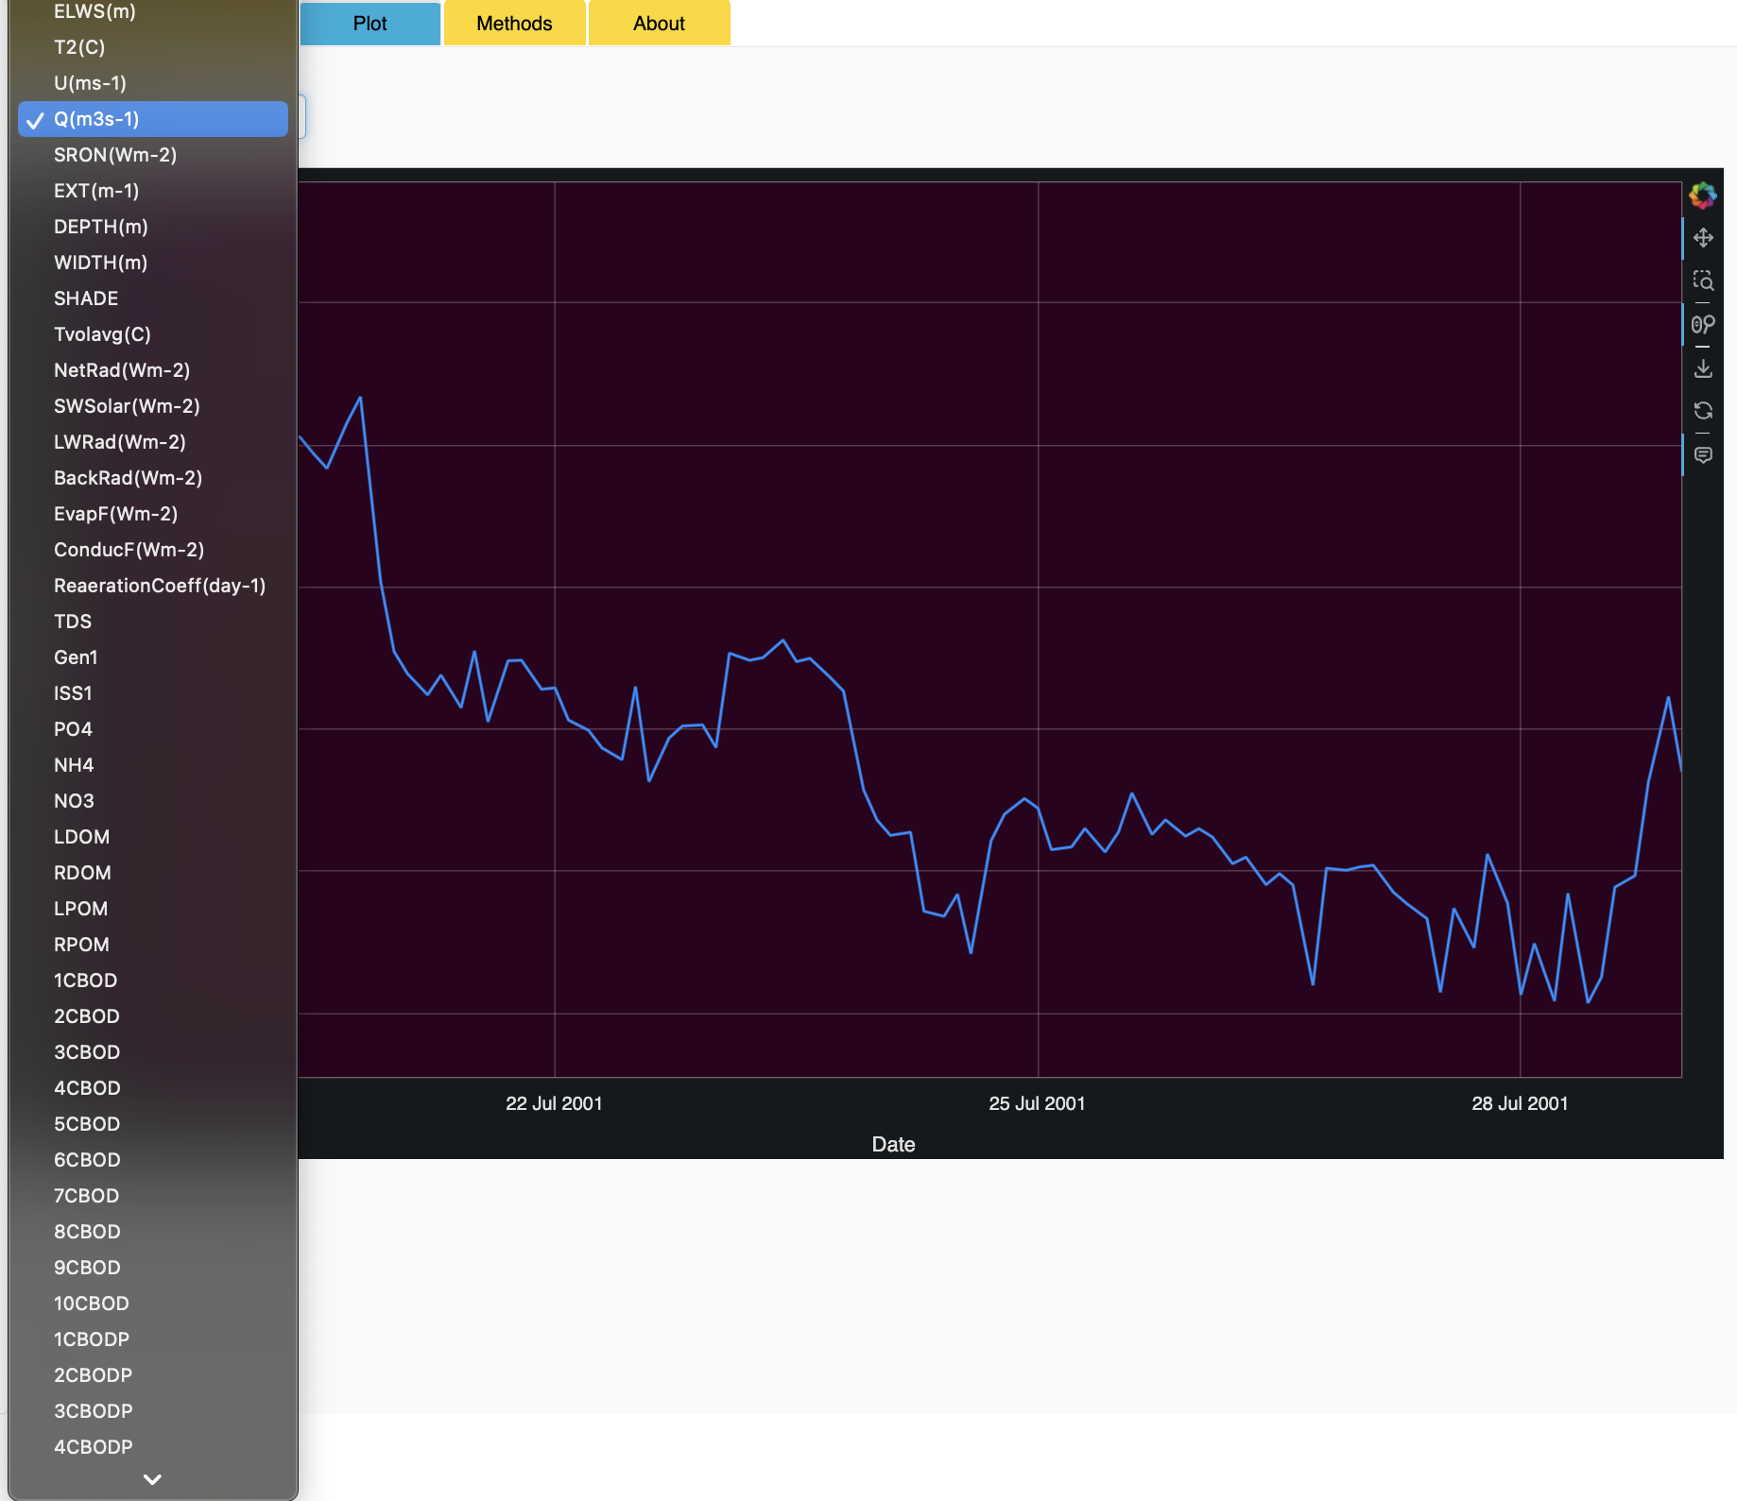
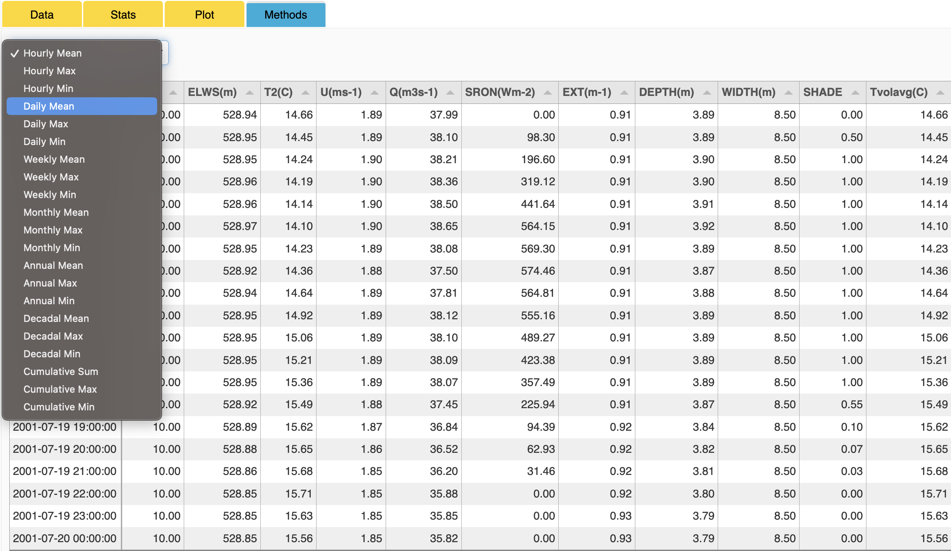
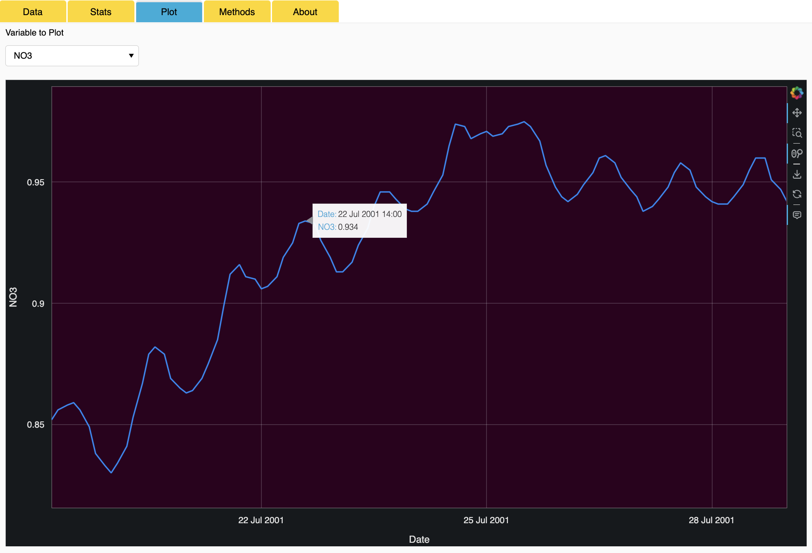
ClearView
Plot tab: select a variable from the drop-down list to plot it. Standard zoom, pan, save tools provided.
Methods tab: Post-processing methods include hourly, weekly, monthly, yearly, decadal, and cumulative mean, max, and min

Slide 16
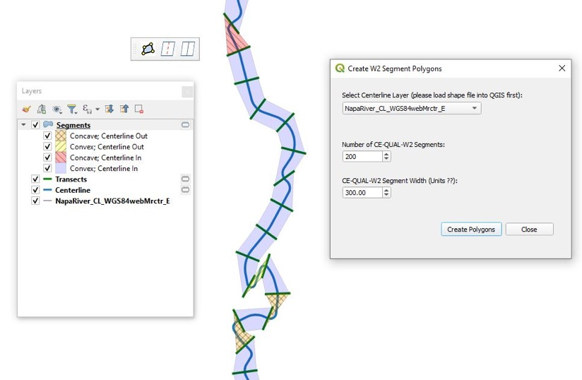
Graphical Bathymetry Editor (QGIS Plug-in)
The Geometry Plug-in helps develop model bathymetry files from a DEM (digital elevation model).
After loading the DEM and shapefile of the centerline, the tool automatically generates the cross-sections.
The user can then split and/or merge cross-sections to refine the model bathymetry.
Then the model bathymetry can be exported for the CE-QUAL-W2 model.

Slide 17
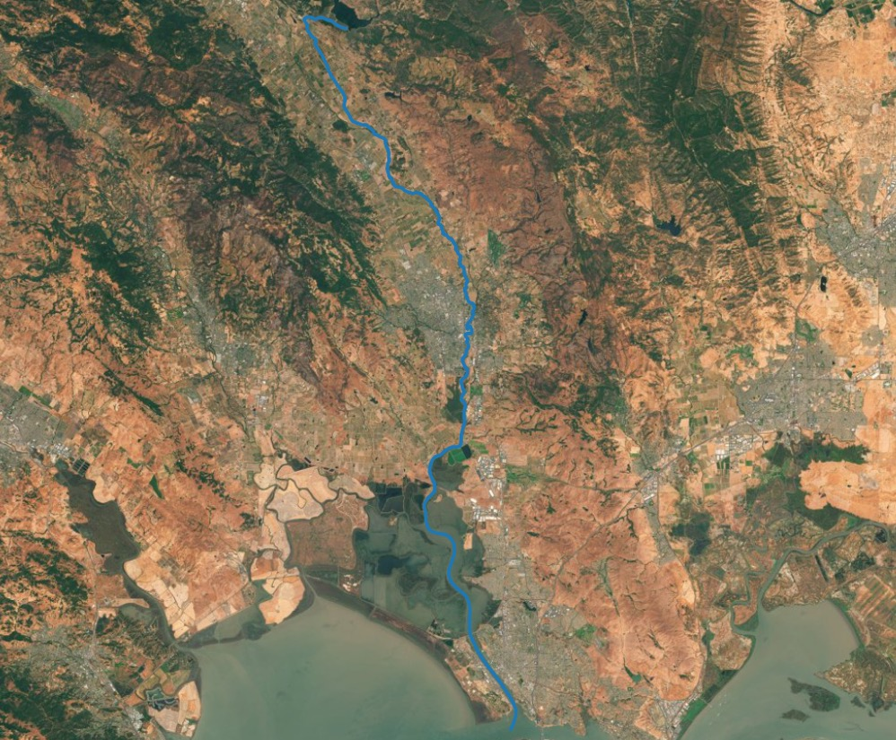
Graphical Bathymetry Editor (QGIS Plug-in)

Slide 18
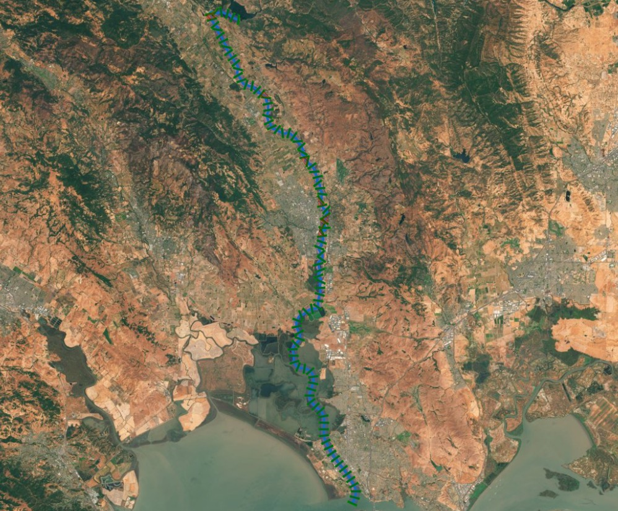
Graphical Bathymetry Editor (QGIS Plug-in)

Slide 19
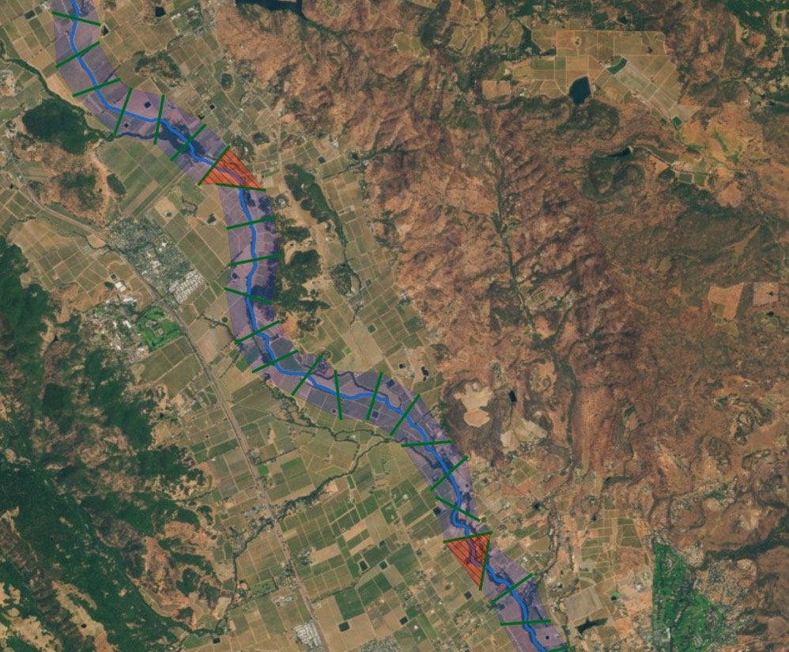
Graphical Bathymetry Editor (QGIS Plug-in)

Slide 20
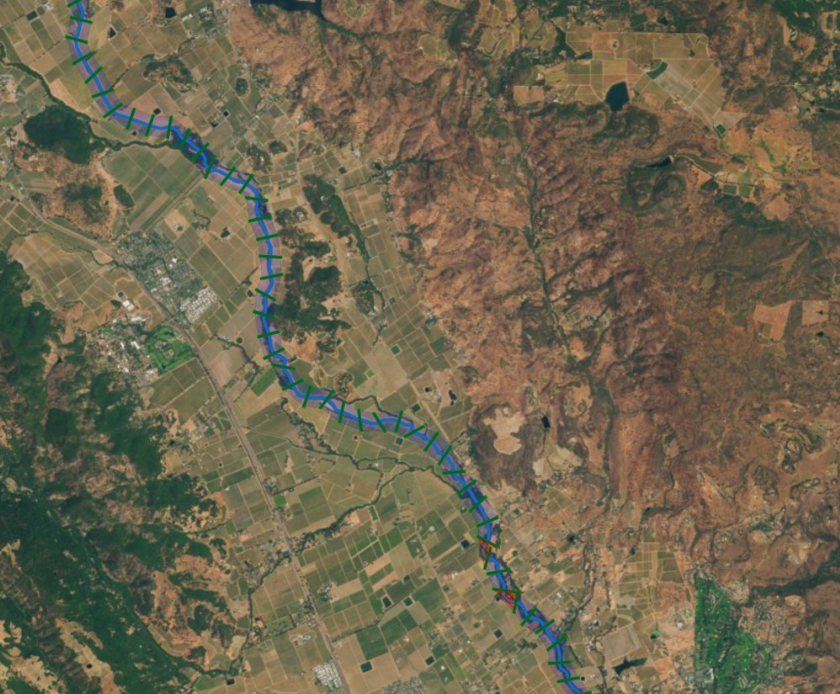
Graphical Bathymetry Editor (QGIS Plug-in)

Slide 21
Graphical Bathymetry Editor (QGIS Plug-in)
Split
Split
Merge
Split
Merge
Merge, then Split

Slide 22

Questions?

