Slide 1
ClearwAter Refactor
2026-04-10

Slide 2
Refactor Objectives
Address Scaling Issues - memory consumption issues
Revisit data management solution in Modules and Riverine
Address clunky data copying-based coupling between Riverine and Modules
Enable chunking of data on time dimension so whole dataset doesn’t need to be held in memory
Add support for float and array, not all data needs to be stored as a n x m x t grid
Reduce Complexity – for both user and developer
Simplify model set up and execution
Reduce the complexity for adding a new processes
Simplify abstractions
One type of variable
Clear patterns for data access and management
Clear patterns for I/O
Moved towards best practices

Slide 3
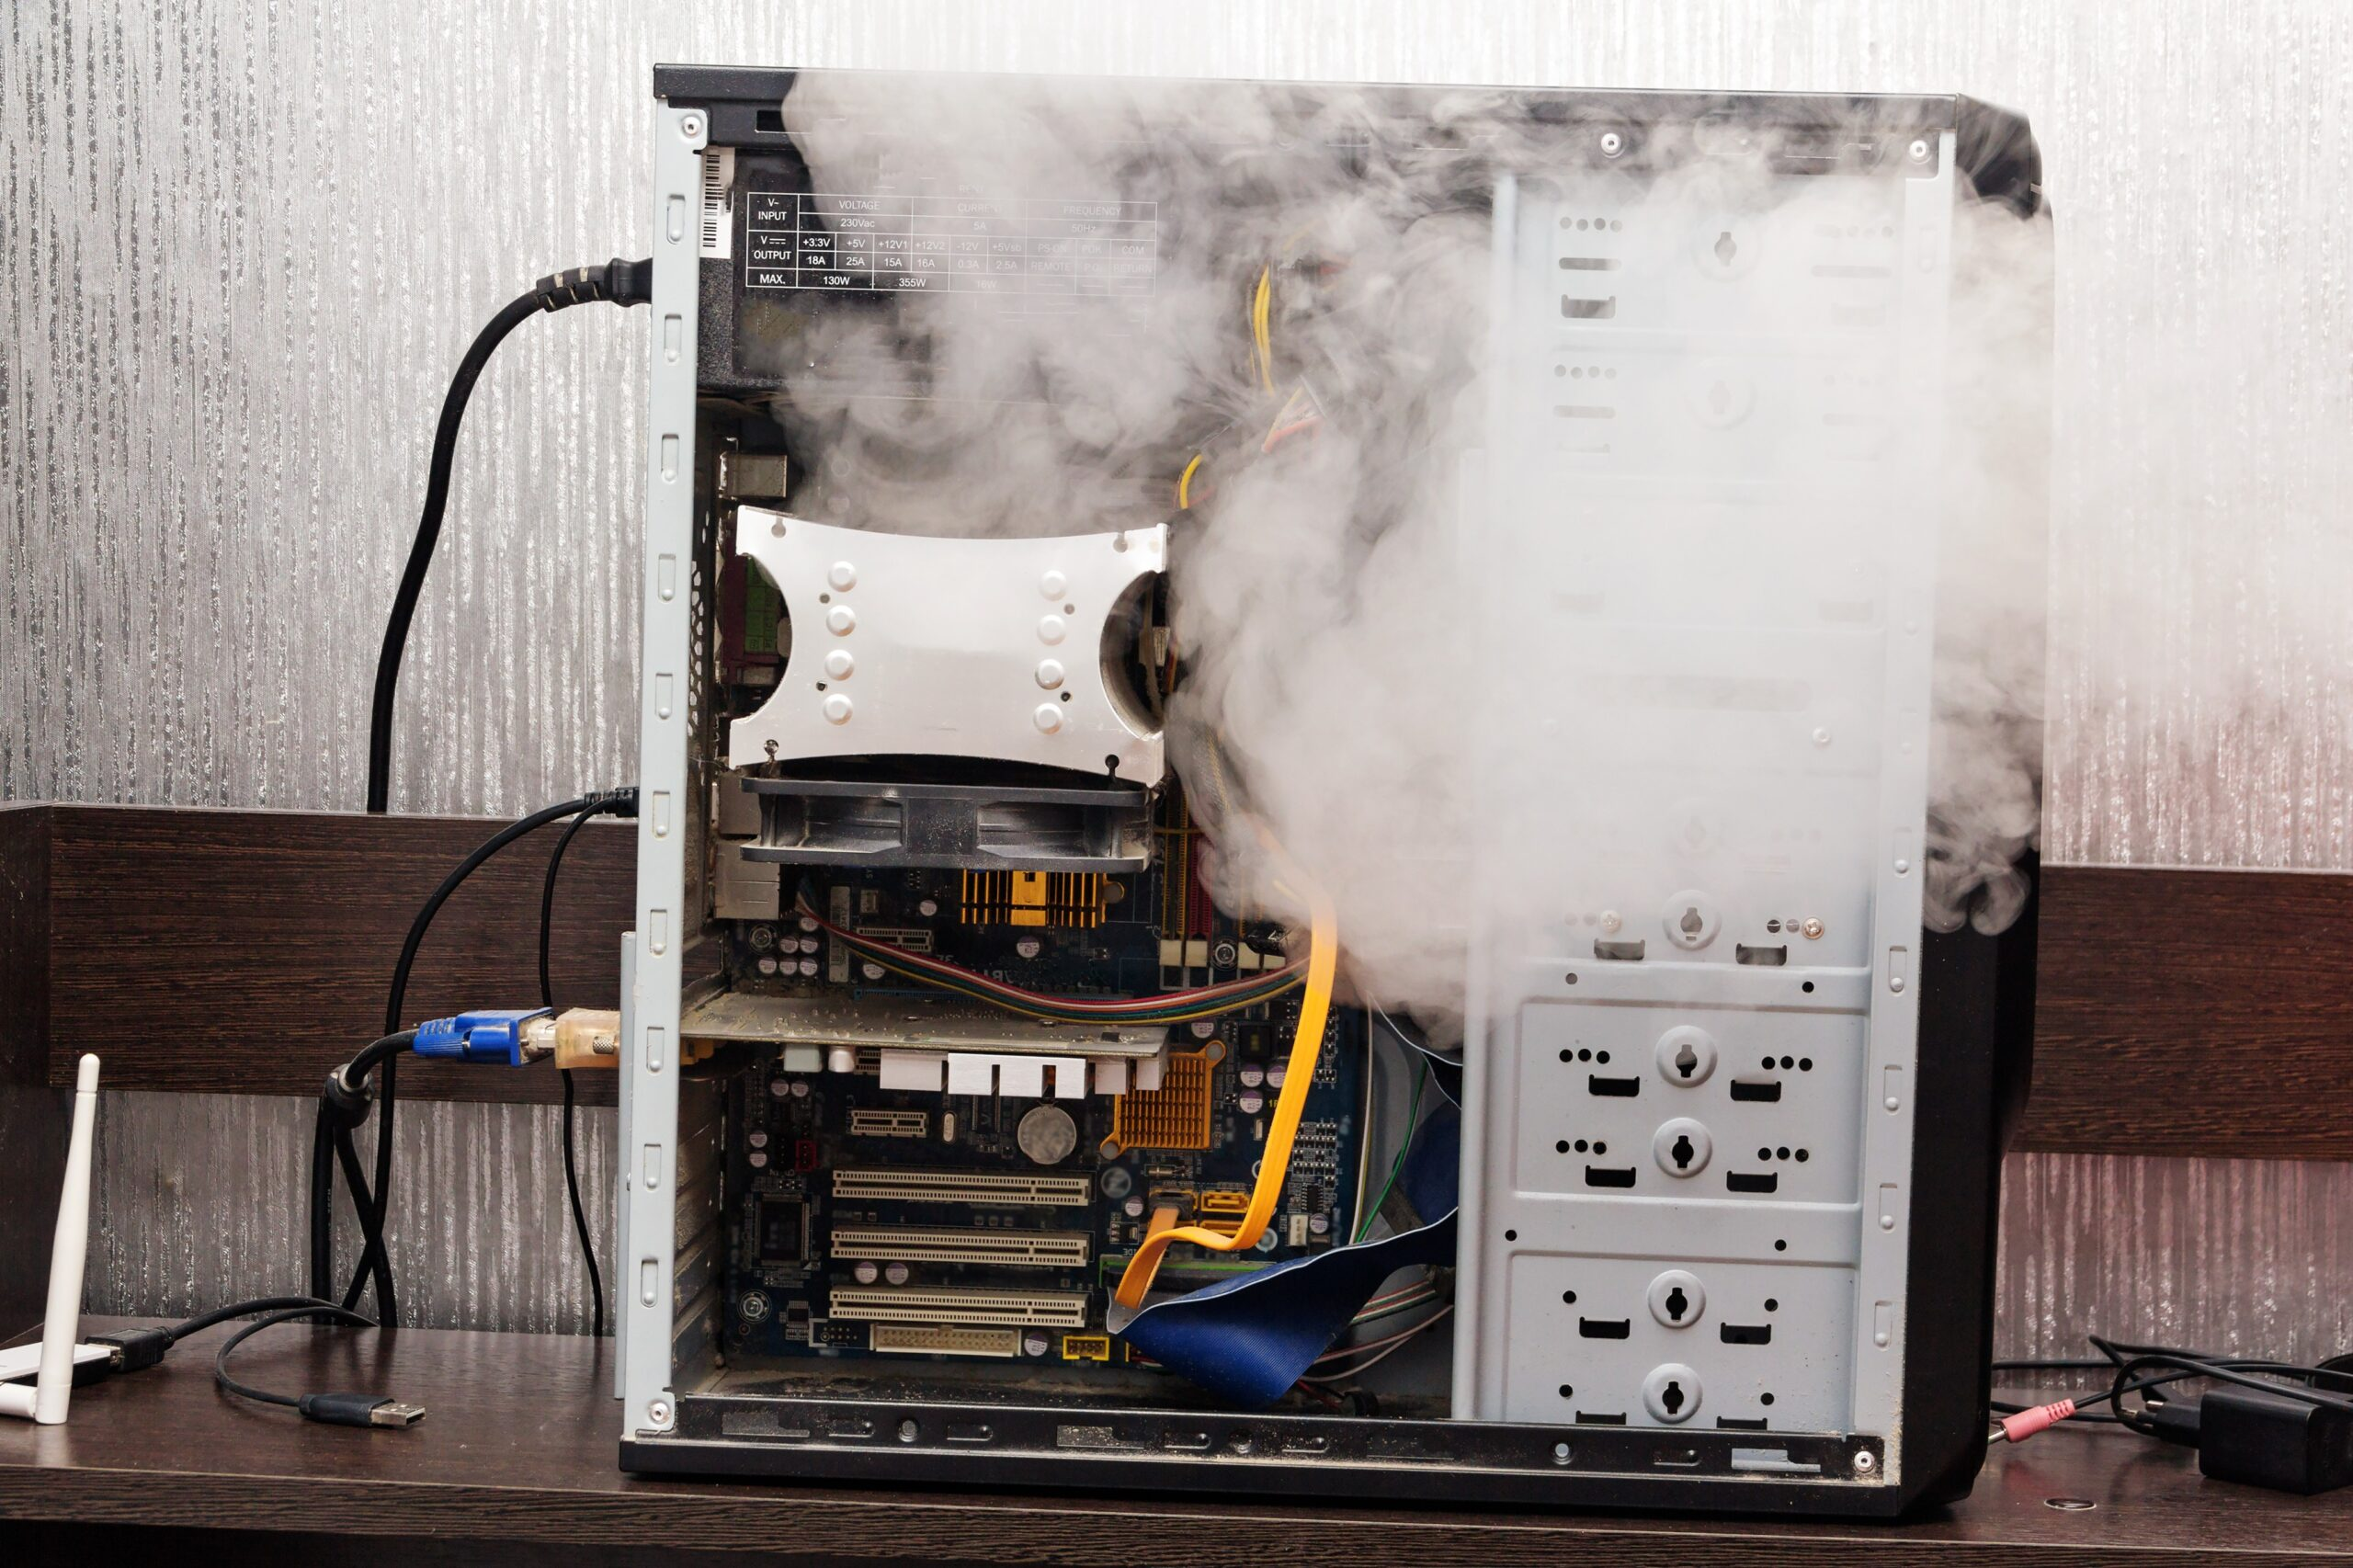
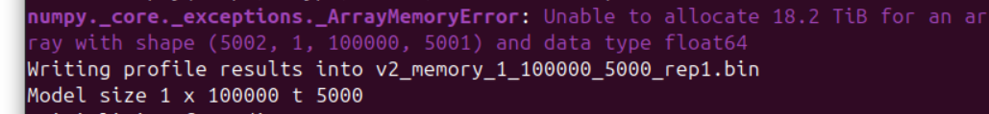
Address Scaling

Slide 4
High Level Changes
Introduced a new ClearWater-Data repository with a set of data management abstractions
This separates out data management and I/O from the model logic
Enables consistent data access patterns and sharing between Riverine and Modules
Address clunky data copying-based coupling between Riverine and Modules
Through the shared VariableRegistry (ClearWater-Data) allowing models to share data directly.
Enable chunking of data on time dimension
Both Riverine and Modules can now run in a chunked mode with a user specified chunk size
Variable management through ChunkedDataStore so the whole dataset doesn’t need to be held in memory
Added support for float and array, not all data needs to be stored as a n x m x t grid
Implemented multiple Variable types based on data type (Float, Array, Gridded) to enable more efficient storage of model parameters.

Slide 5
Testing Set Up
OS: Linux Ubuntu 24.04.4 LTS (running as a VM)
Needed to memory profile
Memory: 16GB
Processor: i7-1370p (4 Cores/Threads dedicated to VM)
Memory Profiling: memray (required OSX/Linux)
CPU Profiling: cprofile)

Slide 6
Metric 1: TSM/Temperature for an N x M x T Matrix
Comparably specified V1 (original) and V2 (refactored) TSM/Temperature model for varying sized grid and number of timesteps
This lets us quickly explore performance under different scales
Note we disabled chunking in these tests to keep comparison consistent.

Slide 7
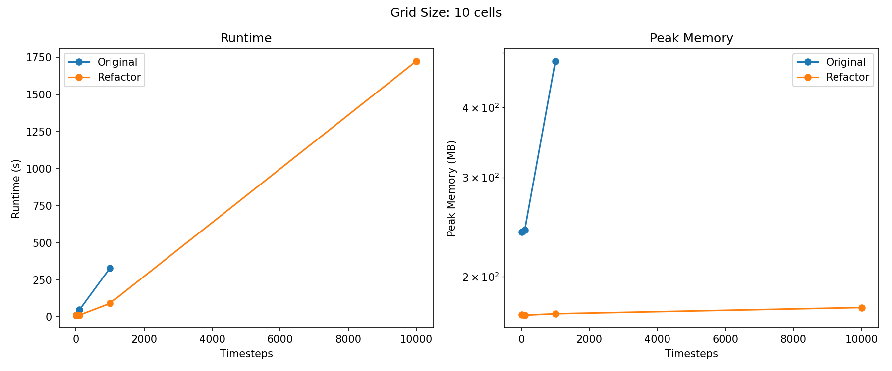
Metric 1: 10 Grid Cells – Varying Timesteps

Slide 8
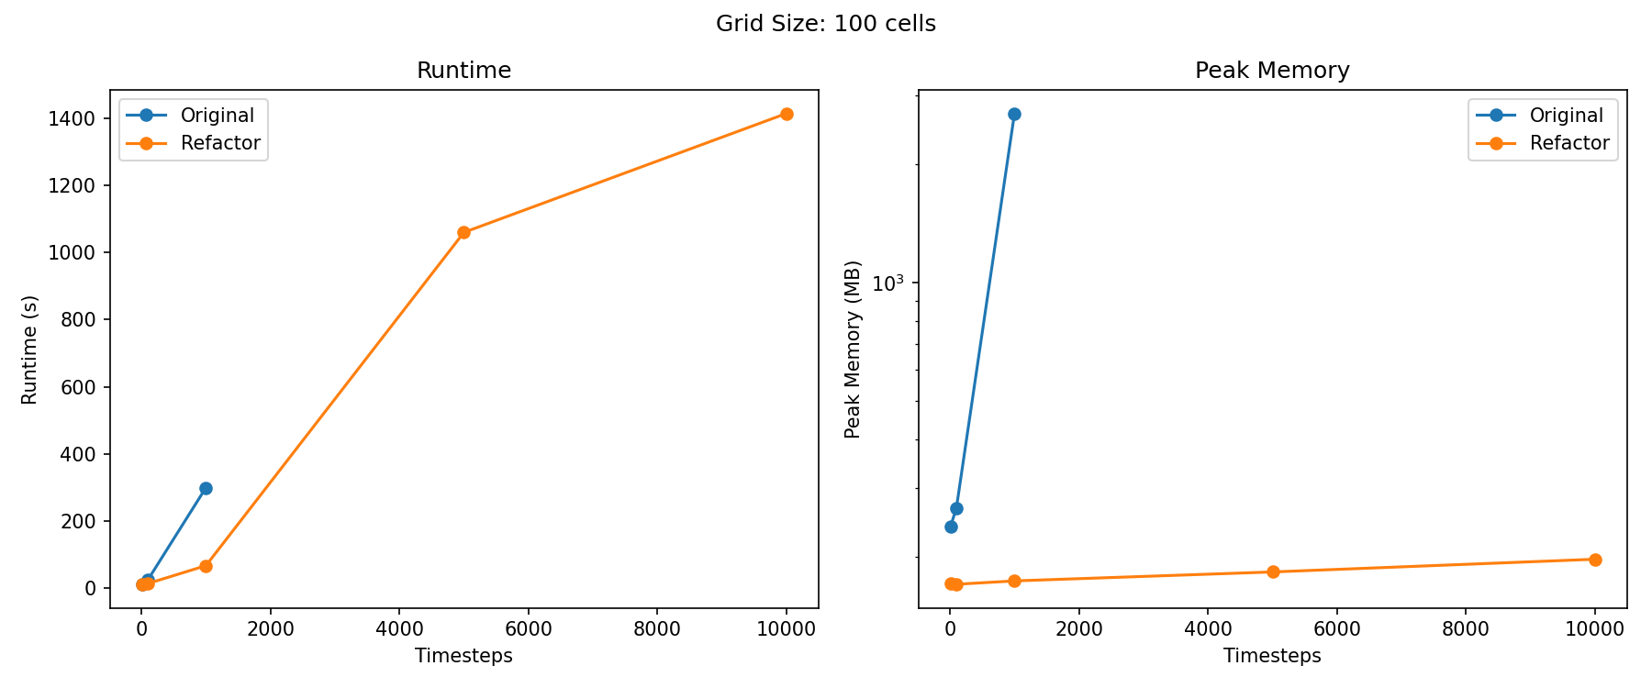
Metric 1: 100 Grid Cells – Varying Timesteps

Slide 9
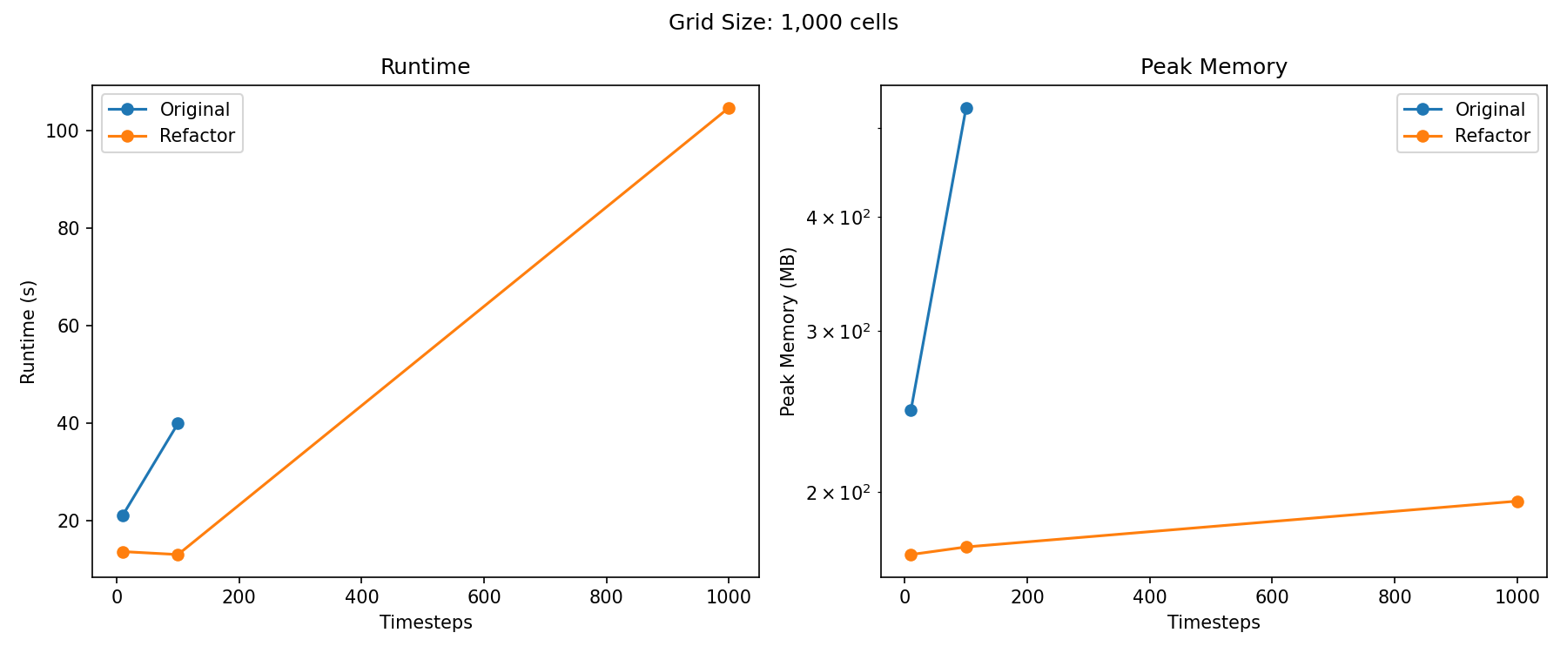
Metric 1: 1000 Grid Cells – Varying Timesteps

Slide 10
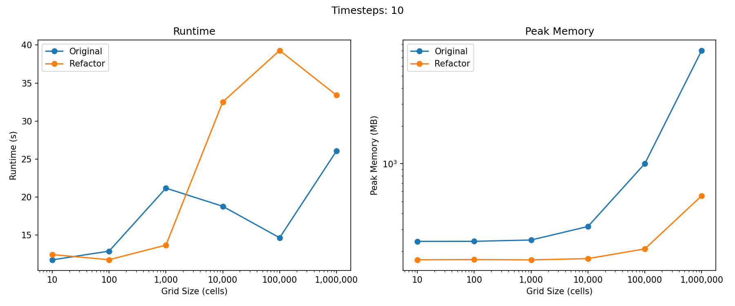
Metric 1: 10 Timesteps– Varying Grids

Slide 11
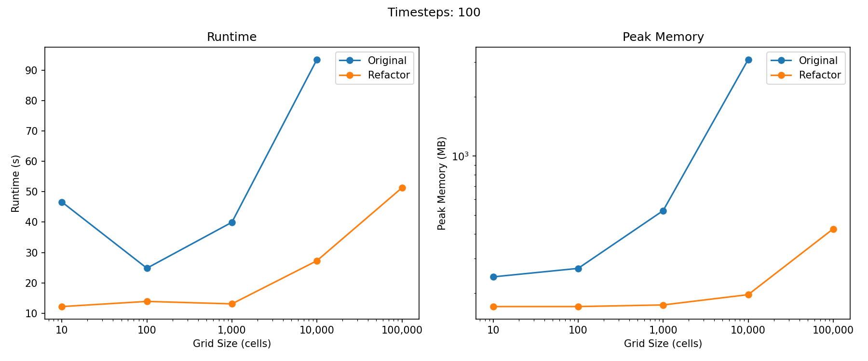
Metric 1: 100 Timesteps– Varying Grids

Slide 12
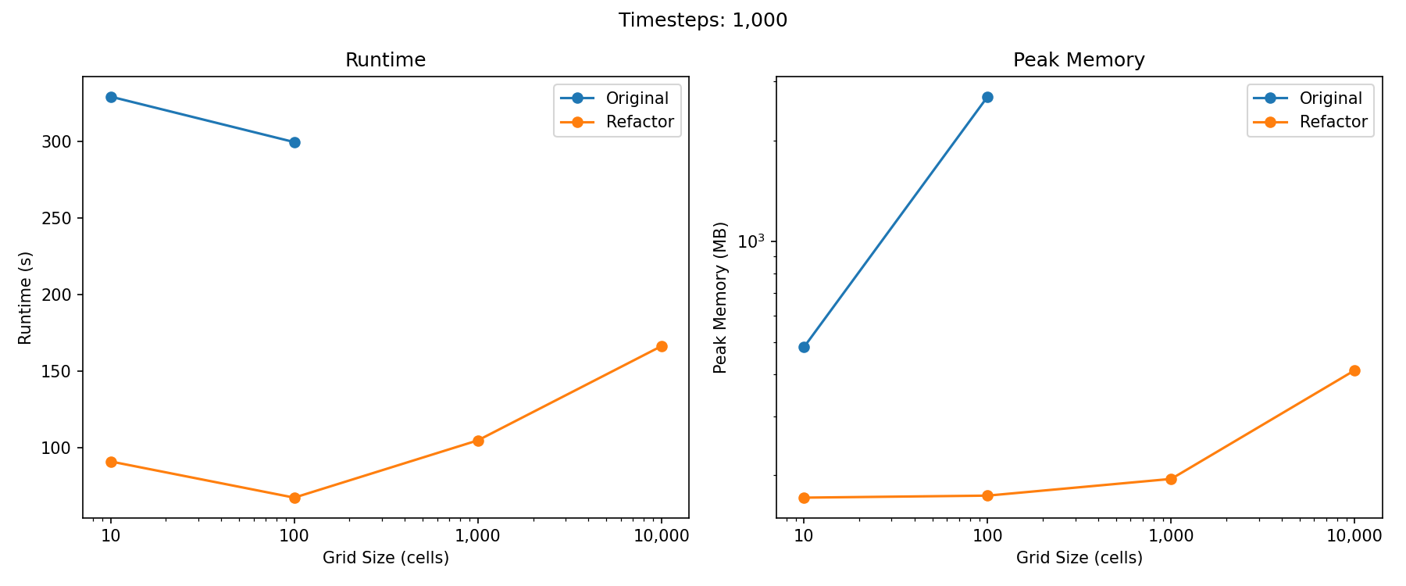
Metric 1: 1000 Timesteps– Varying Grids

Slide 13
Metric 2: Sumwere Creek Coarse Mesh (367 Cells, 960 timesteps)
Ran a coupled Riverine and TSM/Temperature model for the coarse mesh Sumwere Creek model
This shows coupled performance
Original
CPU/Runtime
167s
82s TSM
65s Riverine
20s Unbounded (not in scope of model)
Memory
Max: 1.58 GB
Allocations: 182712
Refactor
CPU/Runtime
76s (2.2x faster)
33s TSM (~60% reduction, or 2.5x faster)
43s Riverine (~34% reduction, or 1.5x faster)
0s Unbounded (100% reduction)
Memory
Max: 1.38GB (~13% reduction)
Allocations: 93128 (~50% reduction)
*Note new chunking features were disabled for V2 during these tests

Slide 14
Metric 2: Sumwere Creek Fine Mesh (6966 Cells, 960 timesteps)
Ran a coupled Riverine and TSM/Temperature model for the fine mesh Sumwere Creek model
This shows coupled performance
Original
CPU/Runtime
171s
80s TSM
86s Riverine
5s Unbounded (not in scope of model)
Memory
Max: 3.9 GB
Allocations: 148052
Refactor
CPU/Runtime
119s (1.4x faster)
56s TSM (~30% reduction, or 1.4x faster)
63s Riverine (~17% reduction, or 1.3x faster)
0s Unbounded (100% reduction)
Memory
Max: 2.8GB (~30% reduction)
Allocations: 46470 (~70% reduction, 3.2x fewer)
*Note new chunking features were disabled for V2 during these tests

Slide 15
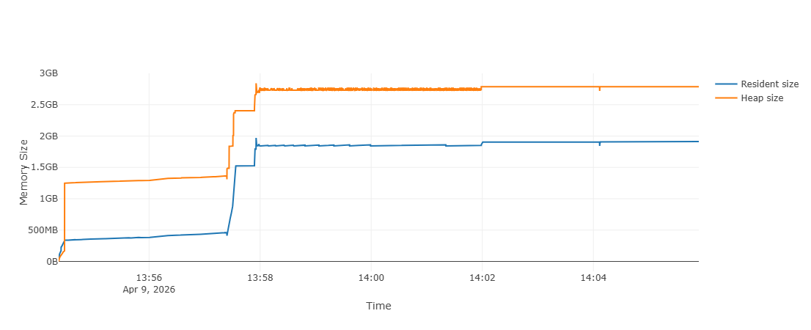
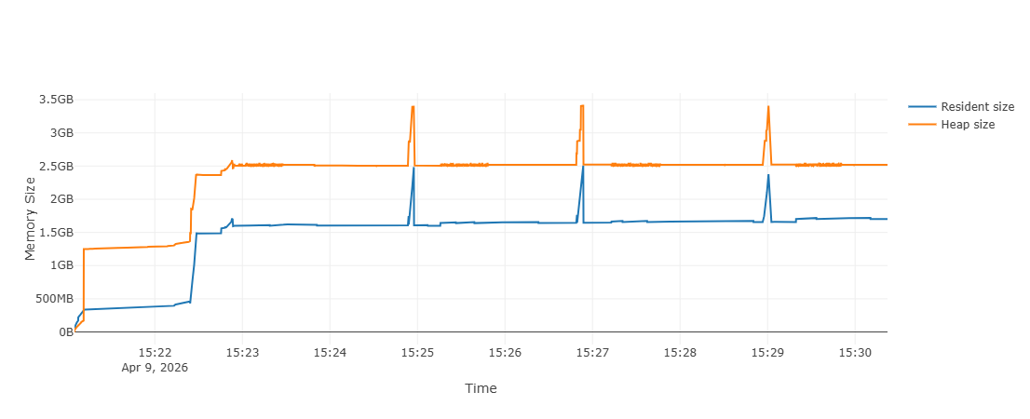
Metric 3: Sumwere Creek Fine Mesh (6966 Cells, 960 timesteps)
Note Chucking uses less RAM on average
Spikes during loading of chunks
Need a larger model to tease out benefits
Chunking increases runtime
No Chunking
Chunking

Slide 16

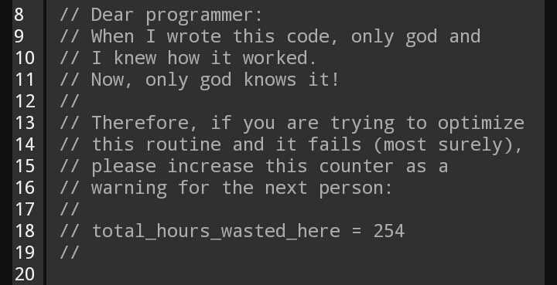
Reduce Complexity

Slide 17
High Level Changes
Easier configuration and setup for Modules through a configuration yaml file
Addressed memory scaling and performance issues when coupling Riverine and Modules through shared memory management approach through intermediate data library (ClearWater-data)
Reenvisioned model execution to move complexity to the model. Eliminated need for user defined coupling loops.
Established simpler abstractions for Modules to enable easier development, extension, and maintenance
Additional Post Processing tools for Riverine
Can performance mass balance and other summary stats
Added intermediate calculations within Riverine
Wetted surface area and depth can now come from Riverine, eliminating the need for external calculations

Slide 18
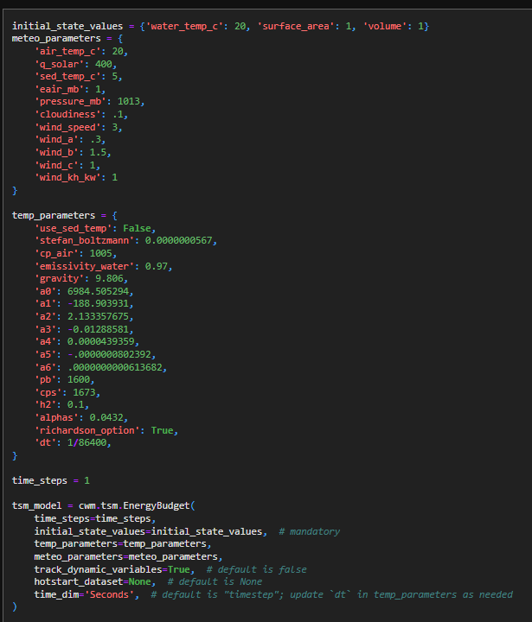
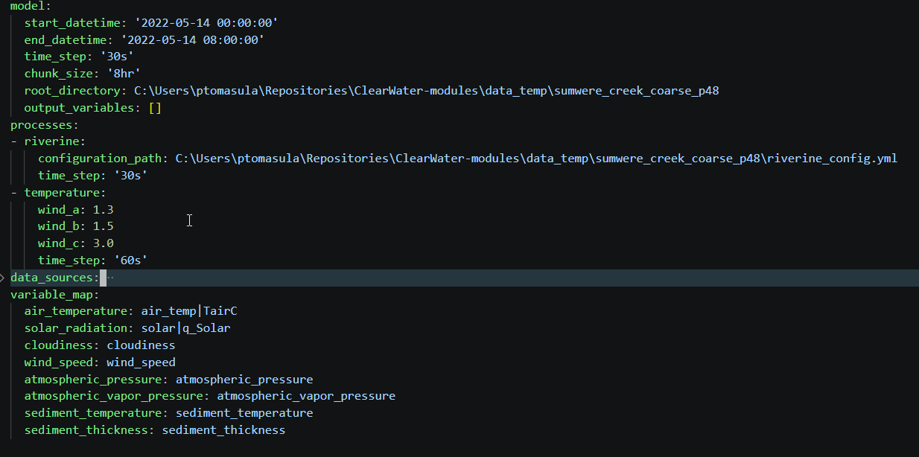
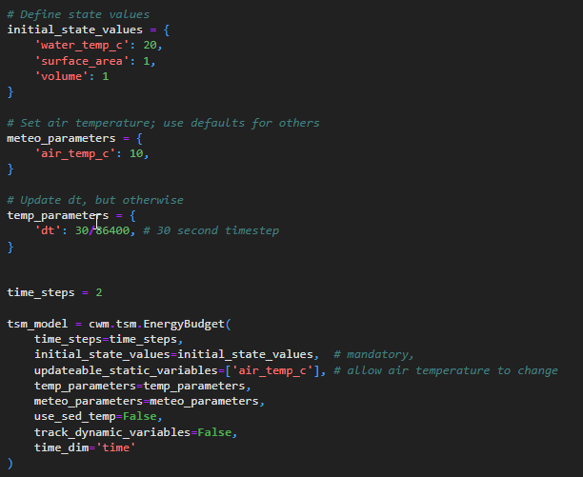
Simply Model: Set Up
Moved to a yaml based on configuration for both Riverine and Modules
Code Heavy
Familiar and Standardized Configuration File

Slide 19
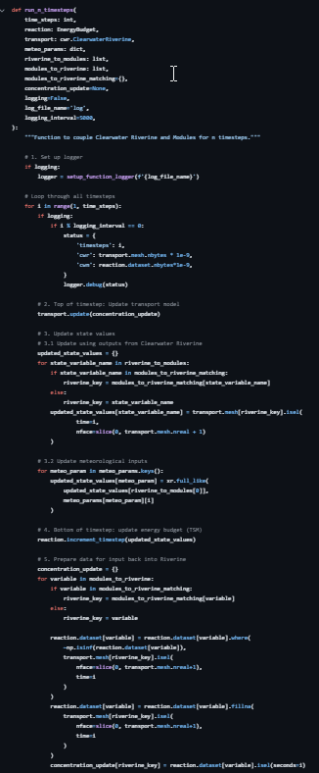
Simply Model: Execution
Moved execution and coupling responsibility to model
User had to write a control loop
And have detailed knowledge how data is stored
Simple Run Command
from clearwater_modules.config import init_from_file
config = r”path_to_config_file”
model = init_from_file(config)
model.run()

Slide 20
Simplify modules abstractions
One variable concept
Replacing state, static, and dynamic variables in original.
Variable subclassing is now more about the structure of the data rather than its use.
Data management has been moved out of the model logic
New variable registry pattern handles data lifecycle
Process just need knowledge of what data they need rather than how to fetch it
Process classes are streamlined

Slide 21
Reduce the complexity for adding a new processes
Very simple Process abstract base class with clear and focused method definitions
Heavily inspired from Xarray Simlab
4 methods required
init_from_config – set class parameters based on information set in the configuration file
init_process [optional] - run once at start-up to get the process ready
validate [optional] – validate that process set up correctly and model state is ready
run (time_step) – runs a provided timesteps and produces update values

