Slide 1
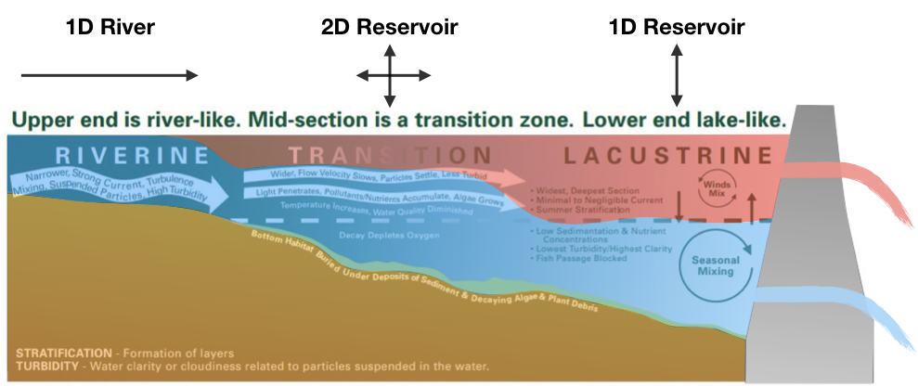
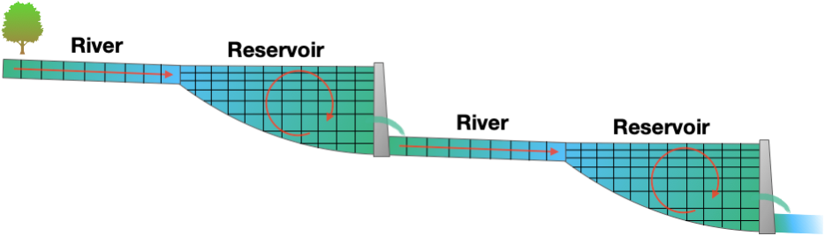
Development of New Capabilities and Enhancements to the USACE Two-Dimensional Reservoir Water Quality Model (CE-QUAL-W2)
SON # 2018-1174
Todd Steissberg (todd.e.steissberg@usace.army.mil)
Problem Statement
Technical Approach Cont’d
USACE needs an improved version of CE-QUAL-W2 capable of performing integrated watershed-scale water quality modeling that supports multi-objective decision-making. The current version lacks critical features that would allow multiple W2 models to be seamlessly and efficiently integrated with other models and data into current modeling systems being utilized by USACE districts.
Develop multi-objective reservoir operation capabilities
Incorporates environmental objectives into the decision-making process
Upgrade hydrodynamic and water quality engine
Improve computational efficiency
Improve stability
Improve selective withdrawal algorithm
Deliver CE-QUAL-W2 v5.0 with documentation
User’s manual
Technical reference manual
Technical Approach
Upgrade water quality kinetics
Incorporate full carbon cycle with N and P cycles
Reformulate BOD group simulations
Incorporate sediment diagenesis module
Upgrade model input and output
Support modern open-source formats: HDF5, JSON, CSV
Develop Python/Jupyter model framework and plotting capabilities
Python libraries will handle I/O
Jupyter notebook interface
Plotting capabilities: time series, bathymetry, 2D contour plots

Slide 2
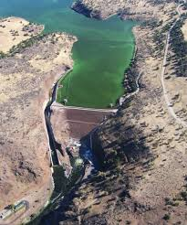
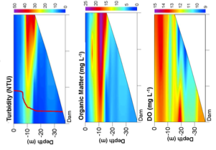
Development of New Capabilities and Enhancements to the USACE Two-Dimensional Reservoir Water Quality Model (CE-QUAL-W2)
SON # 2018-1174
Todd Steissberg (todd.e.steissberg@usace.army.mil)
Value to the Nation
CE-QUAL-W2 v5.0 will support the Corps’ need for environmental assessment, restoration, and management. Its reservoir operations capabilities will enable accurate determination of the decisions that effectively achieve environmental objectives. Critical downstream habitat will be better managed for water quantity (volume, velocity, depths, etc.) as well as water quality objectives (water temperature, dissolved oxygen, total dissolved gas, etc.).
Deliverables by Year
CE-QUAL-W2 v4.3 – 4Q FY21
Python framework & reservoir operations capability for v5.0 – 4Q FY21
CE-QUAL-W2 v5.0 Alpha – 2Q FY22
CE-QUAL-W2 v5.0 Final and Tech Transfer – 4Q FY23
Forecasting Project Hurdles
 | Qtr1 | Qtr2 | Qtr3 | Qtr4
FY21 |  |  |  | W2 v4.3, v5.0 components
FY22 |  | W2 v5.0 Alpha
FY23 |  |  |  | W2 v5.0, Documentation, TN, Webinar
N/A

