Slide 1
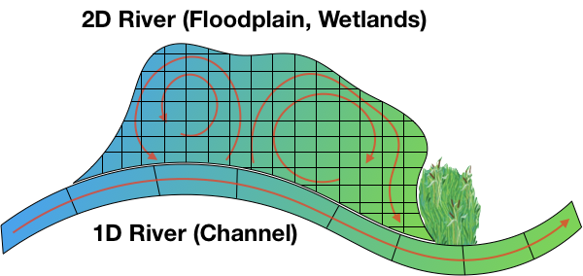
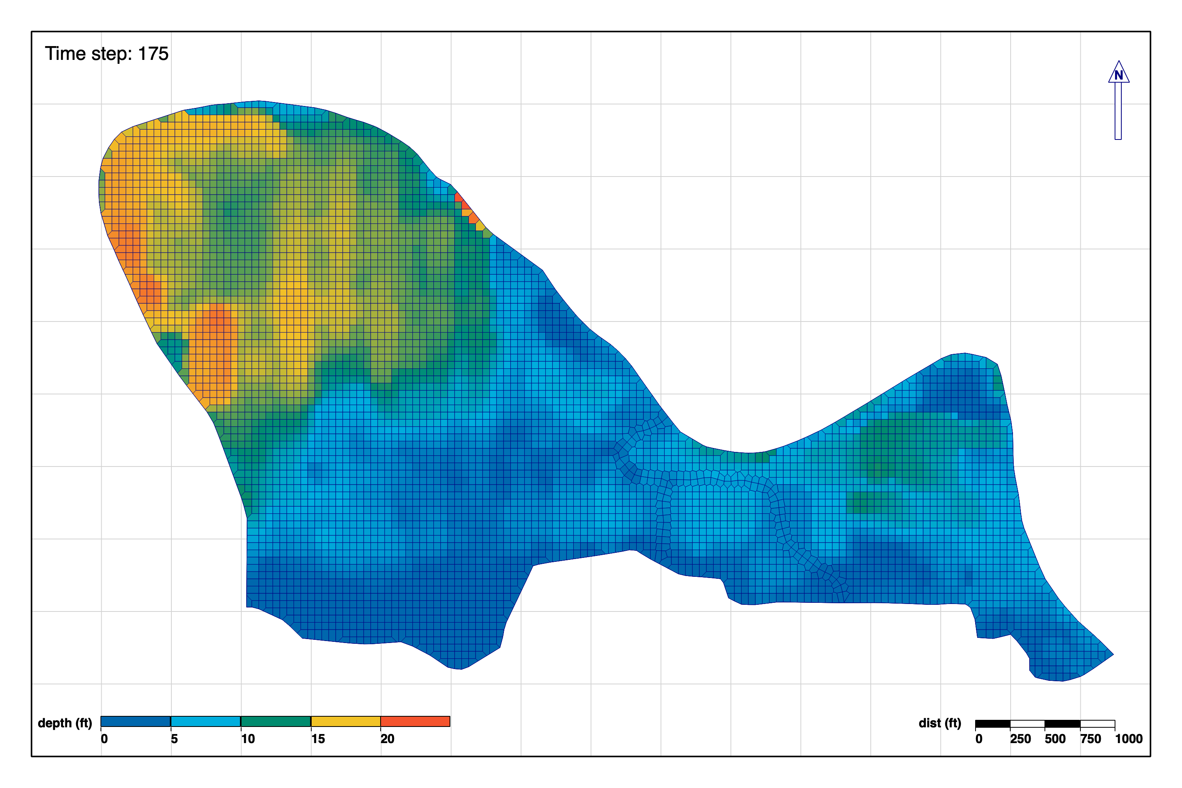
Multi-dimensional Modeling of Interactions between Nutrients and Riparian Vegetation for Improved Riverine Ecosystem Management
SON # 2018-ER-1
Todd Steissberg (todd.e.steissberg@usace.army.mil)
Problem Statement
Technical Approach Cont’d
The Corps needs to quantify the environmental benefits of ecosystem restoration projects for the aquatic environment and riparian buffers. Stream environments are largely controlled by adjacent riparian ecosystems and can be better represented and simulated with a two-dimensional riverine model.
Complete the HEC-RAS 2D riverine simulation tool
Link 2D water quality transport solver, water quality modules, and user interface
Testing and validation
Documentation, technical report
Water quality modeling workshop
Webinar
Technical Approach
Upgrade water quality modules and documentation
Extend capabilities to simulate temperature, general constituents, and nutrients in 2D riverine and floodplain models
Computational Library for Environmental Analysis and Restoration of Watersheds (CLEARWATER)
Develop vegetation and water quality user interface tools
Jupyter notebook interface
Plotting capabilities via Python and open-source libraries

Slide 2
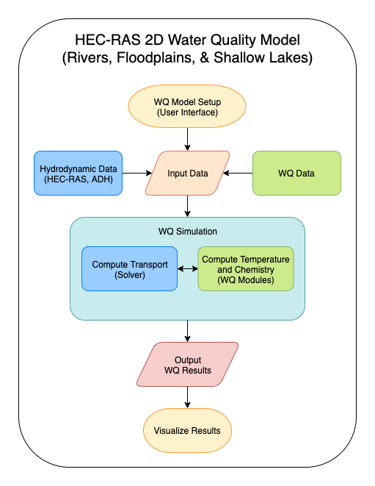
Multi-dimensional Modeling of Interactions between Nutrients and Riparian Vegetation for Improved Riverine Ecosystem Management
SON # 2018-ER-1
Todd Steissberg (todd.e.steissberg@usace.army.mil)
Value to the Nation
The HEC-RAS 2D riverine water quality tool will support the need for a cost-effective science-based impact assessment tool for ecosystem restoration and management. This will improve understanding of the interactions of flow, nutrients, and vegetation for improved riverine ecosystem management and restoration. The net cost is dramatically reduced by leveraging the HEC-RAS models that already exist for most watersheds.
Deliverables by Year
Upgraded water quality modules – 1Q FY21 completed
Water quality and vegetation user interface tools – 1Q FY21 completed
2D water quality transport solver – 2Q FY21 completed
HEC-RAS 2D riverine water quality tool (alpha) – 4Q FY21
Documentation, Technical report – 4Q FY22
Water quality modeling workshop (webinar) – 4Q FY22
Forecasting Project Hurdles
 | Qtr1 | Qtr2 | Qtr3 | Qtr4
FY21 | WQ modules, UI tools | WQ Solver |  | HEC-RAS WQ tool (alpha)
FY22 |  |  |  | Documentation, TR, Workshop
N/A

