Slide 1




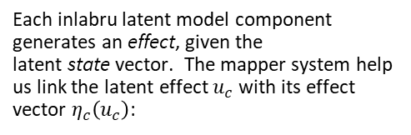


inlabru: : CHEAT SHEET
  Basics
  Model components
  Compatibility with terra and sf
inlabru facilitate spatial modelling using integrated nested Laplace approximation via the R-INLA package. Additionally, extends the GAM-like model class to more general nonlinear predictor expressions, and implements a log Gaussian Cox process likelihood for modelling univariate and spatial point processes based on ecological survey data.
The basic syntax for defining model components is
~ my_component_name(
main = ...,
model = ...
)
  CODE
Model components are specified with general inputs.
my_component_name is a user-chosen label for the model component.
The main argument defines the input data for the component.
model type of model component
Details about the available models can be found by typing:
Where possible, use code that works when run.
cmp = ~ -1 + beta0(1) + beta1(x, model = "linear")
cmp = ~ -1 + beta0(1) + beta1(tl, model = "linear")
  ICONS
Linear and non-linear predictors are specified via general R expressions
These are just font awesome characters
Word balloons
can help explain
code
?component
?INLA::inla.list.models()$latent
eta = y ~ beta0 + beta1
Separate expressions for one or more observation model(s)
  bru_mapper system
  MOCK TABLES
  KEYNOTE
Each inlabru latent model component generates an effect, given the latent state vector. The mapper system help us link the latent effect $u_{c}$ with its effect vector $η_{c}\left(u_{c}\right)$:
I make my cheatsheets in Apple Keynote, and not latex or R Markdown, because presentation software makes it much easier to tweak the visual appearance of a documentEach inlabru latent model component generates an effect, given the latent state vector.
lik = bru_obs(formula = eta,
family = "gaussian",
data = data_set_1)
Use the bru function to fit the model using the components and the observational model(s)
$$η_{c}\left(u_{c}\right)=A_{c}\left(input\right)u_{c},$$
fit.lm = bru(cmp,lik)
$A_{c}\left(input\right)$ is a component model matrix defined based on the component input.
  KEYNOTE TIPS
A list of predefined mappers can be found by typing ?bru_mapper f
  MOCK GRAPHS
Select multiple elements by holding down shift and then selecting each. Click on a selected element before letting go of shift to unselect it.
To group elements together. Select them all , then click Arrange > Group
To evenly space multiple objects, select them all then Right Click > Align objects or Right Click > Distribute objects
Click on a table, then visit Format >Table > Row and Column Size to make even width rows/columns.
A prediction method based on fast Monte Carlo sampling allows posterior prediction of general expressions of the latent variables
pred = predict(fit.lm,
new_data,
~ beta_0 + beta_1, n.samples = 1000)
  TABLES
sub-option | description
citation_package | The LaTeX package to process citations, natbib, biblatex or none
code_folding | Let readers to toggle the display of R code, "none", "hide", or "show"
colortheme | Beamer color theme to use
RStudio® is a trademark of RStudio, Inc. • CC BY SA Your Name • your@email.com • 844-448-1212 • your.website.com • Learn more at webpage or vignette • package version 0.5.0 • Updated: 2017-01

Slide 2

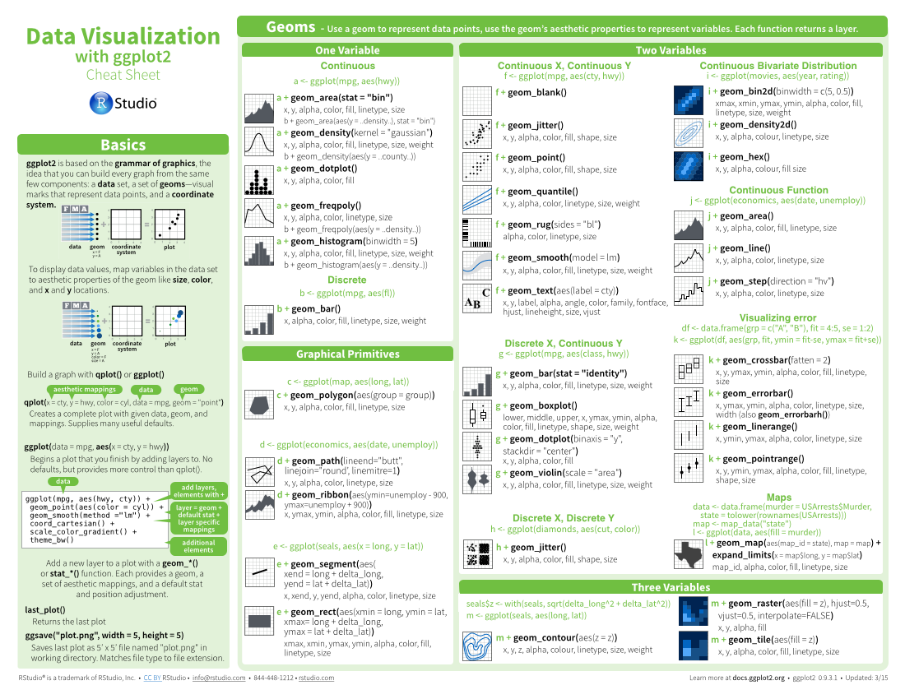
Three Column Layout: : CHEAT SHEET
  Basics
  Layout Suggestions
  Manipulate Variables
Thank you for making a new cheatsheet for R! These cheatsheets have an important job:
Use headers, colors, and/or backgrounds to separate or group together sections.
Create a visual hierarchy. Help users navigate the page with titles, subtitles, and subsubtitles
Quickly identify content with a package hexsticker (if available)
Fit sections to content. Try several different layouts.
Use numbers or arrows to link sections if the order/flow is confusing.
Cheatsheets make it easy for R users
to look up useful information.
  Section 1
  Section 2
  Section 3
  Title
Remember that the best cheatsheets are visual—not written—documents. Whenever possible use visual elements to make it easier for readers to find the information they need.
  SUBTITLE
  SUBSUBTITLE
Use a layout that flows and makes it easy to zero in on specific topics.
  Logistics
  Getting help
  FONTS
  CODE
This template uses several fonts: Helvetica Neue, Menlo, Source Sans pro, which you can acquire for free here, www.fontsquirrel.com/fonts/source-sans-pro, and Font Awesome, which you can acquire here, fortawesome.github.io/Font-Awesome/get-started/
Where possible, use code that works when run.
Word balloons
ggplot(mpg, aes(hwy, cty)) +
geom_point(aes(color = cyl)) +
geom_smooth(method ="lm")
can help explain
code
Use visualizations to explain concepts quickly and concisely.
summary function
To use a font awesome icon, copy and paste one from here fortawesome.github.io/Font-Awesome/cheatsheet/. Then set the text font to font awesome.
  ICONS
☞    
These are just font awesome characters
Use visual elements to make the sheet scannable.
i + geom_area()
x, y, alpha, color, fill, linetype, size
i + geom_line()
x, y, alpha, color, group, linetype, size
  KEYNOTE
  MOCK TABLES
I make my cheatsheets in Apple Keynote, and not latex or R Markdown, because presentation software makes it much easier to tweak the visual appearance of a document
Use visual emphasis (like color, size, and font weight) to make important information easy to find.
  KEYNOTE TIPS
Select multiple elements by holding down shift and then selecting each. Click on a selected element before letting go of shift to unselect it.
To group elements together. Select them all , then click Arrange > Group
To evenly space multiple objects, select them all then Right Click > Align objects or Right Click > Distribute objects
Click on a table, then visit Format >Table > Row and Column Size to make even width rows/columns.
  MOCK GRAPHS
dplyr::lag() - Offset elements by 1
dplyr::lead() - Offset elements by -1
  COPYRIGHT
Each cheatsheet should be licensed under the creative commons license.
To license the sheet as creative commons, put CC'd by <your name> in the small print at the bottom of each page and link it to http://creativecommons.org/licenses/by/4.0/
  TABLES
sub-option | description
citation_package | The LaTeX package to process citations, natbib, biblatex or none
code_folding | Let readers to toggle the display of R code, "none", "hide", or "show"
colortheme | Beamer color theme to use
YOUR LOGO
(optional)
RStudio® is a trademark of RStudio, Inc. • CC BY SA Your Name • your@email.com • 844-448-1212 • your.website.com • Learn more at webpage or vignette • package version 0.5.0 • Updated: 2017-01

Slide 3
mx04
The names of the priors available in `inlabru` can be seen with `names(inla.models()$prior)`
To check which priors are used in a fitted model one can use the function `inla.prior.used()`
You can use the `bru_names(fit.lm)` function to check the names for the different model components.

