Slide 2
data
Initial observations
(Research questions)
Generate theory
Identify variables
Generate hypotheses
Measure variables
Collect data to test theory
Graph data / fit a model
Analyze data

Slide 3
data
Initial observations
(Research questions)
Generate theory
Identify variables
Generate hypotheses
Measure variables
Collect data to test theory
Graph data / fit a model
Analyze data

Slide 4
data
Initial observations
(Research questions)
Generate theory
Identify variables
Generate hypotheses
Measure variables
Collect data to test theory
Graph data / fit a model
Analyze data

Slide 5
data
Initial observations
(Research questions)
Generate theory
Identify variables
Generate hypotheses
Measure variables
Collect data to test theory
Graph data / fit a model
Analyze data

Slide 6
 | No disorder | Disorder | Total
Selected | 3 | 9 | 12
Rejected | 6805 | 845 | 7650
Total | 6808 | 854 | 7662

Slide 7
Score | Mean | Deviation
1 | 2.6 | -1.6
2 | 2.6 | -0.6
3 | 2.6 | 0.4
3 | 2.6 | 0.4
4 | 2.6 | 1.4
 | Total | 0

Slide 8
Score | Mean | Deviation | Squared Deviations
1 | 2.6 | -1.6 | 2.56
2 | 2.6 | -0.6 | 0.36
3 | 2.6 | 0.4 | 0.16
3 | 2.6 | 0.4 | 0.16
4 | 2.6 | 1.4 | 1.96
 | Total | 0 | 5.20

Slide 9










11
7
12
8
15
8
9
???
$$\overline{x}=10$$
$$μ=10$$

Slide 10
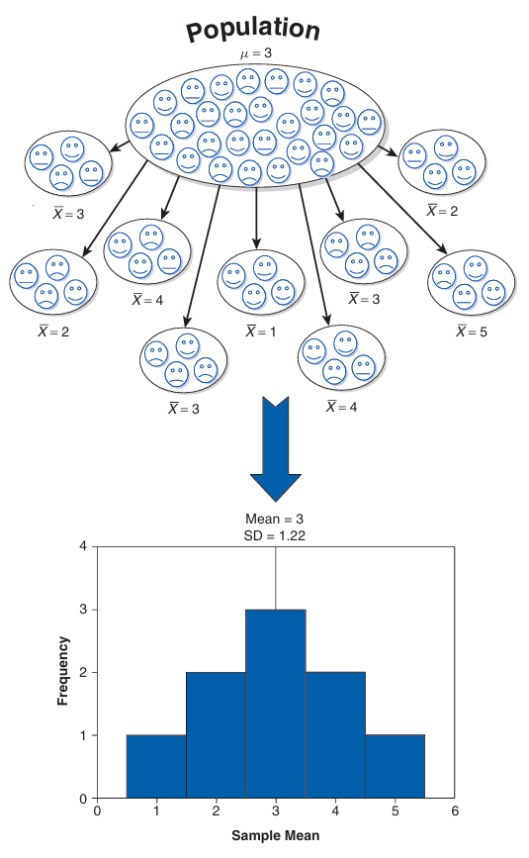

Slide 11
