Slide 1
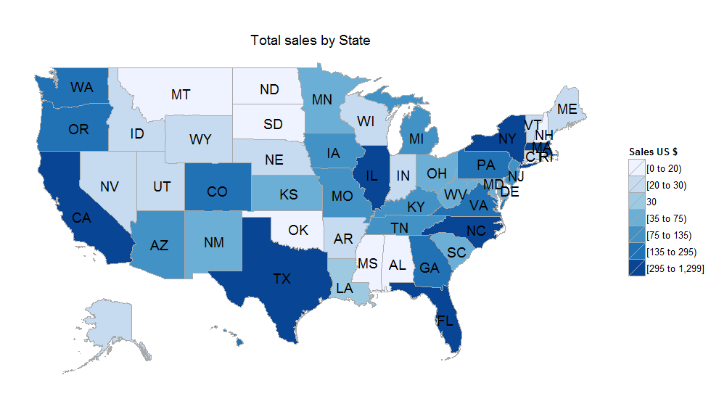
Geospatial Analysis
(choroplethr package)
By Mike Jadoo

Slide 2


Special Thank you
MLK library Digital commons lab

Slide 3
Purpose
Bring about an awareness
Enable individuals to properly create analysis
Generate geospatial maps

Slide 4
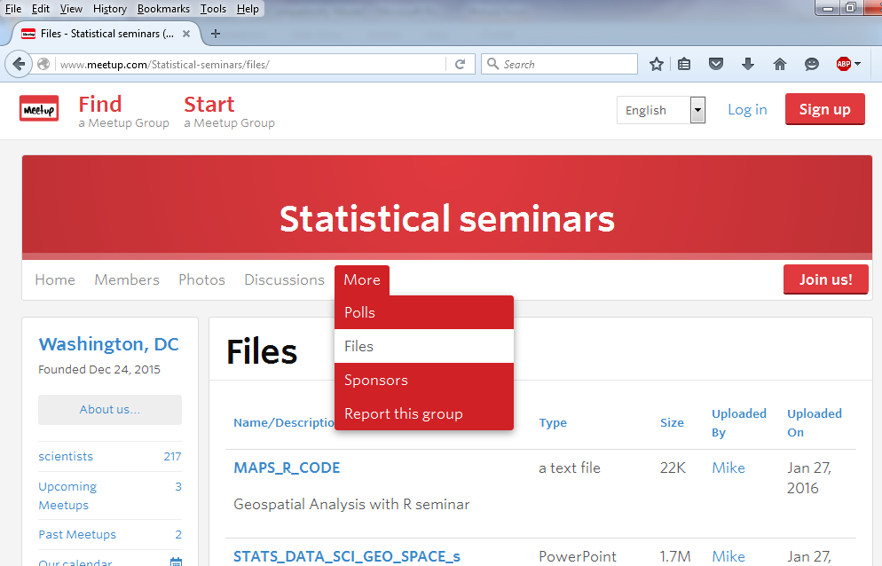
Lecture Structure
Slides, code, datasets are in the groups Meetup files section

Slide 5


Lecture Structure
Using R i386 3.2.4 or R studio
Can follow lecture and hack or hack after
There will be some web exercises

Slide 6

R i386 3.2.4 (32 bit)
PACKAGE | task
CHOROPLETHR | Providing ready-made functions for creating choropleths of common maps and other features.
MAPS | Display of maps. Projection code and larger maps are in separate packages ('mapproj' and 'mapdata').
XLSX | Provide R functions to read/write/format Excel 2007 and Excel 97/2000/XP/2003 file formats
CHOROPLETHRMAPS | Contains maps used by the choroplethr package
GGPLOT2 | Helps with graphics supports choroplethr packages
SPDEP | Allows the uses of spatial autocorrelation functions; moran I, greay C, Gi*
OUTLIERS | Helps find outliers in your dataset
* All packages associated with seminar is located at the top of the code file MAPS_R_CODE.txt

Slide 7



Data: State level Gross Domestic Product (GDP)
Frequency: quarterly
Source: Bureau of Economic Analysis

Slide 8


Data: US state and county population estimates
Frequency: annual
Source: US Census Bureau, American Community Survey

Slide 9
Geospatial Analysis
Geospatial analysis the process of applying statistical data to geographical locations in order to create inferences about a certain area using computer imagery.
Notes:
Cover geographical statistics

Slide 10
Overview
Creating the hypothesis
Finding the data
Fixing/examining the data
Creating the map
Using geographical statistics for analysis
Notes:
Using the choroplethr and choroplethrMaps libraries.
By examining the data we will use statistical measures for different interpretation and geographical statistics for further analysis

Slide 11
Hypothesis
Create the hypothesis
  - What are you trying to analyze or predict
Go over the topics relative theory
  -May involve extensive reading
  but it is the good first start!

Slide 12
Finding the data sources
Government statistical agencies good starting point!!
Can’t find the data your looking for?
Call the agency. Staff is there to help.
There are more providers of data, some have a cost.
Notes:
(Web exercise)

Slide 13
Finding the data sources
Review the methodology, is this acceptable?
Make your own data
        Scale
        subdivision

Slide 14
Other method
Aggregate: may need to blend data sources
Disaggregate: using ratio’s of relevant data
Percentage change show growth over time
Notes:
(go to excel file)

Slide 15
Fix data series
Missing observations –how to deal with them
(depends what scale your using)
- nearest neighbor
- mean or median
Notes:
Outliers- do you need them? If you want to use them highlight these situations because it shows more information.

Slide 16
Geographical Statistics
The study and practice of collecting, analyzing, and presenting data that has a geographic or areal dimension.

Slide 17
Statistics
Old statistical measures with a new exploratory ability
Skewness: measures the degree of symmetry in a distribution
Kutursis: measures the degree of shape (flatness or peakedness) of the data series
[OLD]

Slide 18
Statistics
Old statistical measures with a new exploratory ability
Skewness: if an area shows a level of skewness this means that there are subdivisions that is experiences outliers
Kurtosis: can signal if there are clusters (peaks) of points in an area
[NEW]
Notes:
An introduction to Statistical problems solving in geography pg 52

Slide 19
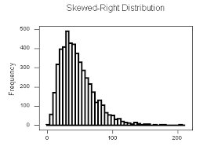
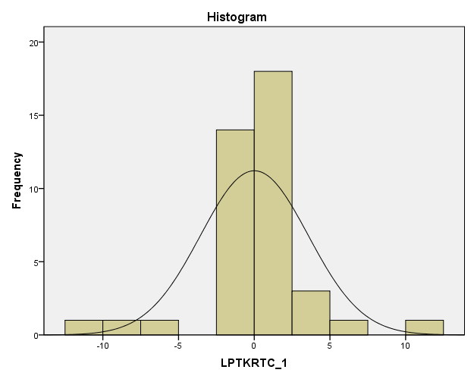
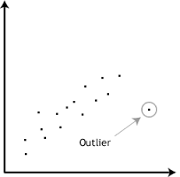
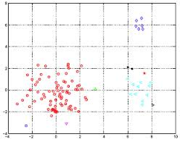
Skewness Kurtosis
Statistical inferences
Geographical inferences

Slide 20

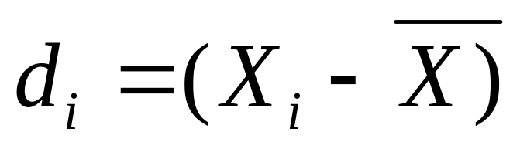
Geographical Statistics
Coefficient Variation: amount of variation in spatial patterns relative to the whole
Individual deviation
Notes:
An Introductino to Statistical Problem Solving in Geography, McGrew,Lembo, Monroe 3rd ed. Descriptive Problem Solving in Geography page 44-47

Slide 21
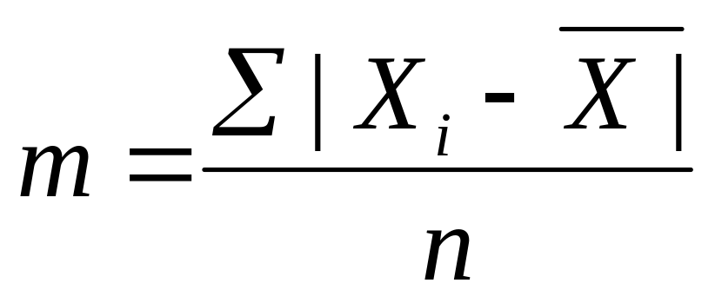
Geographical Statistics
Mean Deviation
Notes:
The mean deviation tells us far, on average, all values are from the mean.

Slide 22
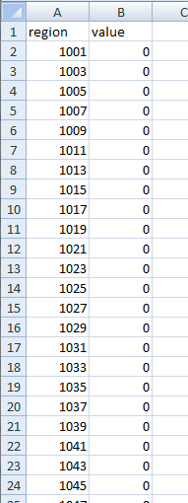
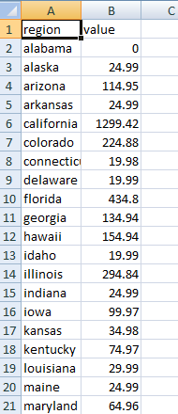
Data Structure
Example of imported table:
County table State table

Slide 23
Creating the map
Which map do you want to make and how many?
-Depends on what are you are analyzing
-Match series with Long/Lat, state and county FIPS code, or zip codes
Notes:
Make sure its in a format that be used easily. Don’t have too many colors.

Slide 24
Creating the map
Some examples using R- Map subdivision
  US map with state lines
  US map with county lines
  State map with county lines
  Maps with zip codes lines

Slide 25
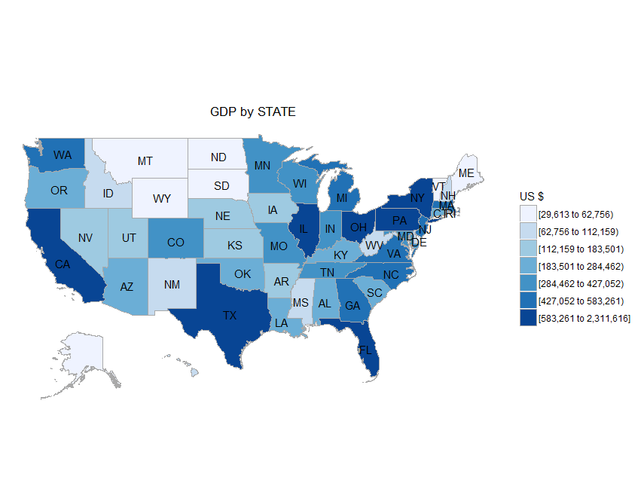
US national map state lines
Starter code:
library(choroplethr)
newdata<-read.csv("E:/COURSE_MATERIAL2/GEO_SPACE/BEA.csv")
state_choropleth(newdata, title = "GDP by STATE“, legend = "US $")

Slide 26
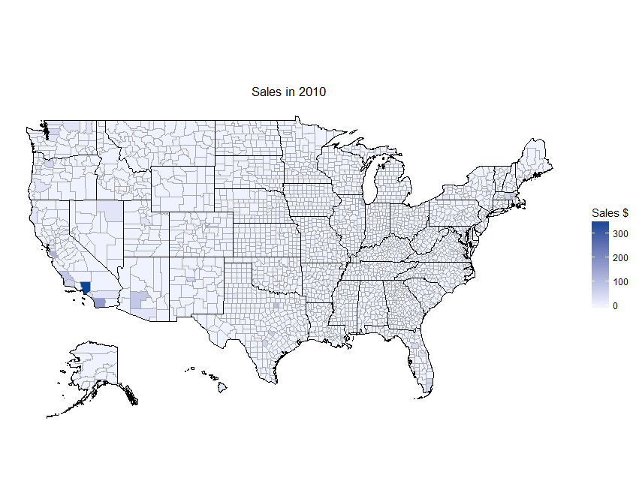
US national map county lines
Starter code:
newdata<-read.csv("E:/COURSE_MATERIAL2/GEO_SPACE/CTY_MAY_MAP_R.csv")
county_choropleth(newdata,title="Total Sales in May", legend="Sales $", num_colors=1)

Slide 27
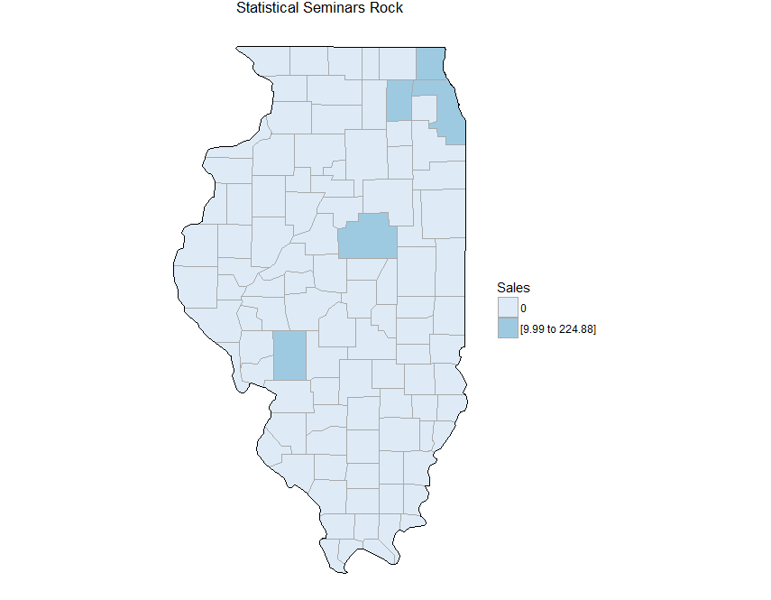
State Map and county lines
Starter code:
library(choroplethr)
newda2ta<-read.csv("E:/COURSE_MATERIAL2/GEO_SPACE/CTY_TOT_SALES_MAP_R.csv")
county_choropleth(newda2ta, state_zoom="illinois", title = "Statistical Seminars Rock",
legend = "Sales",)

Slide 28
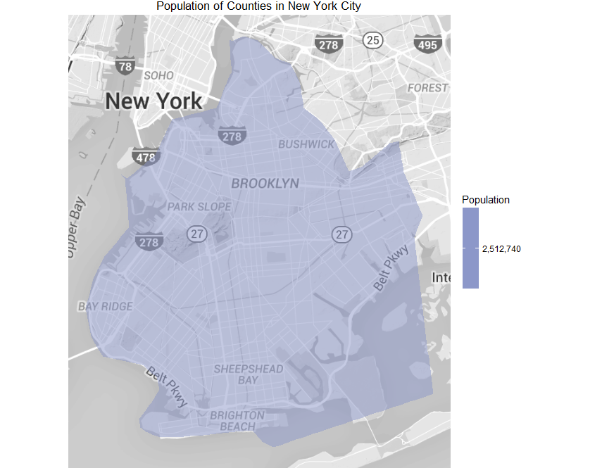
County map with Google ref
Starter code:
library(choroplethrMaps)
data(county.regions)
data(df_pop_county)
county_choropleth(df_pop_county,
title = "Population of Counties in New York City",
legend = "Population",
num_colors = 1,
county_zoom = 36047,
reference_map = TRUE)

Slide 29
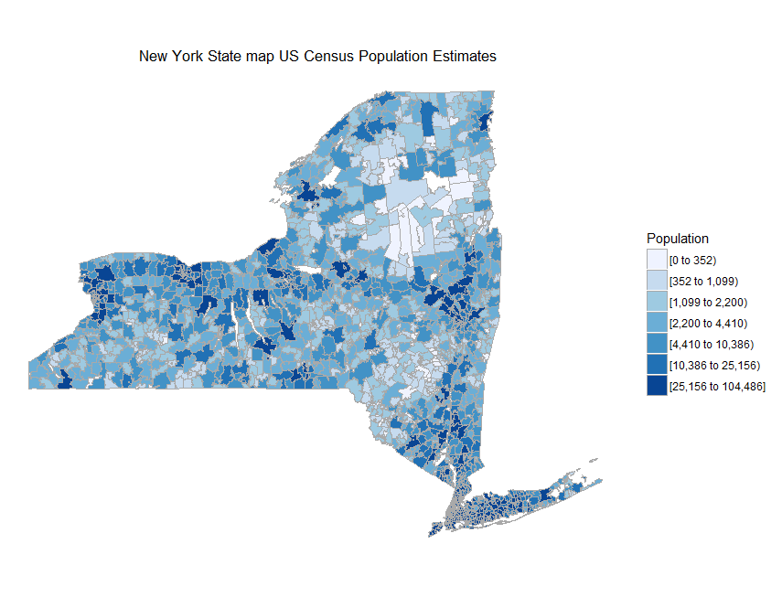
US state map zip code lines
Starter code:
library(devtools)
install_github('arilamstein/choroplethrZip@v1.4.0')
library(choroplethrZip)
data(df_pop_zip)
df_pop_zip
zip_choropleth(df_pop_zip,
state_zoom="new york",
title=" New York State map US Census Population Estimates",
legend="Population")

Slide 30
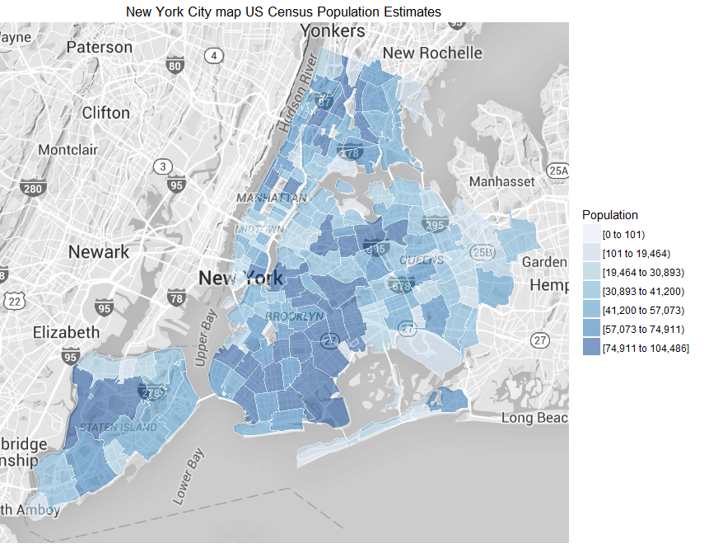
US county map with zip code lines and Google ref
Starter code:
library(devtools)
install_github('arilamstein/choroplethrZip@v1.4.0')
library(choroplethrZip)
data(df_pop_fips)
nyc_fips = c(36005, 36047, 36061, 36081, 36085)
zip_choropleth(df_pop_zip,
county_zoom=nyc_fips,
title="New York City map US Census Population Estimates",
legend="Population",
reference_map=TRUE)

Slide 31
Key Highlights
Outliers
Strange situations in certain areas
Notes:
For any branch of scientific analysis outliers can be/are |
the main point of interest. These values generate attention, |
influses dataset summary statistics, and redirects our researching effort |
and are worth investigating further. Identifing this situaitons in your anaylsis will |
make your report more valuable.

Slide 32
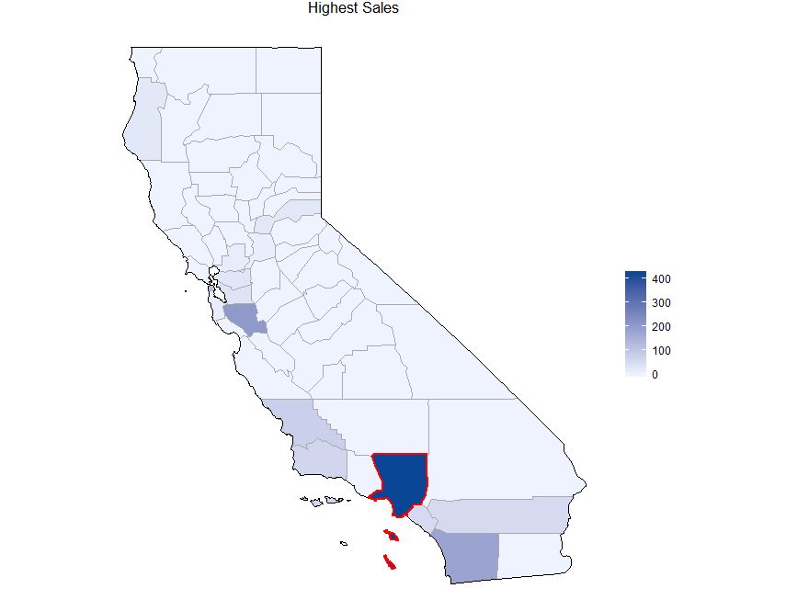
Outliers
Starter code (Ari):
library(ggplot2)
highlight_county = function(county_fips)
{
library(choroplethrMaps)
data(county.map, package="choroplethrMaps", envir=environment())
df = county.map[county.map$region %in% county_fips, ]
geom_polygon(data=df, aes(long, lat, group = group), color = "red", fill = NA, size = 1)
}
library(ggplot2)
choro_outlier = county_choropleth(newda2ta, state_zoom="california", title="Highest Sales", num_colors=1) +
highlight_county(6037)

Slide 33
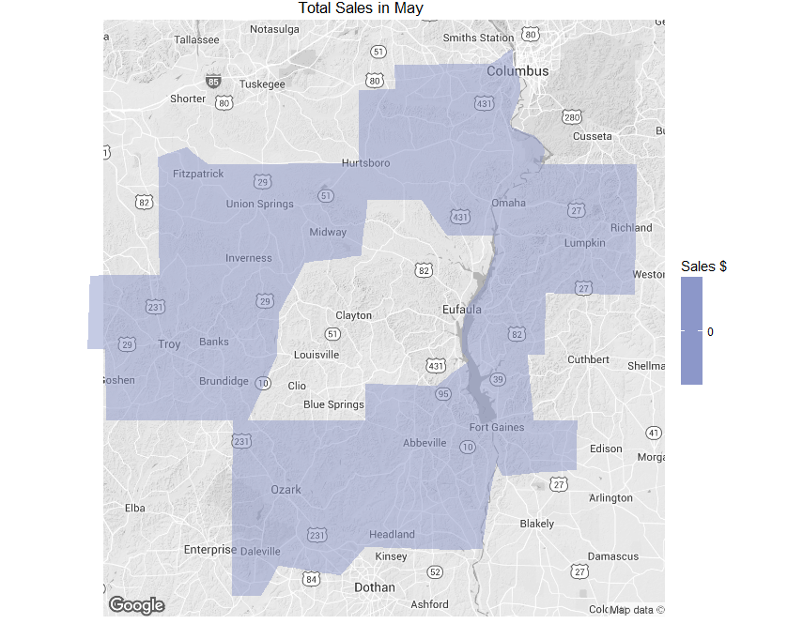
Adjacent Counties Analysis
Go to US Census site official list adjacent counties
Starter code:
n_fips = c(1011, 1045, 1067, 1109, 1113,13061,13239,13259)
county_choropleth(newdata, county_zoom= n_fips, title="Total Sales in May", legend="Sales $", num_colors=1,
reference_map = TRUE)

Slide 34
Spatial Autocorrelation
Measures the degree of areas associated data values tendency to be clustered together
First Law of Geography (Tobler’s Law): everything depends on everything else, but closer things more so

Slide 35
Spatial autocorrelation
Global measures of analysis
Local measures of analysis

Slide 36
Spatial autocorrelation
** TECHNICAL NOTE**
If using the spdep package coordinates needs to be converted first to neighbors list [nb] then to spatial weight [listw]- (Anselin)

Slide 37
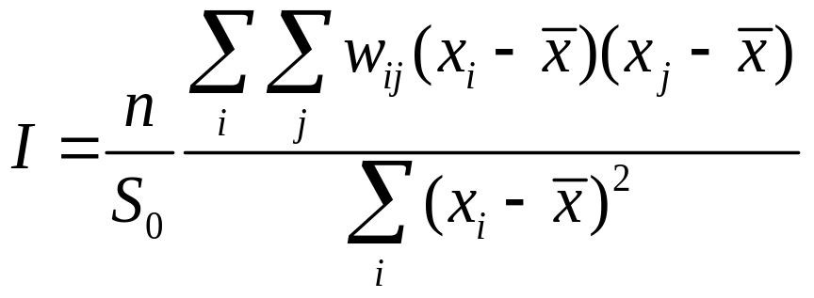
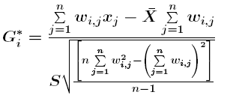
Global Spatial Autocorrelation
Identify and measure the whole area examined and doesn’t describe individual subsections (Murack)
Cluster analysis (Moran I)
Hot spot analysis (GETIS-ORD Gi*)
Notes:
Measures the degree of spatial autocorrelation in set of geographical areas including the statistics being examined (Gunaratna, Liu, Park).
There is a Greay C’s statistics which is similar to Moran I but it has been proving the Moran I has more power

Slide 38
Global Spatial Autocorrelation
Cluster analysis (Moran I)
Hot spot analysis (GETIS-ORD Gi*)
moran.test(newdata3$Av8top,nb2listw(boi))
#OUTPUT:
Moran I test under randomisation
data: newdata3$Av8top
weights: nb2listw(boi)
Moran I statistic standard deviate = 2.24, p-value = 0.01255
alternative hypothesis: greater
sample estimates:
Moran I statistic Expectation Variance
0.2314795 -0.1111111 0.0233917
globalG.test(newdata3$Av8top,nb2listw(boi, style="B"))
#OUTPUT:
Getis-Ord global G statistic
data: newdata3$Av8top
weights: nb2listw(boi, style = "B")
standard deviate = -0.94197, p-value = 0.8269
alternative hypothesis: greater
sample estimates:
Global G statistic Expectation Variance
0.502741777 0.533333333 0.001054695
Notes:
Read the p-value and index. Moran I interpretation the test is not significant and is slightly positively correlated.

Slide 39
Local Indicators of Spatial Autocorrelation
Analyzes the specific areas within a group
Cluster analysis (Moran I)
Hot spot analysis (GETIS-ORD Gi*)

Slide 40
Local Indicators of Spatial Autocorrelation
Moran I
localmoran(newdata3$Av8top,nb2listw(boi))
#OUTPUT:
Ii E.Ii Var.Ii Z.Ii Pr(z > 0)
1 -0.09693758 -0.1111111 0.14710649 0.03695407 0.485260815
2 -0.00270023 -0.1111111 0.06653806 0.42027912 0.337140783
3 0.76302485 -0.1111111 0.14710649 2.27909835 0.011330610
4 0.21848568 -0.1111111 0.22767493 0.69075713 0.244859089
5 0.09329253 -0.1111111 0.22767493 0.42838181 0.334186583
6 0.64928782 -0.1111111 0.09876543 2.41957458 0.007769337
7 0.11005317 -0.1111111 0.04351851 1.06017607 0.144532253
8 0.08226948 -0.1111111 0.04351851 0.92699178 0.176965402
9 -0.22974551 -0.1111111 0.04351851 -0.56868747 0.715215874
10 0.72776515 -0.1111111 0.38881179 1.34532804 0.089259662
attr(,"call")
localmoran(x = newdata3$Av8top, listw = nb2listw(boi))
attr(,"class")
[1] "localmoran" "matrix"

Slide 41
Local Indicators of Spatial Autocorrelation
GETIS-ORD Gi*
localG(newdata3$Av8top,nb2listw(boi))
#OUTPUT:
[1] 0.06782567 -0.05793132 -1.98996426 0.65987906 0.82076260 -2.13377740
[7] -1.61158181 -1.00055525 -1.78151210 1.12463577
attr(,"gstari")
[1] FALSE
attr(,"call")
localG(x = newdata3$Av8top, listw = nb2listw(boi))
attr(,"class")
[1] "localG"

Slide 42
L.I.S.A
These statistics can make analysis more valuable when using maps and spatial data
More information can be derived which can bring about more discoveries

Slide 43
MORE TO EXPLORE !!!!!

Slide 44
?

Slide 45
Recap
Approaching analysis building-hypothesis
Finding/fixing data
New interpretations of statistical measures
Creating Maps
Using geographical statistics to create new analysis

Slide 46
Announcements
Survey- your feedback is welcomed
End of program but there is more to come!!
April 18th –DC2 Digital Nomads 8pm
“How data is made and tips to find it. “
Notes:
Events at:
Datacommunitydc.org
Washingtonstatisticalsoceity.org

Slide 47


Special Thanks
Washington Statistical Society
http://washingtonstatisticalsociety.org/
Data Community DC
http://www.datacommunitydc.org/

Slide 48
Special Thanks
Ari Lamstein- choroplethr package

