Slide 1


BEN LABASCHIN
Agent Memory
From a timeout to a managed commitment.
How evidence becomes durable, revisable guidance.
THE STORY IN THREE MOVES
01
FAIL
02
ROUTE
03
GOVERN
ambiguous timeout
trusted evidence
managed commitment
Head of AI and Engineer @ Workhelix · O’Reilly Author · econoben.dev
Notes:
By the end, engineers should be able to trace one piece of information from an ambiguous operation, through trustworthy organizational evidence and an explicit retention decision, to a governed memory whose effect on later action can be measured.
Planned time: 1:00
I want to start with a timeout—not with an architecture diagram or a definition of memory.
A timeout forces an agent to act under uncertainty: what happened, what evidence should it trust, what should it do next, and should anything from this encounter survive?
Over the next half hour, we will follow one purchasing incident from a duplicate charge to a future agent that behaves correctly because the right evidence survived.
“Managed commitment” is my shorthand for this talk: carrying information forward commits the system to what future work may rely on. It is a synthesis for today, not a formal definition from the book.
Transition: Before we follow that incident, a quick introduction.

Slide 2


ABOUT ME
I’m Ben Labaschin.
ENGINEER
AUTHOR
Head of AI and Engineering @ Workhelix.
I build stateful systems where models, tools, data, and evidence work together.
Author of Agent Memory for O’Reilly
A practical guide to agents that remember, adapt, and work across time.
I focus on memory, retrieval, lifecycle policy, and governed adaptation. · econoben.dev
AGENT MEMORY
02
Notes:
By the end, engineers should be able to trace one piece of information from an ambiguous operation, through trustworthy organizational evidence and an explicit retention decision, to a governed memory whose effect on later action can be measured.
Planned time: 0:30
I’m Ben Labaschin. I’m a Head of AI and Engineering AI / ML Engineer, and I’m writing *Agent Memory* for O’Reilly.
My work sits where models meet tools, data, state, and the operational systems around them. I’m especially interested in agents that need to remember across boundaries without becoming opaque or ungovernable.
This talk distills the learning arc across the first three chapters into one incident we can follow end to end.
Transition: So let’s look at the smallest plausible fix—and why it is wrong.

Slide 3

ABOUT ME
Agent Memory Early Release
Notes:
By the end, engineers should be able to trace one piece of information from an ambiguous operation, through trustworthy organizational evidence and an explicit retention decision, to a governed memory whose effect on later action can be measured.
Planned time: 0:30
I’m Ben Labaschin. I’m a Head of AI and Engineering AI / ML Engineer, and I’m writing *Agent Memory* for O’Reilly.
My work sits where models meet tools, data, state, and the operational systems around them. I’m especially interested in agents that need to remember across boundaries without becoming opaque or ungovernable.
This talk distills the learning arc across the first three chapters into one incident we can follow end to end.
Transition: So let’s look at the smallest plausible fix—and why it is wrong.

Slide 4

A Vendor Timeout
Something Is Off…
The code has symptoms…
def submit_purchase(order_id: str, payload: dict) -> VendorResponse:
response = http_client.post(
"https://buythings.important_vendor.com/purchases",
json=payload,
timeout=2.0,
)
response.raise_for_status()
return VendorResponse.from_json(response.json())
1. It returns a timeout
2. It’s deceptively simple
3. No Error Logs
AGENT MEMORY
03
Notes:
By the end, engineers should be able to trace one piece of information from an ambiguous operation, through trustworthy organizational evidence and an explicit retention decision, to a governed memory whose effect on later action can be measured.
Planned time: 1:15
Here is the fix almost every engineer has either written or reviewed: call the purchasing API; if it times out, try again.
It looks responsible. The request did not return. We have a retry budget. The purchase is important. So we make a second call.
But notice what the code assumes. It treats “I did not receive a response” as equivalent to “the operation did not happen.” Those are not the same statement.
With a read, the distinction may be annoying. With a billable write, it is dangerous. The server may have accepted the purchase, committed it, and then lost the response somewhere between the service and the caller. Our agent sees uncertainty. The vendor may already see a successful charge.
The interesting failure is not that the model lacks intelligence. The code has given it an impoverished action space: success, known failure, or retry. It has no durable operation identity and no way to reconcile an ambiguous result.
Transition: That turns one missing response into two real charges.

Slide 5
THE PLAUSIBLE FIX
The fix looks right.
What does the timeout tell us?
def submit_purchase(order_id, payload):
for attempt in range(3):
try:
return post("/purchases", json=payload, timeout=2.0)
except TimeoutError:
if attempt == 2: raise
continue
Retry budget
Three attempts. Bounded timeout.
Familiar pattern
Reads often tolerate this.
Missing state
A billable write may already have committed.
AGENT MEMORY
03
Notes:
By the end, engineers should be able to trace one piece of information from an ambiguous operation, through trustworthy organizational evidence and an explicit retention decision, to a governed memory whose effect on later action can be measured.
Planned time: 1:15
Here is the fix almost every engineer has either written or reviewed: call the purchasing API; if it times out, try again.
It looks responsible. The request did not return. We have a retry budget. The purchase is important. So we make a second call.
But notice what the code assumes. It treats “I did not receive a response” as equivalent to “the operation did not happen.” Those are not the same statement.
With a read, the distinction may be annoying. With a billable write, it is dangerous. The server may have accepted the purchase, committed it, and then lost the response somewhere between the service and the caller. Our agent sees uncertainty. The vendor may already see a successful charge.
The interesting failure is not that the model lacks intelligence. The code has given it an impoverished action space: success, known failure, or retry. It has no durable operation identity and no way to reconcile an ambiguous result.
Transition: That turns one missing response into two real charges.

Slide 6

THE INCIDENT
The timeout did not mean failure.
01
→
02
→
03
→
04
Request accepted
Response lost
Blind retry
Duplicate charge
The vendor commits the charge.
The agent observes only a timeout.
A fresh request repeats the operation.
The observation was ambiguous. The side effect was not.
A missing response is evidence about the network—not proof about the write.
AGENT MEMORY
04
Notes:
By the end, engineers should be able to trace one piece of information from an ambiguous operation, through trustworthy organizational evidence and an explicit retention decision, to a governed memory whose effect on later action can be measured.
Planned time: 1:30
Walk from left to right with me.
The agent sends the first purchase request. The service accepts it and commits the charge. The response is lost, so the agent observes a timeout. Then the retry path creates a fresh request, often with a fresh identifier, and the service accepts that one too.
The agent can honestly report, “I only saw one success.” The customer can equally honestly report, “I was charged twice.”
This is the first important idea in the talk: an agent’s observation is not the world. A timeout is evidence about the communication path. It is not proof about the state transition on the other side.
Once we say that clearly, “retry” stops being the complete solution. We need a stable identity for the purchase intent so both attempts refer to the same operation. And after an ambiguous outcome, we need reconciliation: inspect authoritative state before deciding whether another side effect is safe.
That engineering correction matters immediately. But we are not at memory yet. Right now, we have changed one execution path.
Transition: The next question is whether the corrected harness changes what the same model can do.

Slide 7

SAME MODEL · DIFFERENT HARNESS
The harness changes the safe action.
BLANK-SLATE
MEMORY-CAPABLE
New request.
Reuse the intent.
Retry after timeout.
Reconcile before retry.
→
Fresh key each attempt
No state reconciliation
Duplicate charge possible
Stable idempotency key
Authoritative state check
One intended purchase
Same model. Different state, evidence, and tools.
AGENT MEMORY
05
Notes:
By the end, engineers should be able to trace one piece of information from an ambiguous operation, through trustworthy organizational evidence and an explicit retention decision, to a governed memory whose effect on later action can be measured.
Planned time: 1:30
Keep the model fixed. Do not make it larger, fine-tune it, or give it a more elaborate persona.
On the left, the harness generates a new request identity for each attempt and treats a timeout as a reason to call again. On the right, the harness preserves the purchase intent’s idempotency key and knows that an ambiguous timeout requires reconciliation before retry.
That difference is not hidden inside model weights. It lives in the system around the model: operation identity, recorded state, retrieval, tools, and policy.
This is why I resist describing agent memory as a feature that means “the chat remembers things.” The more useful question is: what information can the whole agent system carry across a boundary, and how does that information change the next action?
The boundary may be a tool call, a turn, a workflow, a session, or a week later. If the correction is present only in the current prompt, it may help now. If it is represented durably and retrieved under the right conditions, it can change future behavior.
Transition: That gives us the cleanest distinction between context and memory.

Slide 8
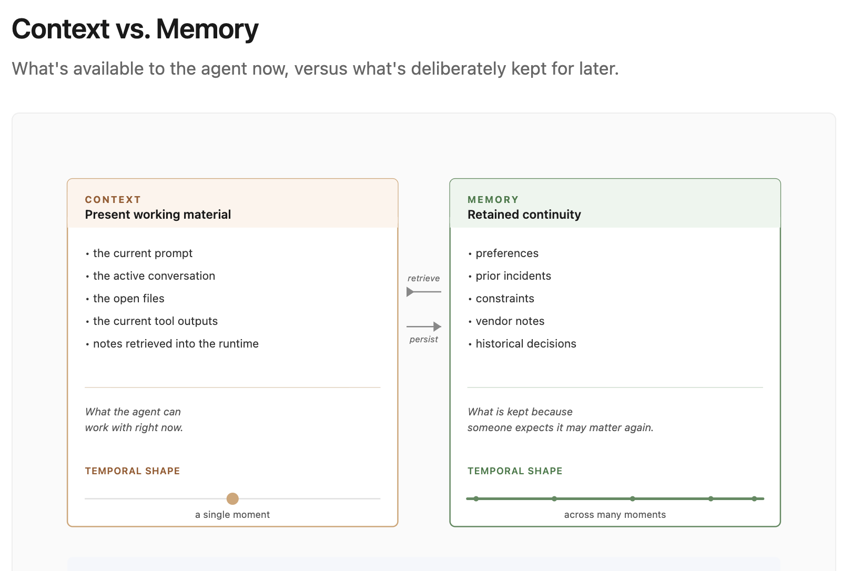
CHAPTER 1 · FIGURE 1-1
Context disappears. Memory is carried.
CONTEXT
Available to the model now—then rebuilt.
MEMORY
Deliberately retained so it can affect later work.
HARNESS
Persistence and retrieval move evidence across boundaries.
AGENT MEMORY
06
Notes:
By the end, engineers should be able to trace one piece of information from an ambiguous operation, through trustworthy organizational evidence and an explicit retention decision, to a governed memory whose effect on later action can be measured.
Planned time: 1:15
This figure from Chapter 1 draws the boundary simply.
Context is the information available to the model for the current inference. It can be rich, accurate, and extremely useful—and still disappear when the window is rebuilt.
Memory is not defined by being old, and it is not defined by sitting in a vector database. Memory is information that the agent system deliberately carries across a boundary so it can affect later work.
That means memory can be implemented in several places: state, records, summaries, facts, procedures, files, graphs, or another durable substrate. The implementation matters, but it comes after the behavioral question: what should survive, and what future decision is it supposed to support?
In our incident, the stable idempotency rule is useful. But calling it useful does not tell us where it came from, whether it is authoritative, or whether it deserves to become durable guidance.
Transition: Before we save evidence, we have to know how it earned a place in the agent’s view of the world.

Slide 9
THE EVIDENCE PATH
The useful answer was already in four places.
01
→
02
→
03
→
04
Vendor docs
Incident + RCA
Current runbook
Engineer correction
Define idempotency and billable semantics.
Explain the duplicate charge and lost response.
Assigns reconciliation and operational scope.
Makes the stable-key rule explicit.
Different sources support different claims; access is not authority.
AGENT MEMORY
07
Notes:
By the end, engineers should be able to trace one piece of information from an ambiguous operation, through trustworthy organizational evidence and an explicit retention decision, to a governed memory whose effect on later action can be measured.
Planned time: 1:00
The agent does not discover the correction from nowhere.
The vendor documentation may define how idempotency works. An incident record may show the duplicate-charge failure. The root-cause analysis may explain the lost response. The current runbook may assign reconciliation responsibility. And an engineer may clarify the exact rule during the interaction.
These sources are not interchangeable. They have different authority, scope, freshness, and relationship to deployed truth. A ticket can document what happened without defining what should happen. A runbook can govern current procedure without proving that every deployment already conforms. A user statement can be immediately useful without being globally authoritative.
So before “memory” is a storage question, it is an evidence-routing question.
Transition: Chapter 2 gives that evidence a path into the agent.

Slide 10
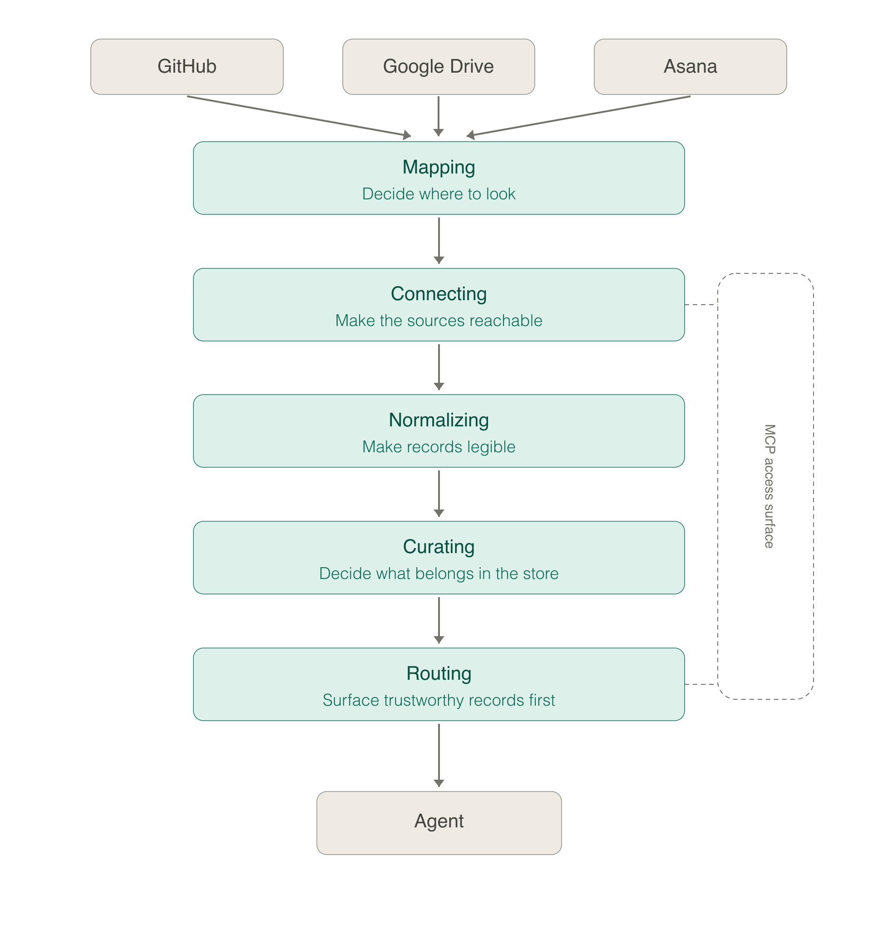
CHAPTER 2 · FIGURE 2-1
Five layers turn sources into usable evidence.
ACCESS
Mapping and connecting make organizational records reachable.
GOVERNANCE
Normalization and curation attach comparable meaning, scope, and authority.
USE
Routing selects the evidence that belongs in this task now.
AGENT MEMORY
08
Notes:
By the end, engineers should be able to trace one piece of information from an ambiguous operation, through trustworthy organizational evidence and an explicit retention decision, to a governed memory whose effect on later action can be measured.
Planned time: 1:45
This is the Chapter 2 system design, and it is doing more than ingestion.
First, connectors make a source reachable. Then normalization gives unlike records a common envelope without pretending they are semantically identical. Methodology captures how to interpret the source: what kind of record it is, which authority applies, what time semantics matter, and what claims it can legitimately support. Routing decides where the evidence can be used.
The important movement is from raw access to governed use.
Suppose the agent can search the purchasing team’s repository. That tells us the runbook is reachable. It does not tell us that an obsolete version is admissible as current guidance. Suppose the latest runbook is admissible. It still may not be relevant to this endpoint or operation. The layers keep those decisions separate so “search found a document” does not silently become “the agent may act on this claim.”
This pipeline is what allows organizational evidence to constrain the agent instead of merely decorating its prompt.
And it sets up the next boundary: Chapter 2 can route an authoritative record into the current task. Chapter 3 asks whether something encountered in that work deserves its own durable representation.
Transition: Those gates sound similar, but collapsing them is how weak evidence becomes confident memory.

Slide 11
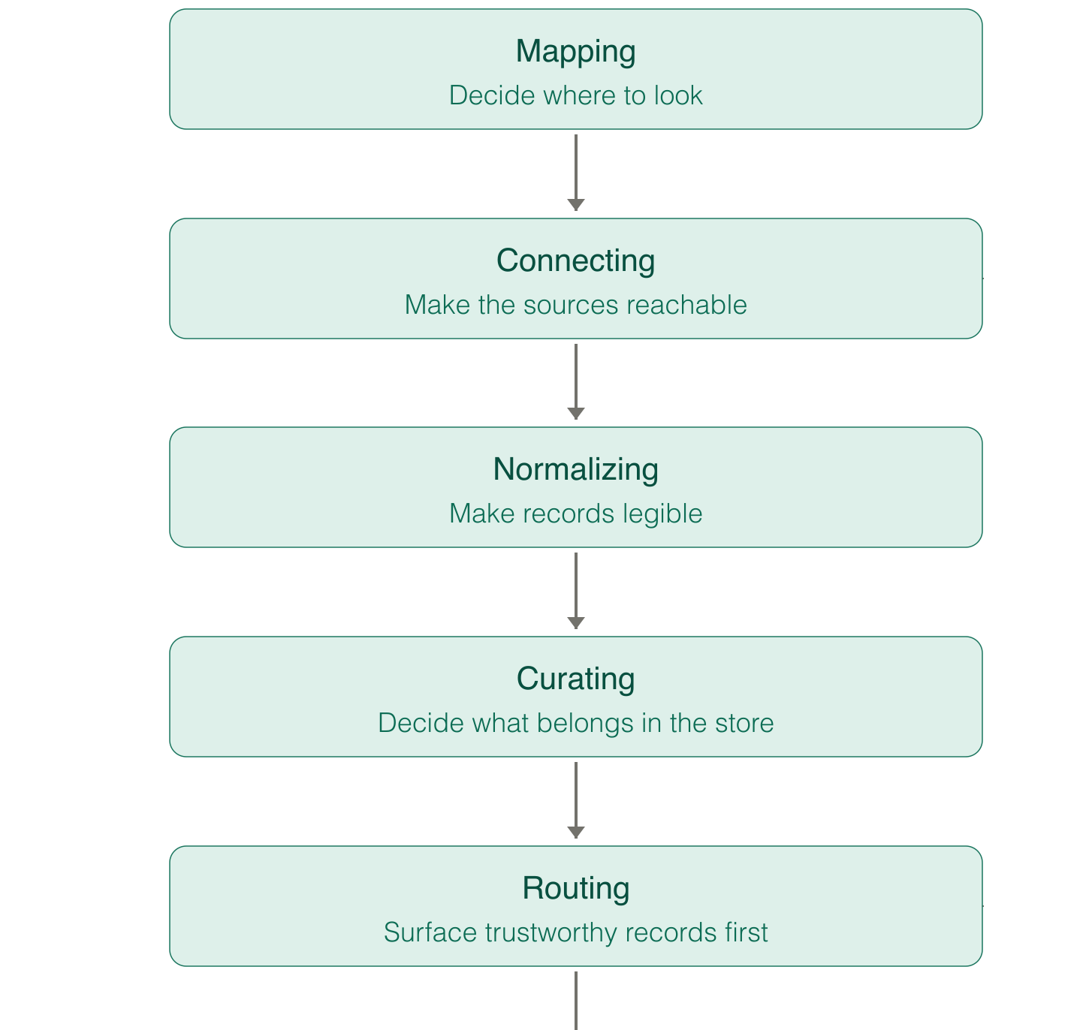
THREE DISTINCT GATES
Reachable is not admissible. Admissible is not relevant.
REACHABLE
Can the system query this source?
ADMISSIBLE
Does the record satisfy the store’s methodology and authority rules?
RELEVANT
Does it belong in this billing decision? A CI retry ticket does not.
AGENT MEMORY
09
Notes:
By the end, engineers should be able to trace one piece of information from an ambiguous operation, through trustworthy organizational evidence and an explicit retention decision, to a governed memory whose effect on later action can be measured.
Planned time: 1:30
Here is the same pipeline with the decision points made explicit.
Reachability asks whether the system can access a record. Admissibility asks whether that record is allowed and fit to support this kind of decision. Relevance asks whether the content bears on this operation now.
Imagine search returns a highly ranked ticket about retrying a flaky CI job. It contains “timeout,” “retry,” and “failure.” It may be perfectly reachable. It may even be admissible as an internal engineering record. It is not relevant evidence for whether a purchase call is safe to repeat.
These distinctions keep provenance attached to claims. They also prevent the memory layer from laundering weak evidence. If a source cannot justify the claim at use time, storing a polished summary of it does not make the claim stronger.
By the time the agent answers the purchasing question, it has vendor semantics, current runbook guidance, and incident evidence in view. Then the engineer adds one sentence that makes the operational correction precise.
Transition: That sentence is where the memory-selection problem begins.

Slide 12

THE CORRECTION
“
Purchase calls must reuse the purchase intent’s idempotency key.
Engineer clarification · checked against vendor semantics and the current runbook
Useful now. Not automatically entitled to persist.
AGENT MEMORY
10
Notes:
By the end, engineers should be able to trace one piece of information from an ambiguous operation, through trustworthy organizational evidence and an explicit retention decision, to a governed memory whose effect on later action can be measured.
Planned time: 1:15
The engineer tells the agent: “Purchase calls must reuse the purchase intent’s idempotency key. Generating a new key for each attempt defeats the protection.”
That is immediately actionable. It explains why the naive fix failed and what a correct retry path must preserve.
But immediate usefulness is not automatic permission to persist.
We still have to ask: Is this person authoritative for the purchasing service? Is the statement local to this endpoint or broadly true? Does it reflect deployed behavior, intended behavior, or both? Is the right durable object a fact, a record of the correction, a procedure, or a link back to the governing runbook? What later evidence would revise or supersede it?
The interaction has produced a candidate. A candidate is not yet a memory. That gap is where memory systems need an explicit decision instead of an automatic “save everything useful” reflex.
Transition: So I want to make that decision uncomfortable for a moment.

Slide 13

AUDIENCE DECISION
Would you save this?
01
USE NOW
Apply to this task.
02
PROPOSE
Open a candidate.
03
COMMIT
Create durable memory.
Useful now ≠ entitled to persist.
AGENT MEMORY
11
Notes:
By the end, engineers should be able to trace one piece of information from an ambiguous operation, through trustworthy organizational evidence and an explicit retention decision, to a governed memory whose effect on later action can be measured.
Planned time: 1:30
Quick show of hands: which action would you take with that sentence—use it for this task, propose it as a candidate, or create durable memory now?
There is no trick answer. Immediate use is the smallest claim: the correction is relevant to this decision. A candidate says the correction may deserve future work, but still needs a retention decision. Creating durable memory is the strongest claim, and it should require corroboration, explicit scope, provenance, and the right authority.
What I do not want is an invisible answer. If the system saves the statement, it should be able to explain who proposed it, what evidence supported it, what future work it is intended to change, and what would reopen the decision.
Every saved memory is a forecast: we are predicting that carrying this representation forward will create more value than confusion, retrieval cost, staleness risk, and maintenance burden.
We cannot see the complete future trace when we make that choice. So we need an explicit decision record, not the fiction of certainty.
Transition: And one sentence may imply more than one kind of future work.

Slide 14
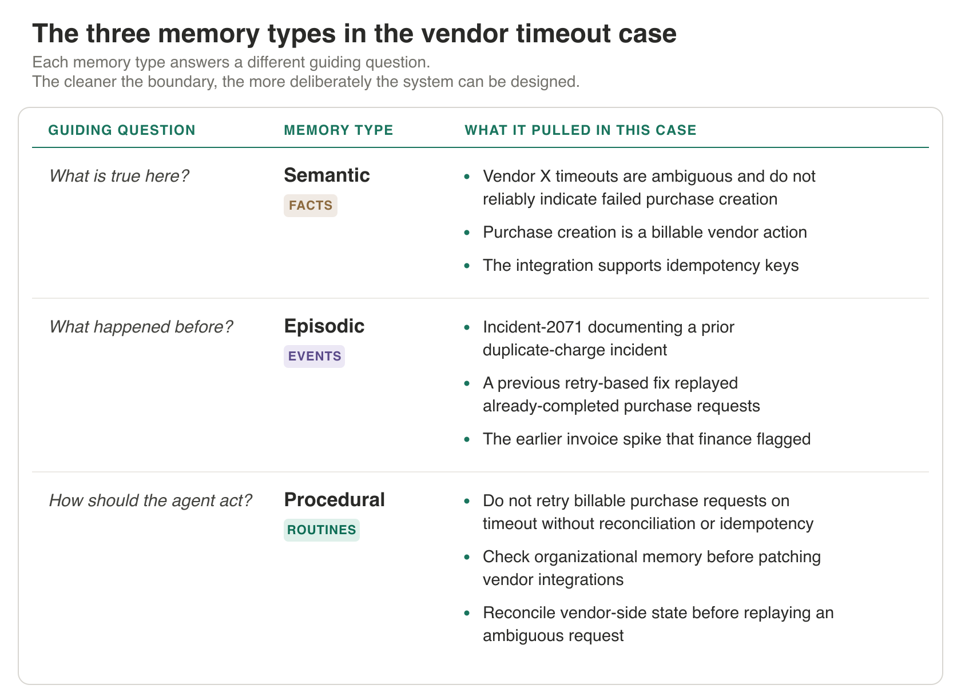
CHAPTER 1 · TABLE 1-1
One encounter creates three candidates.
SEMANTIC
Stable-key reuse is required.
EPISODIC
An engineer corrected the retry assumption.
PROCEDURAL
Reconcile an ambiguous purchase before retrying.
AGENT MEMORY
12
Notes:
By the end, engineers should be able to trace one piece of information from an ambiguous operation, through trustworthy organizational evidence and an explicit retention decision, to a governed memory whose effect on later action can be measured.
Planned time: 1:30
The interaction can produce three different candidates.
A semantic candidate carries the durable claim: purchase attempts for one intent reuse the same idempotency key.
An episodic candidate preserves what happened: during this incident, an engineer corrected the agent’s assumption. That can matter for provenance, review, or learning from a failure.
A procedural candidate carries the action sequence: after an ambiguous timeout, reconcile authoritative purchase state before another billable attempt.
These are not three copies of the same sentence. They have different future-use contracts. The semantic memory supports explanation and reasoning. The episode supports provenance and incident learning. The procedure supports execution.
And we may not retain all three independently. If the episode adds no continuing value beyond its sourced correction, it may remain as provenance rather than a frequently retrieved memory. If the procedure is already governed by the runbook, the right action may be to link or update rather than create a competing instruction.
The source tells us where information came from. The memory type tells us what future work the retained representation must perform.
Transition: To make that operational, the write path needs three explicit objects.

Slide 15

THE WRITE PATH
A saved memory is a forecast.
Durable memory begins only when a future-use claim survives an explicit decision.
01
MemoryCandidate
→
02
RetentionDecision
→
03
ManagedMemory
Proposed content + future job
Policy + authority decide
Owned, versioned, revisable
What future job?
Should policy commit?
Who will maintain it?
Candidates remain inactive until the decision materializes them.
PROPOSE · DECIDE · OWN
AGENT MEMORY
13
Notes:
By the end, engineers should be able to trace one piece of information from an ambiguous operation, through trustworthy organizational evidence and an explicit retention decision, to a governed memory whose effect on later action can be measured.
Planned time: 1:30
The first object is the MemoryCandidate. It preserves the proposed content, provenance, scope, and the future job we think it might support.
The second is the RetentionDecision. This is where the system records the action—retain, reject, link, defer, or another bounded choice—and why. It should not disappear after a boolean write gate.
The third is the ManagedMemory: the durable representation plus the information needed to govern it later. That includes its sources, validity and scope, intended use, current status, and the events that should reopen the decision.
Different systems can allocate proposal, decision, and materialization differently. An agent may edit memory directly. An extractor may propose additive facts. An episode-first system may derive durable claims later. Those are composable write-path patterns, not mutually exclusive product categories.
The durable point is simpler: someone or something proposes; an explicit policy decides; a bounded write path materializes; later evidence has a declared way to change the result.
This is where the talk’s “managed commitment” shorthand becomes useful. Saving a memory is a commitment to carry a claim or procedure forward—but a well-designed system also commits to revisiting it.
Transition: Selection is not the end of memory management. It starts the lifecycle.

Slide 16
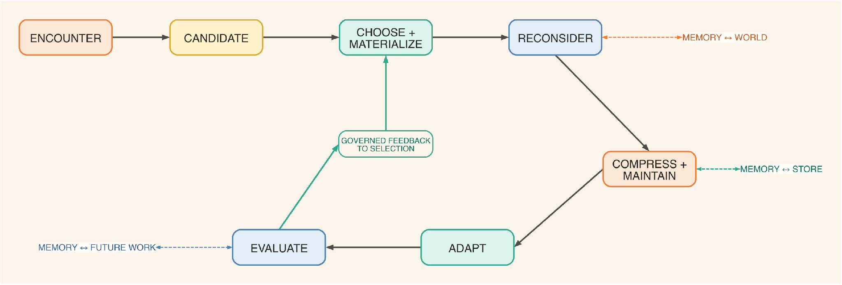
CHAPTER 3 · PROPOSED FIGURE 3-1
Selection starts a lifecycle.
World, store, and future work keep reopening the commitment.
AGENT MEMORY
14
Notes:
By the end, engineers should be able to trace one piece of information from an ambiguous operation, through trustworthy organizational evidence and an explicit retention decision, to a governed memory whose effect on later action can be measured.
Planned time: 1:45
This loop is the core of Chapter 3.
The system encounters information, identifies a candidate, chooses whether and how to materialize it, and then keeps making decisions as evidence changes. It may reconsider the memory, compress or maintain a derived representation, adapt the policy, evaluate the effect, and feed governed evidence into the next selection decision.
Three relationships create pressure on the loop.
Memory to world: deployed behavior or organizational reality changes, so a memory may become stale or false.
Memory to store: corroborating, duplicative, or contradictory evidence changes whether this memory should remain independent.
Memory to future work: usefulness changes relative to retrieval, reasoning, storage, and maintenance cost.
That three-part grouping is a synthesis for the chapter, not an external named taxonomy. It helps us ask a better question than “How important is this memory?” We can ask what relationship changed, which action is justified, and which evidence must survive.
The loop also makes evaluation causal. Evaluation is not a report card at the end. It creates governed evidence that may change future selection—but only through the same decision and activation discipline.
Transition: Now let’s put new evidence into the loop and watch three memories diverge.

Slide 17

ONE EVENT · THREE ACTIONS
Then the runbook changes.
01
02
03
CONSOLIDATE
DEMOTE
SUPERSEDE
Semantic fact
The new source corroborates the stable-key rule.
Correction episode
History stays true; independent retrieval value falls.
Old procedure
A replacement now governs current action.
Same event. Different lifecycle actions.
AGENT MEMORY
15
Notes:
By the end, engineers should be able to trace one piece of information from an ambiguous operation, through trustworthy organizational evidence and an explicit retention decision, to a governed memory whose effect on later action can be measured.
Planned time: 1:15
Later, VIC’s governing purchase-service runbook changes.
The same event should not produce the same operation on every memory.
The stable-key fact gains authoritative corroboration. The system can consolidate or link it with the governing source.
The engineer-correction episode remains historically true, but its independent retrieval value declines once the corrected rule is captured elsewhere. The system can demote it while preserving provenance.
The old procedure is different. If it assigns reconciliation to the wrong component, retrieving it as current guidance could cause harm. That procedure should be superseded or invalidated, with a replacement link and a clear boundary on current use.
In the companion replay, this one runbook event deliberately produces CONSOLIDATE, DEMOTE, and SUPERSEDE. That is not a claim that these are the only available actions. It is a concrete demonstration that lifecycle policy should act on the memory’s role and current evidence, not apply one generic decay rule.
Transition: But how did the system know it was time to reconsider these memories?

Slide 18

TIME AS EVIDENCE
A retention horizon reopens the decision.
TTL
RETENTION HORIZON
Storage clock.
Decision trigger.
Expire after time.
Reopen the commitment.
→
Controls payload lifetime
Can remove without reconsideration
Useful for storage hygiene
Governing source changes
Contradiction or redundancy
Use-and-cost evidence
One manages duration. The other schedules judgment.
AGENT MEMORY
16
Notes:
By the end, engineers should be able to trace one piece of information from an ambiguous operation, through trustworthy organizational evidence and an explicit retention decision, to a governed memory whose effect on later action can be measured.
Planned time: 1:30
A TTL answers a storage question: how long should this object live before an expiration behavior fires?
A retention horizon answers a lifecycle question: what condition should reopen the decision?
That condition may be time, but it may also be a new version of a governing runbook, a contradiction from a higher-authority source, repeated evidence that a memory is redundant, or evidence that its future value no longer justifies its cost.
The distinction matters because elapsed time cannot tell us what changed. A memory can be old and still essential. A memory can be new and already wrong. A historically true episode may remain valid while becoming less useful to retrieve. A procedure may need immediate invalidation even if it was used successfully yesterday.
So the horizon is not an automatic deletion date. It is a trigger that brings the memory, current evidence, and available lifecycle actions back to the policy.
When we preserve that decision boundary, we can explain why the semantic fact was consolidated, the episode demoted, and the procedure superseded instead of saying that all three “expired.”
Transition: Once the decision is open, we still need a way to choose among actions.

Slide 19
A CONDITIONAL DECISION
Choose the action—not a memory score.
01
02
03
CONSTRAINTS
CURRENT EVIDENCE
SMALLEST ACTION
Is this action allowed?
Authority · validity · obligations
What changed?
World · store · future work
Smallest justified change.
Demote · consolidate
Supersede · delete
Signals rank options inside the constraints; they do not replace them.
AGENT MEMORY
17
Notes:
By the end, engineers should be able to trace one piece of information from an ambiguous operation, through trustworthy organizational evidence and an explicit retention decision, to a governed memory whose effect on later action can be measured.
Planned time: 1:45
Many systems assign a memory one importance score and let that number follow it forever. The problem is that a single scalar collapses different questions.
A false memory, a redundant memory, a historically true episode with declining retrieval value, and a rarely used but high-consequence procedure can all land on similar numbers for completely different reasons.
The chapter’s conceptual frame is utility(action | memory, current evidence). This is a synthesis, not a required production formula. The point is to evaluate the treatment under consideration: retain, demote, consolidate, suppress, supersede, delete, or something else the system explicitly supports.
Start with constraints. Governing authority, present validity, explicit invalidation, and binding retention or deletion obligations may rule actions in or out. Then consider softer proxies: recency, repetition, novelty, usage, likely task utility, consequence, reacquisition cost, and lifecycle cost.
Do not let the proxies impersonate constraints. Authority is not reliability. Recency is not truth. Frequency is not continuing value. Novelty is not automatically beneficial.
And preserve the reason. A future reviewer should be able to distinguish “demoted because duplicated by the current runbook” from “suppressed because out of scope” and “deleted because the payload may no longer be retained.”
Transition: That leads to a more precise vocabulary for forgetting.

Slide 20
THE REVISED RUNBOOK
Forgetting is not deletion.
MEMORY
ACTION
WHAT CHANGES
WHAT REMAINS
Semantic fact
Consolidate
Independent retrieval
Source-linked claim
Correction episode
Demote
Ranking priority
History + provenance
Old procedure
Supersede
Active authority
Replacement link
Deletion
Not used
—
No universal expiry
Remove the smallest property the decision requires.
AGENT MEMORY
18
Notes:
By the end, engineers should be able to trace one piece of information from an ambiguous operation, through trustworthy organizational evidence and an explicit retention decision, to a governed memory whose effect on later action can be measured.
Planned time: 1:30
When people say a memory system should forget, they often mean several different operations.
Demotion removes priority. Suppression removes visibility in a declared scope. Consolidation removes the need for an independent representation because another object carries the job. Invalidation removes current applicability. Supersession attaches a replacement. Deletion removes the payload itself.
These are not mandatory steps on a ladder. A dangerous procedure does not need to decay politely through five stages before becoming invalid. And a low-priority episode does not need to be destroyed if its provenance remains useful and permissible to keep.
The practical rule is: remove the smallest property the decision requires while preserving the evidence needed to explain or reverse the action—when policy allows that evidence to remain.
Hard deletion is its own scoped operation. If the same information exists in raw files, facts, graph relationships, vector representations, summaries, and caches, deleting one object is not proof that the system deleted the data. The propagation boundary has to be declared and verified.
Transition: The most common loss of independence is compression, and that creates a different risk.

Slide 21
COMPRESSION AS REPLACEMENT
Compression preserves the future job.
UNSAFE ROLLUP v0
VALIDATED REPLACEMENT v2
Shorter text.
Future-use contract.
Fails validation.
Controlled cutover.
→
Drops the EU exception
Blurs authority
Breaks claim-to-source lineage
Keeps the exception
Names dependencies
Carries a rebuild path
v2 becomes current; v1 remains historical.
AGENT MEMORY
19
Notes:
By the end, engineers should be able to trace one piece of information from an ambiguous operation, through trustworthy organizational evidence and an explicit retention decision, to a governed memory whose effect on later action can be measured.
Planned time: 1:30
VIC now has ten near-duplicate purchase-timeout records. Keeping every detail in the active working set is costly, so we want a derived memory.
The unsafe version produces a smooth generalization and drops the EU-endpoint exception. It is concise, readable, and wrong for one important slice. In the replay, that first rollup fails validation.
The safer version starts with a future-use contract. For this operational job, it must preserve the stable idempotency key, the distinction between an ambiguous timeout and a confirmed failure, service-owned reconciliation, the unresolved EU-endpoint exception, and claim-to-source lineage. Details outside that contract may be discarded or left in linked evidence.
When dependency evidence changes, the system creates a candidate replacement rather than silently mutating the active derived memory. The replay moves from an active version, through a validating candidate, to a controlled cutover in which the new version becomes current and the prior version becomes historical.
Compression quality is therefore not “How much shorter is it?” or even “How similar is it to the transcript?” The question is whether the representation preserves the decisions its declared future job requires.
Transition: We have managed the memory. Now we have to prove that any of this improved the agent’s work.

Slide 22
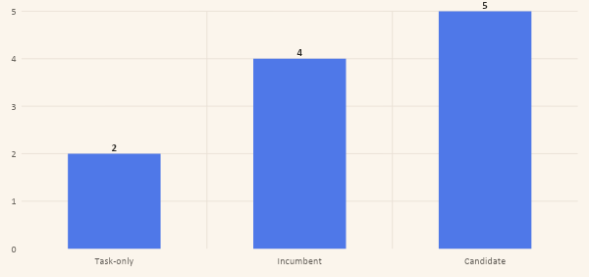
ILLUSTRATIVE OFFLINE REPLAY
Prove that remembering changed the action.
2 / 5 → 5 / 5
cases passed
Candidate: +0.2 cost vs incumbent
Direct source: 5/5 at cost 5.0
Activation: awaiting purchasing owner
Deterministic five-case replay · not a benchmark
AGENT MEMORY
20
Notes:
By the end, engineers should be able to trace one piece of information from an ambiguous operation, through trustworthy organizational evidence and an explicit retention decision, to a governed memory whose effect on later action can be measured.
Planned time: 2:00
An end-to-end success does not tell us that memory deserves credit.
We need to localize the path. Was the needed memory retained? Was it found? Did it survive ranking? Was it loaded? Did the action path actually use it? And compared with a credible alternative, did that use improve the work?
The first stages establish availability. “Used” needs an instrumented control path or a proportionate intervention, not just evidence that the text appeared in context. “Improved” needs a named comparison.
Here are the actual results from the companion example’s deterministic five-case offline replay. I want to label them very precisely: these are illustrative test results for the build-along. They are not a benchmark, production telemetry, or a claim that these numbers generalize.
The task-only arm passes two of five cases. The incumbent memory passes four. The candidate memory passes all five. Direct-source lookup also passes all five, but at a recorded cost of 5.0 cost units. The candidate adds 0.2 cost units relative to the incumbent.
Those comparisons answer different questions. Task-only tells us whether prior information mattered. Incumbent versus candidate isolates the proposed memory change in an established system. Direct-source lookup asks whether the managed layer earns its cost relative to consulting the complete relevant evidence.
The candidate passes the declared hard constraints. It still does not activate itself. The evaluation record remains governed evidence, and activation awaits the purchasing owner. A score can support a decision; it should not silently become permission to rewrite production policy.
Transition: With that evidence in hand, we can replay the opening timeout.

Slide 23
THE NEXT TIMEOUT
The next timeout ends differently.
01
→
02
→
03
→
04
Same intent
Same key
Reconcile first
One charge
The purchase keeps a stable operation identity.
A replay cannot create a second charge.
Check authoritative state before another write.
Return the confirmed purchase.
Route the evidence. Govern the lifecycle. Measure the action.
AGENT MEMORY
21
Notes:
By the end, engineers should be able to trace one piece of information from an ambiguous operation, through trustworthy organizational evidence and an explicit retention decision, to a governed memory whose effect on later action can be measured.
Planned time: 1:45
Return to the opening incident.
The next purchase attempt times out. This time, the harness carries the same purchase intent and the same idempotency key across the boundary. The agent does not infer failure from silence. It reconciles authoritative purchase state before deciding whether another attempt is safe.
The outcome is one intended charge—not because the model suddenly became wiser, but because the system carried the right evidence into the decision under an explicit policy.
That is the full movement of the talk.
Chapter 1 gives us the behavioral test: memory is information carried across a boundary that changes later work.
Chapter 2 gives evidence a governed path from source to use.
Chapter 3 asks which encountered information deserves durable representation, how later evidence changes it, what compression must preserve, and how we prove that remembering helped.
So if you take three questions back to your own agent system, make them these: What evidence are we carrying forward? Who or what is allowed to change it? And what comparison would show that it improved the next action?
Memory is not simply context that survived. It is evidence carried forward under a policy, revised when the world changes, and credited only when it makes the work better.
Landing: The next timeout is the proof. The agent reuses the stable key, reconciles before retry, and avoids the duplicate because the right evidence survived in a governable form.

Slide 24
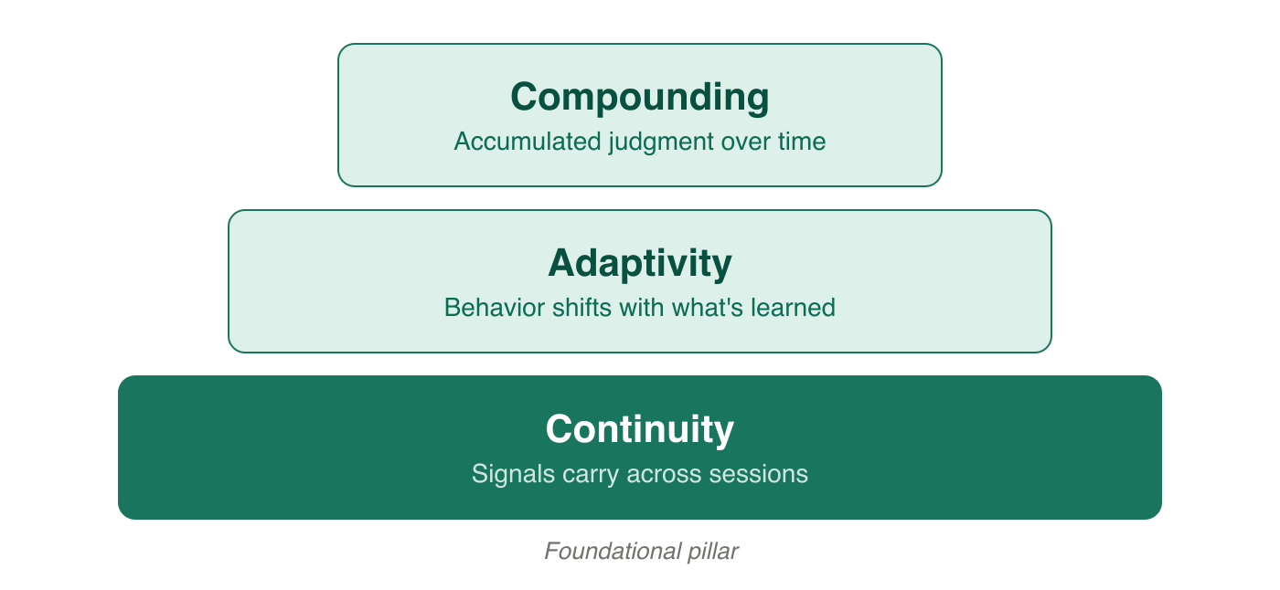
APPENDIX · CHAPTER 1 FIGURE 1-2
Continuity makes adaptation possible.
Continuity → adaptivity → compounding.
AGENT MEMORY
22
Notes:
Appendix. Source: Chapter 1, Figure 1-2, the pyramid of agent-memory traits. Continuity is the foundation; it makes adaptation possible, and accumulated adaptation enables compounding.

Slide 25
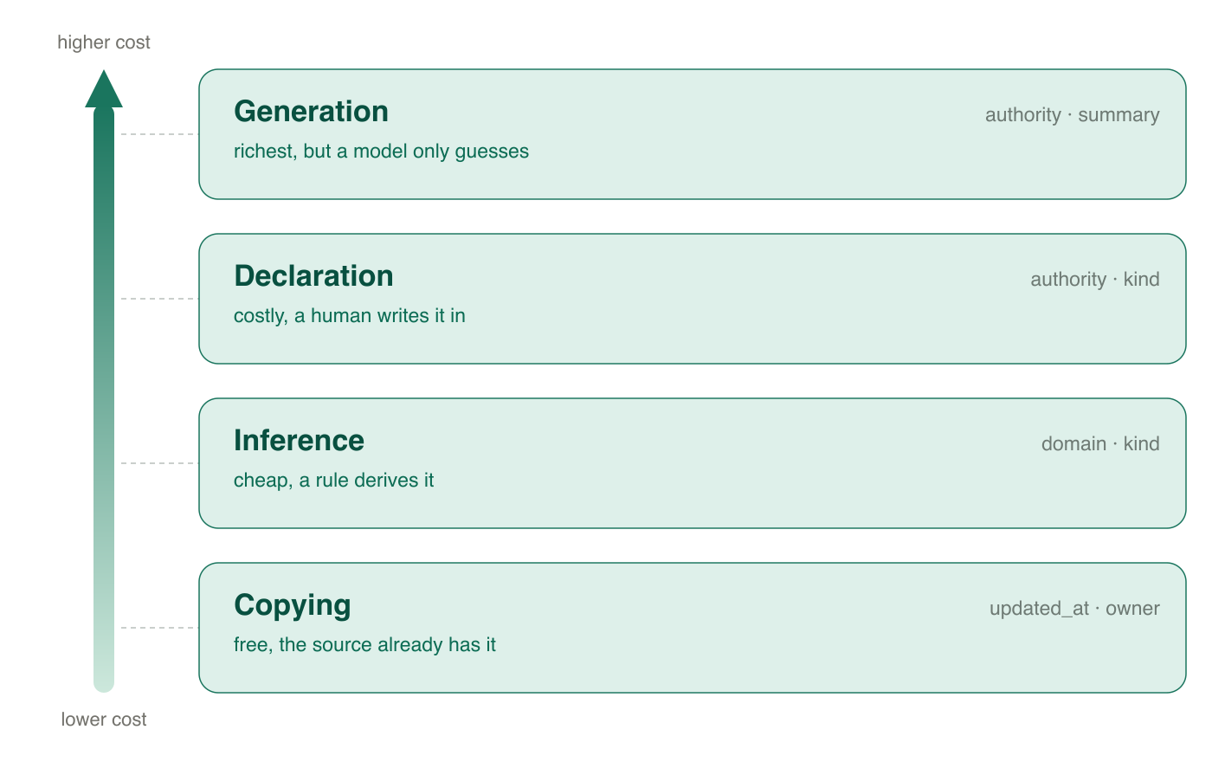
APPENDIX · CHAPTER 2 FIGURE 2-3
Richer meaning costs more to create—and to trust.
COPY
Cheap, direct, and source-grounded.
INFER
Useful and scalable, but imperfect.
DECLARE + GENERATE
Richer meaning still does not create organizational authority.
AGENT MEMORY
23
Notes:
Appendix. Source: Chapter 2, Figure 2-3, the cost-of-meaning gradient. Richer fields can be more useful and more expensive to derive. Generated or inferred meaning does not become authoritative merely because it is fluent.

Slide 26
APPENDIX · NORMALIZATION
Raw records become routed evidence.
A common envelope helps only when each record remains semantically legible.
01
RawRecord
→
02
MemoryRecord
→
03
RoutedEvidence
Identity, source, title, URL, text, metadata
Domain, owner, kind, authority, freshness
Task-scoped and authority-ranked
Can we parse it?
Can we compare it?
Does it matter now?
Technical structure is necessary. Semantic structure makes routing principled.
SHAPE · MEANING · DECISION
AGENT MEMORY
24
Notes:
Appendix. Source: Chapter 2 normalization model. RawRecord preserves source shape; MemoryRecord makes records semantically comparable; RoutedEvidence is task-scoped and authority-aware.

Slide 27
APPENDIX · POLICY REPLAY
Evaluation can propose review—not grant authority.
STATE
EVIDENCE
WHAT OPENS
WHAT CREATES MEMORY
Policy 7
2 supports < 3
Nothing
—
Policy 8b
2 supports ≥ 2
Proposal + owner review
Owner approval
Evaluation
Candidate 5/5
Policy review
Never self-activation
Current status
Hard constraints pass
Awaiting owner
No activation yet
Policy adapts only through a versioned, governed lane.
AGENT MEMORY
25
Notes:
Appendix. Source: Chapter 3 companion replay. Policy 7 does not open review with two supports. Policy 8b opens review, but only purchasing-owner approval creates memory. Evaluation evidence remains proposal evidence and cannot self-activate.

Slide 28
QUESTIONS
Any questions?
What should your agent remember—and who will own the answer?
BEN LABASCHIN
econoben.dev · O’Reilly Author
AGENT MEMORY
26
Notes:
Post-talk Q&A. Invite questions and use the appendix as needed. Keep the prompt visible: what should an agent remember, and who will own the answer?

Slide 29
THANK YOU
Thank you.
Route the evidence. Govern the lifecycle. Measure the action.
BEN LABASCHIN
econoben.dev · O’Reilly Author
AGENT MEMORY
27
Notes:
Post-talk close. Thank the audience and leave the three-part summary visible: route the evidence, govern the lifecycle, and measure the action.

