Slide 1
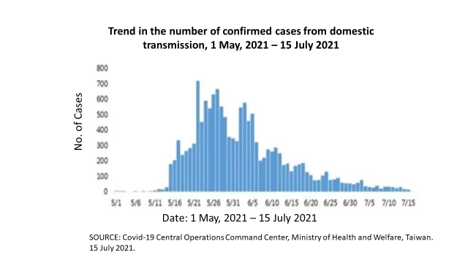
Figure 6: The COVID-19 “Outbreak” in Taiwan 1 May 2021 – 15 July 2021
800
700
600
500
400
300
200
100
0
No. of Cases
5/1 5/6 5/11 5/16 5/21 5/26 5/31 6/5 6/10 6/15 6/20 6/25 6/30 7/5 7/10 7/15
5/1 5/6 5/11 5/16 5/21 5/26 5/31 6/5 6/10 6/15 6/20 6/25 6/30 7/5 7/10 7/15
Source: COVID-19 Central Epidemic Command Center, Ministry of Health and Welfare, Republic of China, Taiwan. 15 July 2021.

Slide 2
Figure 7: Changes in the number of confirmed cases and government response 1 May 2021 – 21 October 2021
5/15 National Level-III Alert
5/15 Level-III Alert Taipei & New Taipei
7/13 Moderation of Level-III Alert
7/27 National Level-II Alert
5/11 National Level-II Alert
Source: Taiwan Centers of Disease Control and Prevention, published in United Daily News 21 October 2021.

