Slide 1


Slide 2

Session 3. Accessing data programmatically using APIs

Slide 3
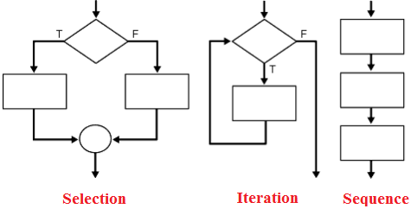
The idea.
Control structures | Flow control | Control statements
We want programs/analysis to take decisions for us.
Without control structures (AKA ‘flow control’) programs don’t do much. What might you want a program to do for you?
Stop or start. [Sequence]
Take a decision on what to do next. [Selection, Conditionality]
Do different things in different conditions:
Time of day, or days of the week;
If data has certain properties: (stock market alert).
Do something many times. [Iteration, Loops].
Dynamic programming / maximisation;
Batches of analysis: downloading, cleaning, charting.

Slide 4
Loops.
STATA | Python | JavaScript
variables = ["debt", "deficit", "GDP", "inflation"]
for i in variables:
print(i)

Slide 5

APIs.

Slide 6
What is an API?
Application Programming Interface
An API is software—an intermediary that helps two applications to talk to each other.
They are everywhere: each time you use an app like Facebook or Instagram, send an instant message, or check your weather app on your phone, you are using an API (example: Apple Watch)
APIs are extremely useful to data scientists because they provide a way to share/access data

Slide 7
API guidance.
They all look different but have a similar set up.
A base url: e.g. https://api.stlouisfed.org/fred/series/observations?
A series of options you can choose: series_id= file_type= time_start=
Often a request for your API key: api_key=
Often, when the API requires more information/choices from you, a series of & symbols. An example:
https://api.stlouisfed.org/fred/series/observations?series_id=UNRATE&api_key=22ee7a76e736e32f54f5df0a7171538d&file_type=json

Slide 8
ECO API.
We have made ours as simple as possible.
https://api.economicsobservatory.com/{COUNTRY}/{SERIES}
You just need to add the country (e.g. GBR) and the series (e.g. INFL).
https://api.economicsobservatory.com/GBR/INFL
To get US growth data all you do is change a few letters:
https://api.economicsobservatory.com/USA/GROW

Slide 9
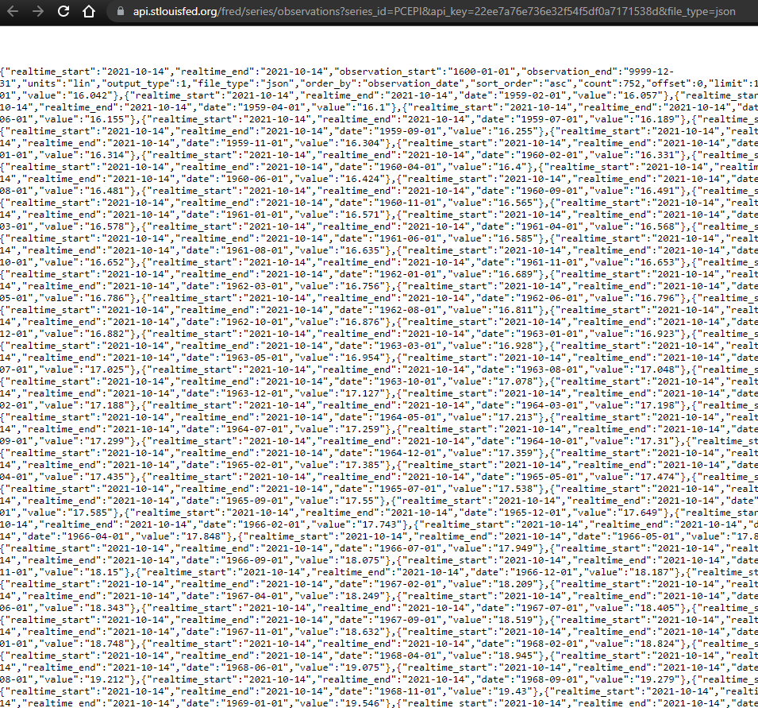

Raw JSON.
Download a JSON formatter plug in for your browser

Slide 10
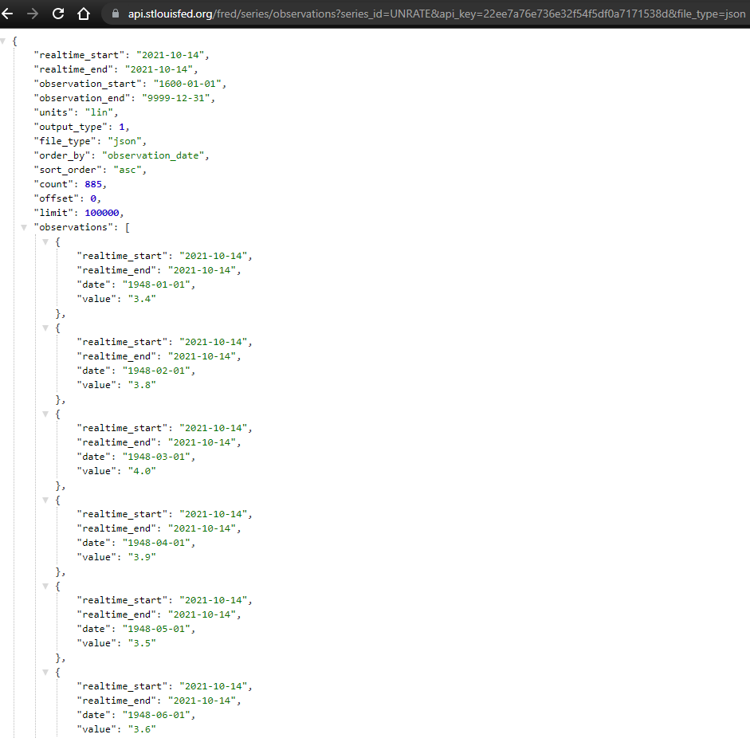

Slide 11
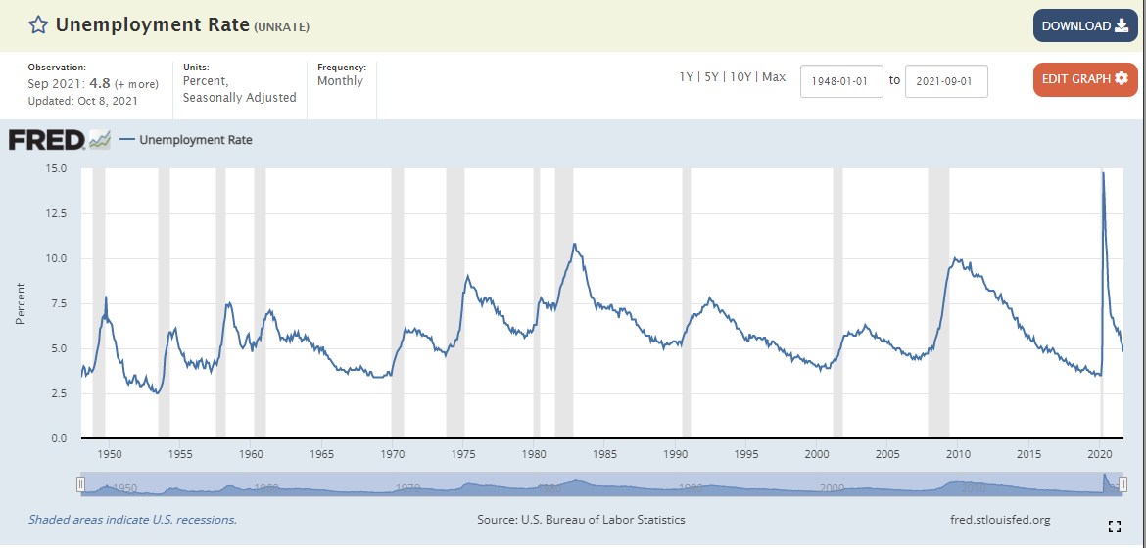

Slide 12
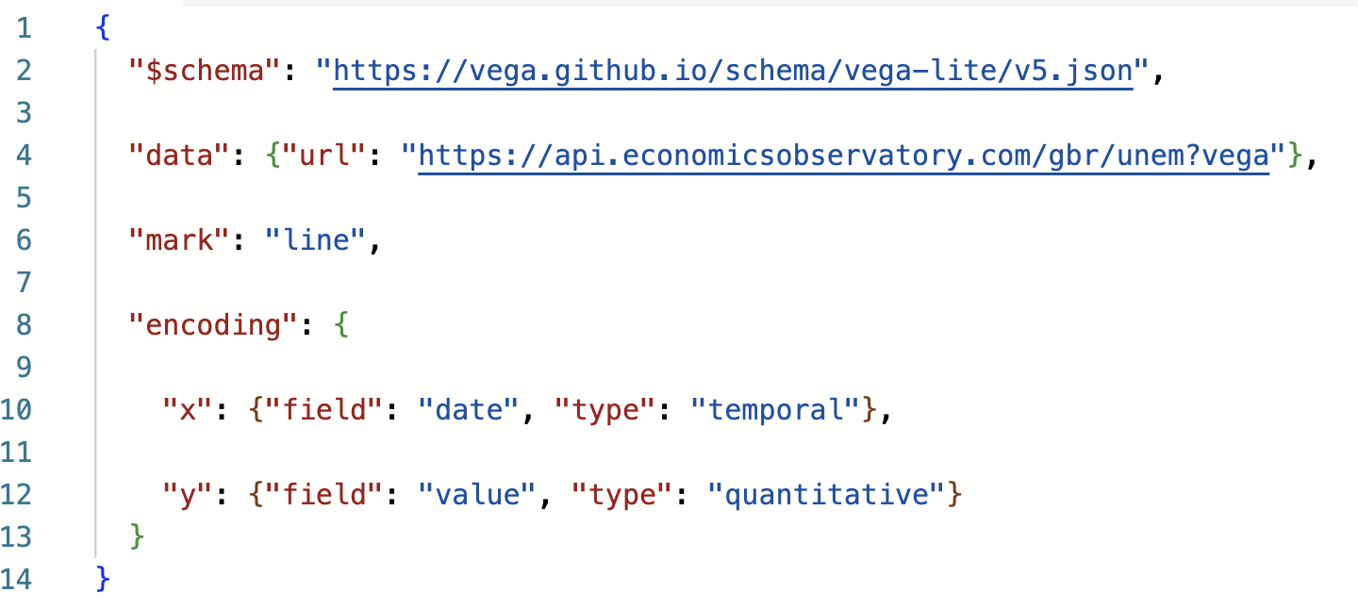
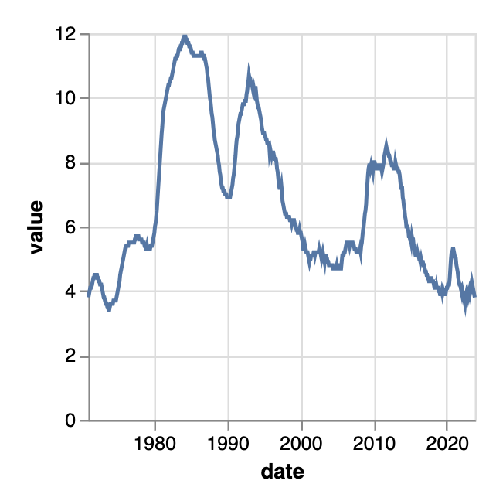
Worked example.
This chart pulls data from the Economics Observatory API:

Slide 13
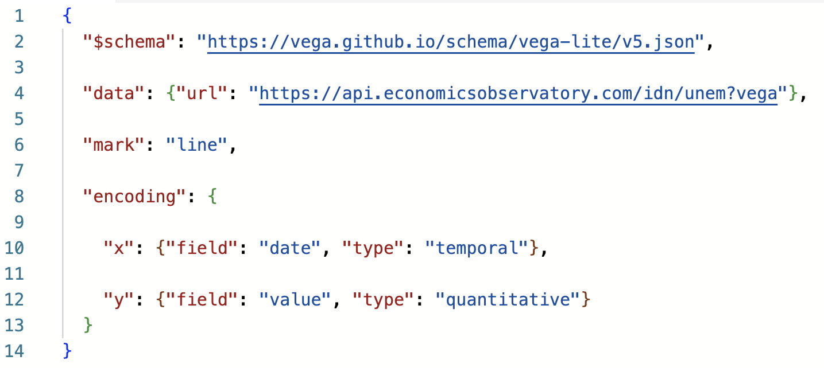
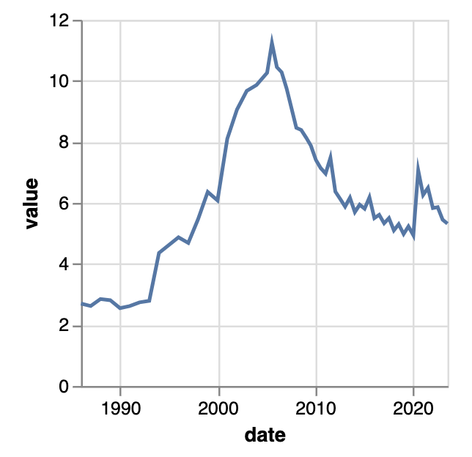
Worked example.
Chart now shows Indonesian data
API URL tweaked
Edit the URL to draw data from a different country:
Notes:
Indonesia

Slide 14
Session 3. Accessing data programmatically
Code-along and automated data access

Slide 15
Session 3. Accessing data programmatically
https://economicsobservatory.com/modern-data-visualisation

Slide 16
Code-along.
In this third practical session, we will be using Google Colab
Quick introduction to loops.
Using a loop with an API to create multiple charts.
Pick you best chart and embed in your site.

Slide 17
Extra slides: Background.

Slide 18
Background. The similarity of programming languages

Slide 19
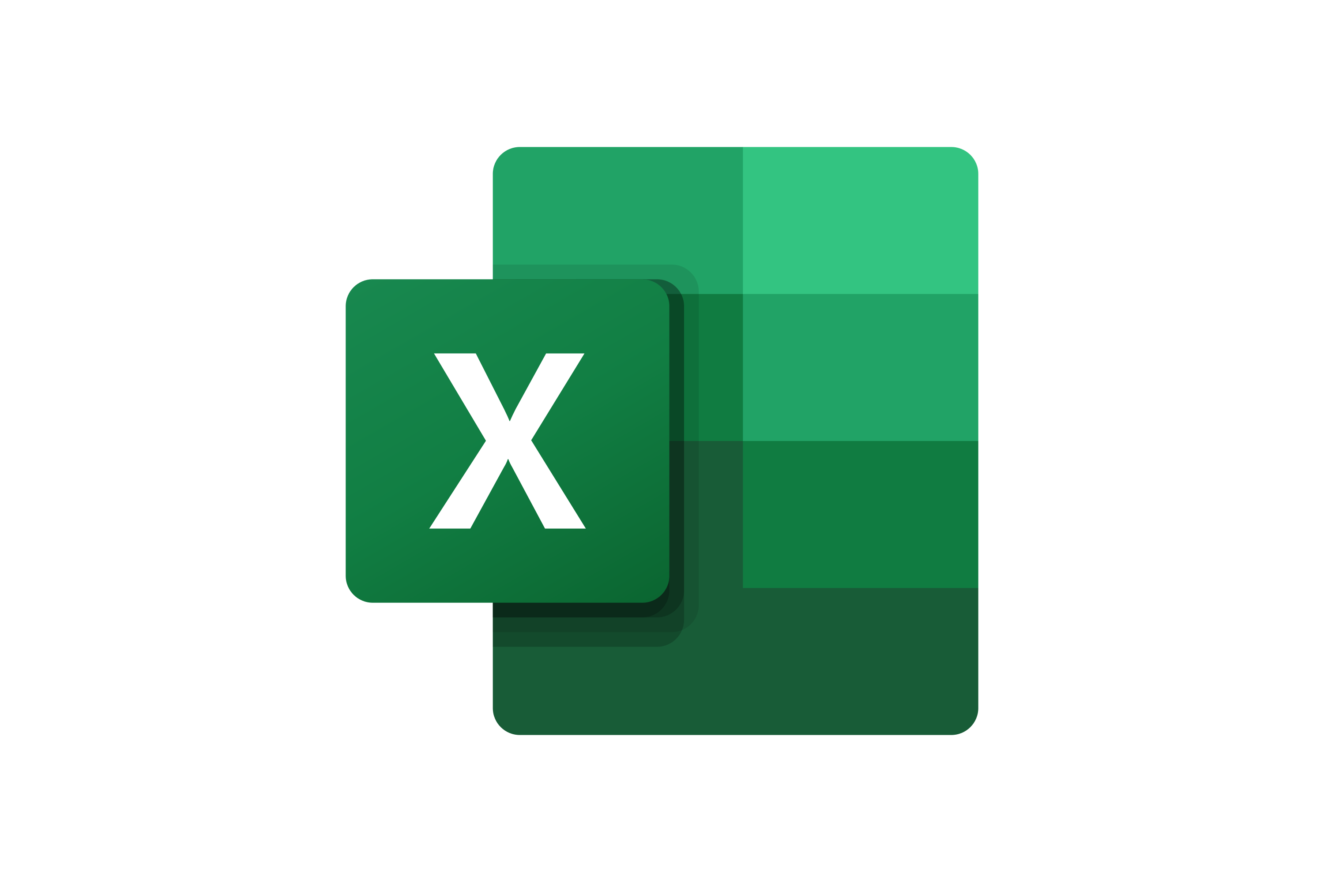




How many languages?
Five?

Slide 20
How many languages?
Three?

Slide 21
Loops.

Slide 22
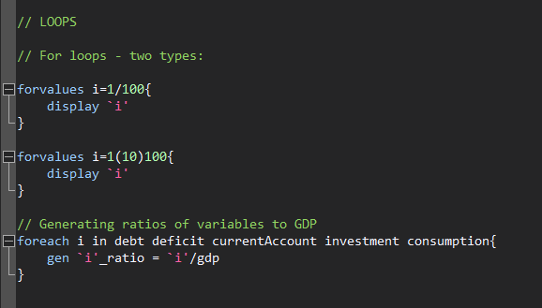
Loops.
STATA | Python | JavaScript

Slide 23
Loops.
STATA | Python | JavaScript
for i in range (1, 100):
print i
for i in range (1, 10, 100):
print i
for i in range (1, 100, 10):
print i
variables = ["debt", "deficit", "GDP", "inflation"]
for i in variables:
print(i)
An example of subtle differences between languages / functions.

Slide 24
Loops.
STATA | Python | JavaScript
for (statement_1; statement_2; statement_3) {
// Code block to run
}
What happens here:
Statement_1 runs once, before the code block starts.
Statament_2 defines a condition that must hold for the code block to run.
Statement_3 runs each time the code block has been executed.

Slide 25
Loops.
STATA | Python | JavaScript
for (let i = 1; i < 101; i++) {
console.log(i);
}
for (let i = 1; i < 101; i+10) {
console.log(i);
}

Slide 26
Loops.
STATA | Python | JavaScript
// Set a list of variables:
variables = ["debt", "deficit", "GDP", "inflation"]
// We can index these:
console.log(variables)
console.log(variables[0])
console.log(variables[3])
// Work out how long this thing is:
len = variables.length
// Iterate though it, printing out each particular variable
for (let i=0; i<len; i++) {
x = variables[i]
console.log(x)
}

