Slide 1


Slide 2
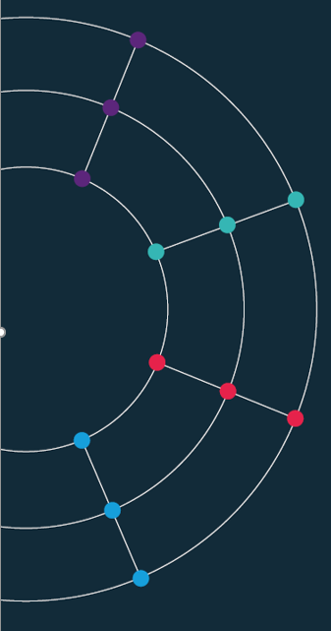
Session 1. Charts as data
[60 min]

Slide 3
Bad, Ugly … and Good.

Slide 4
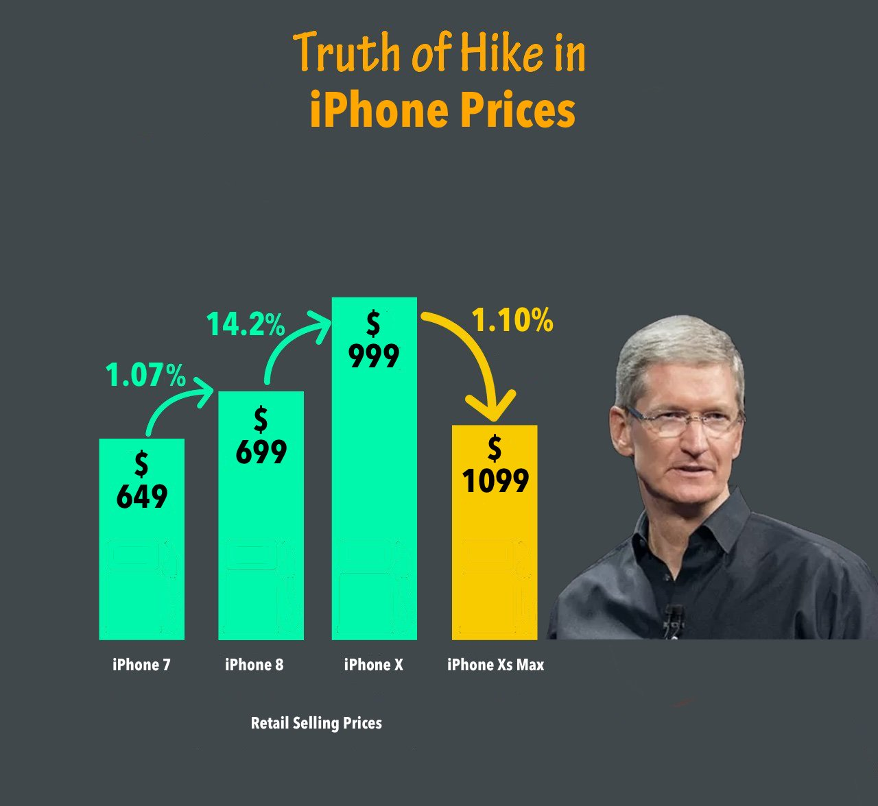
When charts go wrong.
Notes:
RS: insert example of a terrible chart

Slide 5

Notes:
RS: insert example of a terrible chart

Slide 6
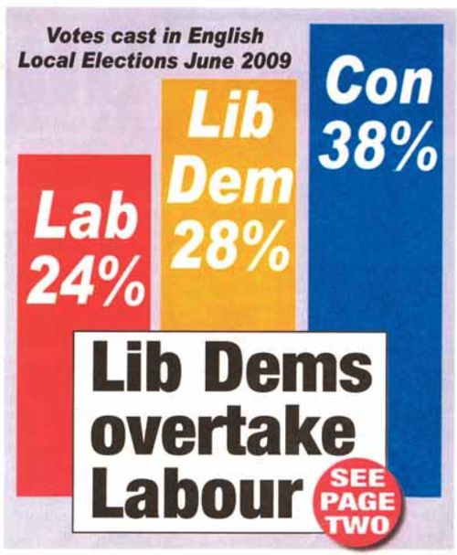
Notes:
RS: insert example of a terrible chart

Slide 7
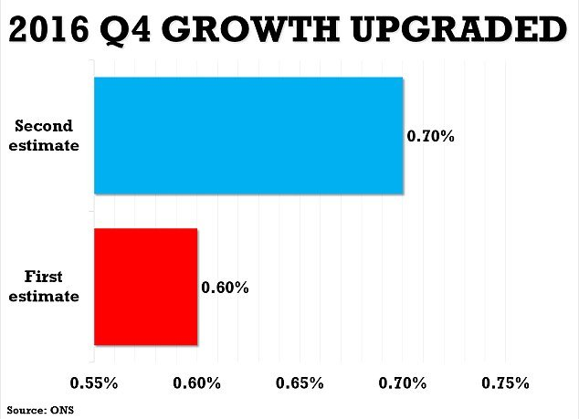
Notes:
RS: insert example of a terrible chart

Slide 8
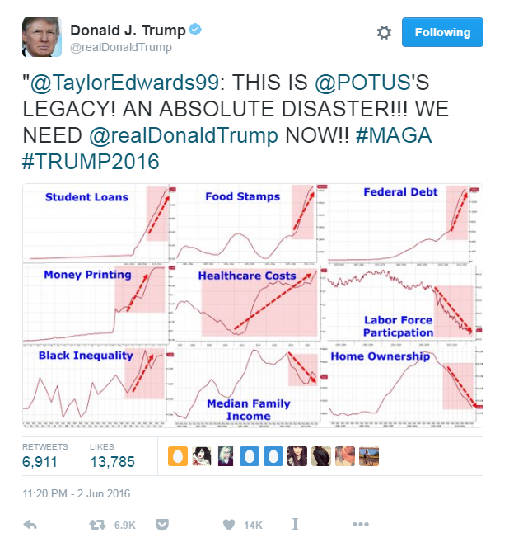
Notes:
RS: insert example of a terrible chart

Slide 9
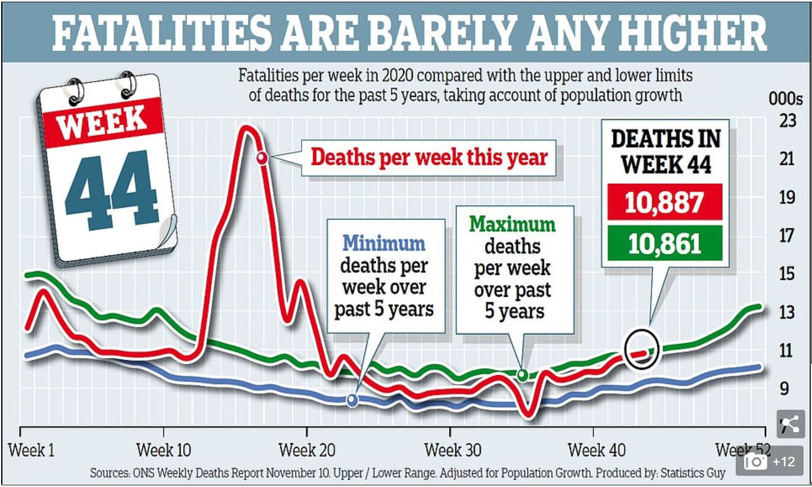
Source: Daily Mail, November 20th 2020

Slide 10

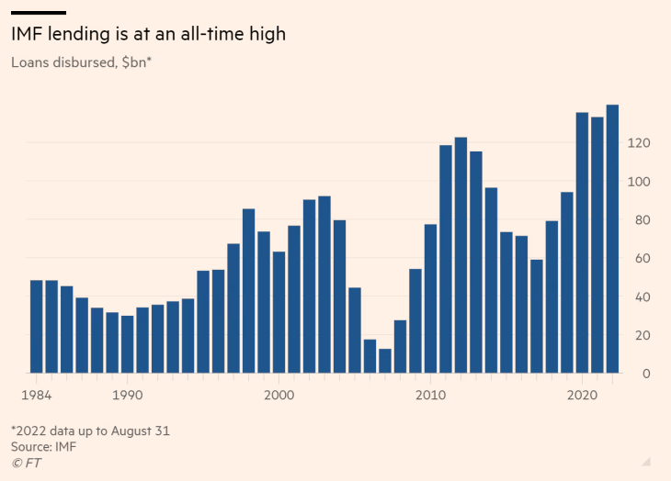
https://www.ft.com/content/eddedee3-669d-42cc-9597-33609a8bff99

Slide 11

Two worked examples. What is wrong here? And how can we improve things?

Slide 12
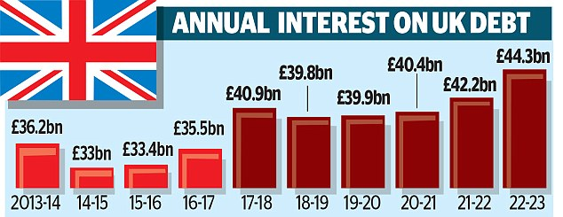
Source: Daily Mail, 2 Jan 2018

Slide 13
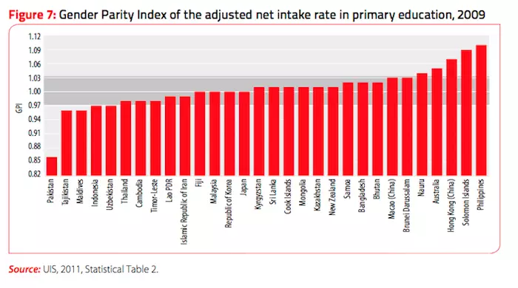

Slide 14
The same data Different stories

Slide 15
Source: Daily Mail, 2 Jan 2018

Slide 19
Source: Daily Mail, 2 Jan 2018

Slide 20
SHARE OF NATIONAL INCOME SPENT ON UK DEBT

Slide 23
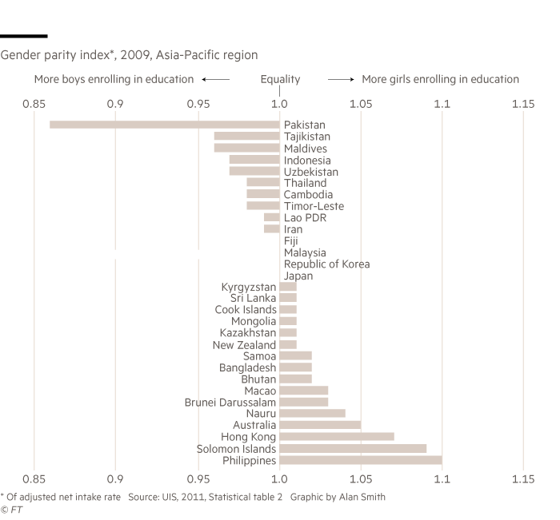

Slide 24
Dataviz heroes. Playfair, Nightingale and other pioneers

Slide 25
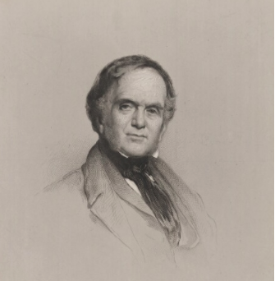
William Playfair.
Born in 1759, William Playfair invented the chart.
The Commercial and Political Atlas (1785) which featured 40 charts covering trade, debt, expenditure and other economic matters
Playfair was the first to add the vertical axis (previous charts did not have this feature, meaning the way data were stacked vertically meant nothing).
His charts were relevant to policy. Playfair made charts that demand those in charge of policy to pay attention
“Information, that is imperfectly acquired, is generally as imperfectly retained; and a man who has carefully investigated a printed table, finds, when done, that he has only a very faint and partial idea of what he has read; and that like a figure imprinted on sand, is soon totally erased and defaced.”
Notes:
RS: insert example of a terrible chart

Slide 26
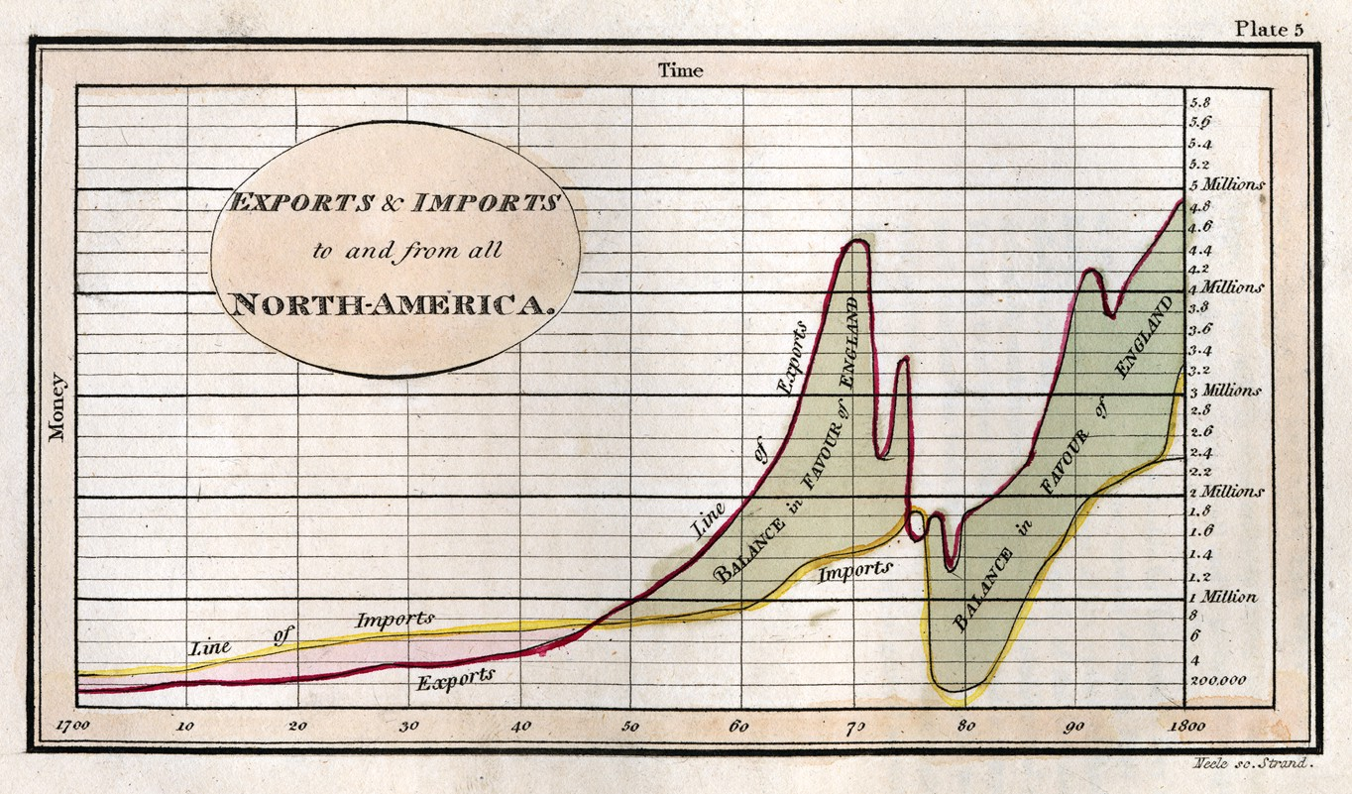
Politics and trade.

Slide 27
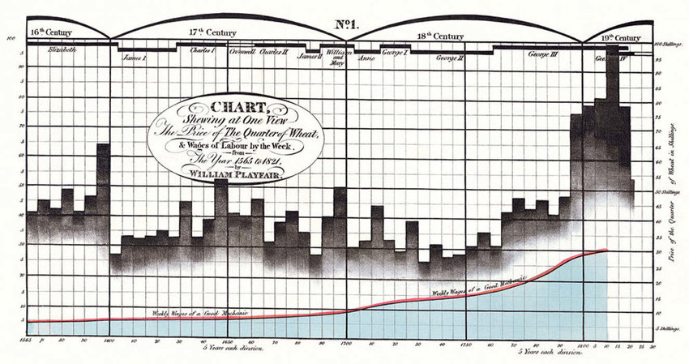
Real wages.

Slide 28
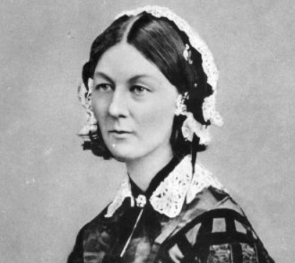
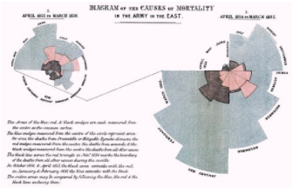
Florence Nightingale.
Born in 1820, she was a disruptor of both medicine and data
Statistician, campaigner, nurse, and inventor, she is best known as the founder of modern nursing: the lady with the lamp
After working on the frontline during the Crimean war, she decided to communicate the miserable conditions she witnessed, creating pioneering using data visualisations to make her case

Slide 29
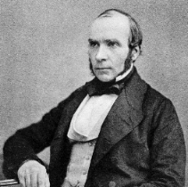
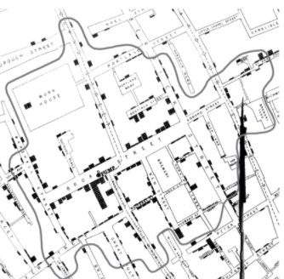
John Snow.
John Snow was an English physician
Studied 1854 cholera epidemic in London
Founding father of epidemiology, a branch of medicine that studies the contraction, spreading and control of disease.
Data pioneer, using carefully plotted maps to solve a problem that had defeated scientists of his day
Story of the Broad Street pump
Notes:
RS: insert example of a terrible chart

Slide 30

Edward Tufte.
The American statistician and graphic design theorist.
The Visual Display of Quantitative Information, April 1983
Primary message: designers didn’t have to sacrifice mathematical accuracy in the quest for elegance
“data-ink ratio” to measure the proportion of a given graphic which was simply illustration rather than a representation of data.
He questioned the “data density” of graphics. And for those graphics which his disliked most coined a new word: “chartjunk”.
Notes:
RS: insert example of a terrible chart

Slide 31
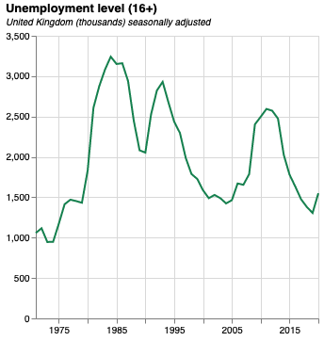
Anatomy of a good chart.
Size. The original version of this chart is 300px by 300px. This is perfect for mobile.
Y axis metric included in the title
Eye-catching colour. Make sure colours are consistent across your work
Subtitle including extra detail (such as units)
Y axis label not needed because of title
X axis label not needed because, in most cases, time is obvious
Quantitative data should start from zero by default
Notes:
RS: insert example of a terrible chart

Slide 32
Charts as data. Visualisation grammars
Vega-lite
[30 min]

