Slide 1


Slide 2

Session 2. Building your first website

Slide 3
Session 2. Building your first website
Introduction + building blocks

Slide 4

Building blocks.

Slide 5
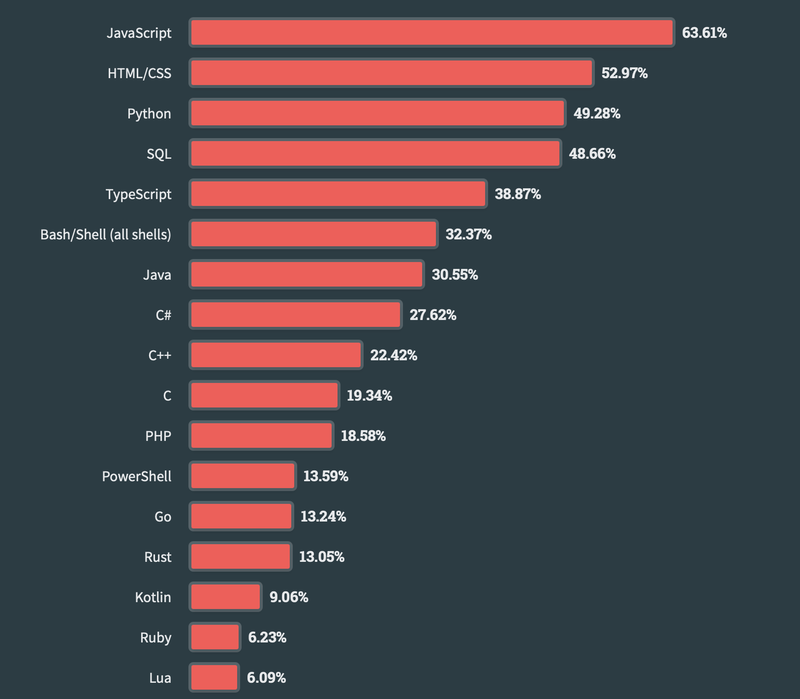
Most used languages, 2023.
https://survey.stackoverflow.co/2023/#technology

Slide 6

HTML.
Hyper-Text Markup Language
1993. Invented at CERN by Tim Berners-Lee.
Big idea. The HT in the name is the big idea. There are/were lots of markup languages, but HTML linked joined documents together, by adding hyperlinks.
Tim Berners-Lee. Image: CERN
https://home.cern/science/computing/birth-web/short-history-web
https://www.vanityfair.com/news/2018/07/the-man-who-created-the-world-wide-web-has-some-regrets

Slide 7
HTML example.
<!DOCTYPE html>
<html>
<!-- THIS IS A COMMENT [HIGHLIGHT TEXT, THEN CONTROL+/] -->
<!-- Economics Observatory, Data Science for Public Policy -->
<head>
<title>Page Title</title>
</head>
<!-- The body contains things you see -->
<!-- Most elements both open and close, with the content in the middle -->
<!-- Indenting is optional, but helps with readability -->
<body>
<h1>My First Heading</h1>
<p>My first paragraph.</p>
</body>
</html>

Slide 8
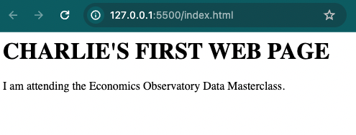
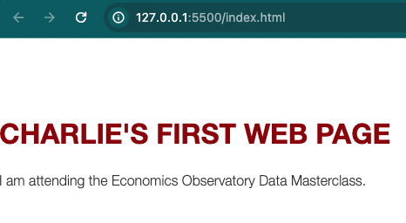
CSS.
No CSS applied:
Cascading Style Sheets
1994. First proposal – again at CERN.
Applies styles to the different parts of your site.
Challenge is to link the styles you chose, to the parts of your site where you wanted them.
This is done using tags (also classes and ids)
CSS applied:

Slide 9
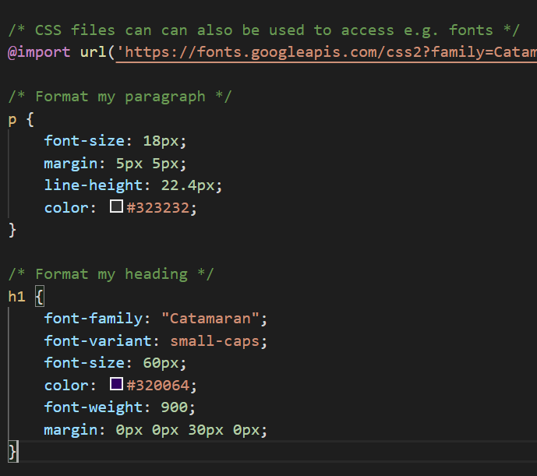
CSS example.

Slide 10
CSS example.

Slide 11
Putting HTML and CSS together.
To link an HTML page to a CSS file you specify the location in the head section of your page. <!-- Here is the head section of my HTML file --> <head> <title>Page Title</title> <!-- Now I add a link to my CSS file --> <link rel="stylesheet" href="example1.css"> </head> The page will now have the styles set out in the CSS file.

Slide 12
JavaScript.
History. JS launched by Netscape in 1995. Key developer was Brendan Eich. Brief war with Microsoft before widespread adoption. Now used in almost all (>95%) of web sites.
In Data Science. Some uses of JS.
Fetching data. Grab data from another site, via an API, when you open your page.
Cleaning and manipulating data. Prepare and analyse the data for use in a chart or table.
Visualising data. Display the data in a way you wish. There are lots of charting “libraries” that do this. For example, Vega Lite and Charts.js.
Interactivity. Make visualisations interactive + sites fun and engaging.

Slide 13
JavaScript example.
<!DOCTYPE html>
<html>
<head>
<!-- JS can be used to load external resources. Here we load Vega Lite library including its “embed” function-->
<script src="https://cdn.jsdelivr.net/npm/vega@5"></script>
<script src="https://cdn.jsdelivr.net/npm/vega-lite@5"></script>
<script src="https://cdn.jsdelivr.net/npm/vega-embed@6"></script>
</head>
<body>
<!-- Create a "figure" tag and give it the UNIQUE id of "Location1" -->
<figure id="Location1"></figure>
</body>
<!-- Next we can use the tag script to tell the HTML file we are going to start writing in JavaScript -->
<script>
// Now we are in JavaScript, so comments start with //
// Declaring a variable, giving it the name chart1_spec, and storing the JSON that defines a chart in it.
var chart1_spec = "s2_chart1.json";
// The vegaEmbed function needs to know (a) what, and (b) where to embed the chart.
vegaEmbed('#Location1', chart1_spec)
</script>
</html>

Slide 14
JavaScript example.
<!DOCTYPE html>
<html>
<head>
<!-- JS can be used to load external resources. Here we load Vega Lite library including its “embed” function-->
<script src="https://cdn.jsdelivr.net/npm/vega@5"></script>
<script src="https://cdn.jsdelivr.net/npm/vega-lite@5"></script>
<script src="https://cdn.jsdelivr.net/npm/vega-embed@6"></script>
</head>
<body>
<!-- Create a "figure" tag and give it the UNIQUE id of "Location1" -->
<figure id="Location1"></figure>
</body>
<!-- Next we can use the tag script to tell the HTML file we are going to start writing in JavaScript -->
<script>
// Now we are in JavaScript, so comments start with //
// Declaring a variable, giving it the name chart1_spec, and storing the JSON that defines a chart in it.
var chart1_spec = "s2_chart1.json";
// The vegaEmbed function needs to know (a) what, and (b) where to embed the chart.
vegaEmbed('#Location1', chart1_spec)
</script>
</html>

Slide 16
Session 2. Building your first website
Code-along

Slide 17
Session 2. Building your first website
https://economicsobservatory.com/modern-data-visualisation

Slide 18
Code-along.
In this second practical session, we will be using VS Code and GitHub to build your personal website.
Edit your HTML (name, bio, etc)
Add some CSS (choose colours, fonts, etc)
Embed an example JSON chart

Slide 19
HTML.
Create and edit your “index.html” file
Use “s2_example1.html” for inspiration

Slide 20
CSS.
Edit your CSS file
Use “s2_example1.css”, “s2_example2.css” or “s2_example3.css” file to start:
Beginner: s2_example1.css
Intermediate: s2_example2.css
Advanced: s2_example3.css
Link “s2_example1.css” (or others) to “index.html” using:
<link rel="stylesheet" href=”s2_example1.css"> (inside html head)

Slide 21
JSON.
Edit your “index.html” file, and add JSON files to your file structure
There are already two example charts embedded in the example HTML. Try replacing these with a chart from Section 1, or adding a new chart altogether

