Slide 1


Slide 2

Data Masterclass. Professor Richard Davies + ECO Data Unit Team London School of Economics – School of Public Policy Monday 19 February

Slide 3

1.0 Motivation. Problems, solutions, and plan for today

Slide 4
















Where we are. The state of play
Analysts will tend to have five steps or more between their raw data and their output.
Example: a journalist, consultant or academic making a chart of GDP in America:
Data source
Public-sector
aggregator
Commercial
aggregator
Analyst
Publisher
Output
JPEG
SVG
SVG
XLS
SVG
TXT
CSV
SVG
BLS
FRED
Bloomberg
Editorial dept
Web team

Slide 5















Where we are. The state of play
Analysts will tend to have five steps or more between their raw data and their output.
Example: a journalist, consultant or academic making a chart of GDP in America
Data source
Public-sector
aggregator
Commercial
aggregator
Analyst
Publisher
Output
JPEG
SVG
SVG
XLS
SVG
TXT
CSV
SVG
BLS
FRED
Bloomberg
Editorial dept
Web team
Note how this system works:
Repetition. Many players, each adding delay or cost. Slow and expensive.
Errors. Each link can, and does, break. Each one adds to the chance of a human error.
Compatibility. Many different file types. Delay and compatibility problems
Storage. Huge data storage requirement, with files stored in each silo along the way. Resource and environmental costs
This system is slow, costly and inaccurate.

Slide 6
Where we are: slow, costly, error prone. The problems we will solve
Analysts will tend to have five steps or more between their raw data and their output.
Example: a journalist, consultant or academic making a chart of GDP in Amercia
Data source
Public-sector
aggregator
Commercial
aggregator
Analyst
Publisher
Output
JPEG
SVG
SVG
XLS
SVG
TXT
CSV
SVG
BLS
FRED
Bloomberg
Editorial dept
Web team
Note how this system works:
Repetition. Many players, each adding delay or cost. Slow and expensive.
Errors. Each link can, and does, break. Each one adds to the chance of a human error.
Compatibility. Many different file types. Delay and compatibility problems
Storage. Huge data storage requirement, with files stored in each silo along the way. Resource and environmental costs
This system is slow, costly and inaccurate.

Slide 7





Where we are going: fast, cheap, accurate The solutions we will offer
The modern approach used our site uses is different.
We are building a single secure channel that links an analyst’s output right back to the raw data.
Data source
Output
Analyst’s code
ONS
Note the differences with the new system:
Automated. Your chart is always up to date. When the raw data updates, it flows through the channel instantly and automatically.
Efficient. The number of players collapses, as do associated costs. There are no data silos – the data shown on your site is the raw data, not a copy of them.
Verifiable. A one-to-one link back to the original data provider means fact checks can be swift.
The result is analysis that is faster, cheaper and more accurate.

Slide 8
Why it matters… …and why Britain’s economists should lead the way
The problems above matter in many fields. They are acute in economics and public policy:
Regular updates. Economic data is high-frequency. This means that the ‘repeated analysis’ problem is particularly strong.
Descriptive analysis. Economists and analysts are aiming to clarify. We need our work to be replicable (someone else can run the code and get the same result) and verifiable.
Normative and policy analysis. Economic data is hard-wired into policy decisions. Getting it right affects people’s lives.

Slide 9
What we are doing. Data at the Economics Observatory
To respond to these issues, we have developed the Economics Observatory Data Hub. This contains three connected tools:
Explore. A new API. This will unify and simplify existing data sources into one stream. The ECO API offers simple URLs that put the user’s needs first, allowing them to access a wide range of metrics from multiple international sources
Build. With improved data access comes better analytics. With our new Chart Builder, users take the latest data directly from source, and display this live in a webpage. No coding skills are needed, but modern tools are being used in the background: Excel and JPEG are out, JavaScript Ordered Notation (JSON), D3.js and Vega-Lite are in.
Share. Robust analysis deserves to be shared. Users can share their visualisations on traditional platforms like Twitter and Instagram, or can post their work to our new timeline for academics, journalists, policy-makers and students to post and discuss their charts.

Slide 10
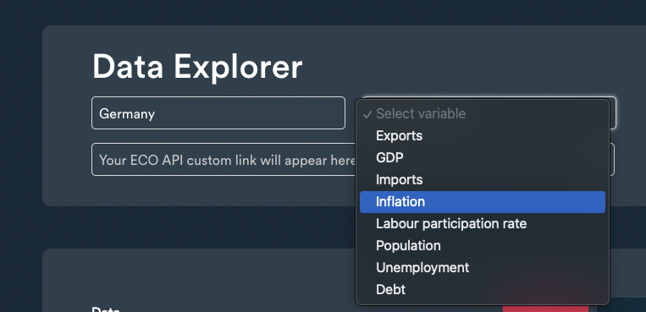
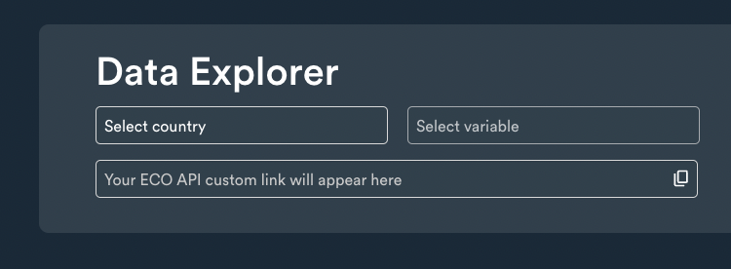
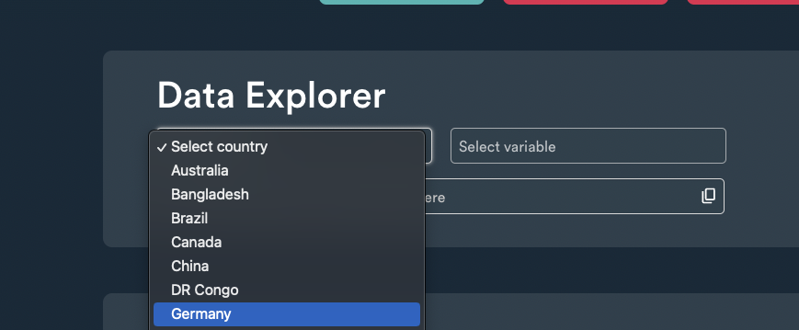
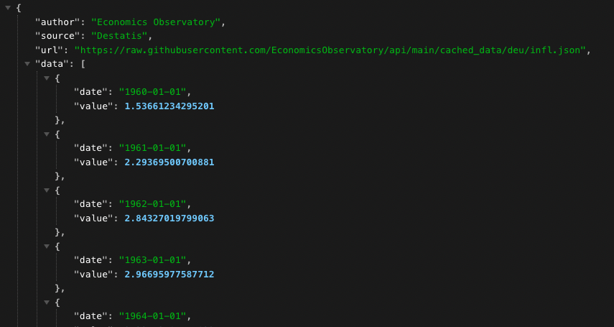
What we are doing. Data at the Economics Observatory
Explore

Slide 11
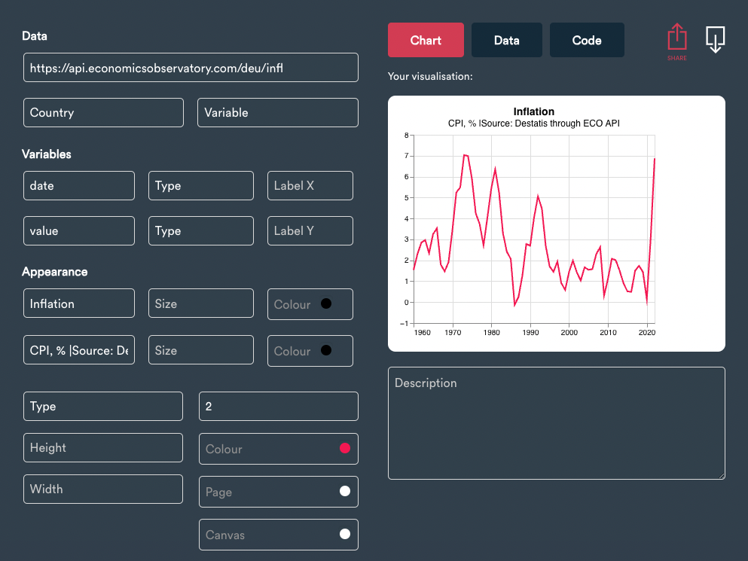
What we are doing. Data at the Economics Observatory
Create

Slide 12
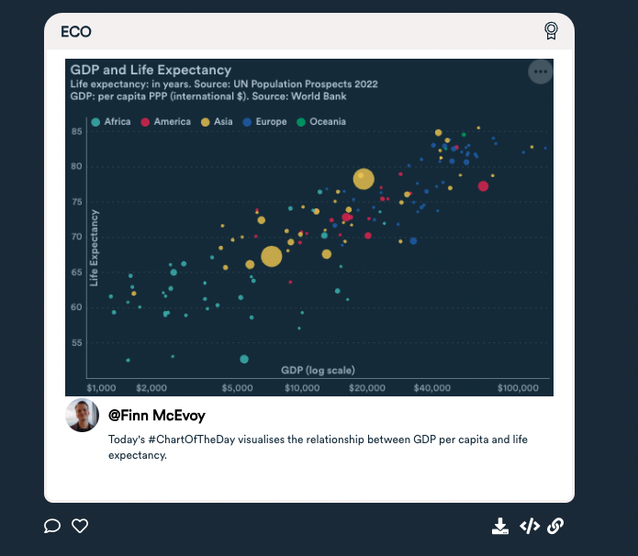
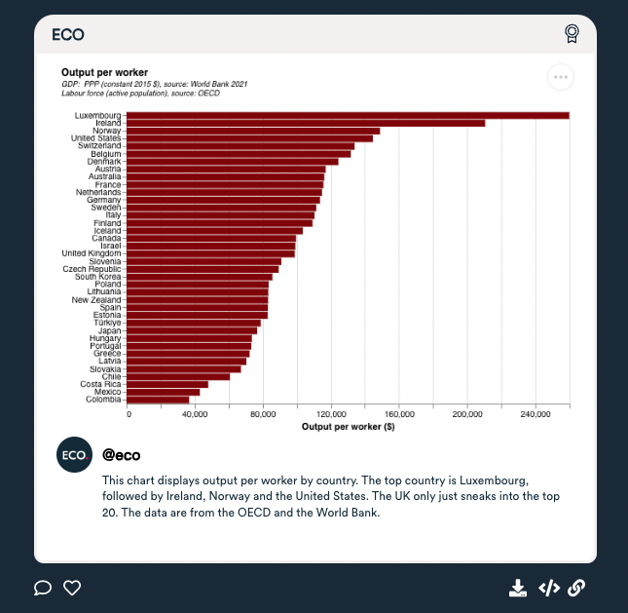
What we are doing. Data at the Economics Observatory
Share

Slide 13
Masterclass outline. Teaching team + more on ECO
Richard Davies | Director
Charlie Meyrick | Research Fellow
Josh Hellings | Data Scientist
Finn McEvoy | Data Scientist
Website: www.economicsobservatory.com
Newsletter: www.economicsobservatory.com/join-us
Data Hub: www.economicsobservatory.com/data-hub

Slide 14
Masterclass outline. What we are covering today
Time | Section | Details
09.00 - 09.30 |  | Welcome coffee. Checking computer set ups.
09.30 - 10.30 | 1 | Charts as data – introducing Vega-Lite
10.30 - 11.00 | Break | Coffee/tea (team available to fix bugs)
11:00 - 12.30 | 2 | My first website – GitHub, HMTL, CSS and JavaScript
12.30 - 13.15 | Lunch | Lunch (team available to fix bugs)
13.15 - 14.15 | 3 | Programming – APIs, if statements, and loops.
14.15 - 15.15 | 4 | Advanced visualisations – beyond two dimensions
15:15 - 15:30 | Break | Coffee/tea (team available to fix bugs)
15.30 - 16.30 | 5 | Scraping – fetching data with Python

Slide 15
1.1 Charts as data. How a new datatype will save you time and errors

Slide 16
JSON data.
JavaScript Object Notation. An important data type. Why use it?
It is the way computers share data.
Most importantly it is what many APIs will deliver – your data will arrive to you in this way.
It looks complicated at first, but is easy to convert into access, change and chart.
Formatted as key : value pairs:
'{"name":“David Beckham", “yearBorn":1975, “team":“Manchester United”}’
Keys are strings, always in double quotes.
Values can be many things: string, number, arrays, objects.
Useful tools:
www.jsonlint.com. Test and format JSON.
JSON formatter. Chrome extension.

Slide 17
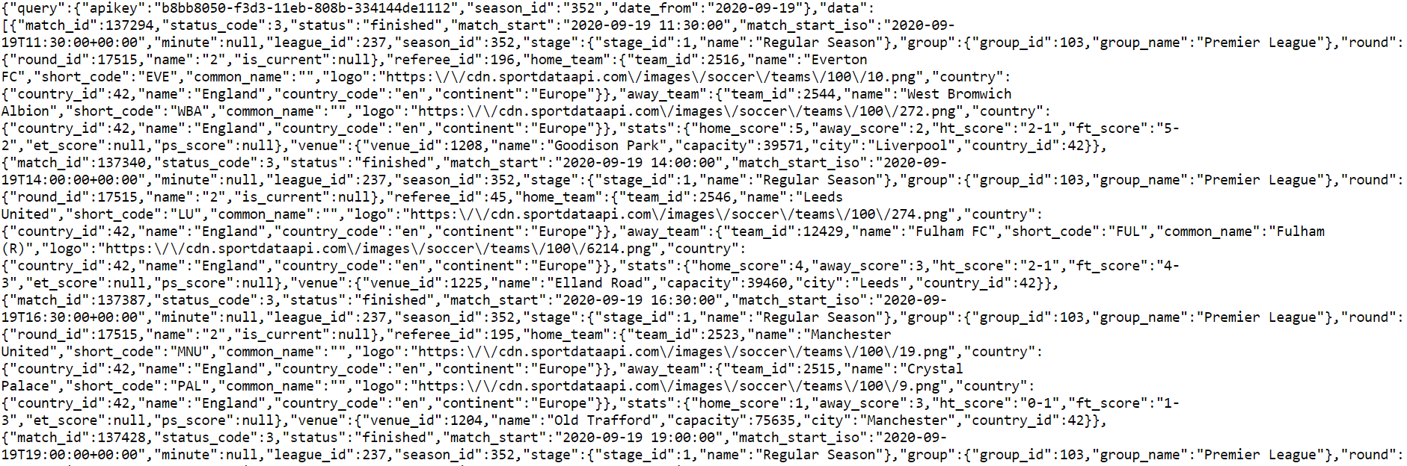
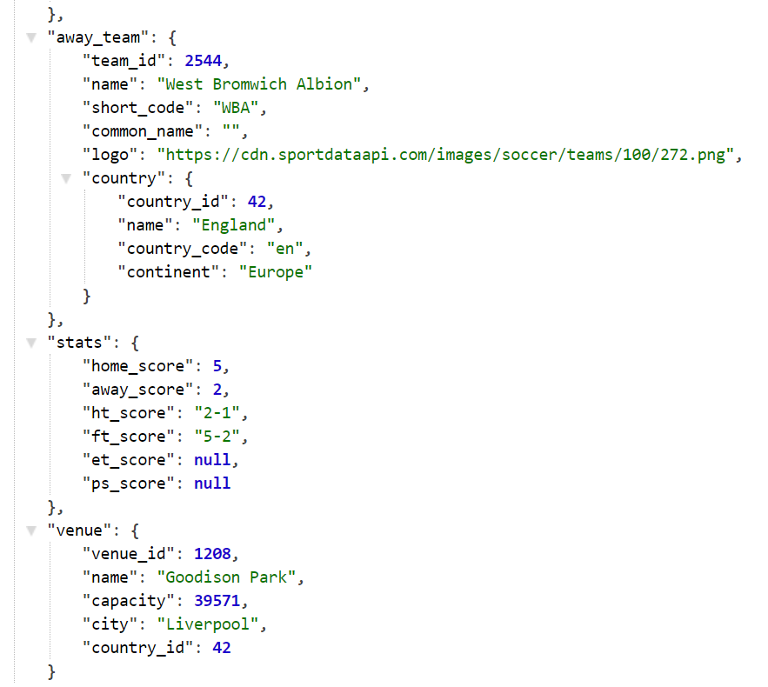
Raw.
Parsed.
API returns. The results of request to Sport Data API.

Slide 18
Why data is great. Some important aspects of the data revolution
Data is great for a host of reasons:
Transparency
Verification
Replication
Sharing
Comparing

Slide 19
Why charts are terrible. The problem we face
Charts can be terrible for many reasons:
Opaque
Repetitious
Inflexible (pixel problems when changing sizes)
During the break: examples of Chart Junk, and Graph Crimes

Slide 20
The state of play. Analysis in 2024
Data
Great
Charts
Terrible

Slide 21
The big idea for today. The core philosophy of our course
Data
Charts
Charts are a type of data.

Slide 22
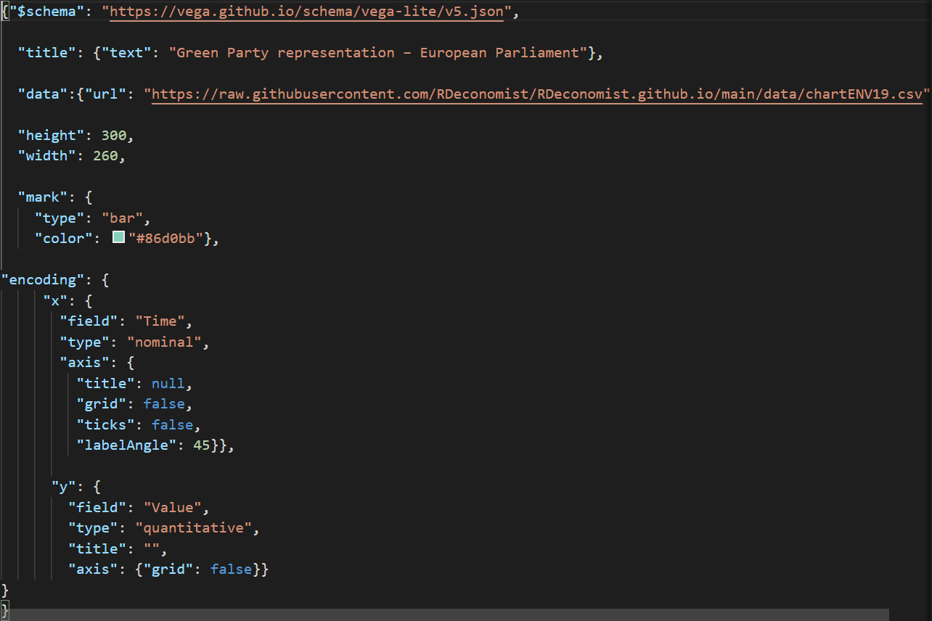
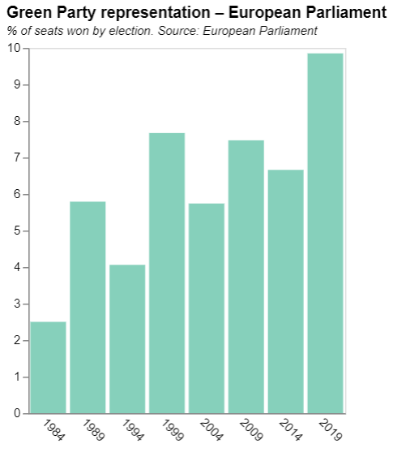
Charts as JSON data.

Slide 23

1.2 Delivering data. Three ways to inject numbers into your chart

Slide 24
Delivering data. Where does the data in your chart come from?
A vital input to your chart is the data that is plotted.
We will meet three:
Embedding data in your chart code
Delivering data from GitHub
Delivering data from an API

Slide 25
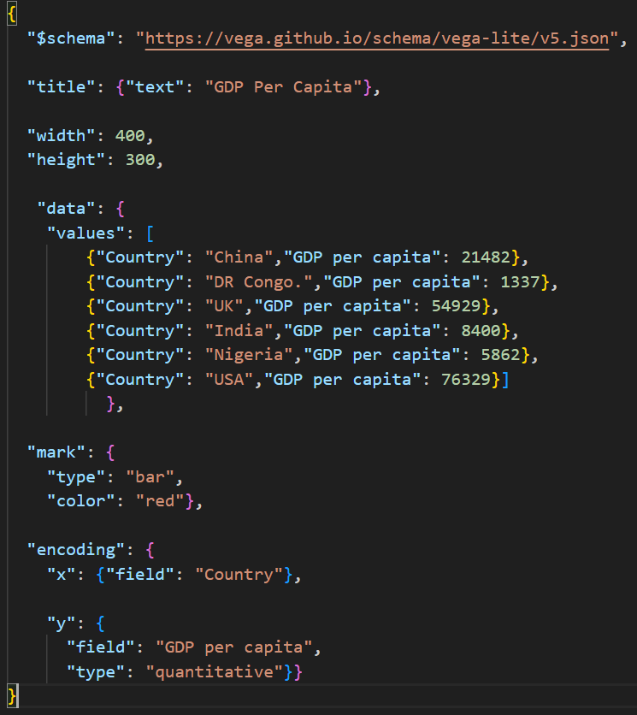
Delivering data 1. Embedding the data in your chart

Slide 26
Delivering data 1. Embedding the data in your chart
The dataset can be seen here.

Slide 27
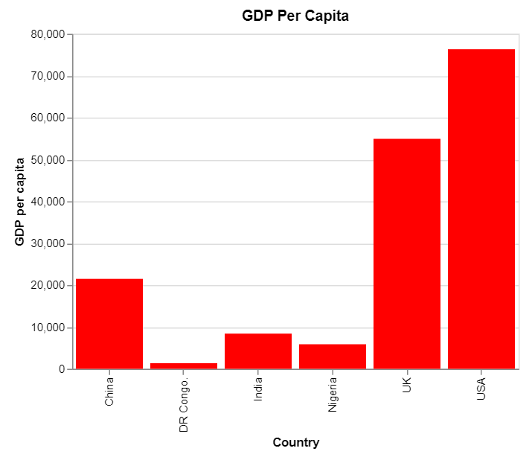
Delivering data 1. Embedding the data in your chart

Slide 28
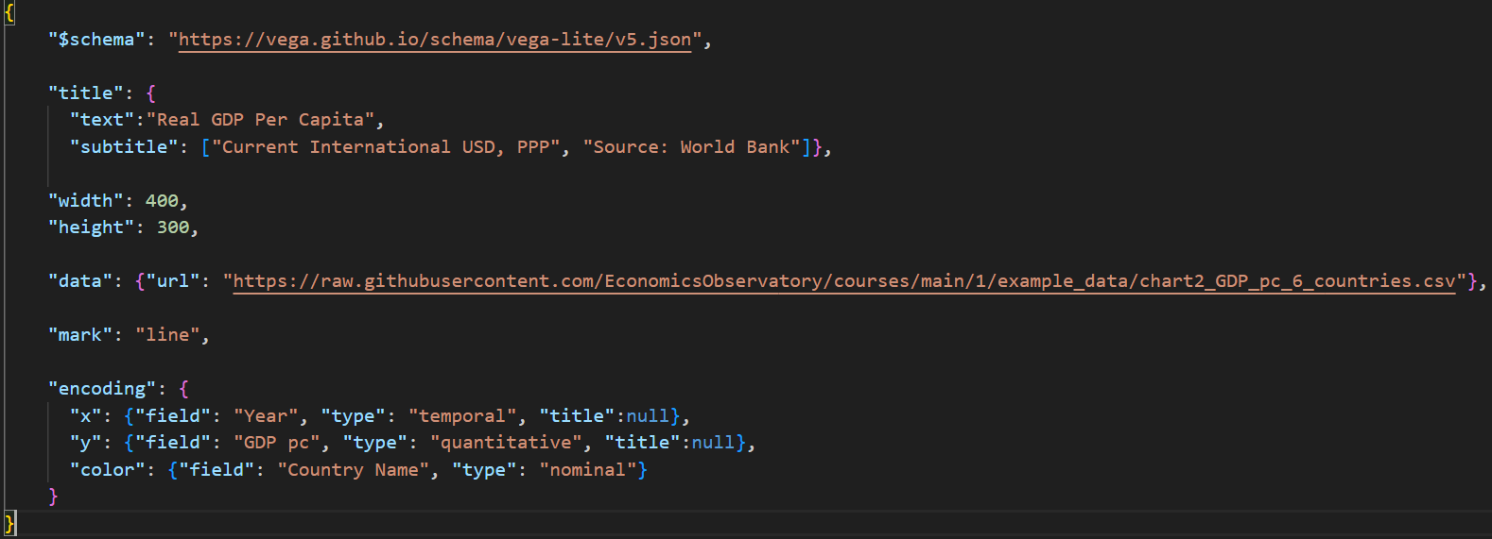
Delivering data 2. Using GitHub to store and deliver your data

Slide 29
Delivering data 2. Using GitHub to store and deliver your data
The data are stored elsewhere on GitHub, via this link

Slide 30
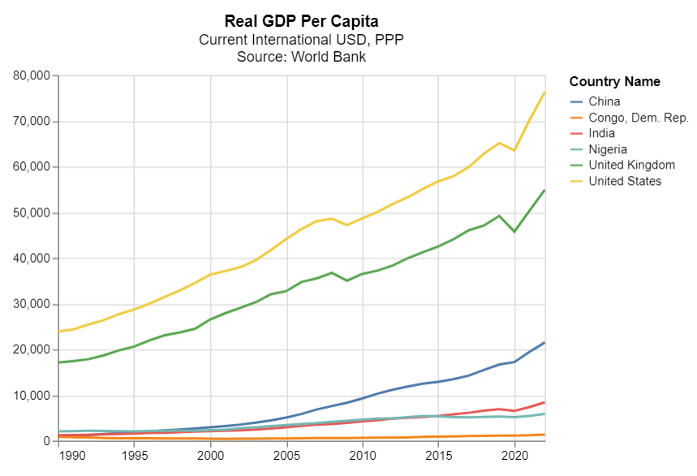
Delivering data 2. Using GitHub to store and deliver your data

Slide 31
Delivering data 2. Using GitHub to store and deliver your data
In our spec we have the following:
"data": {"url": "https://raw.githubusercontent.com/EconomicsObservatory/courses/main/1/example_data/chart2_GDP_pc_6_countries.csv"},
You can open the CSV link in your browser to see the underlying numbers

Slide 32
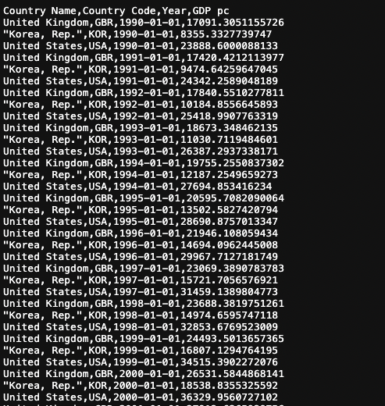
Delivering data 2. Using GitHub to store and deliver your data
In our spec we have the following:
"data": {"url": "https://raw.githubusercontent.com/EconomicsObservatory/courses/main/1/example_data/chart2_GDP_pc_6_countries.csv"},
You can open the CSV link in your browser to see the underlying numbers

Slide 33
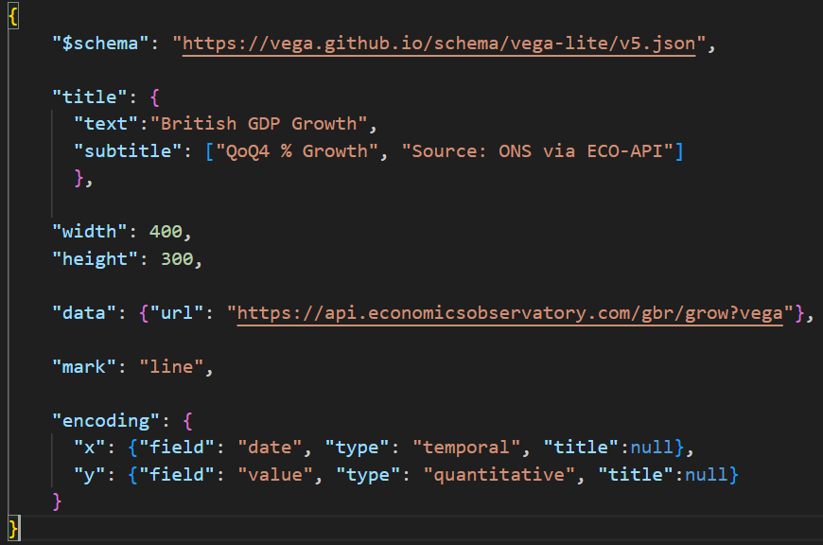
Delivering data 3. Receiving data direct from an API

Slide 34
Delivering data 3. Receiving data direct from an API
The data comes from an external source.
In this case the Economics Observatory API.
[There are thousands of APIs you can use, we will meet more later in the course]

Slide 35
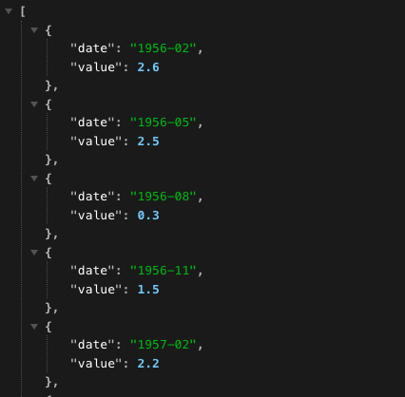
Delivering data 3. Receiving data direct from an API
APIs (in this context) are just like urls.
You can open the API link in your browser to see what is being delivered to your machine.
Here are the underlying numbers from the current example
Note the ‘key-value pairs’

Slide 36
1.3 Code along 1. Playing with Chart specs
https://github.com/EconomicsObservatory/courses/blob/main/README.md

Slide 37
Code-along. First steps towards JSON visualisations
In this first practical session, we will explore the three data delivery types:
Embedded into the design of the chart: “chart1_data_inline.json”
Via CSV file on GitHub: “chart2_data_linked.json”
Via an API: “chart3_data_from_api.json”
The files can be found here:
https://github.com/EconomicsObservatory/courses/blob/main/README.md

Slide 38
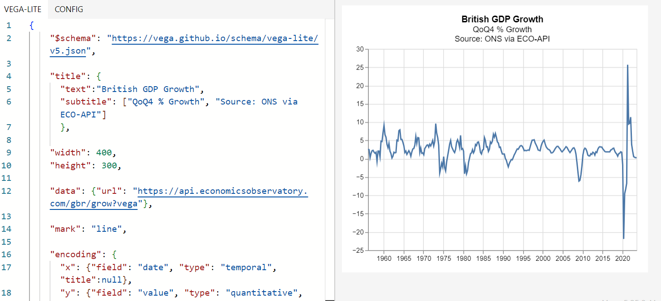
Code-along tool: https://vega.github.io/editor Tool – Vega-Lite editor

Slide 39
Code-along: our tasks Edit three files to make your first JSON visualisations
File 1. Inline data. (chart1_data_inline.json)
Paste the JSON into Vega Lite Editor (https://vega.github.io/editor). Now change:
The colour of the bars.
Swap some of the data to countries that interest you
The size of the chart
File 2. GitHub data. (chart2_data_linked.json). Changes:
The colour variable
The title text
[The variable being plotted]
File 3. API data. (chart3_data_from_api.json). Changes:
The API data being delivered.
The title text
The line colour
https://github.com/EconomicsObservatory/courses/blob/main/README.md

Slide 40
Code-along: our tasks Edit three files to make your first JSON visualisations
File 1. Inline data. (chart1_data_inline.json)
Paste the JSON into Vega Lite Editor (https://vega.github.io/editor). Now change:
The colour of the bars.
Swap some of the data to countries that interest you
The size of the chart
File 2. GitHub data. (chart2_data_linked.json). Changes:
The colour variable
The title text
[The variable being plotted]
File 3. API data. (chart3_data_from_api.json). Changes:
The API data being delivered.
The title text
The line colour
https://github.com/EconomicsObservatory/courses/blob/main/README.md
When happy with your chart:
1. Copy and paste the JSON into your text editor (Visual Studio Code).
2. Save it locally on your machine.
3. Add it to your GitHub pages repository.

