Slide 1

Session 3. Accessing data programmatically
[90 min]

Slide 2
Session 3. Accessing data programmatically
Introduction to data formats
[90 min]
[30 min]

Slide 3
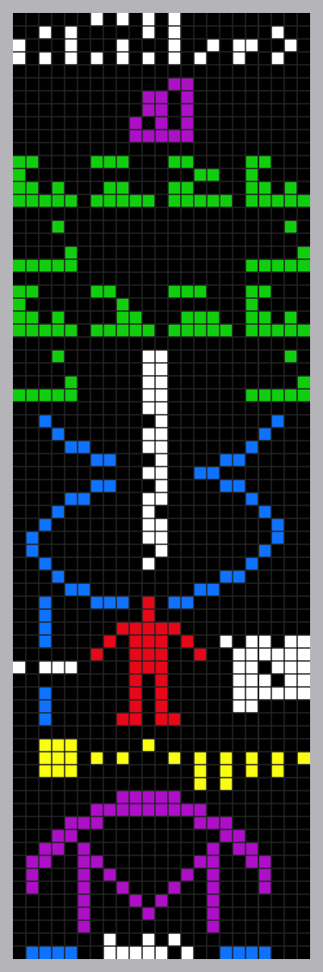

Data. Information. Knowledge.
Notes:
Arecibo message. This is data science. Find what’s important in a sea of data. That’s useful information. Put that information into context. That is knowledge.
In David McCandless’ book, Knowledge is Beautiful, something similar is the inner cover photo.
In this particular course, we will be dealing with the part of data science that you might call “Business Inteligence”.
This is exactly the Data->Information->Knowledge process.
https://www.datapine.com/blog/business-intelligence-for-small-business/

Slide 4
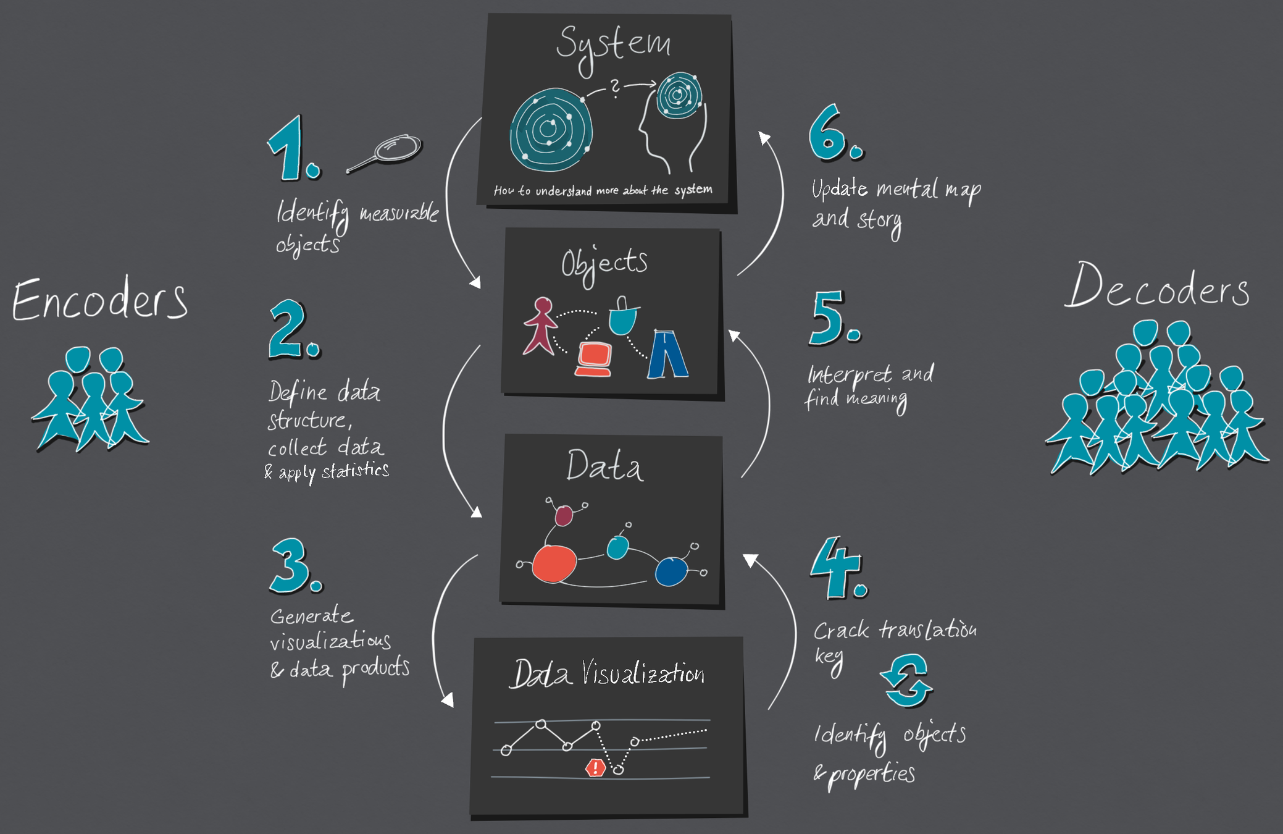

https://medium.com/nightingale/the-cycle-of-encoding-and-decoding-f3ff17010631
Notes:
Data visualisation is a language of conversing with data.
https://medium.com/nightingale/the-cycle-of-encoding-and-decoding-f3ff17010631
You need to correctly learn how to speak the language of data. With everything it start with understanding WHAT are you trying to say.
In the data sceince language, The DATA is the WHAT – the visualisation is the HOW.

Slide 5

visualisation = understanding
"The ability to take data - to be able to understand it, to process it, to extract value from it, to visualize it, to communicate it - that's going to be a hugely important skill in the next decades, ...because now we really do have essentially free and ubiquitous data."
Hal Varian, Chief Economist, Google. The McKinsey Quarterly, 2009. Adapted from UW CSE442.
Notes:
There is an overload of information.
We need a way to figure out what is important and what is not.

Slide 6
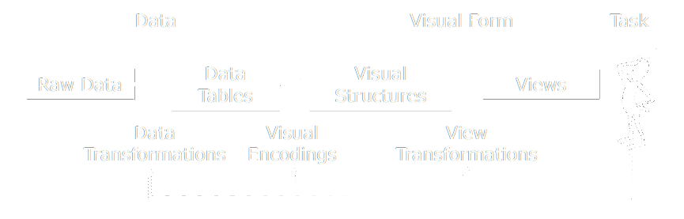
visualisation reference model
Jeffrey Heer, 2018. Adapted from UW CSE442.
Notes:
There is an overload of information.
We need a way to figure out what is important and what is not.

Slide 7
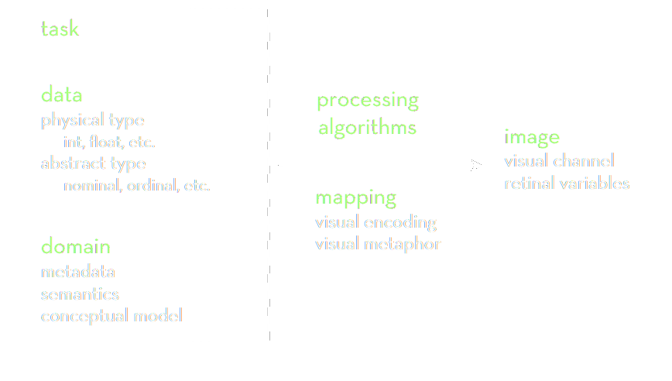
data → visualisation process
Jeffrey Heer, 2018. Adapted from UW CSE442.
Notes:
There is an overload of information.
We need a way to figure out what is important and what is not.

Slide 8

data domain.
Notes:
Open-floor question on what IS data science?

Slide 9
data models | conceptual models
Data models are a low-level description of the data.
Math: sets with operations on them ( + / · ). How many? / What kind?
Conceptual models are higher level mental abstractions.
Semantics and support reasoning. What does is mean/describe?
Examples:
1D float vs Temperature
3D float vs Space
Jeffrey Heer, 2018. Adapted from UW CSE442.
Notes:
Data model machine language

Slide 10
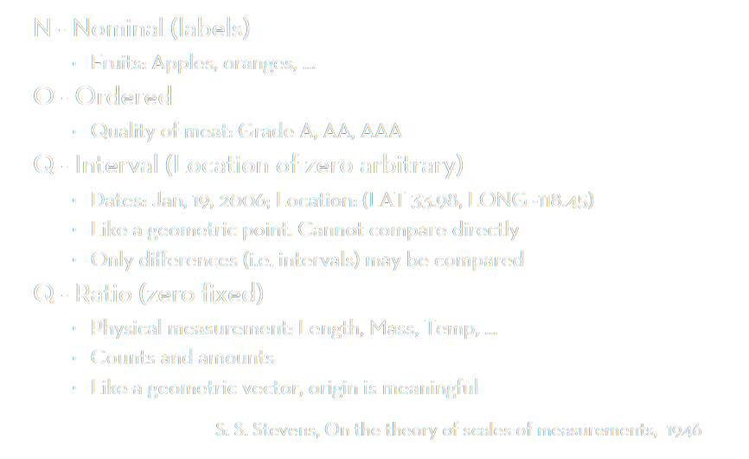
data types
O/Q
(T)
Notes:
Data model machine language

Slide 11
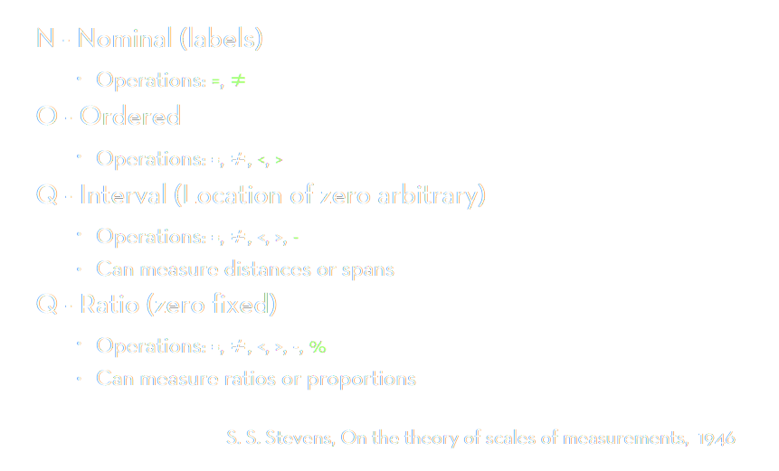
data types
O/Q
(T)
Notes:
Data model machine language

Slide 12
from model to type
Data model 12.3, red, A, 2021-10-111
Conceptual model temperature, colour, candidate ID, date
Working together:
Putting the data into the correct context → correct data type
Watch out for data traps!
“B” can be nominal or ordinal
“February” can be nominal or ordinal (special case of temporal)
“2021” can be anything

Slide 13
data → visualisation process
Jeffrey Heer, 2018. Adapted from UW CSE442.
Notes:
There is an overload of information.
We need a way to figure out what is important and what is not.

Slide 14
data wrangling.
Notes:
Open-floor question on what IS data science?

Slide 15

data standards
Economics Observatory 📐 Data Guidelines ↗
We strive to maintain all data displayed on the site in a standardized, TIDY format. That means that every data point is a row (line) and every data feature is a column. The first column is called the index, and it is the typcially the column, based on which each of the data points gets a unique identifier. Sometimes the index column of datasets is a date, in which case we can treat the the data series as time series.
Economics Observatory 🌌 Visualisation Guidelines ↗
Dénes Csala, Economics Observatory, 2021, based on Hadley Wickham, RStudio, 2012
Notes:
Data model machine language

Slide 16
TIDY data
this (wide form)
should be converted to this (long form)
Country | 2019 | 2020 | 2021
Austria | 42 | 13 | 69
Belgium | 75 | 12 | 77
Country | Year | Value
Austria | 2019 | 42
Austria | 2020 | 13
Austria | 2021 | 69
Belgium | 2019 | 75
Belgium | 2020 | 12
Belgium | 2021 | 77
Notes:
Data model machine language

Slide 17
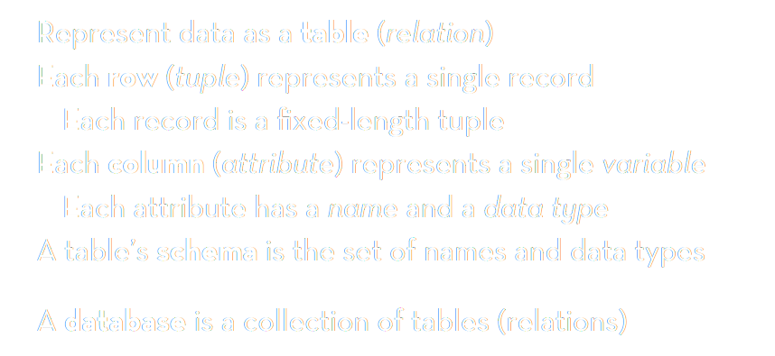
TIDY data
pandas: DataFrame
JavaScript: Object Array
Jeffrey Heer, 2018. Adapted from UW CSE442.
Notes:
There is an overload of information.
We need a way to figure out what is important and what is not.

Slide 18
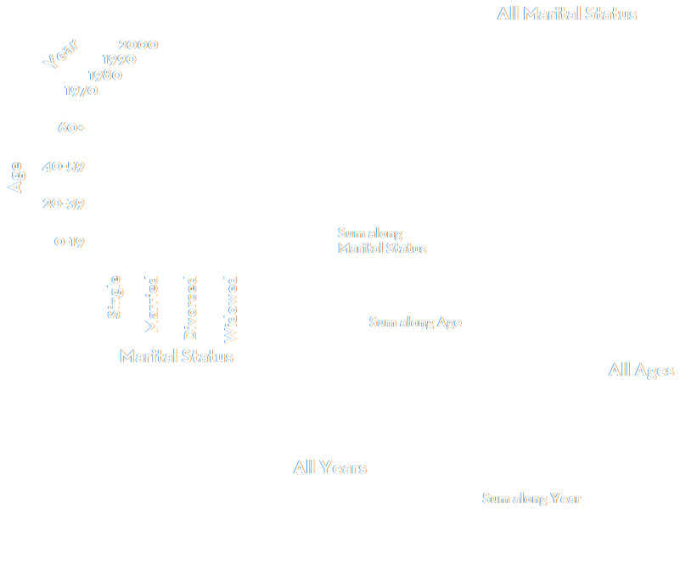
slice or dice
Jeffrey Heer, 2018. Adapted from UW CSE442.
Notes:
There is an overload of information.
We need a way to figure out what is important and what is not.

Slide 19
Session 3. Accessing data programmatically
Code-along
[90 min]
[30 min]

Slide 20
Manipulating data with JavaScript
Vega-Lite Editor
Simple Bar Chart example
JavaScript Object Array
Console. Basic example
API data return

Slide 21
Manipulating data with python
Starting Google Colab.
Dictionaries. Basic example
Custom data request example
Load data into pandas
Display rows/columns
Setting index/columns
stack/unstack (sometimes also called pivot – e.g. in Excel or PowerBI)

Slide 22
Session 3. Accessing data programmatically
Automated data access
[90 min]
[30 min]

Slide 23
What is an API?
Application Programming Interface
An API is a software intermediary that allows two applications to talk to each other. They are everywhere: each time you use an app like Facebook or Instagram, send an instant message, or check your weather app on your phone, you are using an API (example: Apple Watch)
APIs are extremely useful to developers and data scientists because they provide a way to share/access abstracted data and display/use it in a chosen setting

Slide 24
APIs and data science.
APIs are useful for data scientists because they allow us to automate data collection. Rather than manually downloading new data and re-uploading it to a server (like GitHub), we can ask our computer to ‘talk’ to another computer
Some examples:
Covid-19 UK official data
Office for National Statistics
Nomics (cryptocurrencies)
Emissions

Slide 25
API guidance.
They all look different, but have a similar set up.
A base url: e.g. https://api.stlouisfed.org/fred/series/observations?
A series of options you can choose: series_id= file_type= time_start=
Often a request for your API key: api_key=
Often, when the API requires more information/choices from you, a series of & symbols. An example:
https://api.stlouisfed.org/fred/series/observations?series_id=UNRATE&api_key=22ee7a76e736e32f54f5df0a7171538d&file_type=json

Slide 26
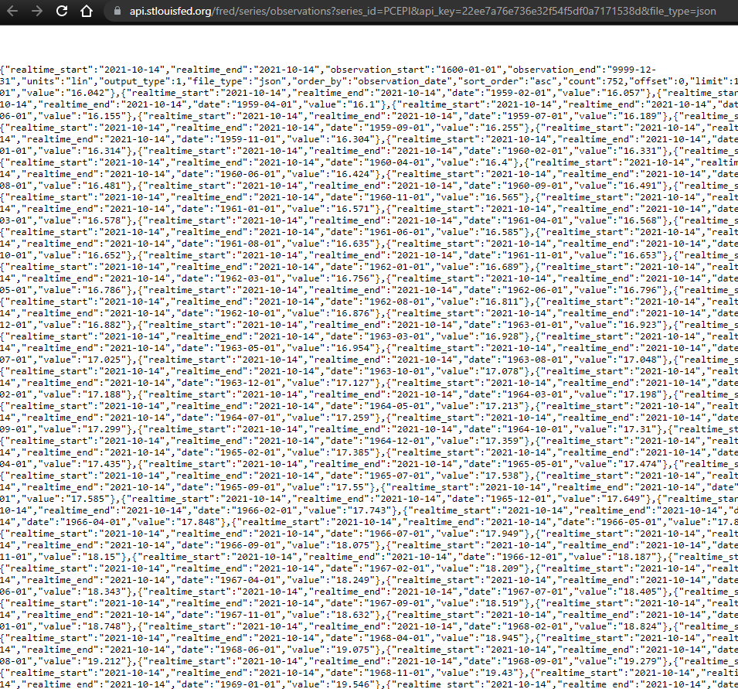

Raw JSON.
Download a JSON formatter plug in for your browser

Slide 27
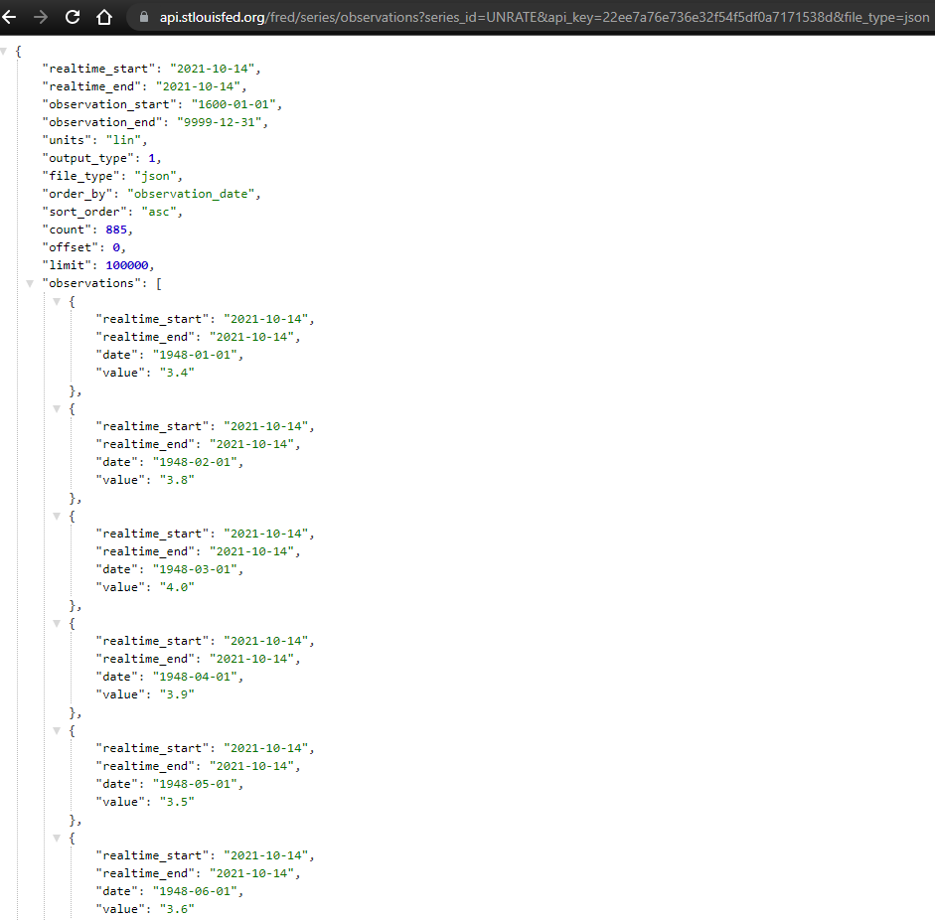

Slide 28
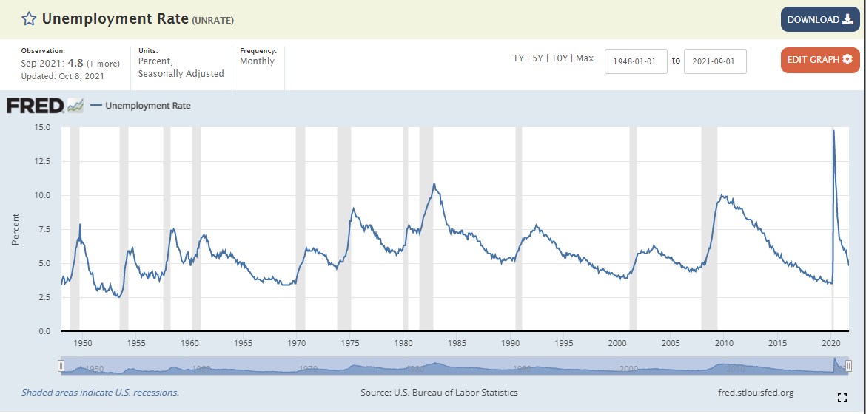

Slide 29
Examples.
Sport data
https://app.sportdataapi.com/api/v1/soccer/matches?apikey=xyzb8050-f3d3-11eb-808b-334144de1112&season_id=1980
Bitcoin data
https://rest.coinapi.io/v1/ohlcv/BTC/USD/history?period_id=8HRS&time_start=2021-08-01T00:00:00&limit=100&apikey=FXA2BB27-5458-4X
There are many more examples in the week 3 DropBox folder.

Slide 30
Golden Rule.
Every API will have a documentation page.
Setting out what queries you can use, the options etc.
Read it.

Slide 31
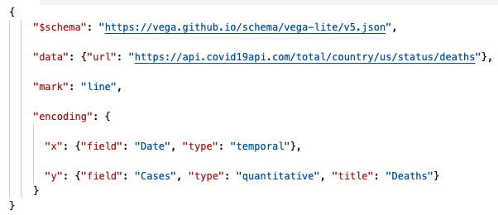
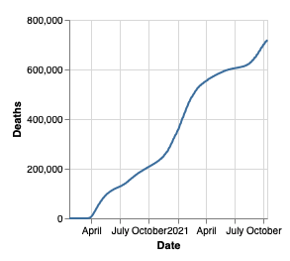
Worked example.
Here is an example of a chart which pulls data from the Global Covid-19 API:

Slide 32
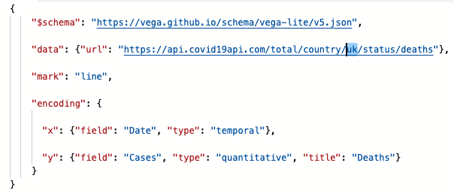
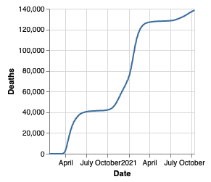
Example.
Chart now shows UK data
API URL tweaked
Edit the URL to draw data from a different country:

Slide 33

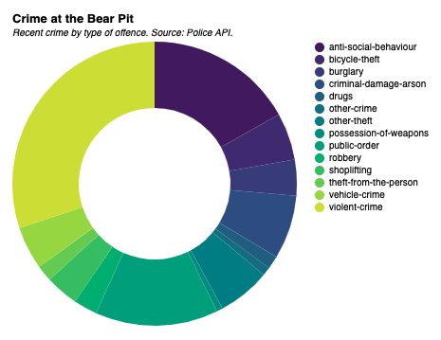
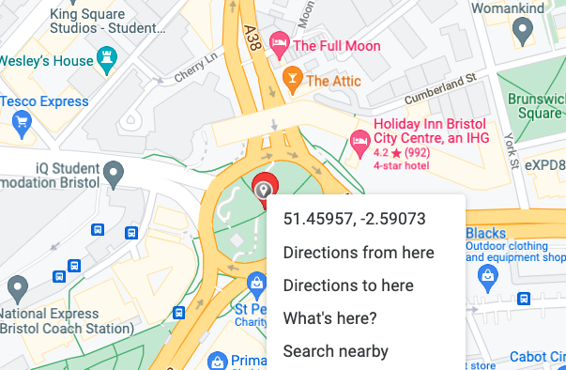
Example.
This chart uses the Police API. The location is selected by entering coordinates in the URL

Slide 34
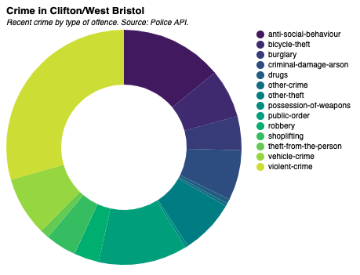
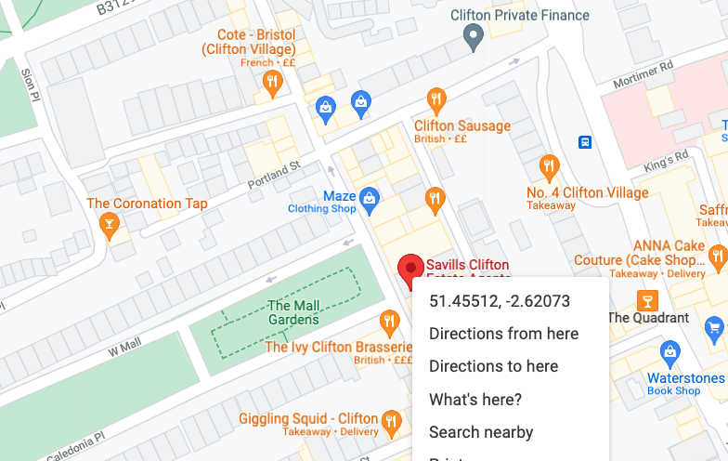
Example.
Change the coordinates in the URL to adjust the crime location to Clifton Village
API URL tweaked using coordinates from Google maps
Chart now shows data for Clifton

