Slide 1


Slide 2

Session 5. Transforming Data

Slide 3
Session 5. Transforming Data
Producing Charts from Multiple Sources (20 minutes)
Guided chart creation (40 minutes)

Slide 4
Transforming Data.
Today, we’ve used data from a single source (API, CSV, JSON) to produce charts:
Data
(API, CSV, JSON)
Chart
(Vega-lite)
Sometimes we need to merge and transform data from different places:
Source 1
Tidy Data
(CSV, JSON)
Chart
(Vega-lite)
Source 2
Source 3

Slide 5
Transforming Data.
In this session, we’ll merge ECO API series to visualise Indian Trade data:
Imports
Ratios
Chart
(Vega-lite)
Exports
GDP

Slide 6
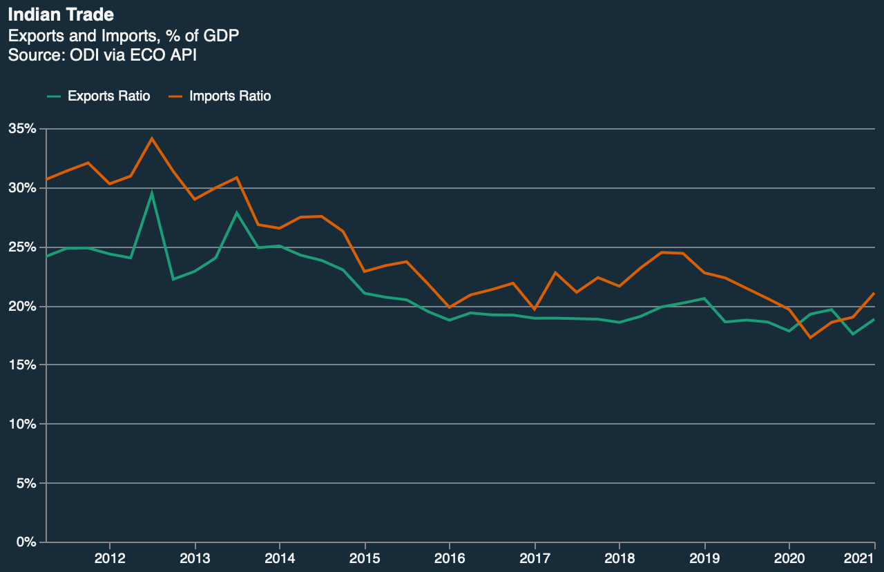
Transforming Data.
In this session, we’ll merge ECO API series to visualise Indian Trade data:

Slide 7
Transforming with Python.
Why use Python (or R, Stata, etc) and not just Excel?
Auditable: allow others to review your process, not just the result
Reproduceable: use and adapt the same code
Automatable: save time – just run the same code again
A rich ecosystem of tools: today we’ll use Pandas
Notes:
On this page, the HTML (2700 lines long!) defines the page we see

Slide 8
Code-along. Transforming Data
In this practical session, we will use Python via Google Colab to fetch, tidy and merge Indian trade data from the Economics Observatory API. There will then be time to make your own charts.
Work through the following guided notebook: “s5_transforming_data.ipynb” (open in Google Colab).

