Slide 1
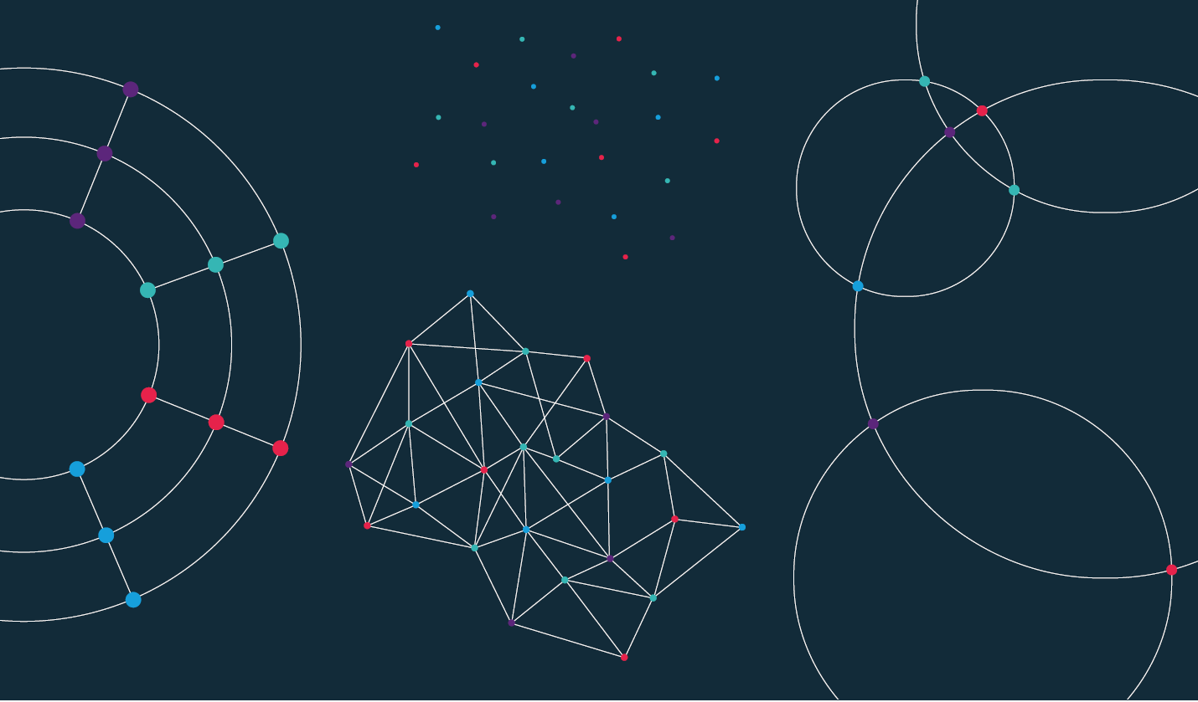

Slide 2
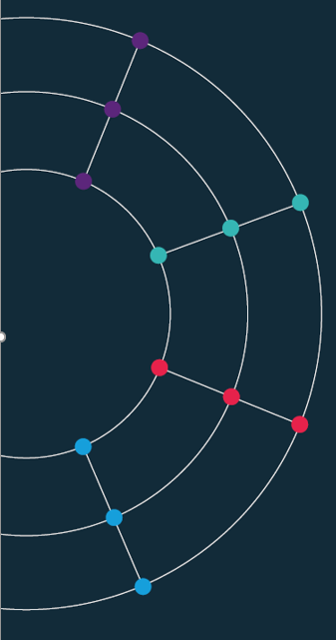
Session 4. Advanced visualisations

Slide 3
Session 4. Advanced visualisations
The grammar of graphics

Slide 4
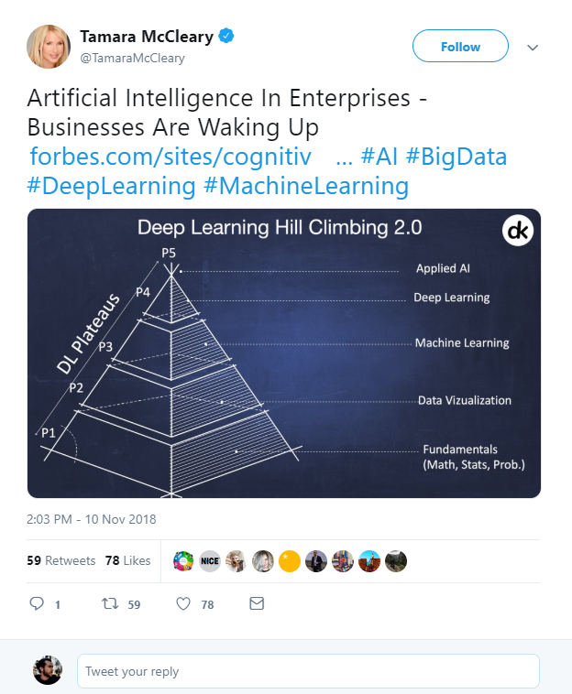

What is Data Science?
Artificial Intelligence?
Machine Learning?
Deep Learning?
Big Data?
https://twitter.com/TamaraMcCleary/status/1061197523610550272
Notes:
Tamara MCcleary – Tech Influencer
The data science pyramid
What do some of the more “fashionable” terms mean?
https://twitter.com/TamaraMcCleary/status/1061197523610550272

Slide 5

Visual language is a sign system.
Images perceived as a set of signs.
Sender encodes information in signs.
Receiver decodes information from signs.
In his foreword to the 1983 English translation, Howard Wainer called Bertin's work “the most important work on graphics since the publication of Playfair's Atlas”
Jacques Bertin, Semiologie Graphique, 1967

Slide 6
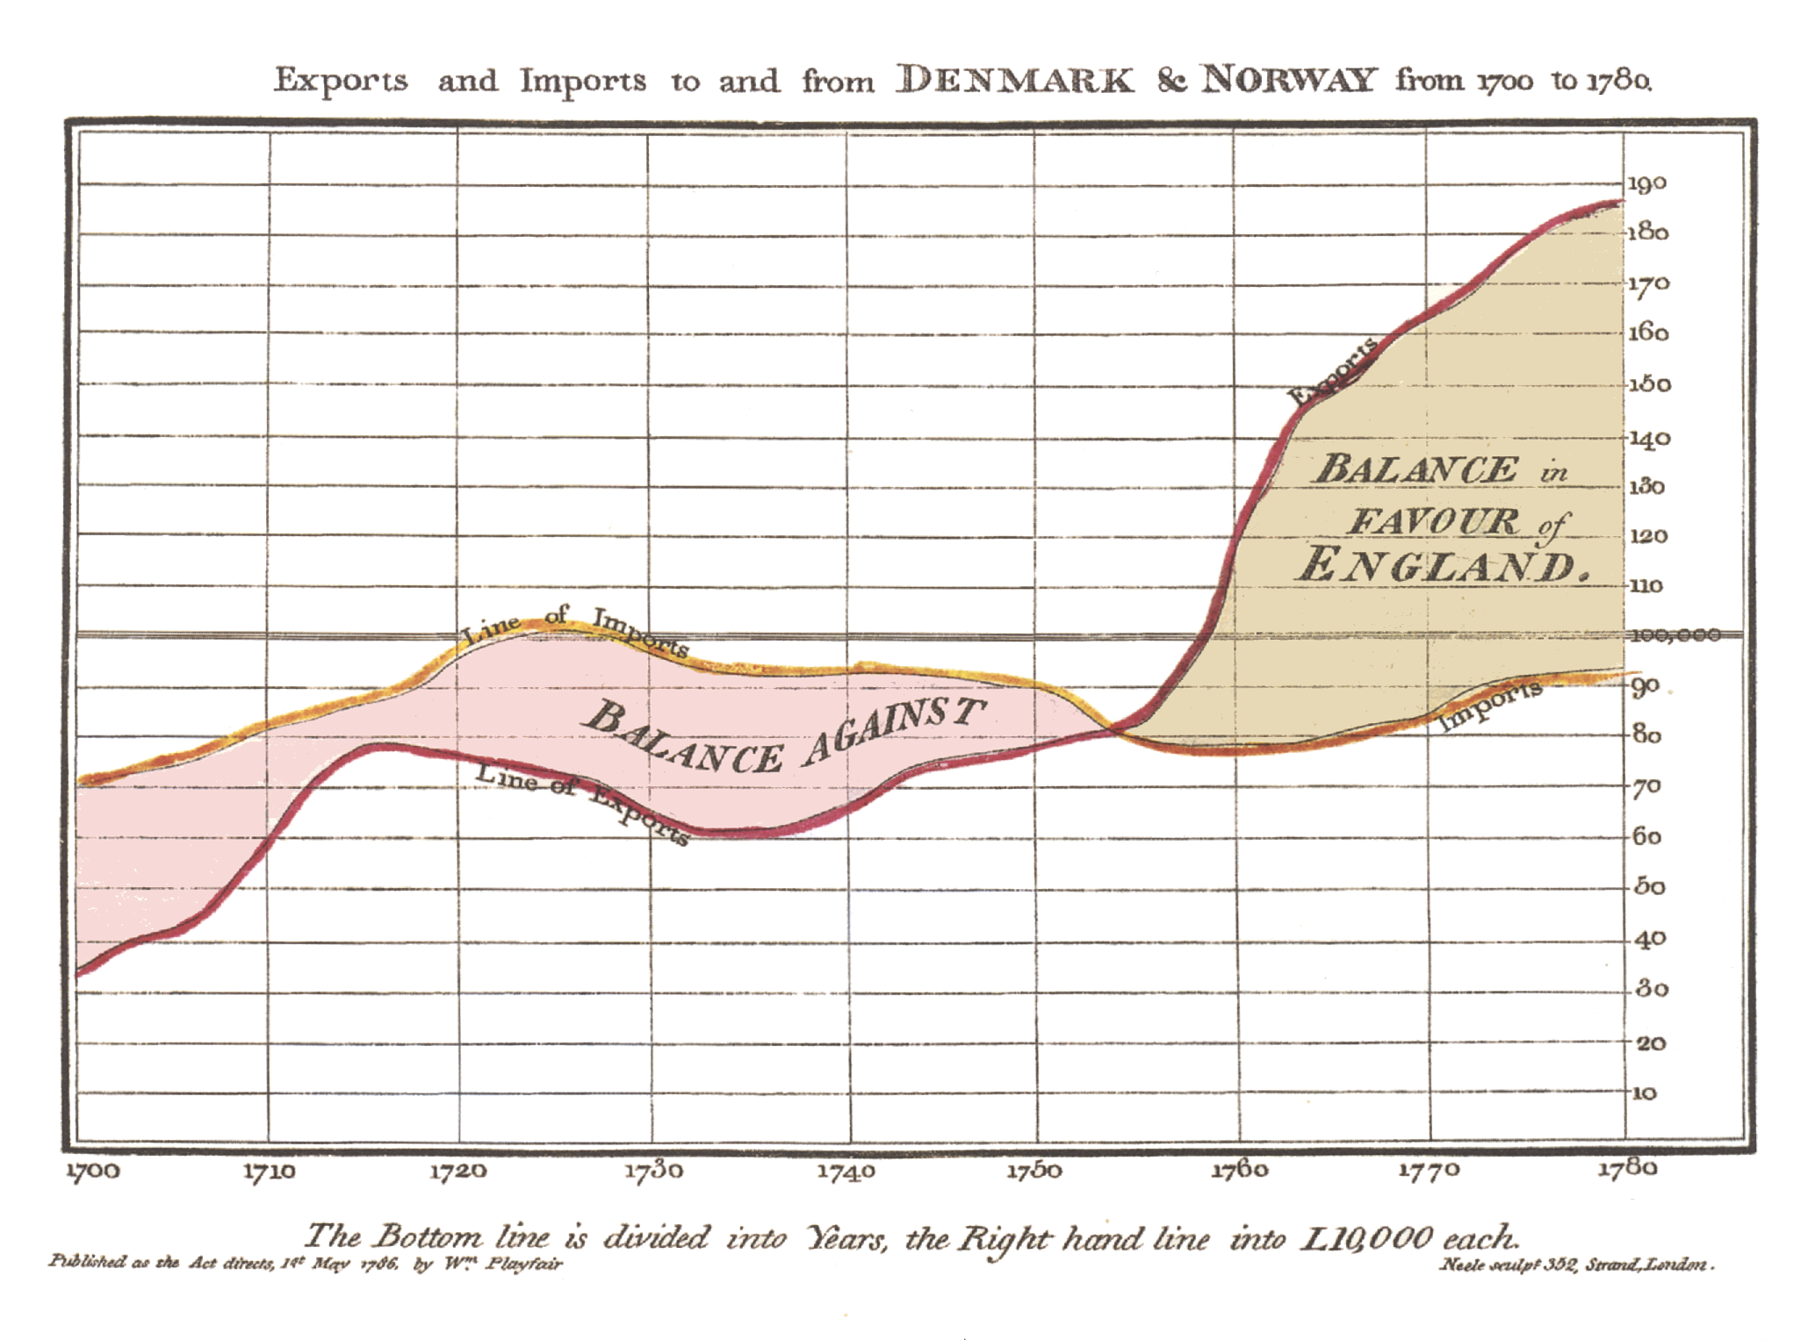
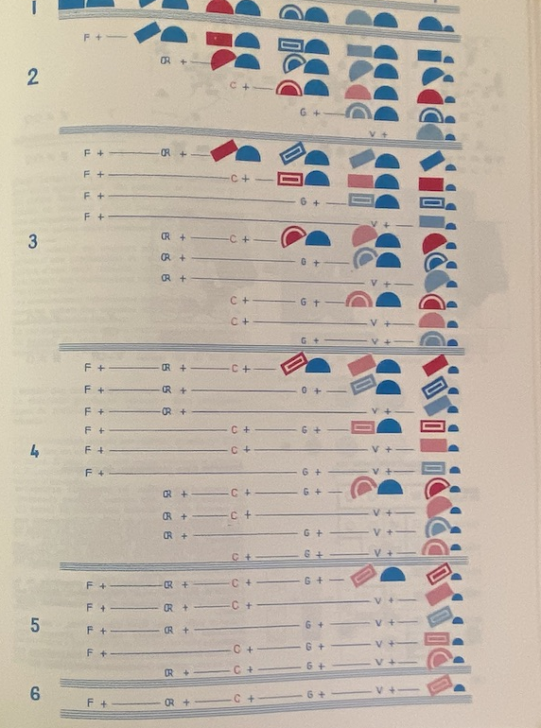
Visual language is a sign system.
William Playfair, The Commerical and Political Atlas, 1785 and Jacques Bertin, Semiologie Graphique, 1967
both collected from Jemery Norman’s HistoryOfIformation.com, 2021
Notes:
https://www.historyofinformation.com/detail.php?entryid=2929
https://www.historyofinformation.com/detail.php?id=3361

Slide 7
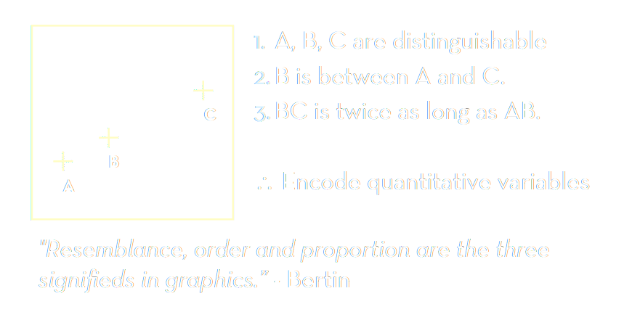
Bertin’s semiology of graphics.
Adapted from Jeffrey Heer, 2018, UW CSE442, after Jacques Bertin, Semiologie Graphique, 1967
Notes:
https://www.historyofinformation.com/detail.php?entryid=2929
https://www.historyofinformation.com/detail.php?id=3361

Slide 8
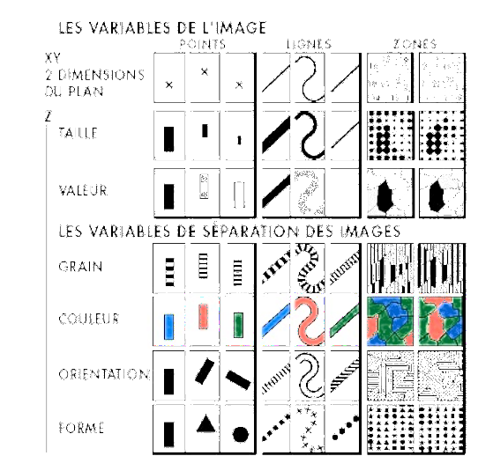
Visual encoding variables. Visual Grammar.
Position (x2)
Size
Value (Saturation)
Texture
Colour
Orientation
Shape
(Time/Animation, Focus, Opacity)
Adapted from Jeffrey Heer, 2018, UW CSE442, after Jacques Bertin, Semiologie Graphique, 1967
Notes:
https://www.historyofinformation.com/detail.php?entryid=2929
https://www.historyofinformation.com/detail.php?id=3361

Slide 9
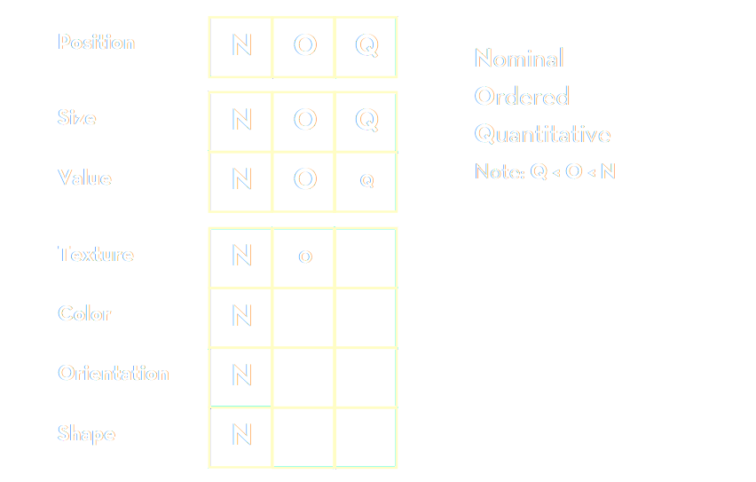
Bertin’s “Levels of Organisation”
Bertin’s list: based on theoretical considerations of semiology
Adapted from Jeffrey Heer, 2018, UW CSE442, after Jacques Bertin, Semiologie Graphique, 1967
Notes:
Bertin’s list – based on theoretical considerations of semiology

Slide 10
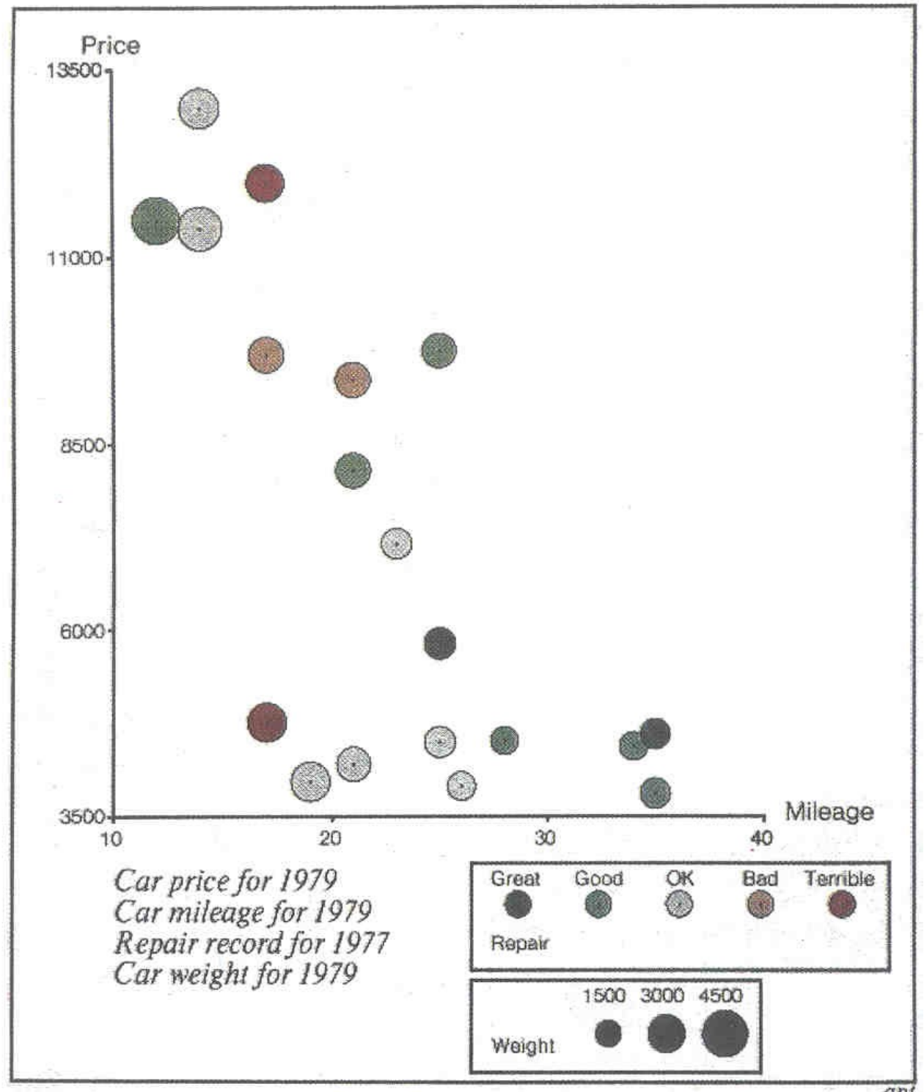
Mackinlay design criteria.
Formalizes Bertin for machines.
Expressiveness A set of facts is expressible in a visual language if the sentences (i.e. the visualisations) express all the facts in the set of data, and only the facts.
Effectiveness A visualisation is more effective than another if the information conveyed by one visualisation is more readily perceived than the information in the other visualization.
Adapted from Jeffrey Heer, 2018, UW CSE442 and Jock Mackinlay’s presentation at Ohio State University, 2005,
both based on Jock Mackinlay, Tableau/Xerox PARC/Stanford 1986
Notes:
http://web.cse.ohio-state.edu/~machiraju.1/teaching/CSE5544/mackinlay_midterm_material.pdf
Vice President of Visual Analysis at Tableau
https://www.tableau.com/learn/whitepapers/data-storytelling-using-visualization-share-human-impact-numbers

Slide 11
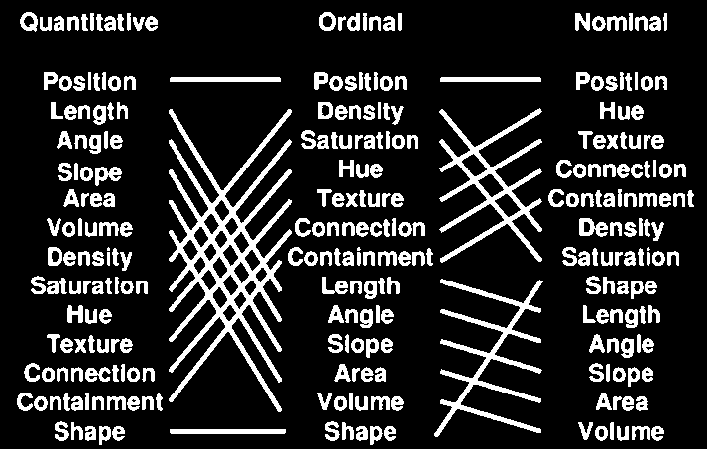
Mackinlay design criteria.
Mackinlay’s list: based on his experiments with computer graphics, trying to automate and formalize the creation of charts
The Vega visual language/grammar is built on Mackinlay’s work
Jock Mackinlay, Tableau/Xerox PARC/Stanford 1986
Notes:
Mackinlay’s list – based on his experiments with computer graphics, trying to automate and formalize the creation of charts
The first charting algorithms. The Vega visual language/grammar is built on Mackilnay’s work.

Slide 12
Which square is lighter?
Notes:
http://web.cse.ohio-state.edu/~machiraju.1/teaching/CSE5544/mackinlay_midterm_material.pdf
Vice President of Visual Analysis at Tableau
https://www.tableau.com/learn/whitepapers/data-storytelling-using-visualization-share-human-impact-numbers

Slide 13
Which square is lighter?
217, 217, 217
> 2 %
212, 212, 212
Notes:
http://web.cse.ohio-state.edu/~machiraju.1/teaching/CSE5544/mackinlay_midterm_material.pdf
Vice President of Visual Analysis at Tableau
https://www.tableau.com/learn/whitepapers/data-storytelling-using-visualization-share-human-impact-numbers

Slide 14
How many times is the right circle larger?
Notes:
http://web.cse.ohio-state.edu/~machiraju.1/teaching/CSE5544/mackinlay_midterm_material.pdf
Vice President of Visual Analysis at Tableau
https://www.tableau.com/learn/whitepapers/data-storytelling-using-visualization-share-human-impact-numbers

Slide 15
How many times is the top bar longer?
7
Notes:
http://web.cse.ohio-state.edu/~machiraju.1/teaching/CSE5544/mackinlay_midterm_material.pdf
Vice President of Visual Analysis at Tableau
https://www.tableau.com/learn/whitepapers/data-storytelling-using-visualization-share-human-impact-numbers

Slide 16

Stevens’ power law.
length
taste
weight
shock
sensation = intensity^{exponent}
Our senses are not linear!
area
volume
loudness
sensation →
intensity →
Stanley Smith Stevens, Harvard, 1957
Notes:
http://web.cse.ohio-state.edu/~machiraju.1/teaching/CSE5544/mackinlay_midterm_material.pdf
Vice President of Visual Analysis at Tableau
https://www.tableau.com/learn/whitepapers/data-storytelling-using-visualization-share-human-impact-numbers

Slide 17
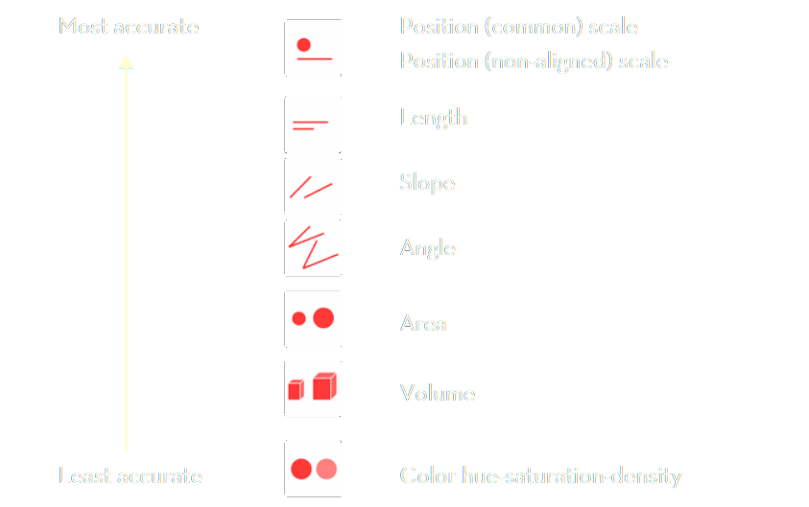
Stevens’ power law.
Stevens’ list: based on psychological experiments with human senses
Stanley Smith Stevens, Harvard, 1957

Slide 18
Visual language is a sign system.
When designing visual information use correct encodings
data → information correct data model
information → knowledge correct visual representation
Bertin’s semiology of graphics
Mackinlay design criteria
Stevens’ power law

Slide 19
Data visualization zoo.
The actual “A Tour through the Visualisation Zoo”
Economics Observatory 🌌 Visualisation Guidelines
Financial Times Visual Vocabulary
Vega Edition of the Visual Vocabulary
The D3 Graph Gallery
Andy Kirks's The Chartmaker Directory
Heer, Bostock, Ogievetsky, A Tour through the Visualization Zoo, ACM, 2010
Notes:
https://homes.cs.washington.edu/~jheer/files/zoo/

Slide 20
Session 4. Advanced visualisations
Adding multi-dimensional charts

Slide 21
Session 4. Advanced visualisations
https://github.com/EconomicsObservatory/courses/blob/main/README.md

Slide 22
Code-along.
In this fourth practical session, we will use Vega-Lite, VS Code and GitHub to explore and embed a multi-dimensional chart into your website using one (or more) of the following:
Beginner: “s4_chart1.json”
Intermediate:
“s4_chart2.json”
“s4_chart3.json” (map)
Advanced: “s4_chart4.json”
More examples: “more_example_charts”

