Slide 1


Slide 2

Data Masterclass. Introduction London School of Economics | Monday 19 February

Slide 3
















Where we are. The state of play
Analysts will tend to have five steps or more between their raw data and their output.
Example: a journalist, consultant or academic making a chart of GDP in America:
Data source
Public-sector
aggregator
Commercial
aggregator
Analyst
Publisher
Output
JPEG
SVG
SVG
XLS
SVG
TXT
CSV
SVG
BLS
FRED
Bloomberg
Editorial dept
Web team

Slide 4















Where we are. The state of play
Analysts will tend to have five steps or more between their raw data and their output.
Example: a journalist, consultant or academic making a chart of GDP in America
Data source
Public-sector
aggregator
Commercial
aggregator
Analyst
Publisher
Output
JPEG
SVG
SVG
XLS
SVG
TXT
CSV
SVG
BLS
FRED
Bloomberg
Editorial dept
Web team
Note how this system works:
Repetition. Many players, each adding delay or cost. Slow and expensive.
Errors. Each link can, and does, break. Each one adds to the chance of a human error.
Compatibility. Many different file types. Delay and compatibility problems
Storage. Huge data storage requirement, with files stored in each silo along the way. Resource and environmental costs
This system is slow, costly and inaccurate.

Slide 5
Where we are: slow, costly, error prone. The problems we will solve
Analysts will tend to have five steps or more between their raw data and their output.
Example: a journalist, consultant or academic making a chart of GDP in Amercia
Data source
Public-sector
aggregator
Commercial
aggregator
Analyst
Publisher
Output
JPEG
SVG
SVG
XLS
SVG
TXT
CSV
SVG
BLS
FRED
Bloomberg
Editorial dept
Web team
Note how this system works:
Repetition. Many players, each adding delay or cost. Slow and expensive.
Errors. Each link can, and does, break. Each one adds to the chance of a human error.
Compatibility. Many different file types. Delay and compatibility problems
Storage. Huge data storage requirement, with files stored in each silo along the way. Resource and environmental costs
This system is slow, costly and inaccurate.

Slide 6





Where we are going: fast, cheap, accurate The solutions we will offer
The modern approach used our site uses is different.
We are building a single secure channel that links an analyst’s output right back to the raw data.
Data source
Output
Analyst’s code
ONS
Note the differences with the new system:
Automated. Your chart is always up to date. When the raw data updates, it flows through the channel instantly and automatically.
Efficient. The number of players collapses, as do associated costs. There are no data silos – the data shown on your site is the raw data, not a copy of them.
Verifiable. A one-to-one link back to the original data provider means fact checks can be swift.
The result is analysis that is faster, cheaper and more accurate.

Slide 7
Why it matters… …and why Britain’s economists should lead the way
The problems above matter in many fields. They are acute in economics and public policy:
Regular updates. Economic data is high-frequency. This means that the ‘repeated analysis’ problem is particularly strong.
Descriptive analysis. Economists and analysts are aiming to clarify. We need our work to be replicable (someone else can run the code and get the same result) and verifiable.
Normative and policy analysis. Economic data is hard-wired into policy decisions. Getting it right affects people’s lives.

Slide 8
What we are doing. Data at the Economics Observatory
To respond to these issues, we have developed the Economics Observatory Data Hub. This contains three connected tools:
Explore. A new API. This will unify and simplify existing data sources into one stream. The ECO API offers simple URLs that put the user’s needs first, allowing them to access a wide range of metrics from multiple international sources
Build. With improved data access comes better analytics. With our new Chart Builder, users take the latest data directly from source, and display this live in a webpage. No coding skills are needed, but modern tools are being used in the background: Excel and JPEG are out, JavaScript Ordered Notation (JSON), D3.js and Vega-Lite are in.
Share. Robust analysis deserves to be shared. Users can share their visualisations on traditional platforms like Twitter and Instagram, or can post their work to our new timeline for academics, journalists, policy-makers and students to post and discuss their charts.

Slide 9
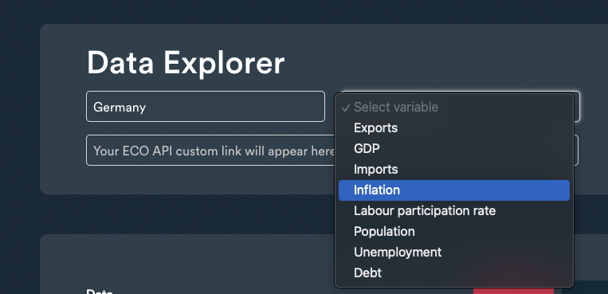
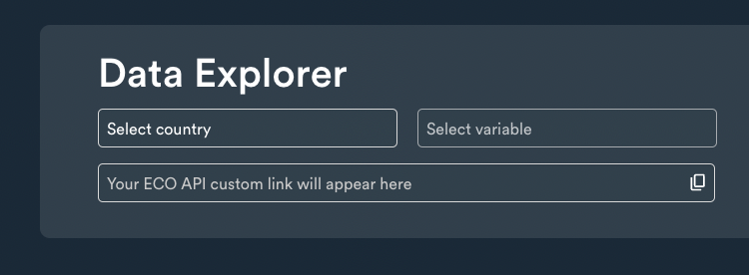
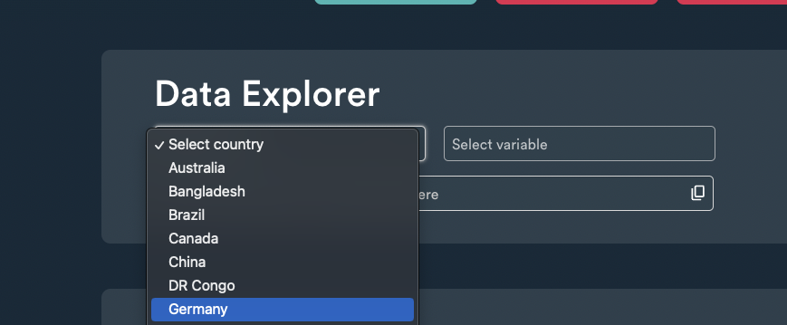
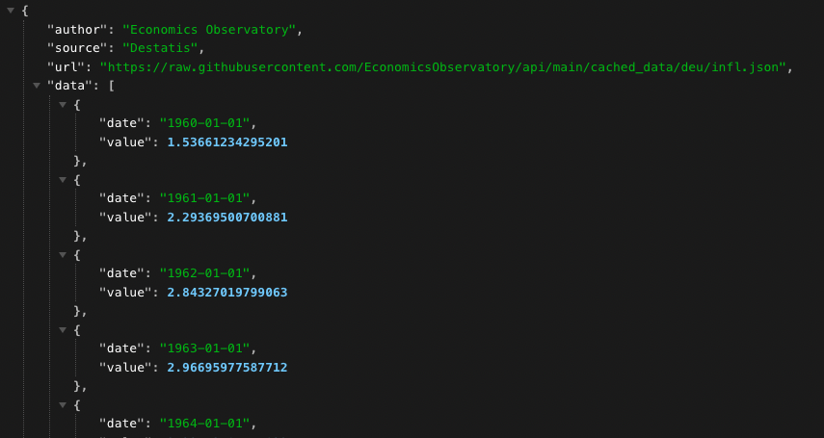
What we are doing. Data at the Economics Observatory
Explore

Slide 10
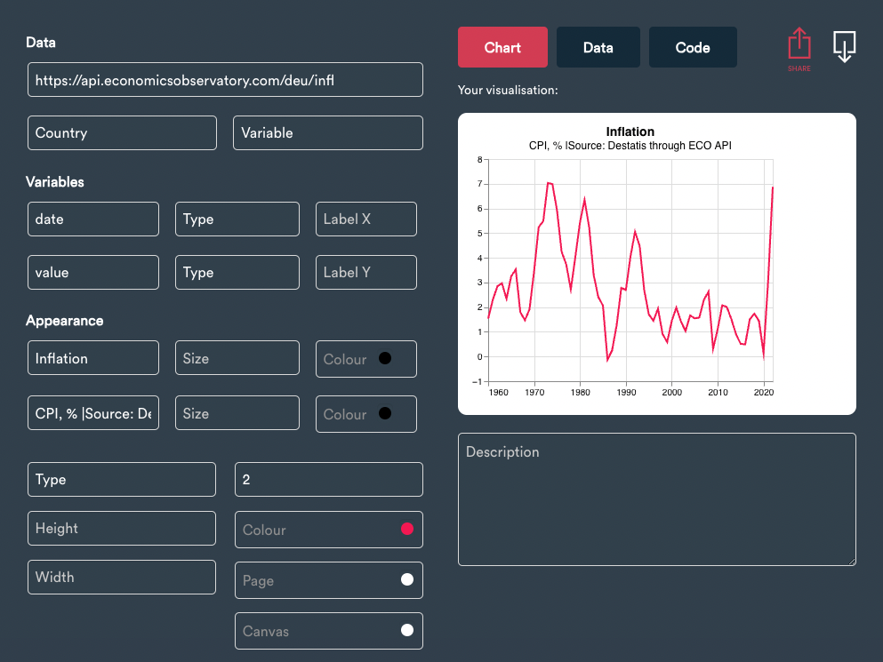
What we are doing. Data at the Economics Observatory
Create

Slide 11
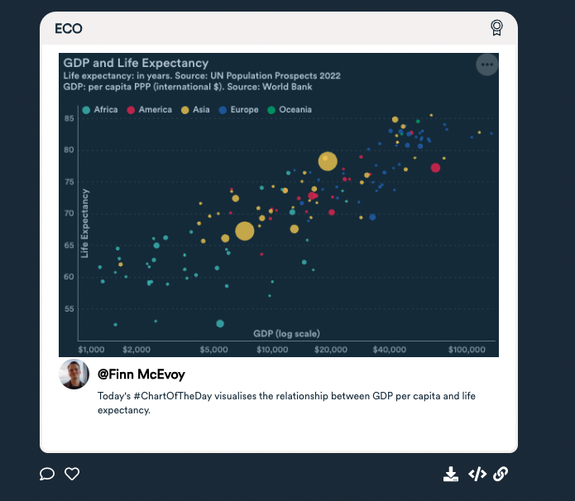
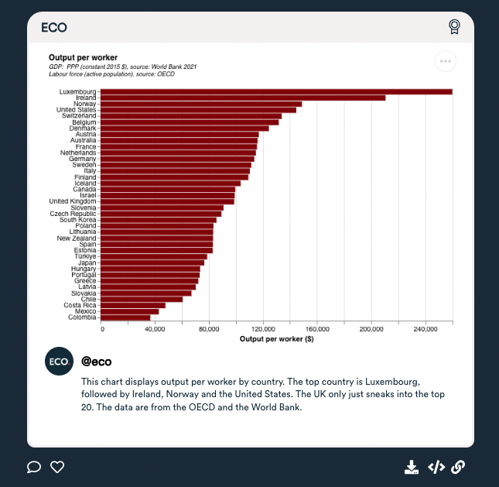
What we are doing. Data at the Economics Observatory
Share

Slide 12
Masterclass outline. Teaching team + more on ECO
Richard Davies | Director
Charlie Meyrick | Research Fellow
Josh Hellings | Data Scientist
Finn McEvoy | Data Scientist
Website: www.economicsobservatory.com
Newsletter: www.economicsobservatory.com/join-us
Data Hub: www.economicsobservatory.com/data-hub

Slide 13
Masterclass outline. What we are covering today
Time | Section | Details
09.00 - 09.30 |  | Welcome coffee. Checking computer set ups.
09.30 - 10.30 | 1 | Charts as data – introducing Vega-Lite
10.30 - 11.00 | Break | Coffee/tea (team available to fix bugs)
11:00 - 12.30 | 2 | My first website – GitHub, HMTL, CSS and JavaScript
12.30 - 13.15 | Lunch | Lunch (team available to fix bugs)
13.15 - 14.15 | 3 | Programming – APIs, if statements, and loops.
14.15 - 15.15 | 4 | Advanced visualisations – beyond two dimensions
15:15 - 15:30 | Break | Coffee/tea (team available to fix bugs)
15.30 - 16.30 | 5 | Scraping – fetching data with Python

Slide 14
Section 1: Charts as data. Introducing Vega-lite

Slide 15
JSON data.
JavaScript Object Notation. An important data type. Why use it?
It is the way computers share data.
Most importantly it is what many APIs will deliver – your data will arrive to you in this way.
It looks complicated at first, but is easy to convert into access, change and chart.
Formatted as key : value pairs (aka name : value pairs)
'{"name":“David Beckham", “kids":4, “team":“Manchester United”}’
Keys are strings, always in double quotes.
Values can be many things: string, number, arrays, objects.
Useful tools:
www.jsonlint.com. Test and format JSON.
JSON formatter. Chrome extension.

Slide 16
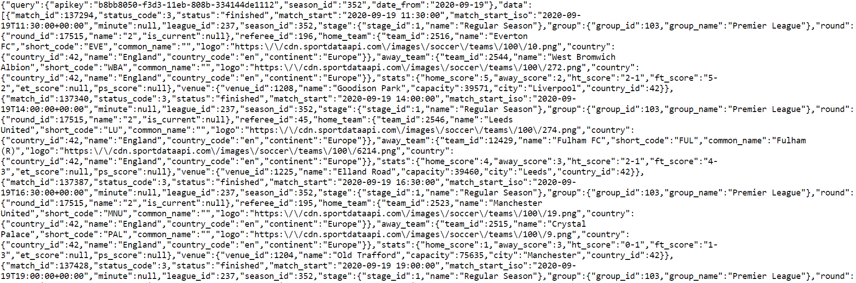
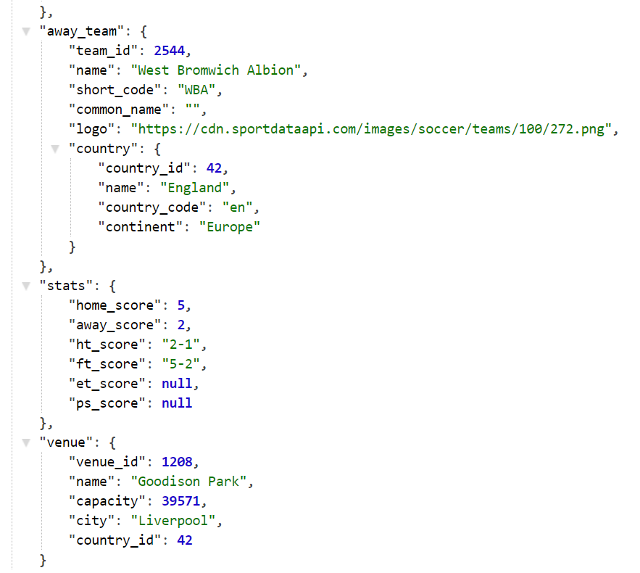
Raw.
Parsed.
API returns. The results of request to Sport Data API.

Slide 17
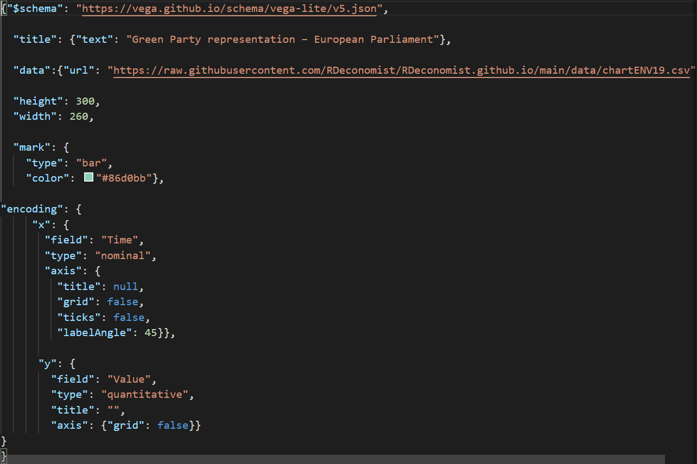
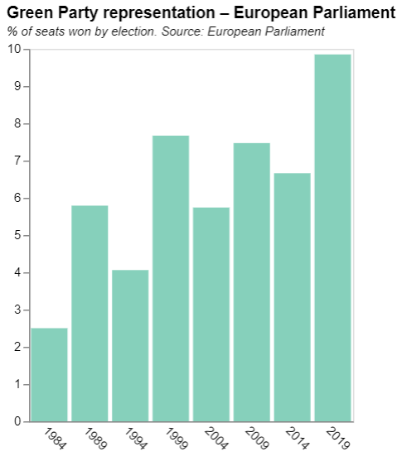
Charts as JSON.

Slide 18
Delivering data. …what does the new method look like?
There are lots of different ways to deliver data to your visualisation. We will focus on the following three:
Embedded into the design of the chart
Via CSV file on GitHub
Via an API

Slide 19
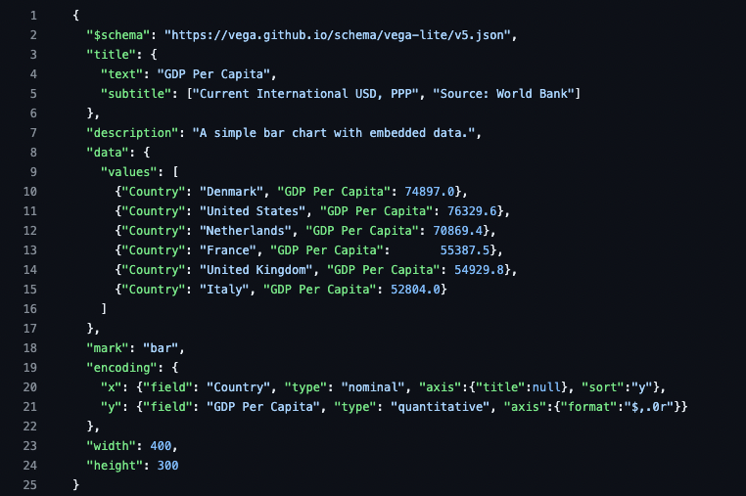
Delivering data. …what does the new method look like?
The data are here
Embedded into the design of the chart

Slide 20
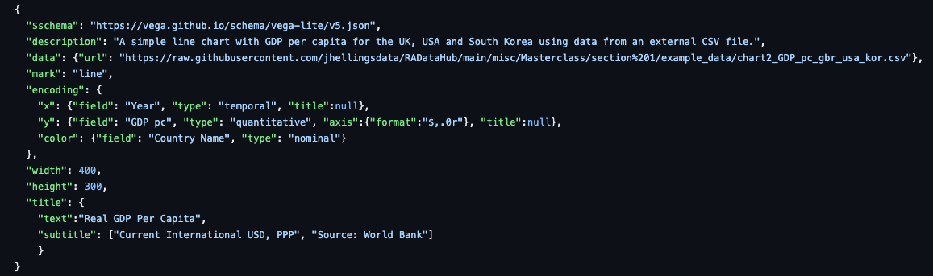
Delivering data. …what does the new method look like?
The data are stored elsewhere on GitHub, via this link
Delivered via a CSV file on GitHub

Slide 21
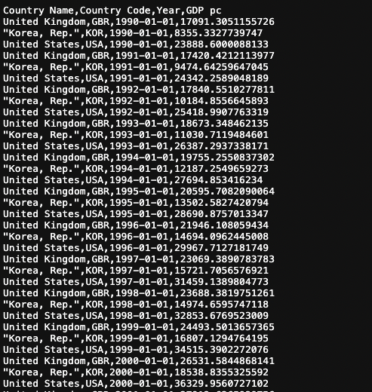
Delivering data. …what does the new method look like?
You can open the CSV link in your browser to see the underlying numbers
Delivered via a CSV file on GitHub

Slide 22
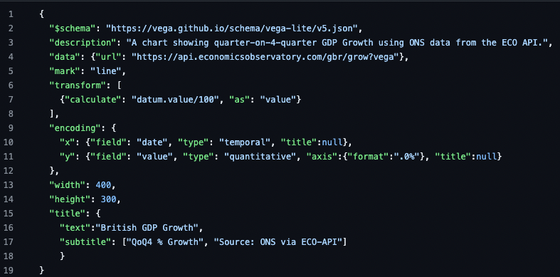
Delivering data. …what does the new method look like?
The data are stored externally, accessed via a special ‘API’ link
Delivered via an API

Slide 23
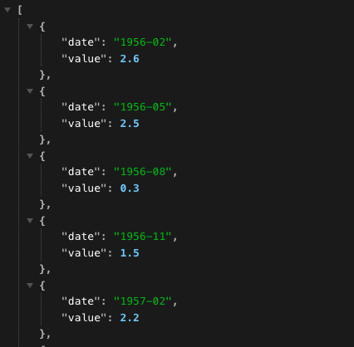
Delivering data. …what does the new method look like?
You can open the API link in your browser to see the underlying numbers. Note the ‘key-value pairs’
Delivered via an API

Slide 24
Session 1. Charts as data
Code-along

Slide 25
Session 1. Charts as data
https://github.com/EconomicsObservatory/courses/blob/main/README.md

Slide 26
Code-along. Exploring the three data types
In this first practical session, we will be using Vega-Lite to explore the three data delivery types:
Embedded into the design of the chart: “chart1_data_inline.json”
Via CSV file on GitHub: “chart2_data_linked.json”
Via an API: “chart3_data_from_api.json”
By the end of the session, you will have downloaded one of the JSON files, and added it to your own personal repository (more on this to follow…)

