Slide 1
Generalized Linear Models (GLMs)
Peter Thompson
Ecostats
November 7th, 2023

Slide 2
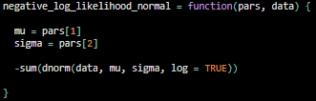

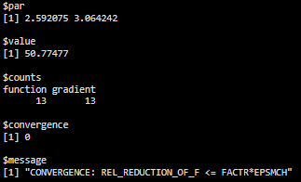
Last time we talked about likelihood…
We’re going to talk more about it today!

Slide 3
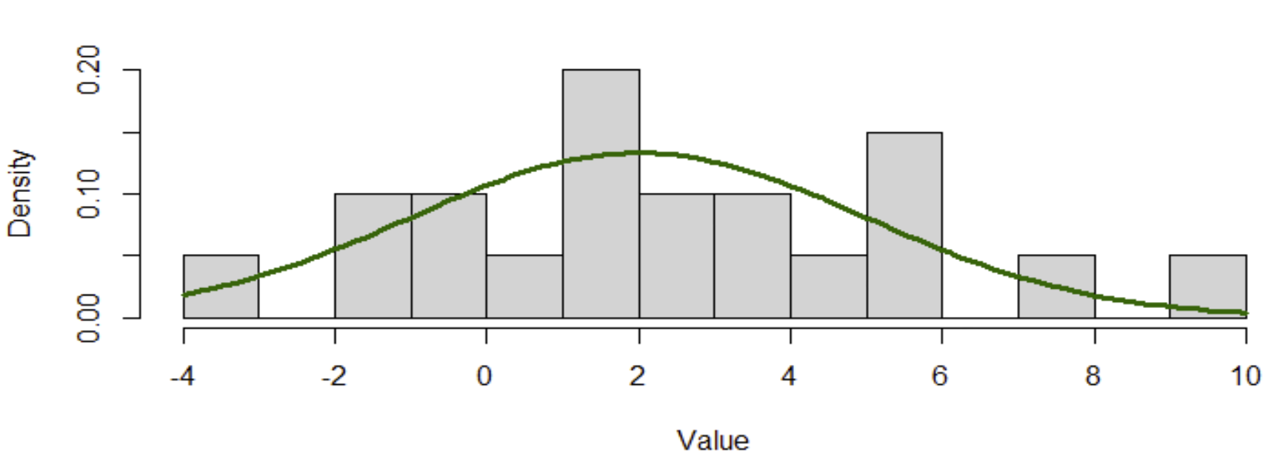
We also talked about distributions!
These “data” are normally distributed

Slide 4
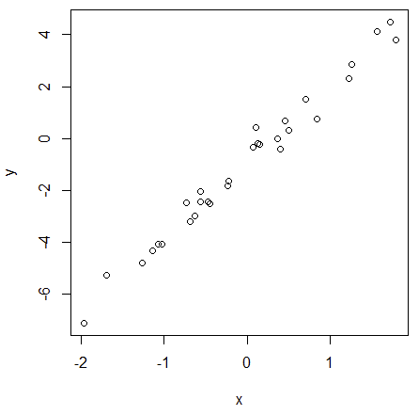
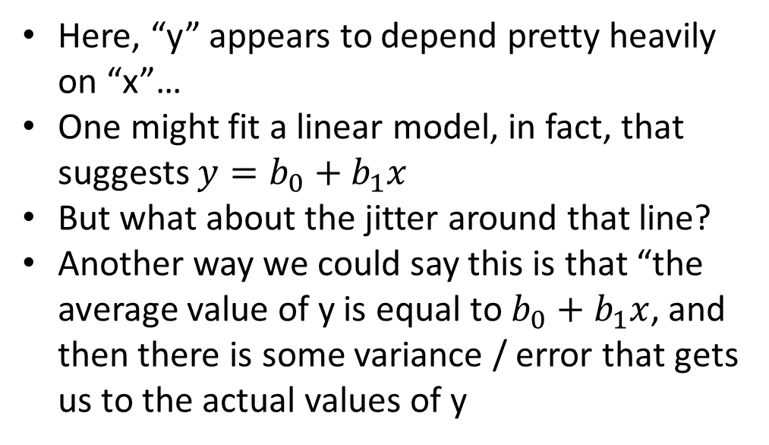
How can we use this logic when one variable depends on another?
Here, “y” appears to depend pretty heavily on “x”…
One might fit a linear model, in fact, that suggests $y=b_{0}+b_{1}x$
But what about the jitter around that line?
Another way we could say this is that “the average value of y is equal to $b_{0}+b_{1}x$, and then there is some variance / error that gets us to the actual values of y

Slide 5
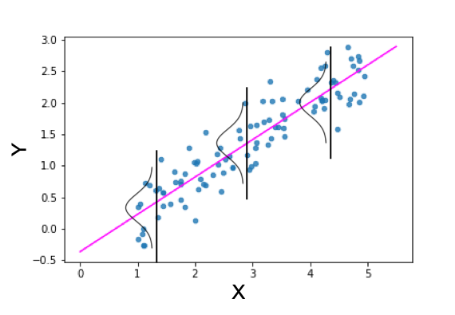
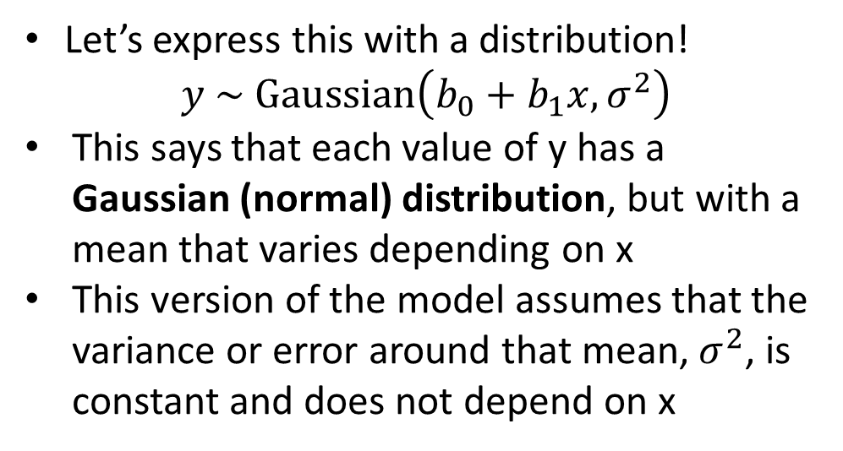
How can we use this logic when one variable depends on another?
Let’s express this with a distribution!
$$y \sim Gaussian\left(b_{0}+b_{1}x, σ^{2}\right)$$
This says that each value of y has a Gaussian (normal) distribution, but with a mean that varies depending on x
This version of the model assumes that the variance or error around that mean, $σ^{2}$, is constant and does not depend on x
towardsdatascience.com

Slide 6
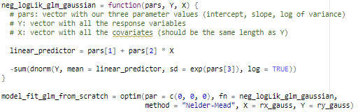
Fitting GLM’s to data
Now that we have expressed our model in the form of one of these simple distributions, it is very easy to generate a likelihood function and optimize it!
Let’s do it!

Slide 7
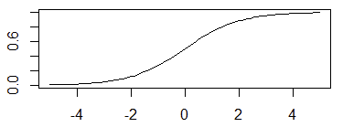
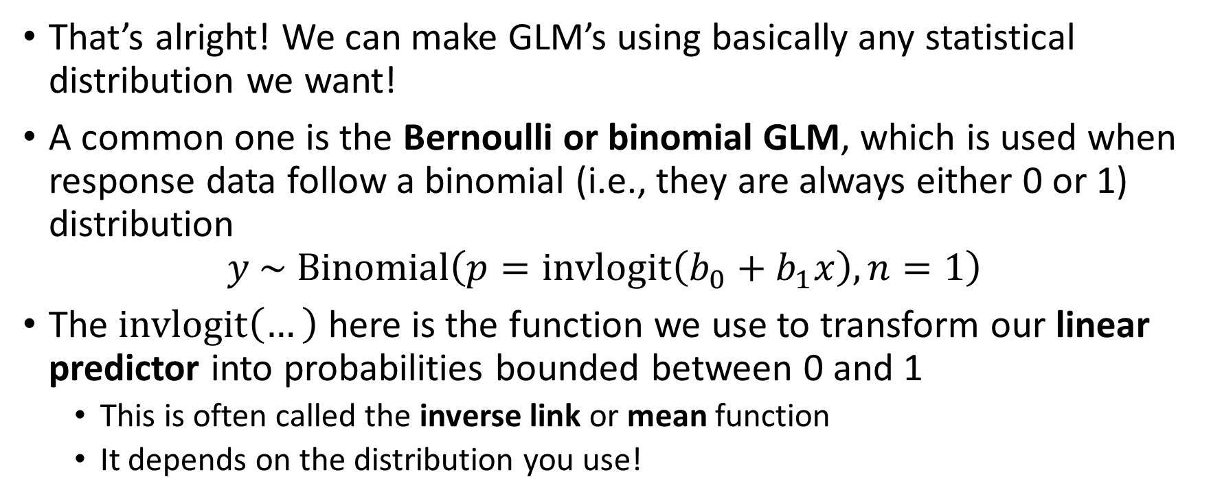
“But my data don’t follow a normal distribution!”
That’s alright! We can make GLM’s using basically any statistical distribution we want!
A common one is the Bernoulli or binomial GLM, which is used when response data follow a binomial (i.e., they are always either 0 or 1) distribution
$$y \sim Binomial\left(p=invlogit\left(b_{0}+b_{1}x\right), n=1\right)$$
The $invlogit\left(…\right)$ here is the function we use to transform our linear predictor into probabilities bounded between 0 and 1
This is often called the inverse link or mean function
It depends on the distribution you use!
?????
Inverse logit function
Let’s try this one too!!

Slide 8
What about random effects?
GLMM’s (generalized linear mixed models) follow the same logic as GLM’s but add random effects
Random effects are latent quantities in our model that are important to the process being modeled, but that we are not typically interested in estimating explicitly
We don’t care that much about the values of the individual random effects but we do care about the distribution that they come from
Now we have random effects following a distribution, plus our data following a distribution that depends on the random effects… this is a hierarchical model!

Slide 9
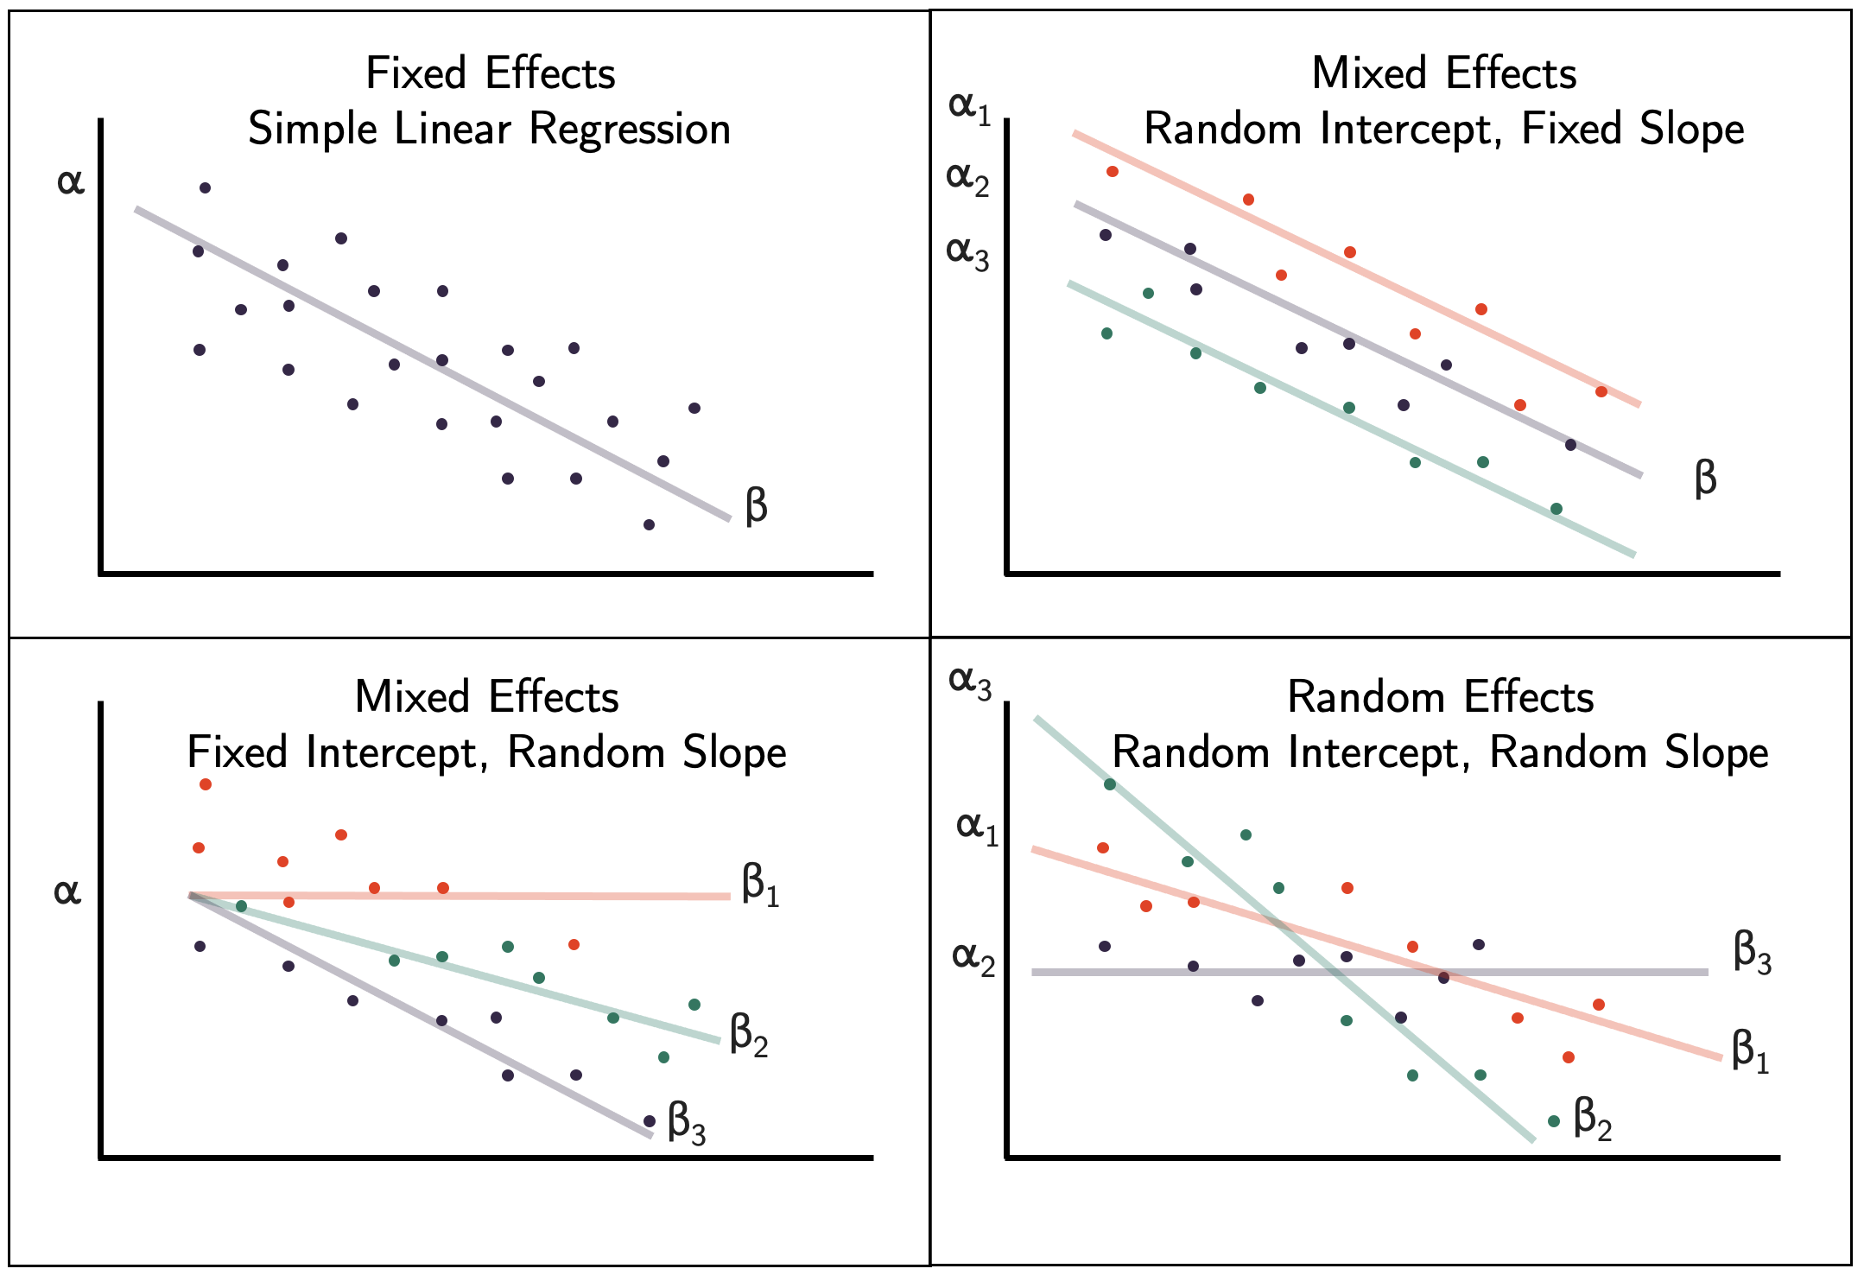

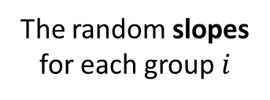
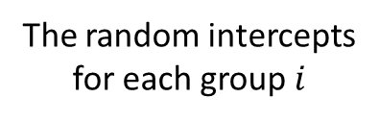
Under the hood of a Gaussian GLMM
$$u_{i} \sim Gaussian\left(0, σ_{r}^{2}\right)$$
$$v_{i} \sim Gaussian\left(0, σ_{s}^{2}\right)$$
$$y \sim Gaussian\left(b_{0}+b_{1}x+u_{g\left(x\right)}+v_{g\left(x\right)}x, σ_{f}^{2}\right)$$
Represents the variability between groups
The random intercepts for each group $i$
The between-group variance in slopes is probably different from that of the intercepts!
The random slopes for each group $i$
Notes:
Things to note here:
The mean of the Gaussian for the random effects is 0 because the effects are added on top of the intercept. Another way to format this would be to have the mean of the u_i’s be b_0, and then remove b_0 from the model below
We now have two different sigma^2 terms in the model! This is because there are now two *types* of variance or error that affect our results. There is error associated with our groups (sigma_r) and error associated with randomness (sigma_f)
3) This model only has a random intercept. We can also add random slopes!

Slide 10
Fitting GLMMs to data
This is rather difficult! We are not going to do this one by hand
In short, instead of maximizing the likelihood of our model (which could be calculated based on the previous equations), we want to maximize the marginal likelihood with the random effects integrated out
Fortunately, we have many tools for this in R!
If you want to write and fit your own random effects model, you can do so with packages like TMB or nimble, which will do some of the hard stuff described above for you
Notes:
Confusing, but the random effects themselves *are* parameters. We don’t know what they are, and they go in the equation. But, we don’t want to estimate them the same way we want to estimate

Slide 11
Advice for fitting mixed-effects models
Think a lot about what random effects you want to include and where
Use the different variance parameters in your model to learn more about the structure of error in your data
Remember that there is no one right way to fit a mixed-effects model, and different datasets / ecological processes will mandate different modelling tools
Be aware of the trade-off between model complexity (# of parameters) and model realism (# of different processes captured)
If your model is really complicated, consider looking into Bayesian methods

