Slide 1

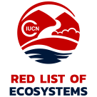









Global Ecosystem Partnership

Slide 2






