Slide 1
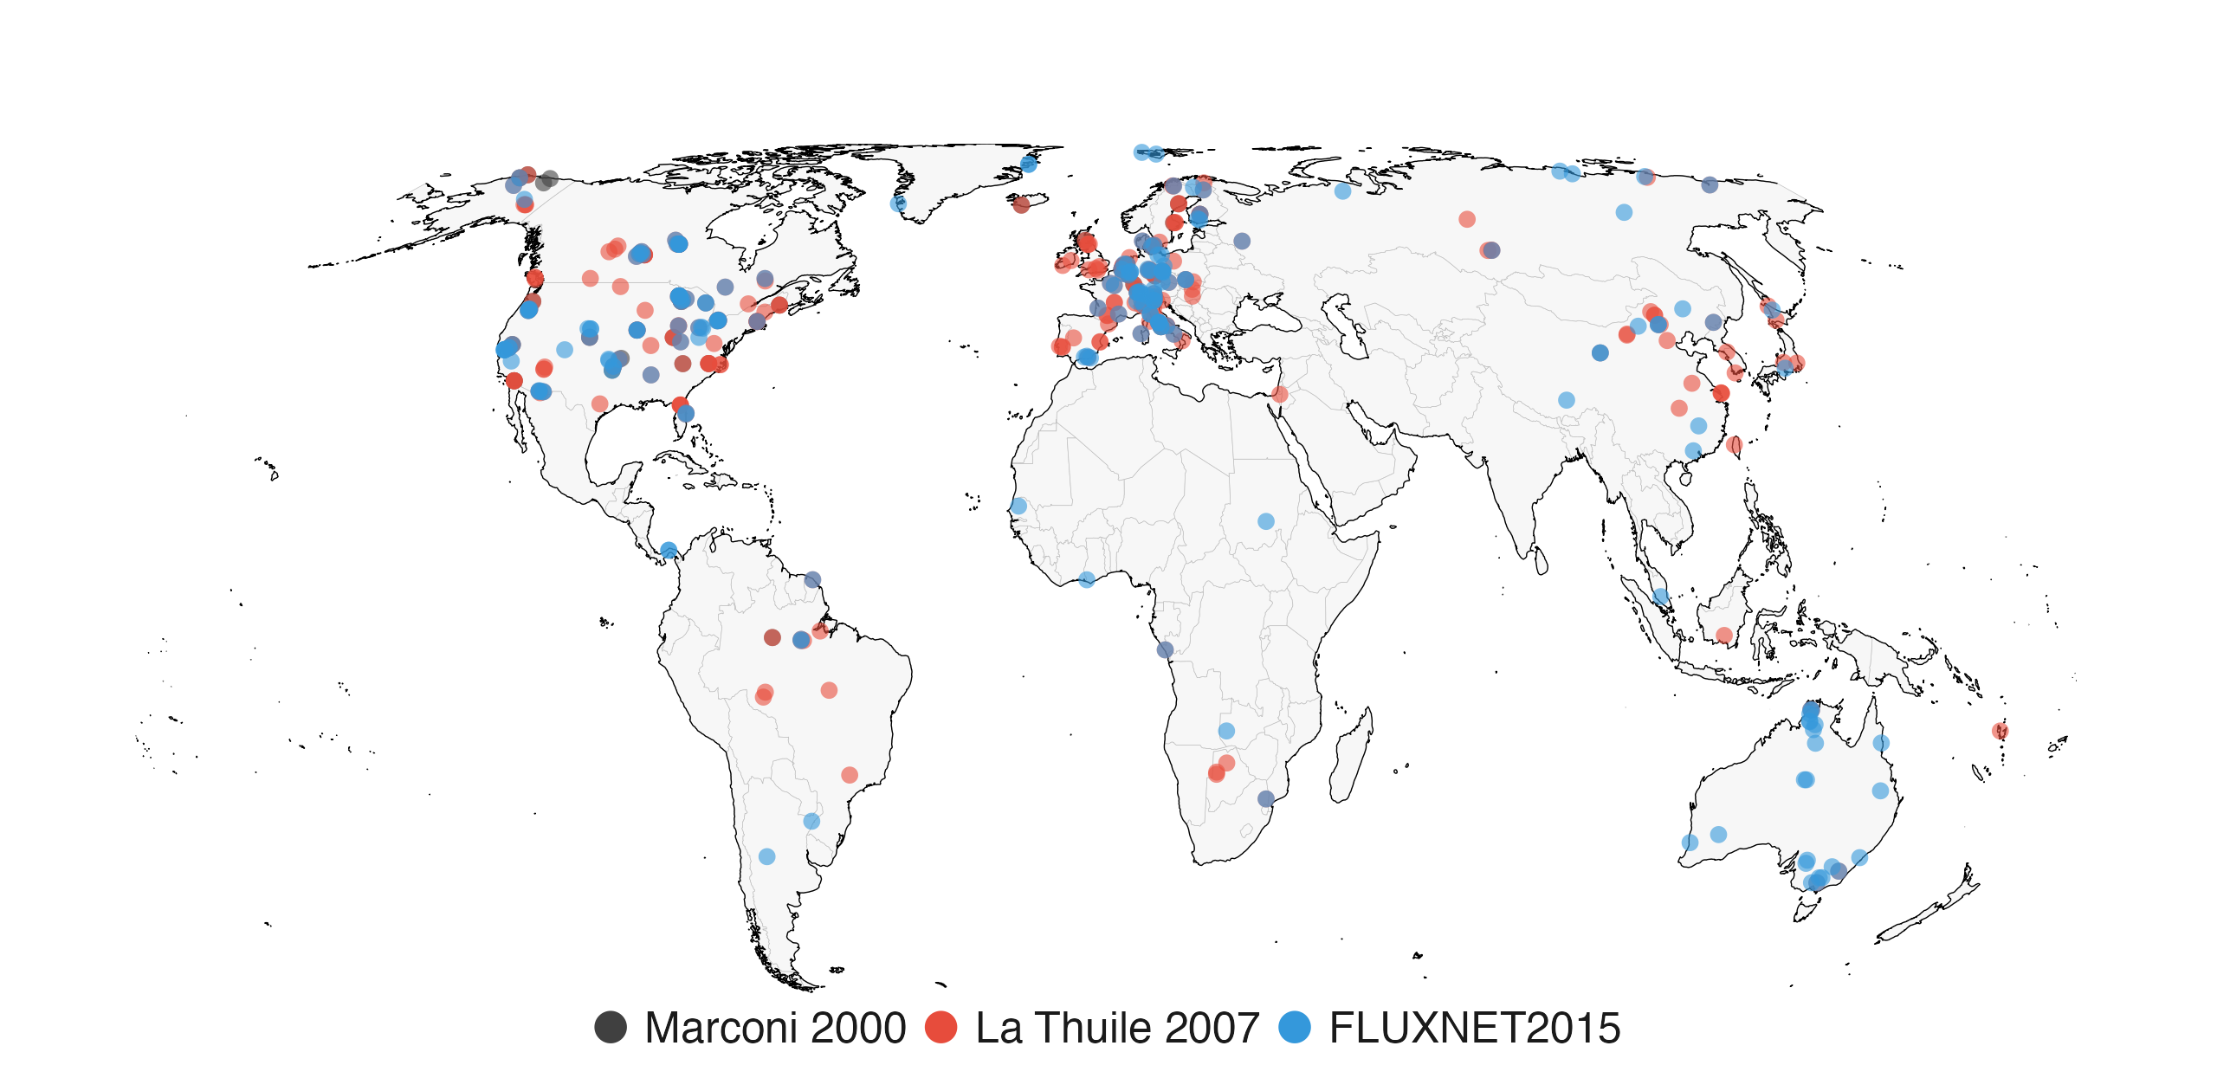
Notes:
Sites belonging to the three historical collections (Marconi 2000, La Thuile 2007, FLUXNET2015), matched to current FLUXNET Shuttle site IDs as for Table 1. n = 499 matched sites (35 Marconi, 252 La Thuile, 212 FLUXNET2015). Coloured as in Figure 2 (Marconi #404040, La Thuile #E74C3C, FLUXNET2015 #3498DB). Snapshot: fluxnet_shuttle_snapshot_20260901T094522.csv.

Slide 2
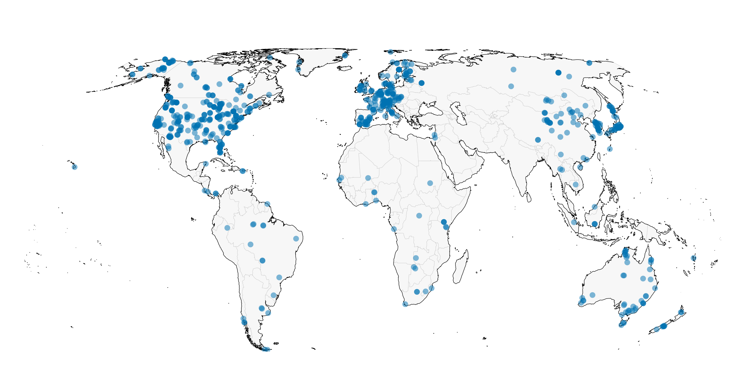
Notes:
All 781 towers in the current FLUXNET Shuttle snapshot, Equal Earth (EPSG:8857) projection. Snapshot: fluxnet_shuttle_snapshot_20260901T094522.csv.

Slide 3
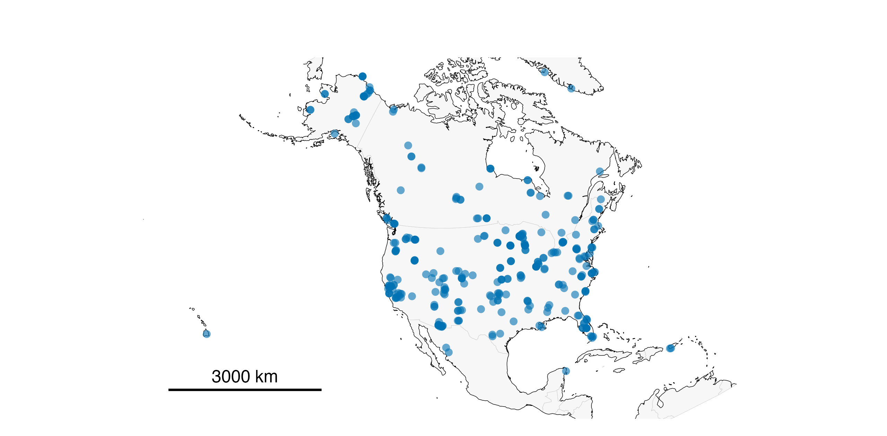
Notes:
North America regional panel: lat [15, 72], lon [-170, -50]; n = 362 towers; scale bar 3000 km; Lambert Azimuthal Equal-Area projection. Snapshot: fluxnet_shuttle_snapshot_20260901T094522.csv.

Slide 4
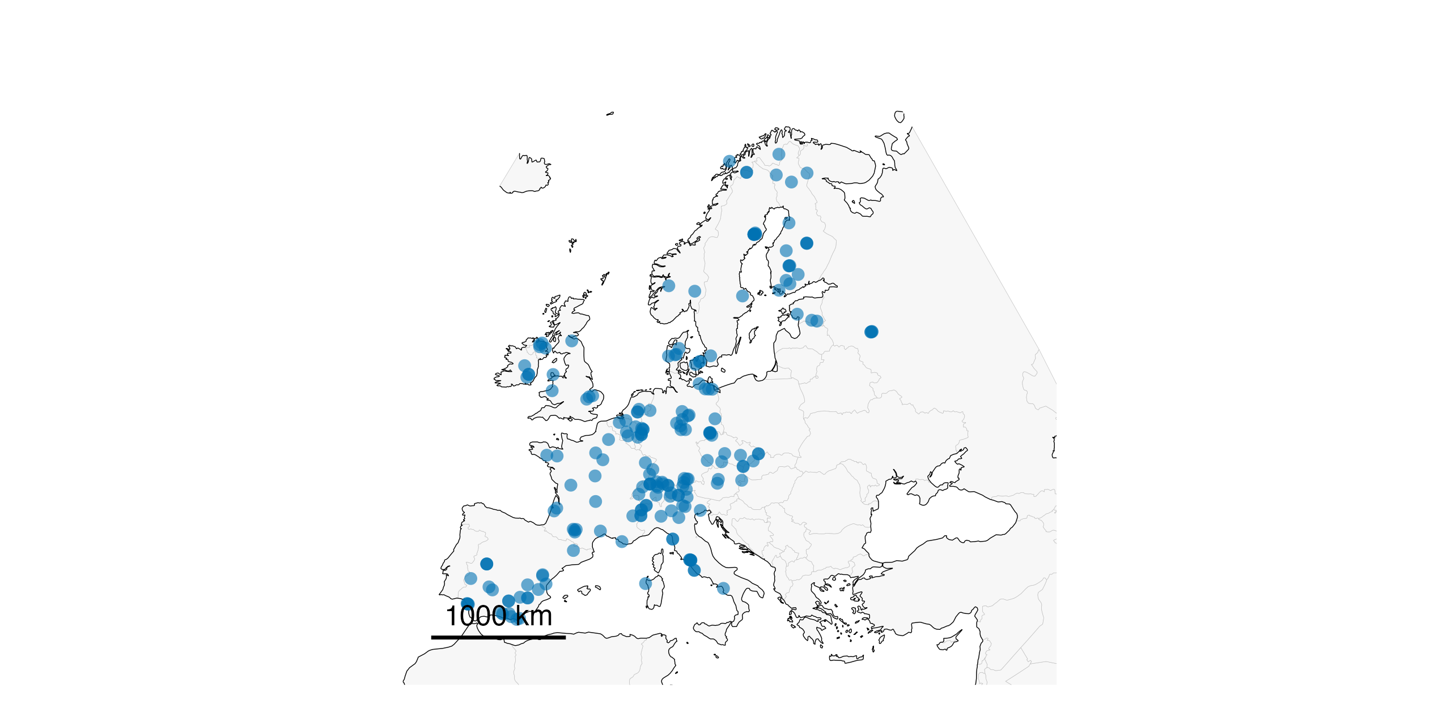
Notes:
Europe regional panel: lat [34, 72], lon [-12, 42]; n = 198 towers; scale bar 1000 km. Snapshot: fluxnet_shuttle_snapshot_20260901T094522.csv.

Slide 5
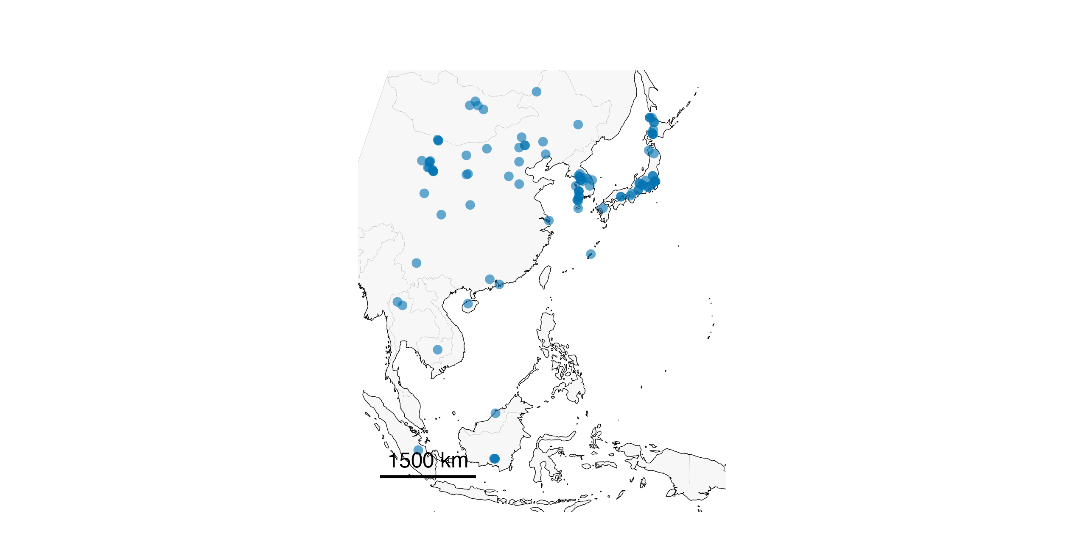
Notes:
East and Southeast Asia regional panel: lat [-10, 51.5], lon [95, 146]; n = 103 towers; scale bar 1500 km. Snapshot: fluxnet_shuttle_snapshot_20260901T094522.csv.

Slide 6
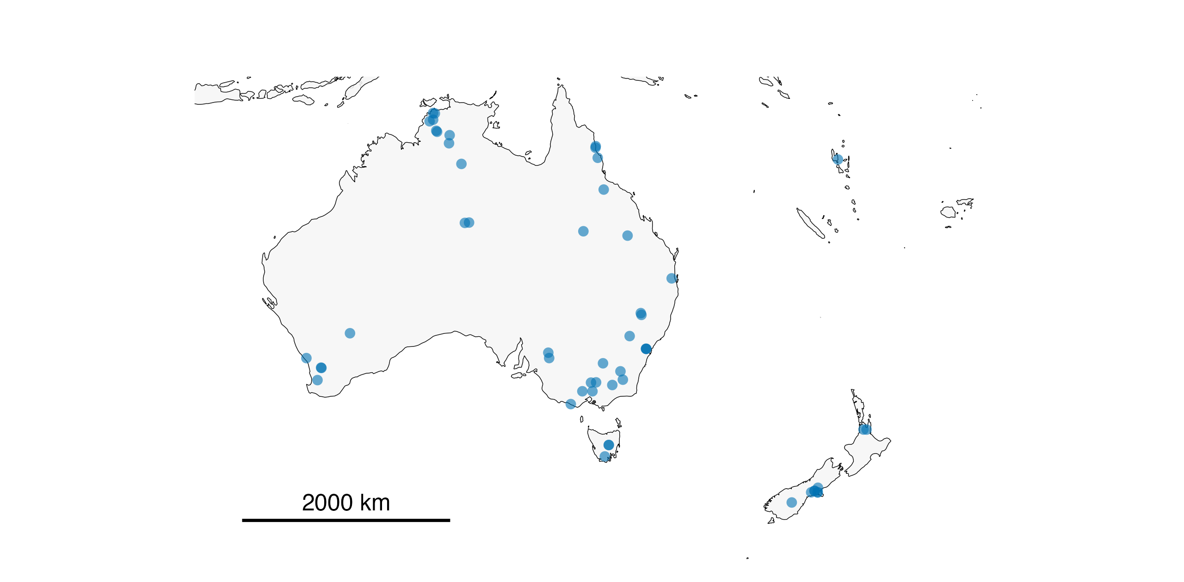
Notes:
Australia and New Zealand regional panel: lat [-48, -10], lon [110, 180]; n = 53 towers; scale bar 2000 km. Snapshot: fluxnet_shuttle_snapshot_20260901T094522.csv.

Slide 7
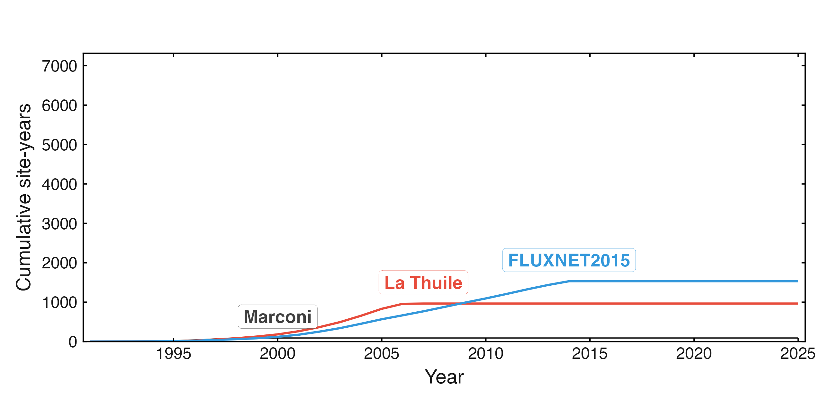
Notes:
Cumulative site-years for the three historical collections (Marconi 2000, La Thuile 2007, FLUXNET2015) only, drawn on the same final axes used by steps 2-3 that follow. Snapshot: fluxnet_shuttle_snapshot_20260920T102211.csv.

Slide 8
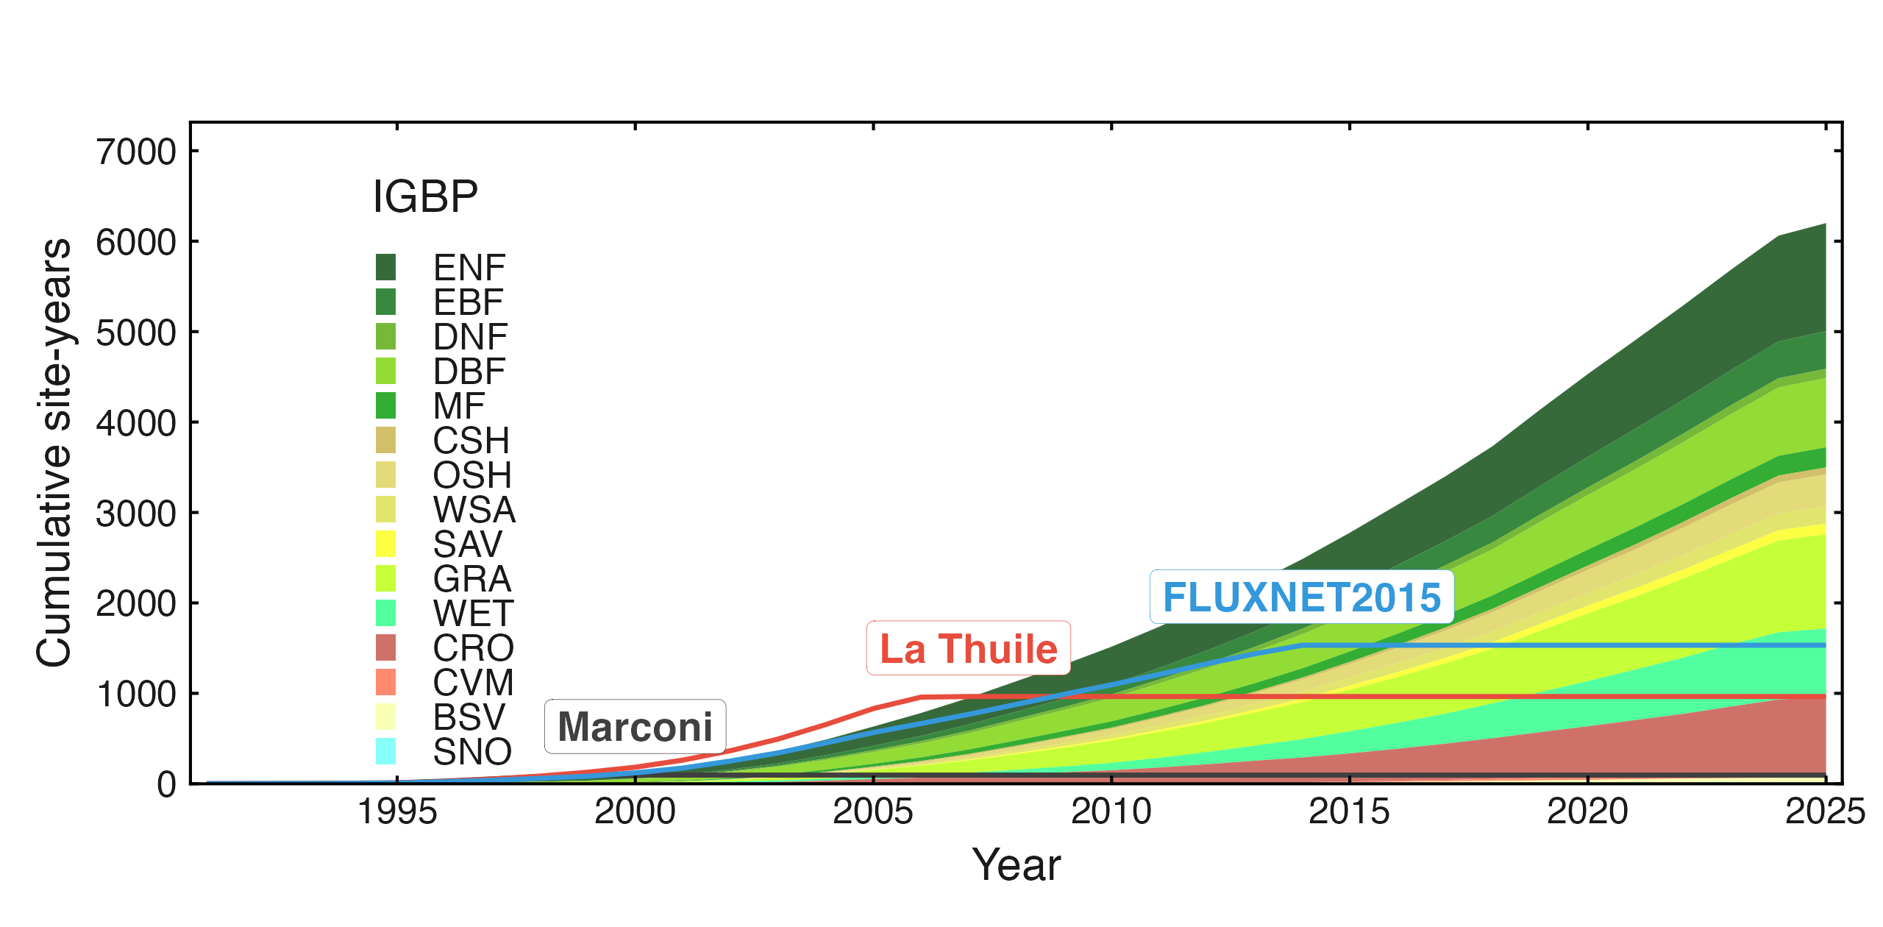
Notes:
Same axes as step 1, with the current FLUXNET Shuttle snapshot's cumulative site-years added as an IGBP-class stacked area (no inset -- the manuscript figure's record-length inset is its own slide, step 3). 781 sites, 6,200 site-years total. Snapshot: fluxnet_shuttle_snapshot_20260920T102211.csv.

Slide 9
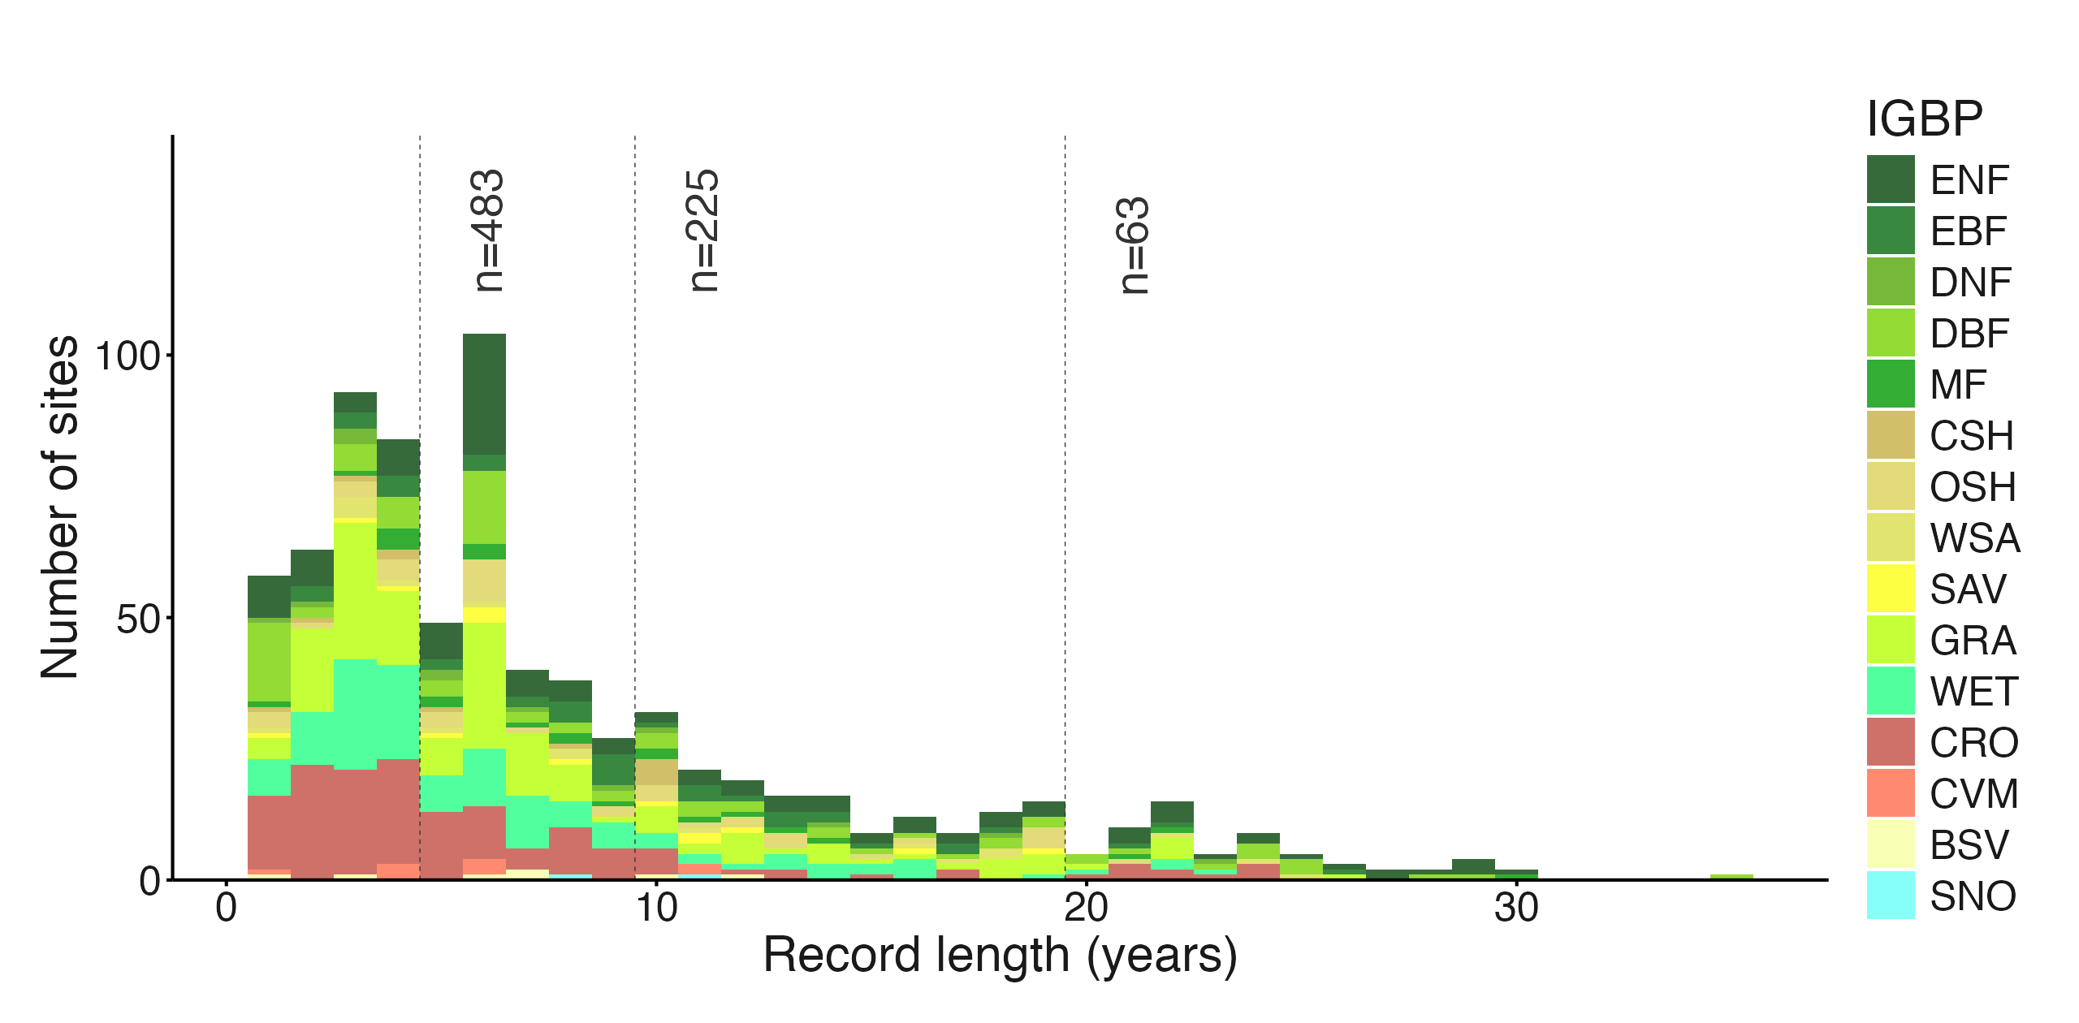
Notes:
Record-length histogram (years of data per site), coloured by IGBP class, with reference lines at 5, 10 and 20 years: n = 483 sites with >=5 years, 225 with >=10 years, 63 with >=20 years (of 781 total). Snapshot: fluxnet_shuttle_snapshot_20260920T102211.csv.

Slide 10
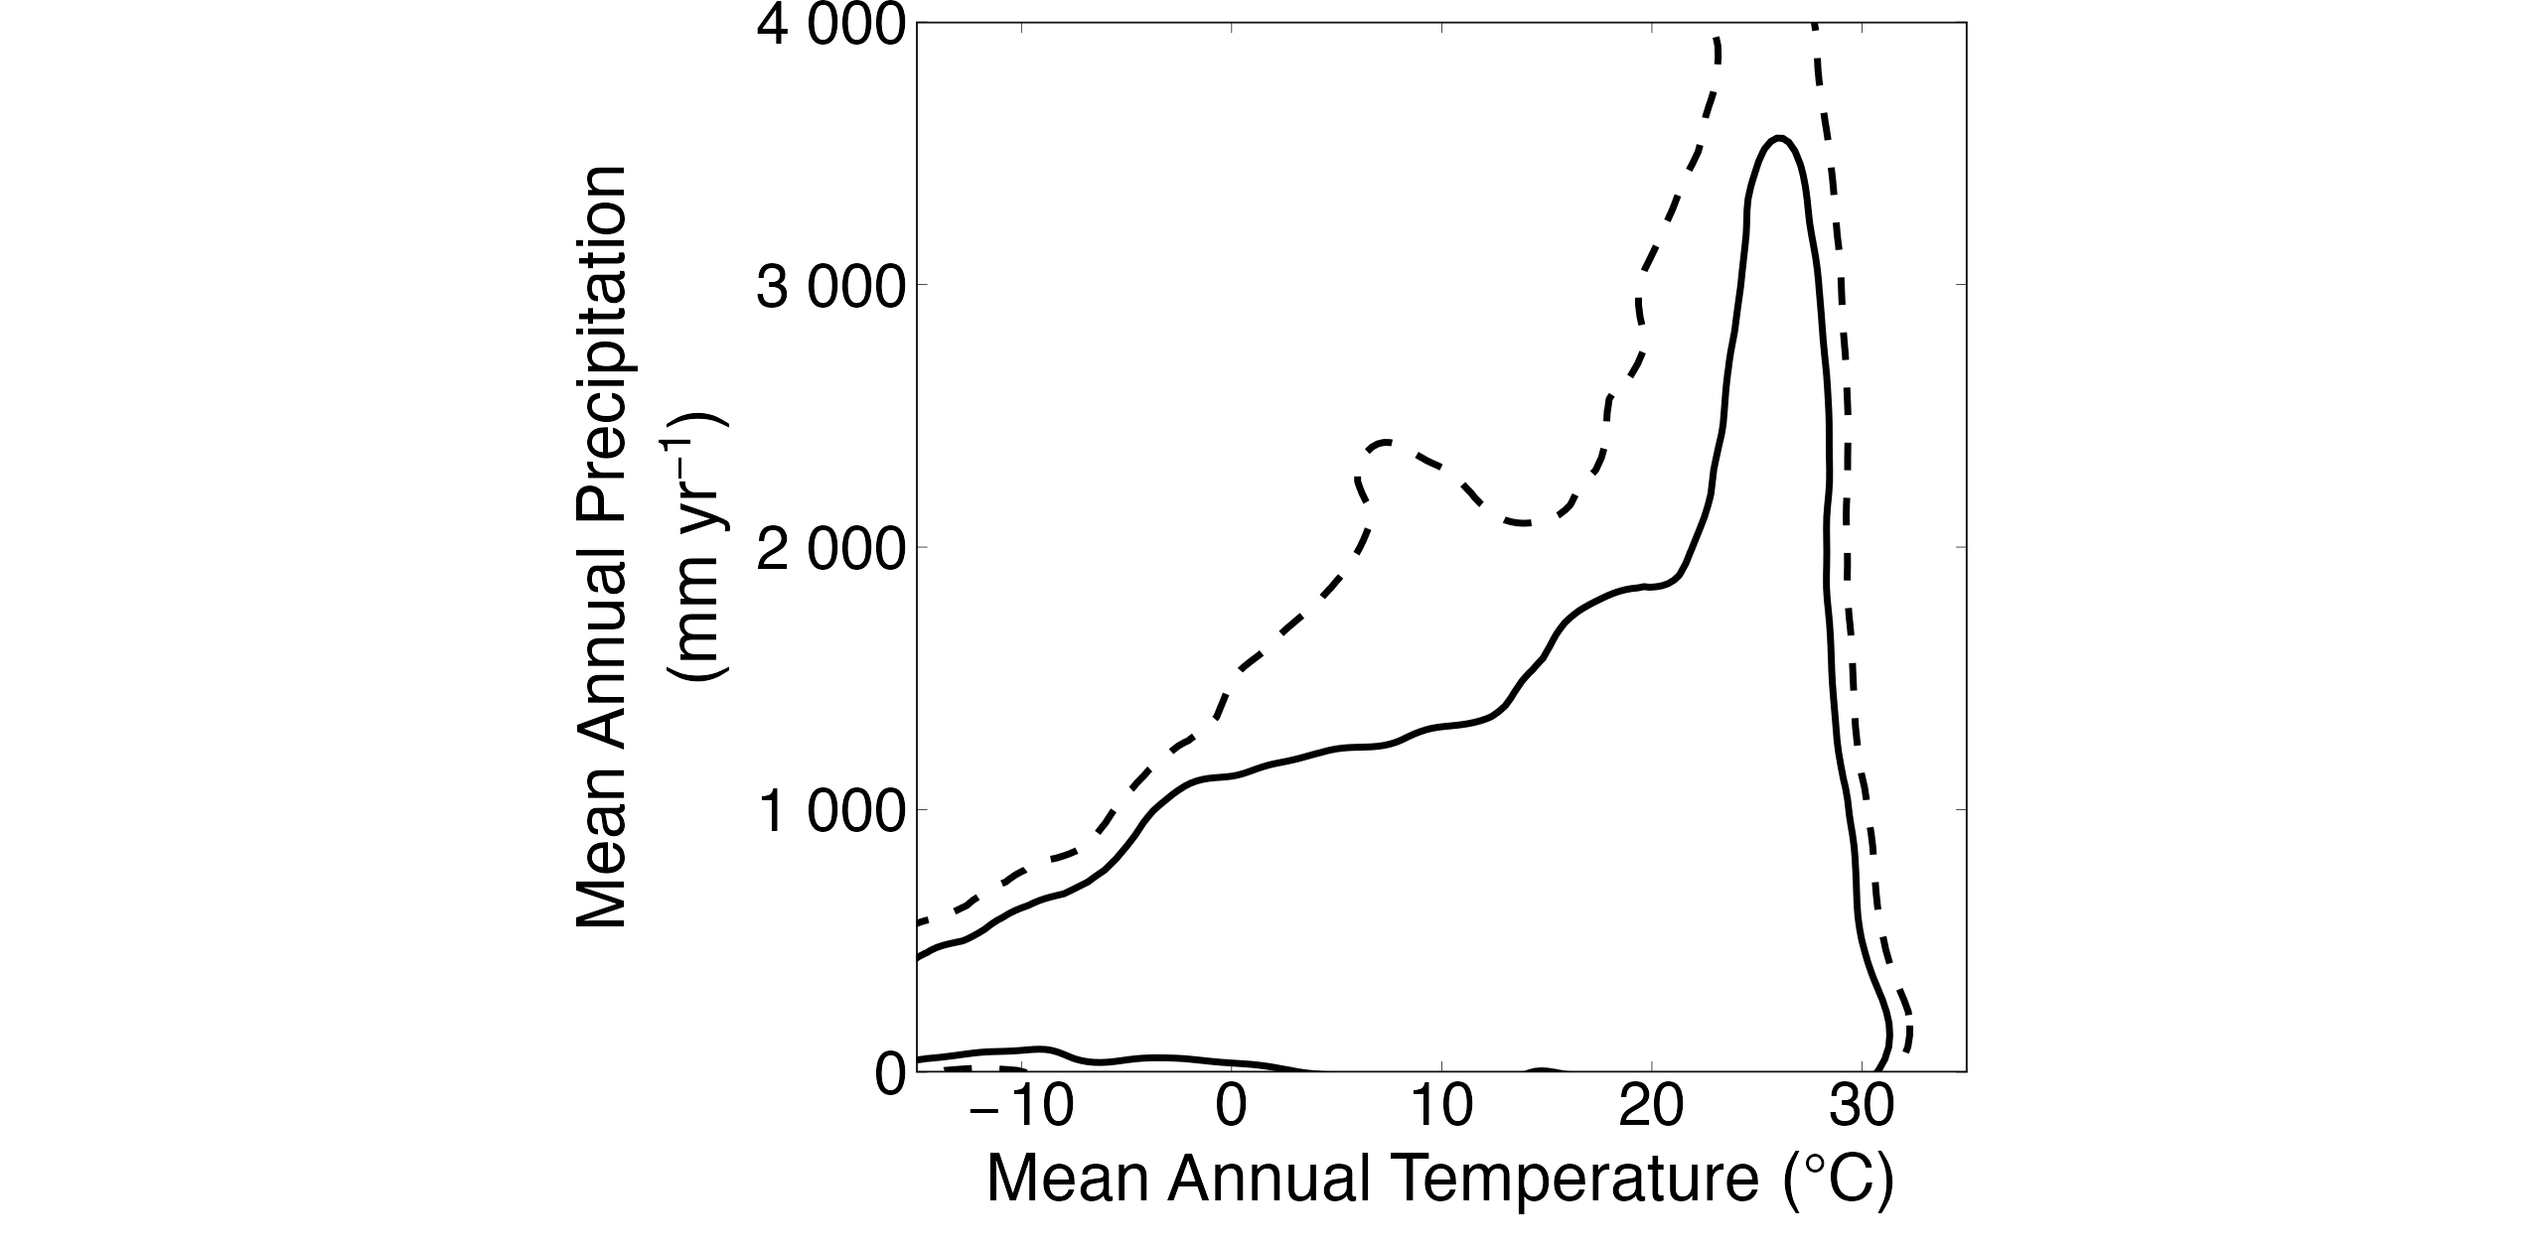
Notes:
Global land climate envelope: 95% and 99% highest-density contours of mean annual temperature vs mean annual precipitation across the land surface (WorldClim v2.1), no FLUXNET sites shown yet. Snapshot: fluxnet_shuttle_snapshot_20260901T094522.csv.

Slide 11
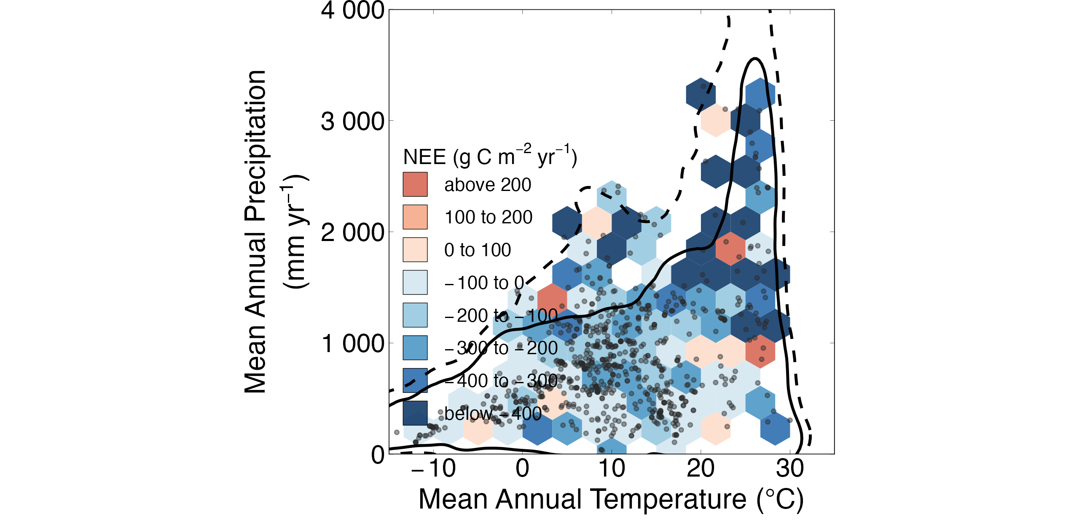
Notes:
Same climate envelope, with the FLUXNET Shuttle network's 781 sites added as a stepped-colour annual-NEE hexbin density layer (656 sites with qualifying annual NEE, 4,375 site-years) plus individual site points. Snapshot: fluxnet_shuttle_snapshot_20260901T094522.csv.

Slide 12
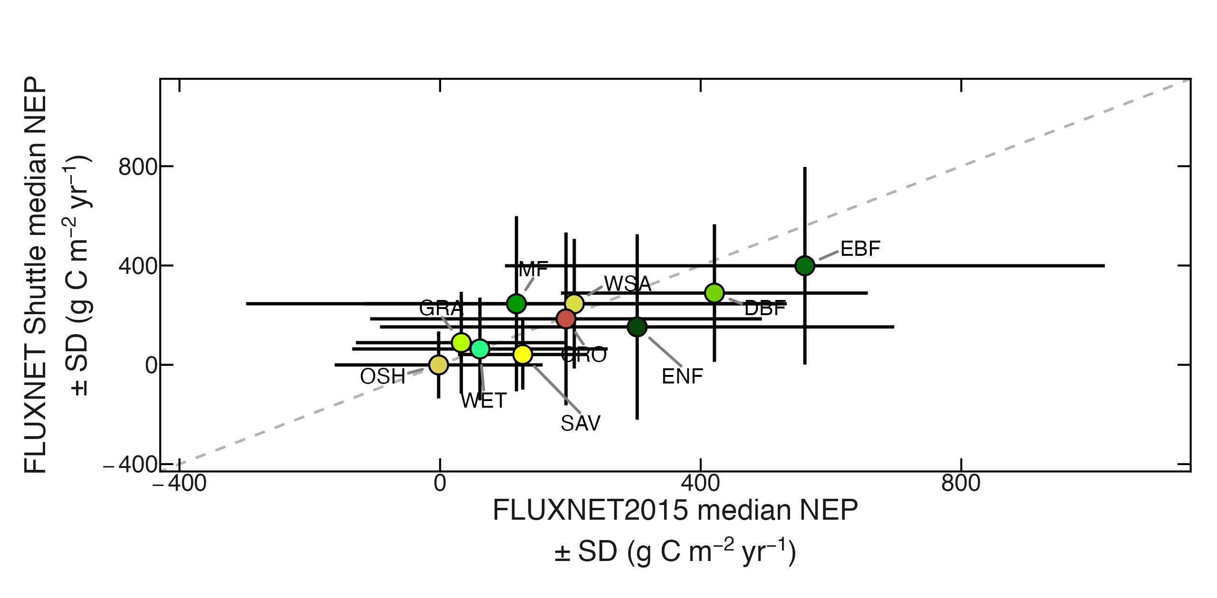
Notes:
FLUXNET2015 vs current FLUXNET Shuttle median NEP +/- SD per IGBP class (n=10 classes; CVM and CSH excluded per the manuscript's classification-exclusion rule). Dashed line = 1:1. Snapshot: fluxnet_shuttle_snapshot_20260901T094522.csv (via data/snapshots/flux_comparison_fluxnet2015_vs_shuttle.csv).

Slide 13
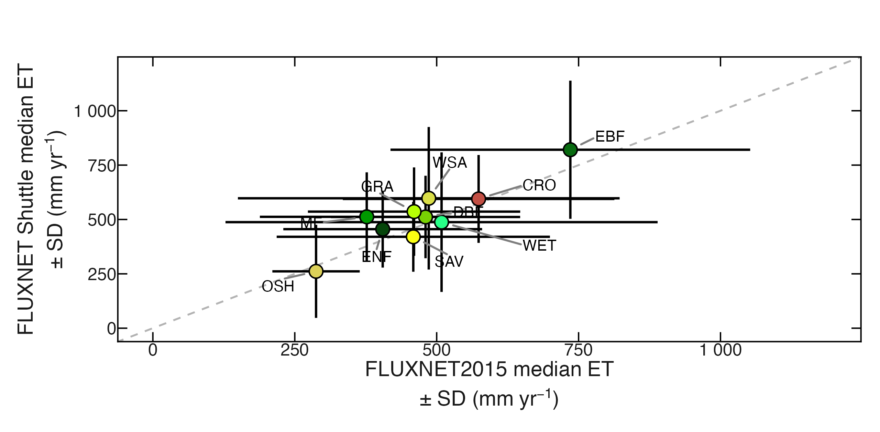
Notes:
FLUXNET2015 vs current FLUXNET Shuttle median ET +/- SD per IGBP class. Dashed line = 1:1. Snapshot: fluxnet_shuttle_snapshot_20260901T094522.csv.

Slide 14
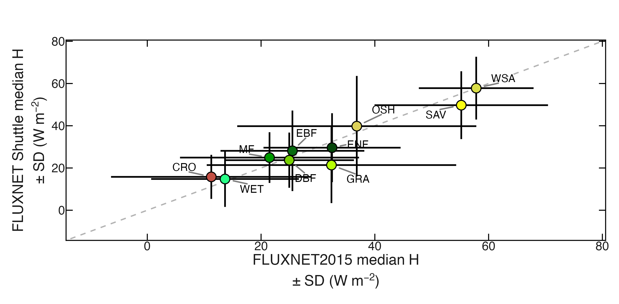
Notes:
FLUXNET2015 vs current FLUXNET Shuttle median H +/- SD per IGBP class. Dashed line = 1:1. Snapshot: fluxnet_shuttle_snapshot_20260901T094522.csv.

Slide 15
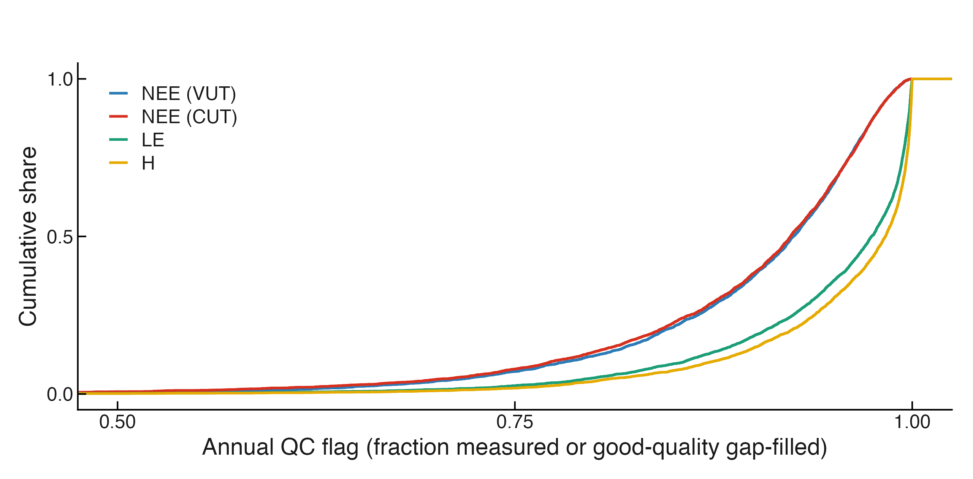
Notes:
Empirical cumulative distribution of the annual QC flag fraction for NEE (VUT), NEE (CUT), LE and H, x-axis 0.5-1.0 (QC_THRESHOLD_YY = 0.50). Values below 0.5 (off the plotted range): NEE_VUT 16/4,033, NEE_CUT 32/4,352, LE 8/4,509, H 7/4,638. Snapshot: fluxnet_shuttle_snapshot_20260920T102211.csv.

Slide 16
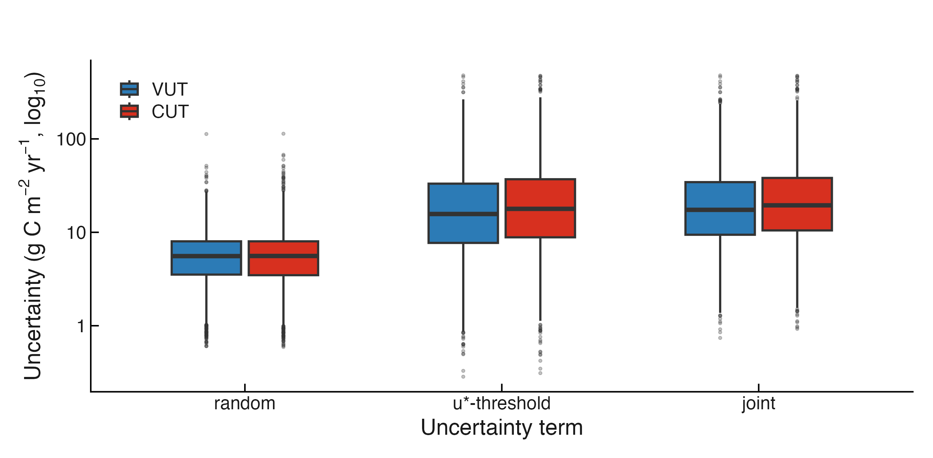
Notes:
Magnitude of each uncertainty term (random, u*-threshold, joint) contributing to usable annual NEE, VUT (n=4,017) vs CUT (n=4,320) compared. Snapshot: fluxnet_shuttle_snapshot_20260920T102211.csv.

Slide 17
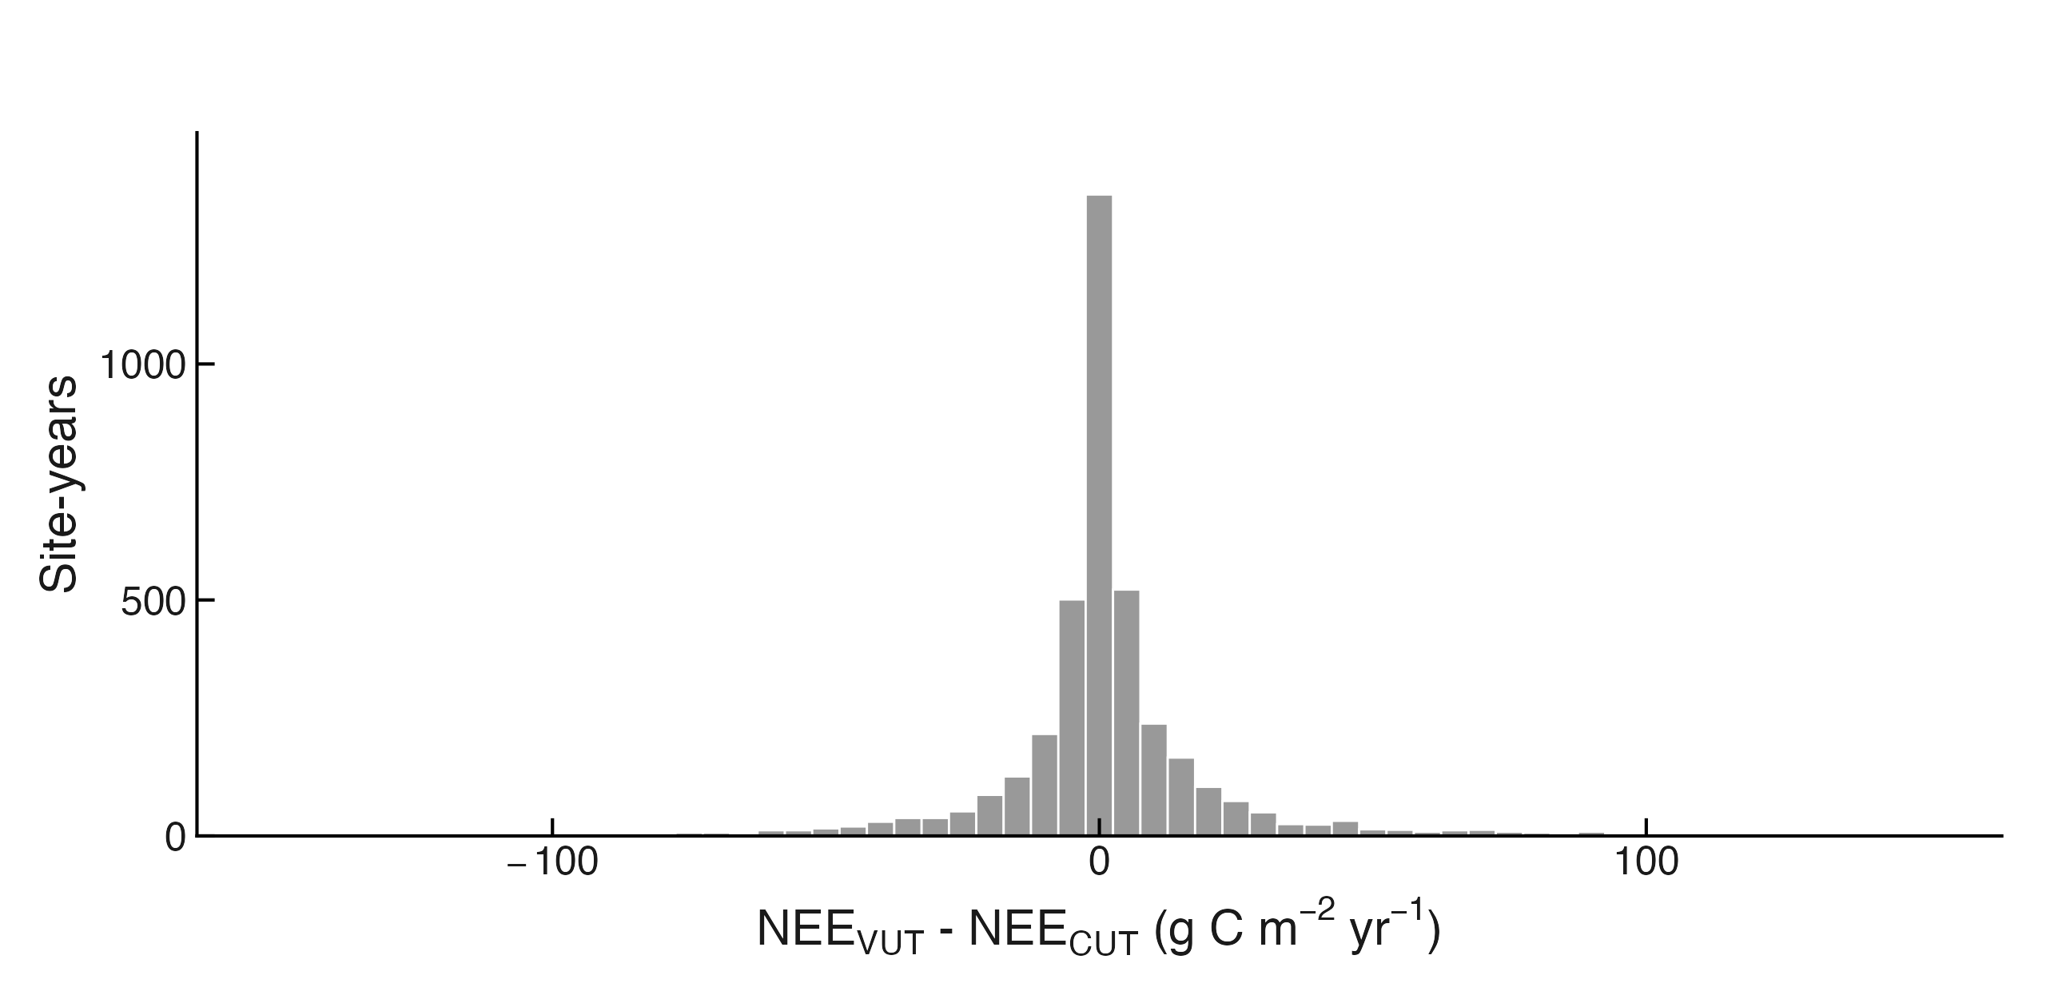
Notes:
Effect of the VUT/CUT processing choice on annual NEE sums, 3,960 site-years with both usable. 152 of 3,960 exceed the combined uncertainty; 20 lack the joint uncertainty term; 86 fall beyond +/-100 g C m-2 yr-1 and 34 beyond +/-150 (the plotted range -- y-axis fixed at 1,490 site-years). Snapshot: fluxnet_shuttle_snapshot_20260920T102211.csv.

Slide 18
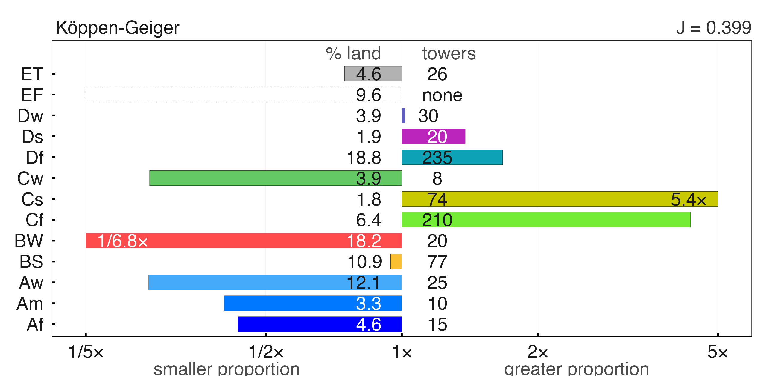
Notes:
Representativeness, Koppen-Geiger climate classes: n = 750 of 781 towers classified, J (weighted Jaccard overlap with global land) = 0.399. Snapshot: fluxnet_shuttle_snapshot_20260901T094522.csv.

Slide 19
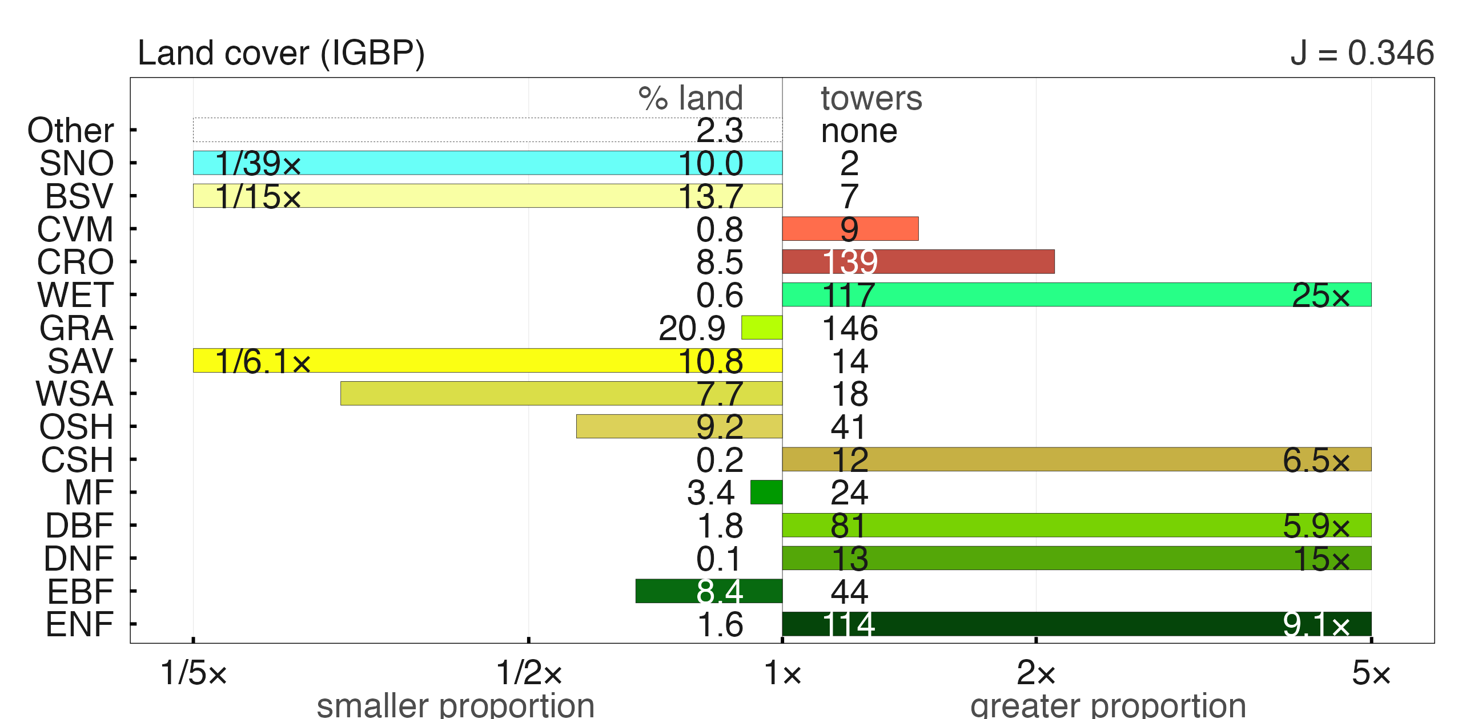
Notes:
Representativeness, IGBP land cover classes: n = 781 of 781, J = 0.346. Snapshot: fluxnet_shuttle_snapshot_20260901T094522.csv.

Slide 20
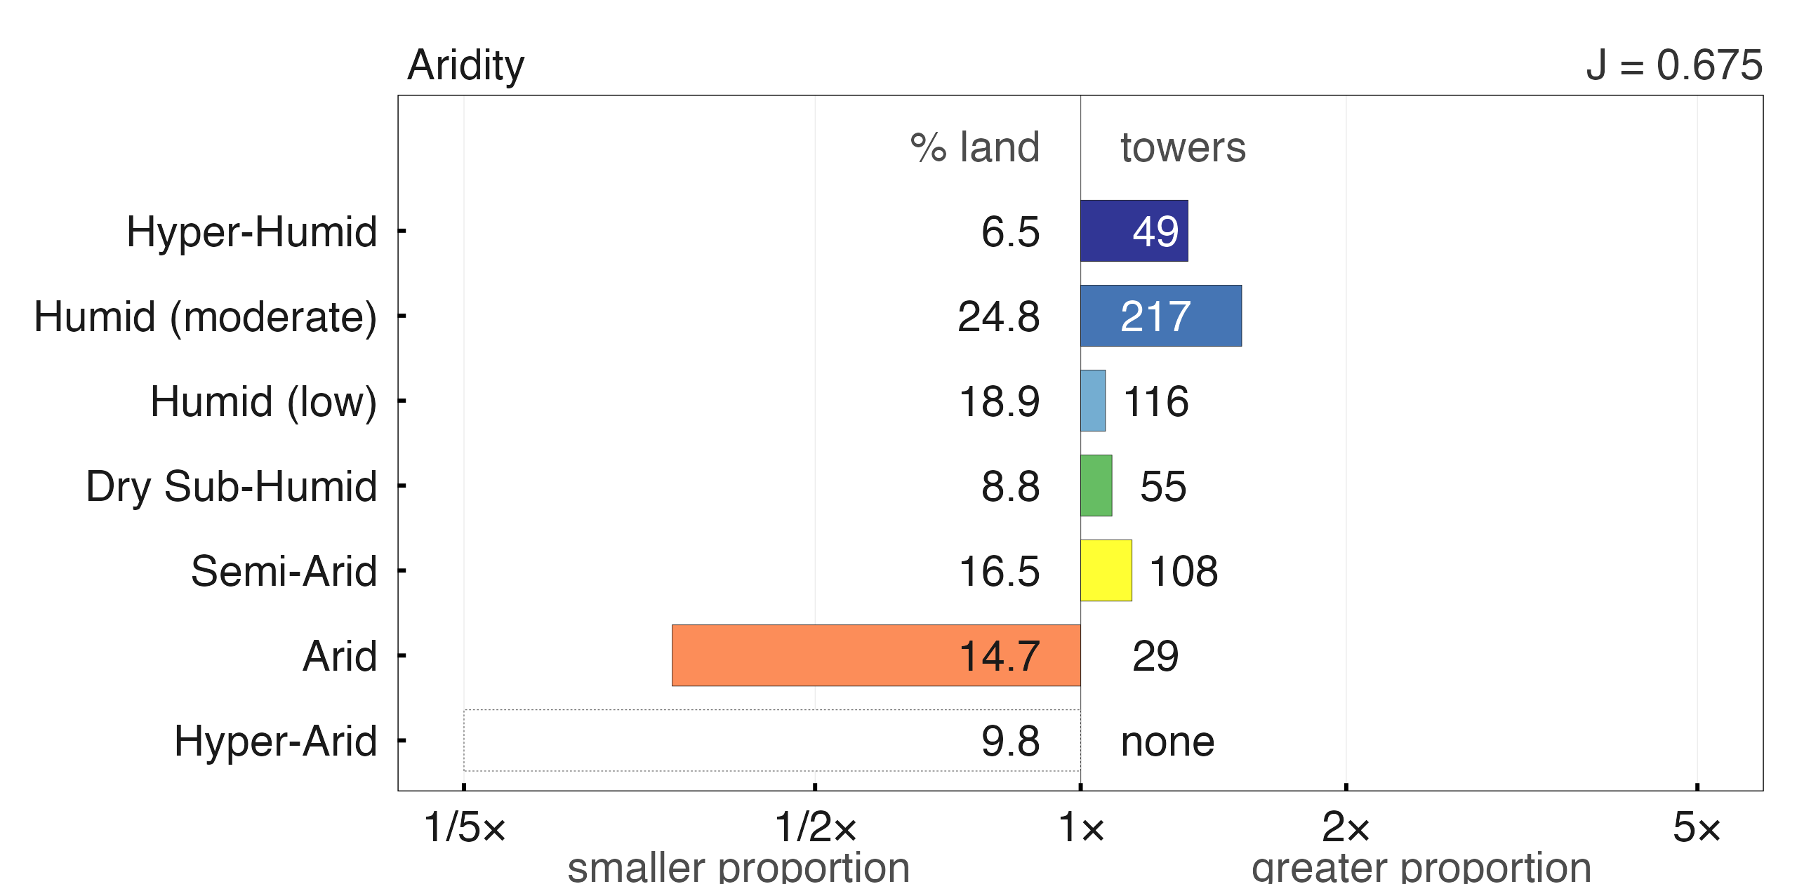
Notes:
Representativeness, CGIAR aridity index classes: n = 574 of 781, J = 0.675. Snapshot: fluxnet_shuttle_snapshot_20260901T094522.csv.

Slide 21
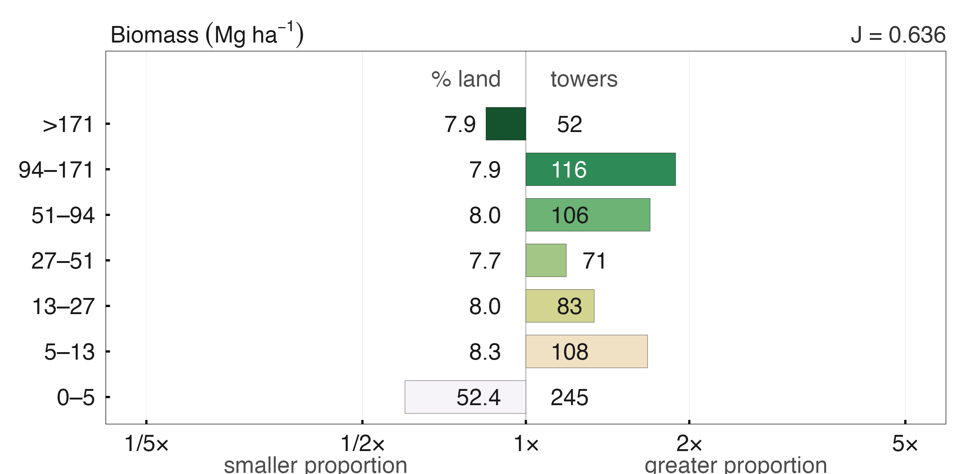
Notes:
Representativeness, ESA CCI aboveground biomass bins: n = 781 of 781, J = 0.636. Snapshot: fluxnet_shuttle_snapshot_20260901T094522.csv.

Slide 22
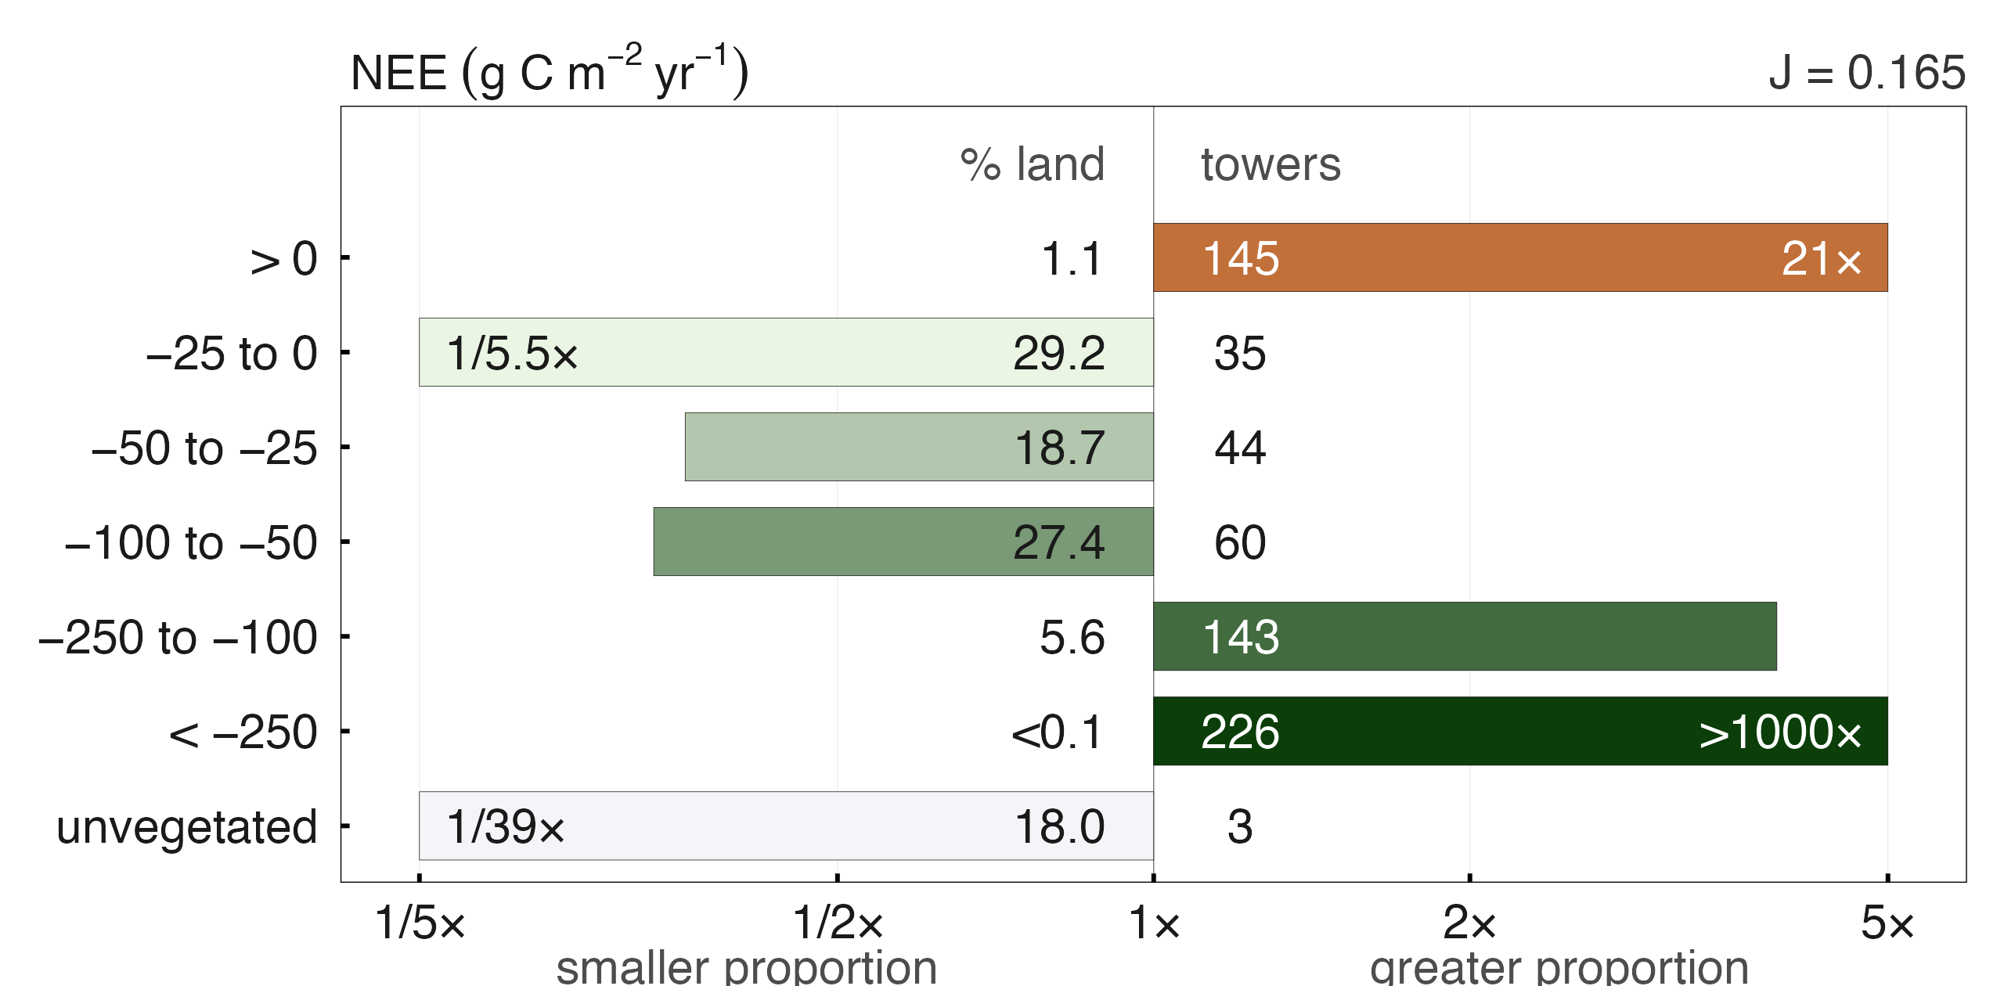
Notes:
Representativeness, TRENDY-ensemble NEE sink/source bins: n = 656 of 781, J = 0.165. Snapshot: fluxnet_shuttle_snapshot_20260901T094522.csv.

Slide 23
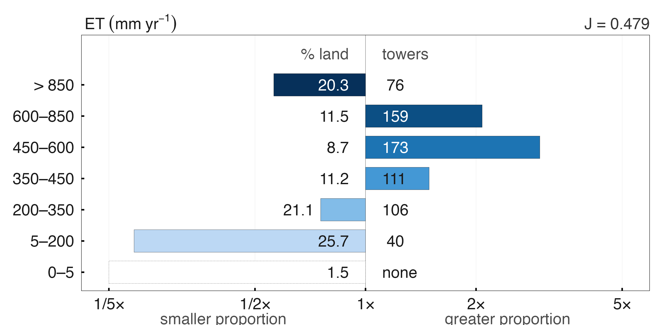
Notes:
Representativeness, TRENDY-ensemble ET bins: n = 665 of 781, J = 0.479. Snapshot: fluxnet_shuttle_snapshot_20260901T094522.csv.

