Slide 1

WCCCD Forms Center
Enterprise forms, secure submissions, and request tracking
Proposed approach for discussion, October 2026
Notes:
Introduce the Forms Center: one framework for internal forms, secure external submissions, and request tracking, starting with an IT pilot.

Slide 2



One framework, three requirements, IT pilot first
Internal forms portal
Secure external submissions
Request lifecycle tracking
One SharePoint entry point to find, complete, and submit departmental forms. IT first, then HR and others.
Controlled intake of vendor and external files. RFPs need stronger controls than general file collection.
Each request traced from submission through review, decision, fulfillment, and closure.
Notes:
SharePoint is the proposed foundation, with supporting Microsoft 365 tools selected during detailed design.

Slide 3





RFP submissions need more than an upload link
Verified vendor identity
General file collection
Can use a simpler process where appropriate, with confidential handling and access limited to authorized staff.
Validation first
If Microsoft 365 can’t meet every RFP control, evaluate a dedicated procurement submission platform.
Enforced submission deadlines
Timestamped receipts
Bids sealed until authorized opening
No vendor sees another’s files
Notes:
These controls are required. A dedicated platform is the fallback if the pilot shows Microsoft 365 cannot meet them, including protection from administrator access.

Slide 4
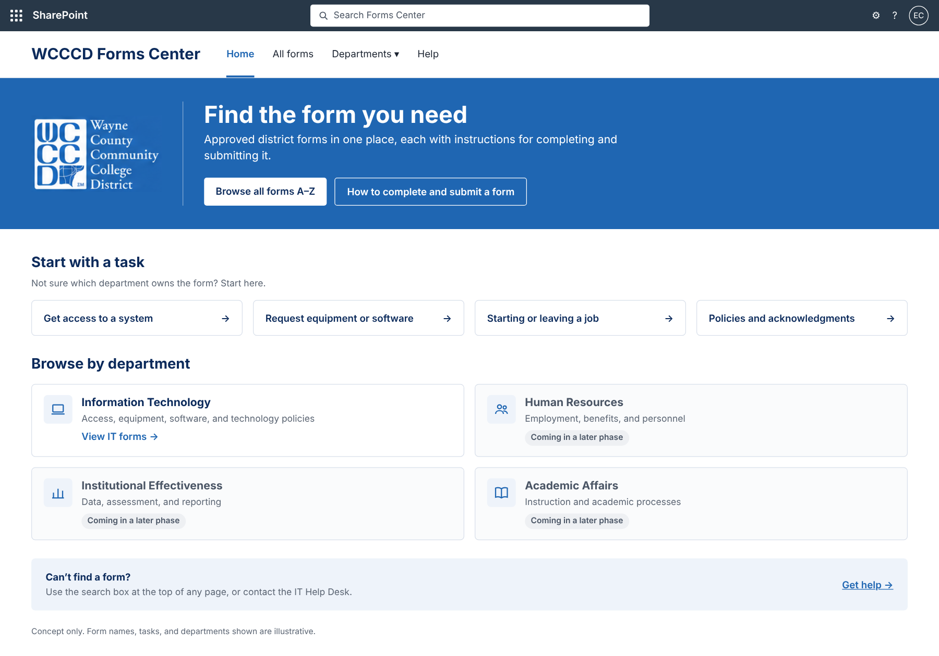
Find forms by search, task, or department
Search
The SharePoint header search covers every form.
Start with a task
For people who don’t know which department owns a form.
Browse by department
IT live in the pilot; others marked for a later phase.
Concept. Content is illustrative.
Notes:
Proposed homepage. Built with standard SharePoint web parts.

Slide 5
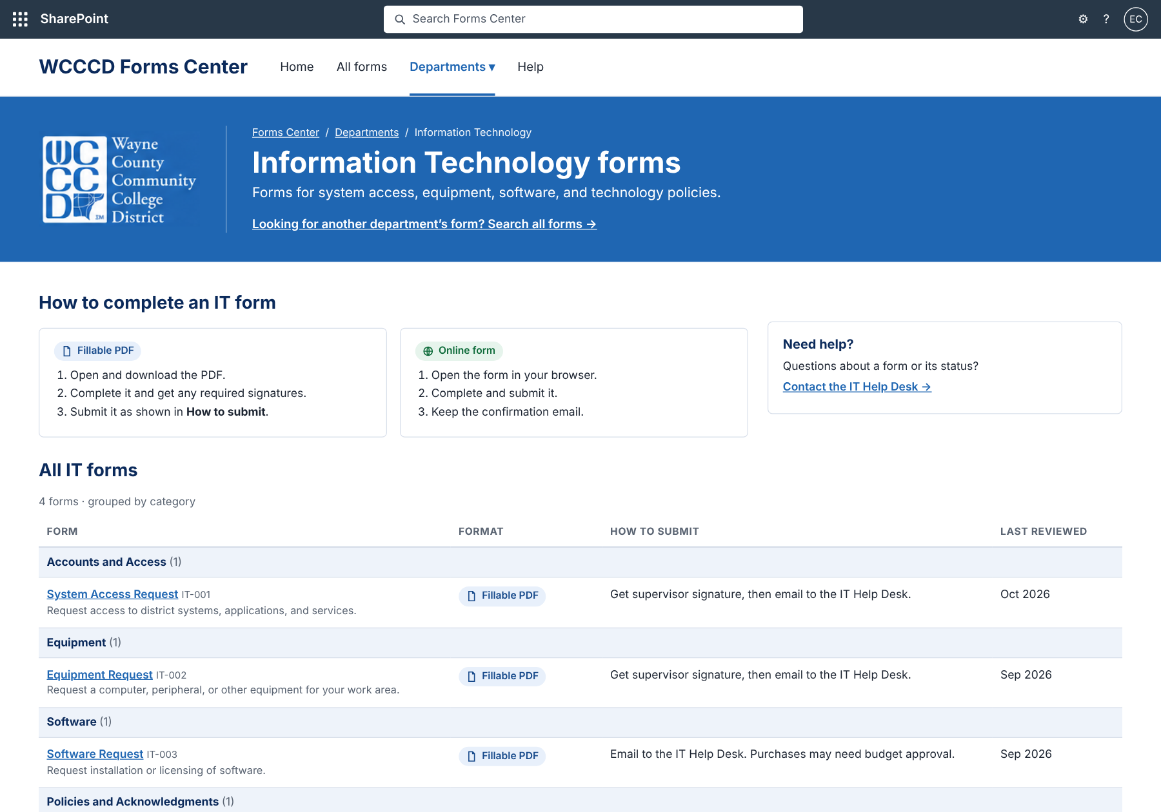
Every form shows how to submit it
Instructions first
Fillable PDF and online form steps, side by side.
One row per form
Format, how to submit, form ID, and last review date.
Grouped by category
Accounts and Access, Equipment, Software, Policies.
Concept. Form names, steps, and dates are illustrative.
Notes:
Proposed IT landing page. The WCCCD logo stays in the blue banner beside the title.

Slide 6
Standard SharePoint first, add-ons later
Standard SharePoint
Microsoft 365 tools
Optional, later
Communication site, one forms library with metadata, filtered views, Quick Links, header search
Microsoft Forms or Power Apps for online forms; Power Automate for routing and review reminders
PnP Modern Search for an in-page search box with filters, if usage shows the need
One library, many views. Adding a department means adding a page and tagging its forms, not rebuilding the site.
Notes:
Products and licensing are confirmed during design and validated through the pilots.

Slide 7
Four phases, starting with an IT pilot
1
2
3
4
Confirm
Pilot IT
Validate intake
Expand
Use cases, IT forms inventory, standards, licensing review
Forms library, IT page, one tracked request workflow
Secure file collection and a controlled RFP test
HR and other departments, owners, training
Durations and resourcing are set in the detailed implementation plan.
Notes:
Control gaps in external intake are resolved before any live solicitation.

Slide 8
Next steps
1
Confirm the overall direction with the CIO
2
Identify the IT forms and the first workflow for the pilot
3
Designate business owners for the three work areas
These decisions shape the detailed implementation plan and schedule.

