Slide 1
Experiments

Slide 2
Arithmetic
exponential variables & linear variables
conjunction of constraints
exponential constraints
linear constraints
parameters for a test
(exp-vars, linear-vars, exp-cons, linear-cons)
(1-2-3-4) stands for 1 exp varialbe (x1) , 2 linear variables (x2,x3) , 3 exp constraints, 4 linear constraints

Slide 3

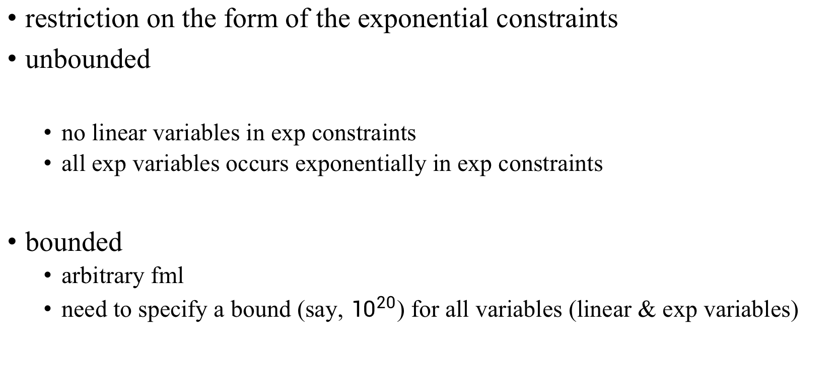
Bounded& Unbounded
restriction on the form of the exponential constraints
unbounded
no linear variables in exp constraints
all exp variables occurs exponentially in exp constraints
bounded
arbitrary fml
need to specify a bound (say, ${10}^{20}$) for all variables (linear & exp variables)

Slide 4

$a_{i}$ random from (-10,10)
$b_{i}$ random from (-10^2,10^2)
$t_{i}$ random from (-10^5,10^5)

Slide 5
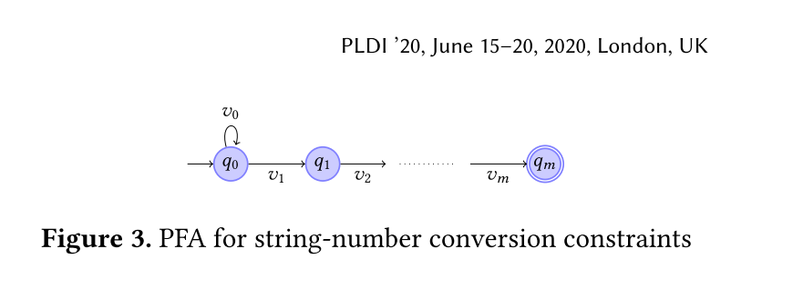
String Constraints

