Slide 1
Decision Procedure for PA with exponential function

Slide 2
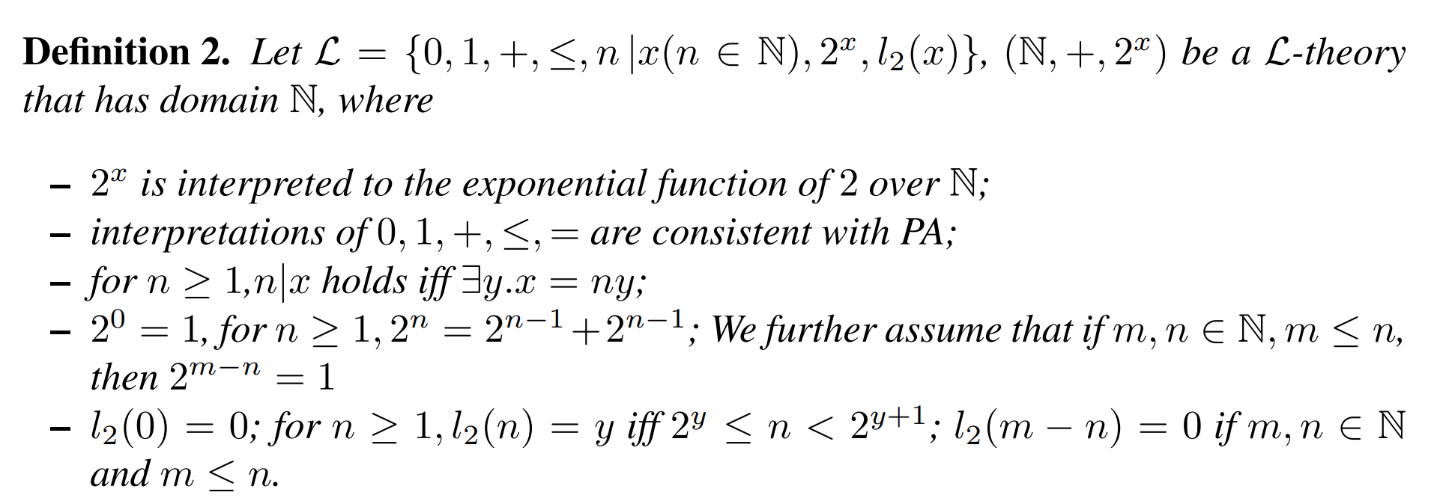
QE algorithm

Slide 3





Normalization
QE-with-order (all possible order, rename)
QEexp eliminate exponential terms of maximal $x_{i}$
no $2^{x_{i}}$ terms
loop from i=n to 0
QElinear eliminate linear terms of $x_{i}$

Slide 4
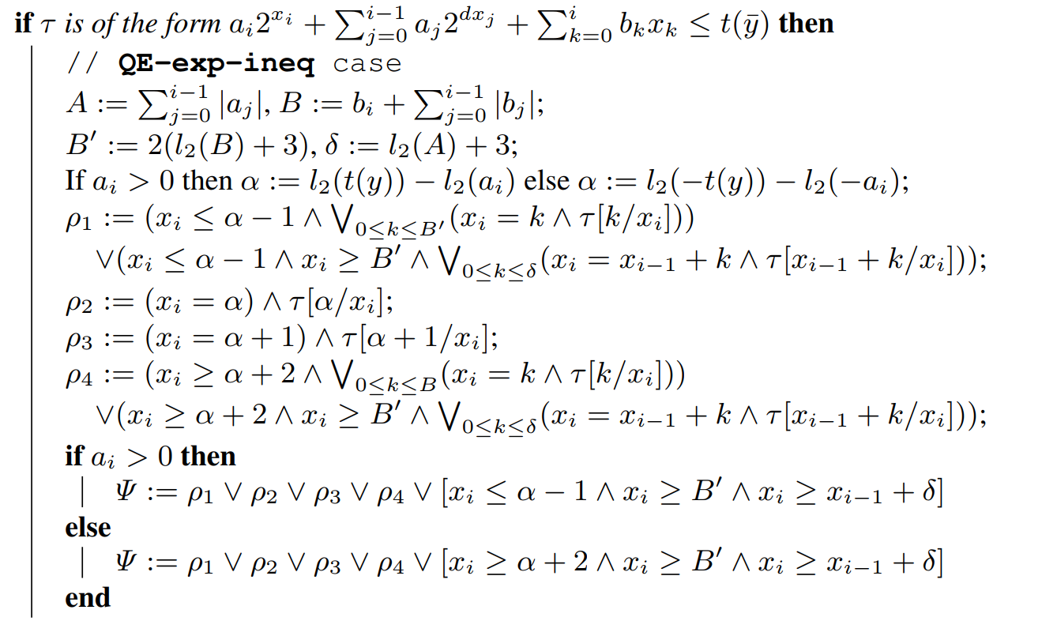

Slide 5

Normalization
QE-with-order (all possible order, rename)
QEexp eliminate exponential terms of maximal $x_{i}$
loop from i=n to 0
no $2^{x_{i}}$ terms
Not always correct!
PA formula

Slide 6

If $x_{3}≥x_{2}≥x_{1}$, apply QE-exp
obtain a formula with $2^{x_{2} },x_{2},x_{1}$
If $x_{1}≥x_{2}≥x_{3}$, can not apply QE-exp
Need a constraint $x_{1},x_{2},x_{3}≤bound$

Slide 7

Solver
A solver for existential quantified formulae
based on QEexp
Optimize
QEexp for all atoms (with $2^{x_{i}}$) in the formula
DFS

