Slide 1
My Portfolio
This is a little description of my work and
my learning

Slide 2
Introduction
My name is Xavier Hueber, I’m a high-school student in France and I wanted to know more about older programming languages as I have the basics of Python and a little knowledge about Visual Basic.
Computer security is I think one of the most important field for the future and interests me.
This portfolio will show you my researches and results during my C learning.

Slide 3
1) My first C project
This exercise was an introduction to C. It’s a very basic project, but it was interesting to see how works C and how does the structure work.
I learned how to write basic C, how to make my first Makefile (with an install part and a clean part) and how to upload my project on a GitHub repository.

Slide 4
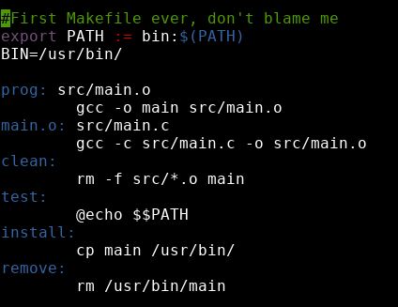
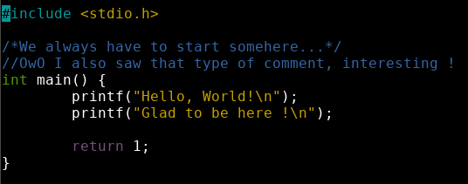
1) My first C project
This is my Makefile, I wanted to make something clean, but I didn’t knew how to install the program at the first place, so I decided to put it in /usr/bin.
To complete my first lesson I had to make a program that writes “Hello World”

Slide 5
1) My first C project
To complete the task I had to search how to make a proper Makefile, I found that website which explained me the basics (website of Lion’s University) and the website of Super User showed me what does the command “make install” (link).
In conclusion : during this first lesson, I learned that C has a strict but easy to read structure which is like Python and requires libraries even for basic things like “printf”. I think that the Makefile was harder to create than the actual program, because I had no idea how to make one and it took me a lot of time to see how to make it.

Slide 6
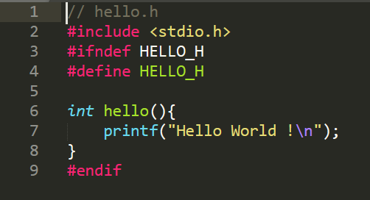
1.2) In-depth look :
In this part I saw how to make a header. It’s very similar to a normal c file, but has to be named differently.
My hello function

Slide 7
My sources :
Website of Lion’s University
Superuser.com
Stackoverflow.com

Slide 8
This work is licensed under a Creative Commons Attribution-ShareAlike 3.0 Unported License.
It makes use of the works of Mateus Machado Luna.

