Slide 1
B Tech Integrated In Plant Training Presentation 2022-2023 Semester: VIII
Presented by : Siddh Sanghvi, C079
Organization Name : Jio Platforms Limited. (JPL)
Industry Mentor : Aditya Chauhan
Faculty Mentor : Prashasti Kanikar
Under the guidance of : Devarshi Aggarwal

Slide 2
Roadmap
About the Organization
About the Department
About the Project/s
Description of technical tasks
Brief of new skills gained
Overall learnings
Comments and Future Plan

Slide 3
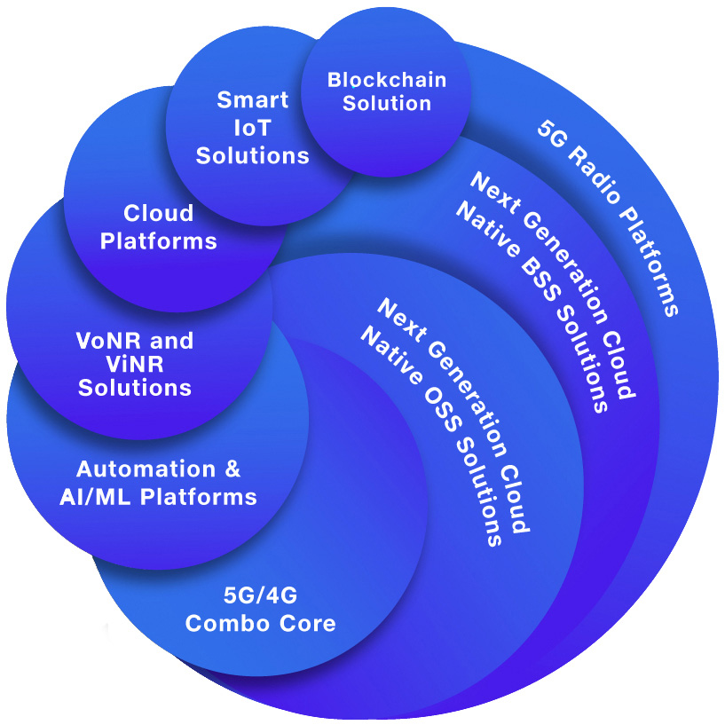
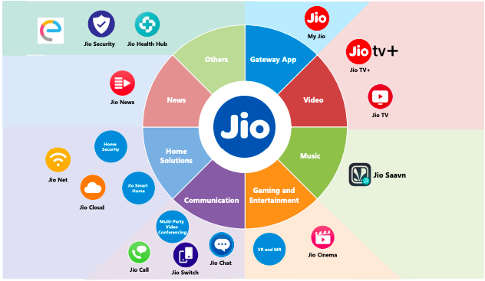
Jio Platforms Limited
Jio Platforms Limited is a prominent Indian telecoms firm that offers a diverse range of digital products and services.
Services include complete 5G and cloud solutions, which include
5G radio
5G core network
AI/ML ATOM platform for 4G/5G
MANO for orchestrating cloud CNF
ACI for deploying cloud infrastructure
and cloud-native OSS platforms.
Jio Platforms also offers online services like
MyJio
JioTV,
JioCinema for live TV streaming,
JioSaavn for video-on-demand,
JioChat for messaging
JioMeet for video conferencing,
JioStore for app distribution for Jio STBs
JioGamesCloud for cloud gaming, etc.
Services offered by JPL

Slide 4
About The Department

Slide 5
Special Initiatives AI/ML
Focused on exploring and developing cutting-edge technologies in the fields of Artificial Intelligence (AI) and Machine Learning (ML).
Create new products and services using AI that can transform the lives of people and businesses in India.
One of the key areas of focus for the department is computer vision. Computer vision is a field of AI that deals with the processing and analysis of images and videos.
The department is working on developing new computer vision-based technologies that can help improve the accuracy of object recognition and tracking in various applications, such as autonomous monitoring, security systems, and retail.
The department is staffed by a team of experienced professionals, who bring a wealth of knowledge and expertise in AI and ML to the table.

Slide 6
About The Projects

Slide 7
Machine Learning Approach to Attendance Score
Problem Statement - The goal of this project is to create a Machine Learning model that calculates employees' attendance based simply on their entry and exit times.
Outcome - The primary goal of this project is to create a Machine Learning model that can reliably predict an employee's attendance score based solely on their arrival and exit times, with no prior knowledge of their work schedules or shifts.
Employee Information
Attendance Score for respective employee
Predictions of Shifts and determining Punctuality
Data Gathering
Used a real time dataset of the organization
Data Cleaning
Model Selection
Research on Clustering Algorithms
Select a algorithm that fits the requirement
Model Fitting
Fit model into selected parameters
Cluster Analysis
Metrics : Elbow method and Silhouette Score
Model fitted on test dataset
Model Testing
Model Deployment
Create script to annotate the data and then calculate accuracy
Deploy loaded model in a pickle file and create a flask app to run on server
Data Preparation
Test Different Distance Calculation Techniques
Removal of duplicates
Removals of outliers
Handling and dropping nan values
Data structuring
Data Validation Verification
Analyzing and comparing Clustering
Process Pipeline Explained

Slide 9
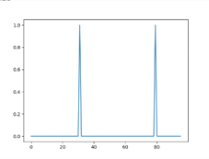
Deep Learning Approach to Classifying Shifts:
Problem Definition – The problem was defined as the need for a more accurate system that can recognize fixed or rotational user.
Outcome – The aim of this project is to build a deep learning model using a fully connected Neural Network that can classify users as either having fixed or rotating shifts.
Classification model
User with Fixed Timings
Model Inferencing
Understand the flaws of previous model.
Data Acquisition
Acquire generated data from servers.
Data Cleaning
Clean and segregate data as per requirements.
Manually verify data
Model Finetuning
Set parameters for the model
Train model
Model Evaluation
Metrics : F1 score, Precision, Recall
Create test dataset
Identify features to be fine tuned.
Annotate Data using scripts

Slide 10
Research and Miscellaneous Projects
Website Development Deck
Research on workflow of website development.
Research and analysis of tools to assist website development.
Research on assistance of AI in development process.
Software Factory
Research on processes and practices to standardize software dev process.
Analysis of current tools used for standardization.
Scaled Agile Framework
Research on software development framework for large enterprises.
Understood agile methodologies and various framework roles.
Remote Site Sensor Certification
Manual sensor checking and certification to find wrongly installed/defective sensors.
Created a spreadsheet with sensors and their conclusions.

Slide 11
Description of Technical Tasks

Slide 12
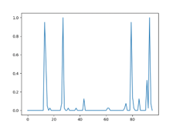
User Classification Statistical Approach
Identified two groups of users in the company employee data.
Classified and grouped the two groups of employees together by finding a similarity in their patterns
User with Fixed Shifts
User with Multiple Shifts

Slide 13
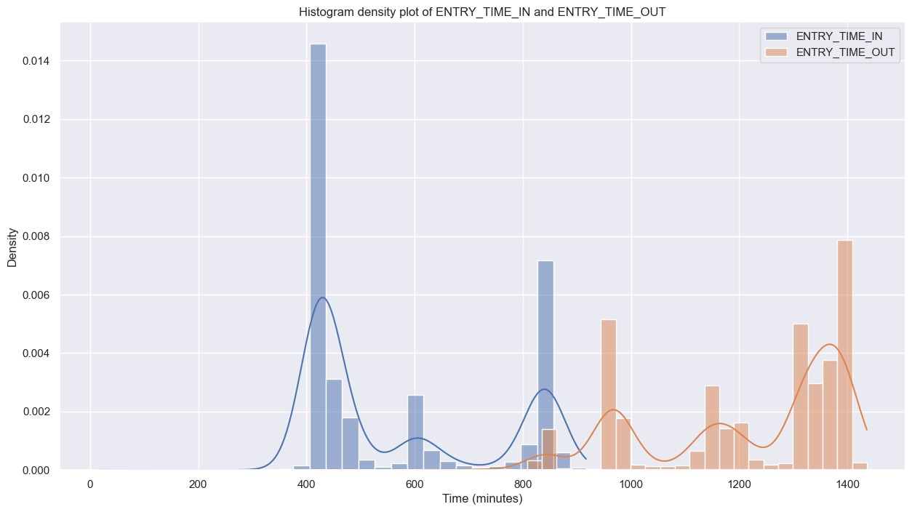
Creating User Profiles
To analyze and to identify patterns and trends in the time series data we are grouping them into together.
Creating a profile of a user by assigning them a group and keeping a frequency of their bin values

Slide 14
Normalizing the User Profiles
Normalizing involves scaling the data to a common range, to eliminate any biases caused by differences in scale.
We normalized the profile of the users to get them in the range of 0 to 1

Slide 15
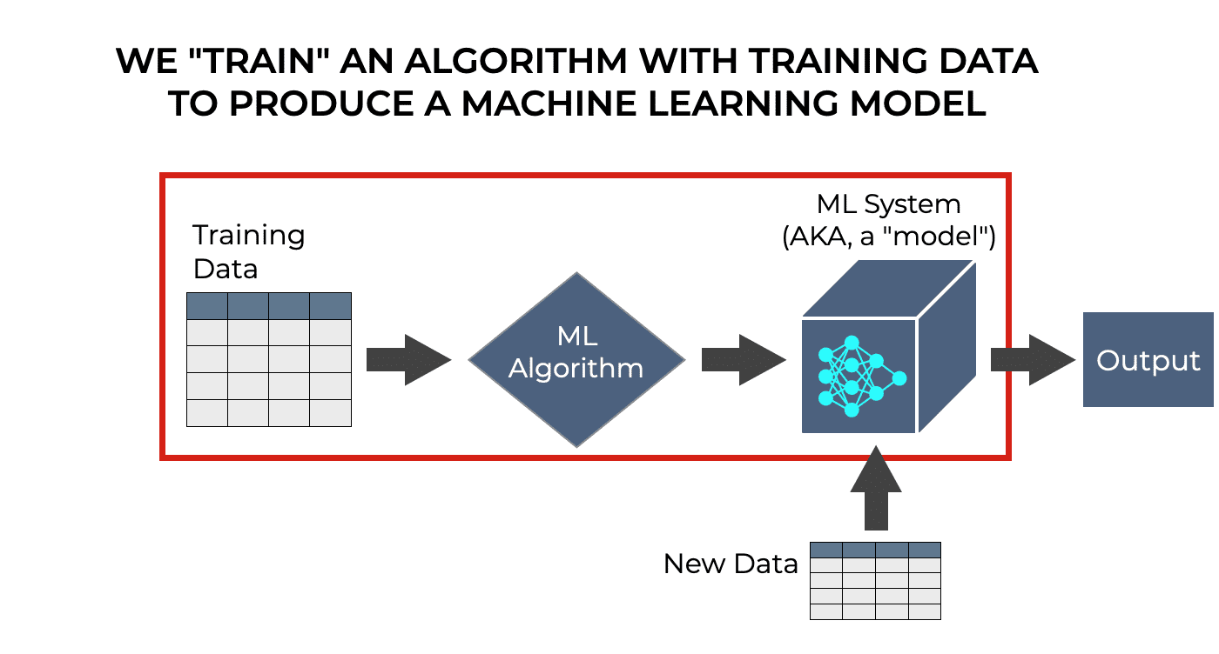
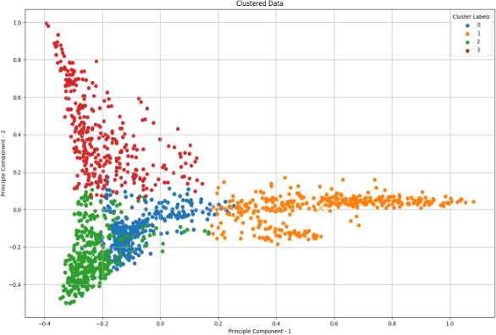
Model Fitting using KMeans
We fitted the training data using Sklearn library into the Sklearn KMeans Clustering Algorithm

Slide 16
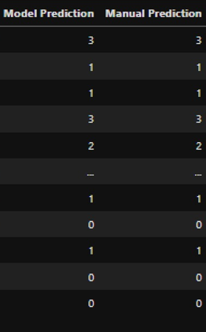
Model Testing and verifying results
To test the correctness and to verify the model we are measuring the accuracy of the model
This is done by annotating a subset of the with their true labels and comparing them predicted labels

Slide 17
Calculation of pairwise distance and determining punctuality
Pairwise distance is the distance between every pair of objects or points in a set. It is calculated using a distance metric in the clustering algorithm
Implemented it using Sklearn to calculate distance from the centroids
Using this distance metric we are determining punctuality of a person
Data Point | Distance to Centroid 1 | Distance to Centroid 2 | Distance to Centroid 3 | Distance to Centroid 4 | Centroid Selection
1 | 1.504747 | 1.49749 | 0.89774 | 1.5202 | 3
2 | 1.41984 | 1.36484 | 1.18093 | 0.46516 | 4
3 | … | …. | …. | ….. | ….
4 | 1.14234 | 0.67039 | 1.29356 | 1.33456 | 2

Slide 18
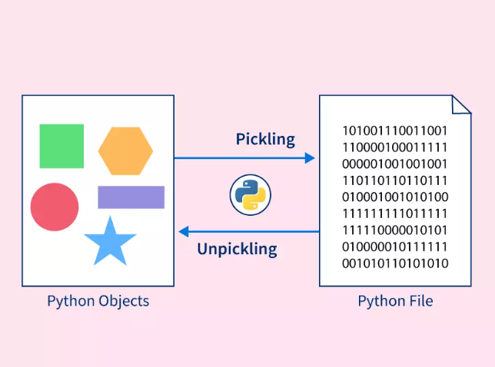
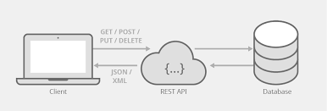
Model Deployment
Once the model is trained, we are saving the model and its parameters in a pickle format using Python pickle library.
We built a Flask app to accept the data via API. Then we are loading the model in the Flask app and return the model prediction in JSON format

Slide 19
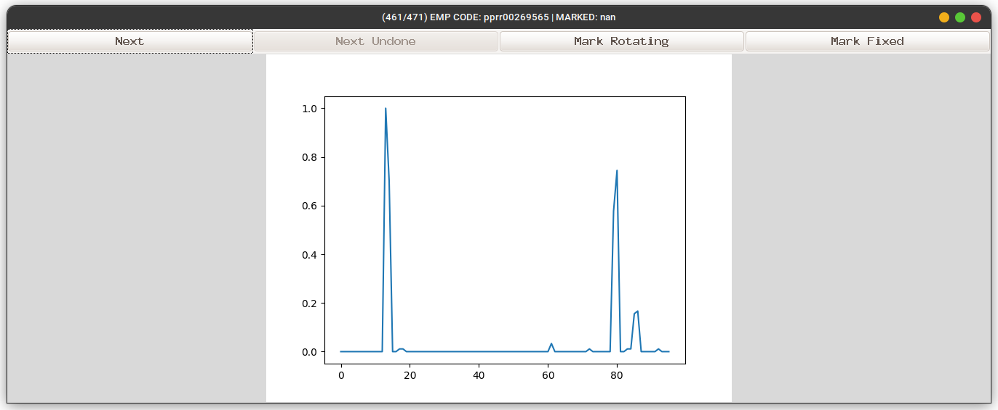
Made a annotation tool using Tkinter
Created a annotation tool using Tkinter library to label the user profile

Slide 20
New Skills Gained
Teamwork and Load distribution
Brain storming and Research
Understanding reliable sources of information
Adaptability and Out of the box thinking
Time management
Communication and Conferencing
Networking
Agile development methodologies
Software Development best practices
Real-world problem-solving skills

Slide 21






Overall Learnings
Data Cleaning and Preprocessing
Data Analytics and Visualizations
AI/ML Applications
Machine Learning Frameworks
Object Oriented Programming
Deployment of a service using Docker
Networking protocols like SSH and SCP
Software Development Practices
NumPy
Seaborn

Slide 22
Comments and Future Plans
I have the following takeaway after my IPT period at Jio Platforms Limited:
This Inplant Training at JPL allowed me to learn valuable skills that will help me in the future
Gained knowledge about the techniques used in projects that use ML
This allowed me to network with professionals in the field
My upcoming plans would be:
Read about new research and staying up to date with the latest technologies.
To build my portfolio with more AI/ML based projects using new technologies
Build a stronger profile by networking and collaborating with professionals in the food

Slide 23
THANK YOU

