Slide 1
The Leadership Portal
Toolkit for Vacancy Planning
Produced in partnership with the Michael and Susan Dell Foundation

Slide 2
Welcome!
An introduction to this guide
If you are reading this you have already encountered the Leadership Portal, a tool developed through a partnership between the Michael and Susan Dell Foundation and the Holdsworth Center. This open-source software builds on the EdFi Educator Preparation Data Model and is designed to help public school districts better track their leadership talent and plan ahead for potential future vacancies in campus leadership. The tool was created between 2021 and 2024 through the employ of programming talent from Developers.net.
At the Holdsworth Center we believe that investing in leadership is key to the success of public schools and the districts that support them. A strong leader enables instructional strategies to thrive in a systemic way that addresses student need. Leaders do this in many ways, including cultivating a shared vision for excellence and equity, developing and retaining great teachers and building a culture of continuous improvement and successful change management. Districts can and must teach and develop this type of leadership through thoughtful long-term strategies and robust talent management systems (processes and tools)
One such system that districts can (and we believe should) employ is what we term the Vacancy Planning Cycle, a set of activities in which district leadership forecasts future campus leadership vacancies, assesses the state of the current bench to fill those vacancies, and intentionally invests in leaders in the pipeline to move them towards readiness for their next role. This is common practice in many industries and is done with some regularity in the education sector when it comes to teachers. When it comes to leaders, however, not only is the practice and process often missing but the data required to do it well is often not available, much less easily accessible. The Leadership Portal is a tool meant to help close this gap.
The slides that follow are a starter kit to support you in leveraging the tool toward this intended aim. Vacancy Planning is a space where the candor and rigor of discussion matter immensely, with structured processes and conversations that employ data well. We hope the prompts and processes outlined here will help you to design such a process for your own system. Data will not give us the answer to as complex a human problem as leadership, but it will support large and small systems in making decisions that are equitable both to the adults involved as well as the students they serve. We hope you’ll leverage your data to this end using the Leadership Portal and let us know what you learn.
The Holdsworth Center
District Support Team

Slide 3
Contents of the toolkit
Objectives
1
Introduction to the Vacancy Planning Cycle……………………………………………….slide 4
2
Forecasting campus leadership vacancies.………………………………………………….slide 11
3
Identifying future leaders & Understanding your bench ……………………….………….slide 21
4
Investing in Future Leaders through targeted development ……………………….……...slide 30
5
Where next?.......................………………………………………………………………….slide 35

Slide 4
Introduction to the Vacancy Planning Cycle
1

Slide 5
To complete the Vacancy Planning Cycle a school district must engage in three primary activities
FORECAST VACANCIES
In our experience, districts consistently underestimate the number of campus leadership vacancies they are likely to see in a given year. It is therefore no surprise that they often find themselves poorly prepared to fill them. Districts must have an accurate picture of how many vacancies they are likely to have in the next few hiring cycles so that they can better plan for how many future leaders they need to prepare.
IDENTIFY LEADERS
Spotting leadership potential can be highly subjective and dependent on “who you know” or who you work under. This means that leadership potential is left untapped in districts without a clear, consistent and rigorous process for reviewing talent. Districts who spend time defining and aligning around what they are looking for in various levels of leadership and creating a robust process to evaluate each potential future leader’s readiness not only can gain a clearer picture of who meets that bar, but they begin to see the gaps individuals have and can partner to close them before they are in the seat.
INVEST & DEVELOP
No one is entirely ready for a role they have not experienced. That said, the closer they are, the more successful they will be. Identifying future leaders means understanding how far they are from ready and then partnering with them to close the most important gaps through targeted development opportunities and programs. Districts who plan for such intentional and differentiated development not only see better results from those they promote but also higher retention among staff.
IDENTIFY LEADERS INVEST & DEVELOP FORECAST VACANCIES

Slide 6
A full Vacancy Planning Cycle spans the academic year, aligning with data availability and the district’s decision-making timelines
Each district will have its own timeline based on when data becomes available and their own internal planning cycles, but the timeline below is what we have seen most often and has been feasible in a maturing system
Aug
Sep
Oct
Nov
Dec
Jan
Feb
Mar
Apr
May
Jun
Jul
Aug
Sep
Forecast potential vacancies for next year / Identify difficult-to-fill positions
Update vacancy projections based on new data
Forecast for the subsequent year
Forecast
Vacancies
Gather data to inform readiness assessment
Assess future leader readiness
Gather data and update readiness assessments
Identify
Leaders
Launch development offerings for the year
Plan development strategy and match future leaders to offerings
Implement development offerings
Invest &
Develop

Slide 7





Multiple stakeholder groups hold data and serve functions important to the Vacancy Planning Cycle
Senior District Leaders
What data do they hold?
District priorities
Leadership expectations
What do they do?
Set targets and timelines
Review and approve development strategy
Human Resources
What data do they hold?
Human capital data
What do they do?
Process management
Make development strategy recommendations
Principal Supervisors
What data do they hold?
Campus needs
Readiness expectations
What do they do?
Collect data from principals
Review input and assign readiness ratings
Drive development
Principals
What data do they hold?
Their own career plans
Performance of their staff
What do they do?
Conduct career conversations with staff
Readiness assessment
Drive development
Future campus leaders
What data do they hold?
Their career goals
Their experiences, strengths, and gaps
What do they do?
Readiness self-assessment

Slide 8






While there are many ways to evaluate bench strength, the Vacancy Planning Cycle centers around a single ratio
How many leaders do you have who are “ready” to take on the role?
How many vacancies do you have?
1:2
1:1
~2:1
We call this the “Ratio of Ready Leaders”
INSUFFICIENT
Districts are forced to either hire externally or place leaders who are not equipped to succeed in the role
MINIMUM
Districts can fill roles with internal candidates but may have little choice when ensuring a candidate is the right fit for a specific campus
~GOAL
Districts should set a target above 1:1 so they have choice and can effectively place leaders in best-fit roles

Slide 9
It is important that the Vacancy Planning Cycle remain independent of the hiring function
HIRING
IDENTIFY LEADERS INVEST & DEVELOP FORECAST VACANCIES
It is the intention of the Vacancy Planning Cycle to improve the bench of ready leaders a district can draw from internally when filling campus leadership vacancies. Future leaders developed through this process should be increasingly competitive in a district’s hiring process. That said, identifying the readiness of future leaders is not pre-selecting them for positions, nor is it the guarantee of a position. It is important that Identification and Hiring remain distinct functions (though it makes sense that some criteria used in both are likely to overlap). Identification is for the sole purpose of development and closing gaps to readiness. Selection should be an open and equitable process in which those not “identified” may still compete and show their strengths and the district retains discretion to hire externally where appropriate. We strongly encourage districts to be transparent and clear about this distinction and the work they are undertaking.

Slide 10

Let’s take a look at what this process could look like for your district
Note: The slides that follow outline the process one might take to plan for principal vacancies. A similar process could be followed when planning for assistant principal vacancies or teacher leader positions

Slide 11
Forecasting Campus Leadership Vacancies
IDENTIFY LEADERS INVEST & DEVELOP FORECAST VACANCIES
2

Slide 12

The first step in the Vacancy Planning Cycle is getting as clear a picture of your potential vacancies as you are able
IDENTIFY LEADERS INVEST & DEVELOP FORECAST VACANCIES
When forecasting your vacancies you should seek to answer these three questions:
How many principal vacancies can we expect to have in the coming year?
What are the major drivers of principal vacancies in our district?
Where are these vacancies most likely to occur?

Slide 13
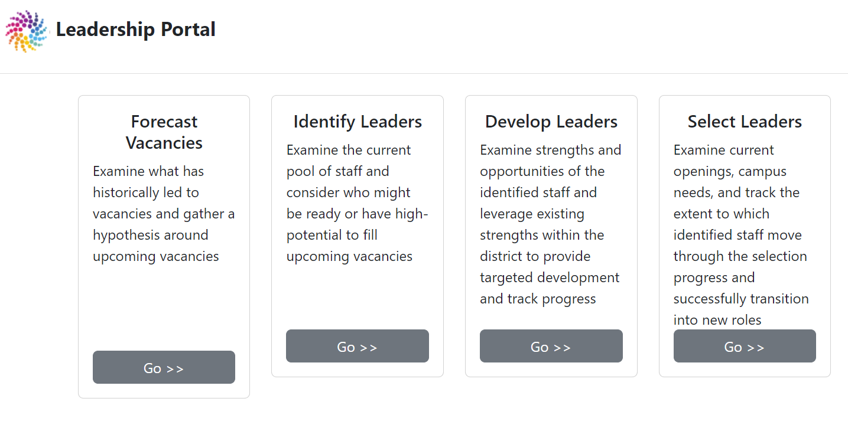
To arrive at answers to these three questions, click through to the Forecast Vacancies page of the Leadership Portal

Slide 14
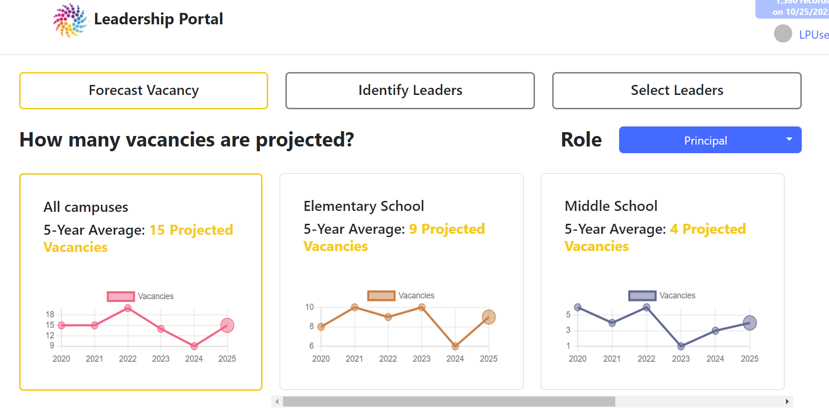
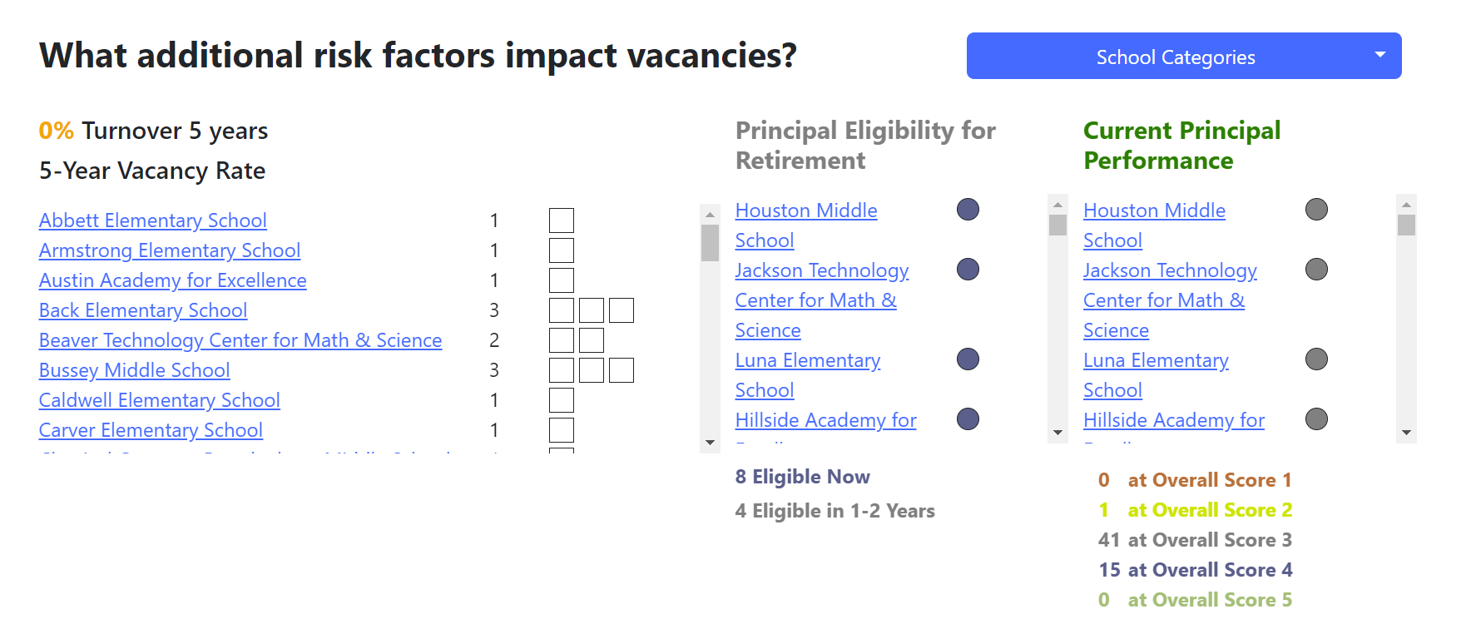
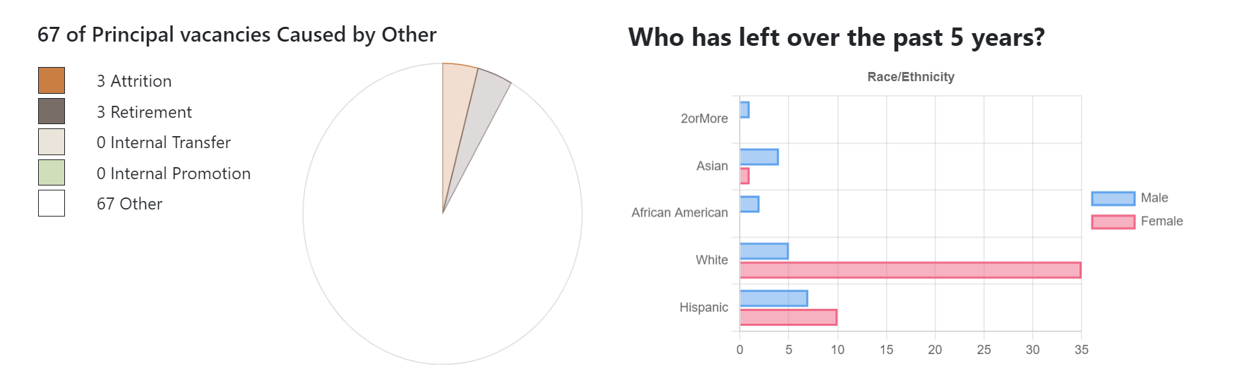
Each section of the Forecast page will help to answer one of these questions
How many principal vacancies can we expect to have in the coming year?
Where are these vacancies most likely to occur?
What are the major drivers of principal vacancies in our district?

Slide 15
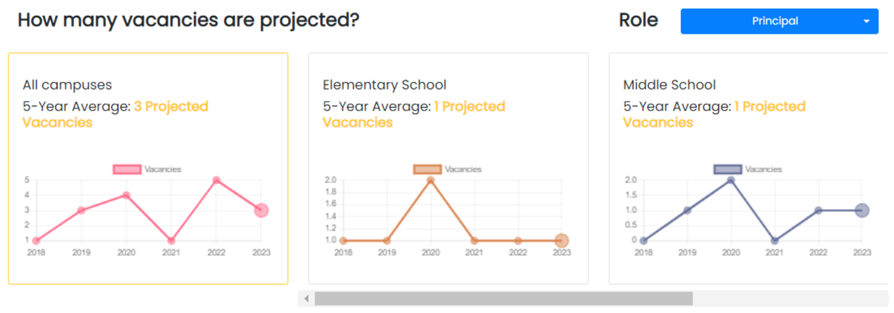
Forecast Vacancies Question 1 | How many principal vacancies can we expect to have in the coming year?
Step 1: Get in the ballpark of projected principal vacancies using historical trends
Directions: Find and note the projected principal vacancies from the corresponding dashboard. See example below:
TOTAL | High (Secondary) | Middle | Elementary
3 | 1 | 1 | 1
You should plan to adjust this number slightly as you review additional data. At the same time, be cautious not to reduce the number too much or count only those vacancies you currently know about or suspect. We have found a straight average of the past five years as depicted in this graph to be a great starting place and often very accurate. To cement this idea, it may help to walk back through last year’s vacancies and assess when in the year those campuses showed up on your radar as potential vacancies. (Be sure to include the cascade effects of transferring leaders as well—these are vacancies you have to consider)

Slide 16
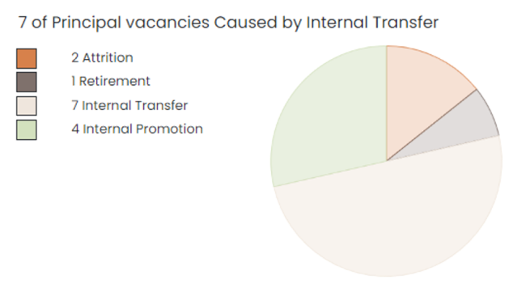
Forecast Vacancies Question 2 | What are the major drivers of principal vacancies in our district?
Step 2: Look under the surface at common causes of vacancies in your district
Directions: Note how prevalent the causes for vacancy are below. You could generalize (most to least common cause) or could do some simple math to find percentages for each cause.
Quit (attrition) | Retired | Promoted (internal) | Transferred (internal)
2 | 1 | 4 | 7
If this data displays as unknown, more than likely, the data cells provided were blank. Many districts do not actively track this in their data systems and the information lies in exit interviews and in the memories of principal supervisors. If this is your situation, consider implementing data governance around this field and creating processes to actively track this in a consistent manner going forward.

Slide 17
It can be useful to engage your team in a longer discussion about what is underlying the prominence of certain drivers
Below are some prompts to get you started
Retirement
Performance
Attrition
Promotion
What drives retention among those eligible for retirement?
How many years do principals typically stay in the role past their retirement eligibility?
How much shared visibility do we have into how principals are performing?
What are the timelines for performance improvement?
How do we think about transfers as a way to drive performance?
How well do we understand career aspirations of our principals?
How well can we gauge satisfaction and engagement?
What draws leaders to our district vs. other nearby systems?
Who is part of our backfill strategy?
Who are potential successors to CO leaders?
Where are we potentially creating new opportunities (roles, campuses, etc.)?

Slide 18
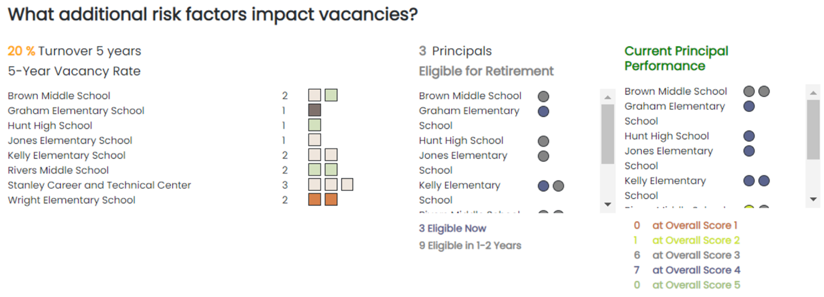
Forecast Vacancies Question 3 (step 1) | Where are these vacancies most likely to occur?
Step 3: Make hypotheses about specific schools that might have vacancies
Directions: This step will be completed leveraging the table on slide 20 of this document.
Page set-up:
Start by numbering the far-left tab with the total number of projected vacancies you landed on in Step 1
In column 2, label each space as elementary, middle, or high based on the number of projected vacancies listed in Step 1 (you do not need to stick to this break down perfectly, but it is a good starting place)
Identifying potential vacancies:
Start with High Schools (because it is the fewest number of schools).
Have a discussion with your team about the High School(s) most likely to have a vacancy leveraging the three visuals referenced above. If you have 1 projected HS vacancy, then just name 1 school most likely to have a vacancy. If you have 2 projected HS vacancies, then name the 2 high schools most likely to have a vacancy.
In this conversation, you can also consider the most common causes of vacancies noted in Step 2. For instance, if internal promotions are your most common cause of vacancy, you might first consider which of your HS principals is interested in and/or seeking a promotion. That could potentially be a high performer listed on the “Current Principal Performance” visual. Also consider if you view one of you HS principals as a potential successor for a Central Office role.
At this stage, this should feel more like art than science. That is ok. It is unlikely you have all the data and perspectives you need in the room. Nonetheless this data can be invaluable in thinking about your bench strength in the next stage.
After high schools, move to middle and then elementary schools.

Slide 19
Forecast Vacancies Question 3 (step 2) | Where are these vacancies most likely to occur?
Step 4: Prioritize potential vacancies based on school needs
HIGHEST priority | MEDIUM priority | LOWEST (relative) priority
Schools where only a small # of candidates could be successful | Schools where some candidates could be successful | Schools where many candidates could be successful Probably a good place for AP being elevated to principal
Directions:
First add notes and criteria to the table above for what might be characterized as a high, medium, or low priority vacancy based on the conversation you’ve just had. There is a start to this that answers the the question of how hard or easy a position is to fill.
Next, go through your list of potential principal vacancies and characterize each as “highest priority,” “medium priority,” or “lowest priority” in the column labeled “Priority level” on slide 20. Try to only name 1-3 campuses as “highest priority.”
Finally, make a few notes about your rationale for the priority level you designated in the final column on slide 20. Focus on naming why the 1-3 highest priority campuses are such high priority. Are there certain skillsets or knowledge an incoming principal needs? Is there an important challenge the new principal will need to solve?

Slide 20
Forecast Vacancies Question 3 | Where are these vacancies most likely to occur?
Template worksheet
# | School Level | School Name | Principal Name | Potential reason this principal may vacate their role | Priority Level | Rationale for priority

Slide 21
Identifying future leaders & Understanding your bench
IDENTIFY LEADERS INVEST & DEVELOP FORECAST VACANCIES
3

Slide 22
The second step is identifying the readiness of our Assistant Principals to step into the principal role.
IDENTIFY LEADERS INVEST & DEVELOP FORECAST VACANCIES
When identifying leaders you should seek to answer three questions:
How big is our bench of qualified applicants?
Who has high potential to be successful as a principal with some focused development?
Who aspires to be a principal?

Slide 23
To begin a conversation around these questions, start by clicking through to the Identify Leaders page of the Leadership Portal

Slide 24
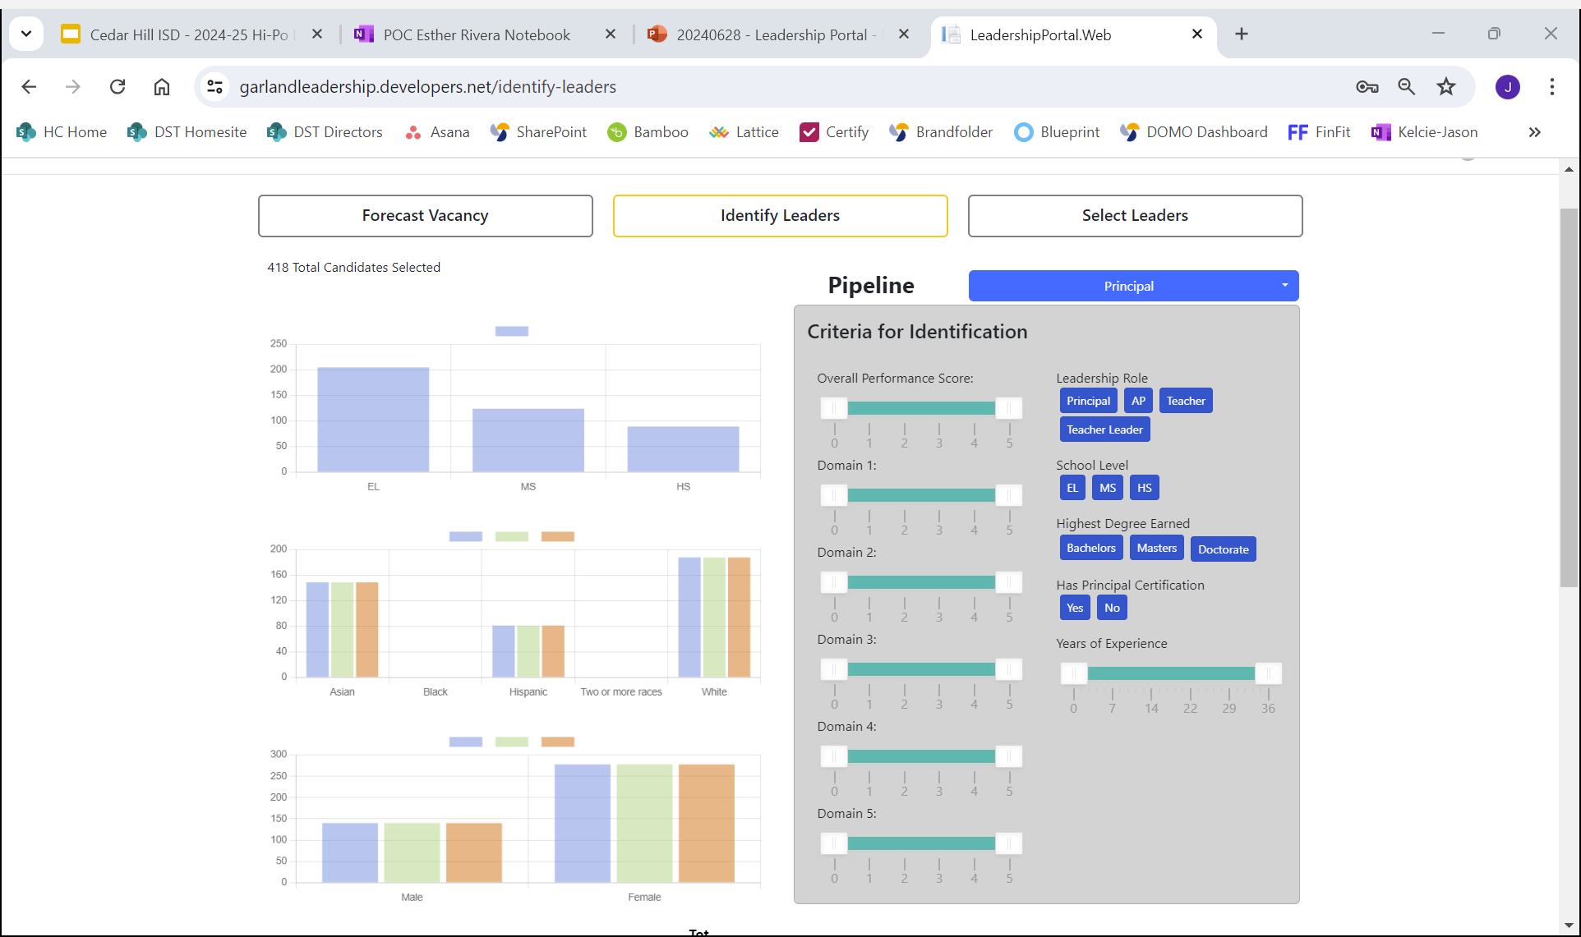
Identify Leaders question 1 | How big is our bench of qualified leaders?
Leveraging the Identification Filters
In this section of the dashboard, district leaders can “cast a broad net” to understand how various expectations and parameters might impact the total number of staff they could potentially consider for a position. In doing so, you may also discover how certain qualification expectations may be unintentionally excluding or giving preference to certain groups.
While these are by no means the total universe of potential factors to be considered in evaluating who may be qualified for a position*, they should spur some initial dialogue about whether this total pool is big enough for your vacancy needs. If so, are they all showing up in your development programs and hiring processes. If not, why not?
It may be that you have a small pool of people who meet the high bar for readiness, so you need to start your development further upstream in your pipeline with those who aspire.
*It extremely important to understand that these are not the total universe of possible levers for consideration. This is merely a launching point, and each district leadership team should carefully consider the additional data points required to successfully execute this process in their district.

Slide 25
Identify Leaders question 2 | Who has high potential to be successful as a principal with some focused development?
Directions:
In this section, district leaders should leverage the list of campuses created from the forecast section with potential upcoming vacancies and consider one highest priority campus. How might your criteria need to tighten for a leader to be successful at that campus? Do this for each highest priority campus.
We recommend a district has some intentional conversation to identify the skills, experiences, and mindsets they expect leaders to have and what indicates that a staff member is on track to attain these.
As an example, consider the framework on the following slide that a district might adapt to better define what both potential and readiness for the principal role look like.

Slide 26

Starter Criteria | Leaders with high potential to be successful principals on day 1
Criteria defining potential for leadership
The following are six criteria that we believe characterize a person with high potential to be successful on day 1 as a new principal. This baseline definition will assist you in beginning the identification process and in establishing a customized version that is specific to your district’s needs.
 | Has it | Needs it | Have they had these experiences? | Have they demonstrated this bar of competency?
Results- & improvement-driven |  |  | Led a content or grade level team Responsible for delivering school-wide results that are critical to the school’s success or standing with the community, state, or district | Ability to manage a team towards improved outcomes for students Continuous learner who protects time to strategize, reflect, and review outcomes in service of students, families, teachers, and the community
Strategy & long-term thinking |  |  | Led an important change effort or new initiative implementation Has exposure to setting budget Has participated in master schedule and calendar | Balances short and long-term thinking with present needs and pressure Can set goals and milestones to help the team/organization move towards an ambitious vision
Organizational mindset |  |  | Has set a collaborative vision for something important Has had a responsibility that requires balancing competing/varying priorities within the school or district | Ability to connect individual goals, initiatives, or teams with the broader vision of the school Consistently anticipates the impact of individual decisions on the school and prioritizes the whole school over smaller units
Communication |  |  | Has been responsible for consistent internal communication that teachers and staff rely on for information Has managed large scale external communication (parents, community, etc.) | Communicates clearly with individuals and groups Ability to communicate through layers of the organization and through various channels/modalities Has mindset and strategies to listen and gather input
Emotional intelligence & maturity |  |  | Has managed challenging 1:1 parental or community relationships Has managed challenging 1:1 or team dynamics with teachers | Has the diverse experience and emotional intelligence required to meet the stress/needs of and adapt to a variety of scenarios and stakeholders
Team culture & cohesion |  |  | Has experience with supervision and performance management Has been responsible for the culture/engagement of a group | Ability to build strong relationships and bring out the best in others Has skills to build a strong team culture and a track record of supporting other adults to work together to achieve results

Slide 27
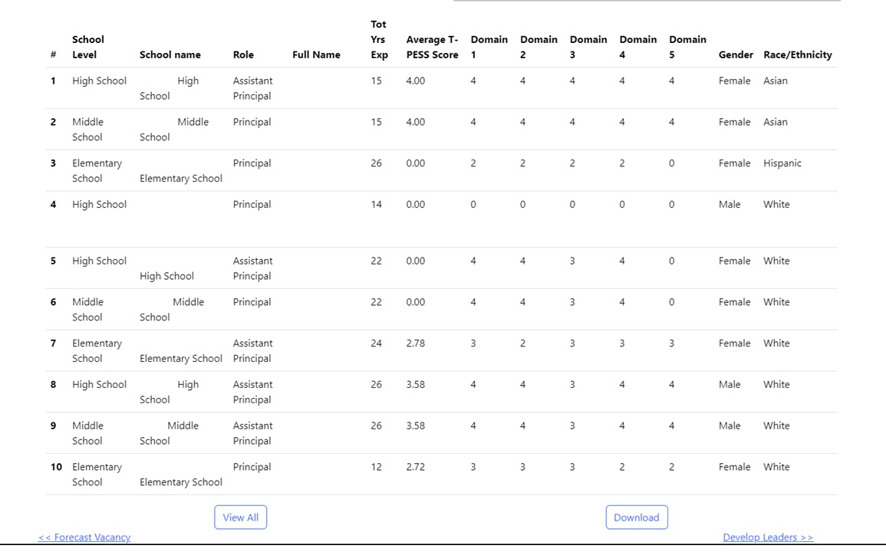
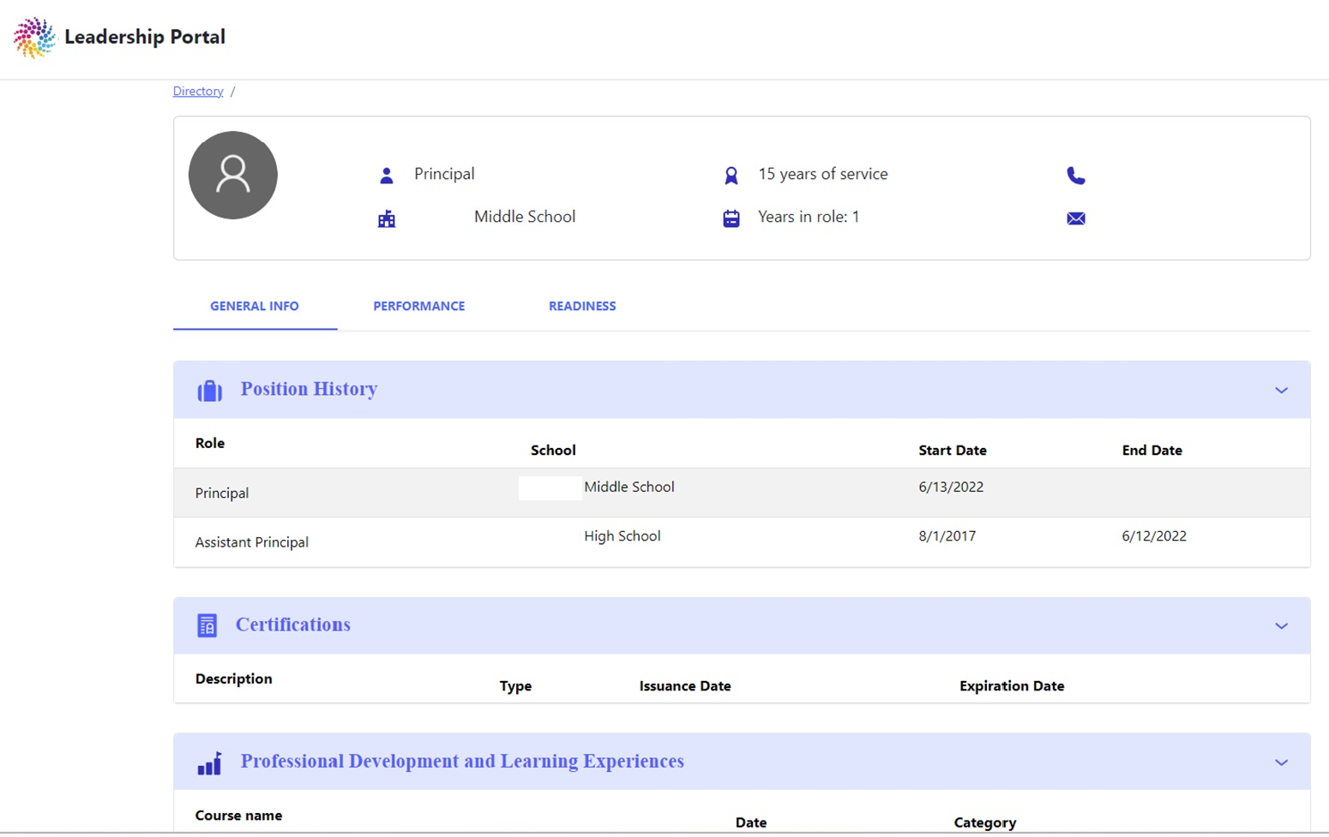
Identify Leaders question 2 | Who has high potential to be successful as a principal with some focused development?
Leveraging the Identification Filters
As you adjust the filters you will see the list of potential leaders change at the bottom of the Identify page, showing you their various qualifications. At this point in the process it will make sense to begin looking at individuals and having conversations about their readiness.
Click through to individual profiles using the links provided for each person as you discuss their readiness. You can start with the data displayed in their profile and then move to the more granular criteria you have defined for readiness (e.g., slide 26). Principals, principal supervisors, and self-ratings can provide important input for this step. This can be gathered via survey or in-person career conversations with the individual.
As you go through this exercise we recommend documenting your conversation in two ways: 1) Estimate the timeline for this individual to be ready for the principalship (e.g., Now, 6 months, 1 year, 2-3 years) and 2) Document the readiness gaps you discuss based on your district’s criteria. While you cannot input the outcomes of your conversation directly into the tool, we encourage you to document this data in a secure file. Consider using the template on slide 29.

Slide 28

Identify Leaders question 3 | Who aspires to be a principal?
If a leader has indicated that they aspire to the next role in their leadership journey this symbol will appear under their name
Why this data matters | Districts should be assessing the readiness of all potential leaders in their system on a regular cycle, not just those who raise their hands or who have principals that promote them. That said, it is important to understand who among your staff is currently seeking promotion and on what timetable. This will help you understand the attractiveness of leadership roles in your district, the expected level of movement, and it will also let you see who among your high-potentials may require encouragement to pursue leadership. You may also decide to offer leadership seminars for all who aspire to leadership for them learn more about your district regardless of readiness.
Tracking who aspires to be a principal
Most districts do not currently track who aspires to be a principal among their APs and teachers. Here are two common methods for collecting this data:
Survey: A district can use surveys to gather information on the aspirations of assistant principal-level staff by asking questions such as:
Do you aspire to be a principal in your district?
Where do you see yourself in the next two to three years?
Where do you see yourself in the next four to five years?
If you feel you are ready to be a principal now, please provide two to three pieces of measurable evidence that could indicate your readiness.
Principal Supervisors: This preferred method ensures district leadership understands the aspirations of APs. The process involves principals engaging in evaluation cycle conversations with their APs and adding in a step that asks about their career aspirations. They then pass that information to the principal supervisor where the data is centrally collected.
Note: This data is meant to better serve district leaders in the process by understanding who aspires to the role and should not be considered a final criteria in determining readiness or in hiring decisions.

Slide 29
Identify Leaders | Our current bench
Template worksheet
Name | Current position and School | Aspires | Readiness level (Ready Now, Ready in 6 months, Ready in 1 year, Ready in 2-3 years, Still developing in current role) | Development priorities | Best-fit development opportunities

Slide 30
Investing in Future Leaders through targeted development
IDENTIFY LEADERS INVEST & DEVELOP FORECAST VACANCIES
4

Slide 31
The third step of Vacancy Planning is investing in and developing those you have identified
The purpose of Vacancy Planning is to help you strengthen your bench by thoughtfully and intentionally investing in and developing the future leaders in your system. In this process we encourage you to think about three questions:
What are the leadership development opportunities we currently provide in our district?
What needs is each opportunity best positioned to address?
What opportunities are the best fit for addressing each individual’s development needs?
IDENTIFY LEADERS INVEST & DEVELOP FORECAST VACANCIES

Slide 32
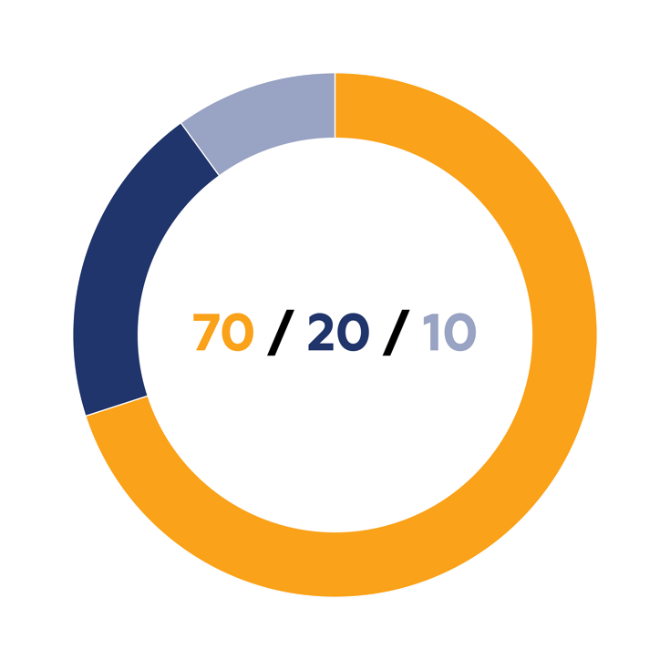
Invest and Develop question 1 | What are the leadership development opportunities we currently provide in our district?
Take an inventory of your current and past efforts to develop leaders.
For many districts this includes:
Cohort-based programs
Leadership Seminar series
Mentoring
Formal coaching
Leading summer school
Graduate programs
Certification programs
External workshops
To the right is a framework we use to think about what leadership development might look like. What have you/could you offer within each of these buckets?
We believe effective leadership development consists of:
70% Experiential Learning
On-the-job learning project
Cross-functional assignment
Job rotation
School-wide project lead
Strategic initiative lead
Residency
20% Social Learning
Coaching
Mentoring
Exposure to high-performing individuals
Peer networking
Consultancy
Job shadowing
10% Formal Learning
Training sessions
Webinars
Articles/books
Workshops
Certification/degree programs

Slide 33
Invest and Develop question 2 | What needs is each opportunity best positioned to address?
Moving from being an assistant principal to a principal requires many shifts in skill, time allocation, and what one values as part of one’s professional identity. Different programs and delivery methods may address some shifts better than others. Below are some key shifts APs must make:
Personal Leadership
SKILL: Maturity
TIME: Protect time to think, reflect, and analyze
VALUES: Trust, accept advice, and receive feedback from team members
Vision and Strategy
SKILL: Taking a broad, long-term perspective
SKILL: Collaboratively setting strategy and goals for the school, balancing future goals (3–5-year plan) with present needs and pressures
TIME: Think time for strategy & long-term planning
VALUES: Success of the entire organization
Professional Presence
SKILL: Humility, listening, and sensing
SKILL: Communicate clearly and effectively with all stakeholders (through multiple layers of an organization)
VALUES: Accept attention and scrutiny that comes with being highly visible
Team and Culture
SKILL: Build a strong team and ensure members work well together
VALUES: Organizational culture
Consider creating or at least thinking through a theory of action for each development offering, articulating what you expect both the immediate and long-term impact of your actions will be and why that matters for the results you are seeking. The table below can provide a structure to this activity:
IF OUR… | Who is/are your target population/s? (e.g., Assistant Principals, Academic Deans, Teacher Leaders)
…WHO ARE… | What needs to be true of applicants coming into the program? (e.g., ready for the principalship, 1-year out from ready, 2-3 years out from ready, high potential, aspiring)
…RECEIVE… | What are you committing to provide to participants? (e.g., training to develop key skills and mindsets, opportunities to step into greater leadership, perspective into the reality of the principal role)
…THEN… | What will be true at the end of the program? (e.g., they will grow in target areas, they will achieve readiness for the principalship, we will better understand our bench)
…SO THAT… | What is the benefit to the district or students? What need are you filling? (e.g., we will have a ready internal candidate for every principal vacancy, we will be better ready to fill vacancies at high needs schools, we will have a sustainably strong bench in 2-3 years, we )

Slide 34
Invest and Develop question 3 | What opportunities are the best fit for addressing each individual’s development needs?
Everyone in your system deserves to be invested in, but not everyone needs the same thing. Go back to slide 29 to define what program/opportunity is best fit for each individual based on their development priorities. We find it helpful to differentiate first those who need Core Development for their current role from those who need High-Potential Development for the next role. We define these as:
The most differentiated component of leadership development for your high-potential staff is on-the-job development. Creating a clear Individual Development Plan for this is essential to its success but is often overlooked. Structuring that learning for adults is essential. An IDP for on-the-job development might include:
Targeted Readiness Criteria: 2-3 skills in which the leader will build capacity
Skill development: Overview how the leader will increase their skill and knowledge
Goals/Outcome(s): What the leader will be able to do after this opportunity?
Success Criteria: How will you know the leader has achieved the desired outcome?
Duration: How long will the leader participate in this opportunity?
Optimal Timing: Start and end dates; Consider a principal's recurring tasks and activities throughout the year.
Experience Supervisor(s): Usually, the leader's immediate manager
Additional Staff/Department Contributors: Individuals who will support; Other departments where the leader may spend time
Action Tasks and deadlines: Outline the actions that the leader will undertake during the experience. Actions may include:
Establish regular 1:1 meetings with supervisor.
Meet with the supervisor to establish stretch opportunity experience objectives, deadlines, major milestones.
Who the leader should collaborate or connect with for learning, observations, and feedback.
What data the leader should collect and analyze
Prepare reports or present findings/outcomes and to whom.
Core Development
High-Potential Development
Targeted for all individuals in a particular role, or at least a very large swath of individuals in a particular role
Focused on helping people improve in one’s current job
Typically happen on set-aside PD days or after school in regularly scheduled professional development
Ideally includes a mix of “push” strategies (content given to them) and “on demand” strategies (content that individuals can access)
Targeted for a small subset of individuals based on their leadership potential
Typically focused on helping people get ready for their next role
Sessions may occur after school or on weekends to accommodate for schedules
Structures include a wider array of learning experiences like coaching and on-the-job experiences, not just formal sessions

Slide 35
Where do we go next?
5

Slide 36
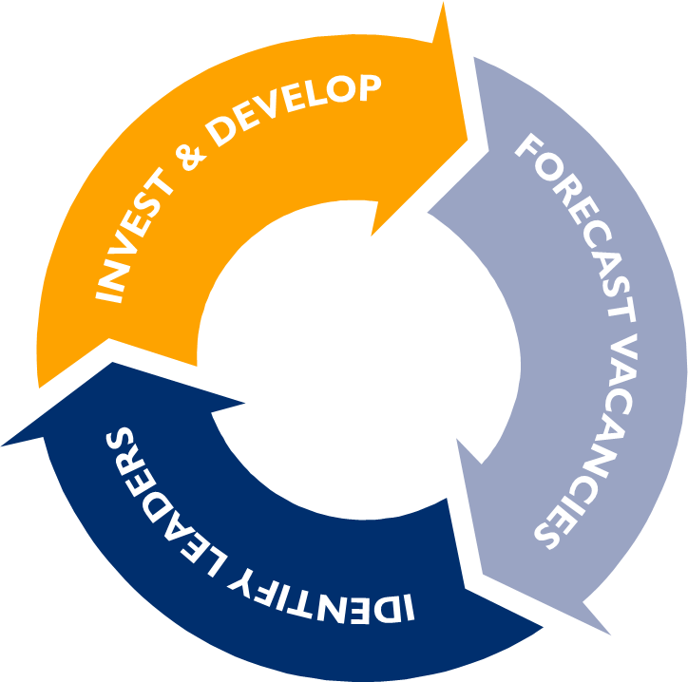
What does success look like? | Implementation of a vacancy planning cycle should result in…
A reliable prediction of how many Principal and AP vacancies your district may have in the upcoming school year
A more specific hypothesis about schools that might have critical vacancies arise
An understanding of your internal bench of potential principals and APs
Providing targeted investments in aspiring leaders who have high potential to help them develop to be "ready" to lead on day 1 in a new leadership role
Through these investments, districts should have a higher ratio of "ready leaders" to leadership vacancies, so that the selection process has a stronger, deeper pool of talent

Slide 37
Where do we go next?
Practice | In the Holdsworth Partnership we go through five cycles of Vacancy Planning, one a year. We know it takes time and repetition to gain skill and deepen the impact of this intentional planning process. Some of these systems are new to our district partners, others are simply revised from what they’re already doing. Each time though we layer on new elements to deepen the conversation and broaden its impact. What’s most important is getting the flywheel turning.
Expand the circle | You may have gone through these exercises by yourself as a district leader, among principal supervisors, or within your human resources or professional development department. The power of these conversations comes in crossing departmental lines, gathering data up and down the organization and building a culture of growth and development through transparency and inclusion.
Look beyond the principalship | Districts quickly realize that if they’re struggling to place principals (particularly amid the high turnover of recent years) they likely need to invest in leaders further and further upstream. We recommend starting with the principalship, but planning for AP and Teacher Leader vacancies carries tremendous power and extends the culture of growth to the entire district

Slide 38


Visit our website for more ideas about how to develop leadership and recommended resources
holdsworthcenter.org

