Slide 1
Intelligent Business Analytics System
For Maximizing Revenue and Efficiency

Slide 2
Why I Built This System
What it is: "Intelligent Business Analytics System" is a dashboard for small-to-medium restaurants to analyze sales data using AI.
The Problem: Restaurants struggle to track customer preferences, predict demand, and analyze large sales data. Small-to-medium restaurants often rely on manual methods or inefficient systems, which limits growth and insights.
Solution: Created the "Intelligent Business Analytics System"—a simple dashboard that uses AI to analyze sales data and provide actionable insights.
Goal: Help restaurant managers optimize menus, identify best-sellers, understand customer sentiment, and plan inventory or promotions.

Slide 3
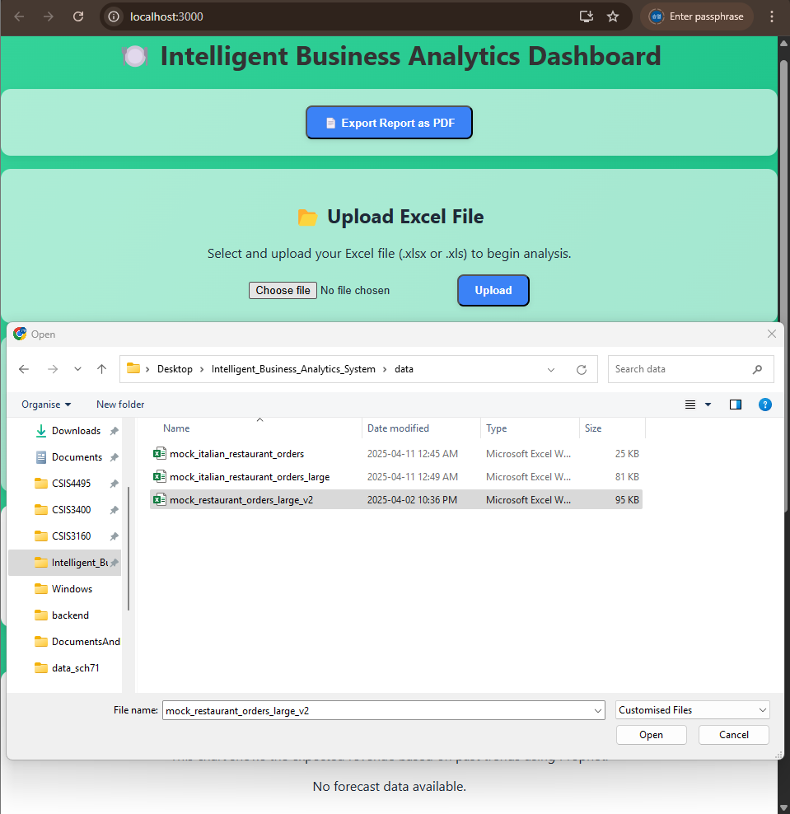
How It Works
Simple Process!
Upload an Excel file contains sales data
The System will process the data using different methods including AI
View results on a dashboard with charts and summaries. Also can download!
Key Features?
Analyze customer reviews about each items (Pos/Neg)
Predict sales for the next 30 days
Categorize menus automatically (drinks, mains, desserts)
Recommend products and find good combinations

Slide 4
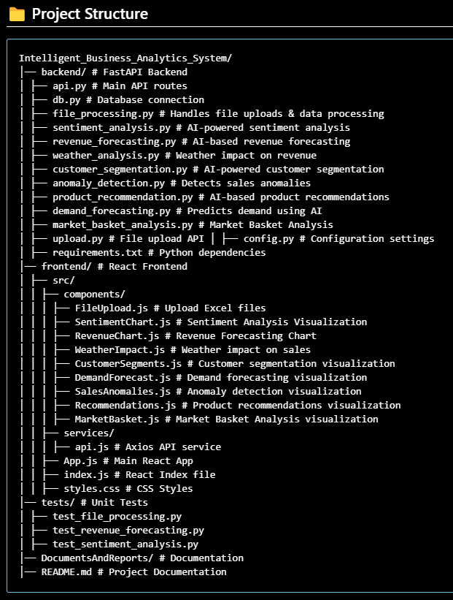
Key Features & Architecture
Sentiment Analysis: Analyzes customer reviews to show positive/negative feedback per menu item.
Revenue Forecasting: Predicts sales trends for the next 30 days to help with planning.
Market Basket Analysis: Finds items often bought together (e.g., pizza + cola).
Menu Categorization: Groups menu items into categories (drinks, mains, desserts) and shows sales breakdown.
Frontend: React + Tailwind + Chart.js
Backend: FastAPI + Python + PostgreSQL
AI/ML: Prophet, PyTorch, Sklearn

Slide 5
Key Features – business value
Improve customer satisfaction by understanding feedback.
Maximize revenue with better inventory planning.
Boost sales with smart combo promotions.

Slide 6
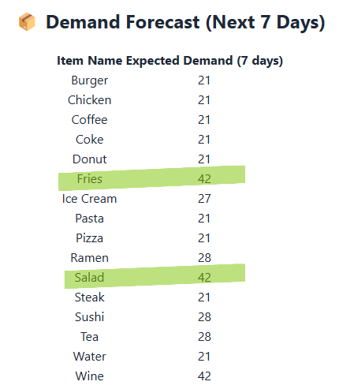
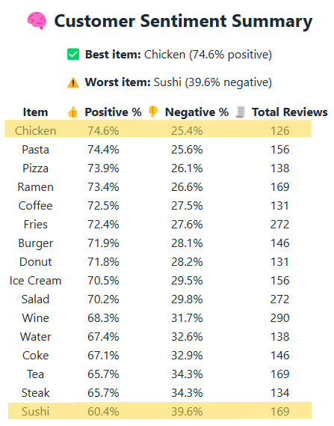
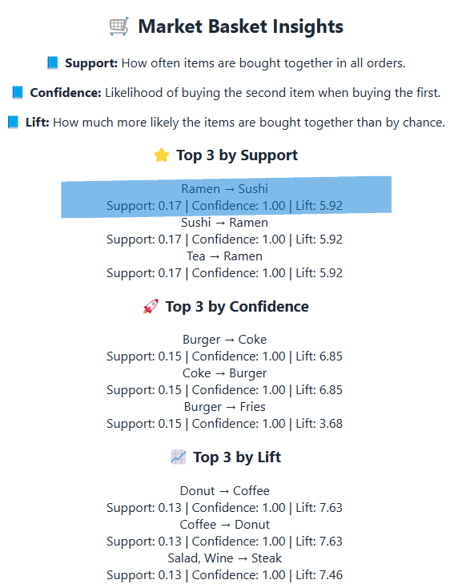
Example Results, Benefits for managing
Customer Sentiment:
74.6% positive reviews for a menu item like Chicken,
39.6% Negative reviews for a menu item like Sushi
Item Combinations: Ramen and Sushi often bought together—perfect for a combo deal.
Demand Prediction: Expect higher demand for Fries and Salad in the next 7 days—stock up!

Slide 7
Challenges and Lessons Learned
Challenges:
Handling varied Excel file formats—solved with flexible parsing logic.
Duplicate recommendations in the system—fixed by adding filters.
Designing a user-friendly UI—improved through multiple iterations.
Lessons Learned:
Build step-by-step: Test small features first to avoid issues.
Focus on user experience: Charts and summaries make data easy to understand.
Use AI responsibly: Switched to local models (Hugging Face) when API limits were an issue.
Satisfying Moment: Completing a practical, intuitive dashboard.

