Slide 1







Trends in technology
Edward Muñoz Garro
2021-01-04

Slide 2



OUTLINE
Executive Summary
Introduction
Methodology
Results
Visualization – Charts
Dashboard
Discussion
Findings & Implications
Conclusion
Appendix

Slide 3

EXECUTIVE SUMMARY
Every day born news technologies, some increase very fast and others are forgot.
Two of the most important factors in this market are
Programming languages.
Databases.
The popularity in technologies between two years are highly variable.
Don’t worry by the changes, is the normal in the technology market, sometime a technology is forgotten and later is popular again.
If a technology is not popular don’t significate that that technology are useless.

Slide 4

INTRODUCTION
Every day born news technologies, some increase very fast and others are forgot.
Two of the most important factors in this market are
Programming languages.
Databases.
Many factors are influents in this market, like region and enterprise focus, by this reason this results don’t apply for any enterprise on the world.

Slide 5

METHODOLOGY
The data was recovered from a public repository.
The focus is quantitative.
The analysis is based on contrast data.
The most important points was
Programming Languages.
Databases.

Slide 6
RESULTS

Slide 7
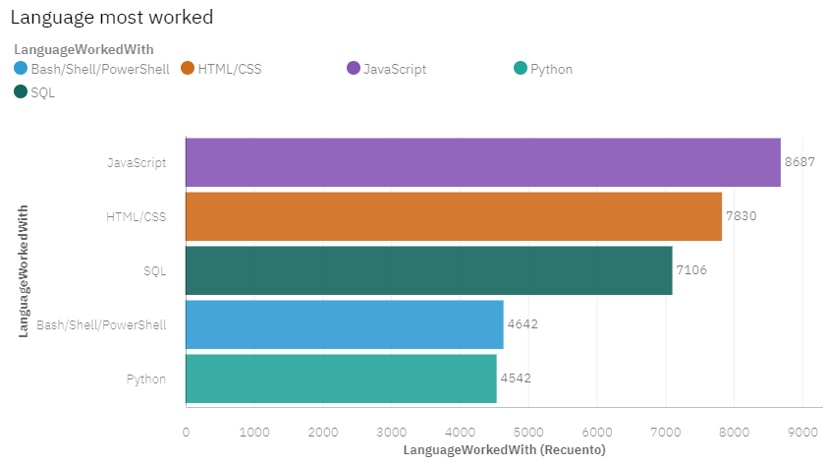
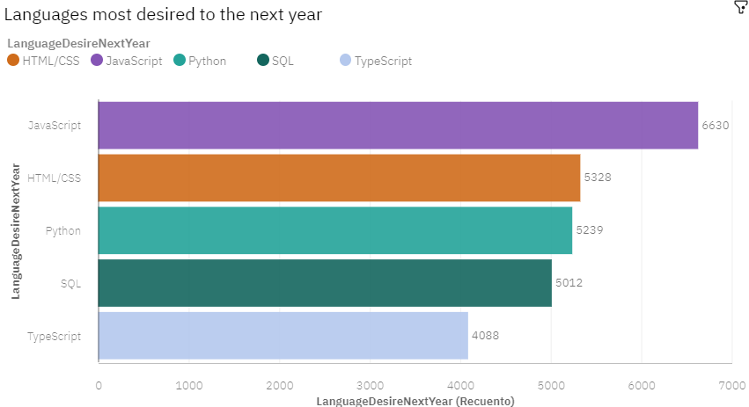
PROGRAMMING LANGUAGE TRENDS
Current Year
Next Year

Slide 8
PROGRAMMING LANGUAGE TRENDS - FINDINGS & IMPLICATIONS
Findings
The best option in this moment is study/invest in javascript or HTML/CSS
SQL is a good option to use.
Don’t use much python is descending.
Implications
Javascript, HTML and CSS maintains the head
SQL is more and more popular.
Python is less and less popular.

Slide 9
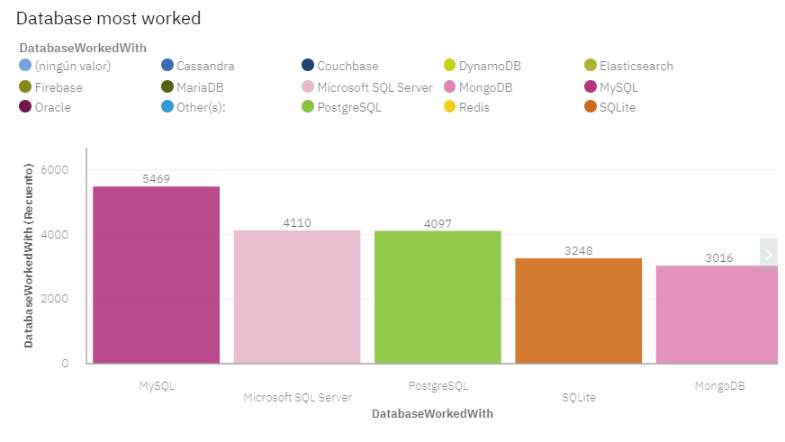
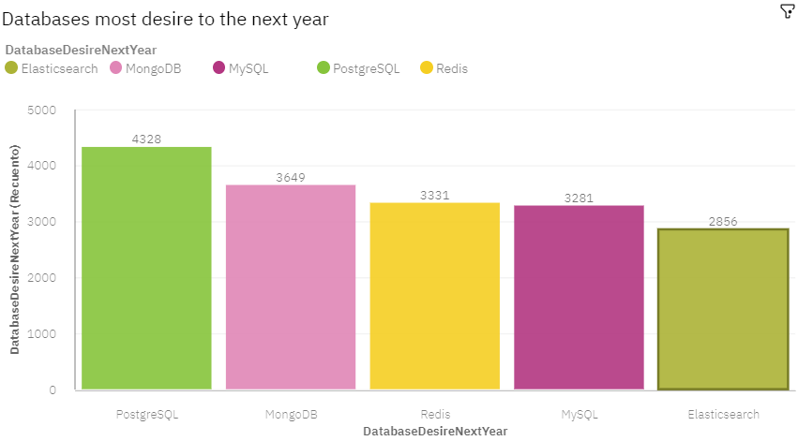
DATABASE TRENDS
Current Year
Next Year

Slide 10
DATABASE TRENDS - FINDINGS & IMPLICATIONS
Findings
Invest in non-rational databases.
Be carefully with relational databases, are decreasing.
Don’t worry this market is very variable.
Implications
Non-relational databases are growing in popularity.
Relational data bases are decreasing in popularity.
Databases trends are highly variables.

Slide 11

DASHBOARD
https://us3.ca.analytics.ibm.com/bi/?perspective=dashboard&pathRef=.public_folders%2FCoursera%2BAssign%2FBuilding%2Ba%2Bdashboard%2Bwith%2BCDE&action=view&mode=dashboard&subView=model00000176ca34440b_00000002

Slide 12
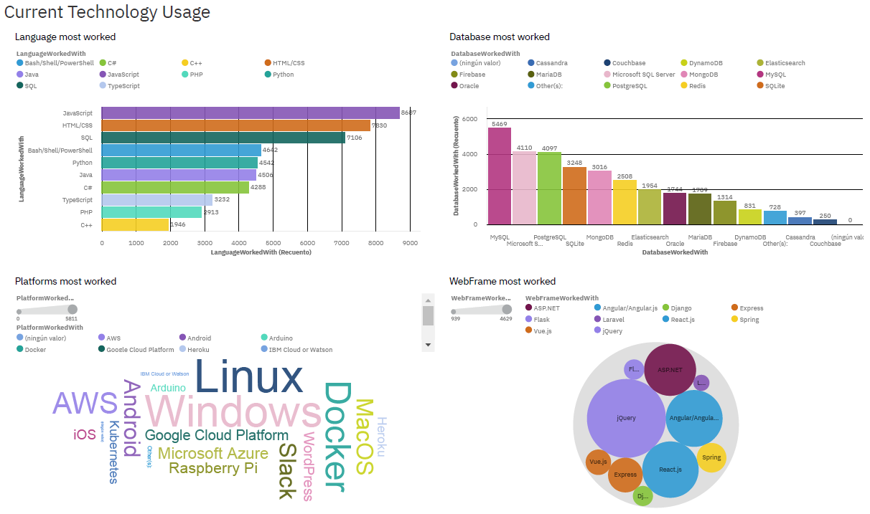
DASHBOARD TAB 1

Slide 13
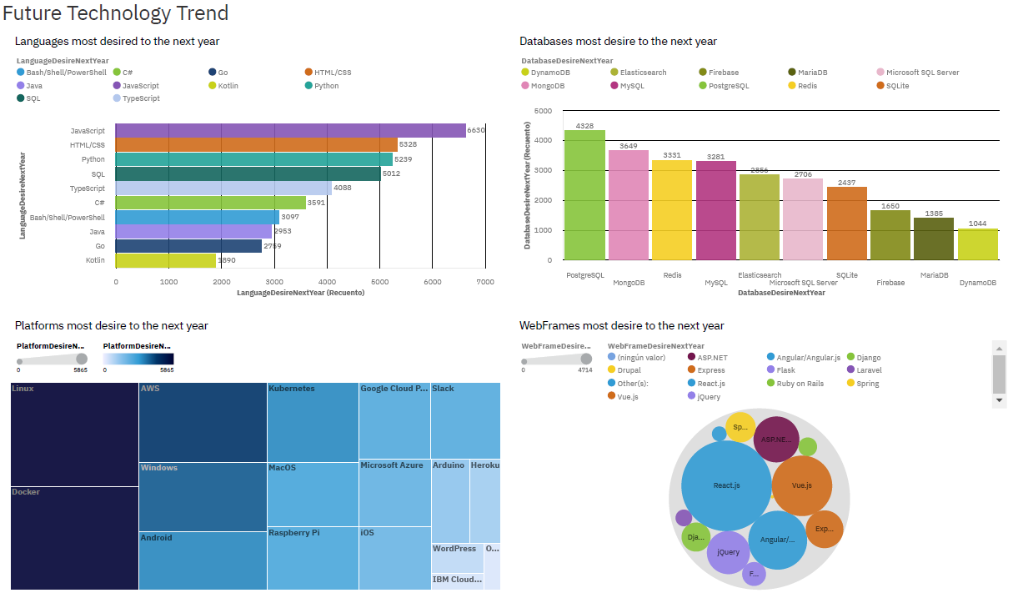
DASHBOARD TAB 2

Slide 14
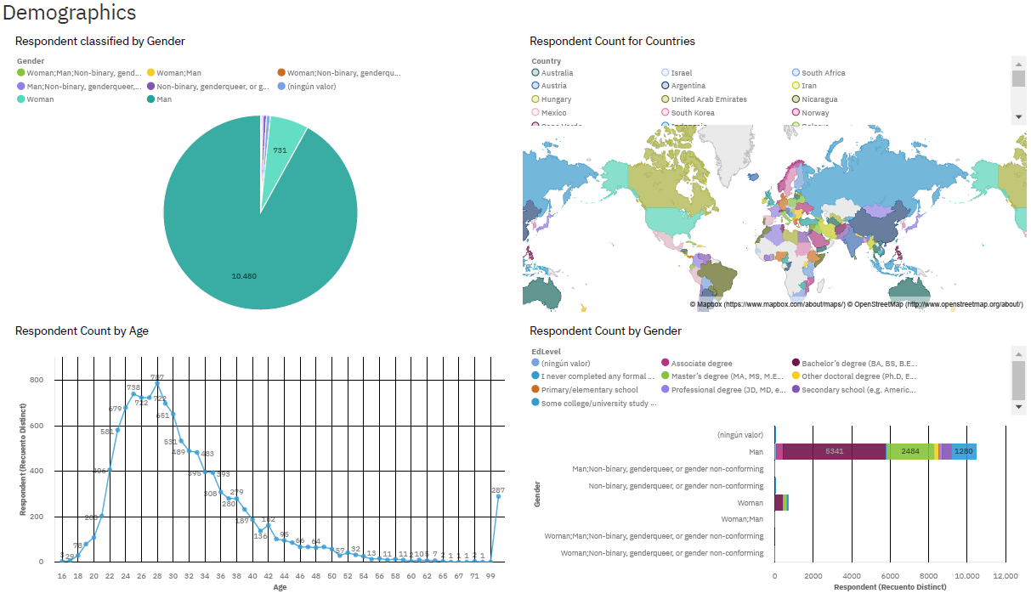
DASHBOARD TAB 3

Slide 15
DISCUSSION
The most popular languajes are javascript and html/css, but what about the pay?
The databases are changing, but the technologies will return?
The results are equals for any county?

Slide 16
OVERALL FINDINGS & IMPLICATIONS
Findings
The best option in this moment is study/invest in javascript or HTML/CSS
Be carefully with relational databases, are decreasing.
Don’t worry this market is very variable.
Implications
Javascript, HTML and CSS maintains the head
Relational data bases are decreasing in popularity.
The trends are highly variables.

Slide 17

CONCLUSION
The technology world is very variable, and we were upgrade constantly.
Some technologies decreasing a time but returns later.
In this moment we need pay attention in non-relational databases and JavaScript technologies like typescript.
Don’t worry by the change, this market is in constantly movement.

Slide 18

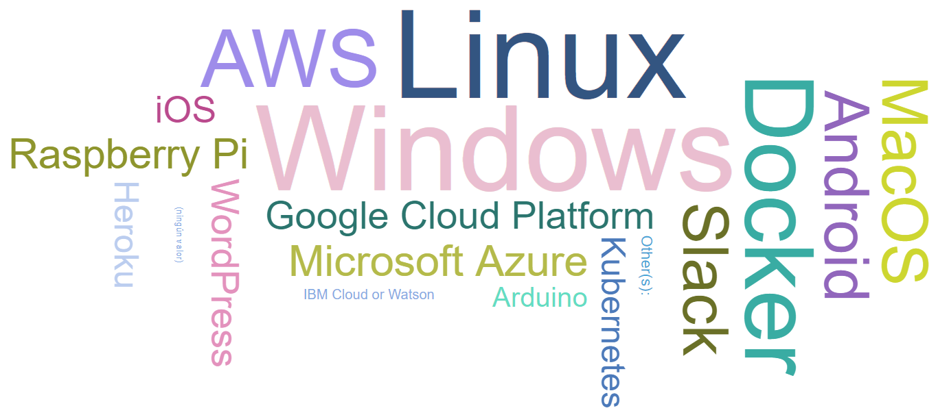
APPENDIX

Slide 19
GITHUB
https://github.com/Ed117/analystCaptone.git

