Slide 1
Frontier Canvas
One AE + Copilot CLI = Production App From Scratch
Edison Borges · ATU Americas · May 2026

Slide 2
Edison Borges
Account Technology Unit · Americas
Field AE focused on Frontier Transformation & AI adoption
Built Frontier Canvas solo using Copilot CLI — the tools we sell
120 commits, 22K+ lines of production code, zero infrastructure cost
Notes:
Keep brief — 20 seconds. The credibility IS the tool you built.

Slide 3
AEs Walk Into CxO Meetings Cold — That’s a Revenue Leak
🚫
📊
🔄
No structured prep tool
40-slide decks don’t fit
Every AE reinvents the wheel
for C-level AI conversations
a 20-minute CxO slot
no evidence-to-insight flow

Slide 4
10 Minutes of Structured Prep Changes the Outcome
🤖 Copilot-native
☁️ Zero infrastructure
Chat + Cowork as engine No custom AI backend
Static site, localStorage $0 cost
✅ Customer-ready
⚡ 10 min to value
CELA compliance baked into every output
Longer than a coffee break? AEs won’t use it

Slide 5

Copilot CLI Turns Natural Language Into Production Code
Notes:
I describe problems in natural language. Copilot plans. I review and approve. It builds, I validate, we deploy.

Slide 6
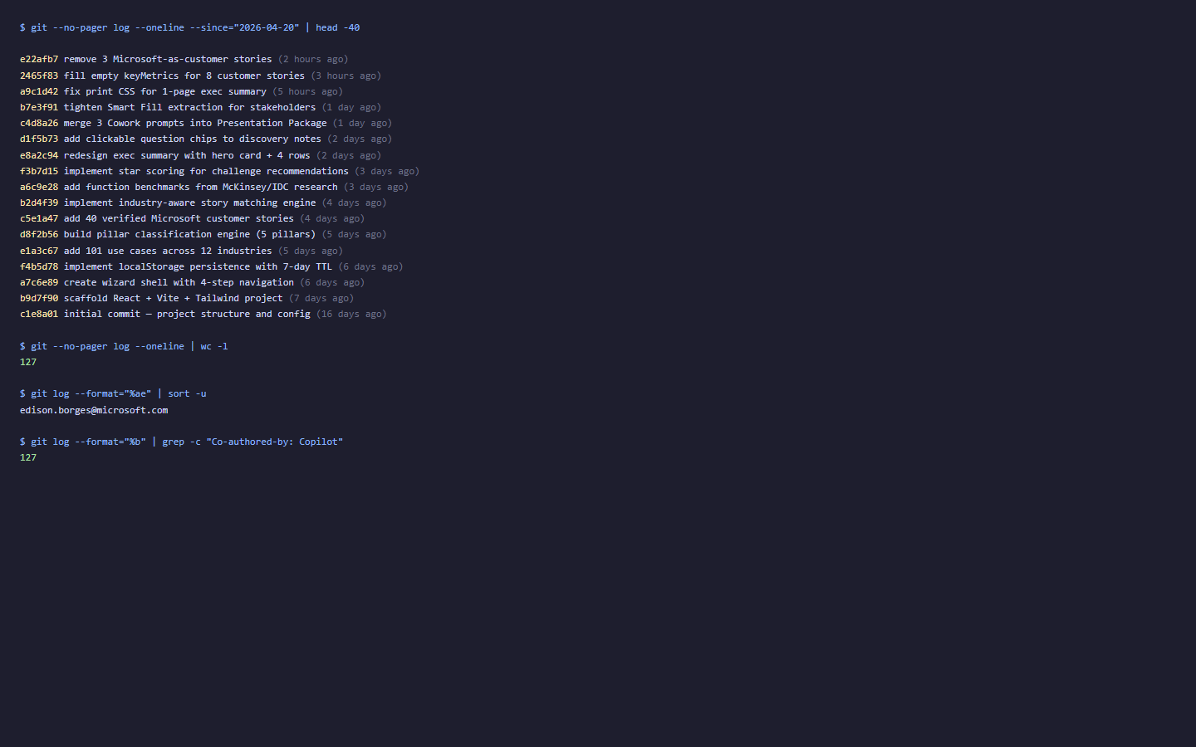
120 Commits · 22K+ Lines · One Person · Zero Cost
120
22K+
85
101
commits
lines of code
customer stories
use cases

Slide 7
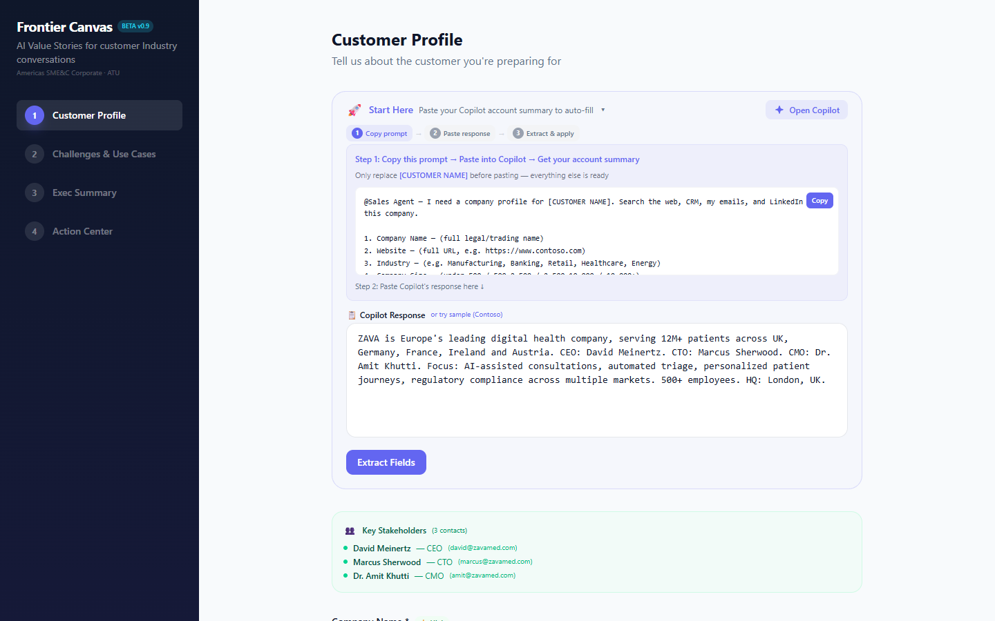
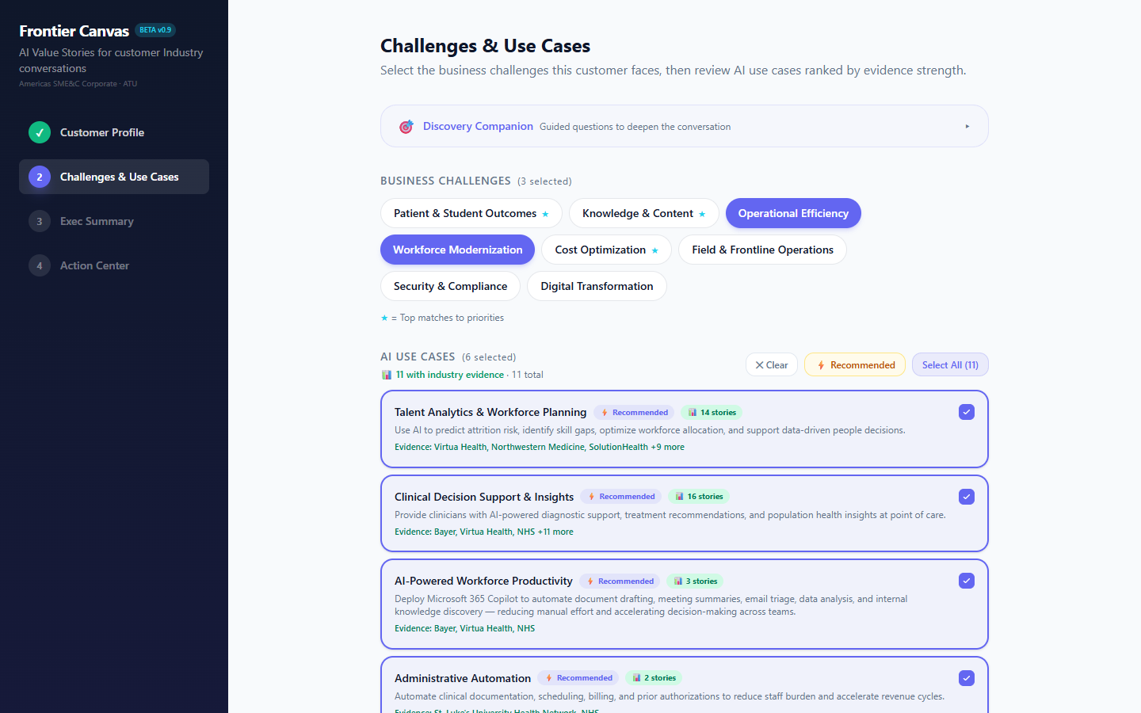
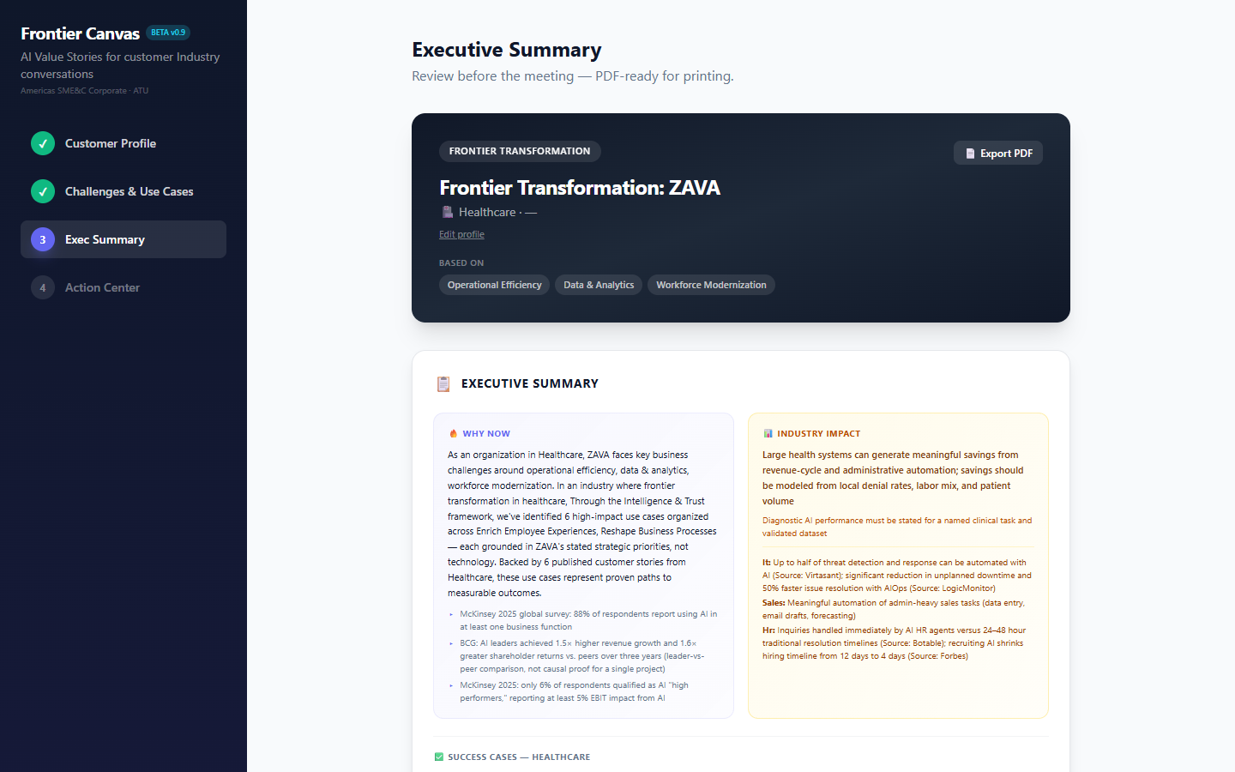
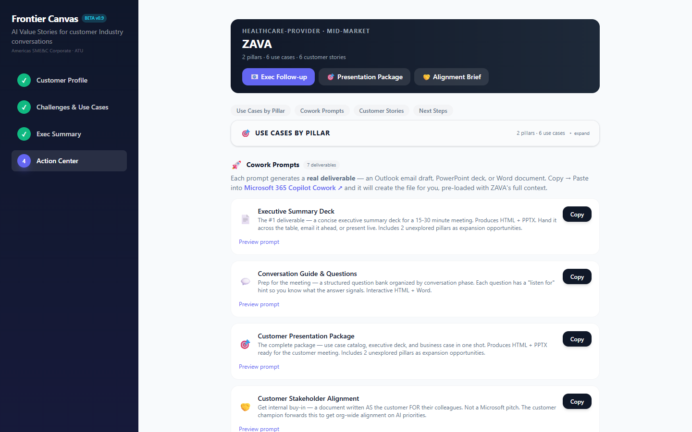
Profile → Challenges → Summary → Action Center
Step 1: Profile
Step 2: Challenges
Step 3: Summary
Step 4: Action Center
Notes:
Profile captures context. Challenges maps priorities. Summary builds the story. Action Center generates 8 customer-ready deliverables.

Slide 8
Real Field Feedback Ships Same Day — Not Next Quarter
FEEDBACK
SHIPPED
“Smart Fill isn’t extracting stakeholders”
→
Broadened to all C-level/VP+ — shipped next day
“Too many prompts, just need one for the meeting”
→
Merged 3 into 1 Customer Presentation Package
“Which Copilot do I use for what?”
→
Distinct Chat vs Cowork buttons with phase badges

Slide 9
This Pattern Scales to Any Solution Area
🔄
🔌
🏆
The Formula
Plug-and-Play
The Proof
Field pain → Copilot CLI builds → Cowork delivers customer output
Swap data (use cases, stories, challenges) for any Solution Area
Building WITH the tools IS the proof they work

Slide 10
What You Now Have That You Didn’t 12 Minutes Ago
A replicable pattern for turning field pain into production tools using Copilot
Living proof that the tools we sell accelerate US — not just customers
A blueprint to build YOUR version for your Solution Area
This slide stays up during Q&A.

Slide 11
Appendix: The 8 Cowork Prompts
📄 Executive Summary Deck
💬 Conversation Guide
Output: HTML + PPTX
Output: HTML + Word
🎯 Customer Presentation
🤝 Stakeholder Alignment
Output: HTML + PPTX
Output: HTML
📧 Executive Briefing Email
📨 Follow-Up Email
Output: Outlook draft
Output: Outlook draft
📋 Account Team Handoff
🏆 Competitive Differentiation
Output: HTML
Output: HTML

