Slide 1
Frontier Canvas
One AE + Copilot CLI = Production App From Scratch
Edison Borges · ATU Americas · May 2026

Slide 2
Edison Borges
Account Technology Strategist · ATU Americas
📷 Add your photo here
🌎 Based in Americas — working across industries and enterprise accounts
🎯 Focused on Frontier Transformation, AI adoption & customer value realization
🛠️ Built Frontier Canvas solo using Copilot CLI — the same tools we sell
💬 Passionate about turning field insights into scalable tools that help the entire ATU
🤝 Previously: [Add your background — industry, prior roles, certifications]
Notes:
Personalize this slide: add your photo, update background line, keep it under 30 seconds. The credibility IS the tool you built.

Slide 3
AEs Walk Into CxO Meetings Cold — That’s a Revenue Leak
🚫
📊
🔄
No structured prep tool
40-slide decks don’t fit
Every AE reinvents the wheel
for C-level AI conversations
a 20-minute CxO slot
no evidence-to-insight flow

Slide 4
10 Minutes → 8 Customer-Ready Deliverables
🤖 Copilot-Native Engine
📧 Email Communications
📋 Step-by-Step AE Guidance
Chat + Cowork powers all outputs No custom AI backend needed
Executive briefing & follow-up emails ready to send from Outlook
Conversation guide with talking points, objection handling & next steps
🎯 Customer Presentations
🤝 Account Team Handoff
✅ CELA Compliance Built In
Exec summary deck, stakeholder map, competitive differentiation
Complete context package for SA, CSM, and partner teams
Every output follows Microsoft guardrails by default
Notes:
Key message: it's not just a dashboard — it produces ready-to-use deliverables that cover the entire meeting lifecycle: before (prep), during (conversation guide), and after (emails, handoff).

Slide 5
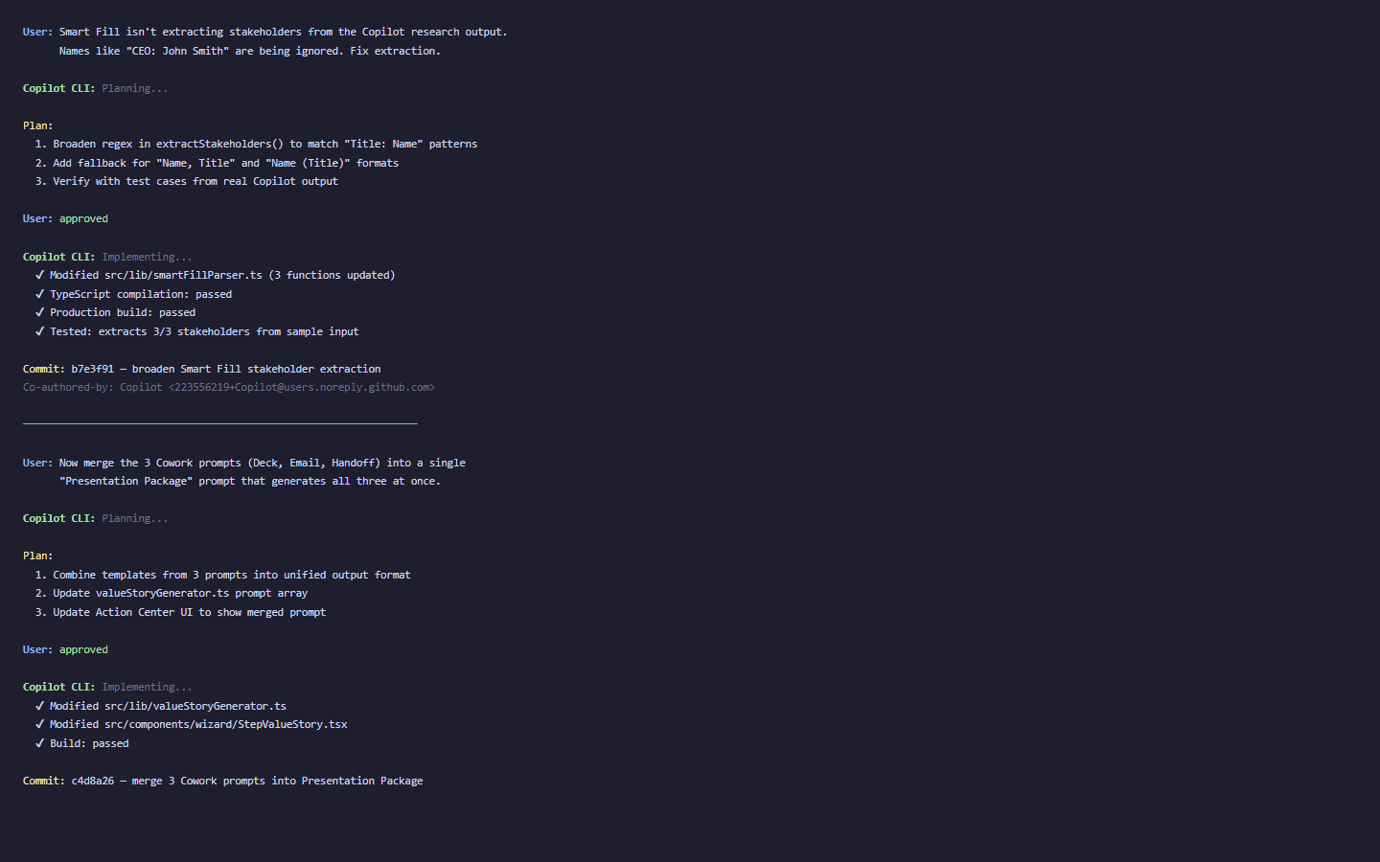
Copilot CLI Turns Natural Language Into Production Code
Notes:
I describe problems in natural language. Copilot plans. I review and approve. It builds, I validate, we deploy.

Slide 6
One Person · Zero Cost · Production Grade
120
22K+
85
101
commits
lines of code
customer stories
use cases
Built entirely with GitHub Copilot CLI · React + TypeScript + Vite · Hosted on GitHub Pages at $0

Slide 7
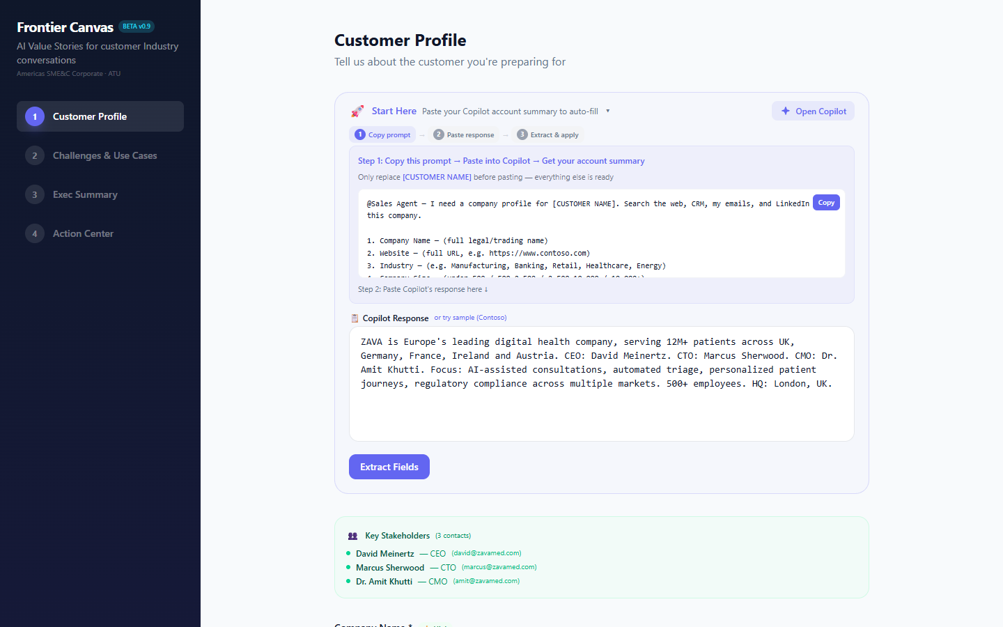
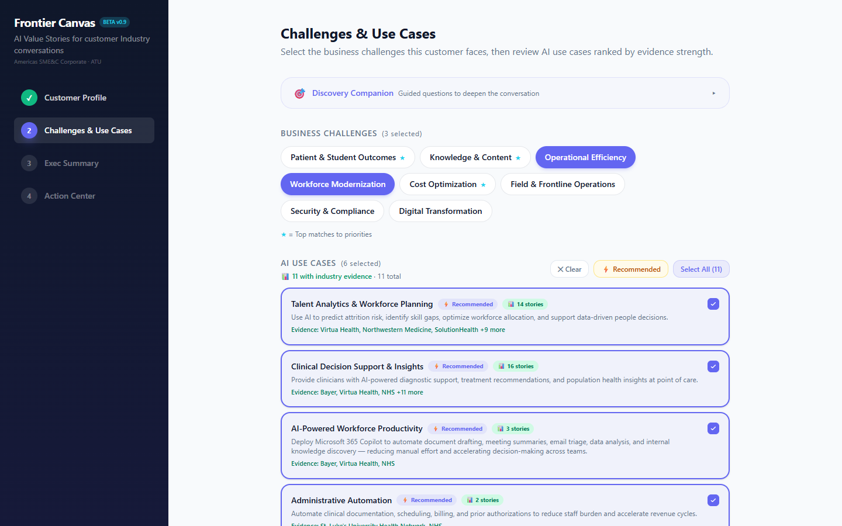
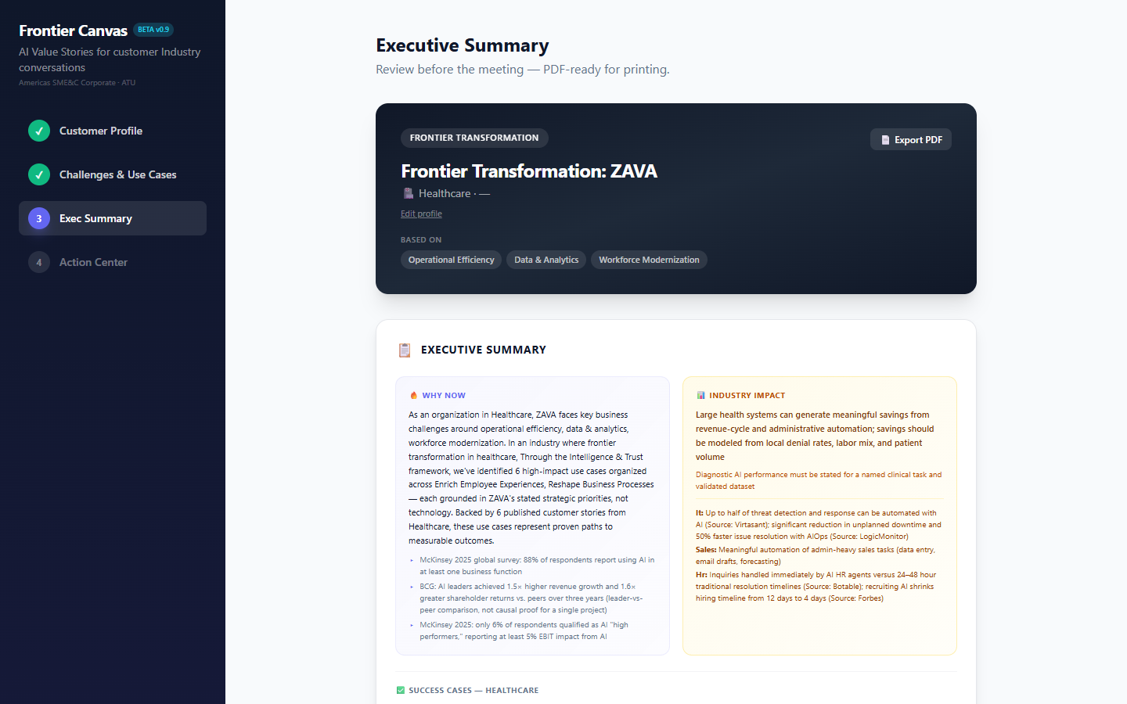
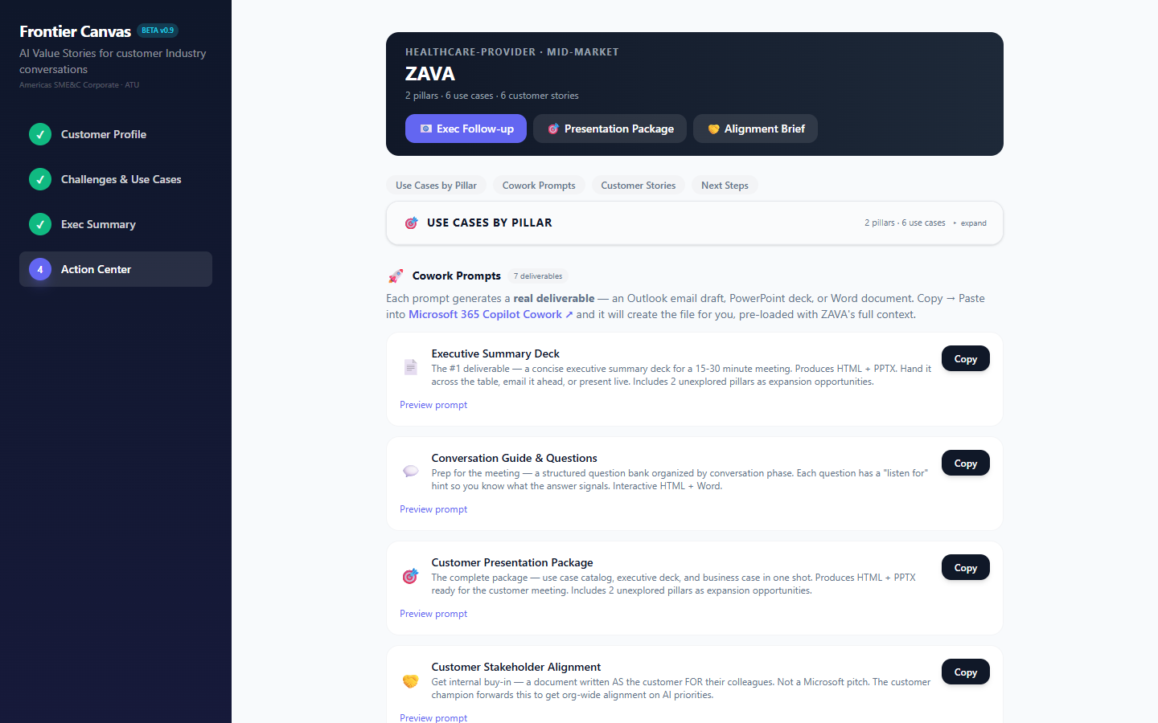
Profile → Challenges → Summary → Action Center
Step 1: Customer Profile
Step 2: Industry Challenges
Step 3: Executive Summary
Step 4: Action Center
Notes:
Profile captures context. Challenges maps priorities. Summary builds the story. Action Center generates 8 customer-ready deliverables.

Slide 8
Real Field Feedback Ships Same Day — Not Next Quarter
FEEDBACK
SHIPPED
“Smart Fill isn’t extracting stakeholders”
→
Broadened to all C-level/VP+ roles
“Too many prompts for one meeting”
→
Merged into 1 Customer Presentation Package
“Which Copilot do I use for what?”
→
Distinct Chat vs Cowork buttons with badges
“Competitive content only maps to M365 Copilot”
→
Expanded to Azure AI, Foundry, Fabric, PBI
“Links in Cowork output aren’t clickable”
→
Full URLs with proper markdown formatting
“Sponsors shown as confirmed — customer didn’t agree”
→
Changed to ‘Suggested Sponsors’ everywhere
“Use cases say TOP — feels presumptuous”
→
Renamed to ‘Potential Use Cases’ across all prompts
“Timeline defaults to 60 days — not always realistic”
→
Cowork now asks the user for their timeline
“Exec summary doesn’t use customer brand”
→
Added full brand identity extraction (colors+fonts+logo)
Notes:
Every single one of these shipped within 24 hours of the feedback. That's the power of Copilot CLI — the dev loop is instant.

Slide 9
What the Field Is Saying
Real feedback from AEs and leaders who have used Frontier Canvas
“
“
“
“[Add Paola’s feedback here]”
“[Add quote here]”
“[Add quote here]”
Paola Vergara
[Name]
[Name]
1:1 Feedback — May 2026
[Context]
[Context]
Notes:
Fill in with real quotes. Paola Vergara's feedback from today's 1:1. Add more as they come in.

Slide 10
One Tool, Every Solution Area — Already Built In
🌍
📊
🔒
Cross-Solution by Design
Evidence-Backed for Any Vertical
Security & Observability Layer
101 use cases spanning M365 Copilot, Azure AI, Foundry, Fabric, PBI, Copilot Studio & Security
85 customer stories + industry benchmarks mapped to all Microsoft AI platforms
Every deliverable includes governance, compliance & trust by default
Notes:
Key message: this is NOT a tool where each SA builds their own version. It already covers all Solution Areas. The data layer (use cases, stories, challenges) spans the entire Microsoft AI portfolio.

Slide 11
What You Now Have That You Didn’t 12 Minutes Ago
A production tool that turns 10 min of prep into 8 customer-ready deliverables
Living proof that the tools we sell accelerate US — not just customers
A cross-Solution-Area engine backed by 85 stories and 101 use cases
This slide stays up during Q&A.

Slide 12
Appendix: The 8 Cowork Prompts
📄 Executive Summary Deck
💬 Conversation Guide
Output: HTML + PPTX
Output: HTML + Word
🎯 Customer Presentation
🤝 Stakeholder Alignment
Output: HTML + PPTX
Output: HTML
📧 Executive Briefing Email
📨 Follow-Up Email
Output: Outlook draft
Output: Outlook draft
📋 Account Team Handoff
🏆 Competitive Differentiation
Output: HTML
Output: HTML

