Slide 2

Authoring Custom Components
@EdCharbeneau
EdCharbeneau.com | Telerik.com

Slide 3
Agenda
Child Content and Templates
Events – EventCallback
Razor Class Libraries

Slide 4
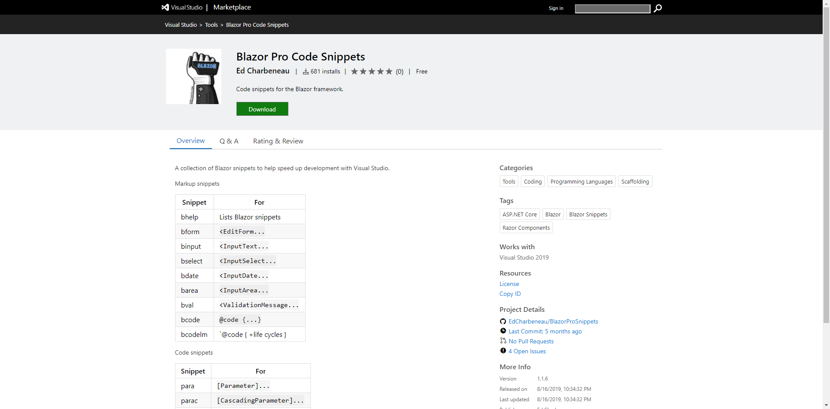
Code Snippets

Slide 5
Child Content and Templates

Slide 6
Problem Statement:
“How do I maintain a list and count of child components”

Slide 7
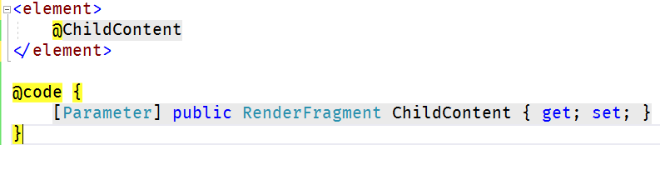
RenderFragment
@ChildContent (singular)
The value of ChildContent is received from the parent component and rendered inside by convention.

Slide 8
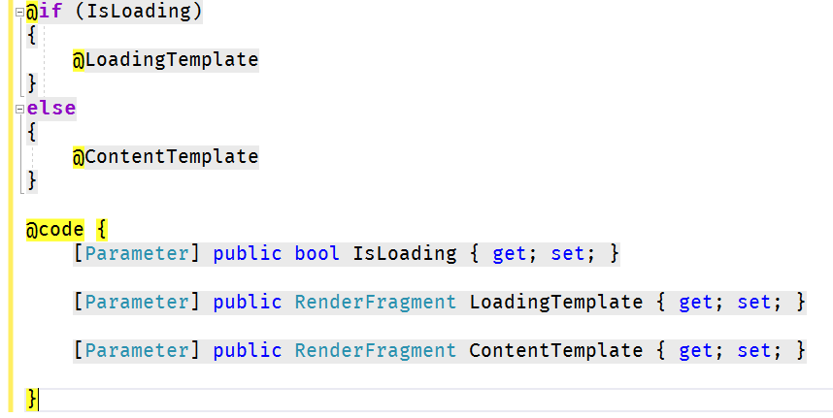
RenderFragment
namedTemplate (one or more ChildContent)

Slide 9
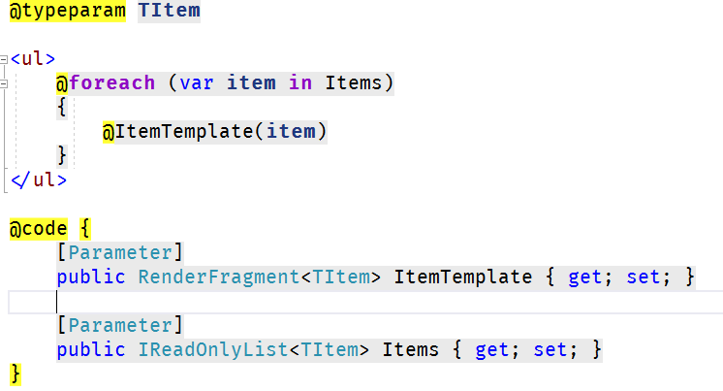
RenderFragment<TItem>
namedTemplate<TItem> (generic)
@typeparam TItem
Most useful for generic list template regions.

Slide 10
Handling Events

Slide 11
Problem Statement:
“How can I implement CRUD operations”

Slide 12
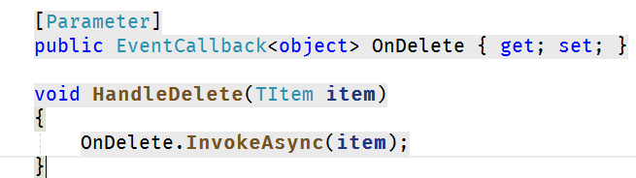
EventCallback<T>
Event delegate for components
Invokes a component re-render

Slide 13
Component Libraries

Slide 14
Problem Statement:
“How do I share components”

Slide 15
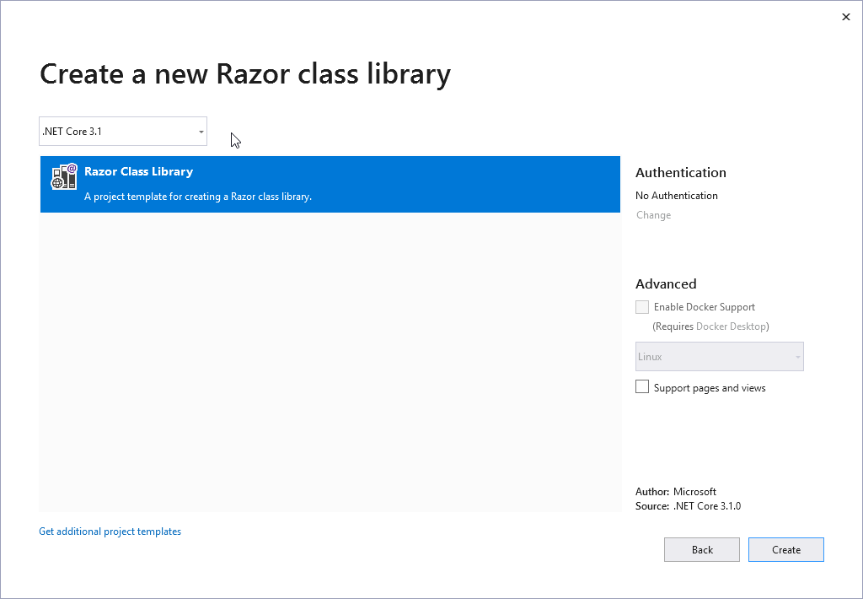
Razor Class Libraries
Shareable via NuGet or project reference
Can contain
  Components
  Layouts
  Pages
  Static assets like: CSS, JS

Slide 16
EdCharbeneau.com
Telerik.com/blazor-ui
BlazorPro.Spinkit
BlazorPro Code Snippets

