Slide 1
B
BEDROCK ASSOCIATION MANAGEMENT
An operating system for
Cinco Landscape Management Association
For everything CLMA owns, maintains, contracts for, and pays for.
Prepared for the CLMA Board
Notes:
Open on the reframe: you are not a homeowner HOA, you are an operations organization. We built around that.

Slide 2
THE NEXT HOUR
What we’ll cover
Who you’d be working with
A local, technology-first management company
1
Why CLMA is different
An operations organization, not a homeowner HOA
2
How we got here
We used the other platforms, then built our own
3
How trustEd works
One field issue, followed start to finish
4
What Amanda does with your documents
Reads contracts, bids, budgets, and reports
5
How we’d start
A clean, low-friction transition
6
Then a live walkthrough and your questions, and the portal itself for any board member who wants to see it.
Notes:
Set the shape of the hour. Presentation now, live demo and Q&A after, portal walkthrough for anyone interested.

Slide 3
WHO YOU’D BE WORKING WITH
A management company that builds its own tools
1
Local and hands-on
2
CPA-led
A Houston-area community management company, not a national call center.
Founded and run by a CPA. Financial rigor is the starting point, not an afterthought.
3
Technology-first
4
Already in your area
We build trustEd ourselves. When the work needs something, we build it, we do not wait on a vendor.
We manage Canyon Gate at Cinco Ranch and Waterview today. We know this part of Houston and these communities.
Notes:
The area proof point is the strongest one: Canyon Gate at Cinco Ranch and Waterview, both nearby, already trusted. Lead with it verbally.

Slide 4
THE STARTING POINT
CLMA is not a homeowner HOA
Your work is operational: common-area assets, landscape and irrigation contracts, field maintenance, vendor performance, capital projects, budgets, and board oversight. So we did not bring you homeowner-HOA software.
1
Assets
2
Vendors
3
Contracts
Monuments, esplanades,
trees, irrigation, lights
Reports, performance,
follow-up
Scope, terms,
renewals, RFPs
4
Budgets
5
Projects
6
Board oversight
Variance tied to
the actual work
Quotes, trackers,
capital work
Decisions, packages,
transparency
Notes:
These six are the buckets everything in the demo maps to. Not violations, not ACC, not voting.

Slide 5
WHY WE BUILT OUR OWN
We used the other platforms first
1
We demoed and ran the leading association platforms ourselves.
As managers, not shoppers. We lived inside them.
2
They are good at holding information and giving you a place to look it up.
A modern portal and database. Genuinely useful.
3
But none of them do the actual management work.
Reading a contract, catching a budget variance, coordinating a vendor, preparing the board item. That still fell to people.
4
So we built trustEd to do the work, not just store the records.
The result is what we are here to show you.
Notes:
This is the credibility line. We are not another vendor with a database. We tried those and had to build the thing that actually works.

Slide 6
THE DIFFERENCE THAT MATTERS
Two different categories
Traditional management software
trustEd
Organizes the work your management team performs.
Performs the work, documents it, and gives the board visibility into the result.
Records live in the system
Reads the contracts and reports
You search for what you need
Flags what needs your attention
You and your manager still do the work
Coordinates vendors and tracks cost
It waits for you
Prepares the board item for you
We did not ask how to put CLMA into software. We asked how much of CLMA’s work the software can do.
Notes:
State the category line out loud. This is the whole positioning against a portal.

Slide 7
THE DEMO, IN ONE THREAD
One issue, start to finish
Follow one real issue, a dead tree on an esplanade, from the moment it is spotted to the line item in the board package.
1
2
3
4
5
6
›
›
›
›
›
Spotted
Logged
Coordinated
Approved
Verified
Reported
Dead tree found on a drive
Pinned to the esplanade asset
Vendor and history pulled, quote reviewed
Bid checked, board approves
Work order, invoice, completion photo
Budget impact into the board package
Notes:
Tell them: keep this thread in mind. Every screen we open is one of these six steps.

Slide 8
STEP 1 AND 2 · SEE IT, LOG IT
Every asset on one map
EXAMPLE RECORD
Esplanade at Main & Canyon Gate
VENDOR
Yellowstone Landscape
SERVICE HISTORY
14 visits YTD
OPEN ISSUES
1 dead tree, replacement quoted
LAST WORK ORDER
Aug 22, mowing and edging
BUDGET
On track, 3% under
Monuments · Esplanades · Irrigation zones · Tree corridors · Intersections
DOCUMENTS
Contract, 6 invoices, photos
Notes:
Click a pin, the record opens. Photos, vendor, history, open issues, invoices, budget. This is your strongest single visual.

Slide 9
STEP 3 · COORDINATE
Vendor oversight that reads the reports
Hand Amanda a vendor report or proposal. She answers what the board actually needs to know:
What work was promised?
What was actually completed?
?
?
What is still open?
Are the same issues recurring?
?
?
Do the invoices match the contract?
What should the board care about this month?
?
?
Notes:
Their July agenda is literally vendor reports, tree counts, pruning maps, irrigation trackers. This is the centerpiece for CLMA.

Slide 10
CONTRACT & RFP INTELLIGENCE
Bids compared, line by line
trustEd reads competing bids and surfaces the real differences, then flags what is missing and shows the source page for every figure.
Compared | Bid A | Bid B | trustEd flag
Acreage covered | 38 ac | 41 ac | Different scope, not apples to apples
Pruning frequency | 2x / yr | 4x / yr | B includes more service
Irrigation responsibility | Excluded | Included | A shifts cost to CLMA
Labor escalation | 5% / yr | None stated | Ask B to confirm
Insurance / additional insured | Yes | Not stated | Require COI before signing
Termination notice | 30 days | 90 days | B harder to exit
Notes:
This is the same thing Amanda just did with our security proposal. Say that: she already does this on real documents.

Slide 11
STEP 4 · FINANCIAL INTELLIGENCE
Ask the number a question
“Why is irrigation over budget?”
Amanda
Irrigation is $38,000 over budget year to date. 62% of it is three emergency repairs in Zones 4, 7, and 11. Here are the work orders, the invoices, and the board approvals behind each one.
Illustrative example. In the live demo Amanda answers from CLMA’s own records.
The variance is not just a number on a report. It is traced back to the work that caused it.
Notes:
This is the AI-native moment. A portal shows the variance. trustEd explains it and hands you the evidence.

Slide 12
STEP 6 · REPORT
The monthly board package, assembled for you
Long operational meetings become one prepared package, built from the same records the work already produced.
1
Financials
2
Vendor performance
3
Project status
4
Open decisions
5
Quotes to review
6
Contracts expiring
7
Exceptions needing board action
Notes:
The last row is the point: exceptions that need a decision are surfaced, not buried in a hundred pages.

Slide 13
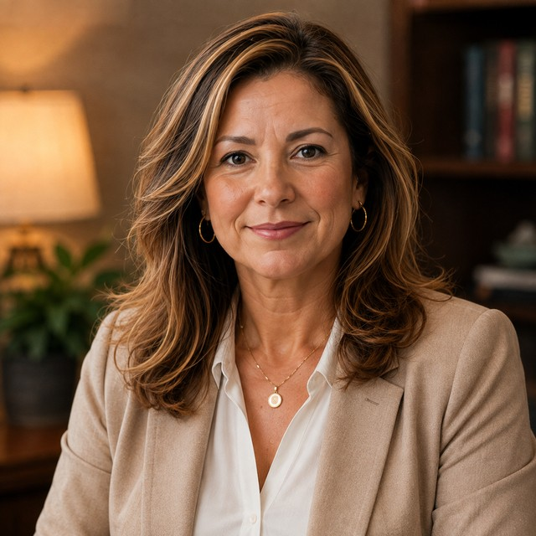
YOUR AI COMMUNITY MANAGER
Meet Amanda
Amanda has CLMA’s contracts, financials, vendor reports, board decisions, projects, and operating history. Ask her anything about the association.
AI
Every answer shows where it came from, and flags anything she cannot verify from the documents.
Notes:
Do NOT lead with the avatar. Show her work first, then reveal: the analysis you have been seeing is Amanda. Then let the president ask a real CLMA question. Accurate answer + cited source beats ten slides.

Slide 14
A CLEAN TRANSITION
How we’d start
Low friction on your side. We do the heavy lifting to bring CLMA into trustEd.
1
Records and documents loaded
2
Your assets mapped
Contracts, financials, vendor reports, and history brought in and indexed so Amanda can read them.
Monuments, esplanades, irrigation zones, tree corridors, and intersections placed on the map.
3
Amanda trained on CLMA
4
Your first board package the new way
She answers from your own records, and shows her sources.
A full monthly package, assembled from the work itself.
Notes:
Keep this concrete but do not over-promise a timeline. The message is: the burden is on us, not on the board.

Slide 15
B
We did not make homeowner-HOA software fit CLMA.
trustEd adapts to how your organization actually operates.
Built by managers who used the other tools first, then built the one that does the work.
Bedrock Association Management
Notes:
Close on this line, then move to the live demo. Do not read the whole deck; let the working product carry it.

