Slide 1
20462D
Administering Microsoft® SQL Server® 2014 Databases

Slide 2

Welcome!
Thank you for joining us today.
We’ve worked together with Microsoft Learning Partners and Microsoft IT Academies to bring you a world-class learning experience, including:
Microsoft Certified Trainers + Instructors. Your instructor is a premier technical and instructional expert who meets ongoing certification requirements.
Customer Satisfaction Guarantee. Our Partners offer a satisfaction guarantee and we hold them accountable for it. At the end of class, please complete an evaluation of
today’s experience. We value your feedback!
Certification Benefits. After training, consider pursuing a Microsoft Certification, to help distinguish your technical expertise and experience. Ask your instructor about available exam promotions and discounts.
We wish you a great learning experience and ongoing career success!

Slide 3
Hello
Instructor: <Instructor Name>
<Title or other credentials, e.g. Microsoft Certified Trainer>
<Affiliation/Company>
<A few words about my technical and professional experience>
Notes:
Fill in the information on this slide and provide your own details.

Slide 4
Student Introductions
Name
Company affiliation
Title/function
Job responsibility
Office 365 experience
SQL experience
Active Directory experience
Your expectations for the course

Slide 5
Facilities
Class hours
Building hours
Parking
Restrooms
Meals
Phones
Messages
Smoking
Recycling

Slide 6
About This Course
Audience
Course Prerequisites
Course Objectives
What You Can Expect
Notes:
This five-day instructor-led course provides students with the knowledge and skills to maintain a Microsoft SQL Server 2014 database. The course focuses on teaching individuals how to use SQL Server 2014 product features and tools related to maintaining a database.
Audience
The primary audience for this course is individuals who administer and maintain SQL Server databases. These individuals perform database administration and maintenance as their primary area of responsibility, or work in environments where databases play a key role in their primary job.
The secondary audience for this course is individuals who develop applications that deliver content from SQL Server databases.
Course Prerequisites
In addition to their professional experience, students who attend this training should already have the following technical knowledge:
Basic knowledge of the Microsoft Windows operating system and its core functionality.
Working knowledge of Transact-SQL.
Working knowledge of relational databases.
Some experience with database design.

Slide 7
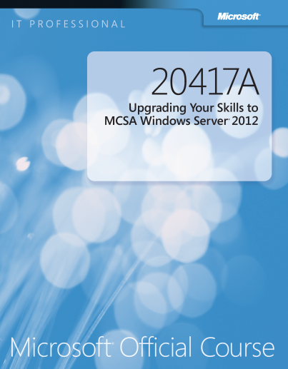
Your Course Materials
Designed to optimize your classroom learning experience.
And support you back on the job.
Microsoft Official Course Handbook
Organized by Modules
Includes Labs + Lab Answer Keys
Module Reviews + Takeaways—great for on-the-job reference

Slide 8
Course Outline
Module 1: Introduction to SQL Server 2014 Database Administration
Module 2: Installing and Configuring SQL Server 2014
Module 3: Working with Databases and Storage
Module 4: Planning and Implementing a Backup Strategy
Module 5: Restoring SQL Server 2014 Databases
Module 6: Importing and Exporting Data
Module 7: Monitoring SQL Server 2014
Module 8: Tracing SQL Server Activity
Module 9: Managing SQL Server Security
Module 10: Auditing Data Access and Encrypting Data
Module 11: Performing Ongoing Database Maintenance
Module 12: Automating SQL Server 2014 Management
Module 13: Monitoring SQL Server 2014 with Notifications and Alerts

Slide 9
Related Courses
20461: Querying Microsoft SQL Server 2014
20463: Implementing a Data Warehouse with Microsoft SQL Server 2014
20464: Developing Microsoft SQL Server 2014 Databases
20465: Designing Solutions for Microsoft SQL Server 2014
20466: Implementing Data Models and Reports with Microsoft SQL Server 2014
20467: Designing Business Intelligence Solutions with Microsoft SQL Server 2014
See the full line of Microsoft Training and Certification resources at: http://www.microsoft.com/learning/

Slide 10
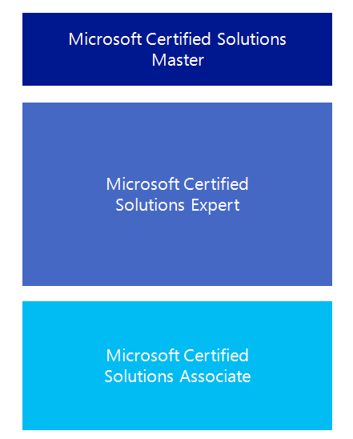

Microsoft Certification Program
Get trained. Get certified.
Get ahead.
Microsoft Certifications demonstrate you have the skills to design, deploy, and optimize the latest technology solutions.
Ask your Microsoft Learning Partner how you can prepare for certification.
Also see:
http://www.microsoft.com/learning/
certification

Slide 11

Preparing for the Labs
Your lab activities will be centered around Adventure Works Cycles, a fictitious manufacturer and seller of cycles and related products.
To complete the labs, you will work in a virtual machine (VM) environment.

Slide 12





Virtual Machine Environment
Virtual Machine Name: | Use as:
20462C-MIA-DC | Domain controller
20462C-MIA-SQL | Database server
MSL-TMG1 (optional) | Internet gateway
MIA-DC
MIA-SQL
ADVENTUREWORKS.MSFT
MSL-TMG1
Notes:
All modules use the same virtual machines for the labs; students should log on to MIA-SQL for all modules. The lab files are located in the D:\Labfiles folder, in subfolders named Lab01, Lab02, and so on. The demonstration files are located in the D:\Demofiles folder in subfolders named Mod01, Mod02, and so on.
For all labs, students should log on as ADVENTUREWORKS\Student with the password Pa$$w0rd.
Each lab includes a Setup.cmd script to reset the lab environment, so there is no need for students to revert the virtual machines to a previous snapshot between labs. However, it is recommended that students take a snapshot of both virtual machines during the following demonstration, so that if necessary, they can revert to a clean starting environment.

Slide 13
Demonstration: Using Hyper-V Manager
In this demonstration, you will learn how to:
Open Hyper-V Manager
Navigate the various sections/panes within Hyper-V Manager
Virtual Machines, Snapshots, and Actions: Server-specific and VM-specific
Identify the VMs used in the labs for this course
Take a Snapshot and Apply a Snapshot
Connect to a VM
Start and log on to a VM
Switch between full screen and window modes
Revert to the previous Snapshot
Shut down a VM
When to use Shut Down or Turn off
Close Hyper-V Manager

