Slide 1
Module 1
Introduction to SQL Server 2014 Database Administration
Notes:
The 20462C-MIA-SQL virtual machine used in the lab for this module includes a lot of software services that can take a while to start. For the best experience, have students start the 20462C-MIA-DC and 20462C-MIA-SQL virtual machines at the beginning of the module so that the services have time to start before students begin the lab.
20462D
1: Introduction to SQL Server 2014 Database Administration

Slide 2
Module Overview
Database Administration Overview Introduction to the SQL Server Platform Database Management Tools and Techniques
Notes:
This module is designed to introduce basic database management concepts, SQL Server, and the tools students will use throughout the rest of the course; in particular SQL Server Management Studio. If students are already familiar with the concepts and tools, you can complete this module quickly. However, don’t underestimate the complexity of SQL Server concepts and tools for students who have no previous experience of them.
20462D
1: Introduction to SQL Server 2014 Database Administration

Slide 3
Lesson 1: Database Administration Overview
What Makes a Good Database Administrator? Common Database Administration Tasks Documenting Database Management Procedures
Notes:
Question
Which of the following categories of information are useful to include in a “run book” to document the way your organization using SQL Server?
( )Option 1: Instance configuration settings
( )Option 2: Transaction log locations
( )Option 3: Contact details for responsible database administrators
( )Option 4: Nightly backup procedures
( )Option 5: All of the above options
Answer
(√) Option 5: All of the above options
20462D
1: Introduction to SQL Server 2014 Database Administration

Slide 4
What Makes a Good Database Administrator?
Technological knowledge and skills
Business-awareness
Organizational skills
Ability to prioritize
Notes:
The workbook content suggests a few important characteristics of a successful database administrator. Encourage students to come up with their own suggestions for attributes other than purely technical skills that help in a DBA role.
20462D
1: Introduction to SQL Server 2014 Database Administration

Slide 5
Common Database Administration Tasks
Provisioning database servers and databases
Maintaining database files and objects
Managing recovery in the event of database failure
Importing and exporting data
Applying security to data
Monitoring and troubleshooting database systems
Notes:
Point out that the performance of these tasks for a SQL Server database solution is covered throughout the rest of the course.
20462D
1: Introduction to SQL Server 2014 Database Administration

Slide 6
Documenting Database Management Procedures
Document information in a “run book”
Configuration settings and file locations
Personnel contact details
Standard maintenance procedures and schedules
Disaster recovery procedures
Notes:
20462D
1: Introduction to SQL Server 2014 Database Administration

Slide 7
Lesson 2: Introduction to the SQL Server Platform
SQL Server Components SQL Server Instances SQL Server Editions SQL Server Versions
Notes:
Question
Which of the following functional requirements must be addressed by running more than one instance of SQL Server on a single physical server?
( )Option 1: You have one database that must be administered by a separate team of DBAs. It is important that the regular team of DBAs cannot access this separate database or assign permissions to it.
( )Option 2: You have one database that should only be used by Human Resources personnel. It is important that users from other departments have no access to the HR database.
( )Option 3: You want to create ten new databases. Your existing SQL server instance already hosts five databases.
( )Option 4: Your hardware team has installed a second multi-core processor in the host server.
( )Option 5: Your company is expanding and you expect to have to support 2000 new users in the next three months.
Answer
(√) Option 1: You have one database that must be administered by a separate team of DBAs. It is important that the regular team of DBAs cannot access this separate database or assign permissions to it.
20462D
1: Introduction to SQL Server 2014 Database Administration

Slide 8
SQL Server Components
Not just a database engine
Relational and business intelligence components
SQL Server Components
Database Engine | Analysis Services
Integration Services | Reporting Services
Master Data Services | Data Quality Services
StreamInsight | Full-Text Search
Replication | PowerPivot
Power View
Notes:
Stress that SQL Server is much more than just a very good relational database engine.
SQL Server is a platform comprising many components.
Talk through each of the components, asking students if they know what they do.
Database Engine – relational database engine based on SQL language (been around a long time – early 90s. The In-memory database engine is new in SQL Server 2014).
Analysis Services – OLAP engine – works with cubes (hypercubes) or in tabular mode (first appeared as OLAP services in SQL Server 7).
Integration Services – used to orchestrate the movement of data between SQL Server components and external systems (in both directions). First appeared in 2005 and replaced DTS.
Reporting Services – reporting engine based on web services and web portal (first appeared as an add-on for SQL Server 2000).
Master Data Services – tooling and engine for managing master or reference data (first appeared in SQL Server 2008 R2).
Data Quality Services – allows building a knowledgebase for data cleansing (first appeared in SQL Server 2012).
StreamInsight – platform for building applications to process high-speed events (first appeared in SQL Server 2008 R2).
Full-Text Search – allows building sophisticated search options into applications (was previously external to SQL Server and only loosely integrated until SQL Server 2008).
Replication – allows moving data between servers to suit data distribution needs (has been part of the product in some form since SQL Server 6.X).
PowerPivot – allows analysis of large volumes of data from different locations quickly (first appeared in SQL Server 2008 R2).
Power View – allows rapid visualization of data from within SharePoint® (first appeared in SQL Server 2012).
20462D
1: Introduction to SQL Server 2014 Database Administration

Slide 9
SQL Server Instances
Many SQL Server components are instance-aware
Instances enable isolation of:
Administration and security configuration
Performance and SLAs
Versions and collations
Two types of instance:
Default instance
Named instance
Notes:
20462D
1: Introduction to SQL Server 2014 Database Administration

Slide 10
SQL Server Editions
Premium Editions
Parallel Data Warehouse | Enterprise
Core Editions
Business Intelligence | Standard
Other Editions
Express | Compact
Developer | Web
Microsoft Azure SQL Database
Notes:
It would be good to have a rough idea of the cost of each edition in your locale, in case students need a comparison.
20462D
1: Introduction to SQL Server 2014 Database Administration

Slide 11
SQL Server Versions
Version | Release Year
1.0 | 1989
1.1 | 1991
4.2 | 1992
4.21 | 1994
6.0 | 1995
6.5 | 1996
7.0 | 1998
2000 | 2000
2005 | 2005
2008 | 2008
2008 R2 | 2010
2012 | 2012
2014 | 2014
Notes:
Students may ask how long SQL Server has been available. Stress that SQL Server is a platform with a rich history of innovation achieved while maintaining strong levels of stability.
Versions 1.0 and 1.1 were OS/2 based. Later versions were based on Windows NT and its successors, such as Windows Server® 2000, Windows Server 2003, Windows Server 2008 and Windows Server 2008 R2.
Mention that, even though SQL Server has been available for many years, it is rapidly evolving with new capabilities and features.
20462D
1: Introduction to SQL Server 2014 Database Administration

Slide 12
Lesson 3: Database Management Tools and Techniques
SQL Server Tools SQL Server Management Studio The sqlcmd Utility Using Transact-SQL to Perform Management Tasks Using Windows PowerShell to Manage SQL Server
Notes:
20462D
1: Introduction to SQL Server 2014 Database Administration

Slide 13
SQL Server Tools
SQL Server Management Studio (SSMS)
SQL Server Configuration Manager (SSCM)
SQL Profiler
SQL Server Database Engine Tuning Advisor (DTA).
SQL Server Import and Export
The sqlcmd utility
The bcp utility
Notes:
20462D
1: Introduction to SQL Server 2014 Database Administration

Slide 14
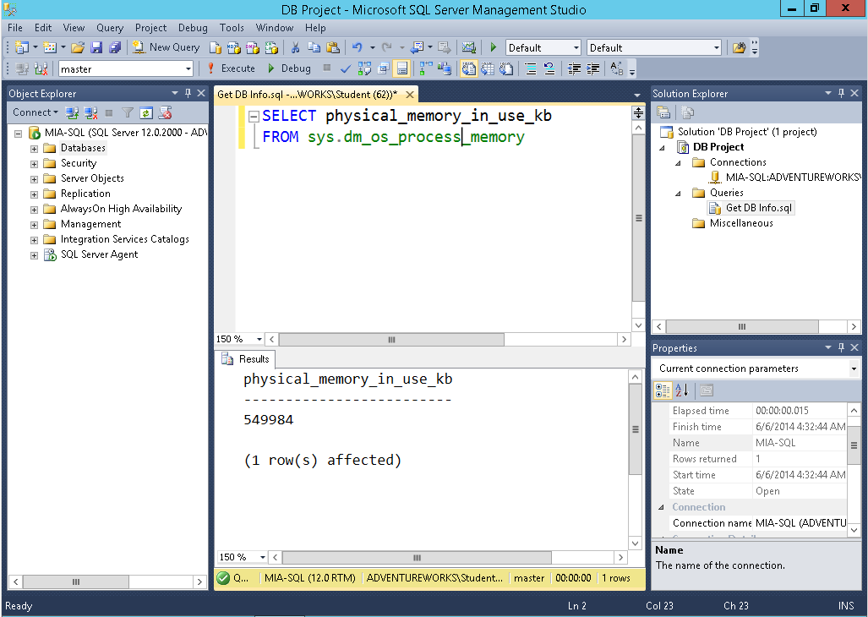
SQL Server Management Studio
Notes:
Point out that the panes in SSMS can be hidden and moved, so the interface may vary when students open the tool for themselves.
20462D
1: Introduction to SQL Server 2014 Database Administration

Slide 15
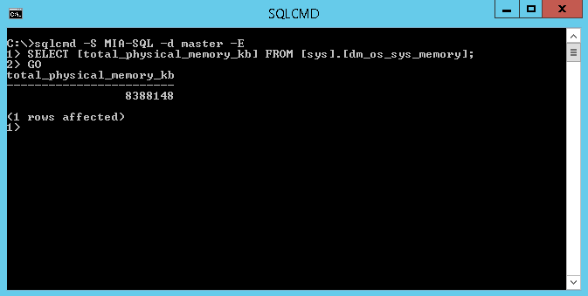
The sqlcmd Utility
Notes:
20462D
1: Introduction to SQL Server 2014 Database Administration

Slide 16
Using Transact-SQL to Perform Management Tasks
Explicit DDL statements
System stored procedures and functions
DBCC commands
CREATE DATABASE AdventureWorks;
EXEC sp_configure 'contained database authentication', 1;
GO
RECONFIGURE;
GO
DBCC CHECKDB;
Notes:
Point out the use of the RECONFIGURE command in the sp_configure example. This statement is required before some configuration setting changes take effect.
20462D
1: Introduction to SQL Server 2014 Database Administration

Slide 17
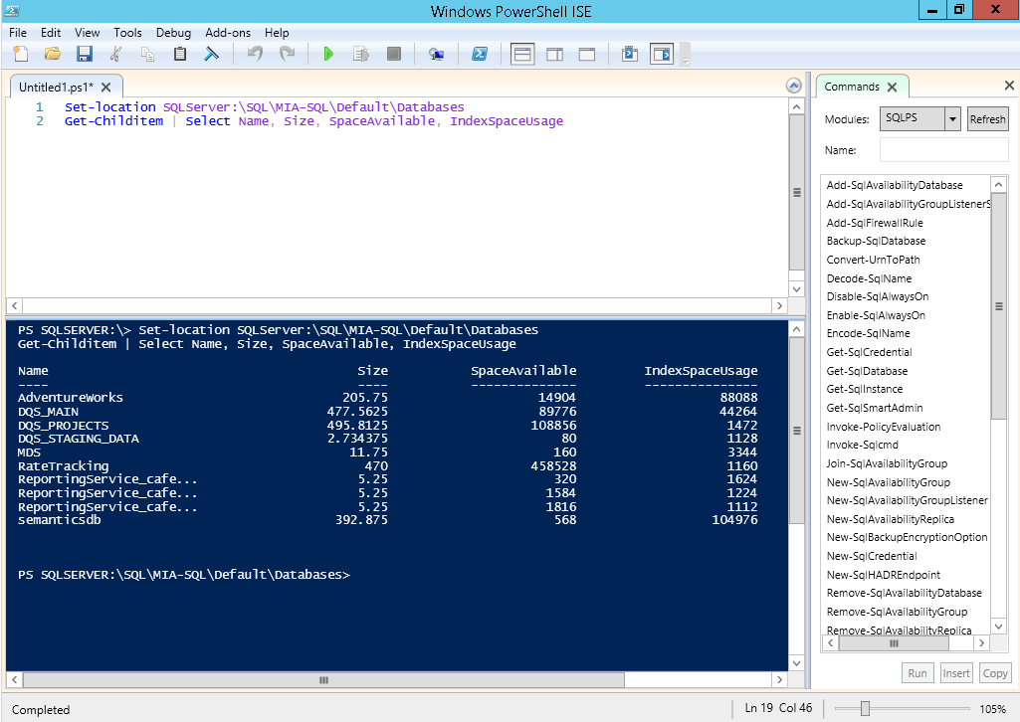
Using Windows PowerShell to Manage SQL Server
Notes:
20462D
1: Introduction to SQL Server 2014 Database Administration

Slide 18
Lab: Using SQL Server Administrative Tools
Exercise 1: Using SQL Server Management Studio Exercise 2: Using the sqlcmd Utility Exercise 3: Using Windows PowerShell with SQL Server
Logon Information
Virtual machine: 20462C-MIA-SQL
User name: ADVENTUREWORKS\Student
Password: Pa$$w0rd
Estimated Time: 45 Minutes
Notes:
Point out that in common with all labs in this course, the first task students must perform is to run a script that prepares the lab environment.
Exercise 1: Using SQL Server Management Studio
The DBAs at Adventure Works Cycles use SQL Server Management Studio as the primary administrative tool for SQL Server databases. You therefore want to familiarize yourself with it.
Exercise 2: Using the sqlcmd Utility
DBAs at Adventure Works Cycles occasionally use sqlcmd to connect to SQL Server and perform maintenance tasks. You therefore want to familiarize yourself with sqlcmd.
Exercise 3: Using Windows PowerShell with SQL Server
IT administrators at Adventure Works use Windows PowerShell to script configuration tasks across a range of services. You want to investigate how to use Windows PowerShell with SQL Server.
20462D
1: Introduction to SQL Server 2014 Database Administration

Slide 19
Lab Scenario
As a new database administrator at Adventure Works Cycles, you plan to familiarize yourself with the SQL Server instance and tools that you will use to manage databases.
Notes:
20462D
1: Introduction to SQL Server 2014 Database Administration

Slide 20
Lab Review
This lab provided an opportunity to become familiar with tools that will be used throughout this course, and which are extensively used by SQL Server database administrators in organizations all over the world. In particular, SQL Server Management Studio is a core tool for database management in SQL Server database solutions.
Notes:
20462D
1: Introduction to SQL Server 2014 Database Administration

Slide 21
Module Review and Takeaways
Review Question(s)
Notes:
Review Question(s)
Question
When might you use each of the management tools you explored in the lab?
Answer
Most SQL Server administration is performed using SQL Server Management Studio from a client workstation. However, you might choose to install sqlcmd on the server itself to assist in troubleshooting and configuration management in an emergency. You might also use sqlcmd to run scripts from client computers where SSMS is not installed, or in automated batch files. Windows PowerShell is increasingly used to provide a consistent management scripting shell across multiple services, and can be useful when you need to automate tasks that involve a combination of configuration management across Windows, SQL Server, and other applications.
20462D
1: Introduction to SQL Server 2014 Database Administration

