Slide 1
Module 6
Importing and Exporting Data
Notes:
The 20462C-MIA-SQL virtual machine used in the lab for this module includes a lot of software services that can take a while to start. For the best experience, have students start the 20462C-MIA-DC and 20462C-MIA-SQL virtual machines at the beginning of the module so that the services have time to start before students begin the lab.
20462D
6: Importing and Exporting Data

Slide 2
Module Overview
Introduction to Transferring Data Importing and Exporting Data Copying or Moving a Database
Notes:
20462D
6: Importing and Exporting Data

Slide 3
Lesson 1: Introduction to Transferring Data
Overview of Data Transfer Available Tools for Data Transfer Improving the Performance of Data Transfers Disabling and Rebuilding Indexes Disabling and Enabling Constraints
Notes:
Question
You are preparing to import a large quantity of data into the Human Resources database after a company merger. Which of the following commands should you run before the import? Choose one answer
( )Option 1: CREATE INDEX idx_emailaddress ON HumanResources.Employees(EmailAddress)
WITH (DROP_EXISTING = ON);
( )Option 2: ALTER TABLE HumanResources.Employees CHECK CONSTRAINT SalaryCap;
( )Option 3: ALTER INDEX ALL ON HumanResources.Employees
REBUILD;
( )Option 4: ALTER INDEX ALL ON HumanResources.Employees
DISABLE;
Answer
(√) Option 4: ALTER INDEX ALL ON HumanResources.Employees
DISABLE;
20462D
6: Importing and Exporting Data

Slide 4
Overview of Data Transfer
ETL:
Extract > Transform > Load
Scenarios:
Copying or moving between servers
Exporting query data to a file
Importing table data from a file
Transforming and restructuring data
Notes:
Provide an overview of bulk data transfer. Describe the main steps involved in any data transfer, including extracting data from any given source, transforming or aggregating (or even de-aggregating -> allocating) the data as needed, and then loading it to any given destination.
20462D
6: Importing and Exporting Data

Slide 5
Available Tools for Data Transfer
Import and Export Wizard
SQL Server Integration Services
Bulk Copy Program
BULK INSERT
OPENROWSET(BULK)
Notes:
Explain the different tools that are used in data transfers.
Highlight the considerations for selecting the data transfer tool for each project.
20462D
6: Importing and Exporting Data

Slide 6
Improving the Performance of Data Transfers
Disable constraints, indexes, and triggers:
No need to check constraints as each row is loaded
Indexes don’t need to be maintained during import
Important to check business requirements before disabling triggers
Minimizing locking:
Consider the use of TABLOCK to speed up the import
Minimizing logging:
Database must be in BULK_LOGGED or SIMPLE model
Additional requirements on table structure and locking
Notes:
Discuss each performance improvement and explain the implication of the action.
20462D
6: Importing and Exporting Data

Slide 7
Disabling and Rebuilding Indexes
Disabling an index:
Prevents user access to the index
Prevents access to the data if it is a clustered index
Keeps index definition in metadata
Speeds up data import in tables
Enabling an index:
Rebuilds the index entirely
Is easy to automate because the metadata is still present
Enabling and disabling indexes is an alternative to dropping and recreating indexes for bulk imports
Notes:
Explain the difference between dropping and disabling an index. The main difference is that dropping completely deletes the index out of the database and the metadata, while disabling only disables the index, keeping the metadata intact.
20462D
6: Importing and Exporting Data

Slide 8
Disabling and Enabling Constraints
Disabling PRIMARY KEY and UNIQUE constraints:
Achieved by disabling the associated index
Causes associated indexes to be rebuilt when enabled
Can cause failures during re-enabling if duplicate values exist
Causes associated foreign key constraints to be disabled
Disabling FOREIGN KEY and CHECK constraints:
Performed directly on the constraint
Causes existing data to be unverified when re-enabled
Notes:
Discuss the different constraints and how they can be disabled and enabled.
20462D
6: Importing and Exporting Data

Slide 9
Lesson 2: Importing and Exporting Data
The SQL Server Import and Export Wizard Demonstration: Using the Import and Export Wizard The bcp Utility Demonstration: Using the bcp Utility The BULK INSERT Statement Demonstration: Using the BULK INSERT Statement The OPENROWSET Function Demonstration: Using the OPENROWSET Function
Notes:
Question
You want import data into a table from a comma-separated text file. Each line in the file contains data for a single product. You want to import only products made by Adventure Works. Which tool should you use for the import?
( )Option 1: The SQL Server Import and Export Wizard
( )Option 2: The bcp utility
( )Option 3: The BULK INSERT statement
( )Option 4: The OPENROWSET function.
Answer
(√) Option 4: The OPENROWSET function.
20462D
6: Importing and Exporting Data

Slide 10
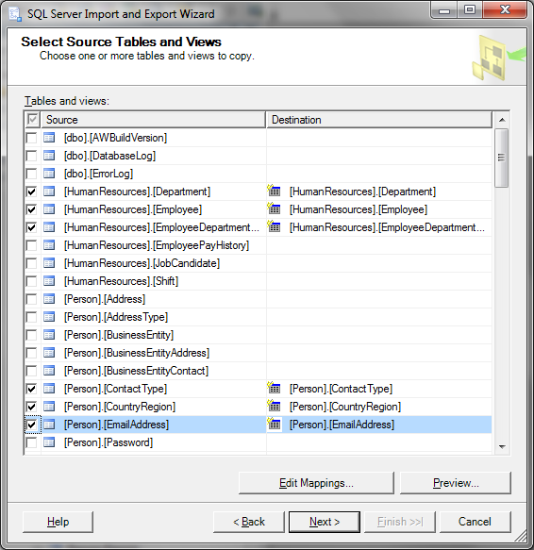
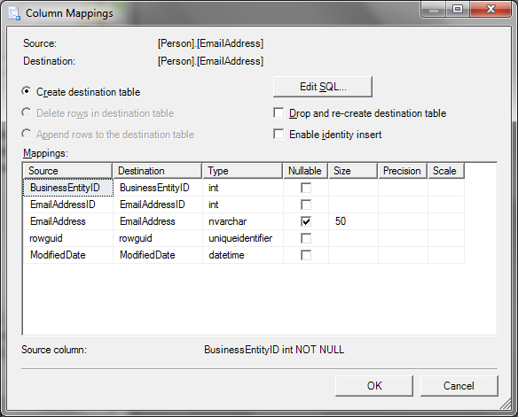
The SQL Server Import and Export Wizard
Easy to use wizard for creating an SSIS package that performs simple data transfers
Notes:
20462D
6: Importing and Exporting Data

Slide 11
Demonstration: Using the Import and Export Wizard
In this demonstration, you will see how to:
Use Import and Export Wizard to export data
Notes:
Preparation Steps
Start the 20462C-MIA-DC and 20462C-MIA-SQL virtual machines.
Demonstration Steps
Use Import and Export Wizard to Export Data
Ensure that the 20462C-MIA-DC and 20462C-MIA-SQL virtual machines are running, and log on to MIA-SQL as ADVENTUREWORKS\Student with the password Pa$$w0rd.
In the D:\Demofiles\Mod06 folder, run Setup.cmd as Administrator.
Start SQL Server Management Studio and connect to the MIA-SQL database engine using Windows authentication.
In Object Explorer, expand Databases. Then right-click the AdventureWorks database, point to Tasks, and click Export Data.
On the Welcome to SQL Server Import and Export Wizard page, click Next.
On the Choose a Data Source page, in the Data source drop-down list, select SQL Server Native Client 11.0. Then ensure that the MIA-SQL server is selected, that Use Windows Authentication is selected, and that the AdventureWorks database is selected; and click Next.
On the Choose a Destination page, in the Data source drop-down list, select Flat File Destination. Then in the File name box type D:\Demofiles\Mod06\Currency.csv, clear the Column names in in the first data row checkbox, and click Next.
On the Specify Table Copy or Query page, ensure that Copy data from one or more tables or views is selected, and click Next.
On the Configure Flat File Destination page, in the Source table or view list, select [Sales].[Currency]. Then ensure that the Row delimiter is {CR}{LF}and the Column delimiter is Comma {,}, and click Next.
On the Save and Run Package page, ensure that Run immediately is selected, and click Next.
On the Complete the Wizard page, click Finish. Then, when the execution is successful, click Close.
20462D
6: Importing and Exporting Data
(More notes on the next slide)

Slide 12
Notes:
Start Excel and open the Currency.csv file in the D:\Demofiles\Mod06 folder and view the data that has been exported. Then close Excel without saving the file.
Use Import and Export Wizard to Export Data
Ensure that the 20462C-MIA-DC and 20462C-MIA-SQL virtual machines are running, and log on to MIA-SQL as ADVENTUREWORKS\Student with the password Pa$$w0rd.
In the D:\Demofiles\Mod06 folder, run Setup.cmd as Administrator.
Start SQL Server Management Studio and connect to the MIA-SQL database engine using Windows authentication.
In Object Explorer, expand Databases. Then right-click the AdventureWorks database, point to Tasks, and click Export Data.
On the Welcome to SQL Server Import and Export Wizard page, click Next.
On the Choose a Data Source page, in the Data source drop-down list, select SQL Server Native Client 11.0. Then ensure that the MIA-SQL server is selected, that Use Windows Authentication is selected, and that the AdventureWorks database is selected; and click Next.
On the Choose a Destination page, in the Data source drop-down list, select Flat File Destination. Then in the File name box type D:\Demofiles\Mod06\Currency.csv, clear the Column names in in the first data row checkbox, and click Next.
On the Specify Table Copy or Query page, ensure that Copy data from one or more tables or views is selected, and click Next.
On the Configure Flat File Destination page, in the Source table or view list, select [Sales].[Currency]. Then ensure that the Row delimiter is {CR}{LF}and the Column delimiter is Comma {,}, and click Next.
On the Save and Run Package page, ensure that Run immediately is selected, and click Next.
On the Complete the Wizard page, click Finish. Then, when the execution is successful, click Close.
Start Excel and open the Currency.csv file in the D:\Demofiles\Mod06 folder and view the data that has been exported. Then close Excel without saving the file.
20462D
6: Importing and Exporting Data

Slide 13
The bcp Utility
Command line tool to import and export data
Use format files to define data schema
Create a format file:
Use a format file:
bcp AdventureWorks.Sales.Currency out
D:\Currency.csv -S MIA-SQL -T -c -t , -r \n
bcp AdventureWorks.Sales.Currency format nul
-S MIA-SQL –T -c -t , -r \n -x -f D:\CurrencyFmt.xml
bcp Finance.dbo.Currency in
D:\Currency.csv -S MIA-SQL -T -f D:\CurrencyFmt.xml
Notes:
The bcp utility offers sophisticated data import and export capabilities that are not discussed in this course. Encourage students to view the bcp utility documentation in SQL Server Books Online for more information.
20462D
6: Importing and Exporting Data

Slide 14
Demonstration: Using the bcp Utility
In this demonstration, you will see how to:
Use bcp to create a format file
Use bcp to export data
Notes:
You can copy and paste the bcp commands from bcp.txt in the D:\Demofiles\Mod06 folder.
Preparation Steps
Complete the previous demonstration in this module.
Demonstration Steps
Use bcp to Create a Format File
Ensure that you have completed the previous demonstration in this module.
Open a command prompt and type the following command to view the bcp syntax help:
bcp -?
In the command prompt window, enter the following command to create a format file:
bcp AdventureWorks.Sales.SalesTaxRate format nul -S MIA-SQL -T -c -t , -r \n -x -f D:\Demofiles\Mod06\TaxRateFmt.xml
Start Notepad and open TaxRateFmt.xml in the D:\Demofiles\Mod06 folder. Then view the XML format file and close notepad.
Use bcp to Export Data
In the command prompt window, enter the following command to export data from SQL Server.
bcp AdventureWorks.Sales.SalesTaxRate out D:\Demofiles\Mod06\SalesTaxRate.csv -S MIA-SQL -T -f D:\Demofiles\Mod06\TaxRateFmt.xml
Close the command prompt.
Start Excel and open the SalesTaxRate.csv file in the D:\Demofiles\Mod06 folder and view the data that has been exported. Then close Excel without saving the file.
20462D
6: Importing and Exporting Data

Slide 15
The BULK INSERT Statement
Provides options similar to bcp
Runs in the SQL Server process
Has CHECK_CONSTRAINTS and FIRE_TRIGGERS options
Can be executed in a user-defined transaction
BULK INSERT AdventureWorks.Sales.OrderDetail
FROM 'F:\orders\neworders.txt'
WITH
(
FIELDTERMINATOR =',',
ROWTERMINATOR ='\n'
);
GO
Notes:
20462D
6: Importing and Exporting Data

Slide 16
Demonstration: Using the BULK INSERT Statement
In this demonstration, you will see how to:
Use the BULK INSERT statement to import data
Notes:
You can copy and paste the Transact-SQL code from Bulk Insert.sql in the D:\Demofiles\Mod06 folder.
Preparation Steps
Complete the previous demonstrations in this module.
Demonstration Steps
Use the BULK INSERT Statement to Import Data
Ensure that you have completed the previous demonstration in this module.
In SQL Server Management Studio, in Object Explorer, under Databases, expand Finance. Then expand the Tables folder, right-click dbo.Currency, and click Select Top 1000 Rows.
View the query results, and verify that the dbo.Currency table is currently empty.
Click New Query, and in the new query pane, enter the following Transact-SQL code:
BULK INSERT Finance.dbo.Currency
FROM 'D:\Demofiles\Mod06\Currency.csv'
WITH
(
FIELDTERMINATOR =',',
ROWTERMINATOR ='\n'
);
Click Execute and note the number of rows affected.
Switch to the query pane that retrieves the top 1000 rows from the dbo.Currency table and click Execute to re-run the SELECT query. Note that the table is now populated with the same number of rows as you noted in the previous step.
20462D
6: Importing and Exporting Data

Slide 17
The OPENROWSET Function
Import rows from a data file based on a format file
Import a file as a BLOB into a single column/row
INSERT INTO dbo.Accounts
SELECT * FROM OPENROWSET (BULK 'D:\Accounts.csv',
FORMATFILE = 'D:\AccountsFmt.xml') AS rows;
INSERT INTO dbo.AccountsDocuments
(FiscalYear, Document)
SELECT 2013 AS FiscalYear,
* FROM OPENROWSET(BULK
'D:\SignedAccounts.pdf',SINGLE_BLOB)
AS Document;
Notes:
20462D
6: Importing and Exporting Data

Slide 18
Demonstration: Using the OPENROWSET Function
In this demonstration, you will see how to:
Use the OPENROWSET function to import data
Notes:
You can copy and paste the Transact-SQL code from OpenRowset.sql in the D:\Demofiles\Mod06 folder.
Preparation Steps
Complete the previous demonstrations in this module.
Demonstration Steps
Use the OPENROWSET Function to Import Data
Ensure that you have completed the previous demonstrations in this module.
In SQL Server Management Studio, in Object Explorer, right-click the dbo.SalesTaxRate table in the Finance database, and click Select Top 1000 Rows.
View the query results, and verify that the dbo.SalesTaxRate table is currently empty.
Click New Query, and in the new query pane, enter the following Transact-SQL code:
INSERT INTO Finance.dbo.SalestaxRate
SELECT * FROM OPENROWSET (BULK 'D:\Demofiles\Mod06\SalesTaxRate.csv’,
FORMATFILE = 'D:\Demofiles\Mod06\TaxRateFmt.xml') AS rows;
Click Execute and note the number of rows affected.
Switch to the query pane that retrieves the top 1000 rows from the dbo.SalesTaxRate table and click Execute to re-run the SELECT query. Note that the table is now populated with the same number of rows as you noted in the previous step.
20462D
6: Importing and Exporting Data

Slide 19
Lesson 3: Copying or Moving a Database
Options for Copying or Moving Databases The Copy Database Wizard Demonstration: Using the Copy Database Wizard Data-Tier Applications Demonstration: Exporting and Importing a Data-tier Application
Notes:
Question
You are creating a second copy of your Customer Relationship Management database by using the Copy Database Wizard. Developers will use the second copy to safely test a new app they have created. Customer calls are continuing as you create the copy. Should you use detach and attach or SQL Server Management Objects for this move?
Answer
Use SQL Server Management Objects.
20462D
6: Importing and Exporting Data

Slide 20
Options for Copying or Moving Databases
Detach and attach
Backup and restore
The Copy Database Wizard
Data-tier applications
Notes:
The backup/restore technique has the advantage that backups should be created regularly anyway and can, therefore, be easily restored without affecting the source system. Performing the restoration is a good test of the current backup strategy. The source database stays online during the whole operation.
20462D
6: Importing and Exporting Data

Slide 21
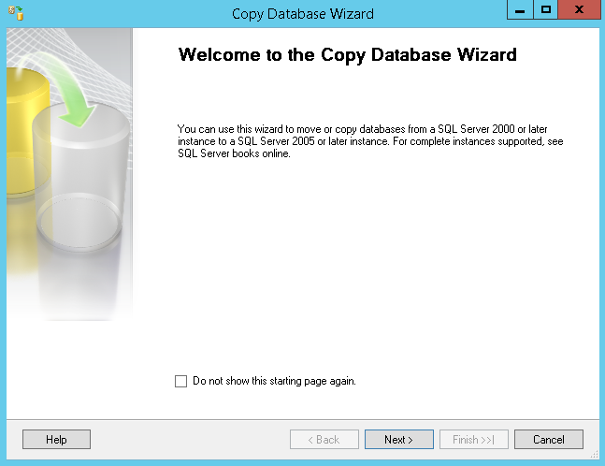
The Copy Database Wizard
Copies the database and all dependent objects
Two options for copy:
Detach and attach
Script new objects transfer
Notes:
20462D
6: Importing and Exporting Data

Slide 22
Demonstration: Using the Copy Database Wizard
In this demonstration, you will see how to:
Use the Copy Database Wizard
Notes:
Preparation Steps
Complete the previous demonstrations in this module.
Demonstration Steps
Use the Copy Database Wizard
Ensure that you have completed the previous demonstrations in this module.
In SQL Server Management Studio, in Object Explorer, in the Connect drop-down list click Database Engine. Then connect to the MIA-SQL\SQL2 instance using Windows authentication.
In Object Explorer, under the MIA-SQL\SQL2 instance, expand Databases and verify that the AdventureWorks database is not listed.
In Object Explorer, under the MIA-SQL instance, right-click the AdventureWorks database, point to Tasks, and click Copy Database.
On the Welcome to the Copy Database Wizard page, click Next.
On the Select a Source Server page, ensure that MIA-SQL is selected with the Use Windows Authentication option, and click Next.
On the Select a Destination Server page, change the Destination server to MIA-SQL\SQL2 and select the Use Windows Authentication option. Then click Next.
On the Select the Transfer Method page, ensure that Use the detach and attach method is selected, and click Next.
On the Select Databases page, in the Copy column, ensure that the AdventureWorks database is selected. Then click Next.
On the Configure Destination Database (1 of 1) page, note the default settings for the database name and file locations. Then click Next.
On the Select Server Objects page, verify that Logins is listed in the Selected related objects list. Then click Next.
20462D
6: Importing and Exporting Data
(More notes on the next slide)

Slide 23
Notes:
On the Configure the Package page, note the default package name and logging options. Then click Next.
On the Scheduling the Package page, ensure that Run immediately is selected, and click Next.
On the Completing the Wizard page, click Finish.
Wait for the operation to complete. Then click Close.
In Object Explorer, under the MIA-SQL\SQL2 instance, right-click Databases and click Refresh. Then verify that the AdventureWorks database has been copied to this instance.
20462D
6: Importing and Exporting Data

Slide 24
Data-Tier Applications
Data-Tier Applications (DACs) are a unit of deployment and management
Database
Dependent server objects
Developers can create DACs in Visual Studio
Packaged as a .dacpac file
DBAs can create DACs from an existing database
Extract a database to a .dacpac file
Export a database and its data to a .bacpac file
DBAs can create databases and dependent objects from DACs
Deploy .dacpac files
Import .bacpac files
Notes:
Point out that one reason to copy a database by exporting and importing a DAC instead of using the Copy Database Wizard is that you can perform the copy in two phases, without requiring connectivity to both the source and target instances at the same time.
20462D
6: Importing and Exporting Data

Slide 25
Demonstration: Exporting and Importing a Data-tier Application
In this demonstration, you will see how to:
Export a data-tier application
Import a data-tier application
Notes:
Preparation Steps
Complete the previous demonstrations in this module.
Demonstration Steps
Export a Data-Tier Application
Ensure that you have completed the previous demonstrations in this module.
In SQL Server Manager, in Object Explorer, under the MIA-SQL instance, right-click the Finance database, point to Tasks, and click Export Data-tier Application. (Be careful to click Export Data-tier Application, and not Extract Data-tier Application.)
On the Introduction page, click Next.
On the Export Settings page, ensure that Save to local disk is selected and enter the path D:\Demofiles\Mod06\Finance.bacpac. Then click the Advanced tab and verify that all tables are selected, and click Next.
On the Summary page, click Finish.
Wait for the export operation to complete, and then click Close.
Import a Data-Tier Application
In SQL Server Management Studio, in Object Explorer, under the MIA-SQL\SQL2 instance, right-click the Databases folder and click Import Data-tier Application.
On the Introduction page, click Next.
On the Import Settings page, ensure that Import from local disk is selected and enter the path D:\Demofiles\Mod06\Finance.bacpac. Then Next.
On the Database Settings page, review the default settings for the database name and file paths, and then click Next.
On the Summary page, click Finish.
Wait for the import operation to complete, and then click Close.
On Object Explorer, under the MIA-SQL\SQL2 instance, if necessary, refresh the Databases folder and verify that the Finance database has been imported.
20462D
6: Importing and Exporting Data

Slide 26
Lab: Importing and Exporting Data
Exercise 1: Using the SQL Server Import and Export Wizard Exercise 2: Using the bcp Utility Exercise 3: Using the BULK INSERT Statement Exercise 4: Using the OPENROWSET Function
Logon Information
Virtual machine: 20462C-MIA-SQL
User name: ADVENTUREWORKS\Student
Password: Pa$$w0rd
Estimated Time: 45 minutes
Notes:
Exercise 1: Using the SQL Server Import and Export Wizard
The production manager has asked you query the InternetSales database in order to summarize historical order volumes for the products Adventure Works sells, and plan future production.
You have created a Transact-SQL query, and the production manager has confirmed that it returns the required data. Now the production manager has asked you to provide the data in a Microsoft Excel workbook.
Exercise 2: Using the bcp Utility
Adventure Works Cycles uses a recruitment agency to find new employees. The agency periodically exports details of potential candidates from its candidate database and sends the data to the Human Resources (HR) department in tab-delimited text format. The HR manager has asked you to import the candidate data into the dbo.JobCandidate table in the HumanResources database.
Exercise 3: Using the BULK INSERT Statement
Adventure Works Cycles sells to customers throughout the world, and the e-ecommerce application developers have updated the web site to support multiple currencies. A comma-delimited file containing currency conversion rates has been uploaded to the M:\ volume used by database server, and you must import this data into the dbo.CurrencyRate table in the InternetSales database.
Exercise 4: Using the OPENROWSET Function
The recruitment agency has sent more job candidate data, and you have decided to import only records for candidates who have supplied an email address.
20462D
6: Importing and Exporting Data

Slide 27
Lab Scenario
You are a DBA at Adventure Works Cycles, with responsibility for the HumanResources, InternetSales, and AWDataWarehouse databases. One of your tasks is to import and export data to and from these database as required.
Notes:
20462D
6: Importing and Exporting Data

Slide 28
Lab Review
Why was it not necessary to disable constraints when importing the currency rates? If the dbo.JobCandidate table has included a column for a resume in Microsoft Word document format, which tool or command could you use to import the document into a column in a table?
Notes:
Question
Why was it not necessary to disable constraints when importing the currency rates?
Answer
The BULK INSERT statement does not check constraints by default.
Question
If the dbo.JobCandidate table has included a column for a resume in Microsoft Word document format, which tool or command could you use to import the document into a column in a table?
Answer
The BULK provider in the OPENROWSET command with the SINGLE_BLOB option.
20462D
6: Importing and Exporting Data

Slide 29
Module Review and Takeaways
Review Question(s) Best Practice
Notes:
Review Question(s)
Question
What other factors might you need to consider when importing or exporting data?
Answer
There are many considerations, including the impact on user and application workloads, and security.
Best Practice:
Choose the right tool for bulk-imports.
Use SSIS for complex transformations.
Use bcp or BULK INSERT for fast imports and exports.
Use OPENROWSET when data needs to be filtered before it gets inserted.
Try to achieve minimal logging to speed up data import.
20462D
6: Importing and Exporting Data

