Slide 1
Module 10
Auditing Data Access and Encrypting Data
Notes:
The 20462C-MIA-SQL virtual machine used in the lab for this module includes a lot of software services that can take a while to start. For the best experience, have students start the 20462C-MIA-DC and 20462C-MIA-SQL virtual machines at the beginning of the module so that the services have time to start before students begin the lab.
20462D
10: Auditing Data Access and Encrypting Data

Slide 2
Module Overview
Auditing Data Access in SQL Server Implementing SQL Server Audit Encrypting Databases
Notes:
20462D
10: Auditing Data Access and Encrypting Data

Slide 3
Lesson 1: Auditing Data Access in SQL Server
Discussion: Auditing Data Access Common Criteria Auditing SQL Trace DML Triggers Demonstration: Using DML Triggers for Auditing SQL Server Audit
Notes:
Question
You are configuring the SQL Server audit service on your server. Which of the following components includes the list of actions that will respond to user operations against data in a table?
( )Option 1: Server Audit Specification
( )Option 2: Database Audit Specification
( )Option 3: Action Group
( )Option 4: Target
( )Option 5: Server Audit
Answer
(√) Option 2: Database Audit Specification
20462D
10: Auditing Data Access and Encrypting Data

Slide 4
Discussion: Auditing Data Access
Why is auditing required?
What methods have you used for auditing?
What are the limitations of the methods you have used?
Which standards that require auditing does your organization need to comply with?
Notes:
It is important for students to understand why there is a need for auditing. On most occasions, this is driven by compliance requirements, but it can also be guided by a need to troubleshoot unexpected occurrences.
Be prepared to provide examples of the regulatory requirements that apply to different industries in the country or region where you are teaching. Encourage student interaction—if two students are working in the same industry, ask them to discuss how they are addressing regulatory compliance issues.
20462D
10: Auditing Data Access and Encrypting Data

Slide 5
Common Criteria Auditing
Common Criteria Compliance:
Ratified as an international standard in 1999
Supersedes C2 rating
ISO standard 15408
Enable common criteria compliance enabled configuration option by using sp_configure:
Residual Information Protection (RIP)
Ability to view login statistics
Column GRANT does not override table DENY
Notes:
Stress that the Common Criteria Compliance now almost always replaces C2 rating as a requirement and students should update any existing applications that use C2 audit.
20462D
10: Auditing Data Access and Encrypting Data

Slide 6
SQL Trace
SQL Server Profiler is used to trace commands sent to the server and errors returned:
Can be heavy on resources
Is run interactively
Can trace command executions
SQL Trace:
A set of system stored procedures that enable you to create traces
Can be used from within applications
Relatively lightweight when well-filtered
Notes:
Point out that, even though people do use SQL Server Profiler for auditing, SQL Trace is a better option, as it has less performance impact.
20462D
10: Auditing Data Access and Encrypting Data

Slide 7
DML Triggers
Triggers can provide part of an auditing solution:
DML triggers for data modification
Logon triggers for tracking logons
Limitations:
Performance impact
Ability to disable triggers
Lack of SELECT triggers
Trigger nesting issues
Complexities around trigger firing order
Notes:
Triggers can play an important role in auditing. Prior to SQL Server 2008, many actions could only be audited by using triggers.
20462D
10: Auditing Data Access and Encrypting Data

Slide 8
Demonstration: Using DML Triggers for Auditing
In this demonstration, you will see how to:
Create a DML trigger for auditing
Notes:
Preparation Steps
Start the 20462C-MIA-DC and 20462C-MIA-SQL virtual machines.
Demonstration Steps
Create a DML Trigger for Auditing
Ensure that the 20462C-MIA-DC and 20462C-MIA-SQL virtual machines are running, and log on to 20462C-MIA-SQL as ADVENTUREWORKS\Student with the password Pa$$w0rd.
In the D:\Demofiles\Mod10 folder, run Setup.cmd as Administrator.
Start SQL Server Management Studio and connect to the MIA-SQL database engine instance using Windows authentication.
Open the DML Trigger.sql script file in the D:\Demofiles\Mod10 folder.
Select the code under the comment Create a log table, and click Execute. This creates a table named AuditRateChange in the HumanResources schema of the AdventureWorks database.
Select the code under the comment Create a trigger, and click Execute. This creates a trigger on the EmployeePayHistory table that fires on updates. When the Rate column is updated, a row is inserted into the AuditRateChange table.
Select the code under the comment Update a rate, and click Execute. This updates a rate in the EmployeePayHistory table.
Select the code under the comment View the audit log, and click Execute. This retrieves the logged details from the AuditRateChange table.
Keep SQL Server Management Studio open for the next demonstration.
20462D
10: Auditing Data Access and Encrypting Data

Slide 9
SQL Server Audit
Event tracking and logging system based on Extended Events
Comprised of:
Audits
Audit specifications
Actions and action groups
Targets
Notes:
Describe each of the objects involved in the audit process.
20462D
10: Auditing Data Access and Encrypting Data

Slide 10
Lesson 2: Implementing SQL Server Audit
SQL Server Audit Overview Creating an Audit Creating a Server Audit Specification Creating Database Audit Specifications User-Defined Audit Actions Reading Audited Events Managing SQL Server Audit Demonstration: Using SQL Server Audit
Notes:
20462D
10: Auditing Data Access and Encrypting Data

Slide 11

SQL Server Audit Overview
Audit: Where and how events are logged
Audit Specification: A set of events to be logged in an audit
Actions and Action Groups: Events that can be included in an audit specification
Action Groups
/ Actions
Audit Specification
Audit
Notes:
Talk the students through each step in the configuration process.
20462D
10: Auditing Data Access and Encrypting Data

Slide 12
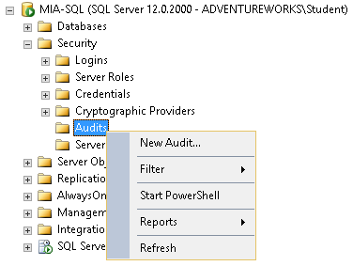
Creating an Audit
Specify:
Target
Queue delay
Action on failure
Set STATE = ON to enable
CREATE SERVER AUDIT SecurityAudit
TO FILE
(FILEPATH = '\\MIA-SQL\AuditFiles\' ,MAXSIZE = 0 MB
,MAX_ROLLOVER_FILES = 2147483647 ,RESERVE_DISK_SPACE = OFF)
WITH
(QUEUE_DELAY = 1000 ,ON_FAILURE = FAIL_OPERATION);
GO
ALTER SERVER AUDIT SecurityAudit
WITH (STATE = ON);
Notes:
Talk through each of the configuration options for an audit.
Briefly mention that the option to shut down the server on audit failure may result in SQL Server not being able to start. This is discussed in more detail in the next lesson.
20462D
10: Auditing Data Access and Encrypting Data

Slide 13
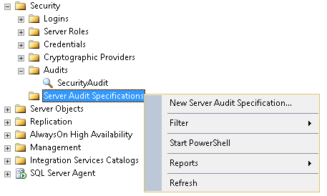
Creating a Server Audit Specification
Specify:
Audit
Action groups to be included
State
CREATE SERVER AUDIT SPECIFICATION AuditLogins
FOR SERVER AUDIT SecurityAudit
ADD (FAILED_LOGIN_GROUP),
ADD (SUCCESSFUL_LOGIN_GROUP)
WITH (STATE = ON);
Notes:
20462D
10: Auditing Data Access and Encrypting Data

Slide 14
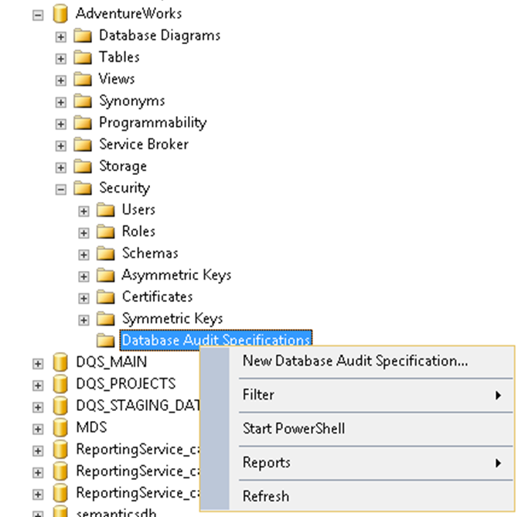
Creating Database Audit Specifications
Specify:
Audit
Action Groups
Actions on specific securable by specific principals
State
USE AdventureWorks;
CREATE DATABASE AUDIT SPECIFICATION
AdventureWorks_DBSecurity
FOR SERVER AUDIT SecurityAudit
ADD
(DATABASE_PRINCIPAL_CHANGE_GROUP),
ADD
(SELECT ON SCHEMA::HumanResources BY db_datareader)
WITH (STATE = ON);
Notes:
Remind students that database audit specifications can only be created in SQL Server Enterprise Edition.
20462D
10: Auditing Data Access and Encrypting Data

Slide 15
User-Defined Audit Actions
Enable you to audit custom events:
Add USER_DEFINED_AUDIT_GROUP to an audit specification
Call sp_audit_write from a stored procedure or trigger
CREATE TRIGGER HR.BonusChecker ON HR.EmployeeBonus
AFTER INSERT
AS
DECLARE @bonus money, @empid integer, @msg nvarchar(4000)
select @bonus = i.Bonus, @empid = i.EmployeeID
from inserted i
IF @bonus > 1000
BEGIN
SET @msg = 'Employee '+ CAST(@empid as varchar(50))
+' bonus is over $1000'
EXEC sp_audit_write @user_defined_event_id = 12,
@succeeded = 1, @user_defined_information = @msg;
END
Notes:
Talk through the code sample in the student notes. Emphasize that sp_audit_write event can be called from any Transact-SQL code (for example, directly by a client, in a stored procedure or function, or in a trigger).
20462D
10: Auditing Data Access and Encrypting Data

Slide 16
Reading Audited Events
Use Event Viewer to view Windows event logs
Retrieve file-based audits by using the sys.fn_get_audit_file function
SELECT event_time, object_id, server_principal_name,
database_name, schema_name, object_name, statement
FROM
sys.fn_get_audit_file('\\MIA-SQL\AuditFiles\*', default, default);
Notes:
20462D
10: Auditing Data Access and Encrypting Data

Slide 17
Managing SQL Server Audit
Enable or disable audits by setting STATE
View audit configuration details in DMVs
Audit considerations include:
Restoring or attaching a database may result in a mismatched GUID
Attaching a database to a different edition of SQL Server may result in the audit not running
Mirrored servers may result in mismatched GUIDs
Auditing a large number of events can cause performance issues
Failure during audit can cause SQL Server to fail to start
Notes:
Describe each of the potential issues to consider when using SQL Server audit.
20462D
10: Auditing Data Access and Encrypting Data

Slide 18
Demonstration: Using SQL Server Audit
In this demonstration, you will see how to:
Create an audit
Create a server audit specification
Create a database audit specification
View audited events
Notes:
Preparation Steps
Complete the previous demonstration. Alternatively, start the 20462C-MIA-DC and 20462C-MIA-SQL virtual machines, log onto 20462C-MIA-SQL as ADVENTUREWORKS\Student with the password Pa$$w0rd, and run Setup.cmd in the D:\Demofiles\Mod10 folder as Administrator. Then start SQL Server Management Studio, and connect to MIA-SQL using Windows authentication.
Demonstration Steps
Create an Audit
If you did not complete the previous demonstration, start the 20462C-MIA-DC and 20462C-MIA-SQL virtual machines, log onto 20462C-MIA-SQL as ADVENTUREWORKS\Student with the password Pa$$w0rd, and run Setup.cmd in the D:\Demofiles\Mod10 folder as Administrator. Then start SQL Server Management Studio, and connect to MIA-SQL using Windows authentication.
In SQL Server Management Studio, open the Audit.sql script file in the D:\Demofiles\Mod10 folder.
Select the code under the comment Create an audit, and click Execute. This creates an audit that logs events to files in D:\Demofiles\Mod10\Audits.
In Object Explorer, expand Security, and expand Audits (if Audits is not expandable, refresh it and try again).
Double-click the AW_Audit audit you created and view its properties. Then click Cancel.
Create a Server Audit Specification
In SQL Server Management Studio, in the Audit.sql script, select the code under the comment Create a server audit specification and click Execute. This creates an audit specification for the AW_Audit audit that logs failed and successful login attempts.
In Object Explorer, refresh the Server Audit Specifications folder and expand it. Then double-click AW_ServerAuditSpec, view its properties, and click Cancel.
20462D
10: Auditing Data Access and Encrypting Data
(More notes on the next slide)

Slide 19
Notes:
Create a Database Audit Specification
In SQL Server Management Studio, in the Audit.sql script, select the code under the comment Create a database audit specification and click Execute. This creates an audit specification for the AW_Audit audit that logs specific actions by individual principals on the HumanResources schema in the AdventureWorks database.
In Object Explorer, expand Databases, expand AdventureWorks, expand Security, and expand Database Audit Specifications (if Database Audit Specifications is not expandable, refresh it and try again).
Double-click AW_DatabaseAuditSpec and view its properties. Then click Cancel.
View Audited Events
Open a command prompt and enter the following command to run sqlcmd as ADVENTUREWORKS\ChadCorbitt. This user is a member of the ADVENTUREWORKS\Personnel global group, which in turn is a member of the ADVENTUREWORKS\HumanResources_Users domain local group.
runas /user:adventureworks\chadcorbitt /noprofile sqlcmd
When prompted for a password, enter Pa$$w0rd.
In the SQLCMD window, enter the following commands to query the HumanResources.Employee table:
SELECT LoginID, JobTitle FROM HumanResources.Employee;
GO
Close the SQLCMD and command prompt windows.
(More notes on the next slide)
20462D
10: Auditing Data Access and Encrypting Data

Slide 20
Notes:
In the D:\Demofiles\Mod10\Audits folder, verify that an audit file has been created.
In SQL Server Management Studio, in the Audit.sql script, select the code under the comment View audited events and click Execute. This queries the files in the audit folder and displays the audited events (to simplify this demonstration, events logged for the Student user and the service account for SQL Server have been excluded).
Note that all events are logged with the server principal name ADVENTUREWORKS\ChadCorbitt despite the fact that this user accesses SQL Server through membership of a Windows group and does not have an individual login.
Keep SQL Server Management Studio open for the next demonstration.
20462D
10: Auditing Data Access and Encrypting Data

Slide 21
Lesson 3: Encrypting Databases
Transparent Data Encryption Overview Configuring Transparent Data Encryption Moving Encrypted Databases Demonstration: Implementing Transparent Data Encryption Extensible Key Management
Notes:
20462D
10: Auditing Data Access and Encrypting Data

Slide 22
Transparent Data Encryption Overview
Service Master Key (SMK)
Created during SQL Server installation
Encrypted by Windows DPAPI
Database Master Key (DMK)
Created in master database
Encrypted by SMK
Server Certificate
Created in master database
Encrypted by DMK
Database Encryption Key (DEK)
Created in user database
Encrypted by server certificate
DPAPI (Windows)
SMK
master DMK
master
Server
certificate
User DB
DEK
Notes:
20462D
10: Auditing Data Access and Encrypting Data

Slide 23
Configuring Transparent Data Encryption
Create a DMK in master database
CREATE MASTER KEY ENCRYPTION BY PASSWORD = ‘Pa$$w0rd’;
Create a Server Certificate in master database
CREATE CERTIFICATE Security_Certificate
WITH SUBJECT = 'DEK_Certificate';
Create a DEK in the user database
CREATE DATABASE ENCRYPTION KEY WITH ALGORITHM = AES_128
ENCRYPTION BY SERVER CERTIFICATE Security_Certificate;
Enable encryption for the user database
ALTER DATABASE AdventureWorks SET ENCRYPTION ON;
Notes:
20462D
10: Auditing Data Access and Encrypting Data

Slide 24
Moving Encrypted Databases
Detach the source database
Copy/move the database files
Create new DMK in the master database
Generate a new server certificate from a backup of the original server certificate and its private key
Attach the database
Notes:
Re-iterate the importance of backing up the server certificate and its private key.
20462D
10: Auditing Data Access and Encrypting Data

Slide 25
Demonstration: Implementing Transparent Data Encryption
In this demonstration, you will see how to:
Create a database master key
Create a server certificate
Create a database encryption key
Enable database encryption
Notes:
Preparation Steps
Complete the previous demonstration. Alternatively, start the 20462C-MIA-DC and 20462C-MIA-SQL virtual machines, log onto 20462C-MIA-SQL as ADVENTUREWORKS\Student with the password Pa$$w0rd, and run Setup.cmd in the D:\Demofiles\Mod10 folder as Administrator. Then start SQL Server Management Studio, and connect to MIA-SQL using Windows authentication.
Demonstration Steps
Create a Database Master Key
If you did not complete the previous demonstration, start the 20462C-MIA-DC and 20462C-MIA-SQL virtual machines, log onto 20462C-MIA-SQL as ADVENTUREWORKS\Student with the password Pa$$w0rd, and run Setup.cmd in the D:\Demofiles\Mod10 folder as Administrator. Then start SQL Server Management Studio, and connect to MIA-SQL using Windows authentication.
In SQL Server Management Studio, open the TDE.sql script file in the D:\Demofiles\Mod10 folder.
Select the code under the comment Create DMK and click Execute. This creates a database master key in the master database.
Create a Server Certificate
In the TDE.sql script, select the code under the comment Create server certificate and click Execute. This creates a certificate and then backs up the certificate and its private key.
Create a Database Encryption Key
In the TDE.sql script, select the code under the comment Create DEK and click Execute. This creates a database encryption key in the ConfidentialDB database.
Enable Database Encryption
In the TDE.sql script, select the code under the comment Enable encryption and click Execute. This enables encryption for the ConfidentialDB database, and retrieves database encryption status from the sys.databases table in the master database.
Review the query results, and verify that the is_encypted value for ConfidentialDB is 1.
Close SQL Server Management Studio without saving any files.
20462D
10: Auditing Data Access and Encrypting Data

Slide 26
Extensible Key Management
EKM enables encryption keys to be stored securely in third-party hardware security modules (HSMs)
Requires additional SQL Server configuration:
The EKM provider enabled option must be on
Credentials must be created to enable SQL Server to access keys in the HSM
Notes:
Configuring EKM is an advanced operation that may vary depending on the specific hardware solution being used for key management.
20462D
10: Auditing Data Access and Encrypting Data

Slide 27
Lab: Auditing Data Access and Encrypting Data
Exercise 1: Implementing Auditing Exercise 2: Implementing Transparent Database Encryption
Logon Information
Virtual machine: 20462C-MIA-SQL
User name: ADVENTUREWORKS\Student
Password: Pa$$w0rd
Estimated Time: 60 minutes
Notes:
Exercise 1: Implementing Auditing
The InternetSales database contains customer information, and as part of your commitment to customer data protection, your corporate compliance team requires that access to customer data is audited.
Exercise 2: Implementing Transparent Database Encryption
You want to ensure the security of the HumanResources database to prevent access to the data it contains in the event that the database files are compromised. To achieve this, you will configure transparent data encryption.
20462D
10: Auditing Data Access and Encrypting Data

Slide 28
Lab Scenario
You are a database administrator at Adventure Works Cycles. For compliance reasons, you must implement auditing of access to customer data in the InternetSales database; and you must protect sensitive personnel data by encrypting the HumanResources database.
Notes:
20462D
10: Auditing Data Access and Encrypting Data

Slide 29
Lab Review
In this lab, you implemented auditing for a SQL Server instance, and you implemented transparent database encryption to protect a database.
Notes:
20462D
10: Auditing Data Access and Encrypting Data

Slide 30
Module Review and Takeaways
Review Question(s) Best Practice
Notes:
Review Question(s)
Question
What are the three targets for SQL Server audits?
Answer
Files, the Windows application log, and the Windows security log.
Question
You may wish to audit actions by a DBA. How would you know if the DBA stopped the audit while performing covert actions?
Answer
Changes to the audit status are logged.
Best Practice: When planning to implement auditing, consider the following best practices:
Choose the option to shut down SQL Server on audit failure. There is usually no point in setting up auditing, and then having situations where events can occur but are not audited. This is particularly important in high-security environments.
Make sure that file audits are placed on drives with large amounts of free disk space and ensure that the available disk space is monitored on a regular basis.
Best Practice: When planning to implement database encryption, consider the following best practices:
Use a complex password to protect the database master key for the master database.
Ensure you back up certificates and private keys used to implement TDE, and store the backup files in a secure location.
If you need to implement data encryption on multiple servers in a large organization, consider using an EKM solution to manage encryption keys.
20462D
10: Auditing Data Access and Encrypting Data

