Slide 1
Module 11
Performing Ongoing Database Maintenance
Notes:
The 20462C-MIA-SQL virtual machine used in the lab for this module includes a lot of software services that can take a while to start. For the best experience, have students start the 20462C-MIA-DC and 20462C-MIA-SQL virtual machines at the beginning of the module so that the services have time to start before students begin the lab.
20462D
11: Performing Ongoing Database Maintenance

Slide 2
Module Overview
Ensuring Database Integrity Maintaining Indexes Automating Routine Database Maintenance
Notes:
20462D
11: Performing Ongoing Database Maintenance

Slide 3
Lesson 1: Ensuring Database Integrity
Introduction to Database Integrity Overview of DBCC CHECKDB DBCC CHECKDB Options DBCC CHECKDB Repair Options Demonstration: Using DBCC CHECKDB
Notes:
Question
Disk space has become an issue on your database server. You have decided to take a backup of the AdventureWorks database and restore it on a new disk. Before this move, you want to check the physical and logical integrity of the databases but you are concerned that they may not be enough disk space to accommodate DBCC and its temporary data. Which of the following commands can you use to check whether there is enough disk space?
( )Option 1: DBCC CHECKDB('AdventureWorks') WITH ALL_ERRORMSGS;
( )Option 2: DBCC CHECKDB('AdventureWorks', NOINDEX);
( )Option 3: DBCC CHECKDB('AdventureWorks') WITH EXTENDED_LOGICAL_CHECKS;
( )Option 4: DBCC CHECKDB('AdventureWorks') WITH PHYSICAL_ONLY;
( )Option 5: DBCC CHECKDB('AdventureWorks') WITH ESTIMATEONLY;
Answer
(√) Option 5: DBCC CHECKDB('AdventureWorks') WITH ESTIMATEONLY;
20462D
11: Performing Ongoing Database Maintenance

Slide 4

Introduction to Database Integrity
Physical integrity
Data pages are written to physical storage as SQL Server requested and can be read correctly
Logical integrity
Data within pages is logically correct
Notes:
20462D
11: Performing Ongoing Database Maintenance

Slide 5
Overview of DBCC CHECKDB
Checks logical and physical integrity in the database
Allocation of all pages in the database
Consistency of tables and indexes
Consistency of the catalog of the database
Offers repair options
Some options permit data loss
Runs online using an internal database snapshot
Should be run frequently
Synchronize executions with your backup strategy, to be able to recover from corruption
Notes:
Describe the checks that DBCC CHECKDB performs. Point out that it is an online operation by default since SQL Server 2005.
Explain that DBCC CHECKDB has repair options but that it is not always possible to repair the database without data loss. Restoring the database is often the best option for repair.
20462D
11: Performing Ongoing Database Maintenance

Slide 6
DBCC CHECKDB Options
Option | Description
PHYSICAL_ONLY | Only checks the physical integrity to reduce overhead
NOINDEX | Does not perform logical checks on nonclustered indexes
EXTENDED_LOGICAL_CHECKS | Performs additional logical checks of indexed views, spatial, and XML indexes
TABLOCK | Uses locks instead of database snapshots
ALL_ERRORMSGS | Returns all error messages instead of the default action that returns the first 200
NO_INFOMSGS | Returns only error messages and no informational messages
ESTIMATEONLY | Estimates the amount of tempdb space that it requires to run
Notes:
Briefly explain the available options in the table.
20462D
11: Performing Ongoing Database Maintenance

Slide 7
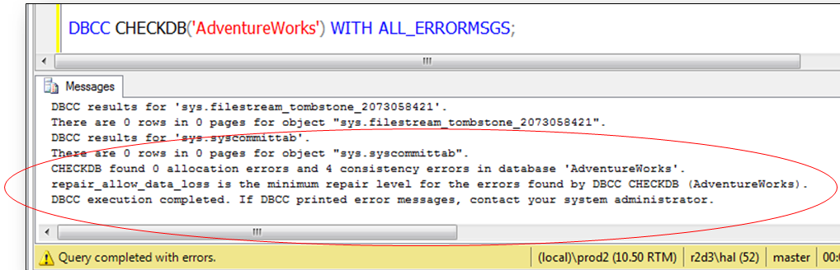
DBCC CHECKDB Repair Options
Database needs to be in SINGLE_USER mode
DBCC CHECKDB output:
REPAIR_REBUILD
REPAIR_ALLOW_DATA_LOSS
Consider restoring a database instead of allowing data loss
Notes:
Explain that the DBCC CHECKDB output provides both the error information and guidance about what action to take.
Emphasize that it is also recommended to back up the database before using any repair option and that repairing the database is the last resort. Typically, it is better to restore a database.
Stress that a corrupt database suggests storage layer issues that need to be resolved or the corruption will probably happen again. It is sometimes possible (but not desirable) to attempt to gain emergency access to a database by using the force startup option. However, for corrupt databases, data loss will still no doubt have occurred.
20462D
11: Performing Ongoing Database Maintenance

Slide 8
Demonstration: Using DBCC CHECKDB
In this demonstration, you will see how to:
Use the DBCC CHECKDB command
Notes:
Preparation Steps
Start the 20462C-MIA-DC, and 20462C-MIA-SQL virtual machines.
Demonstration Steps
Use the DBCC CHECKDB Command
Ensure that the 20462C-MIA-DC and 20462C-MIA-SQL virtual machines are running, and log on to 20462C-MIA-SQL as ADVENTUREWORKS\Student with the password Pa$$w0rd.
In the D:\Demofiles\Mod11 folder, run Setup.cmd as Administrator.
Start SQL Server Management Studio and connect to the MIA-SQL database engine instance using Windows authentication.
Open the DBCCCHECKDB.sql script file in the D:\Demofiles\Mod11 folder.
Select the code under the comment Run DBCC CHECKDB with default options and click Execute. This checks the integrity of the AdventureWorks database and displays detailed informational messages.
Select the code under the comment Run DBCC CHECKDB without informational messages and click Execute. This checks the integrity of the AdventureWorks database and only displays messages if errors are found.
Select the code under the comment Run DBCC CHECKDB against CorruptDB and click Execute. This checks the integrity of the CorruptDB database and identifies some consistency errors in the dbo.Orders table in this database. The last line of output tells you the minimum repair level required.
Select the code under the comment Try to access the Orders table and click Execute. This attempts to query the dbo.Orders table in CorruptDB, and returns an error because of a logical consistency issue.
Select the code under the comment Access a specific order and click Execute. This succeeds, indicating that only some data pages are affected by the consistency issue.
Select the code under the comment Repair the database and click Execute. Note that this technique is used only as a last resort when no valid backup is available. No guarantee on logical consistency in the database (such as foreign key constraints) is provided.
20462D
11: Performing Ongoing Database Maintenance
(More notes on the next slide)

Slide 9
Notes:
Select the code under the comment Access the Orders table and click Execute. This succeeds, indicating that the consistency issue has been repaired.
Select the code under the comment Check the internal database structure and click Execute. No error message are displayed, indicating that the database structure is now consistent.
Select the code under the comment Check data loss and click Execute. Note that a number of order details records have no matching order records. The foreign-key constraint between these tables originally enforced a relationship, but some data has been lost.
20462D
11: Performing Ongoing Database Maintenance

Slide 10
Lesson 2: Maintaining Indexes
How Indexes Affect Performance Types of SQL Server Indexes Index Fragmentation FILLFACTOR and PAD_INDEX Ongoing Maintenance of Indexes Online Index Operations Updating Statistics Demonstration: Maintaining Indexes
Notes:
Question
You want to rebuild a non-clustered index called IX_Skills on the Employees table in the HumanResources database. You run SQL Server Enterprise Edition and want to minimize the impact of this operation on users. What T-SQL command should you execute?
Answer
Use the following command:
ALTER INDEX IX_Skills ON HumanResources.Employees REBUILD
WITH (ONLINE = ON);
20462D
11: Performing Ongoing Database Maintenance

Slide 11
How Indexes Affect Performance
Table Scan
SQL Server reads all data pages
Index
SQL Server uses index pages to find rows
Notes:
Start by mentioning that indexing is covered in detail in course 20464D: Developing Microsoft SQL Server 2014 Databases.
Only a brief discussion of the key points is included here. Make sure that you do not spend too long discussing indexing in this course. It would be easy to lose a whole day talking about this, rather than the time allocated to one lesson.
Use this slide to explain that SQL Server accesses data by using indexes or by scanning all the data pages in a table.
20462D
11: Performing Ongoing Database Maintenance

Slide 12
Types of SQL Server Indexes
Clustered index has data pages in the leaf level
Nonclustered index has pointers to data rows in leaf level
Root index
Intermediate Level
Leaf Level
Notes:
Explain how data is stored and accessed in heaps, clustered indexes, and nonclustered indexes.
Ensure that students understand that there can be only a single clustered index because it determines the logical ordering of the data.
20462D
11: Performing Ongoing Database Maintenance

Slide 13
Index Fragmentation
Fragmentation occurs when data changes cause index pages to split:
Internal fragmentation when pages are not full
External fragmentation when pages are not in logical sequence
Detecting fragmentation:
Index properties in SQL Server Management Studio
sys.dm_db_index_physical_stats
Notes:
Explain why index fragmentation occurs and the two types, and then describe why it impacts the performance of the index. Also note that, if the pages are physically out of order, SQL Server cannot read them sequentially in 64 KB chunks, and this breaks the read-ahead process.
20462D
11: Performing Ongoing Database Maintenance

Slide 14
FILLFACTOR and PAD_INDEX
Leave free space in indexes to avoid fragmentation:
FILLFACTOR (leaf level only)
PAD_INDEX (intermediate and root levels also)
ALTER TABLE Person.Contact
ADD CONSTRAINT PK_Contact_ContactID
PRIMARY KEY CLUSTERED
(
ContactID ASC
) WITH (PAD_INDEX = OFF, FILLFACTOR = 70);
GO
Notes:
Explain how to use the FILLFACTOR and PAD_INDEX options and the effect that they have on index storage.
20462D
11: Performing Ongoing Database Maintenance

Slide 15
Ongoing Maintenance of Indexes
Rebuild:
Rebuilds the whole index
Needs free space in database
Performed as a single transaction with potential requirement for a large amount of transaction log space
Reorganize:
Sorts the pages and is always online
Less transaction log usage
Can be interrupted but still retain work performed to that point
ALTER INDEX CL_LogTime ON dbo.LogTime REBUILD;
ALTER INDEX ALL ON dbo.LogTime REORGANIZE;
Notes:
Explain the two options for defragmenting indexes and compare their pros and cons. Review the code samples on the slide so that students can see how to perform the defragmentation.
20462D
11: Performing Ongoing Database Maintenance

Slide 16
Online Index Operations
Can create, rebuild, and drop indexes online:
Enables concurrent user access to the underlying table and indexes
Only needs short term shared locks at beginning and end of the operation and schema locks during the operation
Typically slower than equivalent offline operation
ALTER INDEX IX_Contact_EmailAddress
ON Person.Contact REBUILD
WITH ( PAD_INDEX = OFF,
FILLFACTOR = 80,
ONLINE = ON,
MAXDOP = 4 );
Notes:
Briefly explain how an index is rebuilt online.
Emphasize that, because of the extra work needed to be done during an online operation, they are typically slower than their offline counterparts. However, this does allow users to access and change the data, which is important in many scenarios.
20462D
11: Performing Ongoing Database Maintenance

Slide 17
Updating Statistics
As data changes, distribution statistics become outdated
Can update statistics automatically or on demand
Do not disable AUTO_UPDATE_STATISTICS
Option | Description
AUTO_UPDATE_STATISTICS | Database option that enables SQL Server to automatically update statistics.
UPDATE STATISTICS | Statement that updates all statistics on a table or specified subset of statistics on demand.
sp_updatestats | System stored procedure that updates all statistics in a database.
Notes:
Mention that statistics are normally managed automatically by SQL Server and that the option to update statistics automatically should not be disabled, except in very rare circumstances. One exception to the general rule about not disabling automatic statistics creation is that when using SQL Server to host SharePoint Server databases, you should set AUTO_CREATE_STATISTICS to OFF.
20462D
11: Performing Ongoing Database Maintenance

Slide 18
Demonstration: Maintaining Indexes
In this demonstration you will see how to:
Maintain indexes
Notes:
Preparation Steps
Complete the previous demonstration in this module. Alternatively, start the 20462C-MIA-DC and 20462C-MIA-SQL virtual machines, log on to 20462C-MIA-SQL as ADVENTUREWORKS\Student with the password Pa$$w0rd, and run Setup.cmd in the D:\Demofiles\Mod11 folder as Administrator.
Demonstration Steps
Maintain Indexes
If you did not complete the previous demonstration in this module, ensure that the 20462C-MIA-DC and 20462C-MIA-SQL virtual machines are running, and log on to 20462C-MIA-SQL as ADVENTUREWORKS\Student with the password Pa$$w0rd. Then, in the D:\Demofiles\Mod11 folder, run Setup.cmd as Administrator.
If SQL Server Management Studio is not already open, start it and connect to the MIA-SQL database engine instance using Windows authentication.
Open the MaintainingIndexes.sql script file in the D:\Demofiles\Mod11 folder.
Select the code under the comment Create a table with a primary key and click Execute. This creates a table with a primary key, which by default creates a clustered index on the primary key field.
Select the code under the comment Insert some data into the table and click Execute. This inserts 10,000 rows into the table.
Select the code under the comment Check fragmentation and click Execute. In the results, note the avg_fragmentation_in_percent and avg_page_space_used_in_percent values for each index level.
Select the code under the comment Modify the data in the table and click Execute. This updates the table.
Select the code under the comment Re-check fragmentation and click Execute. In the results, note that the avg_fragmentation_in_percent and avg_page_space_used_in_percent values for each index level have changed as the data pages have become fragmented.
Select the code under the comment Rebuild the table and its indexes and click Execute. This rebuilds the indexes on the table.
Select the code under the comment Check fragmentation again and click Execute. In the results, note that the avg_fragmentation_in_percent and avg_page_space_used_in_percent values for each index level indicate less fragmentation.
20462D
11: Performing Ongoing Database Maintenance

Slide 19
Lesson 3: Automating Routine Database Maintenance
Overview of SQL Server Maintenance Plans Monitoring Maintenance Plans Demonstration: Creating a Maintenance Plan
Notes:
Question
If you need to execute a maintenance plan with timing that cannot be accommodated by a single schedule, what can you do?
Answer
Add a second schedule.
20462D
11: Performing Ongoing Database Maintenance

Slide 20
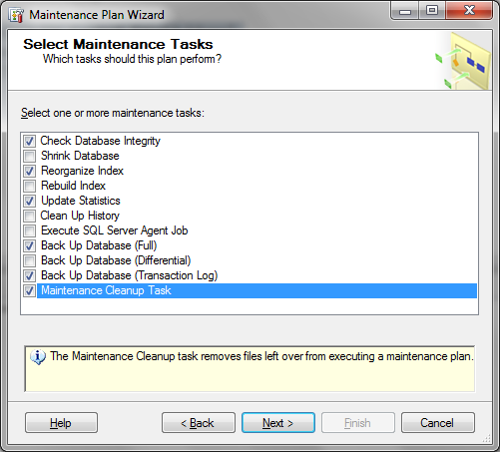
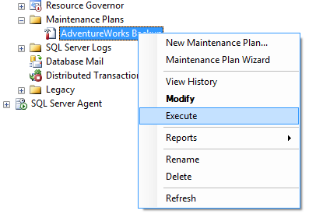
Overview of SQL Server Maintenance Plans
Schedules core maintenance tasks
Uses SSIS to perform tasks
Notes:
Explain that the Maintenance Plan Wizard schedules core maintenance tasks. Note that maintenance plans can use one schedule for all tasks or individual schedules for each one.
Point out that students will learn more about the SQL Server Agent in a later module.
Point out that you may not always include all of the available tasks in a database maintenance plan. For example, shrinking a database is not typically performed as a regular maintenance task.
20462D
11: Performing Ongoing Database Maintenance

Slide 21
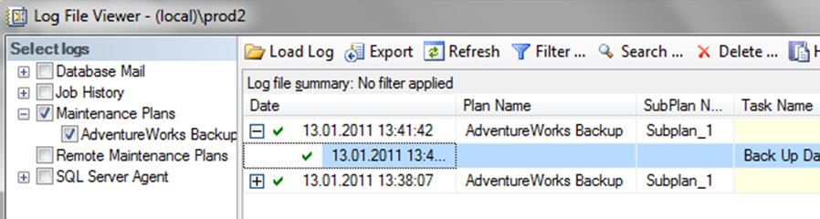
Monitoring Maintenance Plans
Real time monitoring in Job Activity Monitor
Execution results stored in msdb and can also be:
Written to a text file
Sent to an operator
Cleanup tasks to implement retention policies
Notes:
Reiterate that maintenance plans are implemented using SQL Server Agent jobs running SSIS packages. Because of this, real-time monitoring can be done using the Job Activity Monitor.
20462D
11: Performing Ongoing Database Maintenance

Slide 22
Demonstration: Creating a Maintenance Plan
In this demonstration, you will see how to:
Create a maintenance plan
Notes:
Preparation Steps
Complete the previous demonstrations in this module. Alternatively, start the 20462C-MIA-DC and 20462C-MIA-SQL virtual machines, log on to 20462C-MIA-SQL as ADVENTUREWORKS\Student with the password Pa$$w0rd, and run Setup.cmd in the D:\Demofiles\Mod11 folder as Administrator.
Demonstration Steps
Create a Maintenance Plan
If you did not complete the previous demonstration in this module, ensure that the 20462C-MIA-DC and 20462C-MIA-SQL virtual machines are running, and log on to 20462C-MIA-SQL as ADVENTUREWORKS\Student with the password Pa$$w0rd. Then, in the D:\Demofiles\Mod11 folder, run Setup.cmd as Administrator.
If SQL Server Management Studio is not already open, start it and connect to the MIA-SQL database engine instance using Windows authentication.
In Object Explorer, under MIA-SQL, expand Management, right-click Maintenance Plans, and click Maintenance Plan Wizard.
In the Maintenance Plan Wizard window, click Next.
In the Select Plan Properties window, in the Name textbox type Daily Maintenance. Note the available scheduling options and click Change.
In the New Job Schedule window, in the Name textbox type "Daily". In the Occurs drop down list, click Daily. In the Occurs once at textbox, change the time to 3:00 AM, and click OK.
In the Select Plan Properties window, click Next. Then in the Select Maintenance Tasks page, select the following tasks and click Next.
Check Database Integrity
Reorganize Index
Update Statistics
Back up Database (Full)
20462D
11: Performing Ongoing Database Maintenance
(More notes on the next slide)

Slide 23
Notes:
On the Select Maintenance Task Order page, click Next.
On the define Database Check Integrity Task page, select the AdventureWorks database and click OK. Then click Next.
On the Define Reorganize Index Task page, select the AdventureWorks database and click OK, ensure that Tables and Views is selected, and click Next.
On the Define Update Statistics Task page, select the AdventureWorks database and click OK, ensure that Tables and Views is selected, and click Next.
On the Define Backup database (Full) Task page, select the AdventureWorks database and click OK. Then on the Destination tab, ensure that Create a backup file for every database is selected, change the Folder value to D:\Demofiles\Mod11\Backups\ and click Next.
On the Select Report Options page, ensure that Write a report to a text file is selected, change the Folder location to D:\Demofiles\Mod11\ and click Next.
On the Complete the Wizard page, click Finish. Then when the operation has completed, click Close.
In Object Explorer, under Maintenance Plans, right-click Daily Maintenance and click Execute.
Wait a minute or so until the maintenance plan succeeds, and in the Execute Maintenance Plan dialog box, click Close. Then right-click Daily Maintenance and click View History.
In the Log File Viewer - MIA-SQL dialog box, expand the Date value for the Daily Maintenance plan to see the individual tasks.
Keep clicking Refresh and expanding the tasks until four tasks have been completed. Then click Close.
In the D:\Demofiles\Mod11 folder, view the Daily Maintenance_Subplan_1_xxxxx.txt file that has been created.
In the Backups folder, verify that a backup of the AdventureWorks database has been created.
20462D
11: Performing Ongoing Database Maintenance

Slide 24
Lab: Performing Ongoing Database Maintenance
Exercise 1: Managing Database Integrity Exercise 2: Managing Index Fragmentation Exercise 3: Implementing a Maintenance Plan
Logon Information
Virtual machine: 20462C-MIA-SQL
User name: ADVENTUREWORKS\Student
Password: Pa$$w0rd
Estimated Time: 45 minutes
Notes:
Exercise 1: Managing Database Integrity
There has been a disk failure in the I/O subsystem. The disk has been replaced but you want to check the consistency of your existing databases. You will execute DBCC CHECKDB to verify the logical and physical integrity of the AWDataWarehouse, HumanResources, and InternetSales databases on the MIA-SQL instance.
Exercise 2: Managing Index Fragmentation
You have identified fragmentation in the Employees.Employee table in the HumanResources database and you are sure that performance is decreasing as the amount of fragmentation increases. You will rebuild the indexes for any of the main database tables that are heavily fragmented.
Exercise 3: Implementing a Maintenance Plan
You have also identified a degradation of performance in the application when proper index maintenance has not been performed. You want to ensure that there is an early detection of any consistency issues in the HumanResources database and that the index maintenance is automatically executed on a schedule basis. To make sure this regular maintenance occurs, you will create a database maintenance plan to schedule core operations on a weekly basis.
20462D
11: Performing Ongoing Database Maintenance

Slide 25
Lab Scenario
You are a database administrator (DBA) at Adventure Works Cycles, with responsibility for databases on the MIA-SQL SQL Server instance. You must perform the ongoing maintenance of database on this instance, including ensuring database integrity and managing index fragmentation.
Notes:
20462D
11: Performing Ongoing Database Maintenance

Slide 26
Lab Review
After discovering that the InternetSales database contained corrupt pages, what would have been a preferable solution to repairing the database with potential data loss?
Notes:
Question
After discovering that the InternetSales database contained corrupt pages, what would have been a preferable solution to repairing the database with potential data loss?
Answer
Restore the database from the most recent backup, and if possible use a tail-log backup to restore the database to the point of failure.
20462D
11: Performing Ongoing Database Maintenance

Slide 27
Module Review and Takeaways
Review Question(s) Best Practice
Notes:
Review Question(s)
Question
What option should you consider using when running DBCC CHECKDB against large production databases?
Answer
Use the PHYSICAL_ONLY option for regular executions, and perform full checks less frequently.
Best Practice: When planning ongoing database maintenance, consider the following best practices.
Run DBCC CHECKDB regularly.
Synchronize DBCC CHECKDB with your backup strategy.
If corruption occurs, consider restoring the database from a backup, and only repair the database as a last resort.
Defragment your indexes when necessary.
Update statistics on a schedule if you don’t want it to occur during normal operations.
Use maintenance plans to implement regular tasks.
20462D
11: Performing Ongoing Database Maintenance

