Slide 1
Unit Tests
Intro
Testing levels
Black, Gray, White
Unit tests goal
TDD
Mocks, Stubs, Fakes

Slide 2
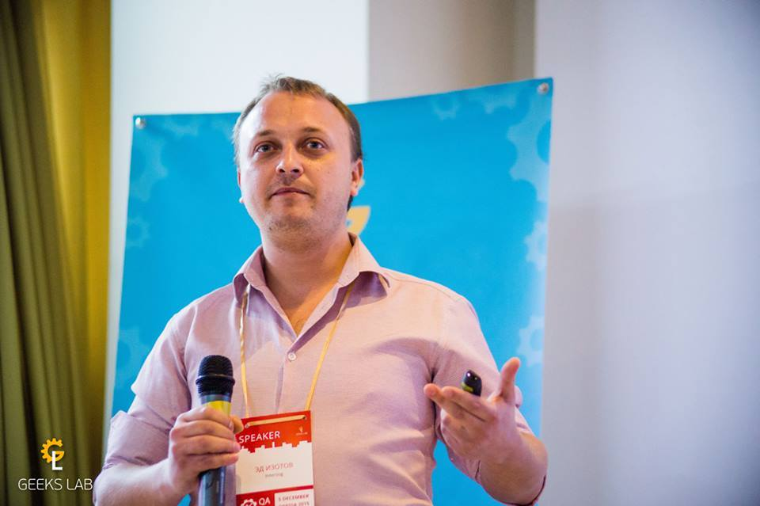
It’s me )
Ed Izotov
Skype: corneliusseo
Email: ed.izotov@gmail.com

Slide 3
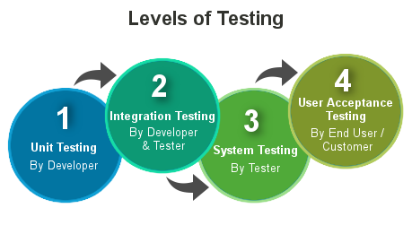
Testing levels
Acceptance
System
Integration
Unit

Slide 4
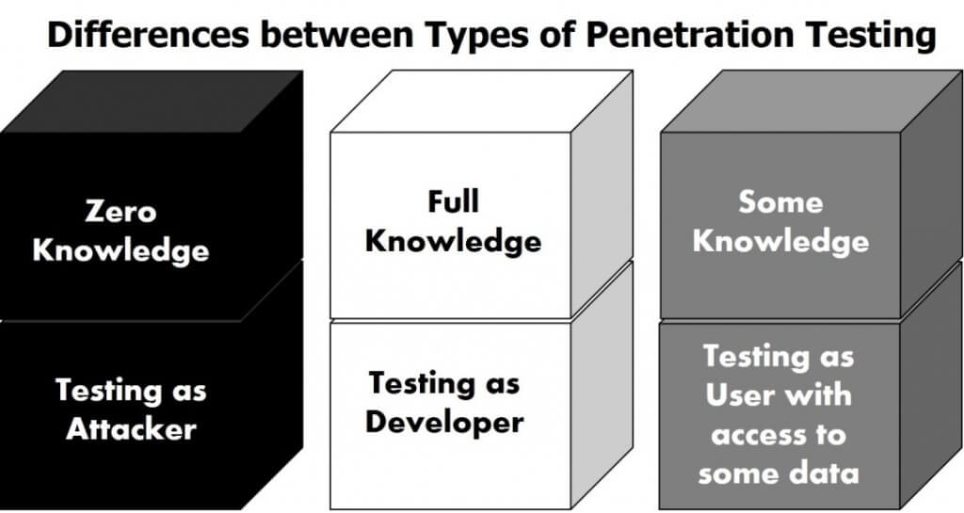
Black, Gray, White

Slide 5
Unit tests goal
Unit testing
Easy code update
Easy integration
Early bug detection

Slide 6
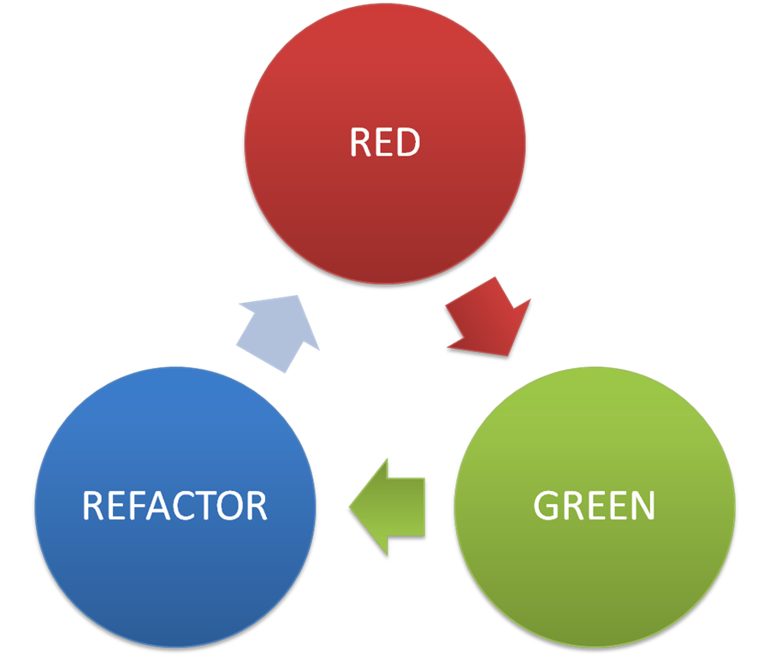
TDD

