Slide 1
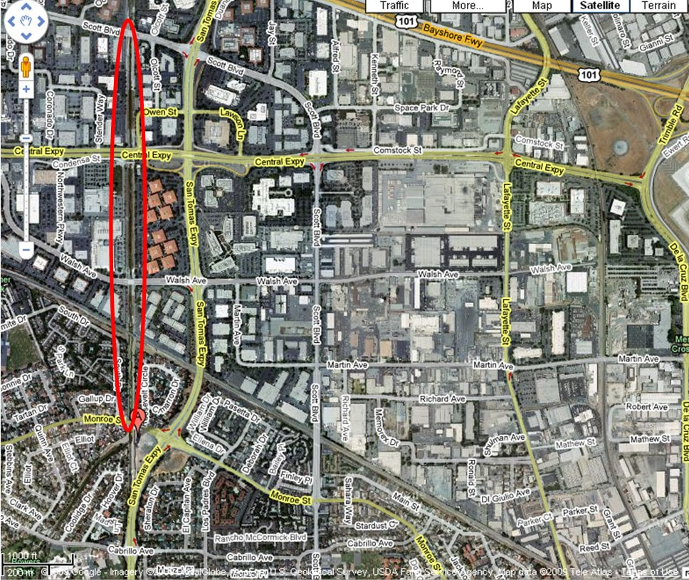
Meet here – this is where we’ll leave the collected trash too.
If you drag thousands of pounds of steel with you, you can deposit it here and walk up the trail to the meeting spot.

