Slide 1
Shape Matching in Linear Time
James Brayton
Matt Goralczyk
Ed Salisbury
CSCI 3412
April 30, 2012

Slide 2
The problem
Linear Time Shape Matching
Can we solve a jigsaw puzzle by matching pieces with each other in linear time?

Slide 3
History
The Jigsaw Problem dates back several decades.
Work on rotating pieces and making them fit properly with no holes or overlaps has been worked on since the 70's and 80's
Pavlidis, 1978
Radack and Badler, 1982
Altman and Easwar, 1987
Rotation independent shape encoding
Chain coding of boundaries
Introduced by Freeman and Garder in 1964
Shape matching techniques borrow from string matching.
Weiner's string matching technique developed in 1973 played a crucial role in image detection today.
Notes:
Altman(1989), Solving The Jigsaw Puzzle Problem In Linear Time, p453.

Slide 4
History
Suffix trees play a crucial role in matching pieces together in linear time.
“Position tree" introduced by Weiner in 1973 provided the concept for the suffix tree data structure.
Linear time construction of suffix trees developed by E. Ukkonen in 1995
Reduced the number of algorithmic techniques
Notes:
P. Weiner (1973). "Linear pattern matching algorithm". 14th Annual IEEE Symposium on Switching and Automata Theory. pp. 1â€“11.
E. Ukkonen. (1995). On-line construction of suffix trees. Algorithmica 14(3):249-260.

Slide 5
Research and Applications
Computer Vision
Computer Aided Design
Robotics
Medical Imaging
Fingerprint matching
Human Genome Project
Nano and micro-scale self-assembly of organic matter
DNA self-assembly
Shape matching helps define methods for quantifying the similarity between arbitrarily complex shapes
Notes:
[1] http://www.cs.utsa.edu/~carola/research/shapeMatchingCurves.html
[2] http://www.aimatshape.net/resources/v-lectures/shapematching
[3] http://arxiv.org/abs/1012.4521
[4] http://igitur-archive.library.uu.nl/math/2002-0301-143753/2001-03.pdf

Slide 6
Complexity
Jigsaw Puzzle Problem is NP-Complete if parameters are not restricted
In our case, we have restricted our boundaries by limiting the number of puzzle pieces we create
We further restricted it by only matching puzzle pieces two at a time
Both puzzle pieces matched in linear time, but total matching of puzzle may not be.
Finally, we restricted how the puzzle pieces are generated
No pieces fit completely inside another piece
Multiple unique edges to discourage false matches
Notes:
Altman(1989), Solving The Jigsaw Puzzle Problem In Linear Time, p455.

Slide 7
Generating a jigsaw puzzle
User supplies an image, number of pieces, and variance:
$ make_pieces image.png 16 10
This does the following:
Load in the image
Remove any transparency
Replace black (0,0,0) with (1,1,1)
Replace blue (0, 0, 255) with (0, 0, 254)
Draw blue lines for edges, and black lines for sides
Draw appropriate number of lines using trig functions and variance (the length of the opposite side)
Example: 16 pieces = 3 lines horizontally and 3 lines vertically

Slide 8
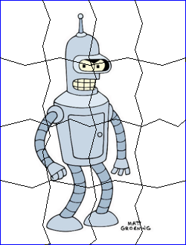
Generating a jigsaw puzzle

Slide 9
Breaking the puzzle into pieces
Go through the puzzle image (starting in the upper left), and do the following:
Keep track of visited pixels in a boolean matrix
If current isn’t visited and isn’t an edge or side:
Store current pixel in the body set
Check up, down, left, and right of current pixel to check if it is a side or edge (black or blue)
Store in a set of each type (adjacent, side, edge)
Pick next pixel from adjacent set
When adjacent set is empty:
Save body, sides, and edges as a new piece
Save data files for the piece
Find the next non-visited pixel

Slide 10
PUZZLE file formats
Image is in PNG format, with transparent background. Black for sides, blue for edges
XY file stores relative X,Y coordinates for each side pixel (but not edges)
ROT file stores rotations based on the relative location of two pixels, in clockwise order

Slide 11
Rotations
Rotations use a simple unit circle to determine the angle between each pixel, but encoded to be a single digit for each angle:
2
3
1
4
0
5
7
6

Slide 12
Rotation direction
In order to maintain clockwise direction for each rotation file, do the following:
Follow the line (side or edge), and keep track of the direction followed. At each point, take the determinant of the current pixel and the next pixel’s position and keep a total:
direction += (currentX * nextY) – (currentY * nextX)
If direction is negative, “reverse” the line before saving the rotation and coordinate files
In order to reverse the rotations, each direction needs to be converted from CCW to CW, and vice-versa

Slide 13

Sample Puzzle piece
2.png:
2.xy:
0 1
1 2
1 3
2 4
2 5
2 6
3 7
3 8
3 9
4 10
4 11
5 12
5 13
5 14
…
2.rot:
323223223232232322322323221222122122212212221221222122122212223222232223…

Slide 14
Shape matching
In order to match 2 shapes, the problem becomes one where we find the longest substring
The way we do this is to use position trees (aka suffix trees)

Slide 15
Building a suffix tree
Example: “MISSISSIPPI”
First, build a list of possible suffixes:
MISSISSIPPI
ISSISSIPPI
SSISSIPPI
SISSIPPI
ISSIPPI
SSIPPI
SIPPI
IPPI
PPI
PI
I
I
IPPI
ISSIPPI
ISSISSIPPI
MISSISSIPPI
PI
PPI
SIPPI
SISSIPPI
SSIPPI
SSISSIPPI
Then sort them:

Slide 16
Building a suffix tree
I
IPPI
ISSIPPI
ISSISSIPPI
MISSISSIPPI
PI
PPI
SIPPI
SISSIPPI
SSIPPI
SSISSIPPI
root

Slide 17
Building a suffix tree
I
IPPI
ISSIPPI
ISSISSIPPI
MISSISSIPPI
PI
PPI
SIPPI
SISSIPPI
SSIPPI
SSISSIPPI
root
I

Slide 18
Building a suffix tree
I
IPPI
ISSIPPI
ISSISSIPPI
MISSISSIPPI
PI
PPI
SIPPI
SISSIPPI
SSIPPI
SSISSIPPI
root
I
PPI

Slide 19
Building a suffix tree
I
IPPI
ISSIPPI
ISSISSIPPI
MISSISSIPPI
PI
PPI
SIPPI
SISSIPPI
SSIPPI
SSISSIPPI
root
I
PPI
SSIPPI

Slide 20
Building a suffix tree
I
IPPI
ISSIPPI
ISSISSIPPI
MISSISSIPPI
PI
PPI
SIPPI
SISSIPPI
SSIPPI
SSISSIPPI
root
I
PPI
SSI
PPI
SSIPPI

Slide 21
Building a suffix tree
I
IPPI
ISSIPPI
ISSISSIPPI
MISSISSIPPI
PI
PPI
SIPPI
SISSIPPI
SSIPPI
SSISSIPPI
root
I
MISSISSIPPI
PPI
SSI
PPI
SSIPPI

Slide 22
Building a suffix tree
I
IPPI
ISSIPPI
ISSISSIPPI
MISSISSIPPI
PI
PPI
SIPPI
SISSIPPI
SSIPPI
SSISSIPPI
root
I
MISSISSIPPI
PI
PPI
SSI
PPI
SSIPPI

Slide 23
Building a suffix tree
I
IPPI
ISSIPPI
ISSISSIPPI
MISSISSIPPI
PI
PPI
SIPPI
SISSIPPI
SSIPPI
SSISSIPPI
root
I
MISSISSIPPI
P
PPI
SSI
I
PI
PPI
SSIPPI

Slide 24
Building a suffix tree
I
IPPI
ISSIPPI
ISSISSIPPI
MISSISSIPPI
PI
PPI
SIPPI
SISSIPPI
SSIPPI
SSISSIPPI
root
I
MISSISSIPPI
SIPPI
P
PPI
SSI
I
PI
PPI
SSIPPI

Slide 25
Building a suffix tree
I
IPPI
ISSIPPI
ISSISSIPPI
MISSISSIPPI
PI
PPI
SIPPI
SISSIPPI
SSIPPI
SSISSIPPI
root
I
MISSISSIPPI
SI
P
PPI
SSIPPI
PPI
SSI
I
PI
PPI
SSIPPI

Slide 26
Building a suffix tree
I
IPPI
ISSIPPI
ISSISSIPPI
MISSISSIPPI
PI
PPI
SIPPI
SISSIPPI
SSIPPI
SSISSIPPI
root
I
MISSISSIPPI
S
P
PPI
SSI
I
PI
I
SIPPI
PPI
SSIPPI
PPI
SSIPPI

Slide 27
Building a suffix tree
I
IPPI
ISSIPPI
ISSISSIPPI
MISSISSIPPI
PI
PPI
SIPPI
SISSIPPI
SSIPPI
SSISSIPPI
root
I
MISSISSIPPI
S
P
PPI
SSI
I
PI
I
SI
PPI
SSIPPI
PPI
SSIPPI
PPI
SSIPPI

Slide 28
SUBstring matching
In order to match shapes, first we build what is called a generalised suffix tree, which will contain both strings we’re searching in
In order to differentiate between the strings, we use a terminating character (one that is outside of the alphabet) to make sure we find the substring in both strings
Example:
MONTANA$
BANANA%

Slide 29
Generalised suffix tree
$
%
A$
A%
ANA$
ANA%
ANANA%
BANANA%
MONTANA$
NA$
NA%
NANA%
NTANA$
ONTANA$
TANA$
MONTANA$
ONTANA$
NTANA$
TANA$
ANA$
NA$
A$
$
BANANA%
ANANA%
NANA%
ANA%
NA%
A%
%
+
=

Slide 30
GENERalised suffix tree
$
%
A$
A%
ANA$
ANA%
ANANA%
BANANA%
MONTANA$
NA$
NA%
NANA%
NTANA$
ONTANA$
TANA$
$
TANA$
%
ONTANA$
A
BANANA%
MONTANA$
A
$
N
N
%
NA
NA
A
A
TANA$
$
NA%
$
NA%
%
%

Slide 31
SUBstring matching
To find the longest substring in the suffix tree, it’s a simple depth-first search, with a slight modification
In order to make sure that the substring is in both strings, check to make sure that the node has at least two children, consisting of the terminating characters ($ and %)

Slide 32
SUBSTRING MATCHING
To see if two shapes match:
$ match_pieces bender 1 2
This will load in the two rotation files and “reverse” the second one
It will then append a terminating character to each string (A and B), and then build a generalised suffix tree with the strings
When the longest substring is found, it will return a percentage matched, the offsets in the rotation files, and the length of the substring

Slide 33
SUBSTRING MATCHING
To build the suffix tree, it takes non-linear time, but to do the actual matching, it takes linear time
Building the tree is worst case of O(n log n)
Matching requires only depth-first search which is O(n)

Slide 34
SUBSTRING MATCHING
Time to compare 2 random strings of X length each
The suffix tree with 2x 20000 characters contained ~28,000 nodes

Slide 35
Joining shapes
To join two pieces, the user provides the folder name, piece numbers, the offsets for each file, and the length of the substring:
$ join_pieces bender 1 2 34 23 30
This will load in both XY files, check to make sure that there is no overlap, generate a new image with the appropriate side joined, and generate new XY and rotation files

Slide 36
JOINing shapes
To check that there is no overlap, the join function will create a new image that is 3 times the size of both pieces (whichever is larger), and copy the first image to this new image
It will then try to copy the second image to it, making sure that the pixel isn’t occupied
If it finds an overlap, it exits with 0
If not, it will recolor the overlapping pixels (to prevent it from being considered a matchable side)
It will then trim the edges and save it as a new image and return the image number of the newly saved image

Slide 37

JOINED shape
10.xy:
161 1
161 2
162 3
162 4
162 5
162 6
163 7
163 8
163 9
163 10
164 11
164 12
…
10.png
10.rot:
323223223232232322322323221222122122212212221221222122122212223222232223…

Slide 38
User interface
Built on Javascript, PHP, HTML, CSS, AJAX
System calls are made with PHP to functions written in C++
User can upload an image to be used as the puzzle
User selects number of pieces to generate.
Piece amounts are perfect square values
This makes the puzzle less trivial and more appealing to the eye
make_pieces function generates pieces and places them in it’s own directory

Slide 39
User interface
User can a drag a piece onto another one and try to join them
match_pieces function attempts to check if pieces match
Matching pieces get fused into a combined piece
join_pieces function fuses together two matching pieces
The linear time of the matching function is important here
Quick matching time means less lag when checking if two images match

Slide 40
Future work
Non-perfect square puzzle pieces
Use Ukkonen’s Algorithm to build suffix trees in linear time
Add caching for matched pieces
Eliminate having to run match pieces every time
Ability to match more than two puzzle pieces at time

Slide 41
Results and conclusions
Limitations:
Shapes that aren’t “regular”
PNG and JPEG support only
Match function occasionally returns false matches
Currently no ability to undo puzzle matches from UI

Slide 42
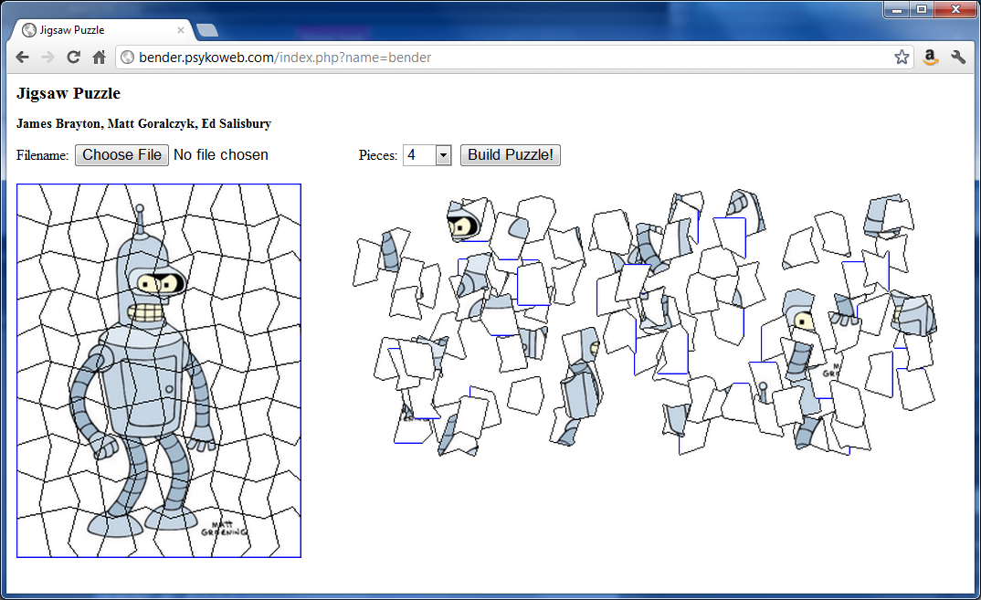
DEMO
Demo: http://bender.psykoweb.com

Slide 43
THANK YOU You may now Applaud
Any Questions?

