Slide 1



RSG – Turkey 2021 Student Symposium Command Line Basics
Eda Şamiloğlu

Slide 2
Command Line Basics
The command line is the current line within the terminal which can be used to input text commands.
The command line allows users to run a vast range of commands and includes facilities to run successive commands as one single operation, with the output of one command fed directly into the next. It is also the starting point for running most bioinformatics software.
Notes:
command - a type of input, typically given in a terminal, which instructs the system to perform a given task.

Slide 3
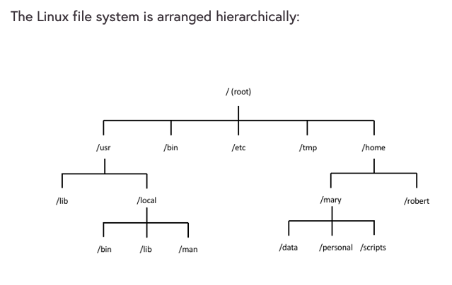


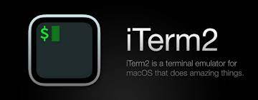
Directories and Files
In Linux, as with other operating systems, information is stored in files.
Open your terminal or an online cloud shell!
Your file organization
might be different

Slide 4
Directories and Files
In Linux, as with other operating systems, information is stored in files.
pwd:
The pwd command displays (“prints” to the screen)
the current working directory.
Your file organization
might be different
whoami:
Displays your logged in user id.

Slide 5
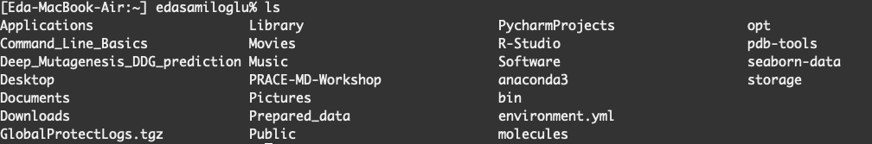
Changing the current directory
ls: Directory listing.
cd: Change current working directory.
cd : Back to home directory.

Slide 6
Clear the terminal screen and explore man
clear: Clear the terminal screen.
man: Man pages, the user manual.
man clear

Slide 7
Create a directory and using text editor nano
mkdir: The mkdir command creates a directory.
mkdir example
cd example
ls
touch file
open file
nano file
name: Eda
surname: Şamiloğlu
workshop: RSG-Turkey Command Line Tools
session name: Command Line Basics

Slide 8
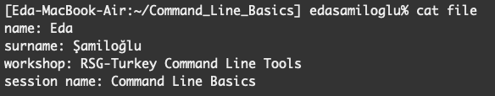
Display file content
cat : The cat utility reads files sequentially, writing them to the standard output.
cat file

Slide 9
Combining command lines
cat : The cat utility reads files sequentially, writing them to the standard output.
cat file
cp file first_nano_experience
mv first_nano_experience ..
rm file
ls
cd ..
rmdir example (rm –r)

Slide 10
Working with FASTA file - sequence.fasta
cp: Copies the contents of the source-file to the target-file.
cp sequence.fasta sequence.fasta_copy
ls
ls –l
ls -lrt

Slide 11
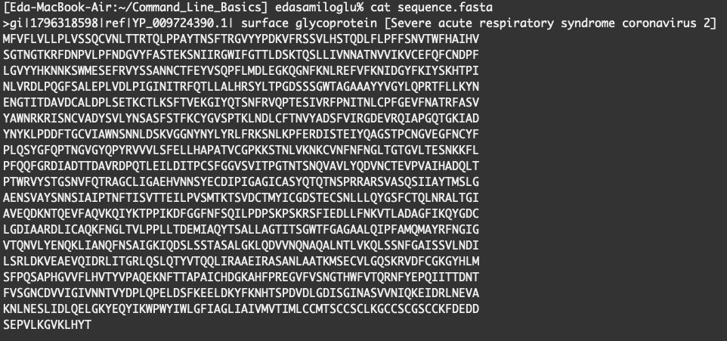
Working with FASTA file - sequence.fasta
cat sequence.fasta
nano sequence.fasta

Slide 12
Working with FASTA file - sequence.fasta
mv sequence.fasta surface_glycoprotein
head surface_glycoprotein
head -1 surface_glycoprotein
tail surface_glycoprotein

Slide 13
Bonus: git version control
mkdir my_project
cd my_project/
cp ../surface_glycoprotein .
ls
git init:
ls -la
git add: The command used to add a file that is in the working directory to the staging area.
git add surface_glycoprotein

Slide 14
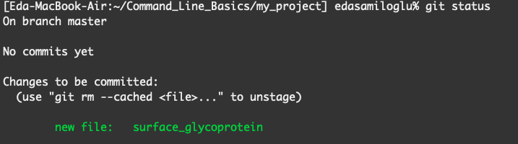
Bonus: git version control
git status: Lists all new or modified files to be committed
git commit -m "new file added"

Slide 15
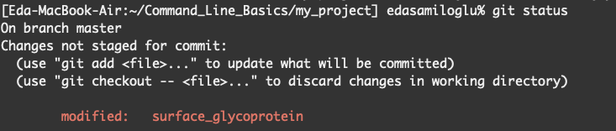
Bonus: git version control
nano surface_glycoprotein and remove first line
git diff
git checkout
To save changes:

Slide 16
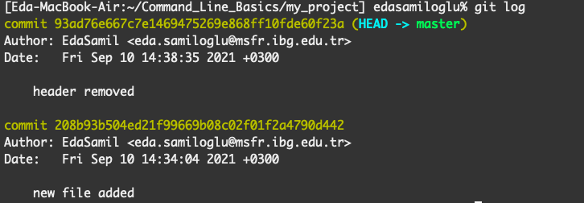
Bonus: git version control
git log: To see the history of commit you made to your files.

Slide 17


Slide 18
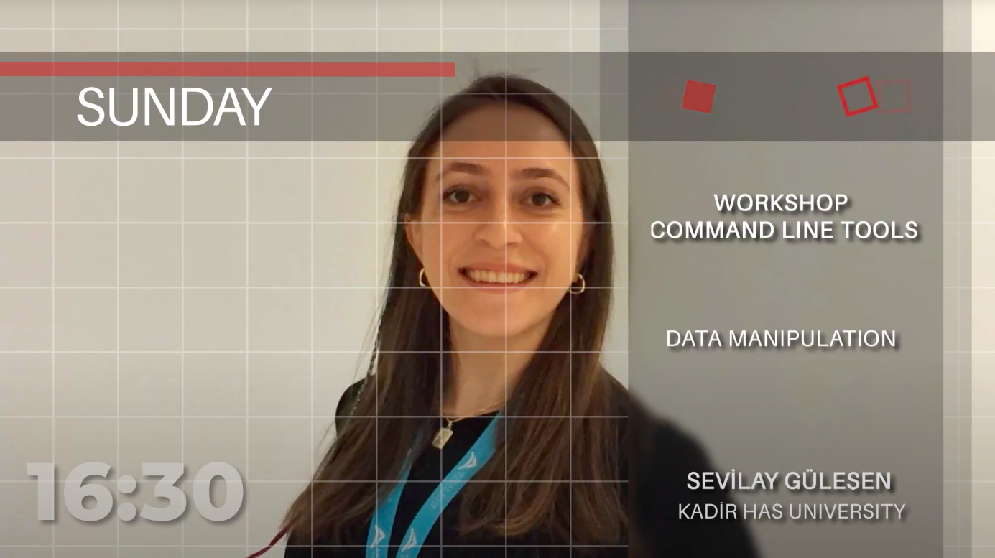

Slide 19

https://www.futurelearn.com/courses/linux-for-bioinformatics

