Slide 1
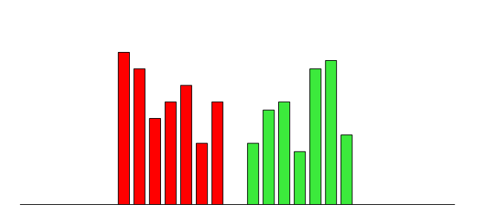
Figure 1
Bids (placed by buyers; you sell at this price)
Asks (placed by sellers; you buy at this price)
Amount of BTC available at this price
Price 1
Price 2
. . .
BTC price (increasing)

Slide 2
Figure 2
9 BTC
7 BTC
4 BTC
1 BTC = 3 k EUR
1 BTC = 3.3k EUR
1 BTC = 3.5k EUR

